Slide 1
CAU-IIKH
Interactive Intelligent Kitchen Helper
20182705 고주형 20185784 김호성
20182610 손희승 20162874 이준협
20142611 이하람

Slide 2
What “IIKH” is
IIKH
Recipe Name
Description of Recipe
Needed Ingredients
Recipe
Plan Name
Meal Plan of Breakfast Lunch Dinner
Plan
“Convenience”
of Kitchen User
Management

Slide 3


Cream Pasta Recipe ~~~~~~~~~~~ ~~~~~~~~~~~ ~~~~~~~ ~~~~~~~~~
Steak Recipe ~~~~~~~~~~~ ~~~~~~~~~~~ ~~~~~~~ ~~~~~~~~~
Fried Chicken Recipe ~~~~~~~~~~~ ~~~~~~~~~~~ ~~~~~~~ ~~~~~~~~~
Lamb Curry Recipe ~~~~~~~~~~~ ~~~~~~~~~~~ ~~~~~~~ ~~~~~~~~~
Soup Recipe ~~~~~~~~~~~ ~~~~~~~~~~~ ~~~~~~~ ~~~~~~~~~
Curry Recipe ~~~~~~~~~~~ ~~~~~~~~~~~ ~~~~~~~ ~~~~~~~~~
Steak Recipe ~~~~~~~~~~~ ~~~~~~~~~~~ ~~~~~~~ ~~~~~~~~~
Garlic Soup Recipe ~~~~~~~~~~~ ~~~~~~~~~~~ ~~~~~~~ ~~~~~~~~~
Onion Soup Recipe ~~~~~~~~~~~ ~~~~~~~~~~~ ~~~~~~~ ~~~~~~~~~

Slide 4

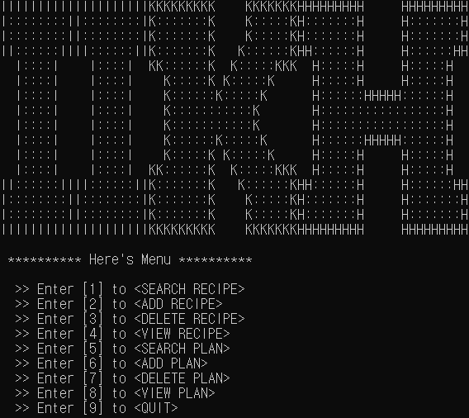
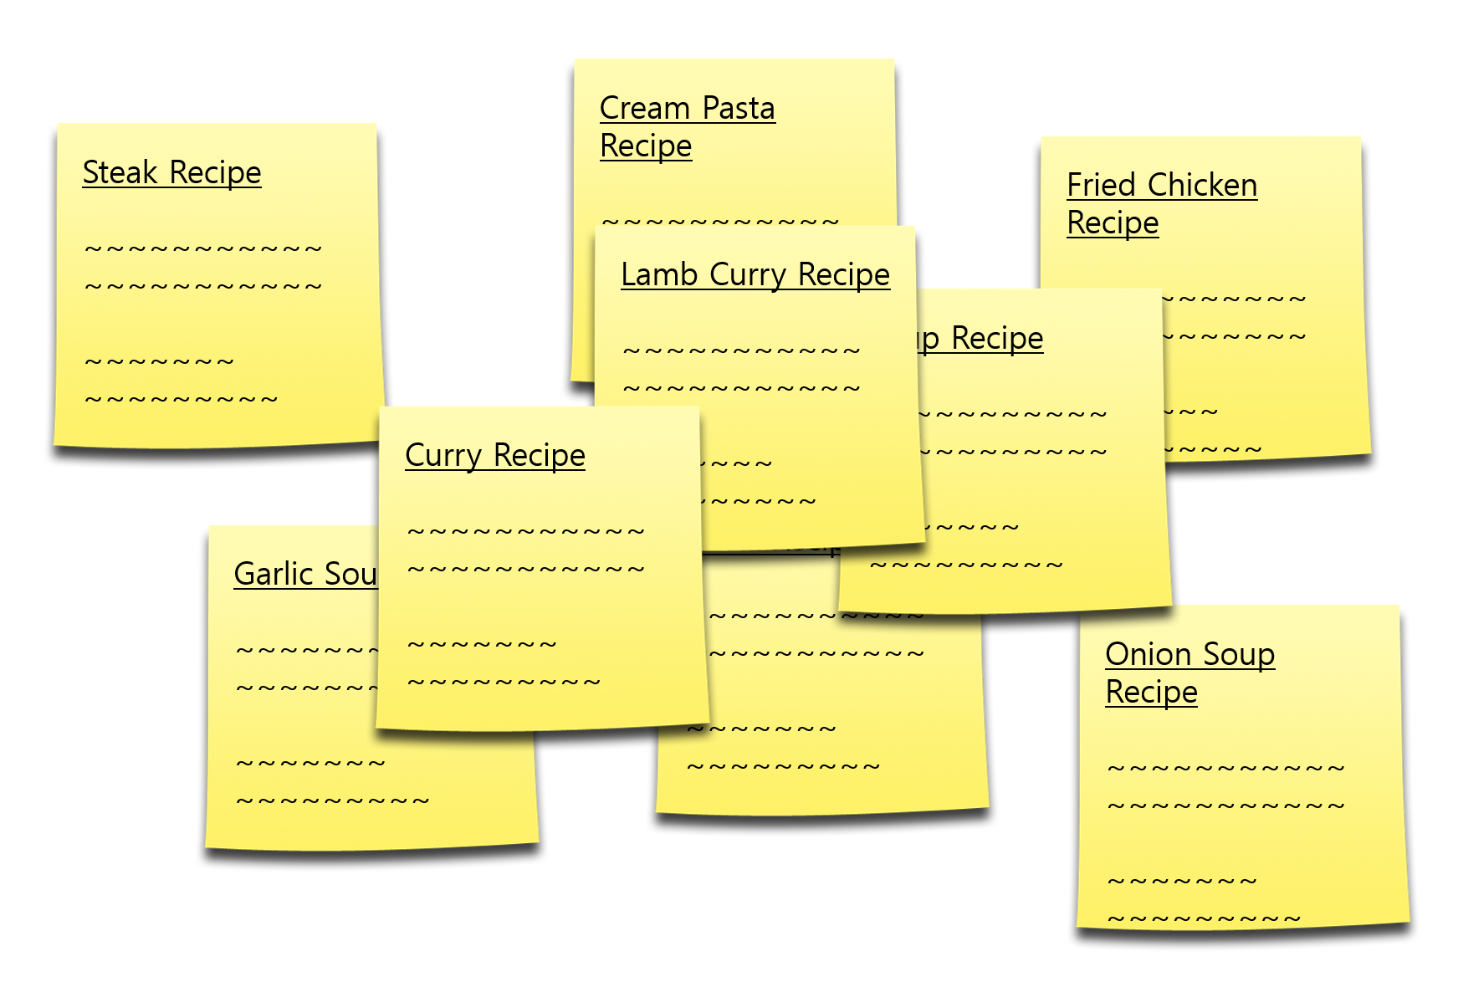

Slide 5
What we focused on
“UX”

Slide 6
“UX”
How to add recipes from internet.
Will you type everything in console?
How to share my recipe.
콘솔 창의 한계 -> 파일의 형식에 집중

Slide 7
“CSV”
How to add recipes from internet.
Will you type everything in console?
How to share my recipe.

Slide 8
Process of IIKH Project

Slide 9
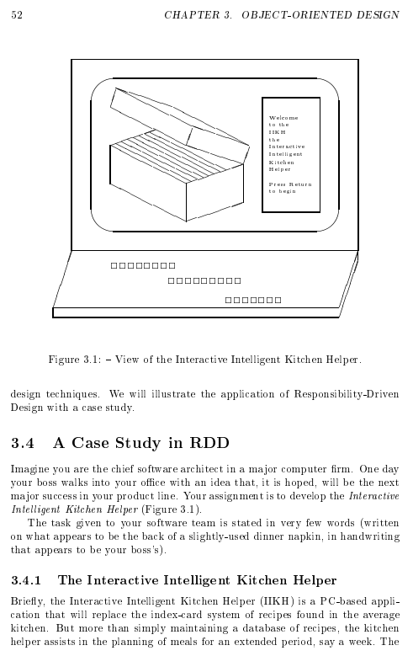
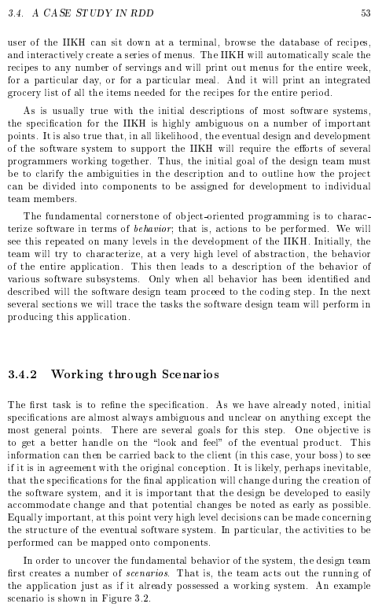
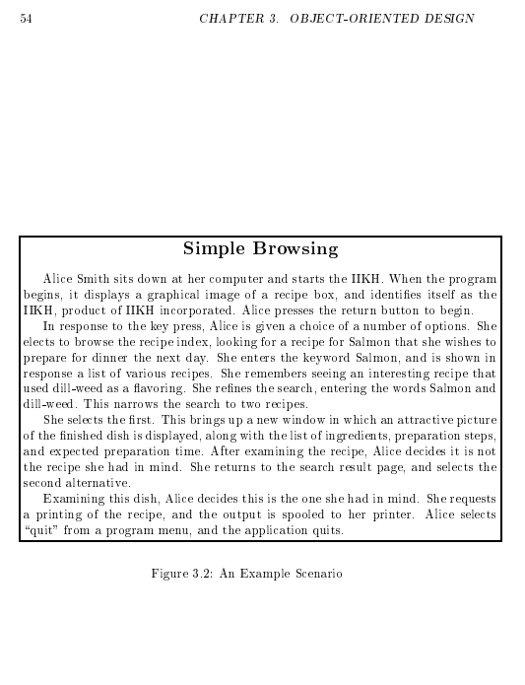
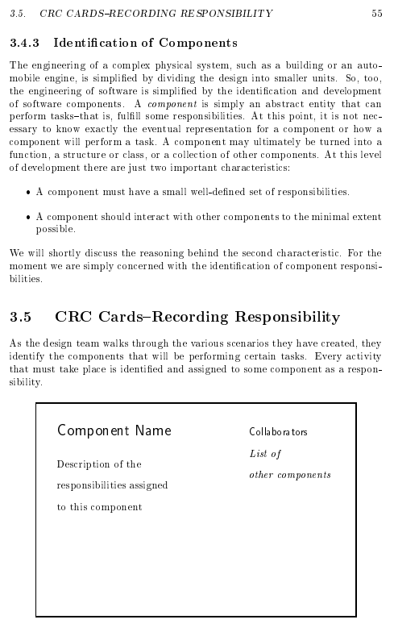
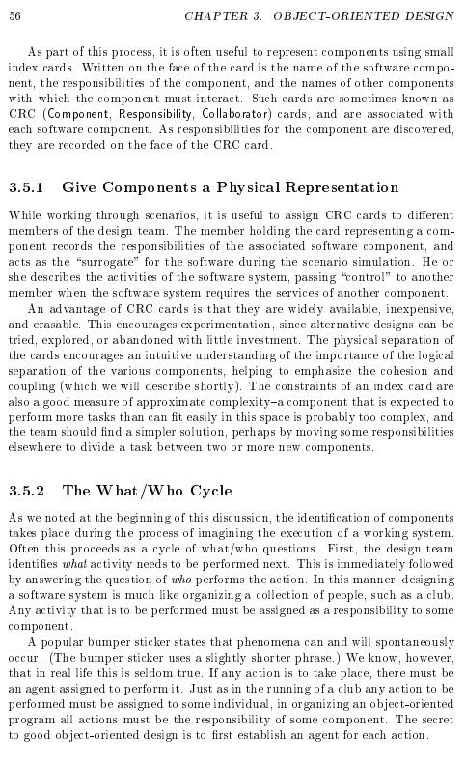
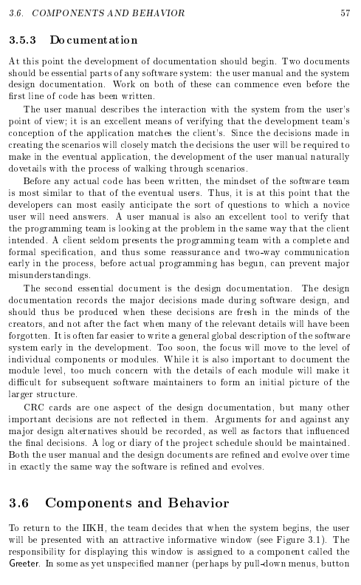
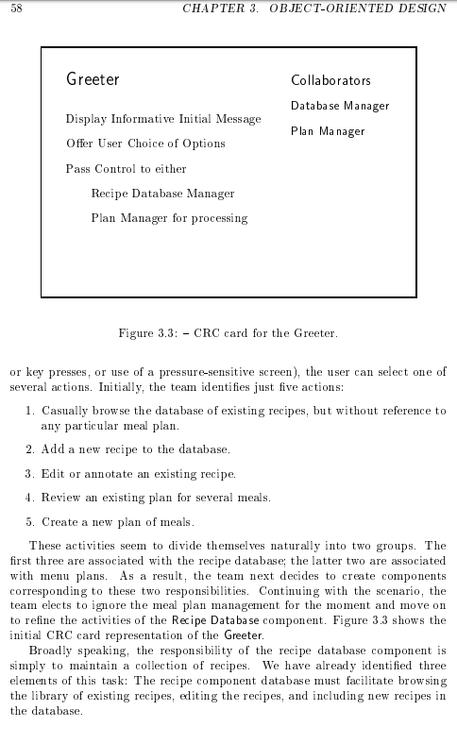
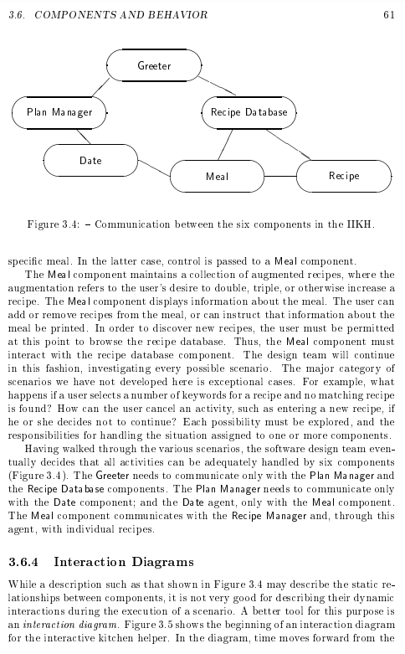
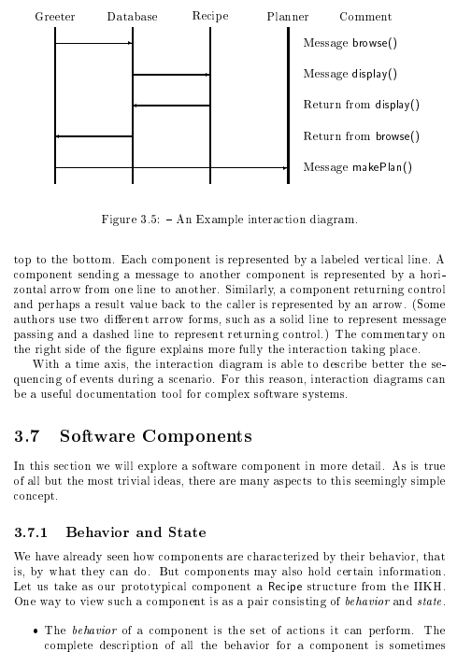
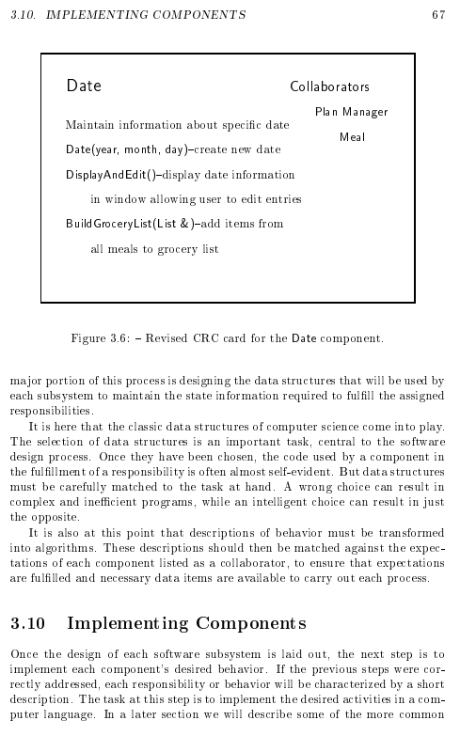
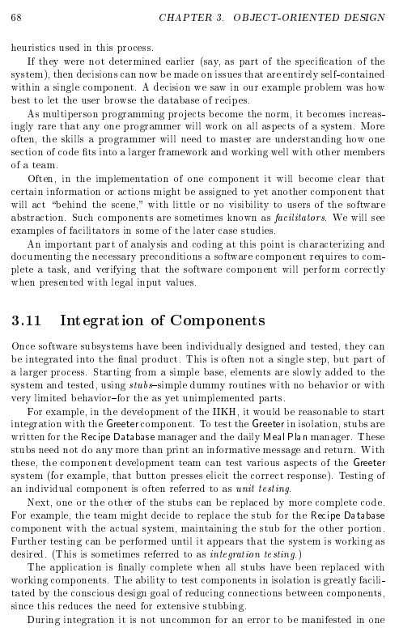
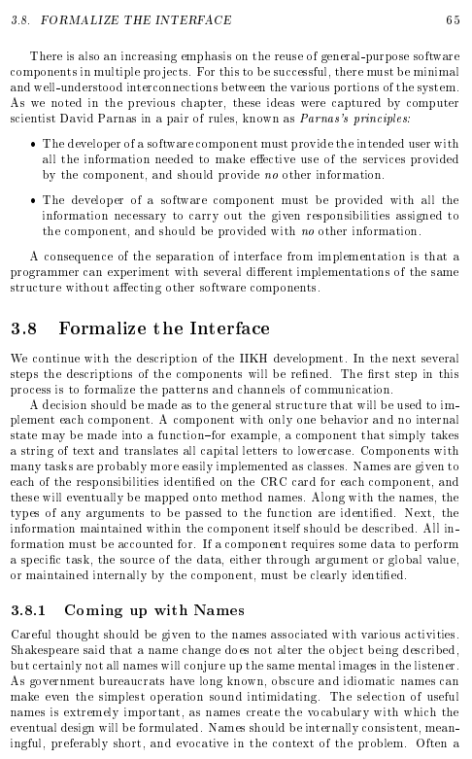
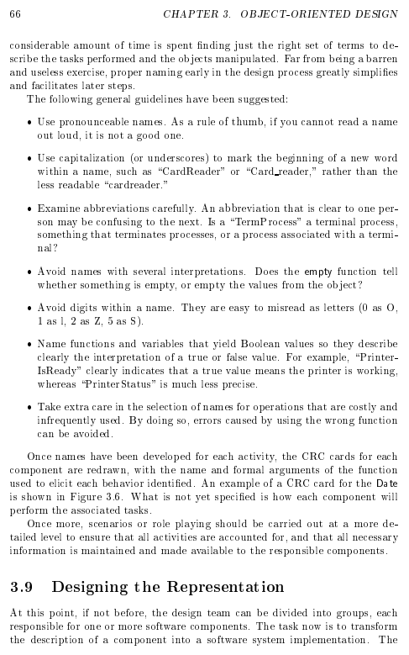
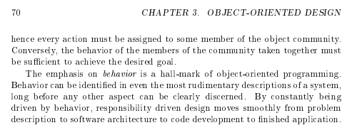
What is our Task?

Slide 10
What we needed
Greeter
User Interface
“Design of Components”
CSV Parser
Inner Structure
Read csv file Write csv files
Process Data Manage Database (PlanDB/RecipeDB)
Handle Exception
“Whose Responsibility is it?”

Slide 11
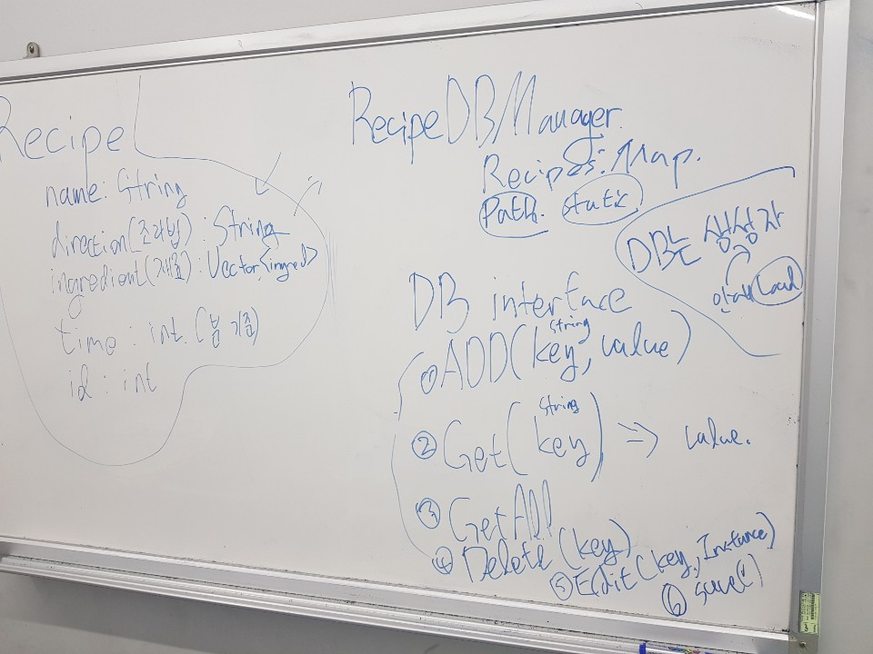
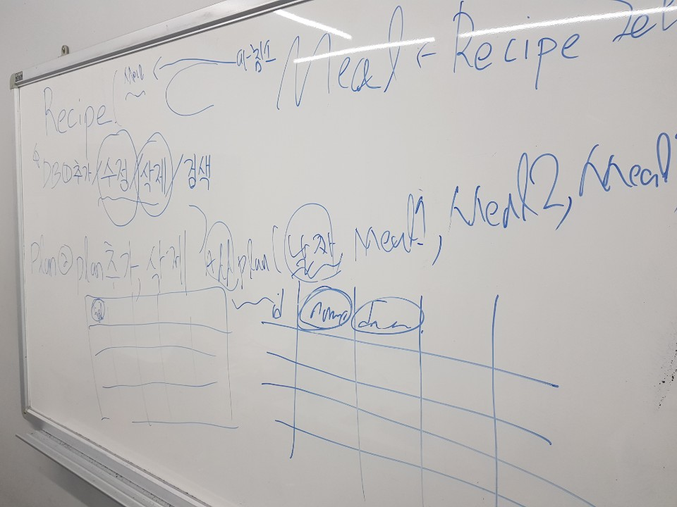
What we did

Slide 12
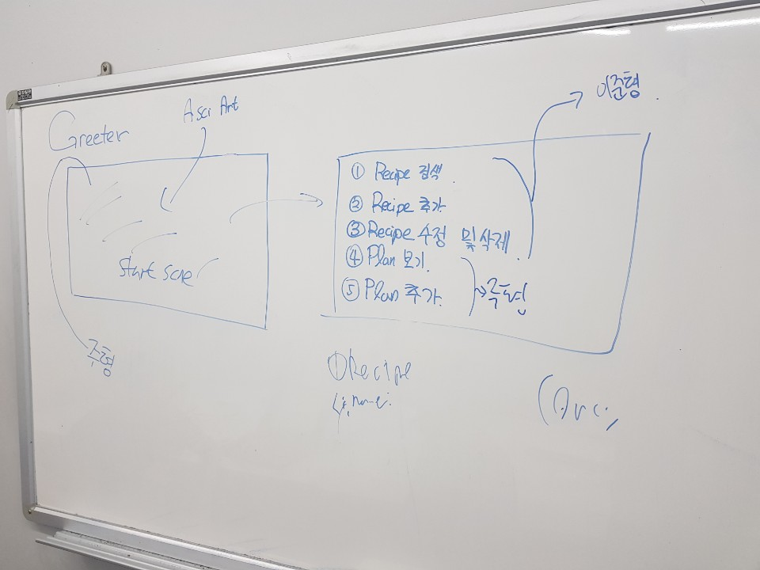
What we did

Slide 13
What we did
이 페이지에서 설계를 바탕으로 UML을 만들었다고 설명하면서
UML 홈페이지로 가면 될 듯

Slide 14
Encapsulation
CSV Parser
Inner
Structure
Greeter
Public
Public
Hidden
Private
Public
Hidden
Hidden
Private
Private
read / write
Function
_save Function
Public
selectMenu
Function
_search /showall 등등…
Communicate
Communicate

Slide 15
Functionality
Search Recipe
Add Recipe
Delete Recipe
View Recipe
Search Plan
Add Plan
Delete Plan
View Plan
Quit

