Slide 1
AU vs NZ Salary Analysis
Cost Savings Assessment for Position Relocation
FY 2024-2025 | 36 Comparable Roles Analyzed

Slide 2

Data Quality & Cleaning
42
36
6
Total Rows
Clean Rows
Rejected Rows
Processed and reviewed
Validated for analysis (85.7%)
Quality issues identified
Rejection Breakdown
Invalid IRD numbers
Suspicious net/gross ratios
Duplicate entries
3 records excluded due to identification errors
2 records flagged for anomalous calculations
1 record resolved by retaining lowest amounts
Exchange rate applied: 1 NZD = 0.92 AUD

Slide 3
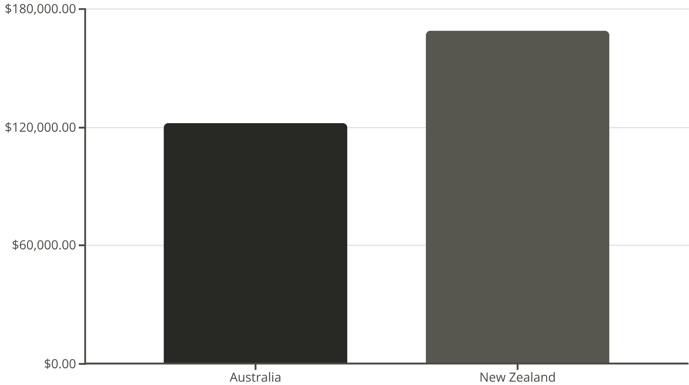
Statistical Analysis
Paired t-test comparing AU vs NZ gross salaries
Statistical Results
Key Findings
Sample size: 36 paired observations
NZ positions cost 38.4% more than AU positions
t-statistic: -6.25
Highly significant statistical difference confirms substantial cost variance between markets
p-value: < 0.0001
Salary difference: $46,919

Slide 4
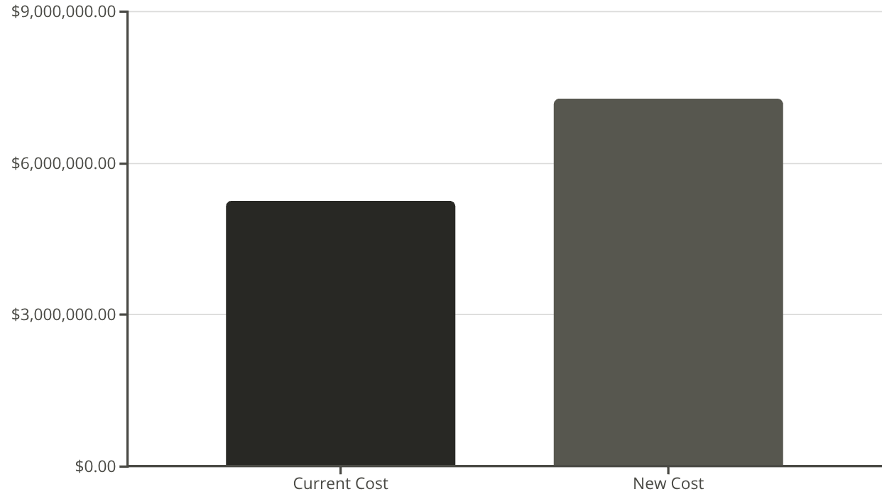
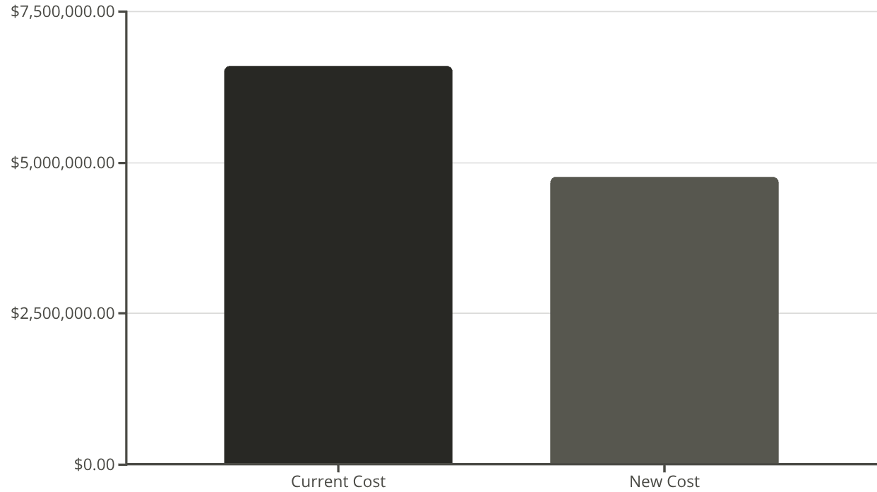
Cost Savings Analysis
Future AU Positions
Future NZ Positions
43
39
Scenario 1: AU → NZ
Scenario 2: NZ → AU
Cost Increase: -$2.02M (-38%) ⚠ NOT RECOMMENDED
Savings: +$1.83M (+28%) ✓ RECOMMENDED

Slide 5

Key Takeaways & Recommendations
Relocate future NZ positions to Australia to achieve $1.83M in annual cost savings
27.7% reduction in compensation costs
Immediate Impact
Avoid NZ Expansion
Moving NZ positions to AU delivers substantial savings while maintaining operational capability
AU to NZ relocation increases costs by 38.4%—not financially viable under current conditions
Exchange Rate Risk
Implementation Strategy
Monitor NZD/AUD fluctuations (currently 0.92)—could impact projected savings by ±5-8%
Phase relocation over 12-18 months, validate talent availability in Australian markets
Data Quality: 85.7% validation rate across 36 comparable roles ensures robust analysis

