Slide 1
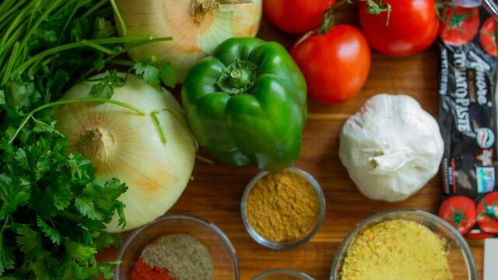
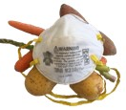
Food Survey During Covid-19
A Data Science Project Work
Top Mentor [Batch 55]

Slide 2
Agenda
Introduction
Problem Statemen & Data Source
Objectives & Methodology
Solution Description

Slide 3
Introduction
Coronavirus infectious disease 2019 (COVID-19) is currently one of the most important public health crises affecting the global human population. It continues to spread widely, as the world still lacks specific treatments and a vaccine for the virus. The scenario of COVID-19 in India seems obscure due to the lack of adequate data, therefore, we developed an electronic questionnaire and distributed it online among Local people. The aim of this study was to understand by doing survey on Food intake by people during COVID-19.

Slide 4
Objectives
To Spread health awareness regarding food.
To analyze what are the chances of a person getting infected due to lack of awareness of food management.
To see what kind of food supplies needed by the people from their local general stores during lockdown and help the stores to be ready with the stock.
What kind & what type of measurements people applied for their health by seeing the covid spread.

Slide 5

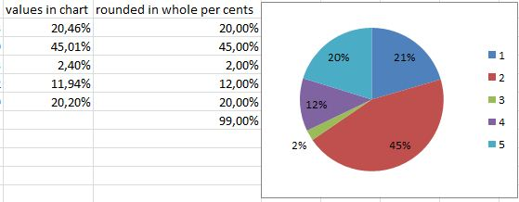

Methodology
Data Collection Using
Google Forms & Excel to store Feedbacks
Analyzing the results using Excel Formulas
Showing the analyzed data in the form of Graphs/Pie chart

Slide 6
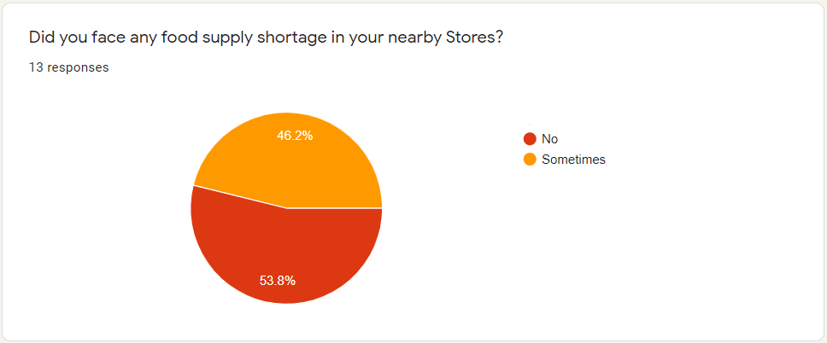
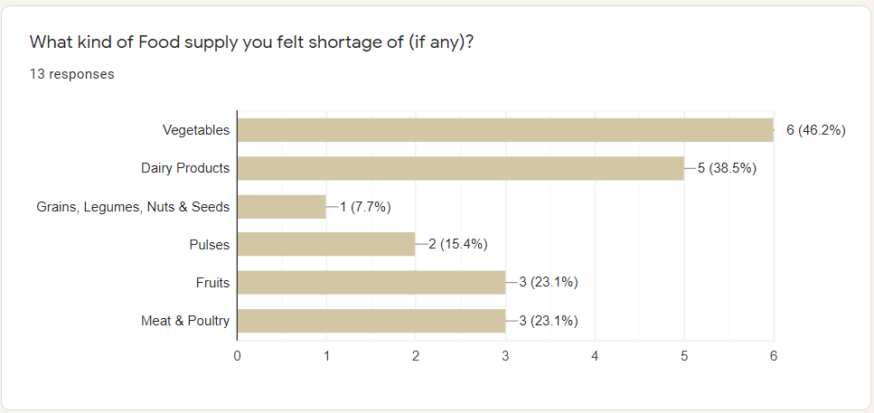
Analysis Result
During the lockdown people did face some food stock shortage, with the analysis we will get to know what kind of food stock they felt shortage of, with this we can approach for a solution of which food is needed to be restock in local stores.
As it is clear from the graph that majority of people found difficulty in two stocks those are Vegetables & Dairy products.

Slide 7
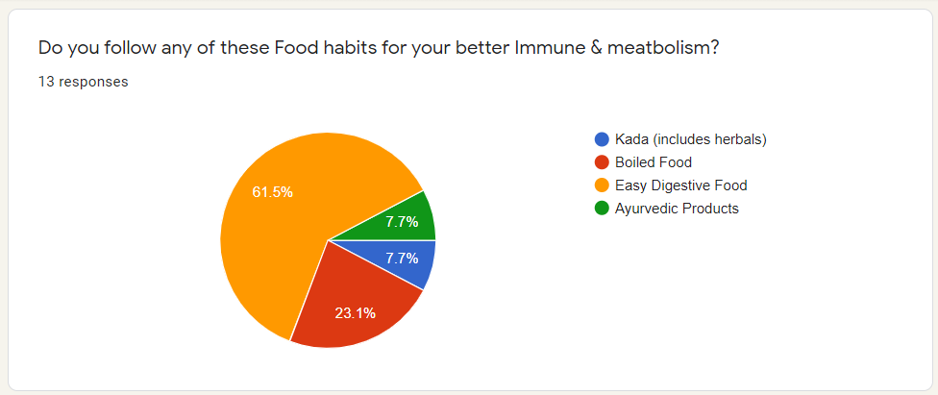
Impact
As it is clear from the pie chart shown that only few people were taking any preventive measures to keep check their immune and taking home medicinal remedies & majority people are having their casual daily food which they used to take before corona.
This has happened due to lack of awareness among people like how to reduce the chances of getting infected by the virus by some precautions just by food.

Slide 8
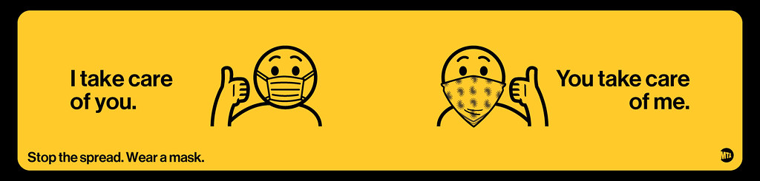
THANK YOU
Amartya Chatterjee
89561xxxxx

