Slide 1
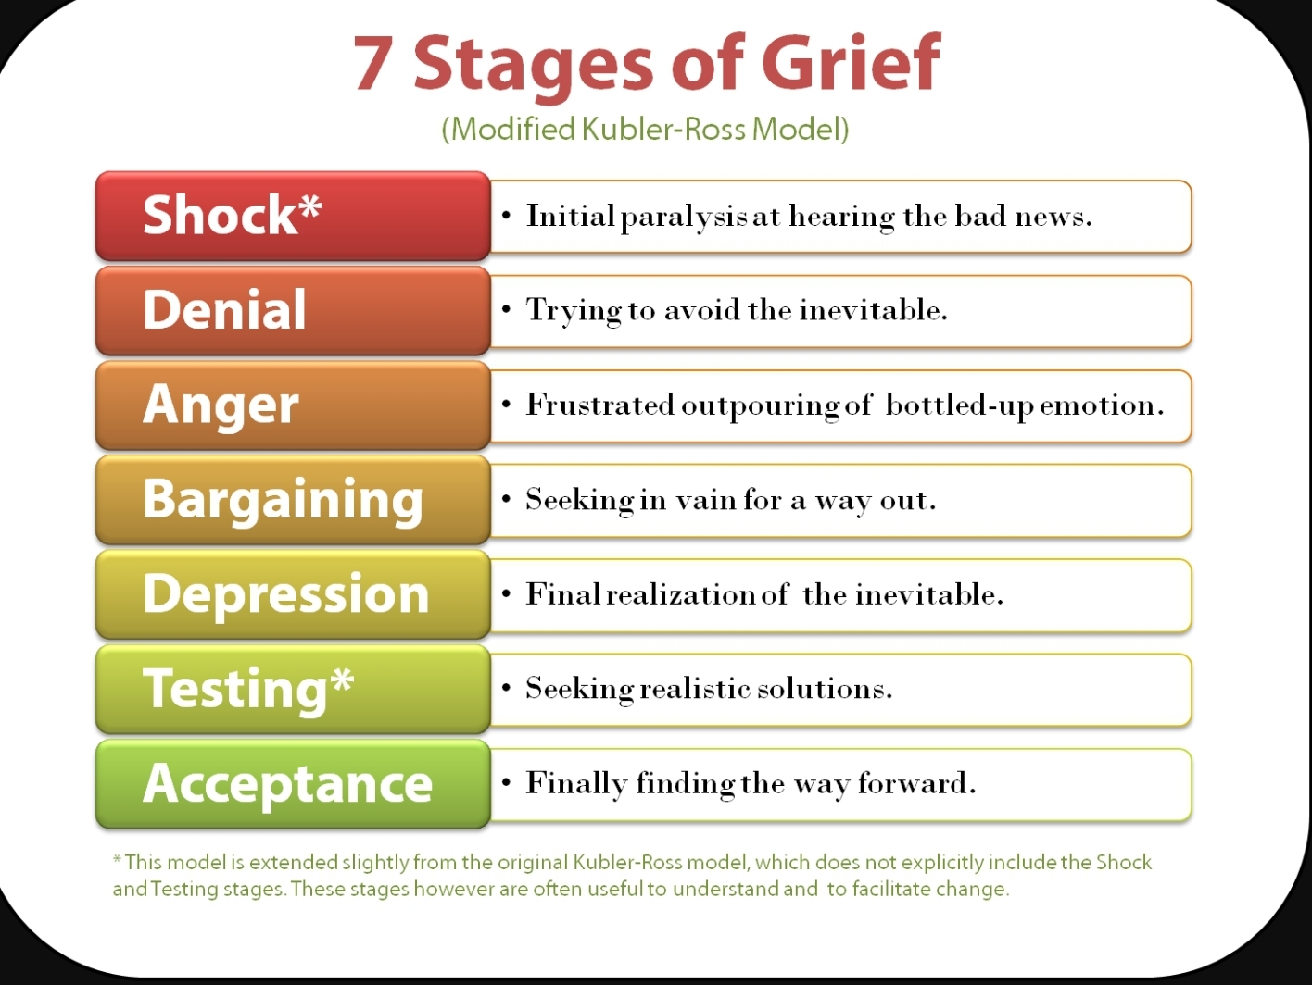
Session 1 DONE! Session 2 is now in session?
Bash! No if loops and butts about it!
Programming

Slide 2

Session 2: terminal session
Where we think we are
Where we actually are
Where we want to be

Slide 3
-h / --help # almost all tools come with a help list that shows the avaialable commands and how to use them
mkdir --help
ls --help
sed --help
> # directing output to a location
>> # adding an output to a location
1> # STDout
2> # STDerr
&> # STDout + STDerr (all output)

Slide 4
Variables in bash.
variable_bool=true
#this type of variable is called a boolean, and can only be either true or false
variable_bool=false
#It comes from binary statements that have only a 0 or 1 sollution, 1+1 = 0 (well, 1 0)
variable_numeric=12346579.13213155678
#integers (hole numbers), floats (numbers with decimal points) and in other languages a double (64bit, wheras floats are 32 bit)
variable_string="i'm a string"
#A string is not part of an instrument, it's a string of characters
variable_array=(“I” am 4 collection of individual elements)
#A array (sometimes called vector in other languages) is a collection of things, can be other variables, integers, strings, whatever)

Slide 5
Arrays have indices...
Example:
variable_array=(i am a collection of individual elements)
echo ${variable_array[1]} will return "am“
Keep in mind, bash will always want to interpret whatever it gets on STDin, to be a object or command....
This is why
${variable_array[1]}
will just return an error "am: command not found"
Bash is dumb dumb, so you have to be smart when tyring to make it do something

Slide 6
Calling on variables
${variable}
#This bracket tells bash that a variable is coming, and it's content should be used.
$(variable)
#This stands for command substitution; it means run command and put its output here.
$variable
#This will assume variable is a command to run

Slide 7
examples
variable_A="I am a string"
echo ${variable_A}
Will give you “I am a string”
variable_B=$(echo ${variable_A})
echo ${variable_B}
Will give you “I am a string”
function x {
echo ${variable_A}
}
variable_C="x"
$variable_C
Will give you “I am a string”

Slide 8
If else statements
variable=99
if ${variable}=2; then
echo "Variable is indeed a 2"
fi
if ${variable}=1; then
echo "Variable is indeed a 1"
else
echo "Variable is not 1"
fi
If [[ variable_a=1 && variable_ ]]; then
If ${variable_a}=1 && ${variable_b}=3; then
if ${variable}=1; then
echo "Variable is indeed a 1"
elif ${variable}=2; then
echo "Variable is a 2"
else
echo "Variable is neither 1 or 2"
fi
If else statements
variable=2
if ${variable}=2; then
echo "Variable is indeed a 2"
fi
if ${variable}=1; then
echo "Variable is indeed a 1"
else
echo "Variable is not 1"
fi
If [[ variable_a=1 && variable_ ]]; then
If ${variable_a}=1 && ${variable_b}=3; then
if ${variable}=tue; then
echo “keep socks on"
elif ${variable}=false; then
echo “change socks“
Else
echo “ you probably need to see a doctor”
fi

Slide 9
If else statements
variable=1
if [[ $variable -gt 1 ]]; do
echo "Variable is greater than 1"
elif [[ $variable -eq 1 ]]; do
echo "Variable is equal to 1"
elif [[ $variable -lt 1 ]]; do
echo "Variable is lower than 1"
fi
Boolean if statments
variable=true
if $variable ; then
echo "The variable is True"
else
echo "The variable is False"
fi

Slide 10
For loop
count_ah_ah_ah=(for_loop_file1.txt for_loop_file2.txt for_loop_file3.txt for_loop_file4.txt)
clear
for items in ${count_a_a_a); do
cat ${items}
sleep 2
clear
done

Slide 11
While loops
i = 1
while read line; do
if [[ i -gt 2 ]]; then
echo $line
sleep 2
else
echo $line
sleep 2
clear
fi
i=$((i + 1))
done < while_loop_example.txt

Slide 12


