Slide 1
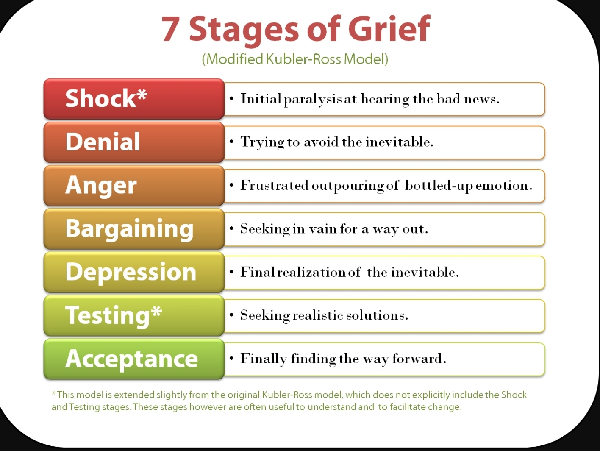
Session 1 DONE! Session 2 is now in session?
Bash! No if loops and butts about it!
Programming

Slide 2

Session 2: terminal session
Where we think we are
Where we actually are
Where we want to be

Slide 3
Recap:
-h / --help # almost all tools come with a help list that shows the avaialable commands and how to use them
mkdir --help
ls --help
sed --help
> # directing output to a location
>> # adding an output to a location
1> # STDout
2> # STDerr
&> # STDout + STDerr (all output)
Keep in mind STDin > tool_does_something > STDout/STDerr
For example
echo “banana 4 a manky” > important_phrases.txt [tool] [input = STDin] [redirect output] [new destination]

Slide 4
Variables in bash.
variable_bool=true
#this type of variable is called a boolean, and can only be either true or false
variable_bool=false
#It comes from binary statements that have only a 0 or 1 sollution, 1+1 = 0 (well, 1 0)
variable_numeric=12346579.13213155678
#integers (hole numbers), floats (numbers with decimal points) and in other languages a double (64bit, wheras floats are 32 bit)
variable_string="i'm a string"
#A string is not part of an instrument, it's a string of characters, it represents text
variable_array=(“I” am 4 collection of individual elements)
#An array (sometimes called vector in other languages) is a collection of things,
can be other variables, integers, strings, whatever)

Slide 5
Arrays have indices...
Example:
variable_array=(i am a collection of individual elements)
echo ${variable_array[1]} will return "am“
Keep in mind, bash will always want to interpret whatever it gets on STDin, to be a object or command....
This is why
${variable_array[1]}
will just return an error "am: command not found"
Bash is dumb dumb, it tries to extract “am” from the array. But then since you didn’t tell it what to do with “am”,
it assumes it might be software or a tool? Similar to typing mkdir or cd in the terminal.
So you have to be smart when tyring to make it do something, in this case we can send that “am” to ‘echo’, a tool that
takes anything from the STDin and just echo’s it back to the STDout.

Slide 6
Calling on variables
${variable}
#This bracket tells bash that a variable is coming, and it's content should be used.
$(variable)
#This stands for command substitution; it means run command and put its output here.
$variable
#This will assume variable is a command to run

Slide 7
examples
variable_A="I am a string"
echo ${variable_A}
Will give you “I am a string”
variable_B=$(echo ${variable_A})
echo ${variable_B}
Will give you “I am a string”
function x {
echo ${variable_A}
}
variable_C="x"
$variable_C
Will give you “I am a string”

Slide 8
If else statements
variable=99
if ${variable}=2; then
echo "Variable is indeed a 2"
fi
if ${variable}=1; then
echo "Variable is indeed a 1"
else
echo "Variable is not 1"
fi
If [[ variable_a=1 && variable_ ]]; then
If ${variable_a}=1 && ${variable_b}=3; then
if ${variable}=1; then
echo "Variable is indeed a 1"
elif ${variable}=2; then
echo "Variable is a 2"
else
echo "Variable is neither 1 or 2"
fi
If else statements
variable=2
if ${variable}=2; then
echo "Variable is indeed a 2"
fi
if ${variable}=1; then
echo "Variable is indeed a 1"
else
echo "Variable is not 1"
fi
If [[ variable_a=1 && variable_ ]]; then
If ${variable_a}=1 && ${variable_b}=3; then
if ${variable}=tue; then
echo “keep socks on"
elif ${variable}=false; then
echo “change socks“
Else
echo “ you probably need to see a doctor”
fi

Slide 9
If else statements
variable=1
if [[ $variable -gt 1 ]]; do
echo "Variable is greater than 1"
elif [[ $variable -eq 1 ]]; do
echo "Variable is equal to 1"
elif [[ $variable -lt 1 ]]; do
echo "Variable is lower than 1"
fi
Boolean if statments
variable=true
if $variable ; then
echo "The variable is True"
else
echo "The variable is False"
fi

Slide 10
For loop
count_ah_ah_ah=(for_loop_file1.txt for_loop_file2.txt for_loop_file3.txt for_loop_file4.txt)
clear
for items in ${count_a_a_a); do
cat ${items}
sleep 2
clear
done

Slide 11
While loops
i = 1
while read line; do
if [[ i -gt 2 ]]; then
echo $line
sleep 2
else
echo $line
sleep 2
clear
fi
i=$((i + 1))
done < while_loop_example.txt

Slide 12


