Slide 1
Operational QR modules as ERP interface

Slide 2
Why are ERPs important
For Small Scale Manufacturing
Understanding production costs as a function of warehouse space
Understand impacts of lead-times on cash-flow
Creating logical standard processes based on existing flows

Slide 3
Issues with traditional ERPs
Large bulky software packages that ignore small customers
* SAP integration, error codes, proprietary language

Slide 4
Issues with small scale subscription based ERPs
Weak functionality
Lack of scalability

Slide 5
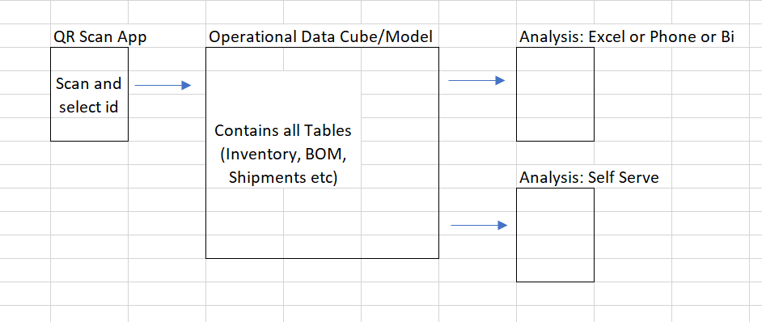
QR Code based modules

Slide 6
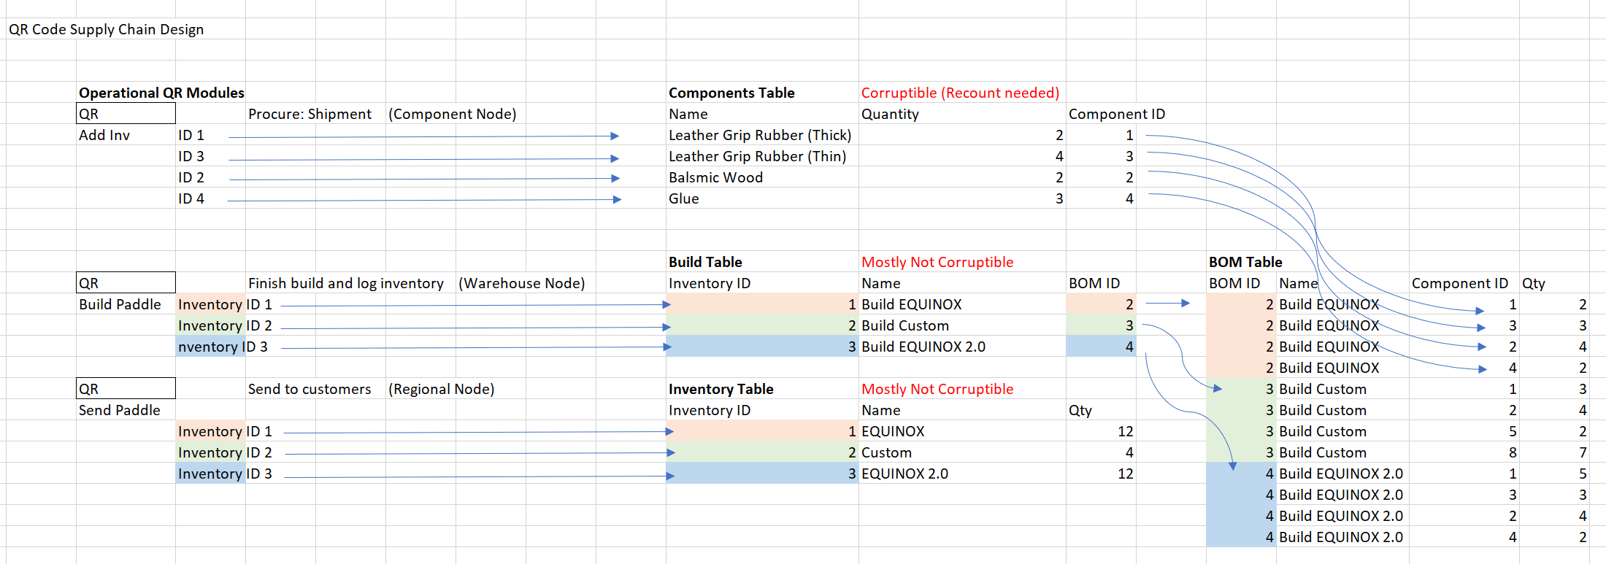
Component, Build and Inventory Nodes

Slide 7
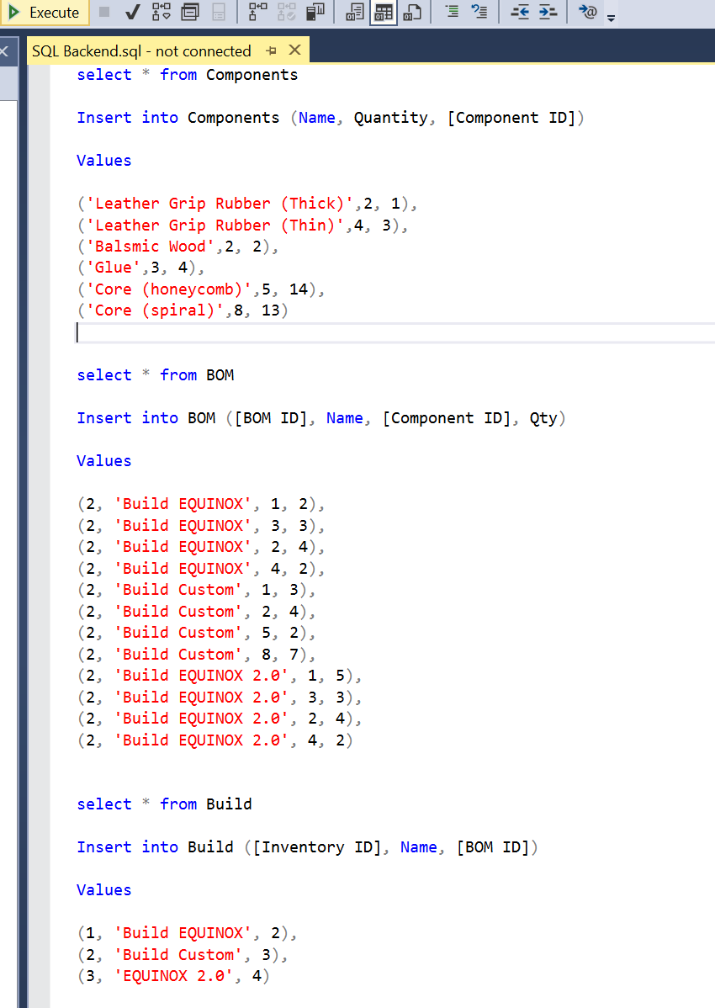
Scalable SQL Server Backend
~$5 to $10 a month based on Azure cloud pay as you go
Simple SQL tables to configuration for future operational modules
Stored Procs to interface with QR signals

Slide 8
Azure hosted front-end python app
QR code deep-links to inventory interface
One click to log inventory actions (inventory modules)
Instant data-model update
View changes in phone PBI or excel data model

Slide 9
Full Implementation
~$500 (-10 billable hours)
- Structure and build inventory modules (2 hours)
- Configuration and Generate QR (2 hours)
- Configurate app and sql ( 4 hours)
- Reconcile current inventory levels (2 hours)

