Slide 1
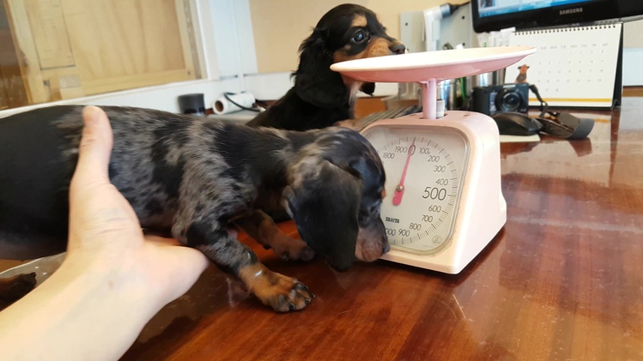
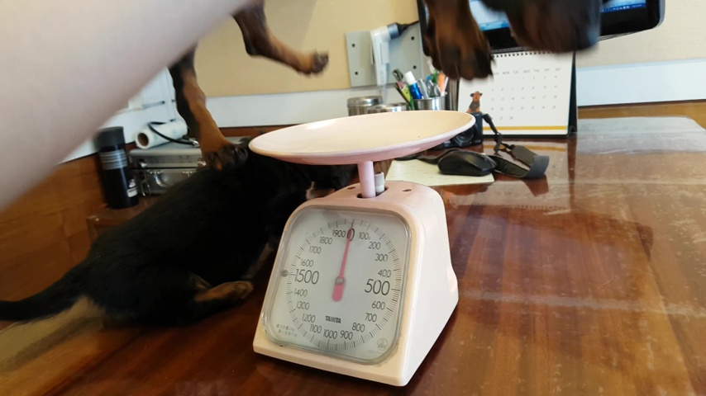
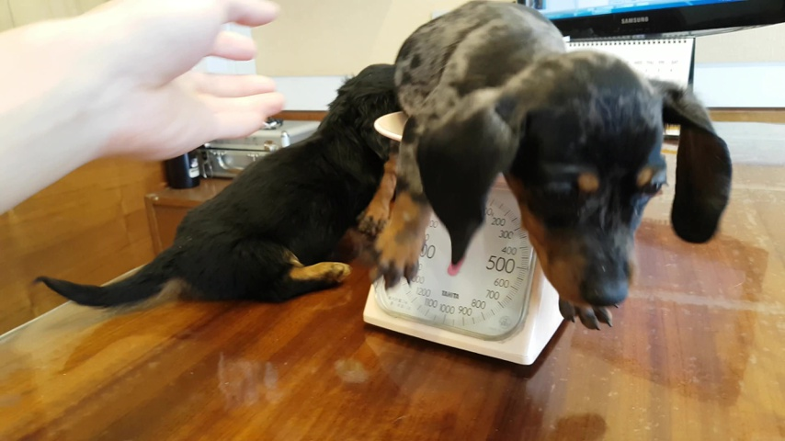
Shared weights
Candidate formation
Video
Observations
States + history
h²
ū²
Propose
Reset
Update
Self-attention
P¹
Host model
tanh
carry
Cross-attention
1
Masks
Decision heads
2
1−β
β
Obs.
3
State reasoner
h¹
States
y¹
K
U
R
S
Old state
P², π²
Propose
Refine
−λc¹
1−g
g
Verify
Verify
Write
Self-attention
P²
Next state
Output adapter
Cross-attention
1
Decision heads
2
Multiply
Add
Frozen
1
Identity
Obs.
Null
Output
3
0
1
Probability
K
U
R
S
K: Keep
U: Update
R: Revive
S: Suppress
(a) Overview
(b) Propose–Verify
(c) Verified transition
Notes:
Paper method illustration. Public display name: State reasoner. The overview, shared-weight Propose/Verify detail and verified transition retain the author-provided final design. The candidate gates are schematic. Soft associations, competition and action probabilities illustrate the mechanism, not experimental results. K/U/R/S denote Keep/Update/Revive/Suppress. Source: author-provided editable research figure.
DAVIS 2017 dogs-scale (train), frames 00000, 00020, 00040. Original video: https://www.youtube.com/watch?v=HhxyxHB8lFM . Dataset: https://davischallenge.org/davis2017/code.html . Photographs are original dataset frames. Colored overlays and mask contours use official ground-truth identities 1 and 2, not model predictions. Other annotated objects are intentionally omitted. Research and non-commercial illustration; no commercial permission is granted. Official README Credits says CC BY 4.0 whereas Terms of Use says CC BY-NC 4.0; this public demonstration follows the stricter CC BY-NC 4.0 and the original-source conditions. License: https://creativecommons.org/licenses/by-nc/4.0/ . Cite Pont-Tuset et al., The 2017 DAVIS Challenge on Video Object Segmentation, arXiv:1704.00675; Perazzi et al., A Benchmark Dataset and Evaluation Methodology for Video Object Segmentation, CVPR 2016.
Selected vector primitives: academic-figure-master, https://github.com/DuNGEOnmassster/academic-figure-master . Operation icons: Lucide circle-plus and circle-x, https://github.com/lucide-icons/lucide/tree/main/icons . Recolored and scaled editable geometry. Full licenses follow.
MIT License
Copyright (c) 2026 Mingzhe Zheng
Permission is hereby granted, free of charge, to any person obtaining a copy
of this software and associated documentation files (the "Software"), to deal
in the Software without restriction, including without limitation the rights
to use, copy, modify, merge, publish, distribute, sublicense, and/or sell
copies of the Software, and to permit persons to whom the Software is
furnished to do so, subject to the following conditions:
The above copyright notice and this permission notice shall be included in all
copies or substantial portions of the Software.
THE SOFTWARE IS PROVIDED "AS IS", WITHOUT WARRANTY OF ANY KIND, EXPRESS OR
IMPLIED, INCLUDING BUT NOT LIMITED TO THE WARRANTIES OF MERCHANTABILITY,
FITNESS FOR A PARTICULAR PURPOSE AND NONINFRINGEMENT. IN NO EVENT SHALL THE
AUTHORS OR COPYRIGHT HOLDERS BE LIABLE FOR ANY CLAIM, DAMAGES OR OTHER
LIABILITY, WHETHER IN AN ACTION OF CONTRACT, TORT OR OTHERWISE, ARISING FROM,
OUT OF OR IN CONNECTION WITH THE SOFTWARE OR THE USE OR OTHER DEALINGS IN THE
SOFTWARE.
ISC License
Copyright (c) 2026 Lucide Icons and Contributors
Permission to use, copy, modify, and/or distribute this software for any
purpose with or without fee is hereby granted, provided that the above
copyright notice and this permission notice appear in all copies.
THE SOFTWARE IS PROVIDED "AS IS" AND THE AUTHOR DISCLAIMS ALL WARRANTIES
WITH REGARD TO THIS SOFTWARE INCLUDING ALL IMPLIED WARRANTIES OF
MERCHANTABILITY AND FITNESS. IN NO EVENT SHALL THE AUTHOR BE LIABLE FOR
ANY SPECIAL, DIRECT, INDIRECT, OR CONSEQUENTIAL DAMAGES OR ANY DAMAGES
WHATSOEVER RESULTING FROM LOSS OF USE, DATA OR PROFITS, WHETHER IN AN
ACTION OF CONTRACT, NEGLIGENCE OR OTHER TORTIOUS ACTION, ARISING OUT OF
OR IN CONNECTION WITH THE USE OR PERFORMANCE OF THIS SOFTWARE.
---
The following Lucide icons are derived from the Feather project:
airplay, alert-circle, alert-octagon, alert-triangle, aperture, arrow-down-circle, arrow-down-left, arrow-down-right, arrow-down, arrow-left-circle, arrow-left, arrow-right-circle, arrow-right, arrow-up-circle, arrow-up-left, arrow-up-right, arrow-up, at-sign, calendar, cast, check, chevron-down, chevron-left, chevron-right, chevron-up, chevrons-down, chevrons-left, chevrons-right, chevrons-up, circle, clipboard, clock, code, columns, command, compass, corner-down-left, corner-down-right, corner-left-down, corner-left-up, corner-right-down, corner-right-up, corner-up-left, corner-up-right, crosshair, database, divide-circle, divide-square, dollar-sign, download, external-link, feather, frown, hash, headphones, help-circle, info, italic, key, layout, life-buoy, link-2, link, loader, lock, log-in, log-out, maximize, meh, minimize, minimize-2, minus-circle, minus-square, minus, monitor, moon, more-horizontal, more-vertical, move, music, navigation-2, navigation, octagon, pause-circle, percent, plus-circle, plus-square, plus, power, radio, rss, search, server, share, shopping-bag, sidebar, smartphone, smile, square, table-2, tablet, target, terminal, trash-2, trash, triangle, tv, type, upload, x-circle, x-octagon, x-square, x, zoom-in, zoom-out
The MIT License (MIT) (for the icons listed above)
Copyright (c) 2013-present Cole Bemis
Permission is hereby granted, free of charge, to any person obtaining a copy
of this software and associated documentation files (the "Software"), to deal
in the Software without restriction, including without limitation the rights
to use, copy, modify, merge, publish, distribute, sublicense, and/or sell
copies of the Software, and to permit persons to whom the Software is
furnished to do so, subject to the following conditions:
The above copyright notice and this permission notice shall be included in all
copies or substantial portions of the Software.
THE SOFTWARE IS PROVIDED "AS IS", WITHOUT WARRANTY OF ANY KIND, EXPRESS OR
IMPLIED, INCLUDING BUT NOT LIMITED TO THE WARRANTIES OF MERCHANTABILITY,
FITNESS FOR A PARTICULAR PURPOSE AND NONINFRINGEMENT. IN NO EVENT SHALL THE
AUTHORS OR COPYRIGHT HOLDERS BE LIABLE FOR ANY CLAIM, DAMAGES OR OTHER
LIABILITY, WHETHER IN AN ACTION OF CONTRACT, TORT OR OTHERWISE, ARISING FROM,
OUT OF OR IN CONNECTION WITH THE SOFTWARE OR THE USE OR OTHER DEALINGS IN THE
SOFTWARE.

Slide 2
Candidate formation
h²
ū²
Reset
Update
tanh
carry
1−β
β
Old state
P², π²
1−g
g
Next state
h²: reasoned state; ū²: matched evidence
β: internal carry weight
g: verified association/action gate
Internal gates are schematic.
Notes:
Paper method illustration. Public display name: State reasoner. The overview, shared-weight Propose/Verify detail and verified transition retain the author-provided final design. The candidate gates are schematic. Soft associations, competition and action probabilities illustrate the mechanism, not experimental results. K/U/R/S denote Keep/Update/Revive/Suppress. Source: author-provided editable research figure.
DAVIS 2017 dogs-scale (train), frames 00000, 00020, 00040. Original video: https://www.youtube.com/watch?v=HhxyxHB8lFM . Dataset: https://davischallenge.org/davis2017/code.html . Photographs are original dataset frames. Colored overlays and mask contours use official ground-truth identities 1 and 2, not model predictions. Other annotated objects are intentionally omitted. Research and non-commercial illustration; no commercial permission is granted. Official README Credits says CC BY 4.0 whereas Terms of Use says CC BY-NC 4.0; this public demonstration follows the stricter CC BY-NC 4.0 and the original-source conditions. License: https://creativecommons.org/licenses/by-nc/4.0/ . Cite Pont-Tuset et al., The 2017 DAVIS Challenge on Video Object Segmentation, arXiv:1704.00675; Perazzi et al., A Benchmark Dataset and Evaluation Methodology for Video Object Segmentation, CVPR 2016.
Selected vector primitives: academic-figure-master, https://github.com/DuNGEOnmassster/academic-figure-master . Operation icons: Lucide circle-plus and circle-x, https://github.com/lucide-icons/lucide/tree/main/icons . Recolored and scaled editable geometry. Full licenses follow.
MIT License
Copyright (c) 2026 Mingzhe Zheng
Permission is hereby granted, free of charge, to any person obtaining a copy
of this software and associated documentation files (the "Software"), to deal
in the Software without restriction, including without limitation the rights
to use, copy, modify, merge, publish, distribute, sublicense, and/or sell
copies of the Software, and to permit persons to whom the Software is
furnished to do so, subject to the following conditions:
The above copyright notice and this permission notice shall be included in all
copies or substantial portions of the Software.
THE SOFTWARE IS PROVIDED "AS IS", WITHOUT WARRANTY OF ANY KIND, EXPRESS OR
IMPLIED, INCLUDING BUT NOT LIMITED TO THE WARRANTIES OF MERCHANTABILITY,
FITNESS FOR A PARTICULAR PURPOSE AND NONINFRINGEMENT. IN NO EVENT SHALL THE
AUTHORS OR COPYRIGHT HOLDERS BE LIABLE FOR ANY CLAIM, DAMAGES OR OTHER
LIABILITY, WHETHER IN AN ACTION OF CONTRACT, TORT OR OTHERWISE, ARISING FROM,
OUT OF OR IN CONNECTION WITH THE SOFTWARE OR THE USE OR OTHER DEALINGS IN THE
SOFTWARE.
ISC License
Copyright (c) 2026 Lucide Icons and Contributors
Permission to use, copy, modify, and/or distribute this software for any
purpose with or without fee is hereby granted, provided that the above
copyright notice and this permission notice appear in all copies.
THE SOFTWARE IS PROVIDED "AS IS" AND THE AUTHOR DISCLAIMS ALL WARRANTIES
WITH REGARD TO THIS SOFTWARE INCLUDING ALL IMPLIED WARRANTIES OF
MERCHANTABILITY AND FITNESS. IN NO EVENT SHALL THE AUTHOR BE LIABLE FOR
ANY SPECIAL, DIRECT, INDIRECT, OR CONSEQUENTIAL DAMAGES OR ANY DAMAGES
WHATSOEVER RESULTING FROM LOSS OF USE, DATA OR PROFITS, WHETHER IN AN
ACTION OF CONTRACT, NEGLIGENCE OR OTHER TORTIOUS ACTION, ARISING OUT OF
OR IN CONNECTION WITH THE USE OR PERFORMANCE OF THIS SOFTWARE.
---
The following Lucide icons are derived from the Feather project:
airplay, alert-circle, alert-octagon, alert-triangle, aperture, arrow-down-circle, arrow-down-left, arrow-down-right, arrow-down, arrow-left-circle, arrow-left, arrow-right-circle, arrow-right, arrow-up-circle, arrow-up-left, arrow-up-right, arrow-up, at-sign, calendar, cast, check, chevron-down, chevron-left, chevron-right, chevron-up, chevrons-down, chevrons-left, chevrons-right, chevrons-up, circle, clipboard, clock, code, columns, command, compass, corner-down-left, corner-down-right, corner-left-down, corner-left-up, corner-right-down, corner-right-up, corner-up-left, corner-up-right, crosshair, database, divide-circle, divide-square, dollar-sign, download, external-link, feather, frown, hash, headphones, help-circle, info, italic, key, layout, life-buoy, link-2, link, loader, lock, log-in, log-out, maximize, meh, minimize, minimize-2, minus-circle, minus-square, minus, monitor, moon, more-horizontal, more-vertical, move, music, navigation-2, navigation, octagon, pause-circle, percent, plus-circle, plus-square, plus, power, radio, rss, search, server, share, shopping-bag, sidebar, smartphone, smile, square, table-2, tablet, target, terminal, trash-2, trash, triangle, tv, type, upload, x-circle, x-octagon, x-square, x, zoom-in, zoom-out
The MIT License (MIT) (for the icons listed above)
Copyright (c) 2013-present Cole Bemis
Permission is hereby granted, free of charge, to any person obtaining a copy
of this software and associated documentation files (the "Software"), to deal
in the Software without restriction, including without limitation the rights
to use, copy, modify, merge, publish, distribute, sublicense, and/or sell
copies of the Software, and to permit persons to whom the Software is
furnished to do so, subject to the following conditions:
The above copyright notice and this permission notice shall be included in all
copies or substantial portions of the Software.
THE SOFTWARE IS PROVIDED "AS IS", WITHOUT WARRANTY OF ANY KIND, EXPRESS OR
IMPLIED, INCLUDING BUT NOT LIMITED TO THE WARRANTIES OF MERCHANTABILITY,
FITNESS FOR A PARTICULAR PURPOSE AND NONINFRINGEMENT. IN NO EVENT SHALL THE
AUTHORS OR COPYRIGHT HOLDERS BE LIABLE FOR ANY CLAIM, DAMAGES OR OTHER
LIABILITY, WHETHER IN AN ACTION OF CONTRACT, TORT OR OTHERWISE, ARISING FROM,
OUT OF OR IN CONNECTION WITH THE SOFTWARE OR THE USE OR OTHER DEALINGS IN THE
SOFTWARE.

