Slide 1
GETITQUICK
Get your job quick

Slide 2
PROBLEM STATEMENT
Build a system that recommends jobs based on resume.

Slide 3
OVERVIEW
People are facing problem in finding suitable jobs.
The same problem is being faced by the hiring companies.
We made a platform which can help them to overcome this problem.

Slide 4
BASIC IDEA OF OUR PROJECT
Firstly user has to put their resume into our platform.
There are two ways to do so.
Users can either put a pdf of their resume and our system will take out information from it or they can use an another option to fill up the form which is there on our platform.
Then the platform automatically make a overview of their resume and reflect it in the form of a pie chart and suggest jobs to the users.

Slide 5
APPROACH
We made a easy to use website for interaction with our users.
We used HTML, CSS, BOOTSTRAP, JAVASCRIPT for our website frontend.
We have a mechanism in our website which take up the user’s resume and put that in a tool which will analyze their resume and suggest the best jobs.
We made our tool using PYTHON and its libraries.

Slide 6
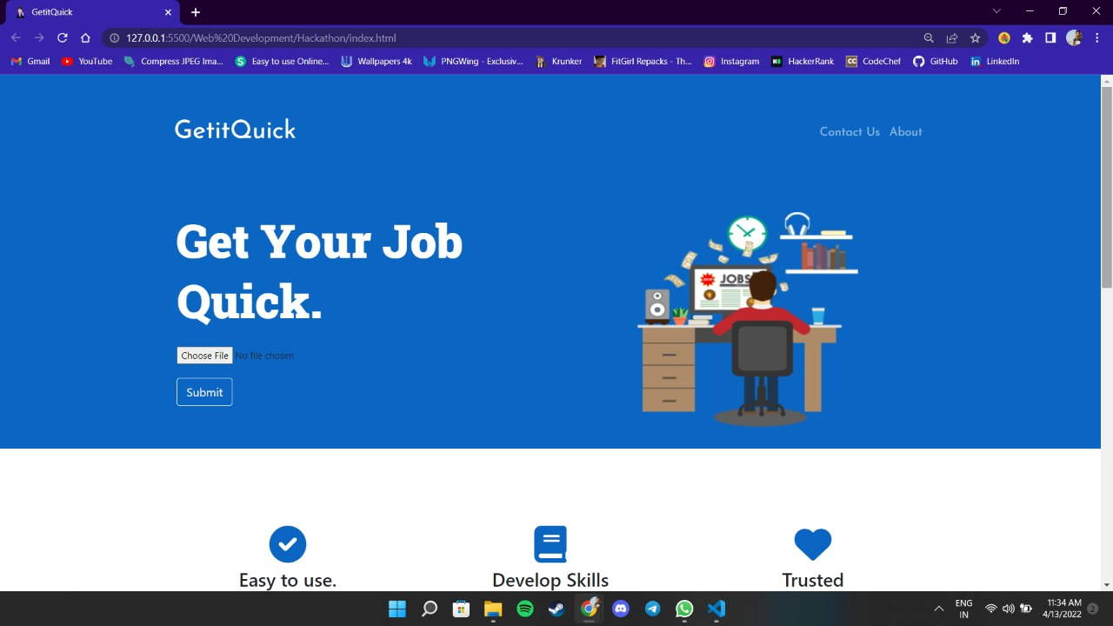
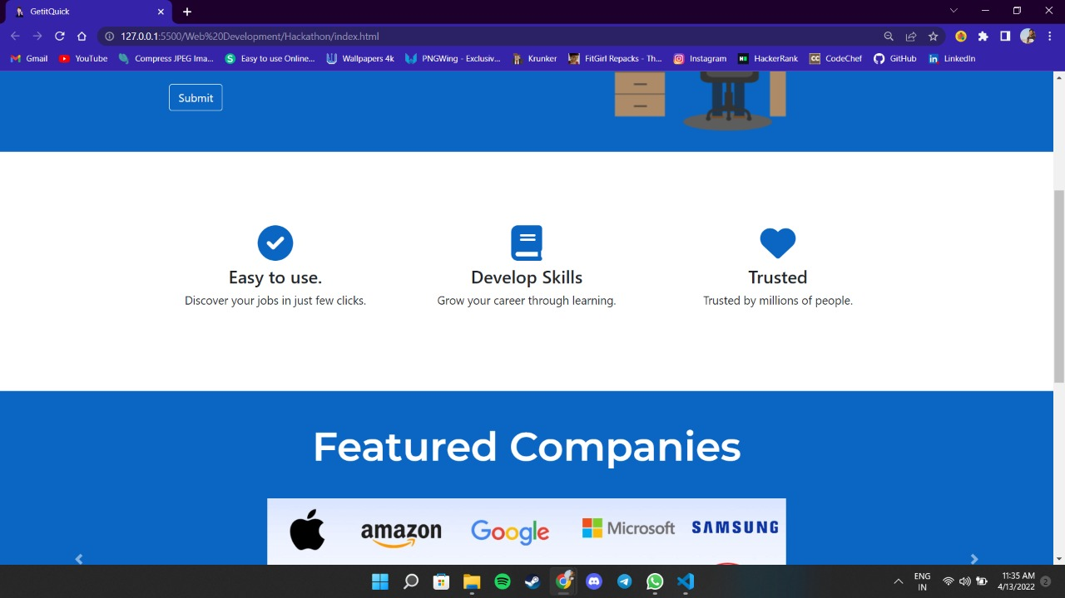
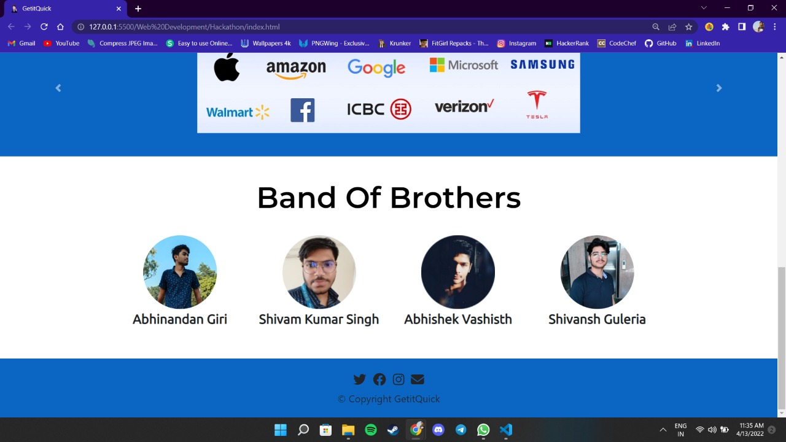
OUR WEBSITE

Slide 7
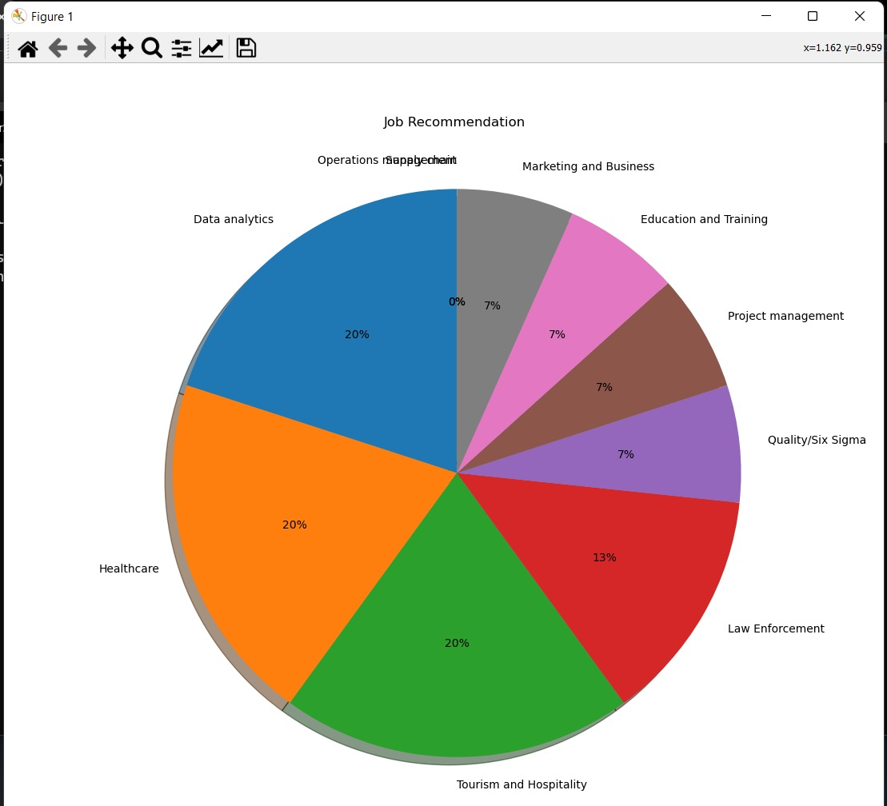
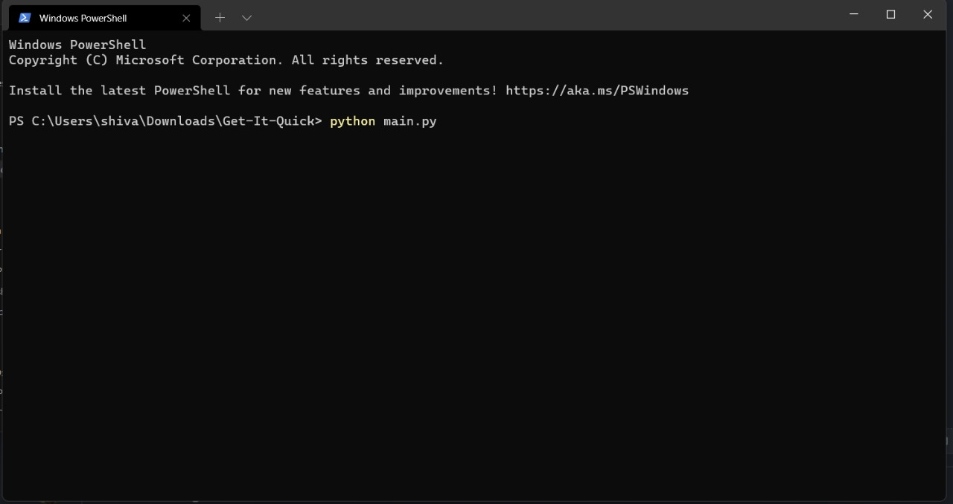
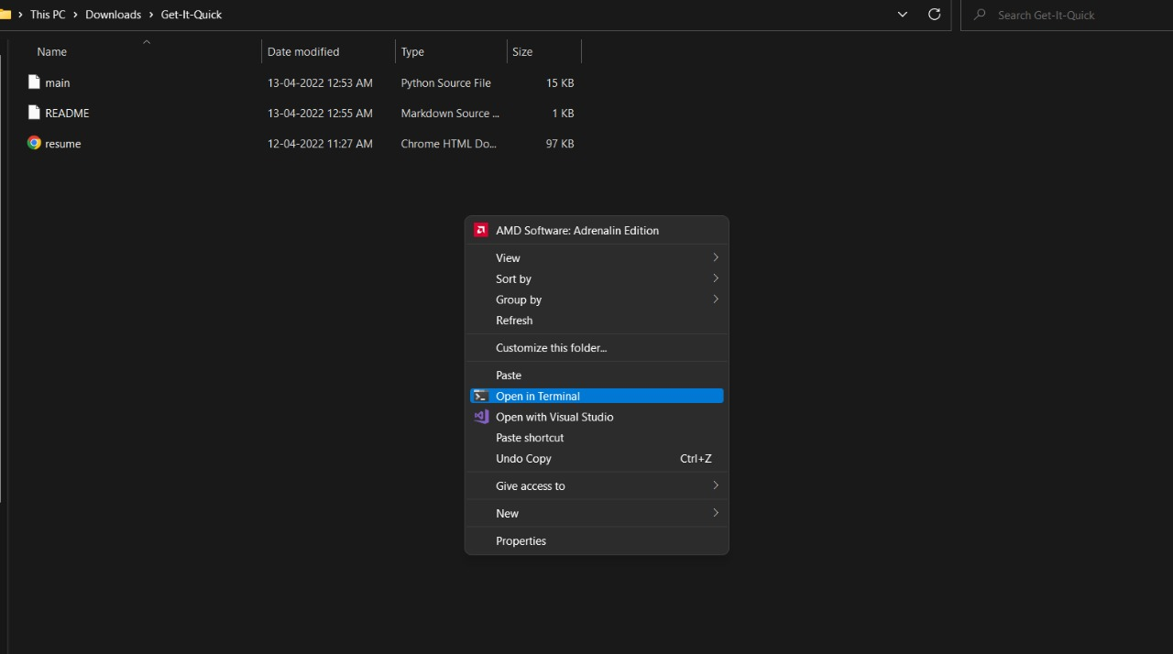
OUR TOOL

Slide 8
PROJECT LINKS
WEBSITE LINK :-https://iamnileshkumarbibhuti.github.io/GETITQUICK.github.io/
PROJECT LINK :-https://github.com/ iamnileshkumarbibhuti/Get-It-Quick

Slide 9
TEAM MEMBERS
TEAM LEADER:-
Nilesh Kumar Bibhuti

Slide 10
THANK YOU

