Slide 1
CONFERENCE PRESENTATION
Lightweight Object Detection
for Driver Monitoring
A subject-disjoint benchmark
Oumar Mamoun Ibrahim · Mohamad Khairi bin Ishak
Khalid Ammar · Nada Masood Mirza
Notes:
Timing: 35 seconds. Open with the research question: which lightweight detector should we deploy when the driver is someone the model has never seen? State that the answer is not a single winner; it is a measurable trade-off among localization, reliability, and speed.
[Sources]
- Manuscript title and author block: docs/manuscript/main.tex

Slide 2
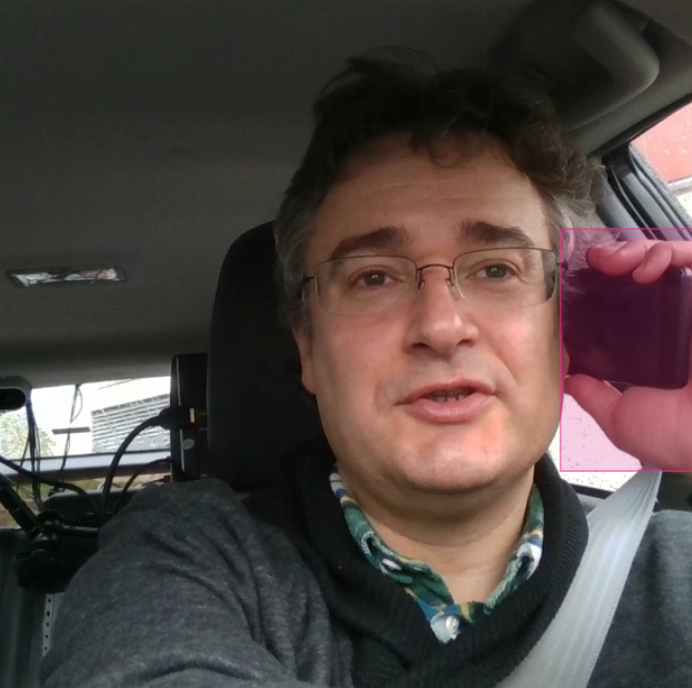
Reliable cues must generalize to unseen drivers
Identity should not
become a shortcut.
Detection localizes the evidence
Exposes misses and false alarms
Supports real-time deployment
2
Notes:
Timing: 65 seconds. Begin with why this matters: in-cabin systems face new identities, illumination, viewpoints, and occlusion. Explain that bounding boxes make the evidence inspectable, unlike a whole-frame label that can exploit background or identity. Clarify that this is single-frame cue detection, not fatigue or intent inference.
[Sources]
- Manuscript Introduction and Task Definition: docs/manuscript/main.tex
- Euro NCAP driver-monitoring context: https://www.euroncap.com/en/for-engineers/protocols/safety-assist/
- Asset: docs/assets/examples/phone_use_annotation_example.png

Slide 3
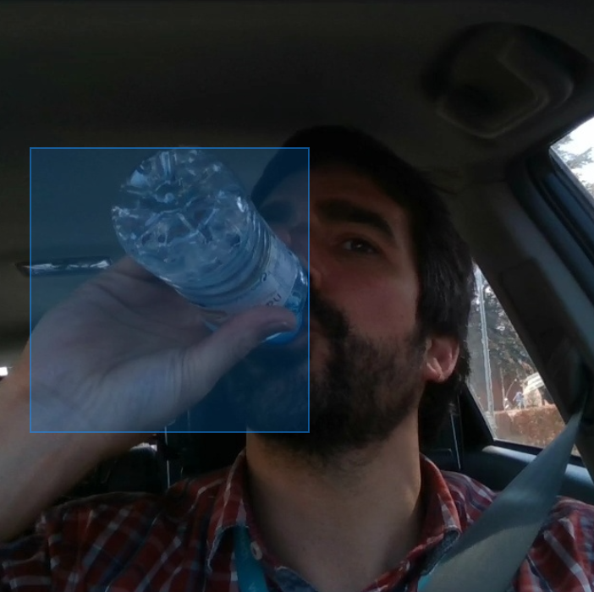
Comparisons often blur the deployment question
Whole-frame recognition
Efficient activity labels—but spatial evidence can remain implicit.
Specialized detectors
Many architectures; different splits, negatives, thresholds, and timing boundaries.
The missing controlled comparison
Subject-disjoint testing + validation-only thresholds + all negative frames + synchronized latency.
3
Notes:
Timing: 70 seconds. Keep the review short. Contrast classification and detection, then explain why cross-paper rankings are unreliable when identity leakage, negative-frame handling, threshold tuning, and latency definitions differ. End by naming the controlled gap this work addresses.
[Sources]
- Manuscript Related Work: docs/manuscript/main.tex
- DMD dataset: https://doi.org/10.1007/978-3-030-58523-5_39
- Drive&Act dataset: https://doi.org/10.1109/ICCV.2019.00289
- Asset: docs/assets/examples/drinking_annotation_example.png

Slide 4
A controlled RGB benchmark anchors the study
15,723
14
4
3
frames
drivers
visible cues
paired seeds
Complementary NIR experiment: 8 systems · 2 negative exposures · 1 fixed seed
4
Notes:
Timing: 55 seconds. Establish scope without listing all training settings. The RGB benchmark is primary: 15,723 frames from 14 drivers, four cues, and three paired seeds. The NIR experiment is complementary—not a modality comparison—and tests the effect of greater negative exposure across eight model families.
[Sources]
- Manuscript RGB Dataset, Split, Models, and Exploratory NIR Protocol: docs/manuscript/main.tex

Slide 5
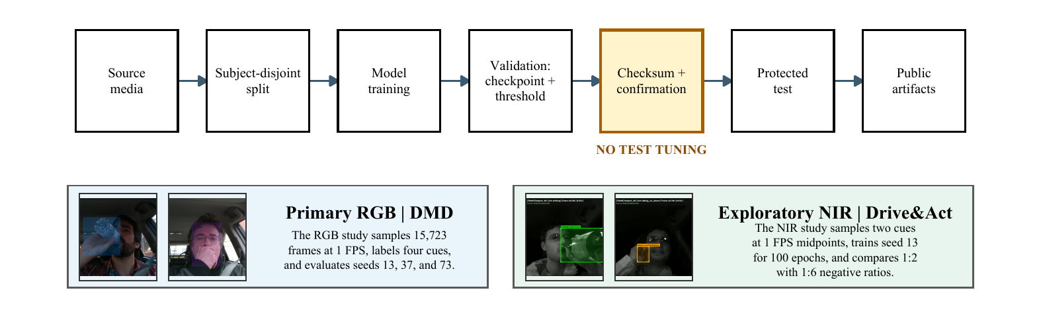
Protect the test set from tuning
Subject-disjoint split · validation-only threshold · all negatives retained
5
Notes:
Timing: 75 seconds. Walk left to right. Subjects—not frames—are split. Train and validate before a checksum and confirmation gate. Select confidence thresholds only on validation data. Touch the protected test set once for final evaluation. Explain that all sampled negative frames stay in the benchmark so nuisance detections are measurable.
[Sources]
- Manuscript Methodology: docs/manuscript/main.tex
- Figure asset: results/summary/figures/protocol_workflow.pdf

Slide 6
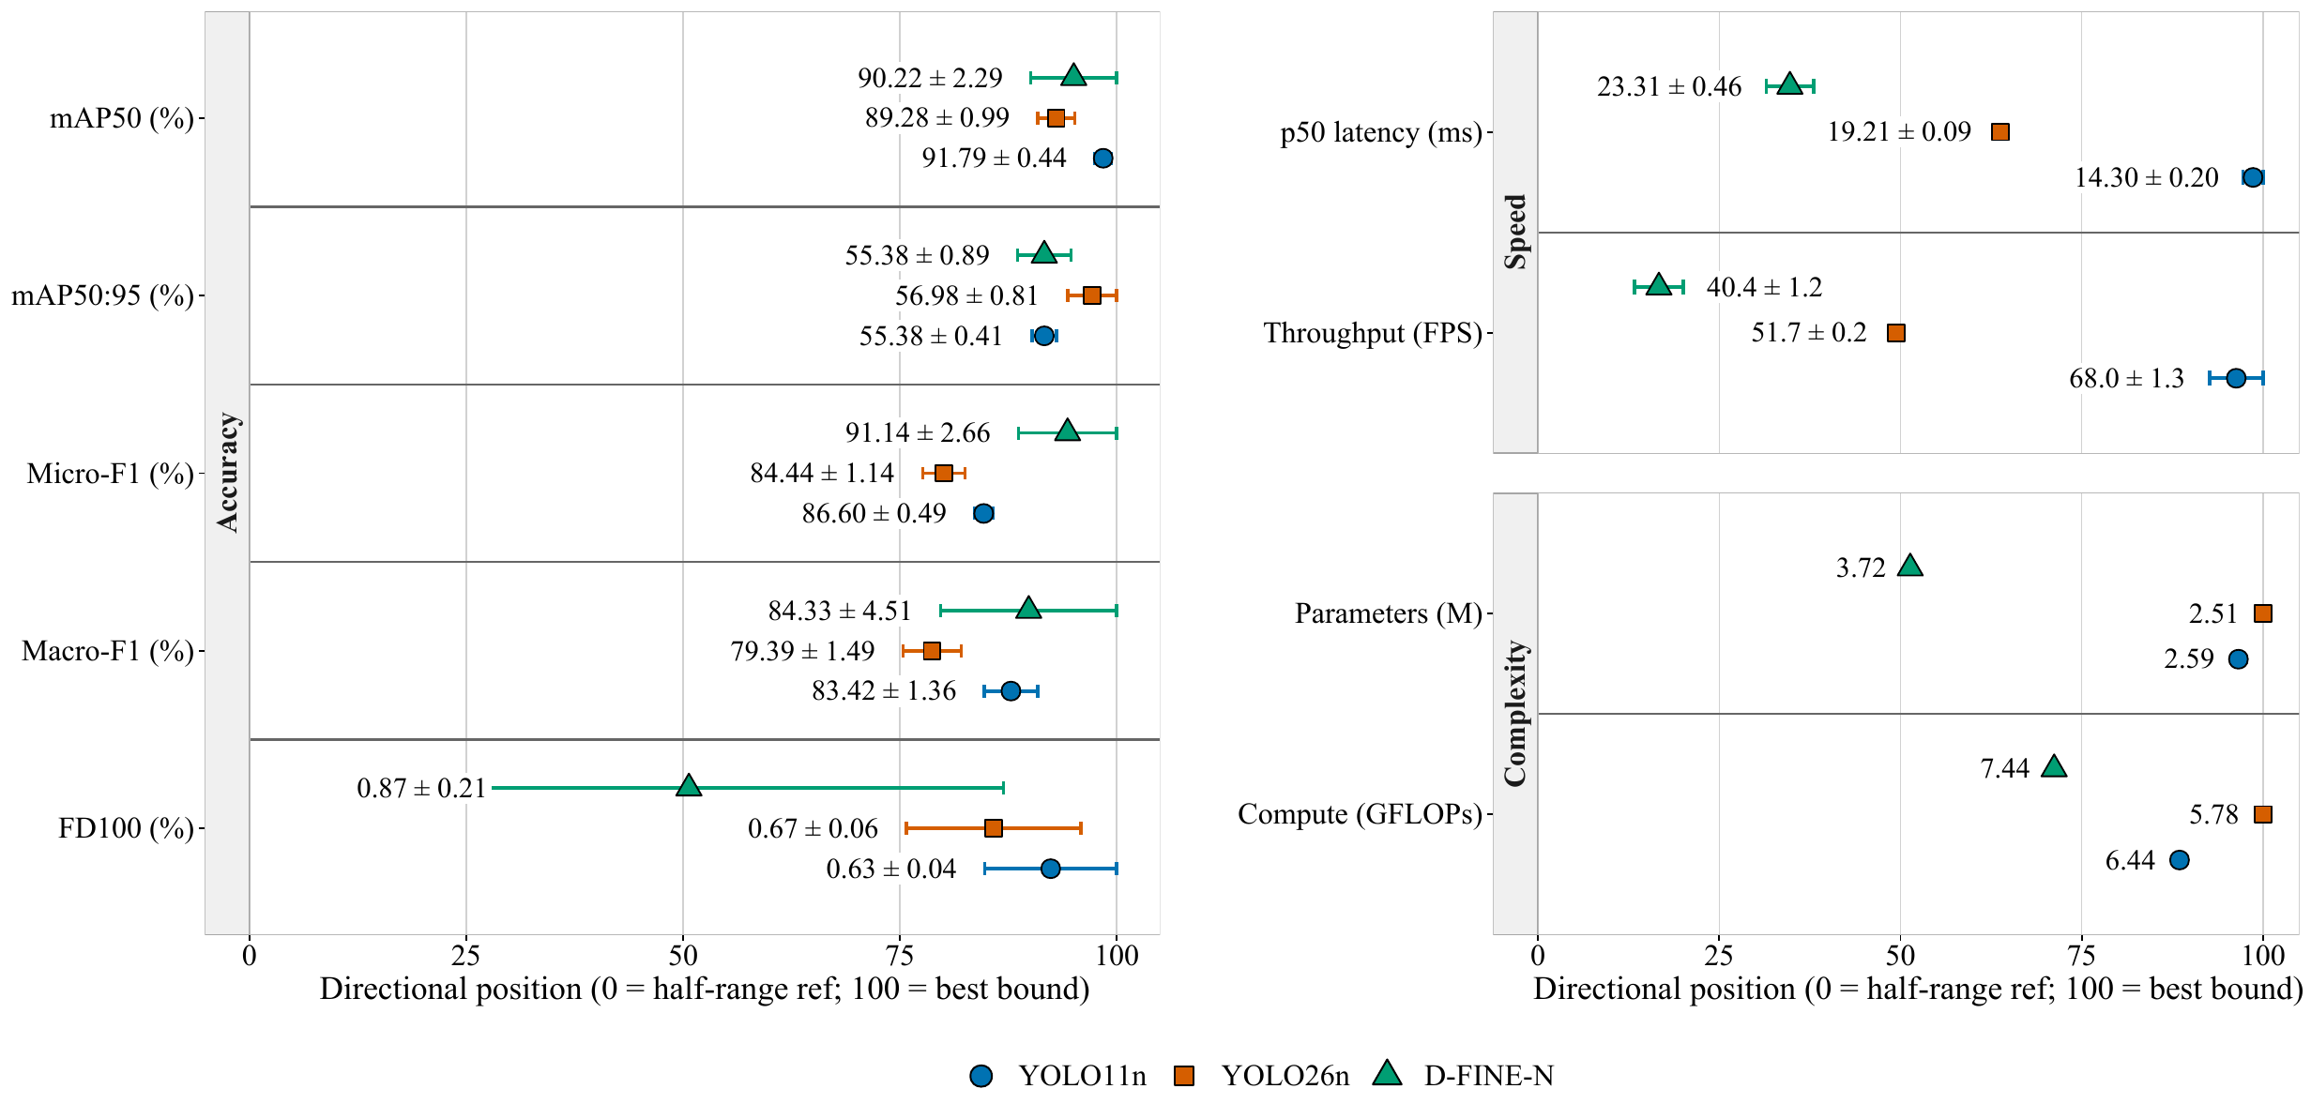
No detector wins accuracy, reliability, and speed
YOLO11n
Coarse-IoU accuracy
68.0 FPS throughput
YOLO26n
Strict-IoU localization
56.98% mAP@0.5:0.95
D-FINE-N
Calibrated reliability
91.14% micro-F1
6
Notes:
Timing: 95 seconds. This is the central result. Use the directional plot, not every table value. YOLO11n leads coarse-IoU accuracy and throughput; YOLO26n leads strict-IoU localization; D-FINE-N leads calibrated micro- and macro-F1 but is slower. Emphasize that these are system-level results under native recipes.
[Sources]
- Manuscript Table III and Aggregate RGB Results: docs/manuscript/main.tex
- Figure asset: results/RGB/summary/figures/normalized_model_comparison.pdf

Slide 7
Driver identity matters more than seed variation
Subject 10
54.11–78.79%
across systems
A pooled score hides
the difficult driver.
7
Notes:
Timing: 85 seconds. Point to Subject 10. The performance swing across held-out drivers is much larger than pooled seed standard deviation. This is the defense for subject-level reporting: aggregate metrics can look stable while a deployment-critical identity fails.
[Sources]
- Manuscript Held-Out Subject Sensitivity: docs/manuscript/main.tex

Slide 8
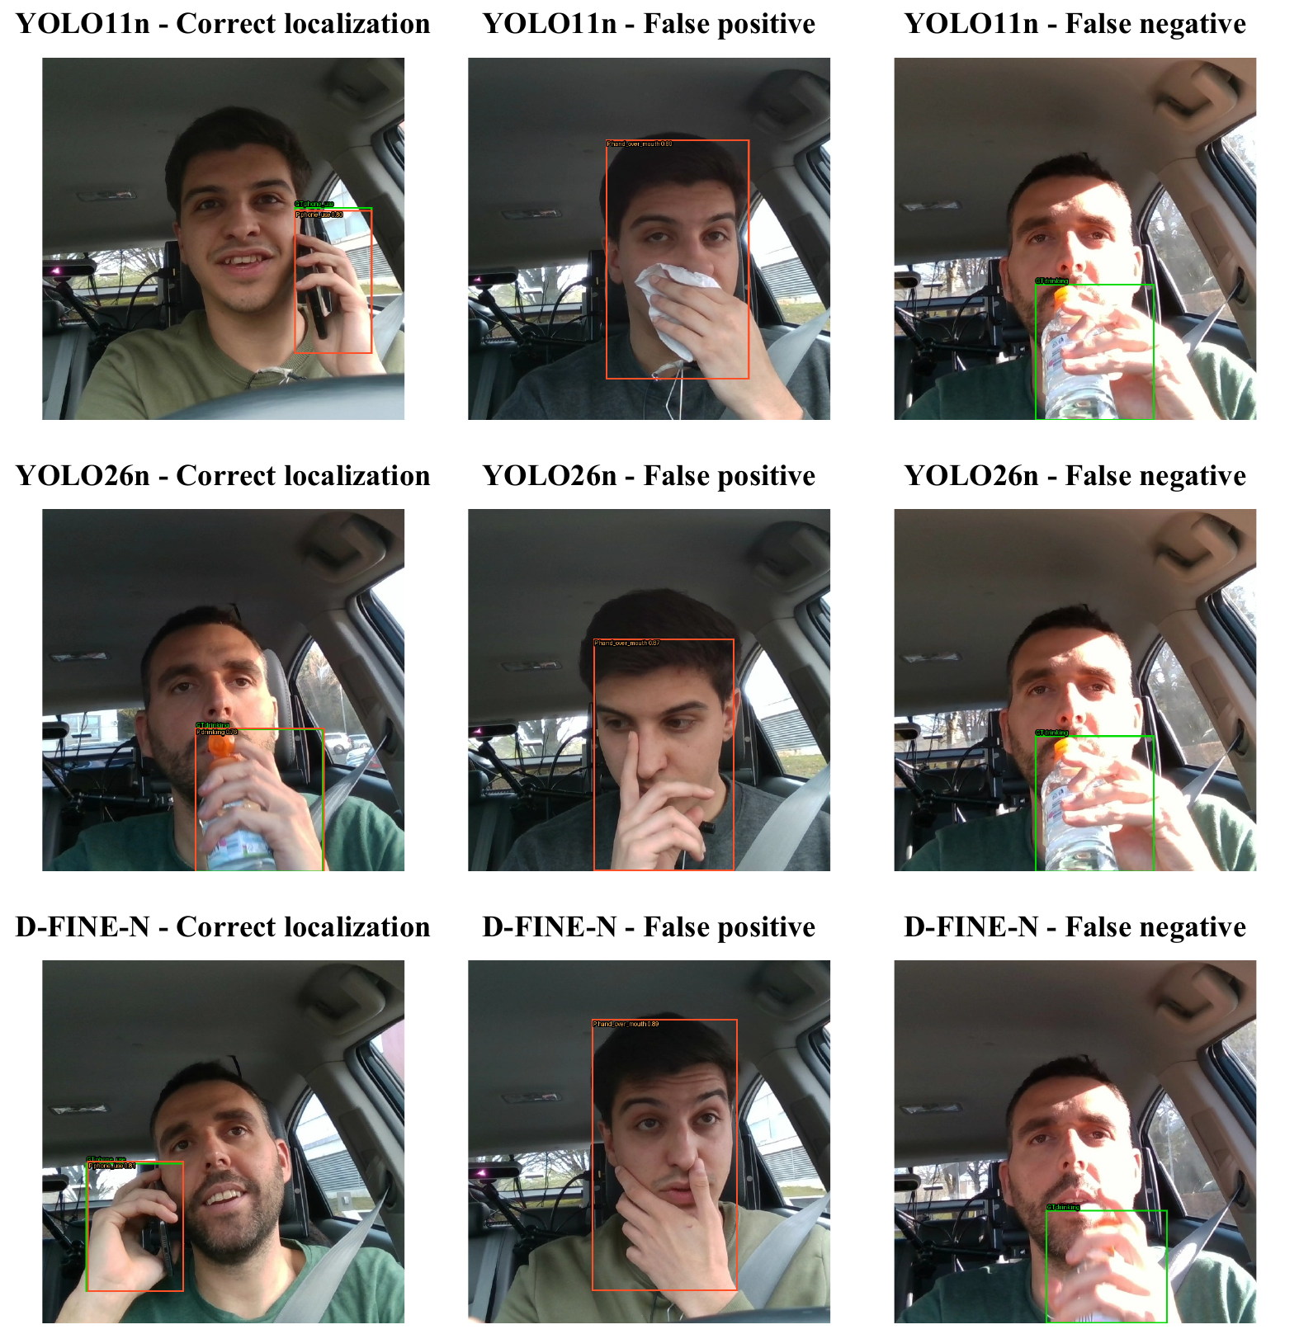
Spatial detection errors are debuggable
Correct
Cue and location agree
False positive
Cue-like nominal negative
False negative
Glare and small targets
8
Notes:
Timing: 75 seconds. Use one example per column. Correct detections localize the intended interaction. False negatives show glare and small drinking targets. The false-positive example is more important: a nominal negative can be visually cue-like, exposing ontology or missed-label risk that a structural annotation audit cannot resolve.
[Sources]
- Manuscript Qualitative Error Analysis: docs/manuscript/main.tex
- Figure asset: results/RGB/summary/figures/qualitative_examples.pdf

Slide 9
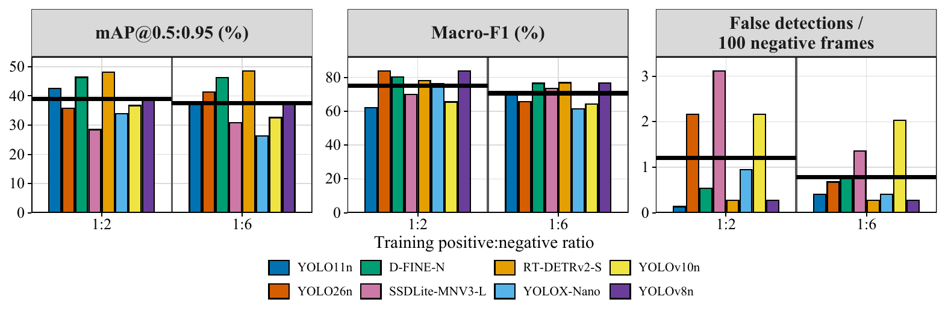
More negative exposure is not a universal benefit
3 / 8
1 / 8
improved strict-IoU AP
improved micro-F1
9
Notes:
Timing: 85 seconds. The 1:6 condition triples unique negatives and increases optimizer updates, so this is an exposure study rather than a causal ratio ablation. Strict-IoU AP improves for only three of eight systems; micro-F1 improves for only SSDLite. The direction is model-dependent, so 'more negatives' is not a safe universal prescription.
[Sources]
- Manuscript Exploratory NIR Results: docs/manuscript/main.tex
- Figure asset: results/NIR/summary/figures/training_negative_exposure.pdf

Slide 10
Choose the detector for the failure cost
False alarms cost more
Localization must be precise
Calibrated F1 matters most
YOLO11n
YOLO26n
D-FINE-N
Lowest FD₁₀₀
Highest throughput
Best mAP@0.5:0.95
Smallest model
Best micro- and macro-F1
Higher latency
Validate again on the target population and hardware.
10
Notes:
Timing: 80 seconds. Translate the benchmark into a decision. If nuisance alerts erode trust, start with YOLO11n. If precise boxes feed downstream gaze or posture logic, YOLO26n's strict-IoU advantage matters. If calibrated detection reliability dominates and latency is acceptable, D-FINE-N leads. End with the caveat that the target population and hardware still require validation.
[Sources]
- Manuscript Discussion and Conclusion: docs/manuscript/main.tex

Slide 11
TAKEAWAY
No detector wins every
deployment axis.
Q&A
Split by subject
Tune only on validation
Report the failures
github.com/IamOumarIbrahim/
lightweight-driver-behavior-detection
Notes:
Timing: 45 seconds, then questions. Resolve the opening: the best system depends on which error is expensive. Reiterate the three methodological practices—subject-level splits, validation-only calibration, and visible failure reporting. Invite questions about the split, operating-point selection, class imbalance, NIR exposure design, and hardware timing.
[Sources]
- Manuscript Conclusion and Data and Code statement: docs/manuscript/main.tex
- Repository: https://github.com/IamOumarIbrahim/lightweight-driver-behavior-detection

