Slide 1

DATABASE MANAGEMENT SYSTEMS – PL/SQL
MCA 3RD SEMESTER,
SIKKIM UNIVERSITY

Slide 2
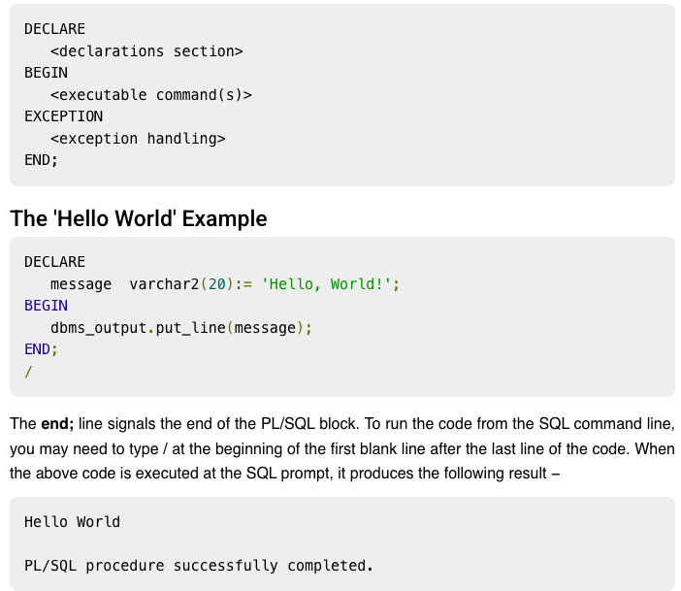
PL/SQL
Every PL/SQL statement ends with a semicolon (;). PL/SQL blocks can be nested within other PL/SQL blocks using BEGIN and END.
Following is the basic structure of a PL/SQL block −

Slide 3
THE PL/SQL IDENTIFIERS
PL/SQL identifiers are constants, variables, exceptions, procedures, cursors, and reserved words.
The identifiers consist of a letter optionally followed by more letters, numerals, dollar signs, underscores, and number signs and should not exceed 30 characters.
By default, identifiers are not case-sensitive.
So you can use integer or INTEGER to represent a numeric value.
You cannot use a reserved keyword as an identifier.

Slide 4
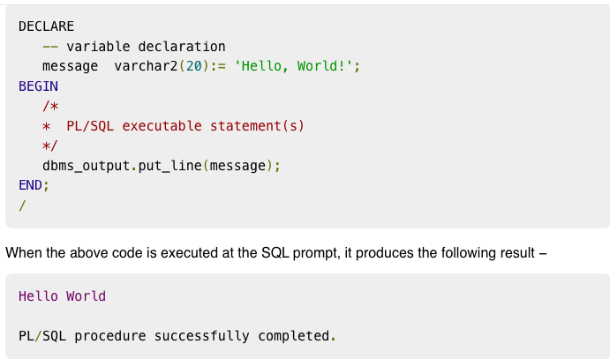
THE PL/SQL COMMENTS
Program comments are explanatory statements that can be included in the PL/SQL code that you write and helps anyone reading its source code.
All programming languages allow some form of comments.
The PL/SQL supports sin Agle-line and multi-line comments.
All characters available inside any comment are ignored by the PL/SQL compiler.
The PL/SQL single-line comments start with the delimiter -- (double hyphen) and multi-line comments are enclosed by /* and */.

Slide 5
Variable Declaration in PL/SQL
The syntax for declaring a variable is −
variable_name [CONSTANT] datatype [NOT NULL] [:= | DEFAULT initial_value]
EXAMPLE
sales number(10, 2);
pi CONSTANT double precision := 3.1415;
name varchar2(25);
address varchar2(100);

Slide 6
INITIALIZING VARIABLES IN PL/SQL
Whenever you declare a variable, PL/SQL assigns it a default value of NULL. If you want to initialize a variable with a value other than the NULL value, you can do so during the declaration, using either of the following −
The DEFAULT keyword
The assignment operator
Example −
counter binary_integer := 0;
greetings varchar2(20) DEFAULT 'Have a Good Day';

Slide 7
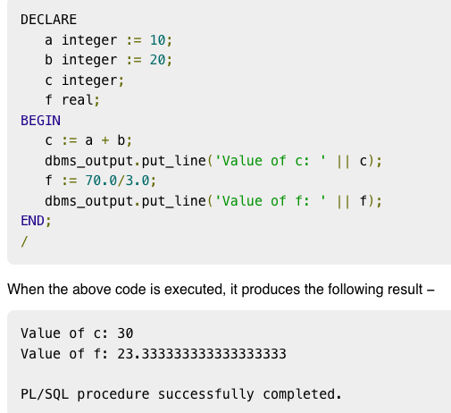
EXAMPLE

Slide 8
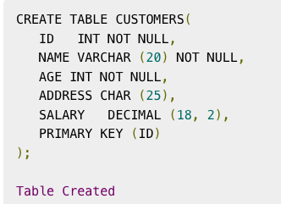
ASSIGNING SQL QUERY RESULTS TO PL/SQL VARIABLES
You can use the SELECT INTO statement of SQL to assign values to PL/SQL variables.
For each item in the SELECT list, there must be a corresponding, type-compatible variable in the INTO list.
The following example illustrates the concept.
Let us create a table named CUSTOMERS −

Slide 9
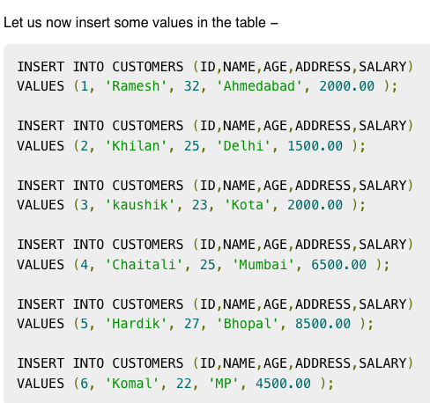

Slide 10
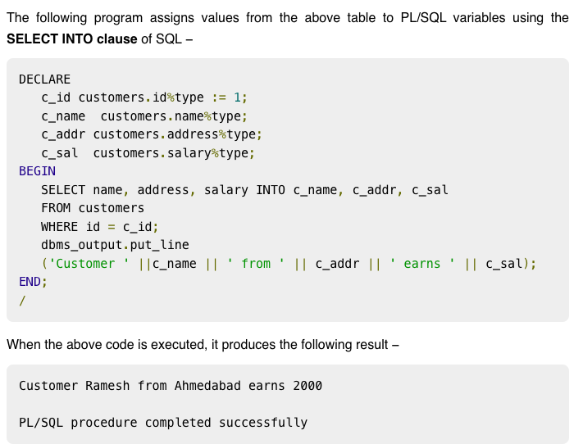
ASSIGNING SQL QUERY RESULTS TO PL/SQL VARIABLES

Slide 11
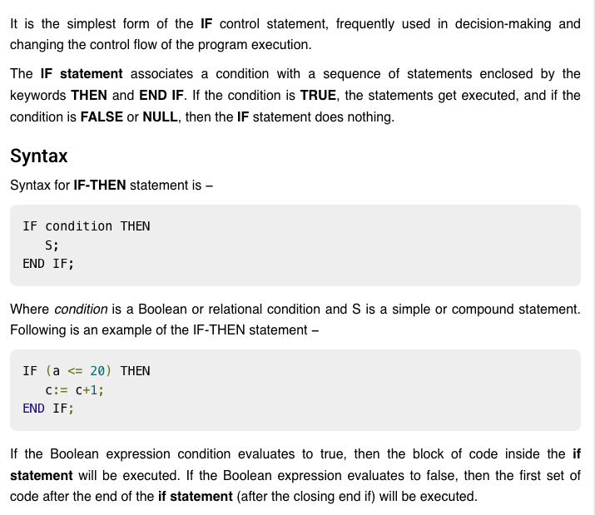
PL/SQL - Conditions

Slide 12
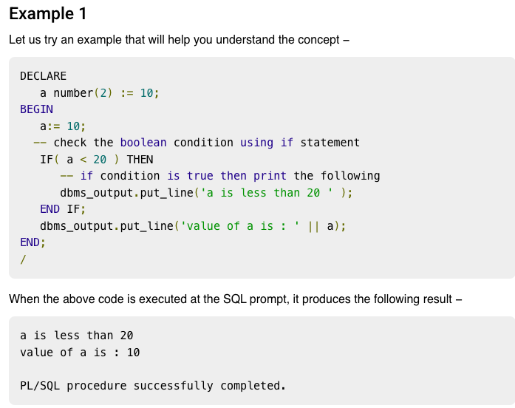

Slide 13
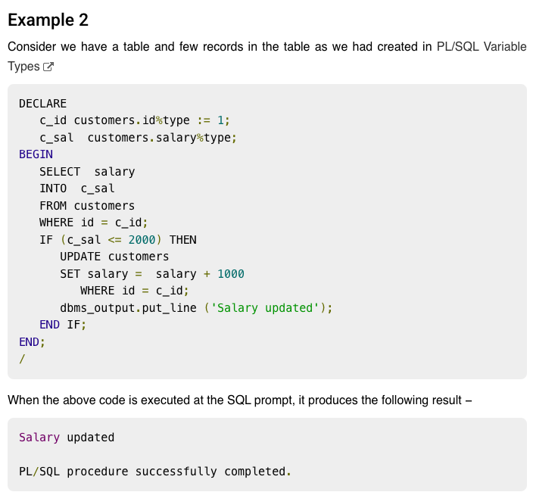

Slide 14
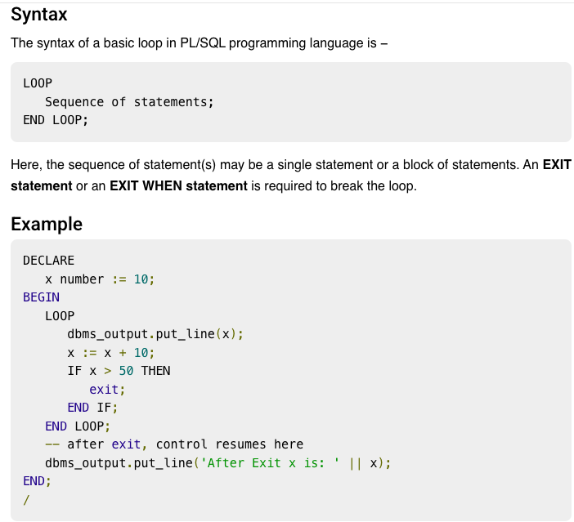
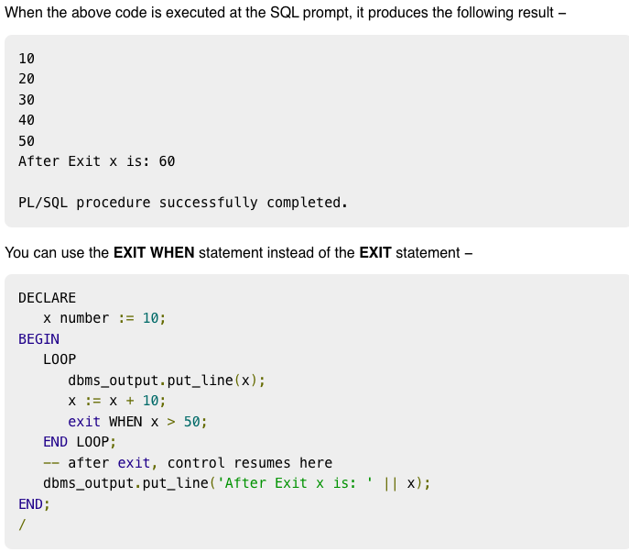
PL/SQL BASIC LOOP

Slide 15
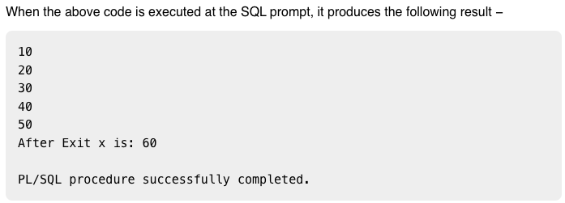
PL/SQL BASIC LOOP

Slide 16
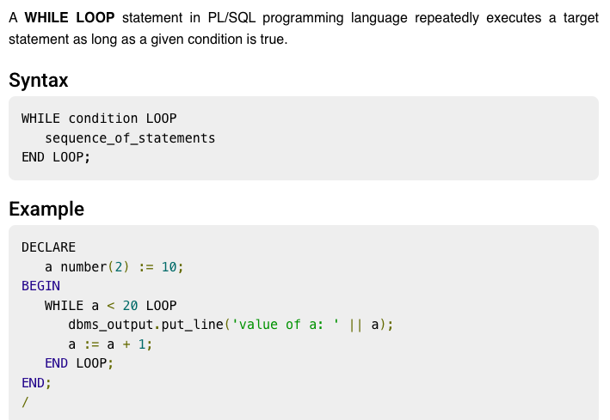
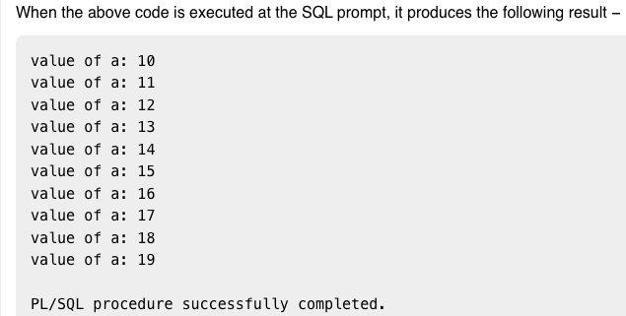
PL/SQL WHILE LOOP

Slide 17
PL/SQL WHILE LOOP

Slide 18
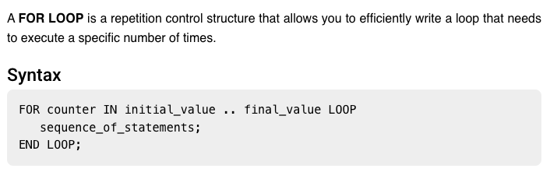
PL/SQL FOR LOOP

Slide 19
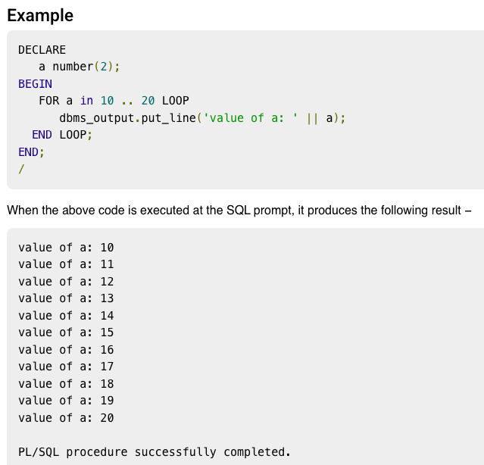
PL/SQL FOR LOOP

Slide 20
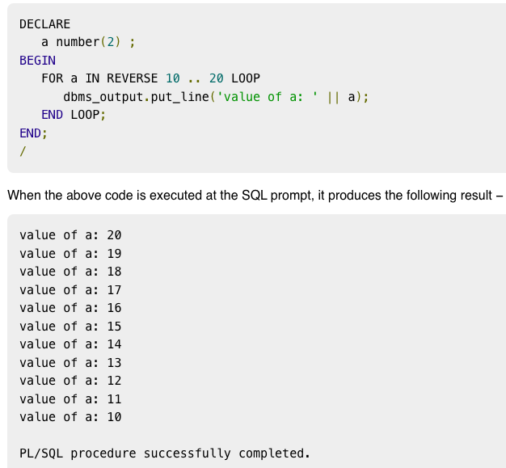
REVERSE FOR LOOP STATEMENT

Slide 21
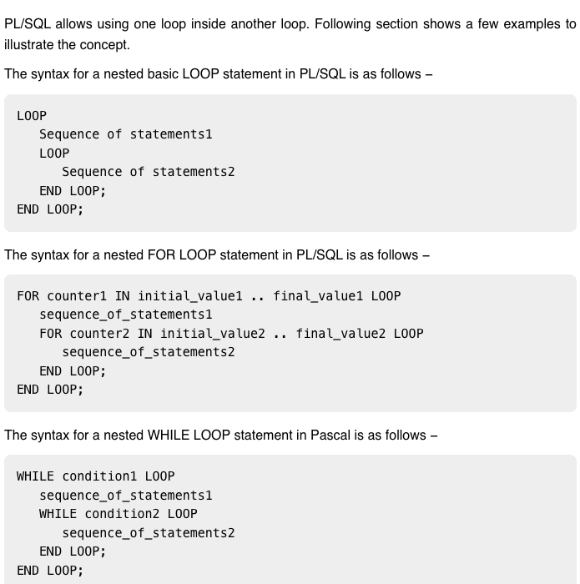
NESTED LOOP

Slide 22
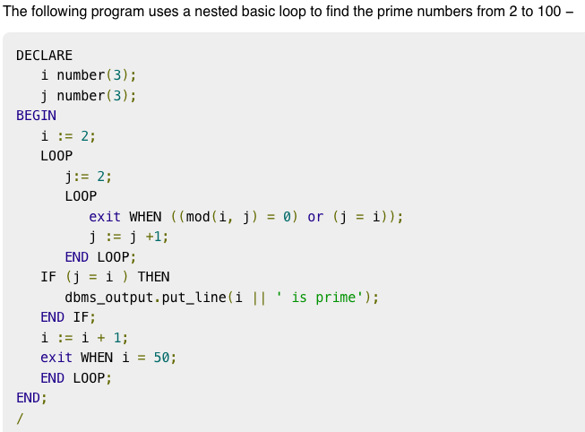
NESTED LOOP EXAMPLE

Slide 23
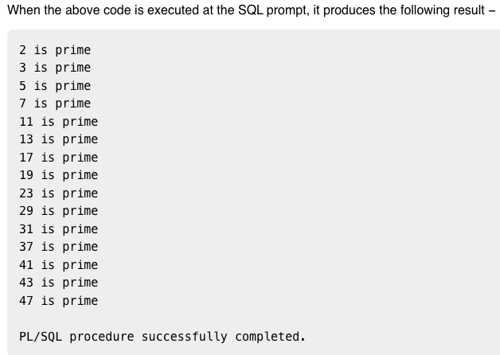
NESTED LOOP EXAMPLE

Slide 24
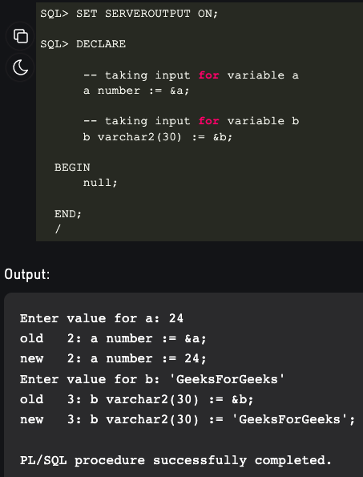
TAKING INPUT FROM USER

Slide 25
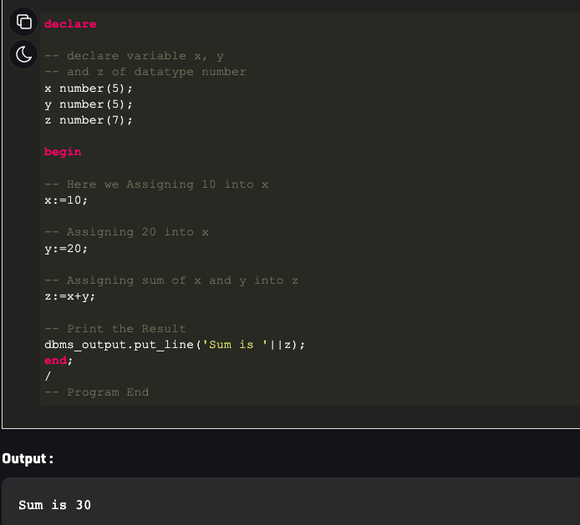
EXERCISES
1. Write a PL/SQL code to add two numbers.

Slide 26
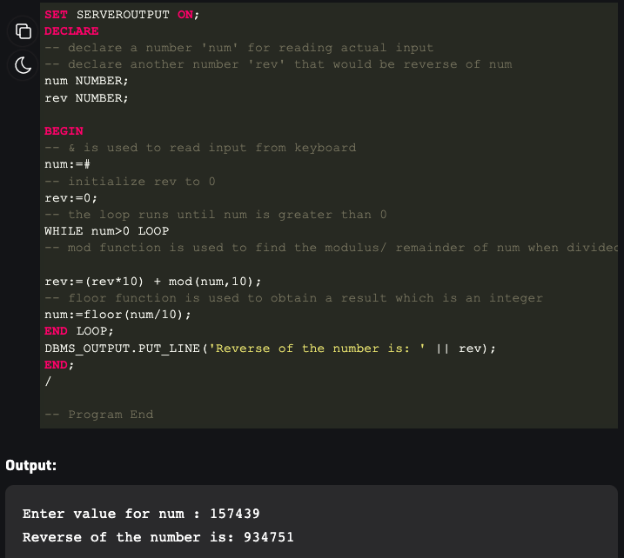
EXERCISES
2. Write a PL/SQL code to reverse a number.

Slide 27
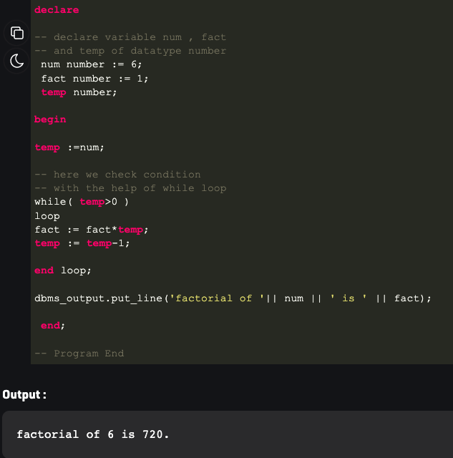
EXERCISES
3. Write a PL/SQL code to find factorial of a number.

Slide 28
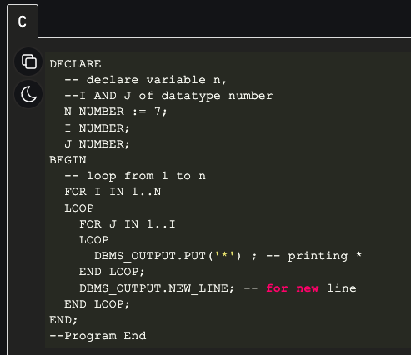

EXERCISES
4. Write a PL/SQL code to print the following pattern.

Slide 29
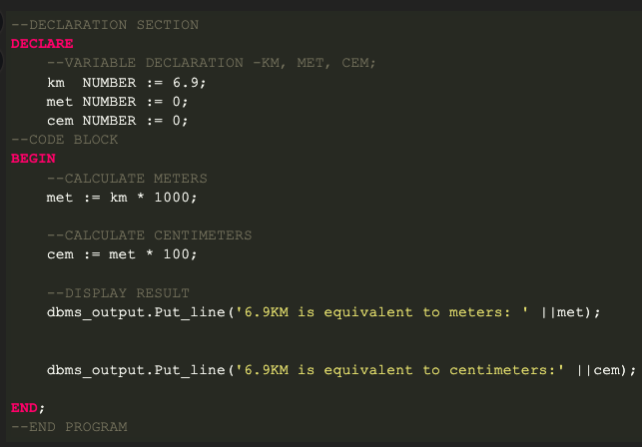

EXERCISES
5. Given distance in kilometres write PL/SQL code to convert it into meters and centimeters. Examples: Input: KM = 10
Output:
10 KM is equivalent to 10000 meters
10 KM is equivalent to 1000000 centimeters
Input: KM = 2.5
Output: 2.5 KM is equivalent to 2500 meters 2.5 KM is equivalent to 250000 centimeters
output

Slide 30
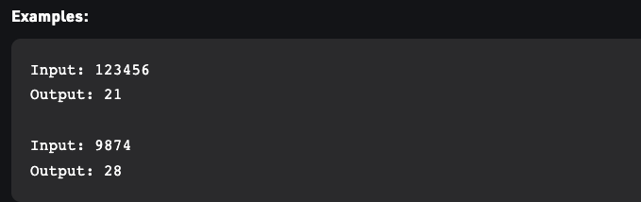
EXERCISES
6. Write a PL/ SQL code to find sum of digits of a number.

Slide 31
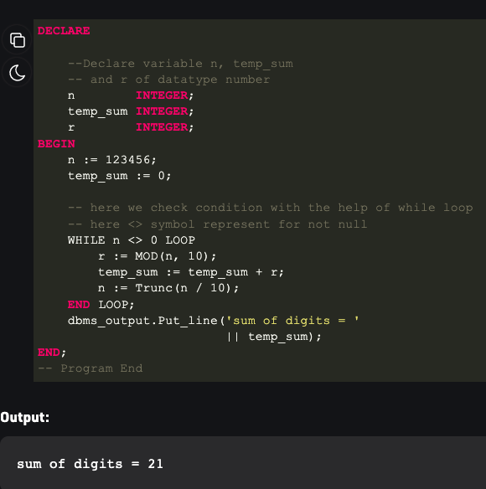
SOLUTION

Slide 32
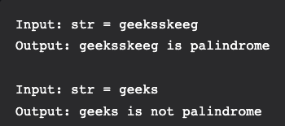
EXERCISES
7. Check whether a string is palindrome or not in PL/SQL

Slide 33
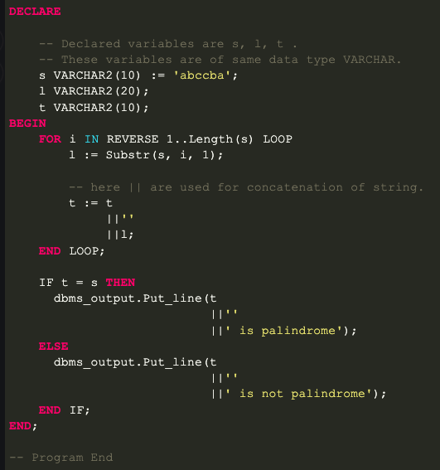
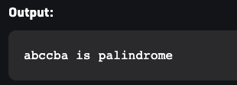
SOLUTION

Slide 34
PL/SQL AND SQL TABLES
Example 1:
In this example, we are going to see how to perform DML operations in PL/SQL. We are going to insert the below four records into emp table. Then we are going to update the salary of ‘XXX’ to 15000, and we are going to delete the employee record ‘ZZZ’. Finally, we are going to project the details of the employee ‘XXX’.
EMP_NAME | EMP_NO | SALARY | MANAGER
BBB | 1000 | 25000 | AAA
XXX | 1001 | 10000 | BBB
YYY | 1002 | 10000 | BBB
ZZZ | 1003 | 7500 | BBB

Slide 35
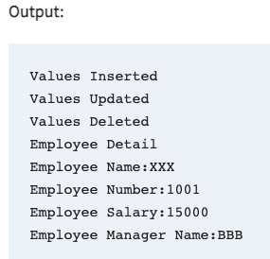
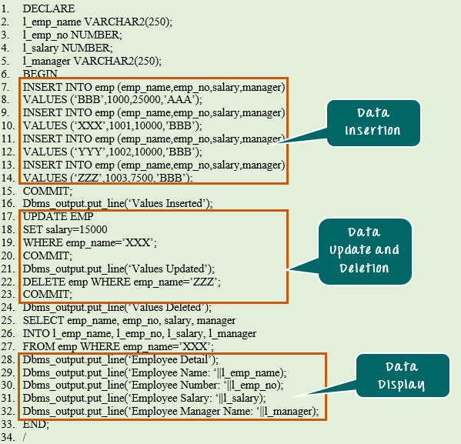
SOLUTION

Slide 36
CODE EXPLANATION
Code line 2-5: Declaring the variable.
Code line 7-14: Inserting the records into emp table.
Code line 15: Committing the insert transactions.
Code line 17-19: Updating the salary of the employee ‘XXX’ to 15000
Code line 20: Committing the update transaction.
Code line 22: Deleting the record of ‘ZZZ’
Code line 23: Committing the delete transaction.
Code line 25-27: Selecting the record of ‘XXX’ and populating into the variable l_emp_name, l_emp_no, l_salary, l_manager.
Code line 28-32: Displaying the fetched records value.

Slide 37
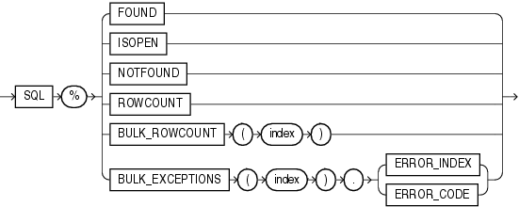
PL/SQL CURSOR

Slide 38
PL/SQL CURSOR
When an SQL statement is processed, Oracle creates a memory area known as context area. A cursor is a pointer to this context area.
It contains all information needed for processing the statement. In PL/SQL, the context area is controlled by Cursor. A cursor contains information on a select statement and the rows of data accessed by it.
A cursor is used to referred to a program to fetch and process the rows returned by the SQL statement, one at a time. There are two types of cursors:
Implicit Cursors
Explicit Cursors
1) PL/SQL Implicit Cursors
The implicit cursors are automatically generated by Oracle while an SQL statement is executed, if you don't use an explicit cursor for the statement.
These are created by default to process the statements when DML statements like INSERT, UPDATE, DELETE etc. are executed.
Orcale provides some attributes known as Implicit cursor's attributes to check the status of DML operations. Some of them are: %FOUND, %NOTFOUND, %ROWCOUNT and %ISOPEN.

Slide 39
PL/SQL CURSOR
For example: When you execute the SQL statements like INSERT, UPDATE, DELETE then the cursor attributes tell whether any rows are affected and how many have been affected. If you run a SELECT INTO statement in PL/SQL block, the implicit cursor attribute can be used to find out whether any row has been returned by the SELECT statement. It will return an error if there no data is selected.
The following table soecifies the status of the cursor with each of its attribute.
Attribute | Description
%FOUND | Its return value is TRUE if DML statements like INSERT, DELETE and UPDATE affect at least one row or more rows or a SELECT INTO statement returned one or more rows. Otherwise it returns FALSE.
%NOTFOUND | Its return value is TRUE if DML statements like INSERT, DELETE and UPDATE affect no row, or a SELECT INTO statement return no rows. Otherwise it returns FALSE. It is a just opposite of %FOUND.
%ISOPEN | It always returns FALSE for implicit cursors, because the SQL cursor is automatically closed after executing its associated SQL statements.
%ROWCOUNT | It returns the number of rows affected by DML statements like INSERT, DELETE, and UPDATE or returned by a SELECT INTO statement.

Slide 40
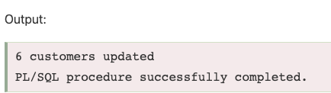
PL/SQL IMPLICIT CURSOR EXAMPLE
Create customers table and have records:
Let's execute the following program to update the table and increase salary of each customer by 5000. Here, SQL%ROWCOUNT attribute is used to determine the number of rows affected:
DECLARE
total_rows number(2);
BEGIN
UPDATE customers
SET salary = salary + 5000;
IF sql%notfound THEN
dbms_output.put_line('no customers updated');
ELSIF sql%found THEN
total_rows := sql%rowcount;
dbms_output.put_line( total_rows || ' customers updated ');
END IF;
END;
/
ID | NAME | AGE | ADDRESS | SALARY
1 | Ramesh | 23 | Allahabad | 20000
2 | Suresh | 22 | Kanpur | 22000
3 | Mahesh | 24 | Ghaziabad | 24000
4 | Chandan | 25 | Noida | 26000
5 | Alex | 21 | Paris | 28000
6 | Sunita | 20 | Delhi | 30000

Slide 41
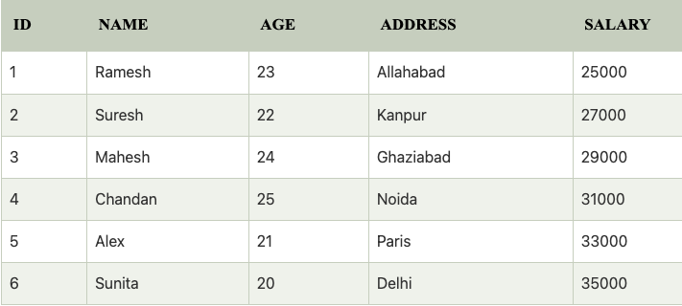
Now, if you check the records in customer table, you will find that the rows are updated.

Slide 42
2) PL/SQL Explicit Cursors
The Explicit cursors are defined by the programmers to gain more control over the context area. These cursors should be defined in the declaration section of the PL/SQL block.
It is created on a SELECT statement which returns more than one row.
Following is the syntax to create an explicit cursor:
Syntax of explicit cursor
Following is the syntax to create an explicit cursor:
CURSOR cursor_name IS select_statement;;
Steps:
We need to follow these steps while working with an explicit cursor.
Declare the cursor to initialize in the memory.
Open the cursor to allocate memory.
Fetch the cursor to retrieve data.
Close the cursor to release allocated memory.

Slide 43
1) Declare the cursor:
It defines the cursor with a name and the associated SELECT statement.
Syntax for explicit cursor decleration
CURSOR name IS
SELECT statement;
2) Open the cursor:
It is used to allocate memory for the cursor and make it easy to fetch the rows returned by the SQL statements into it.
Syntax for cursor open:
OPEN cursor_name;
3) Fetch the cursor:
It is used to access one row at a time. You can fetch rows from the above-opened cursor as follows:
Syntax for cursor fetch:
FETCH cursor_name INTO variable_list;
4) Close the cursor:
It is used to release the allocated memory. The following syntax is used to close the above-opened cursors.
Syntax for cursor close:
Close cursor_name;

Slide 44
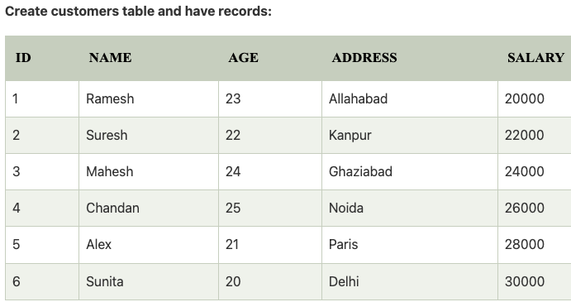
PL/SQL Explicit Cursor Example
Explicit cursors are defined by programmers to gain more control over the context area. It is defined in the declaration section of the PL/SQL block. It is created on a SELECT statement which returns more than one row.
Let's take an example to demonstrate the use of explicit cursor. In this example, we are using the already created CUSTOMERS table.
Create customers table and have records as shown.

Slide 45
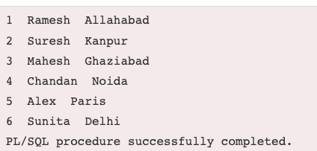
PL/SQL Explicit Cursor Example
Create procedure:
Execute the following program to retrieve the customer name and address.
DECLARE
c_id customers.id%type;
c_name customers.name%type;
c_addr customers.address%type;
CURSOR c_customers is
SELECT id, name, address FROM customers;
BEGIN
OPEN c_customers;
LOOP
FETCH c_customers into c_id, c_name, c_addr;
EXIT WHEN c_customers%notfound;
dbms_output.put_line(c_id || ' ' || c_name || ' ' || c_addr);
END LOOP;
CLOSE c_customers;
END;
/
Output:

Slide 46
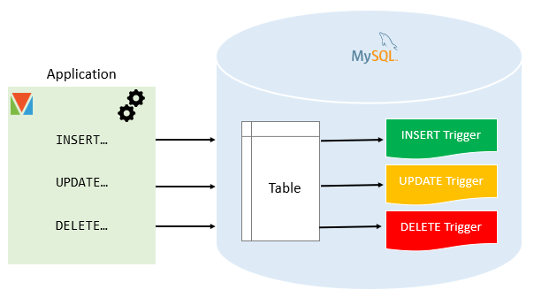
PL/SQL TRIGGER

Slide 47
PL/SQL TRIGGER
Trigger is invoked by Oracle engine automatically whenever a specified event occurs.
Trigger is stored into database and invoked repeatedly, when specific condition match.
Triggers are stored programs, which are automatically executed or fired when some event occurs.
Triggers are written to be executed in response to any of the following events.
A database manipulation (DML) statement (DELETE, INSERT, or UPDATE).
A database definition (DDL) statement (CREATE, ALTER, or DROP).
A database operation (SERVERERROR, LOGON, LOGOFF, STARTUP, or SHUTDOWN).
Triggers could be defined on the table, view, schema, or database with which the event is associated

Slide 48
PL/SQL TRIGGER
Advantages of Triggers
These are the following advantages of Triggers:
Trigger generates some derived column values automatically
Enforces referential integrity
Event logging and storing information on table access
Auditing
Synchronous replication of tables
Imposing security authorizations
Preventing invalid transactions

Slide 49
PL/SQL TRIGGER
Creating a trigger:
Syntax for creating trigger:
CREATE [OR REPLACE ] TRIGGER trigger_name
{BEFORE | AFTER | INSTEAD OF }
{INSERT [OR] | UPDATE [OR] | DELETE}
[OF col_name]
ON table_name
[REFERENCING OLD AS o NEW AS n]
[FOR EACH ROW]
WHEN (condition)
DECLARE
Declaration-statements
BEGIN
Executable-statements
EXCEPTION
Exception-handling-statements
END;

Slide 50
PL/SQL TRIGGER
Here,
CREATE [OR REPLACE] TRIGGER trigger_name
It creates or replaces an existing trigger with the trigger_name.
{BEFORE | AFTER | INSTEAD OF} : This specifies when the trigger would be executed. The INSTEAD OF clause is used for creating trigger on a view.
{INSERT [OR] | UPDATE [OR] | DELETE}: This specifies the DML operation.
[OF col_name]: This specifies the column name that would be updated.
[ON table_name]: This specifies the name of the table associated with the trigger.
[REFERENCING OLD AS o NEW AS n]: This allows you to refer new and old values for various DML statements, like INSERT, UPDATE, and DELETE.
[FOR EACH ROW]: This specifies a row level trigger, i.e., the trigger would be executed for each row being affected. Otherwise the trigger will execute just once when the SQL statement is executed, which is called a table level trigger.
WHEN (condition): This provides a condition for rows for which the trigger would fire. This clause is valid only for row level triggers.

Slide 51
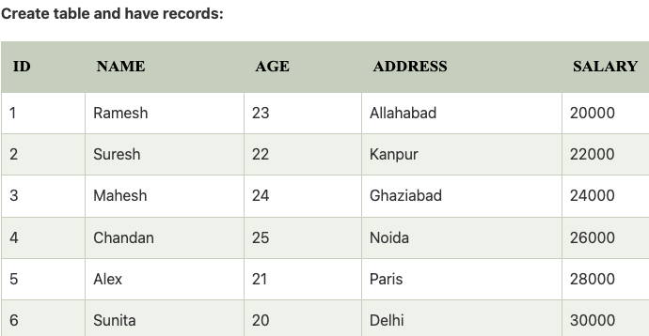
PL/SQL TRIGGER EXAMPLE
Let's take a simple example to demonstrate the trigger. In this example, we are using the following CUSTOMERS table:
Create table and have records as shown.
Create trigger
Let's take a program to create a row level trigger for the CUSTOMERS table that would fire for INSERT or UPDATE or DELETE operations performed on the CUSTOMERS table.
This trigger will display the salary difference between the old values and new values.

Slide 52
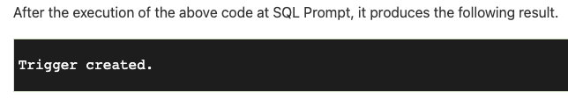
PL/SQL TRIGGER EXAMPLE
CREATE OR REPLACE TRIGGER display_salary_changes
BEFORE DELETE OR INSERT OR UPDATE ON customers
FOR EACH ROW
WHEN (NEW.ID > 0)
DECLARE
sal_diff number;
BEGIN
sal_diff := :NEW.salary - :OLD.salary;
dbms_output.put_line('Old salary: ' || :OLD.salary);
dbms_output.put_line('New salary: ' || :NEW.salary);
dbms_output.put_line('Salary difference: ' || sal_diff);
END;
/

Slide 53
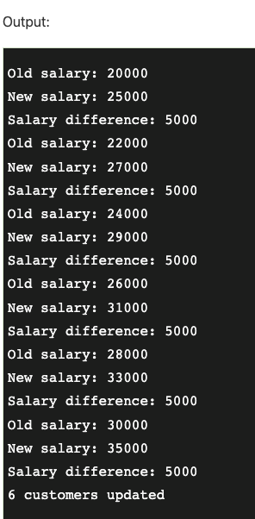
Check the salary difference by procedure:
Use the following code to get the old salary, new salary and salary difference after the trigger created.
DECLARE
total_rows number(2);
BEGIN
UPDATE customers
SET salary = salary + 5000;
IF sql%notfound THEN
dbms_output.put_line('no customers updated');
ELSIF sql%found THEN
total_rows := sql%rowcount;
dbms_output.put_line( total_rows || ' customers updated ');
END IF;
END;
/
Note: As many times you executed this code, the old and new both salary is incremented by 5000 and hence the salary difference is always 5000.

Slide 54
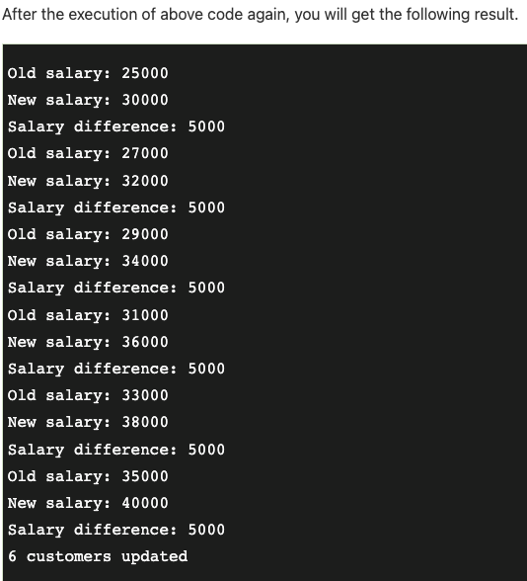
After the execution of the code again, you will get the following result.
Important Points
Following are the two very important point and should be noted carefully.
OLD and NEW references are used for record level triggers these are not available for table level triggers.
If you want to query the table in the same trigger, then you should use the AFTER keyword, because triggers can query the table or change it again only after the initial changes are applied and the table is back in a consistent state.

