Slide 1

DATABASE MANAGEMENT SYSTEMS LAB
MCA
3RD SEMESTER
SIKKIM UNIVERSITY
18TH OCT 2022
-PRATIKSHYA SHARMA

Slide 2
IN Operator With a SubQuery
The IN Operator in SQL allows to specifies multiple values in WHERE clause, it can help you to easily test if an expression matches any value in the list of values.
The use of IN Operator reduces the need for multiple OR conditions in statements like SELECT, INSERT, UPDATE, and DELETE.
Sub Queries:
The SQL queries where one or more SELECT statements are nested with the WHERE clause of another SELECT statement are called subquery.
The first statement of such type of query is called outer query where as the inside one is called an inner query.
In the execution of such queries, the inner query will be evaluated first, and the outer query receives the value of the inner query.

Slide 3
IN Operator With a SubQuery
A Subquery or Inner query or a Nested query is a query within another SQL query and embedded within the WHERE clause.
A subquery is used to return data that will be used in the main query as a condition to further restrict the data to be retrieved.
Subqueries can be used with the SELECT, INSERT, UPDATE, and DELETE statements along with the operators like =, <, >, >=, <=, IN, BETWEEN, etc.

Slide 4
IN Operator With a SubQuery
There are a few rules that subqueries must follow −
Subqueries must be enclosed within parentheses.
A subquery can have only one column in the SELECT clause, unless multiple columns are in the main query for the subquery to compare its selected columns.
An ORDER BY command cannot be used in a subquery, although the main query can use an ORDER BY. The GROUP BY command can be used to perform the same function as the ORDER BY in a subquery.
Subqueries that return more than one row can only be used with multiple value operators such as the IN operator.
The SELECT list cannot include any references to values that evaluate to a BLOB, ARRAY, CLOB, or NCLOB.
A subquery cannot be immediately enclosed in a set function.
The BETWEEN operator cannot be used with a subquery. However, the BETWEEN operator can be used within the subquery.

Slide 5
Subqueries with the SELECT Statement
Subqueries are most frequently used with the SELECT statement.
Syntax
SELECT column_name [, column_name ] FROM table1 [, table2 ] WHERE column_name OPERATOR (SELECT column_name [, column_name ] FROM table1 [, table2 ] [WHERE])

Slide 6
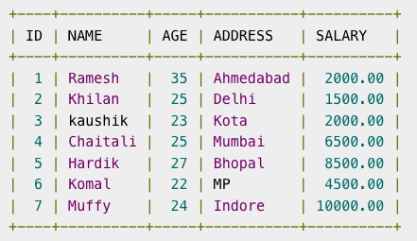
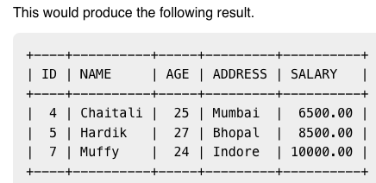
Example
Consider the CUSTOMERS table having the following records.
Now, let us check the following subquery with a SELECT statement.
SELECT * FROM CUSTOMERS WHERE ID IN (SELECT ID FROM CUSTOMERS WHERE SALARY > 4500) ;This would produce the following result.

Slide 7
Subqueries with the INSERT Statement
Subqueries also can be used with INSERT statements.
The INSERT statement uses the data returned from the subquery to insert into another table.
The selected data in the subquery can be modified with any of the character, date or number functions.
Syntax
INSERT INTO table_name [ (column1 [, column2 ]) ] SELECT [ *|column1 [, column2 ] FROM table1 [, table2 ] [ WHERE VALUE OPERATOR ]

Slide 8
Example
Consider a table CUSTOMERS_BKP with similar structure as CUSTOMERS table. Now to copy the complete CUSTOMERS table into the CUSTOMERS_BKP table, you can use the following syntax.
INSERT INTO CUSTOMERS_BKP SELECT * FROM CUSTOMERS WHERE ID IN (SELECT ID FROM CUSTOMERS) ;

Slide 9
Subqueries with the UPDATE Statement
The subquery can be used in conjunction with the UPDATE statement.
Either single or multiple columns in a table can be updated when using a subquery with the UPDATE statement.
SYNTAX
UPDATE table SET column_name = new_value [ WHERE OPERATOR [ VALUE ] (SELECT COLUMN_NAME FROM TABLE_NAME) [ WHERE) ]

Slide 10
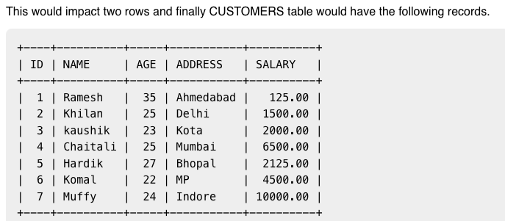
Example
Assuming, we have CUSTOMERS_BKP table available which is backup of CUSTOMERS table. The following example updates SALARY by 0.25 times in the CUSTOMERS table for all the customers whose AGE is greater than or equal to 27.
UPDATE CUSTOMERS SET SALARY = SALARY * 0.25 WHERE AGE IN (SELECT AGE FROM CUSTOMERS_BKP WHERE AGE >= 27 );

Slide 11
Subqueries with the DELETE Statement
The subquery can be used in conjunction with the DELETE statement like with any other statements mentioned in previous slides.
Syntax
DELETE FROM TABLE_NAME [ WHERE OPERATOR [ VALUE ] (SELECT COLUMN_NAME FROM TABLE_NAME) [ WHERE) ]

Slide 12
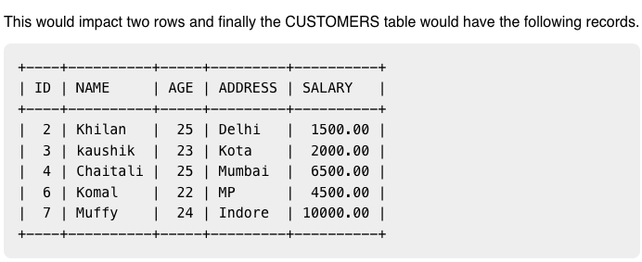
Example
Assuming, we have a CUSTOMERS_BKP table available which is a backup of the CUSTOMERS table. The following example deletes the records from the CUSTOMERS table for all the customers whose AGE is greater than or equal to 27.
DELETE FROM CUSTOMERS WHERE AGE IN (SELECT AGE FROM CUSTOMERS_BKP WHERE AGE >= 27 );

Slide 13
EXISTS Operator
The SQL The EXISTS operator is used to test for the existence of any record in a subquery.
The EXISTS operator returns TRUE if the subquery returns one or more records.
EXISTS Syntax
SELECT column_name(s) FROM table_name WHERE EXISTS (SELECT column_name FROM table_name WHERE condition);

Slide 14
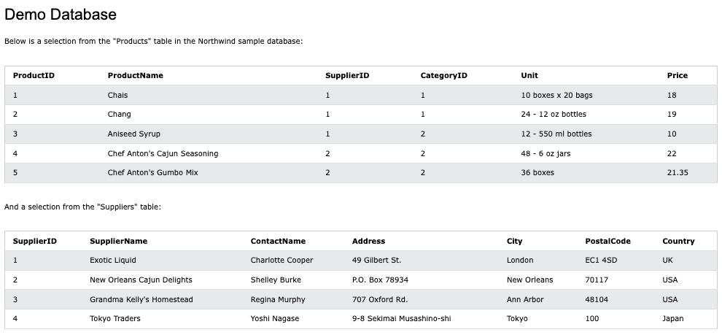

Slide 15
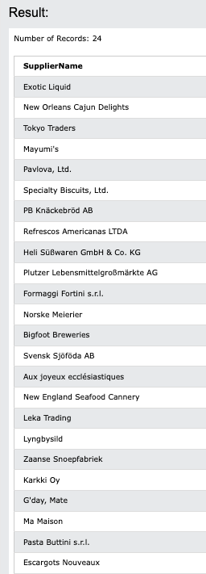
SQL EXISTS Examples
The following SQL statement returns TRUE and lists the suppliers with a product price less than 20:
Example
SELECT SupplierName FROM Suppliers WHERE EXISTS (SELECT ProductName FROM Products WHERE Products.SupplierID = Suppliers.supplierID AND Price < 20);

Slide 16
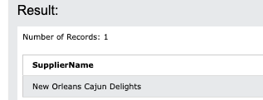
The following SQL statement returns TRUE and lists the suppliers with a product price equal to 22:
Example
SELECT SupplierName FROM Suppliers WHERE EXISTS (SELECT ProductName FROM Products WHERE Products.SupplierID = Suppliers.supplierID AND Price = 22);

Slide 17
GROUP BY
The SQL The GROUP BY statement groups rows that have the same values into summary rows, like "find the number of customers in each country".
The GROUP BY statement is often used with aggregate functions (COUNT(), MAX(), MIN(), SUM(), AVG()) to group the result-set by one or more columns.
Syntax
SELECT column_name(s) FROM table_name WHERE condition GROUP BY column_name(s) ORDER BY column_name(s);

Slide 18
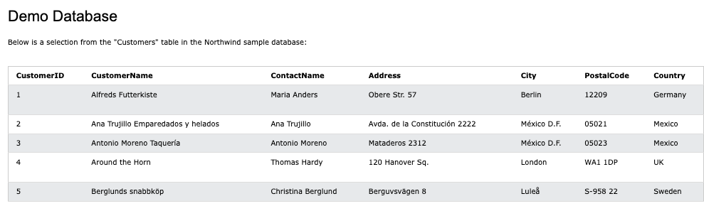

Slide 19
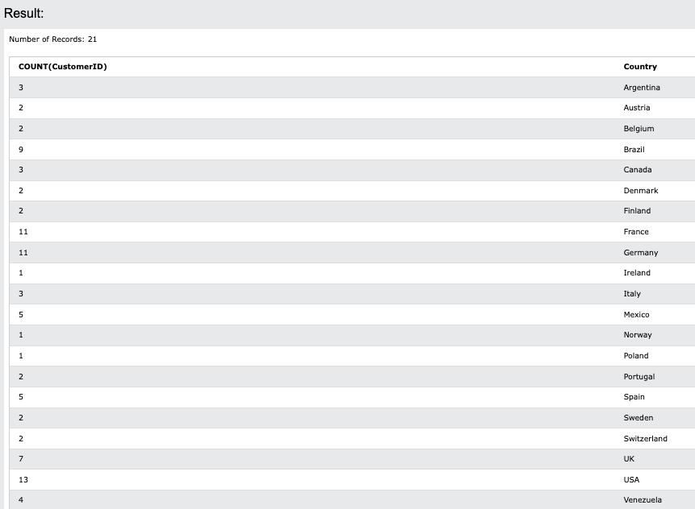
SQL GROUP BY Examples
The following SQL statement lists the number of customers in each country:
Example
SELECT COUNT(CustomerID), Country FROM Customers GROUP BY Country;

Slide 20
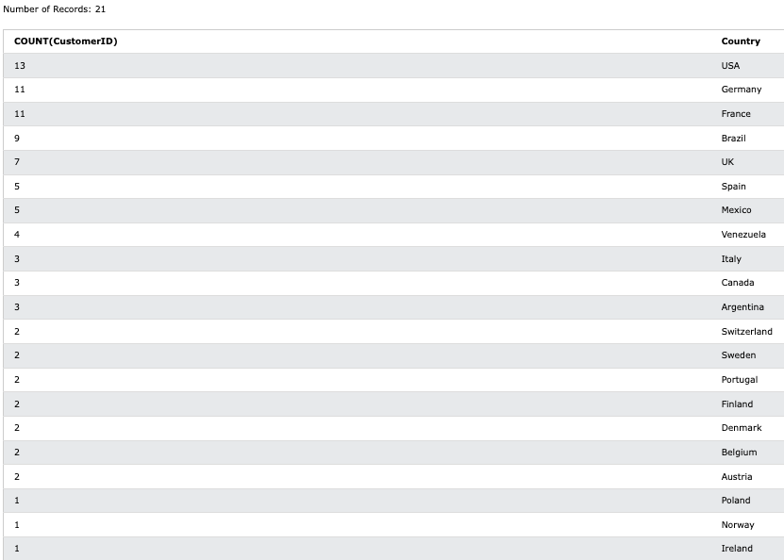
The following SQL statement lists the number of customers in each country, sorted high to low.
Example
SELECT COUNT(CustomerID), Country FROM Customers GROUP BY Country ORDER BY COUNT(CustomerID) DESC;

Slide 21
SQL HAVING Clause
The HAVING clause was added to SQL because the WHERE keyword cannot be used with aggregate functions.
Syntax
SELECT column_name(s) FROM table_name WHERE condition GROUP BY column_name(s) HAVING condition ORDER BY column_name(s);

Slide 22
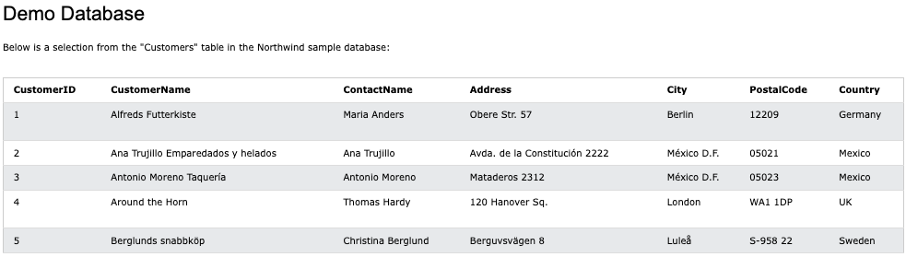

Slide 23
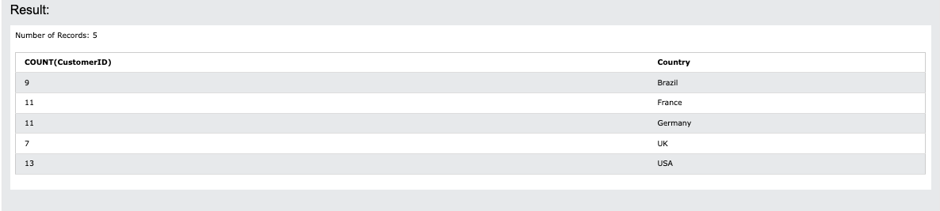
SQL HAVING Examples
The following SQL statement lists the number of customers in each country. Only include countries with more than 5 customers.
Example
SELECT COUNT(CustomerID), Country FROM Customers GROUP BY Country HAVING COUNT(CustomerID) > 5;

Slide 24
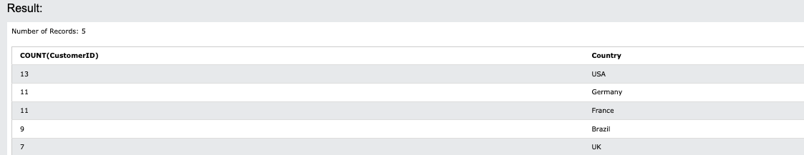
The following SQL statement lists the number of customers in each country, sorted high to low (Only include countries with more than 5 customers).
Example
SELECT COUNT(CustomerID), Country FROM Customers GROUP BY Country HAVING COUNT(CustomerID) > 5 ORDER BY COUNT(CustomerID) DESC;

Slide 25
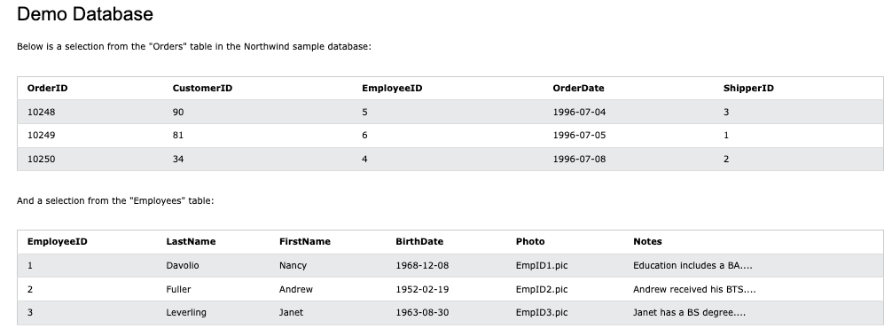

Slide 26
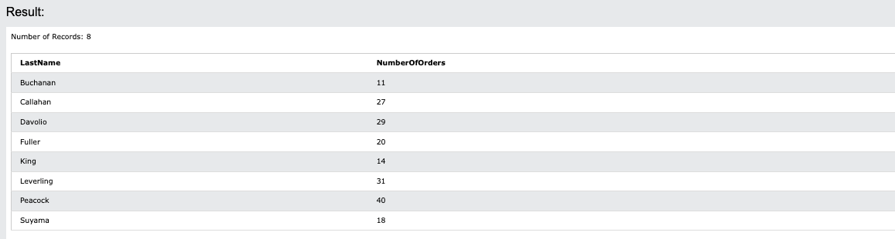
The following SQL statement lists the employees that have registered more than 10 orders.
Example
SELECT Employees.LastName, COUNT(Orders.OrderID) AS NumberOfOrders FROM (Orders INNER JOIN Employees ON Orders.EmployeeID = Employees.EmployeeID) GROUP BY LastName HAVING COUNT(Orders.OrderID) > 10;

Slide 27
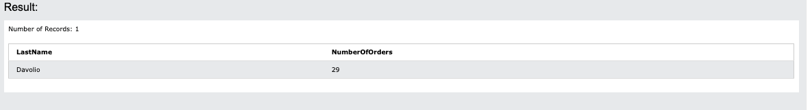
The following SQL statement lists if the employees "Davolio" or "Fuller" have registered more than 25 orders:
Example
SELECT Employees.LastName, COUNT(Orders.OrderID) AS NumberOfOrders FROM Orders INNER JOIN Employees ON Orders.EmployeeID = Employees.EmployeeID WHERE LastName = 'Davolio' OR LastName = 'Fuller' GROUP BY LastName HAVING COUNT(Orders.OrderID) > 25;

Slide 28
SQL STRING FUNCTIONS

Slide 29
REVERSE() Function
The REVERSE() function reverses a string and returns the result.
Syntax
REVERSE(string)
Example
Reverse the text in CustomerName:
SELECT REVERSE(CustomerName) FROM Customers;

Slide 30
SQL | Views
Views in SQL are kind of virtual tables.
A view also has rows and columns as they are in a real table in the database.
We can create a view by selecting fields from one or more tables present in the database.
A View can either have all the rows of a table or specific rows based on certain condition.
Syntax
CREATE VIEW view_name AS SELECT column1, column2..... FROM table_name WHERE condition; view_name: Name for the View table_name: Name of the table condition: Condition to select rows

Slide 31
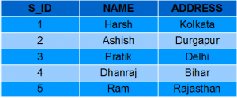
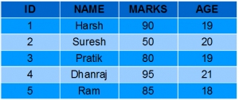
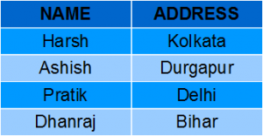
StudentDetails
StudentMarks
In this example we will create a View named DetailsView from the table StudentDetails.
Query:
CREATE VIEW DetailsView AS SELECT NAME, ADDRESS FROM StudentDetails WHERE S_ID < 5;
To see the data in the View, we can query the view in the same manner as we query a table.
SELECT * FROM DetailsView;
Output:

Slide 32
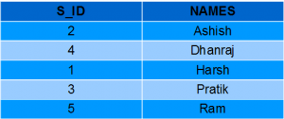
In this example, we will create a view named StudentNames from the table StudentDetails.
CREATE VIEW StudentNames AS SELECT S_ID, NAME FROM StudentDetails ORDER BY NAME;
If we now query the view as,
SELECT * FROM StudentNames;
Output

Slide 33
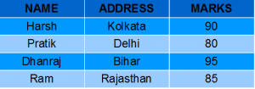
Creating View from multiple tables
In this example we will create a View named MarksView from two tables StudentDetails and StudentMarks.
To create a View from multiple tables we can simply include multiple tables in the SELECT statement.
Query:
CREATE VIEW MarksView AS SELECT StudentDetails.NAME, StudentDetails.ADDRESS, StudentMarks.MARKS FROM StudentDetails, StudentMarks WHERE StudentDetails.NAME = StudentMarks.NAME;
To display data of View MarksView:
SELECT * FROM MarksView;
Output:

Slide 34
DELETING VIEWS
SQL allows us to delete an existing View.
We can delete or drop a View using the DROP statement.
Syntax:
DROP VIEW view_name;
view_name: Name of the View which we want to delete.
For example, if we want to delete the View MarksView, we can do this as:
DROP VIEW MarksView;

Slide 35
UPDATING VIEWS
There are certain conditions needed to be satisfied to update a view.
If any one of these conditions is not met, then we will not be allowed to update the view.
The SELECT statement which is used to create the view should not include GROUP BY clause or ORDER BY clause.
The SELECT statement should not have the DISTINCT keyword.
The View should have all NOT NULL values.
The view should not be created using nested queries or complex queries.
The view should be created from a single table. If the view is created using multiple tables then we will not be allowed to update the view.

Slide 36
UPDATING VIEWS
We can use the CREATE OR REPLACE VIEW statement to add or remove fields from a view.
Syntax:
CREATE OR REPLACE VIEW view_name AS SELECT column1,coulmn2,.. FROM table_name WHERE condition;

Slide 37

Example
If we want to update the view MarksView and add the field AGE to this View from StudentMarks Table, we can do this as:
CREATE OR REPLACE VIEW MarksView AS SELECT StudentDetails.NAME, StudentDetails.ADDRESS, StudentMarks.MARKS, StudentMarks.AGE FROM StudentDetails, StudentMarks WHERE StudentDetails.NAME = StudentMarks.NAME;
If we fetch all the data from MarksView now as:
SELECT * FROM MarksView;
Output:

Slide 38
Inserting a row in a view:
We can insert a row in a View in a same way as we do in a table.
We can use the INSERT INTO statement of SQL to insert a row in a View.
Syntax
INSERT INTO view_name(column1, column2 , column3,..) VALUES(value1, value2, value3..); view_name: Name of the View

Slide 39
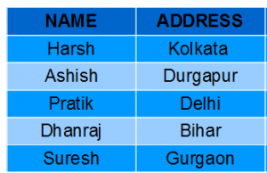
Example:
In the below example we will insert a new row in the View DetailsView which we have created above in the example of “creating views from a single table”.
INSERT INTO DetailsView(NAME, ADDRESS) VALUES("Suresh","Gurgaon");
If we fetch all the data from DetailsView now as,
SELECT * FROM DetailsView;
Output:

Slide 40
Deleting a row from a View
Deleting rows from a view is also as simple as deleting rows from a table.
We can use the DELETE statement of SQL to delete rows from a view.
Also deleting a row from a view first delete the row from the actual table and the change is then reflected in the view.
Syntax:
DELETE FROM view_name WHERE condition;
view_name:Name of view from where we want to delete rows
condition: Condition to select rows

Slide 41
Example:
In this example we will delete the last row from the view DetailsView which we just added in the above example of inserting rows.
DELETE FROM DetailsView WHERE NAME="Suresh";
If we fetch all the data from DetailsView now as,
SELECT * FROM DetailsView;
Output:

Slide 42
VIEWS WITH CHECKPOINT
The WITH CHECK OPTION clause in SQL is a very useful clause for views.
It is applicable to a updatable view.
If the view is not updatable, then there is no meaning of including this clause in the CREATE VIEW statement.
The WITH CHECK OPTION clause is used to prevent the insertion of rows in the view where the condition in the WHERE clause in CREATE VIEW statement is not satisfied.
If we have used the WITH CHECK OPTION clause in the CREATE VIEW statement, and if the UPDATE or INSERT clause does not satisfy the conditions then they will return an error.

Slide 43
Example:
In the below example we are creating a View SampleView from StudentDetails Table with WITH CHECK OPTION clause.
CREATE VIEW SampleView AS SELECT S_ID, NAME FROM StudentDetails WHERE NAME IS NOT NULL WITH CHECK OPTION;
In this View if we now try to insert a new row with null value in the NAME column then it will give an error because the view is created with the condition for NAME column as NOT NULL.
For example,though the View is updatable but then also the below query for this View is not valid:
INSERT INTO SampleView(S_ID) VALUES(6);
NOTE: The default value of NAME column is null.

