Slide 1

DATABASE MANAGEMENT SYSTEMS – PL/SQL
MCA 3RD SEMESTER,
SIKKIM UNIVERSITY

Slide 2
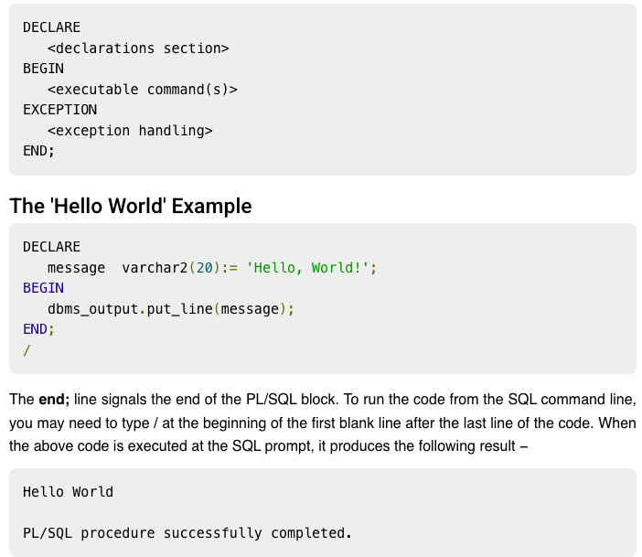
PL/SQL
Every PL/SQL statement ends with a semicolon (;). PL/SQL blocks can be nested within other PL/SQL blocks using BEGIN and END.
Following is the basic structure of a PL/SQL block −

Slide 3
THE PL/SQL IDENTIFIERS
PL/SQL identifiers are constants, variables, exceptions, procedures, cursors, and reserved words.
The identifiers consist of a letter optionally followed by more letters, numerals, dollar signs, underscores, and number signs and should not exceed 30 characters.
By default, identifiers are not case-sensitive.
So you can use integer or INTEGER to represent a numeric value.
You cannot use a reserved keyword as an identifier.

Slide 4
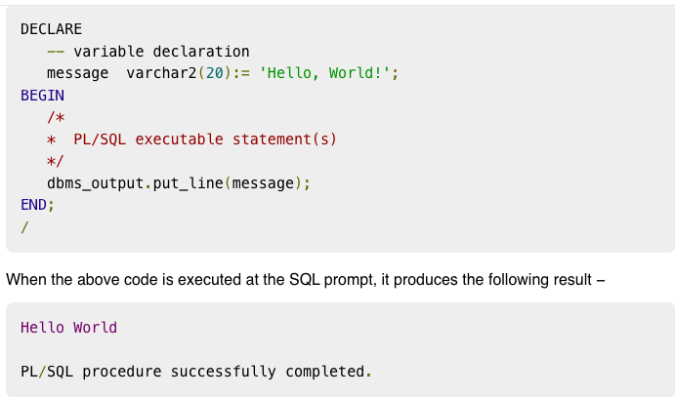
THE PL/SQL COMMENTS
Program comments are explanatory statements that can be included in the PL/SQL code that you write and helps anyone reading its source code.
All programming languages allow some form of comments.
The PL/SQL supports sin Agle-line and multi-line comments.
All characters available inside any comment are ignored by the PL/SQL compiler.
The PL/SQL single-line comments start with the delimiter -- (double hyphen) and multi-line comments are enclosed by /* and */.

Slide 5
Variable Declaration in PL/SQL
The syntax for declaring a variable is −
variable_name [CONSTANT] datatype [NOT NULL] [:= | DEFAULT initial_value]
EXAMPLE
sales number(10, 2);
pi CONSTANT double precision := 3.1415;
name varchar2(25);
address varchar2(100);

Slide 6
INITIALIZING VARIABLES IN PL/SQL
Whenever you declare a variable, PL/SQL assigns it a default value of NULL. If you want to initialize a variable with a value other than the NULL value, you can do so during the declaration, using either of the following −
The DEFAULT keyword
The assignment operator
Example −
counter binary_integer := 0;
greetings varchar2(20) DEFAULT 'Have a Good Day';

Slide 7
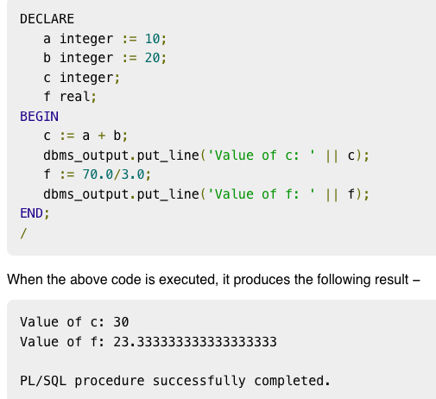
EXAMPLE

Slide 8
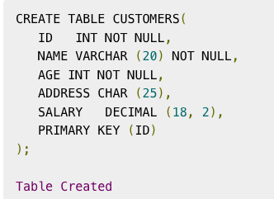
ASSIGNING SQL QUERY RESULTS TO PL/SQL VARIABLES
You can use the SELECT INTO statement of SQL to assign values to PL/SQL variables.
For each item in the SELECT list, there must be a corresponding, type-compatible variable in the INTO list.
The following example illustrates the concept.
Let us create a table named CUSTOMERS −

Slide 9
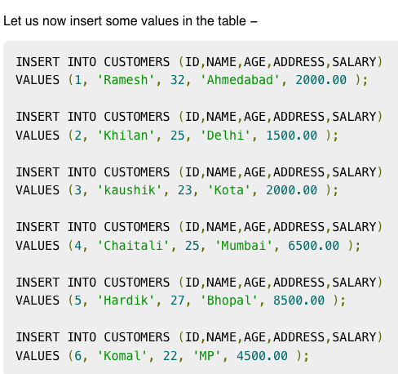

Slide 10
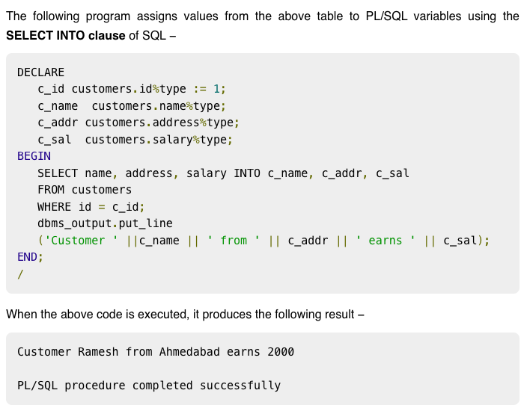
ASSIGNING SQL QUERY RESULTS TO PL/SQL VARIABLES

Slide 11
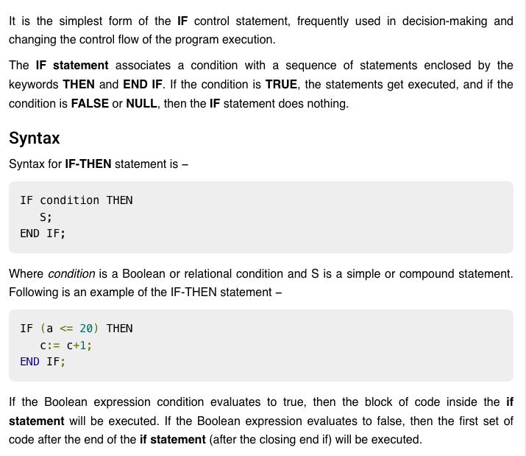
PL/SQL - Conditions

Slide 12
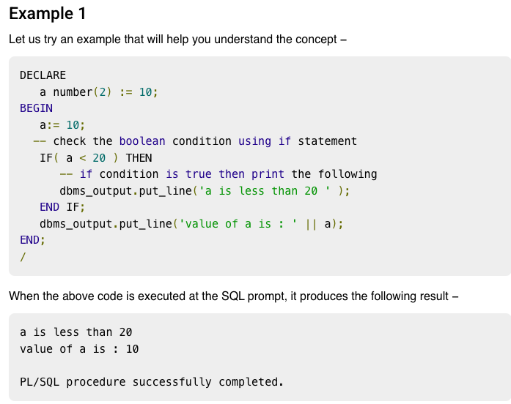

Slide 13
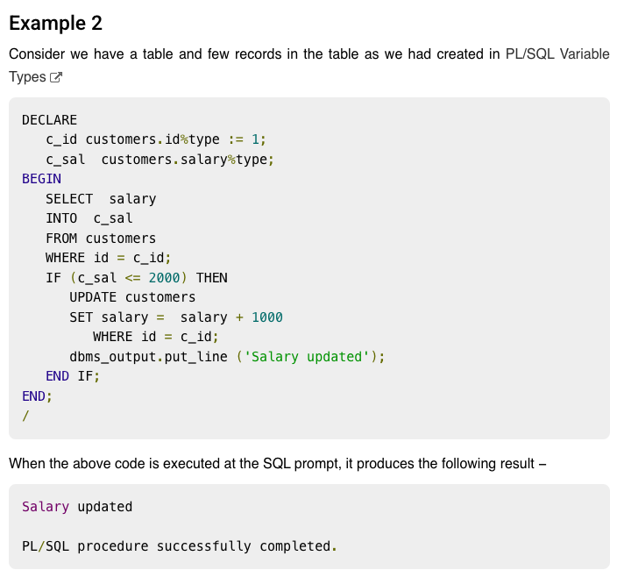

Slide 14
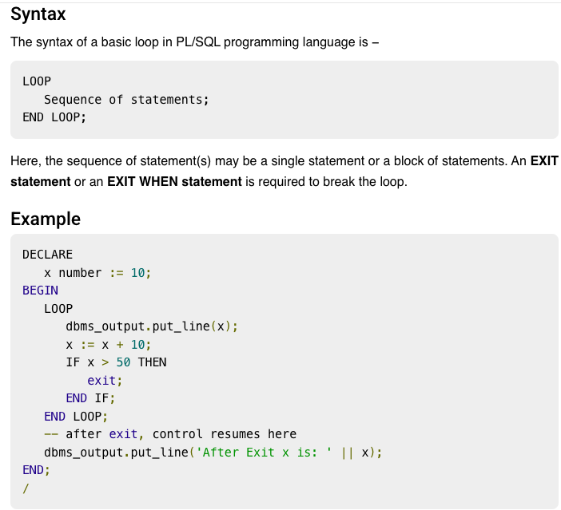
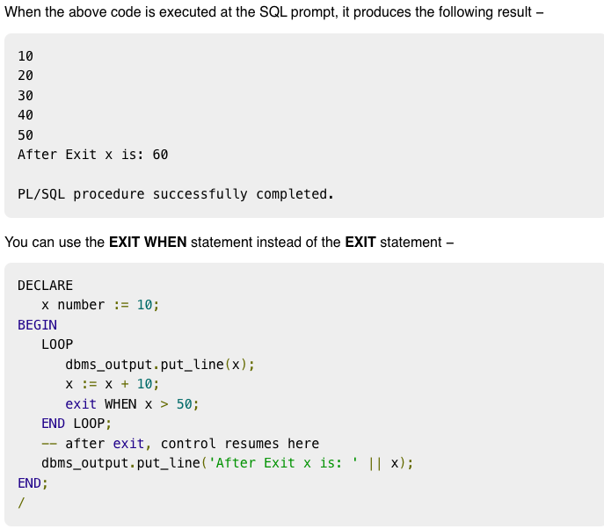
PL/SQL BASIC LOOP

Slide 15
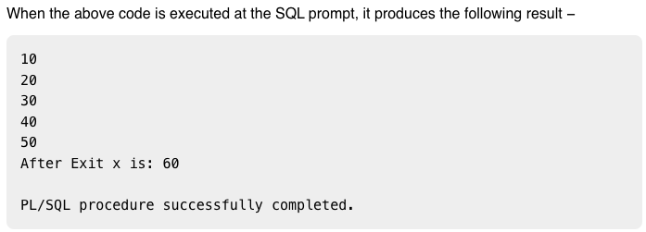
PL/SQL BASIC LOOP

Slide 16
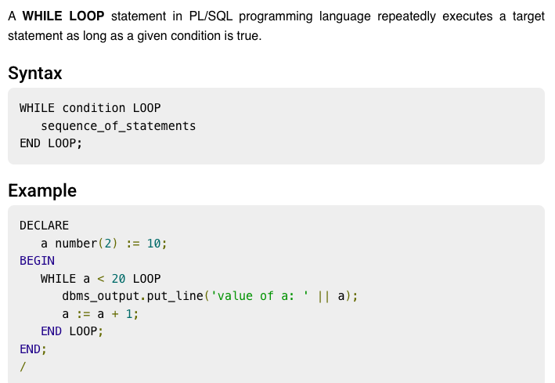
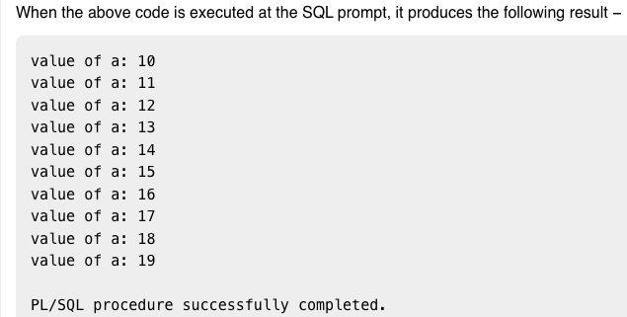
PL/SQL WHILE LOOP

Slide 17
PL/SQL WHILE LOOP

Slide 18
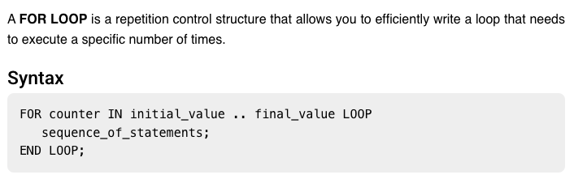
PL/SQL FOR LOOP

Slide 19
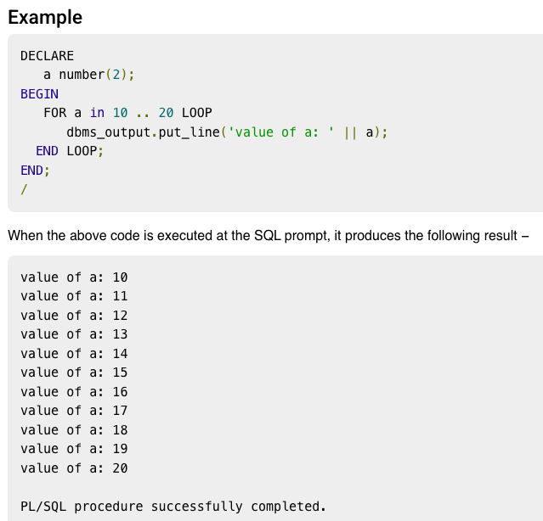
PL/SQL FOR LOOP

Slide 20
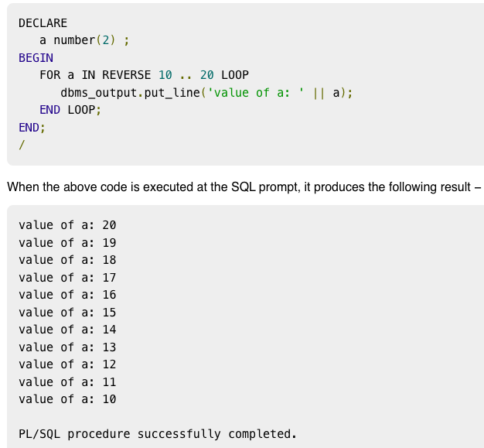
REVERSE FOR LOOP STATEMENT

Slide 21
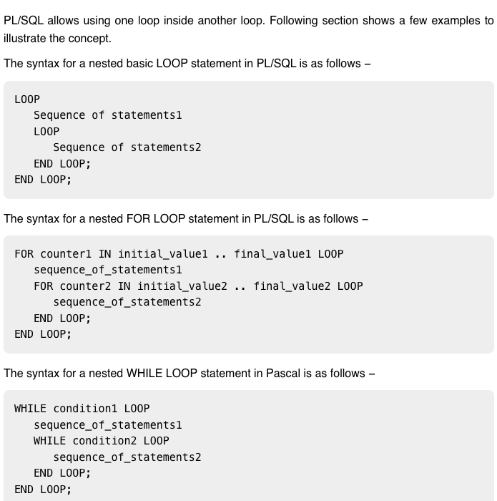
NESTED LOOP

Slide 22
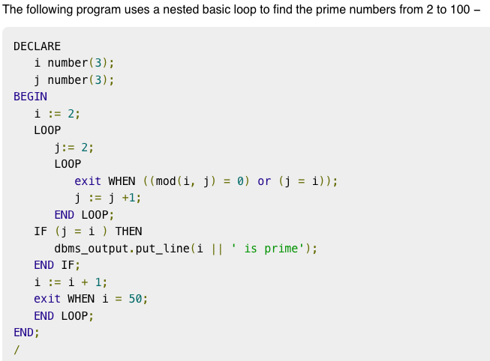
NESTED LOOP EXAMPLE

Slide 23
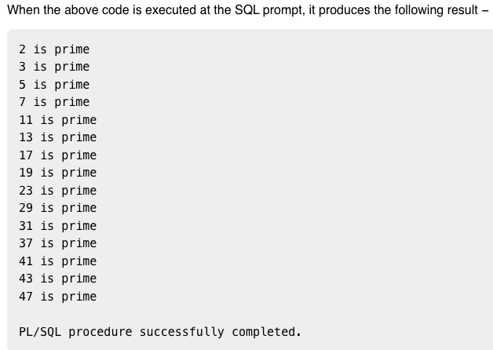
NESTED LOOP EXAMPLE

Slide 24
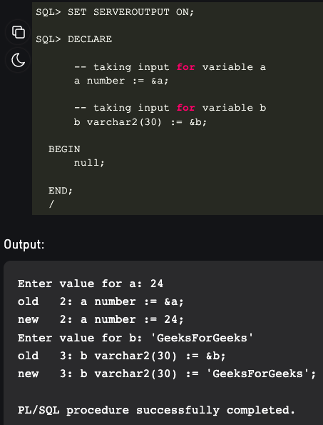
TAKING INPUT FROM USER

Slide 25
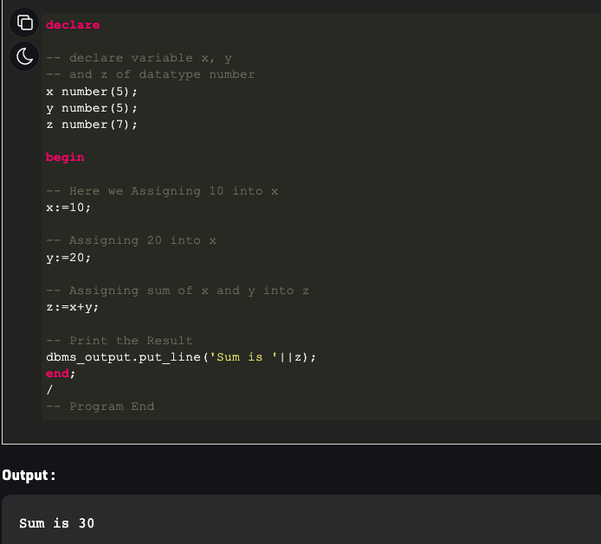
EXERCISES
1. Write a PL/SQL code to add two numbers.

Slide 26
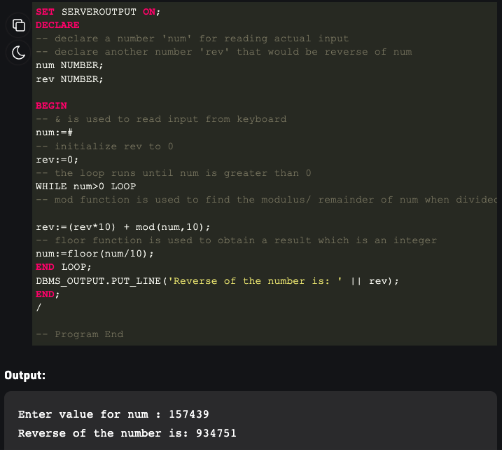
EXERCISES
2. Write a PL/SQL code to reverse a number.

Slide 27
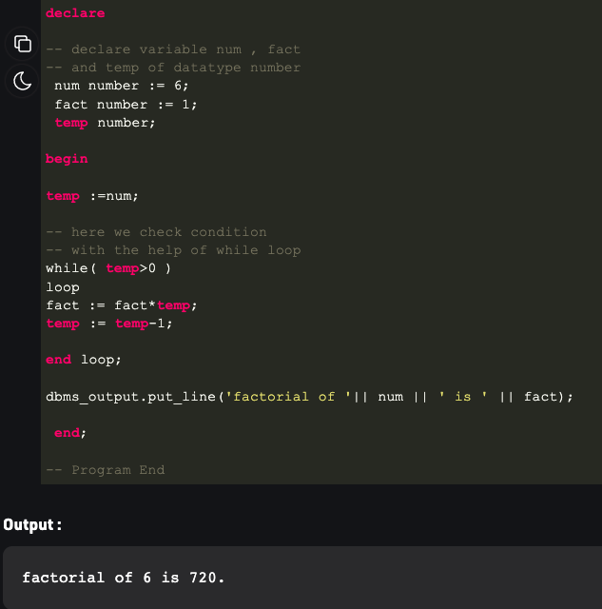
EXERCISES
3. Write a PL/SQL code to find factorial of a number.

Slide 28
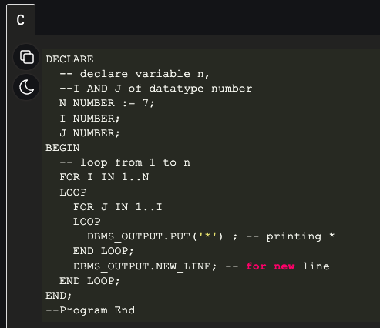

EXERCISES
4. Write a PL/SQL code to print the following pattern.

Slide 29
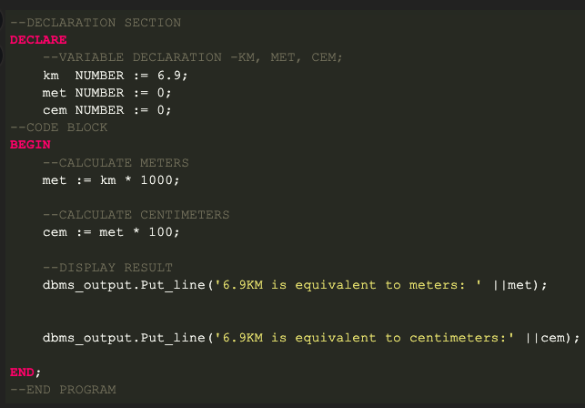

EXERCISES
5. Given distance in kilometres write PL/SQL code to convert it into meters and centimeters. Examples: Input: KM = 10
Output:
10 KM is equivalent to 10000 meters
10 KM is equivalent to 1000000 centimeters
Input: KM = 2.5
Output: 2.5 KM is equivalent to 2500 meters 2.5 KM is equivalent to 250000 centimeters
output

Slide 30
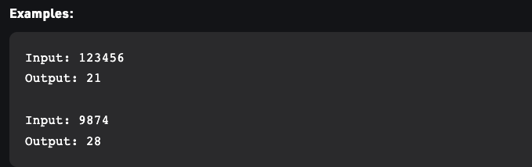
EXERCISES
6. Write a PL/ SQL code to find sum of digits of a number.

Slide 31
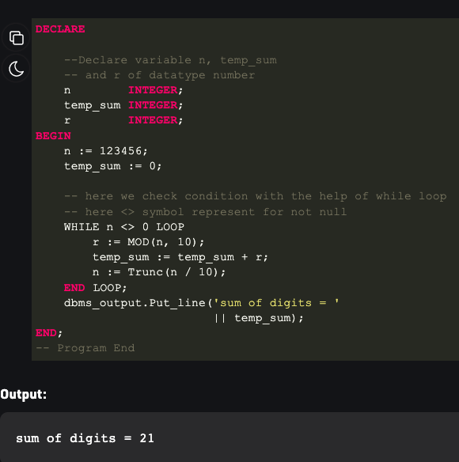
SOLUTION

Slide 32
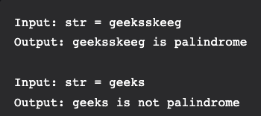
EXERCISES
7. Check whether a string is palindrome or not in PL/SQL

Slide 33
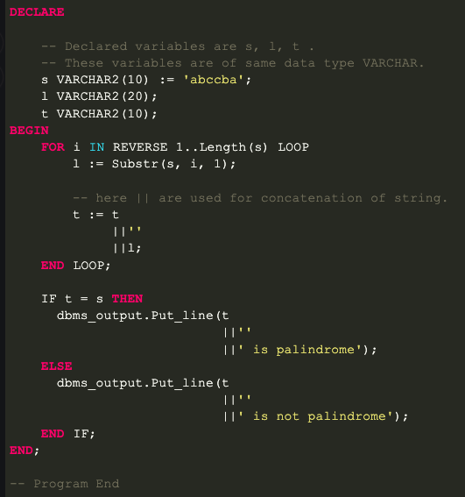
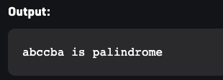
SOLUTION

Slide 34
PL/SQL AND SQL TABLES
Example 1:
In this example, we are going to see how to perform DML operations in PL/SQL. We are going to insert the below four records into emp table. Then we are going to update the salary of ‘XXX’ to 15000, and we are going to delete the employee record ‘ZZZ’. Finally, we are going to project the details of the employee ‘XXX’.
EMP_NAME | EMP_NO | SALARY | MANAGER
BBB | 1000 | 25000 | AAA
XXX | 1001 | 10000 | BBB
YYY | 1002 | 10000 | BBB
ZZZ | 1003 | 7500 | BBB

Slide 35
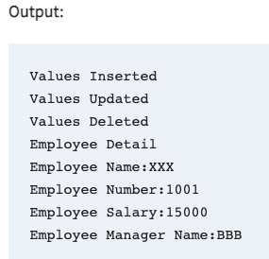
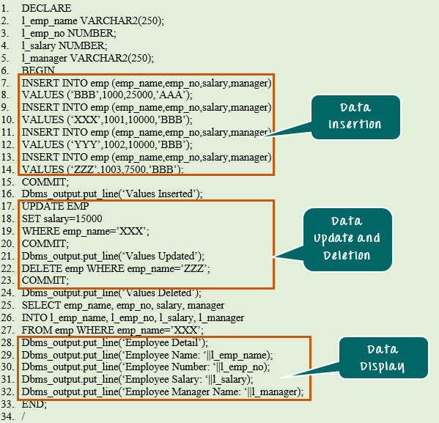
SOLUTION

Slide 36
CODE EXPLANATION
Code line 2-5: Declaring the variable.
Code line 7-14: Inserting the records into emp table.
Code line 15: Committing the insert transactions.
Code line 17-19: Updating the salary of the employee ‘XXX’ to 15000
Code line 20: Committing the update transaction.
Code line 22: Deleting the record of ‘ZZZ’
Code line 23: Committing the delete transaction.
Code line 25-27: Selecting the record of ‘XXX’ and populating into the variable l_emp_name, l_emp_no, l_salary, l_manager.
Code line 28-32: Displaying the fetched records value.

