Slide 1


CSS(Cascading Style Sheets) “Add style to your web pages” MCA 3rd Semester SIKKIM UNIVERSITY
-Pratikshya Sharma

Slide 2


Introduction
CSS is the language we use to style an HTML document (Web Page).
CSS stands for Cascading Style Sheets
CSS describes how HTML elements are to be displayed on screen, or in other media
CSS saves a lot of work. It can control the layout of multiple web pages all at once
External stylesheets are stored in CSS files

Slide 3


CSS Demo - One HTML Page - Multiple Styles!
Here we will show one HTML page displayed with four different stylesheets. Click on the "Stylesheet 1", "Stylesheet 2", "Stylesheet 3", "Stylesheet 4" links below to see the different styles:

Slide 4
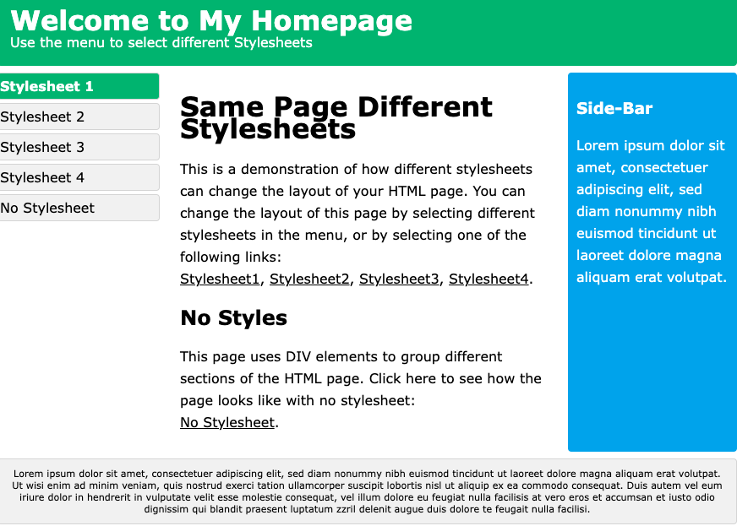
CSS Demo - One HTML Page - Multiple Styles!
Style 1

Slide 5
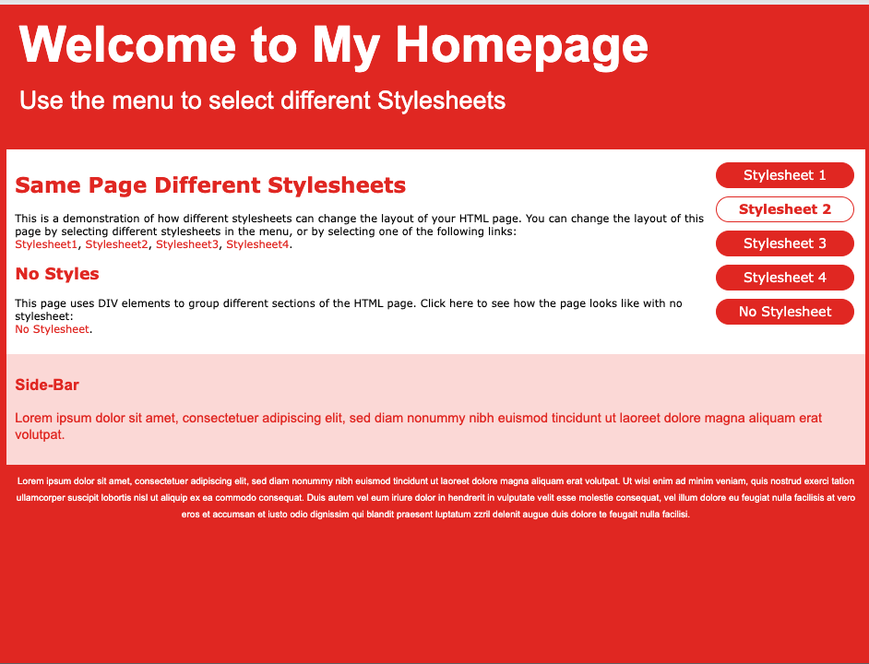
CSS Demo - One HTML Page - Multiple Styles!
Style 2

Slide 6

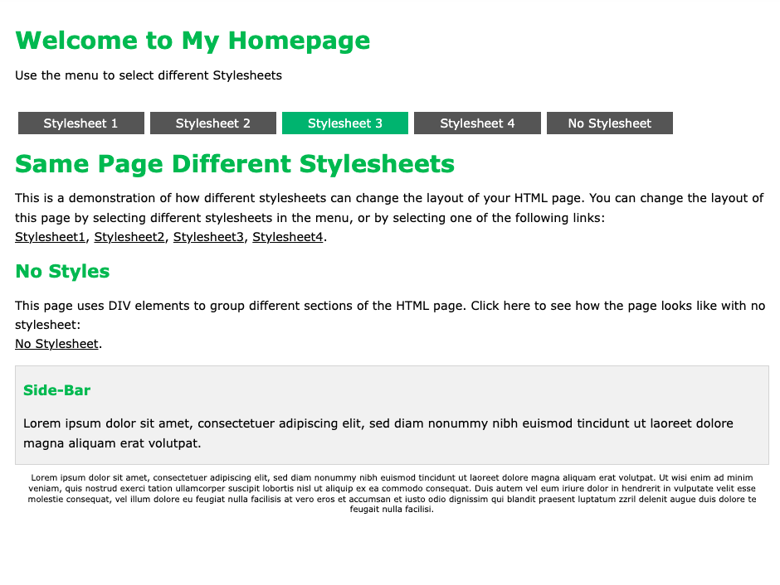
CSS Demo - One HTML Page - Multiple Styles!
Style 3

Slide 7
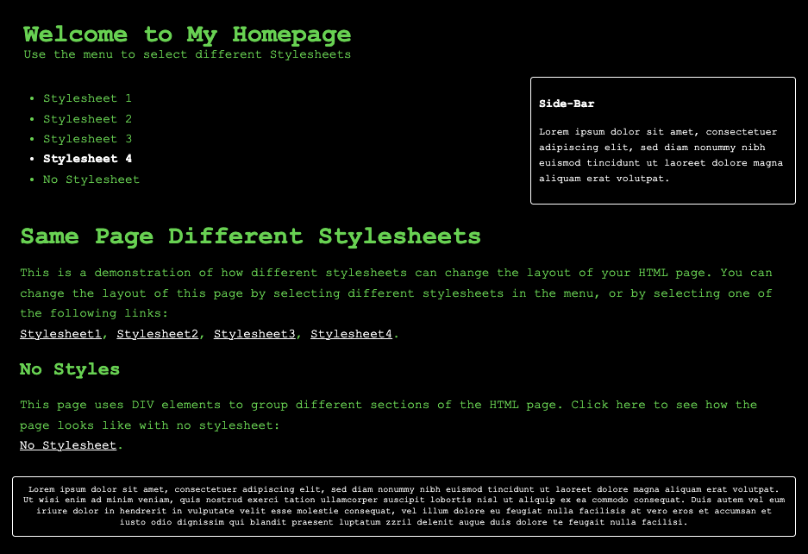
CSS Demo - One HTML Page - Multiple Styles!
Style 4

Slide 8
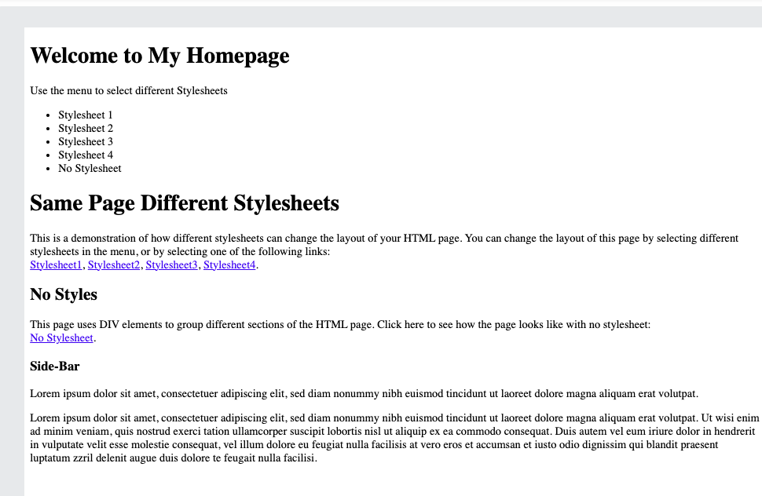
CSS Demo - One HTML Page - Multiple Styles!
No Style

Slide 9
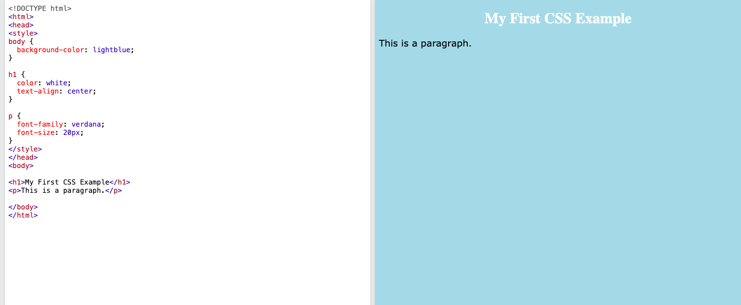
CSS Example

Slide 10
Why Use CSS?
CSS Solved a Big Problem.
HTML was NEVER intended to contain tags for formatting a web page!
HTML was created to describe the content of a web page, like:
<h1>This is a heading</h1>
<p>This is a paragraph.</p>
When tags like <font>, and color attributes were added to the HTML 3.2 specification, it started a nightmare for web developers.
Development of large websites, where fonts and color information were added to every single page, became a long and expensive process.
To solve this problem, the World Wide Web Consortium (W3C) created CSS.
CSS removed the style formatting from the HTML page!
CSS is used to define styles for your web pages, including the design, layout and variations in display for different devices and screen sizes.
The style definitions are normally saved in external .css files.
With an external stylesheet file, you can change the look of an entire website by changing just one file!

Slide 11
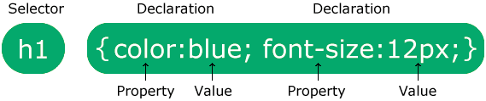
CSS Syntax
CSS rule consists of a selector and a declaration block
The selector points to the HTML element you want to style.
The declaration block contains one or more declarations separated by semicolons.
Each declaration includes a CSS property name and a value, separated by a colon.
Multiple CSS declarations are separated with semicolons, and declaration blocks are surrounded by curly braces.

Slide 12

Example
In this example all <p> elements will be center-aligned, with a red text color:
p { color: red; text-align: center; }
Example Explained
p is a selector in CSS (it points to the HTML element you want to style: <p>).
color is a property, and red is the property value
text-align is a property, and center is the property value

Slide 13
CSS Selectors
A CSS selector selects the HTML element(s) you want to style.
CSS selectors are used to "find" (or select) the HTML elements you want to style.
We can divide CSS selectors into five categories:
Simple selectors (select elements based on name, id, class)
Combinator selectors (select elements based on a specific relationship between them)
Pseudo-class selectors (select elements based on a certain state)
Pseudo-elements selectors (select and style a part of an element)
Attribute selectors (select elements based on an attribute or attribute value)

Slide 14
CSS id Selector
The id selector uses the id attribute of an HTML element to select a specific element.
The id of an element is unique within a page, so the id selector is used to select one unique element!
To select an element with a specific id, write a hash (#) character, followed by the id of the element.
Example:
The CSS rule below will be applied to the HTML element with id="para1":
#para1 { text-align: center; color: red; }

Slide 15
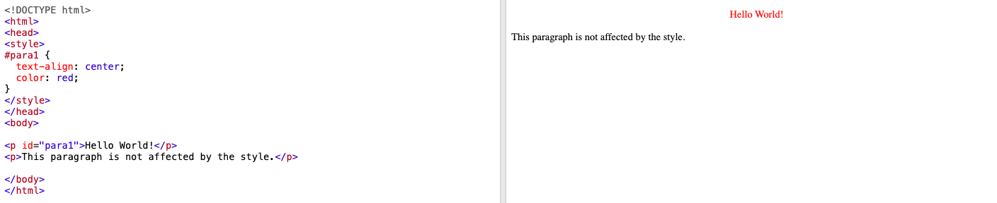
Example

Slide 16
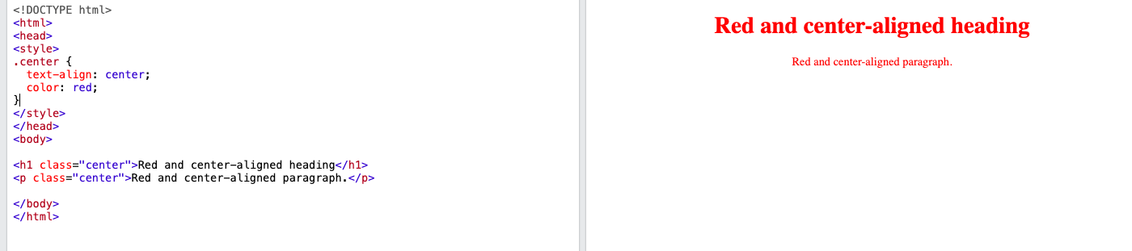
CSS class Selector
The class selector selects HTML elements with a specific class attribute.
To select elements with a specific class, write a period (.) character, followed by the class name.
Example
In this example all HTML elements with class="center" will be red and center-aligned:
.center { text-align: center; color: red; }

Slide 17
CSS class Selector
You can also specify that only specific HTML elements should be affected by a class.
Example
In this example only <p> elements with class="center" will be red and center-aligned:
p.center { text-align: center; color: red; }

Slide 18
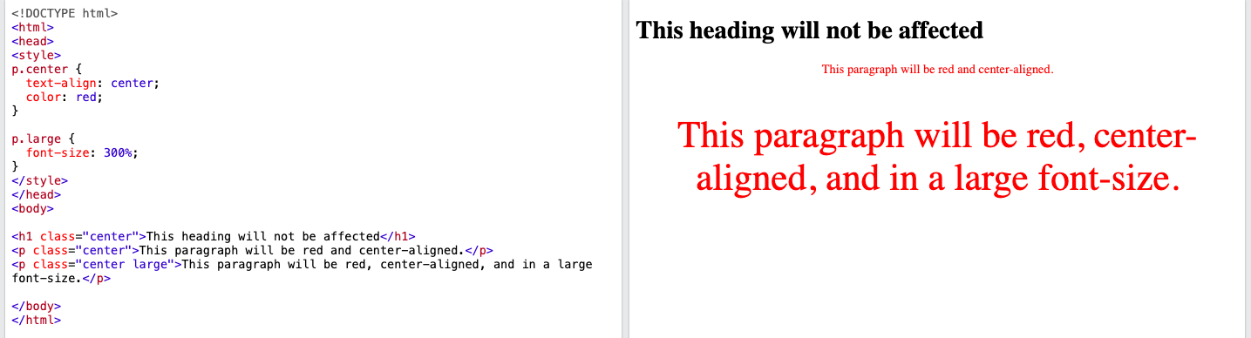
CSS class Selector
HTML elements can also refer to more than one class.
Example
In this example the <p> element will be styled according to class="center" and to class="large":
<p class="center large">This paragraph refers to two classes.</p>

Slide 19
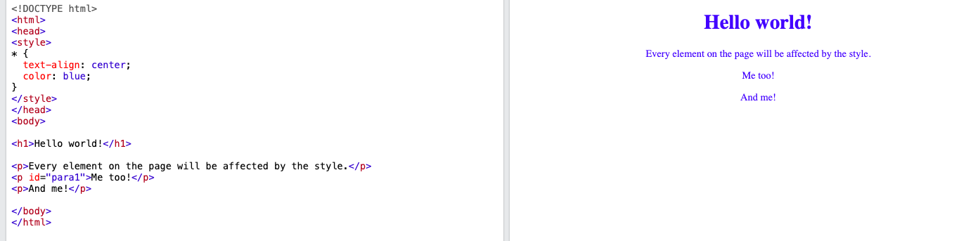
The CSS Universal Selector
The universal selector (*) selects all HTML elements on the page.
Example
The CSS rule below will affect every HTML element on the page:
* { text-align: center; color: blue; }

Slide 20
The CSS Grouping Selector
The grouping selector selects all the HTML elements with the same style definitions.
Look at the following CSS code (the h1, h2, and p elements have the same style definitions).
h1 { text-align: center; color: red; } h2 { text-align: center; color: red; } p { text-align: center; color: red; }
Example
In this example we have grouped the selectors from the code above:
h1, h2, p { text-align: center; color: red; }

Slide 21
It will be better to group the selectors, to minimize the code.
To group selectors, separate each selector with a comma.
Example
In this example we have grouped the selectors from the code above:
h1, h2, p { text-align: center; color: red; }

Slide 22
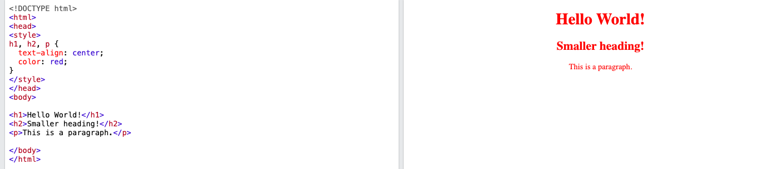

Slide 23
All CSS Simple Selectors
Selector | Example | Example description
#id | #firstname | Selects the element with id="firstname"
.class | .intro | Selects all elements with class="intro"
element.class | p.intro | Selects only <p> elements with class="intro"
* | * | Selects all elements
element | p | Selects all <p> elements
element,element,.. | div, p | Selects all <div> elements and all <p> elements

Slide 24
How To Add CSS
When a browser reads a style sheet, it will format the HTML document according to the information in the style sheet.
Three Ways to Insert CSS
There are three ways of inserting a style sheet:
External CSS
Internal CSS
Inline CSS

Slide 25
External CSS
Example
External styles are defined within the <link> element, inside the <head> section of an HTML page:
<!DOCTYPE html> <html> <head> <link rel="stylesheet" href="mystyle.css"> </head> <body> <h1>This is a heading</h1> <p>This is a paragraph.</p> </body> </html>
With an external style sheet, you can change the look of an entire website by changing just one file!
Each HTML page must include a reference to the external style sheet file inside the <link> element, inside the head section.

Slide 26
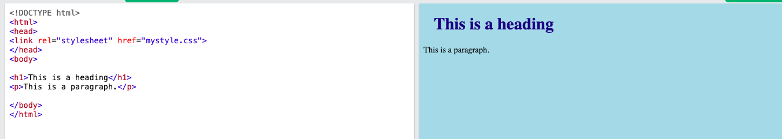
External CSS

Slide 27
External CSS
Here is how the "mystyle.css" file looks:
"mystyle.css"
body { background-color: lightblue; } h1 { color: navy; margin-left: 20px; }
An external style sheet can be written in any text editor, and must be saved with a .css extension.
The external .css file should not contain any HTML tags.
Note:
Do not add a space between the property value and the unit: Incorrect (space): margin-left: 20 px; Correct (nospace): margin-left: 20px;

Slide 28
Internal CSS
An internal style sheet may be used if one single HTML page has a unique style.
The internal style is defined inside the <style> element, inside the head section.

Slide 29
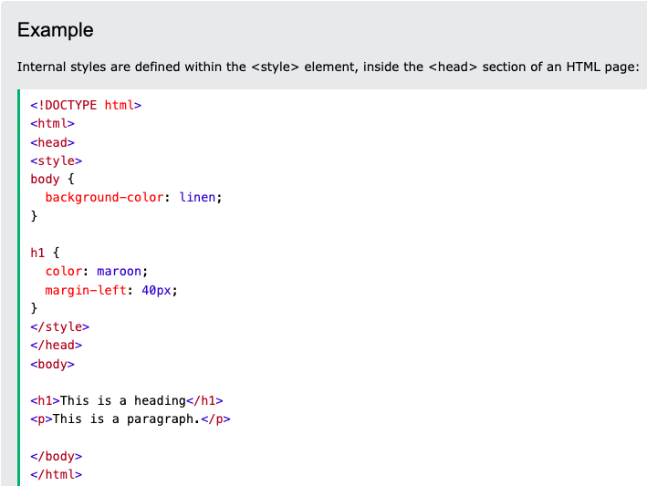

Slide 30
Inline CSS
Example
Inline styles are defined within the "style" attribute of the relevant element:
<!DOCTYPE html> <html> <body> <h1 style="color:blue;text-align:center;">This is a heading</h1> <p style="color:red;">This is a paragraph.</p> </body> </html>
An inline style may be used to apply a unique style for a single element.
To use inline styles, add the style attribute to the relevant element. The style attribute can contain any CSS property.

Slide 31
