Slide 2
Chapter 4
Basic SQL

Slide 3
Chapter 4 Outline
Overview of SQL
SQL Data Definition (DDL) for Specifying a Relational Database Schema
  CREATE statements
  Specifying Constraints
Basic Retrieval Queries in SQL
  SELECT … FROM … WHERE … statements
Basic Database Modification in SQL
  INSERT, DELETE, UPDATE statements

Slide 4
Overview of SQL
SQL is a standard, comprehensive language, based on the relational model
SQL includes capabilities for many functions:
  DDL statements for creating schemas and specifying data types and constraints
  Statements for specifying database retrievals
  Statements for modifying the database
  Statements for specifying views, triggers, and assertions (see Chapter 5)
  Many other capabilities
We introduce the first three capabilities in this chapter

Slide 5
SQL Features in This Chapter
Basic SQL DDL
  Includes the CREATE statements
  Has a comprehensive set of SQL data types
  Can specify key, referential integrity, and other constraints
  Object-oriented features of SQL DDL will be presented in Chapter 11
Basic Retrieval Queries in SQL
  SELECT … FROM … WHERE … statements
Basic Database Modification in SQL
  INSERT, DELETE, UPDATE statements

Slide 6
SQL: Origins and History
Evolution of the SQL Standard
  First standard approved in 1989 (called SQL-89 or SQL1)
  Comprehensive revision in 1992 (SQL-92 or SQL2)
  Third big revision in 1999 (SQL-99, a trimmed-down version of a more ambitious revision known as SQL3)
  Other revisions known as SQL:2003, SQL:2006, SQL:2008
Origins of SQL
  Originally called SEQUEL (Structured English Query Language), then SQL (Structured Query Language)
  Developed at IBM Research for experimental relational DBMS called System-R in the 1970s

Slide 7
SQL Data Definition
CREATE statement can be used to:
  Create a named database schema
  Create individual database tables and specify data types for the table attributes, as well as key, referential integrity, and NOT NULL constraints
  Create named constraints
Other commands can modify the tables and constraints
  DROP and ALTER statements (discussed in Chapter 5)
Notes:
SQL uses the terms table, row, column for formal terms relation, tuple and attributes. We will use them interchangeably.
Main SQL command for data definition is CREATE, which can be used to create schemas, tables, domains, views, assertions, triggers.

Slide 8
CREATE TABLE
In its simplest form, specifies a new base relation by giving it a name, and specifying each of its attributes and their data types (INTEGER, FLOAT, DECIMAL(i,j), CHAR(n), VARCHAR(n), DATE, and other data types)
A constraint NOT NULL may be specified on an attribute
CREATE TABLE DEPARTMENT (
DNAME VARCHAR(15) NOT NULL,
DNUMBER INT NOT NULL,
MGRSSN CHAR(9) NOT NULL,
MGRSTARTDATE DATE );

Slide 9
CREATE TABLE (cont.)
CREATE TABLE can also specify the primary key, UNIQUE keys, and referential integrity constraints (foreign keys)
Via the PRIMARY KEY, UNIQUE, and FOREIGN KEY phrases
  CREATE TABLE DEPARTMENT (
  DNAME VARCHAR(15) NOT NULL,
  DNUMBER INT NOT NULL,
  MGRSSN CHAR(9) NOT NULL,
  MGRSTARTDATE DATE,
  PRIMARY KEY (DNUMBER),
  UNIQUE (DNAME),
  FOREIGN KEY(MGRSSN) REFERENCES EMPLOYEE);

Slide 10
Example: The COMPANY Database
Figure 3.7 (next slide) shows the COMPANY database schema diagram introduced in Chapter 3
Referential integrity constraints shown as directed edges from foreign key to referenced relation
Primary key attributes of each table underlined

Slide 12
Example: The COMPANY DDL
Figure 4.1 (following two slides) shows example DDL for creating the tables of the COMPANY database
Circular reference problem:
  In Figure 3.7, some foreign keys cause circular references:
    EMPLOYEE.Dno → DEPARTMENT.Dnumber
    DEPARTMENT.Mgr_ssn → EMPLOYEE.Ssn
  One of the tables must be created first without the FOREIGN KEY in the CREATE TABLE statement
    The missing FOREIGN KEY can be added later using ALTER TABLE (see Chapter 5)

Slide 13
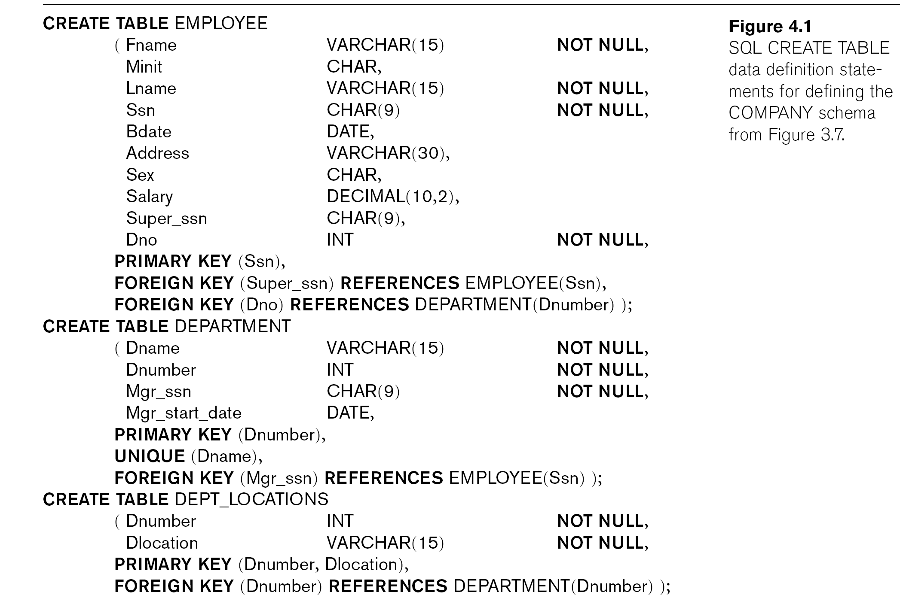
Continued next page…

Slide 14
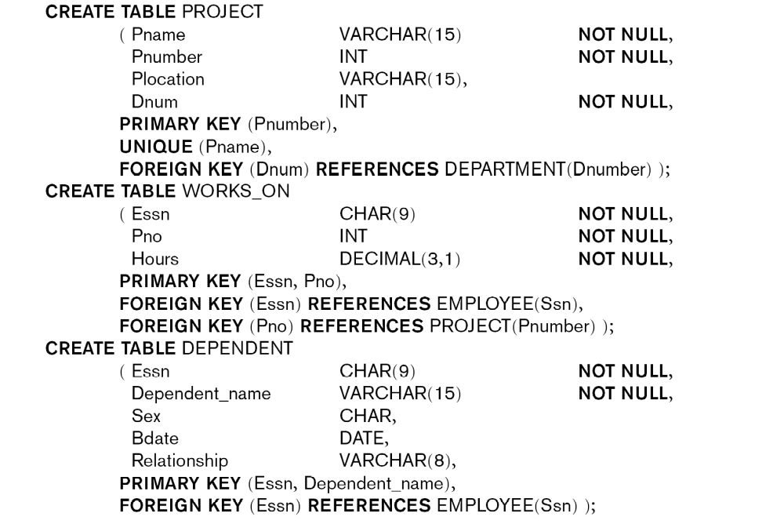

Slide 15
The CREATE SCHEMA Statement
A DBMS can manage multiple databases
DBA (or authorized users) can use CREATE SCHEMA to have distinct databases; for example:
CREATE SCHEMA COMPANY AUTHORIZATION 'Smith';
Each database has a schema name (e.g. COMPANY)
User 'Smith' will be “owner” of schema, can create tables, other constructs in that schema
Table names can be prefixed by schema name if multiple schemas exist (e.g. COMPANY.EMPLOYEE)
Prefix not needed if there is a “default schema” for the user
Concept of catalog – a named collection of schemas

Slide 16
Basic SQL Data Types
Basic numeric data types:
  Integers: INTEGER (or INT), SMALLINT
  Real (floating point): FLOAT (or REAL), DOUBLE PRECISION
  Formatted: DECIMAL(i,j) (or DEC (i,j) or NUMERIC(i,j)) specify i total decimal digits, j after decimal point
    i called precision, j called scale
Basic character string data types:
  Fixed-length: CHAR(n) or CHARACTER(n)
  Variable-length: VARCHAR(n) or CHAR VARYING(n) or CHARACTER VARYING(n)
  Placed in single quotation marks, case sensitive
  Fixed length strings padded with blanks to the right
  Alphabeticaly ordered
  Concatenation operator ||
  CLOB

Slide 17
SQL Data Types (cont)
Bit – string data types:
  BIT(n), BIT VARYING (n), default length of n is 1
  Literal bit strings – B’0101’
  Variable length bit strings – BLOB in Kb/Mb/Gb
Boolean data types:
  TRUE/FALSE/UNKNOWN
Large object data types:
  Binary large objects: BLOB(n)
  Can be used to store attributes that represent images, audio, video, or other large binary objects
  Character large objects: CLOB(n)
  Can be used attributes that store articles, news stories, text files, and other large character objects

Slide 18
SQL Data Types (cont)
DATE data type:
  Standard DATE formatted as yyyy-mm-dd
  For example, DATE '2010-01-22'
  Older formats still used in some systems, such as 'JAN-22-2010'
  Values are ordered, with later dates larger than earlier ones
TIME data type:
  Standard TIME formatted as hh:mm:ss
  E.g., TIME '15:20:22' represents 3.20pm and 22 seconds
  TIME(i) includes and additional i-1 decimal digits for fractions of a second
  E.g., TIME(5) value could be '15:20:22.1234‘
  < comparison works for DATE and TIME
  Literal values – DATE’2008-09-27’ or TIME’09:10:12’

Slide 19
SQL Data Types (cont)
TIMESTAMP data type:
  A DATE combined with a TIME(i), where the default i=7
  For example, TIMESTAMP '2010-01-22 15:20:22.123456'
  A different i>7 can be specified if needed
INTERVAL
  represents a relative YEAR/MONTH or DAY/TIME (e.g. 2 years and 5 months, or 5 days 20 hours 3 minutes 22 seconds)
  Can be used to increment/decrement an absolute value of DATE/TIME/TIMESTAMP
Other SQL data types exist; we presented the most common ones

Slide 20
Specifying Constraints in SQL
Basic constraints in SQL as part of table creation (Key constraints, Referential integrity constraints, Restrictions on attribute domains & NULLs)
Attribute constraints & attribute defaults
NOT NULL constraints, implicit for key attributes, can be defined for others.
Default value for an attribute –
Restrict attribute or domain value using CHECK
Key and Referential Integrity constraints
PRIMARY key – PRIMARY KEY clause
UNIQUE key –
FOREIGN KEY clause

Slide 21
Specifying Referential Integrity Options and Naming of Constraints
We can specify RESTRICT (the default), CASCADE, SET NULL or SET DEFAULT on referential integrity constraints (foreign keys)
Separate options for ON DELETE, ON UPDATE
Figure 4.2 (next slide) gives some examples
A constraint can be given a constraint name; this allows to DROP the constraint later (see Chapter 5)
Constraint names should be unique in a schema
Figure 4.2 illustrates naming of constraints

Slide 23
Specifying DOMAIN Constraints Using the CHECK Clause
Another type of constraint can be specified using CHECK
E.g., CHECK (Dnumber > 0 AND Dnumber < 21) can be specified after the Dnumber attribute
Alternatively, a special domain can be created with a domain name using CREATE DOMAIN
E.g. CREATE DOMAIN D_NUM AS INTEGER CHECK (Dnumber > 0 AND Dnumber < 21);
D_NUM can now be used as the data type for the Dnumber attribute of the DEPARTMENT table, as well as for Dnum of PROJECT, Dno of EMPLOYEE, and so on
CHECK can also be used to specify more general constraints (see Chapter 5)

Slide 24
Basic Retrieval Queries in SQL
SQL basic statement for retrieving information from a database is the SELECT statement
  NOTE: This is not the same as the SELECT operation of the relational algebra (see Chapter 6)
Important distinction between practical SQL model and the formal relational model (see Chapter 3):
  SQL allows a table (relation) to have two or more tuples that are identical in all their attribute values
  Hence, an SQL relation (table) is a multi-set (sometimes called a bag) of tuples; it is not a set of tuples
SQL relations can be constrained to be sets by specifying PRIMARY KEY or UNIQUE attributes, or by using the DISTINCT option in a query

Slide 25
Bag (Multiset) versus Set
A bag or multi-set is like a set, but an element may appear more than once
  Example: {A, B, C, A} is a bag (but not a set). {A, B, C} is a bag (and also a set).
  Bags also resemble lists, but the order is irrelevant in a bag.
Example:
  {A, B, A} = {B, A, A} as bags
  However, [A, B, A] is not equal to [B, A, A] as lists

Slide 26
Basic Retrieval Queries in SQL (cont.)
Simplest form of the SQL SELECT statement is called a mapping or a SELECT-FROM-WHERE block
Our examples use the COMPANY database schema
SELECT <attribute list>
FROM <table list>
WHERE <condition>
  <attribute list> is a list of attribute names whose values are to be retrieved by the query, also called projection attributes
  <table list> is a list of the table (relation) names required to process the query
  <condition> is a conditional (Boolean) expression that identifies the tuples to be retrieved by the query, also known as selection condition

Slide 27
Simple SQL Queries (cont.)
Query text ends with a semi-colon
First example of a simple query on one table (relation)
Query 0: Retrieve the birthdate and address of the employee whose name is 'John B. Smith'
Use the EMPLOYEE table only
  Q0:SELECT BDATE, ADDRESS
  FROM EMPLOYEE
  WHERE FNAME='John' AND MINIT='B’
  AND LNAME='Smith’ ;

Slide 28
Simple SQL Queries (cont.)
Example of a query that uses two tables
Query 1: Retrieve the name and address of all employees who work for the 'Research' department.
  Q1:SELECT FNAME, LNAME, ADDRESS
  FROM EMPLOYEE, DEPARTMENT
  WHERE DNAME='Research' AND DNUMBER=DNO ;
  (DNAME='Research') is called a selection condition
  (DNUMBER=DNO) is called a join condition (it joins two tuples from EMPLOYEE and DEPARTMENT tables whenever EMPLOYEE.DNO=DEPARTMENT.DNUMBER)
  Select-project-join query

Slide 29
Simple SQL Queries (cont.)
A selection condition refers to attributes from a single table, and selects (chooses) those records that satisfy the condition
A join condition generally refers to attributes from two tables, and joins (or combines) pairs of records that satisfy the condition
In the previous query:
  (DNAME='Research') chooses the DEPARTMENT record
  (DNUMBER=DNO) joins the record with each EMPLOYEE record that works for that department

Slide 30
Simple SQL Queries (cont.)
Query 2 (needs 3 tables): For every project located in 'Stafford', list the project number, the controlling department number, and the department manager's last name, address, and birthdate.
Q2: SELECT PNUMBER, DNUM, LNAME, BDATE, ADDRESS
FROM PROJECT, DEPARTMENT, EMPLOYEE
WHERE DNUM=DNUMBER AND MGRSSN=SSN
AND PLOCATION='Stafford' ;
  In Q2, there are two join conditions
  The join condition DNUM=DNUMBER relates a PROJECT record to its controlling DEPARTMENT record
  The join condition MGRSSN=SSN relates the controlling DEPARTMENT to the EMPLOYEE who manages that department

Slide 31
Qualifying Attribute Name with Table Name
An attribute name in an SQL query can be prefixed (or qualified) with the table name
Examples:
  EMPLOYEE.LNAME
  DEPARTMENT.DNAME
Query Q1 can be rewritten as:
SELECT EMPLOYEE.FNAME, EMPLOYEE.LNAME, EMPLOYEE. ADDRESS
FROM EMPLOYEE, DEPARTMENT
WHERE DEPARTMENT.DNAME='Research' AND DEPARTMENT.DNUMBER=EMPLOYEE.DNO ;

Slide 32
Aliasing Table Names Using Tuple Variables
An alias (or tuple variable) can be used instead of the table name when prefixing attribute names
Example:
Query Q1 can be rewritten as follows using the aliases D for DEPARTMENT and E for EMPLOYEE:
SELECT E.FNAME, E.LNAME, E. ADDRESS
FROM EMPLOYEE AS E, DEPARTMENT AS D
WHERE D.DNAME='Research' AND D.DNUMBER=E.DNO ;

Slide 33
Renaming of Attributes
It is also possible to rename the attributes of a table within a query; new attribute names are listed in the same order that the attributes where specified in CREATE TABLE
This is sometimes necessary for certain joins (see Chapter 5)
Example: Query Q1 can be rewritten as follows:
SELECT E.FN, E.LN, E. ADR
FROM DEPARTMENT AS D(DNM, DNO, MSSN, STRDATE), EMPLOYEE AS E(FN,MI,LN,S,BD,ADR,SX,SAL,SU,DNO)
WHERE D.DNM='Research' AND D.DNO=E.DNO ;

Slide 34
Queries that Require Qualifying of Attributes Names
In SQL, all attribute names in a particular table must be different
  However, the same attribute name can be used in different tables
  In this case, it is required to use aliases if both tables are used in the same query
  Example: Suppose that the attribute name NAME was used for both DEPARTMENT name and PROJECT name
Query: For each project, retrieve the project's name, and the name of its controlling department.
Q: SELECT P.NAME, D.NAME
FROM PROJECT AS P, DEPARTMENT AS D
WHERE P.DNUM=D.DNUMBER ;
In Q, P.NAME refers to the NAME attribute in the PROJECT table, and D.NAME refers to the NAME attribute in the DEPARTMENTtable,

Slide 35
Queries that Require Qualifying of Attributes (cont.)
Some queries need to refer to the same relation twice
  In this case, aliases are also required
Query 8: For each employee, retrieve the employee's name, and the name of his or her immediate supervisor.
Q8: SELECT E.FNAME, E.LNAME, S.FNAME, S.LNAME
FROM EMPLOYEE AS E , EMPLOYEE AS S
WHERE E.SUPERSSN=S.SSN ;
  In Q8, E and S are two different aliases or tuple variables for the EMPLOYEE relation
  We can think of E and S as two different copies of EMPLOYEE; E represents employees in role of supervisees and S represents employees in role of supervisors
  The join condition joins two different employee records together (a supervisor S and a subordinate E)

Slide 36
Missing WHERE-clause
The WHERE-clause is optional in an SQL query
A missing WHERE-clause indicates no condition; hence, all tuples of the relations in the FROM-clause are selected
  This is equivalent to the condition WHERE TRUE
Example: Retrieve the SSN values for all employees.
  Q9: SELECT SSN
  FROM EMPLOYEE ;
If more than one relation is specified in the FROM-clause and there is no WHERE-clause (hence no join conditions), then all possible combinations of tuples are joined together (known as CARTESIAN PRODUCT of the relations)

Slide 37
Missing WHERE-clause (cont.)
Example:
  Q10: SELECT SSN, DNAME
  FROM EMPLOYEE, DEPARTMENT
  In this query, every EMPLOYEE is joined with every DEPARTMENT
  It is extremely important not to overlook specifying any selection and join conditions in the WHERE-clause; otherwise, incorrect and very large query results are produced

Slide 38
Retrieving all the Attributes Using Asterisk (*)
To retrieve all the attribute values of the selected tuples, a * (asterisk) is used, which stands for all the attributes
Examples:
  Q1C:SELECT *
  FROM EMPLOYEE
  WHERE DNO=5 ;
  Q1D:SELECT *
  FROM EMPLOYEE, DEPARTMENT
  WHERE DNAME='Research' AND DNO=DNUMBER ;

Slide 39
Eliminating Duplicates Using DISTINCT
As mentioned earlier, SQL does not treat a relation as a set but a multiset (or bag); duplicate tuples can appear
To eliminate duplicate tuples in a query result, the keyword DISTINCT is used
Example: Result of Q11 may have duplicate SALARY values; result of Q11A does not have any duplicate values
  Q11: SELECT SALARY
  FROM EMPLOYEE
  Q11A: SELECT DISTINCT SALARY
  FROM EMPLOYEE

Slide 40
Set and Multiset Operations in SQL
SQL has directly incorporated some set operations
The set operations are: union (UNION), set difference (EXCEPT or MINUS) and intersection (INTERSECT)
Results of these set operations are sets of tuples; duplicate tuples are eliminated from the result
Set operations apply only to type compatible relations (also called union compatible); the two relations must have the same attribute types and in the same order
Set operations typically applied to the results of two separate queries; e.g Q1 UNION Q2

Slide 41
Set Operations (cont.)
Example: Query 4: Make a list of all project names for projects that involve an employee whose last name is 'Smith' as a worker on the project or as a manager of the department that controls the project.
  Q4: (SELECT PNAME
  FROM PROJECT, DEPARTMENT, EMPLOYEE
  WHERE DNUM=DNUMBER AND MGRSSN=SSN AND LNAME='Smith')
  UNION
  (SELECT PNAME
  FROM PROJECT, WORKS_ON, EMPLOYEE
  WHERE PNUMBER=PNO AND
  ESSN=SSN AND LNAME='Smith') ;

Slide 42
Multiset Operations in SQL
SQL has multiset operations when the user does not want to eliminate duplicates from the query results
These are: UNION ALL, EXCEPT ALL, and INTERSECT ALL; see examples in Figure 4.5 (next slide)
Results of these operations are multisets of tuples; all tuples and duplicates in the input tables are considered when computing the result
Multiset operations also apply only to type compatible relations
Typically applied to the results of two separate queries; e.g Q1 UNION ALL Q2 ;

Slide 44
Substring Comparison Conditions
The LIKE comparison operator is used to compare partial strings
Two reserved characters are used: '*' (or '%' in some implementations) replaces an arbitrary number of characters, and '_' replaces a single arbitrary character
Conditions can be used in WHERE-clause

Slide 45
Substring Comparison Conditions (cont.)
Example: Query 25: Retrieve all employees whose address is in Houston, Texas. Here, the value of the ADDRESS attribute must contain the substring 'Houston,TX‘ in it.
  Q25: SELECT FNAME, LNAME
  FROM EMPLOYEE
  WHERE ADDRESS LIKE '*Houston,TX*' ;

Slide 46
Substring Comparison Conditions (cont.)
Example: Query 26: Retrieve all employees who were born during the 1950s.
  Here, '5' must be the 3rd character of the string (according to the standard format for DATE yyyy-mm-dd), so the BDATE value is '_ _5_ _ _ _ _ _ _', with each underscore as a place holder for a single arbitrary character.
Q26: SELECT FNAME, LNAME
FROM EMPLOYEE
WHERE BDATE LIKE '_ _5_ _ _ _ _ _ _';
The LIKE operator allows users to get around the fact that each value is considered atomic and indivisible
  Hence, in SQL, character string attribute values are not atomic

Slide 47
Applying Arithmetic in SQL Queries
The standard arithmetic operators '+', '-'. '*', and '/' (for addition, subtraction, multiplication, and division, respectively) can be applied to numeric attributes and values in an SQL query
Example: Query 27: Show the effect of giving all employees who work on the 'ProductX' project a 10% raise.
  Q27: SELECT FNAME, LNAME, 1.1*SALARY
  FROM EMPLOYEE, WORKS_ON, PROJECT
  WHERE SSN=ESSN AND PNO=PNUMBER AND PNAME='ProductX’ ;

Slide 48
Ordering a query result using the ORDER BY clause
The ORDER BY clause is used to sort the tuples in a query result based on the values of some attribute(s)
Example: Query 28: Retrieve a list of employees and the projects each works in, ordered by the employee's department, and within each department ordered alphabetically by employee last name.
  Q28: SELECT DNAME, LNAME, FNAME, PNAME
  FROM DEPARTMENT, EMPLOYEE, WORKS_ON, PROJECT
  WHERE DNUMBER=DNO AND SSN=ESSN AND PNO=PNUMBER
  ORDER BY DNAME, LNAME ;

Slide 49
ORDER BY (cont.)
The default order is in ascending order of values
We can specify the keyword DESC if we want a descending order; the keyword ASC can be used to explicitly specify ascending order, even though it is the default
Without ORDER BY, the rows in a query result appear in some system-determined (random) order

Slide 50
Summary of Basic SQL Queries
A basic query in SQL can consist of up to four clauses, but only the first two, SELECT and FROM, are mandatory
Two additional clauses (GROUP BY and HAVING) will be discussed in Chapter 5
The four basic clauses are specified in the following order:
SELECT <attribute list>
FROM <table list>
[WHERE <condition>]
[ORDER BY <attribute list>]

Slide 51
SQL Statements for Updating the Database
There are three SQL commands to modify the database: INSERT, DELETE, and UPDATE
INSERT is used for adding one or more records to a table
DELETE is for removing records
UPDATE is for modifying existing records
Some operations may be rejected if they violate integrity constraints; others may propagate additional updating automatically if specified in the database schema

Slide 52
INSERT statement
Used to add one or more tuples (records) to a relation (table)
Values for the attributes should be listed in the same order as the attributes were specified in the CREATE TABLE command
Attributes that have defaults values can be omitted in the new record(s)
Can violate – domain, key, entity integrity, Referential integrity constaints

Slide 53
INSERT statement (cont.)
Example:
  U1: INSERT INTO EMPLOYEE
  VALUES ('Richard','K','Marini', '653298653', '30-DEC-52',
  '98 Oak Forest,Katy,TX', 'M', 37000,'987654321', 4 ) ;
An alternate form of INSERT specifies explicitly the attribute names that correspond to the values in the new tuple
  Attributes with NULL or default values can be left out
Example: Insert a tuple for a new EMPLOYEE for whom we only know the FNAME, LNAME, and SSN attributes.
  U1A: INSERT INTO EMPLOYEE (FNAME, LNAME, SSN)
  VALUES ('Richard', 'Marini', '653298653') ;

Slide 54
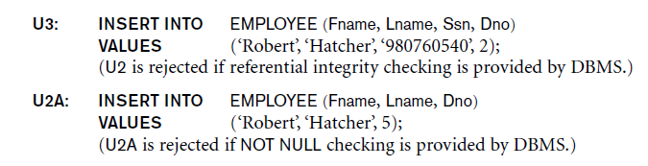
INSERT statement (cont.)
Constraints specified in the DDL are automatically enforced by the DBMS when updates are applied to the database
Can insert multiple tuples in one INSERT statement
  The values in each tuple are enclosed in parentheses

Slide 55
INSERT statement (cont.)
Can also insert tuples from a query result into a table
Example: Suppose we want to create a temporary table that has the employee last name, project name, and hours per week for each employee.
  A table WORKS_ON_INFO is created by U3A, and is loaded with the summary information retrieved from the database by the query in U3B.
  U3A: CREATE TABLE WORKS_ON_INFO
  (EMP_NAME VARCHAR(15),
  PROJ_NAME VARCHAR(15),
  HOURS_PER_WEEK DECIMAL(3,1));
  U3B: INSERT INTO WORKS_ON_INFO (EMP_NAME, PROJ_NAME, HOURS_PER_WEEK)
  SELECT E.LNAME, P.PNAME, W.HOURS
  FROM EMPLOYEE E, PROJECT P, WORKS_ON W
  WHERE E.SSN=W.ESSN AND W.PNO=P.PNUMBER ;

Slide 56
INSERT statement (cont.)
Note: The WORKS_ON_INFO table may not be up-to-date if we change the tuples in the WORKS_ON, PROJECT, or EMPLOYEE relations after executing U3B.
We have to use CREATE VIEW (see Chapter 5) to keep such a table up to date.

Slide 57
DELETE Statement
Removes tuples from a relation
  Includes a WHERE-clause to select the tuples to be deleted
  Referential integrity should be enforced (via REJECT, CASCADE, SET NULL, or SET DEFAULT)
  Tuples are deleted from only one table at a time (unless CASCADE is specified on a referential integrity constraint)
  Missing WHERE-clause deletes all tuples in the relation; the table then becomes an empty table
  Number of tuples deleted is the number of tuples selected by the WHERE-clause

Slide 58
DELETE Statement (cont.)
Examples:
  U4A: DELETE FROM EMPLOYEE
  WHERE LNAME='Brown' ;
  U4B: DELETE FROM EMPLOYEE
  WHERE SSN='123456789’ ;
  U4C: DELETE FROM EMPLOYEE
  WHERE DNO = 5 ;
  U4D: DELETE FROM EMPLOYEE ;

Slide 59
UPDATE Statement
Used to modify attribute values of one or more selected tuples
A WHERE-clause selects the tuples to be modified
An additional SET-clause specifies the attributes to be modified and their new values
Each command modifies tuples in the same relation
Referential integrity should be enforced (via REJECT, CASCADE, SET NULL, or SET DEFAULT)
Updating a primary key may propagate updates to foreign key values in referencing relations if referential triggered action is specified in DDL

Slide 60
UPDATE Statement (cont.)
Example: Change the location and controlling department number of project number 10 to 'Bellaire' and 5, respectively.
  U5: UPDATE PROJECT
  SET PLOCATION = 'Bellaire', DNUM = 5
  WHERE PNUMBER=10 ;

Slide 61
UPDATE Statement (cont.)
Example: Give all employees in department number 5 a 10% raise in salary
  U6: UPDATE EMPLOYEE
  SET SALARY = SALARY *1.1
  WHERE DNO = 5 ;
In this request, the modified SALARY value depends on the original SALARY value in each tuple
  The reference to the SALARY attribute on the right of = refers to the old SALARY value before modification
  The reference to the SALARY attribute on the left of = refers to the new SALARY value after modification

Slide 62
Some Other Features of SQL
More complex query features: nested queries, aggregate functions, GROUP BY, HAVING, EXISTS function (see Chapter 5)
Views, assertions, schema modification (Chapter 5)
Triggers (Chapter 5 and Section 26.1)
Object-relational features (Chapter 11, Section 11.2)
Programming techniques (Chapter 13)
Transaction features (Chapter 21, Section 21.6)
Database Security (Chapter 24, Section 24.2)

Slide 63
Chapter 4 Summary
Overview of SQL
SQL Data Definition (DDL) for Specifying a Relational Database Schema
  CREATE statements
  Specifying Constraints
Basic Retrieval Queries in SQL
  SELECT … FROM … WHERE … statements
Basic Database Modification in SQL
  INSERT, DELETE, UPDATE statements

Slide 64
Oracle Dates and Times
Rather than 2 entities, Oracle only uses one, DATE, stored in a special internal format month, day, and year, hour, minute, and second.
The DATE type used same way as other built-in types such as INT.
For example-
Create Table x(a int, b date);
For displaying a DATE value, TO_CHAR function is used
Default DATE format - "DD-MON-YY".
Select b From x; : 01-APR-98
Whenever a DATE value is displayed, Oracle will call TO_CHAR automatically with the default DATE format.
Override it with own DATE format.
SELECT TO_CHAR(b, 'YYYY/MM/DD') AS b FROM x; 1998/04/01
The general usage of TO_CHAR is:TO_CHAR(<date>, '<format>')

Slide 65
Oracle Dates and Times
Function TO_DATE - Converts a string to a DATE value. Default - "DD-MON-YY".
INSERT INTO x VALUES(99, '31-may-98');
TO_DATE explicitly: insert into x values(99, to_date('1998/05/31:12:00:00AM', 'yyyy/mm/dd:hh:mi:ssam'));
General usage :TO_DATE(<string>, '<format>')
You can change the default DATE from "DD-MON-YY" to something you like by issuing the following command in sqlplus:
alter session set NLS_DATE_FORMAT='<my_format>';The change is only valid for the current sqlplus session.
The Current Time - built-in function SYSDATE returns a DATE value containing the current date and time on your system.
select to_char(sysdate, 'Dy DD-Mon-YYYY HH24:MI:SS') as "Current Time" from dual; -- Tue 21-Apr-1998 21:18:27

Slide 66
Oracle Dates and Times
Operations on DATE
compare 2 DATE values using the standard comparison operators such as =, !=, >,
You can subtract two DATE values, and the result is a FLOAT (number of days between the two DATE values. In general, the result may contain a fraction because DATE also has a time component.
adding, multiplying, and dividing two DATE values are not allowed.
You can add and subtract constants to and from a DATE value, and these numbers will be interpreted as numbers of days. For example, SYSDATE+1 will be tomorrow. You cannot multiply or divide DATE values.
With the help of TO_CHAR, string operations can be used on DATE values as well. For example, to_char(<date>, 'DD-MON-YY') like '%JUN%' evaluates to true if <date> is in June.

Slide 67
Oracle Dates and Times
popular formats
MM | Numeric month (e.g., 07)
MON | Abbreviated month name (e.g., JUL)
MONTH | Full month name (e.g., JULY)
DD | Day of month (e.g., 24)
DY | Abbreviated name of day (e.g., FRI)
YYYY | 4-digit year (e.g., 1998)
YY | Last 2 digits of the year (e.g., 98)
RR | Like YY, but the two digits are ``rounded'' to a year in the range 1950 to 2049. Thus, 06 is considered 2006 instead of 1906
AM (or PM) | Meridian indicator
HH | Hour of day (1-12)
HH24 | Hour of day (0-23)
MI | Minute (0-59)
SS | Second (0-59)

