Slide 1
Chapter 13
Introduction to SQL Programming Techniques

Slide 2
Chapter 13 Outline
Database Programming: Techniques and Issues
Embedded SQL, Dynamic SQL, and SQLJ
Database Programming with Function Calls: SQL/CLI and JDBC
Database Stored Procedures
and SQL/PSM
Comparing the Three Approaches

Slide 3
Introduction to SQL
Programming Techniques
Database access from general purpose programming languages (Ch 13) and scripting languages (Ch 14)
Database applications
  Host language
    Java, C/C++/C#, COBOL, or some other programming language
  Data sublanguage
    SQL
  Database programming language – PL/SQL, SQL/PSM
SQL standards
  Continually evolving
  Each DBMS vendor may have some variations from standard

Slide 4
Database Programming: Techniques and Issues
Interactive interface
  SQL commands typed directly into a monitor – SQLPLUS for ORACLE, Management Studio for MSSQL
  Execute file of commands - @<filename>
  Useful for schema constraint creation, ad-hoc queries, but not for executing access from programs
Application programs or database applications
  Main approach to access
  Used as canned transactions by the end users access a database
  May have Web interface – e commerce apps (ch 14)
  Several techniques as discussed next

Slide 5
Three main approaches to Database Programming
Embedding database commands (SQL) in general purpose prog lang – embedded SQL, dynamic SQL(SQLJ for Java)
Using a Library of procedures/functions (APIs) for accessing database (ODBS, SQL/CLI,JDBC)
SQL standard that allowing programming modules (SQL/PSM) – a brand new language

Slide 6
Approaches to Database Programming
1.Embedding database commands in a general-purpose programming language (host language)
  Database statements identified by a special prefix like EXEC SQL for embedded SQL
  Precompiler or preprocessor scans the source program code
    Identify database statements and extract them for processing by the DBMS
    Replace them with function calls to DBMS generated code
  Called embedded SQL

Slide 7
Approaches to Database Programming (cont’d.)
2. Using a library of database functions
  Library of functions available to the host programming language to connect to DB, execute query or update
  Application programming interface (API)
3. Designing a brand-new language
  Database programming language designed from scratch – Oracle’s PL/SQL
  Additional programming structures – loops, conditions
First two approaches are more common but suffer from impedance mismatch

Slide 8
Impedance Mismatch
Differences between database model and programming language model
  Data type of programming language differ from attribute data types
    Binding for each host programming language
    Specifies for each attribute type the compatible programming language types
  Binding to map query result (data table) to programming language data structure
    Binding for query result through Cursor or iterator variable
    Loop over the tuples in a query result

Slide 9
Typical Sequence of Interaction in Database Programming
Client/Server model
Open a connection to database server – using URL, login credential
Interact with database by submitting queries, updates, and other database commands
Terminate or close connection to database
Program can access multiple database connections at same time or one at a time

Slide 10
Embedded SQL, Dynamic SQL, and SQLJ
Embedding SQL statements
  C language – embedded SQL
  Java language - SQLJ
Programming language called host language
Can embed most SQL statements – data or constraint definitions, queries, updates, view definitions

Slide 11
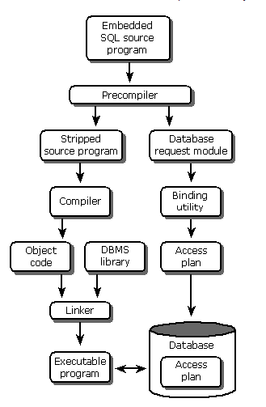

Slide 12
Retrieving Single Tuples with Embedded SQL
EXEC SQL
  Prefix to distinguish from programming language statements
  Preprocessor separates embedded SQL statements from host language code
  Terminated by a matching END-EXEC
    Or by a semicolon (;)
Shared variables
  Used in both the C program and the embedded SQL statements
  Prefixed by a colon (:) in SQL statement
  Distinguishes from schema constructs (attributes)

Slide 13
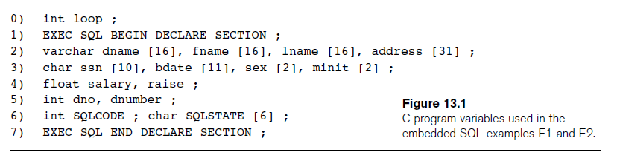
Retrieving Single Tuples with Embedded SQL (cont’d.)
SQL Type C type
INTEGER, SMALLINT, REAL, DOUBLE – long, short, float, double
CHAR[i], VARCHAR[i] - char [i+1], varchar [i+1]

Slide 14
Retrieving Single Tuples with Embedded SQL (cont’d.)
Connecting to the database
  CONNECT TO <server name>AS <connection name>
  AUTHORIZATION <user account name and password> ;
Change connection
  SET CONNECTION <connection name> ;
Terminate connection
  DISCONNECT <connection name> ;

Slide 15
Retrieving Single Tuples with Embedded SQL (cont’d.)
SQLCODE and SQLSTATE communication variables
  Used by DBMS to communicate exception or error conditions
SQLCODE variable – return value by DBMS after execution of each database command
  0 = statement executed successfully
  100 = no more data available in query result
  < 0 = indicates some error has occurred
  ORACLE – SQLCA.SQLCODE – EXEC SQL include SQLCA

Slide 16
Retrieving Single Tuples with Embedded SQL (cont’d.)
SQLSTATE
  String of five characters
  ‘00000’ = no error or exception
  Other values indicate various errors or exceptions
  For example, ‘02000’ indicates ‘no more data’ when using SQLSTATE
  Better to use SQLSTATE than SQLCODE

Slide 17
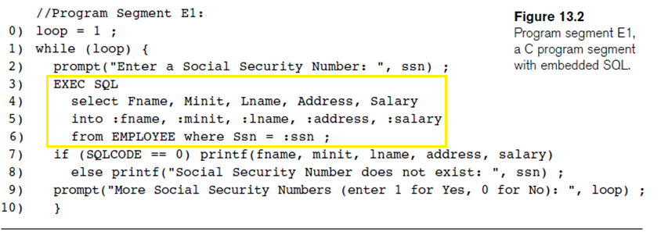
Retrieving Single Tuples with Embedded SQL (cont’d.)
Program loop that takes in a ssn number and prints out corresponding employee details

Slide 18
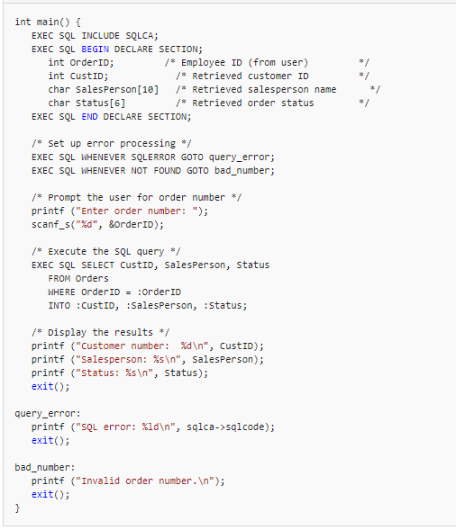
Another Example

Slide 19
Retrieving Multiple Tuples with Embedded SQL Using Cursors
Cursor
  Points to a single tuple (row) from result of query
OPEN CURSOR command
  Fetches query result and sets cursor to a position before first row in result
  Becomes current row for cursor
FETCH commands
  Moves cursor to next row in result of query

Slide 20
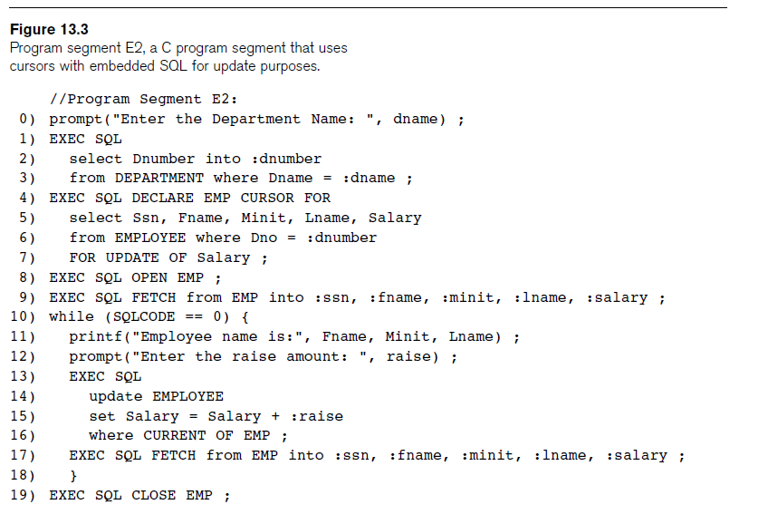

Slide 21
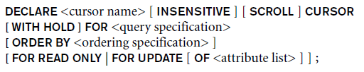
Retrieving Multiple Tuples with Embedded SQL Using Cursors (cont’d.)
FOR UPDATE OF
  List the names of any attributes that will be updated by the program
Fetch orientation
  Added using value: NEXT, PRIOR, FIRST, LAST, ABSOLUTE i, and RELATIVE i

Slide 22
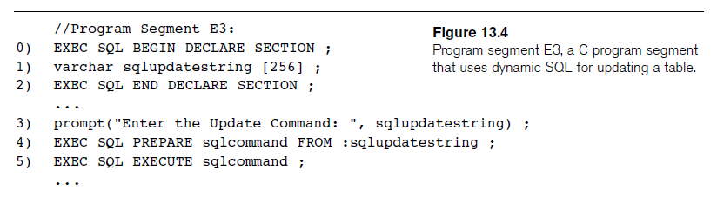
Specifying Queries at Runtime Using Dynamic SQL
Dynamic SQL
  Execute different SQL queries or updates dynamically at runtime
Dynamic update
Dynamic query

Slide 23
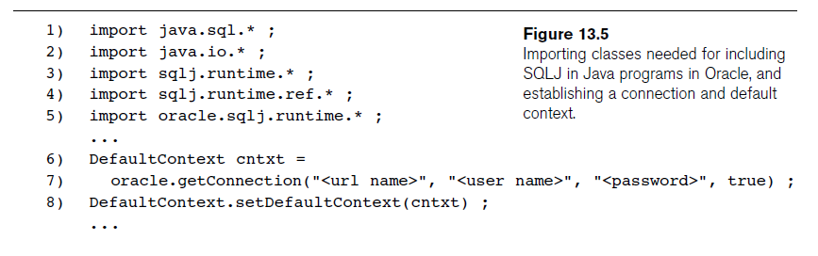
SQLJ: Embedding SQL Commands in Java
Standard adopted by several vendors for embedding SQL in Java
Import several class libraries
Default context – return object from getConnection class of SQLJ
Uses exceptions for error handling
  SQLException is used to return errors or exception conditions
SQLJ translator converts SQL stmts into Java, executed using JDBC interface

Slide 24
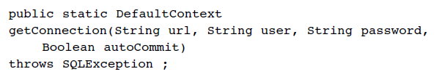
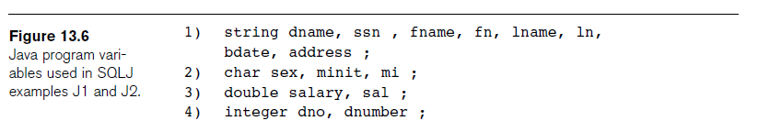
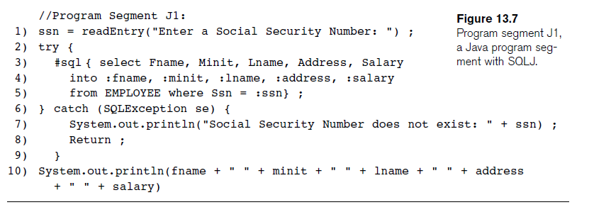
SQLJ: Embedding SQL Commands in Java (cont’d.)

Slide 25
Retrieving Multiple Tuples in SQLJ Using Iterators
Iterator
  Object associated with a collection (set or multiset) of records in a query result
Named iterator
  Associated with a query result by listing attribute names and types in query result
Positional iterator
  Lists only attribute types in query result

Slide 26
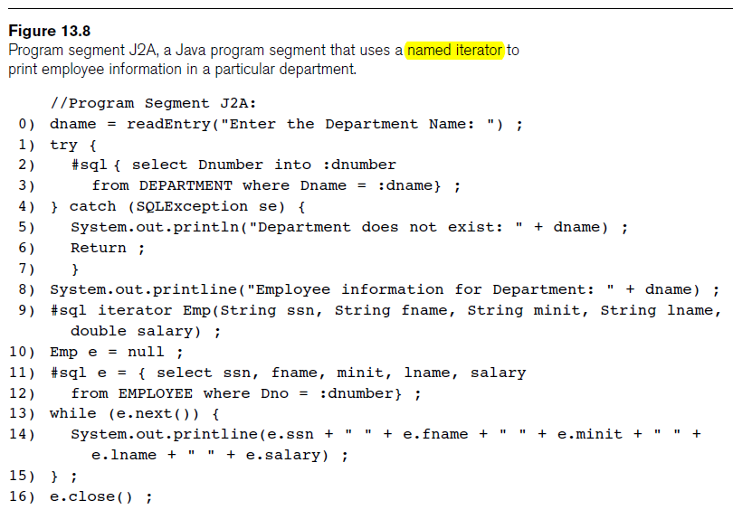
Retrieving Multiple Tuples in SQLJ Using Iterators (cont’d.)

Slide 27
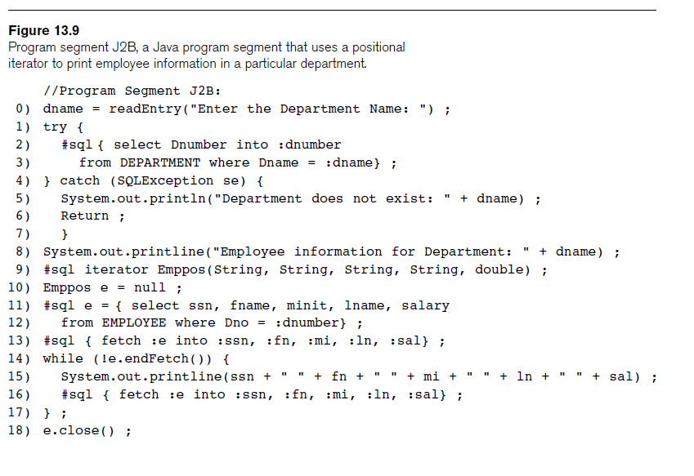
Retrieving Multiple Tuples in SQLJ Using Iterators (cont’d.)

Slide 28
Database Programming with Function Calls: SQL/CLI & JDBC
Use of function calls
  Dynamic approach for database programming
Library of functions
  Also known as application programming interface (API)
  Used to access database
SQL Call Level Interface (SQL/CLI)
  Part of SQL standard

Slide 29
SQL/CLI: Using C as the Host Language
Environment record
  Track one or more database connections
  Set environment information
Connection record
  Keeps track of information needed for a particular database connection
Statement record
  Keeps track of the information needed for one SQL statement

Slide 30
SQL/CLI: Using C as the Host Language (cont’d.)
Description record
  Keeps track of information about tuples or parameters
Handle to the record
  C pointer variable makes record accessible to program

Slide 31
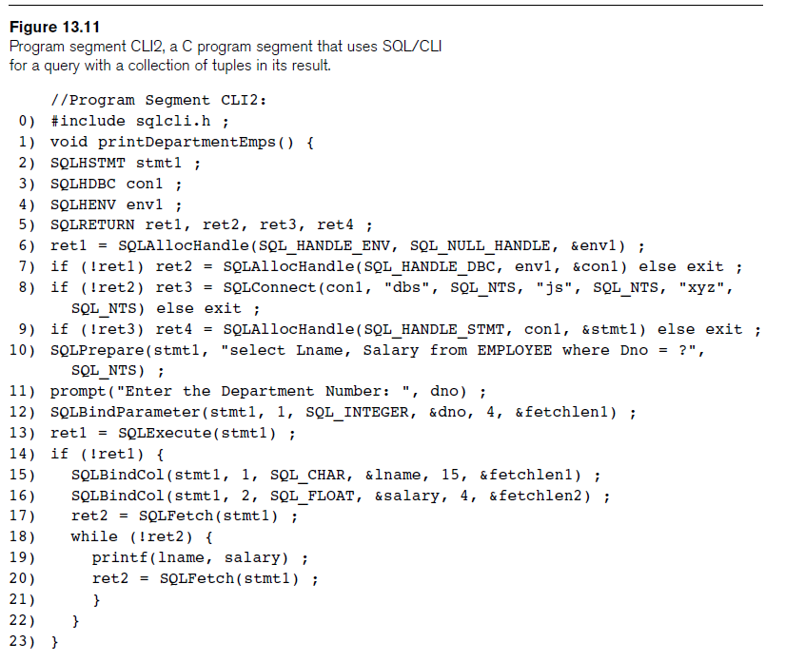

Slide 32
JDBC: SQL Function Calls for Java Programming
JDBC
  Java function libraries
Single Java program can connect to several different databases
  Called data sources accessed by the Java program
Class.forName("oracle.jdbc.driver.OracleDriver")
  Load a JDBC driver explicitly

Slide 33
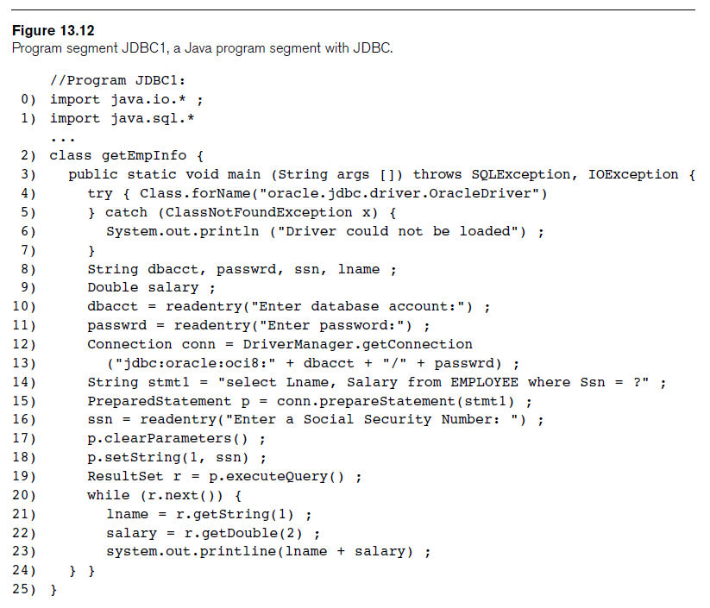

Slide 34
JDBC: SQL Function Calls for Java Programming
Connection object
Statement object has two subclasses:
  PreparedStatement and CallableStatement
Question mark (?) symbol
  Represents a statement parameter
  Determined at runtime
ResultSet object
  Holds results of query

Slide 35
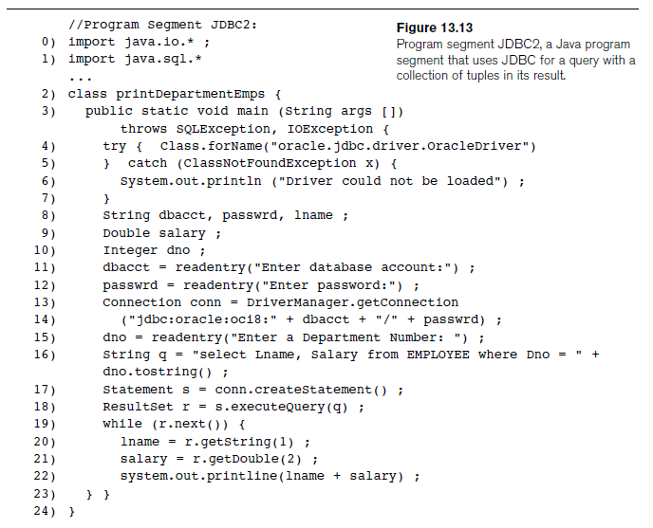

Slide 36
Database Stored Procedures and SQL/PSM
Stored procedures
  Program modules stored by the DBMS at the database server
  Can be functions or procedures
SQL/PSM (SQL/Persistent Stored Modules)
  Extensions to SQL
  Include general-purpose programming constructs in SQL

Slide 37
Database Stored Procedures and Functions
Persistent stored modules
  Stored persistently by the DBMS
Useful:
  When database program is needed by several applications
  To reduce data transfer and communication cost between client and server in certain situations
  To enhance modeling power provided by views

Slide 38
Database Stored Procedures and Functions (cont’d.)
Declaring stored procedures:
  CREATE PROCEDURE <procedure name> (<parameters>)
  <local declarations>
  <procedure body> ;
  declaring a function, a return type is necessary, so the declaration form is
  CREATE FUNCTION <function name> (<parameters>)
  RETURNS <return type>
  <local declarations>
  <function body> ;

Slide 39
Database Stored Procedures and Functions (cont’d.)
Each parameter has parameter type
  Parameter type: one of the SQL data types
  Parameter mode: IN, OUT, or INOUT
Calling a stored procedure: from interactive interface or from embedded SQL or SQLJ or from JDBC (CallableStatement)
  CALL <procedure or function name> (<argument list>) ;

Slide 40
SQL/PSM: Extending SQL for Specifying Persistent
Stored Modules
Conditional branching statement:
  IF <condition> THEN <statement list>
  ELSEIF <condition> THEN <statement list>
  ...
  ELSEIF <condition> THEN <statement list>
  ELSE <statement list>
  END IF ;
  Example – (next slide)

Slide 41
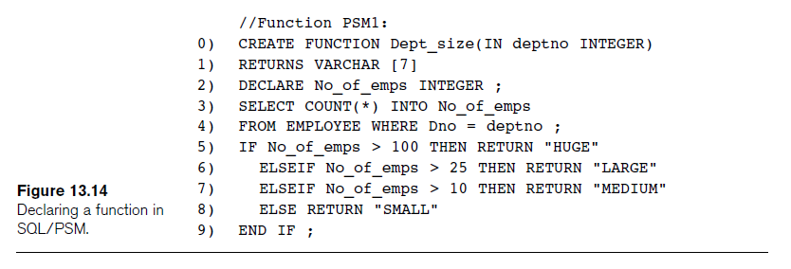
SQL/PSM (cont’d.)

Slide 42
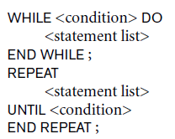

SQL/PSM (cont’d.)
Constructs for looping
LEAVE <loop name> to break loop when condition is satisfied

Slide 43
Comparing the Three Approaches
Embedded SQL Approach
  Query text checked for syntax errors and validated against database schema at compile time
  For complex applications where queries have to be generated at runtime
    Function call approach more suitable

Slide 44
Comparing the Three Approaches (cont’d.)
Library of Function Calls Approach
  More flexibility
  More complex programming
  No checking of syntax done at compile time
Database Programming Language Approach
  Does not suffer from the impedance mismatch problem
  Programmers must learn a new language

Slide 45
Summary
Techniques for database programming
  Embedded SQL
  SQLJ
  Function call libraries
  SQL/CLI standard
  JDBC class library
  Stored procedures
  SQL/PSM

