Slide 1
Investment Advisor
Team Members:
Devraj Jadeja
Gaurav Aggarwal
Neha Sirohi
Pulkit Sharma

Slide 2
Introduction

Slide 3
Project Objective:
Finding our client’s potential investment amount for further investing in stocks.
Analysing data provided by BSC to evaluate the risk involved to invest in top 500 companies.
Recommending top 5 companies to invest in as per customer’s risk taking capacity.
Additionally, we had to look into the KPI’S to identify the top stock in various sectors.

Slide 4
Tools used for Project
Python(Numpy & Pandas)
Google Sheets
Gspread API
Microsoft Excel

Slide 5
Adjustments
Some columns had null values ,populated it with 0 .
Income in negative(Income updated from 100 to 10000)
There were no result for high Risk taking profile, kept it as it is.

Slide 6
Dashboard

Slide 7
Different KPI’s
Dividend yield(%)
Earning yield(%)
EV/EBITDA
Company having the dividend yield between 2% and 5% are considered good.
the best-yielding do better than that, often around 4% to 5%.
Earnings yield is the inverse of the P/E ratio. Earnings yield is one indication of value; a low ratio may indicate an overvalued stock, or a high value may indicate an undervalued stock.
The lower the EV-to-EBITDA ratio, the more attractive the company may be as a potential investment.
As a general guideline, an EV/EBITDA value below 10 is commonly interpreted as healthy and above average

Slide 8
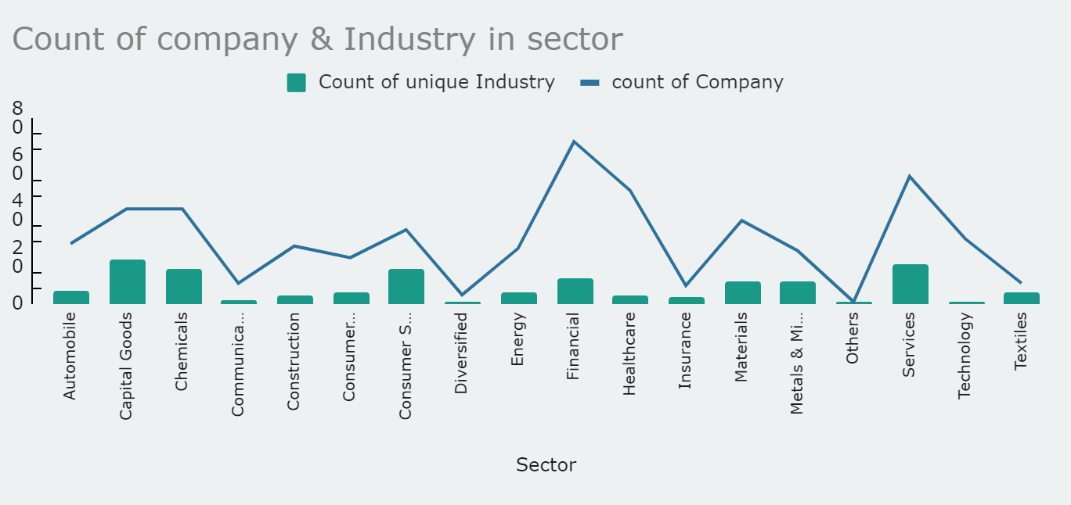
Insights

Slide 9
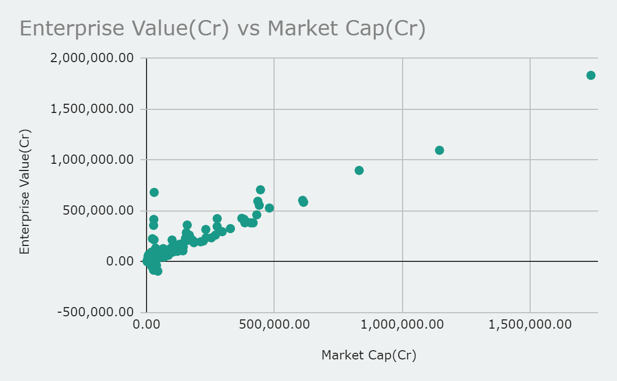
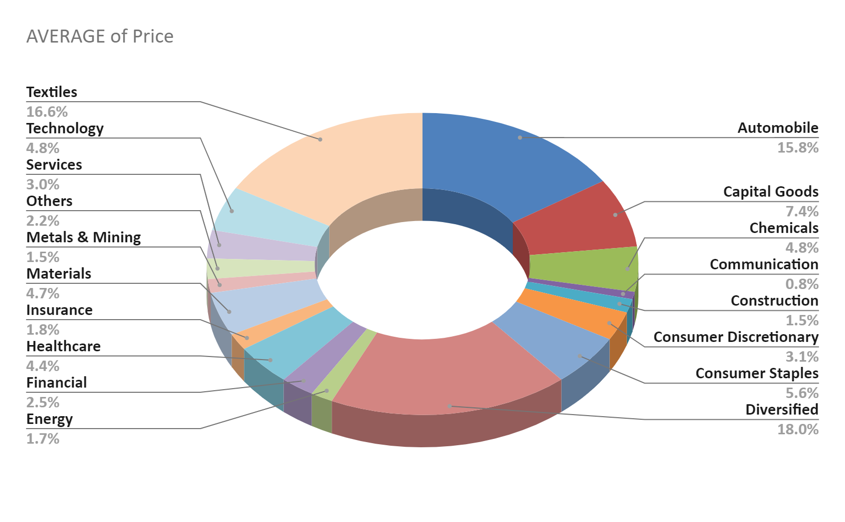
Insights
35
25
15

Slide 10
Challenges
Irregular dataset
The data set has Noise and missing values
Amount to be invested is in negative
API
Integration of Google sheets with Jupyter Notebook and automations in it.
Making KPI
Figure out the best KPI which are suitable according to the data to demonstrate.
New to finance
As we don't know about the stock and finance we face some issue in the selection of stocks.

Slide 11
Learning Outcomes(of Team)
API integrations
Learn to connect Google Sheet with Jupyter
Learn about GSPREAD library in python
Learning Of Finance
Get to know about the finance and Stock.
Team Management
Learn to work in a team
Learn to put different thoughts together
Automations
How to automate a google sheets(google Developer) with the help of jupyter notebook.

Slide 12
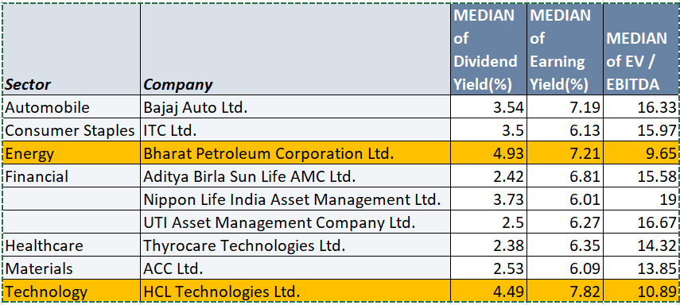
Conclusions
The best stock to invest in is Bharat petroleum and HCL technologies because all the condition as per the KPI are fulfilled :-
Dividend yield should be between 2% to 5%.
Earning yield should be close to 7.
EV/EBITDA should be close to 10.

Slide 13
References
https://docs.gspread.org/en/latest/
https://www.getsmarteraboutmoney.ca/invest/investment-products/stocks/6-indicators-used-to-assess-stocks/
https://www.wallstreetmojo.com/key-performance-indicators/
https://tradebrains.in/financial-ratio-analysis-must-know/
https://stackoverflow.com/questions/73136200/extract-values-from-pandas-groupby-into-a-new-dataset-combining-single-values
https://stackoverflow.com/questions/16675258/python-gspread-how-can-i-update-multiple-cells-with-different-values-at-once

Slide 14




The Team
Devraj Jadeja
PD13_135
Gaurav Aggarwal
PD14_012
Neha Sirohi
PD14_008
Pulkit Sharma
PD14_ 054

