Slide 1
INTRODUCTION TO BIOENGINEERING (BBL1020)
Control in living systems

Slide 2
Gene expression
control of cell division
Hormones, signals & receptors
feedback control
control failure & disease

Slide 3
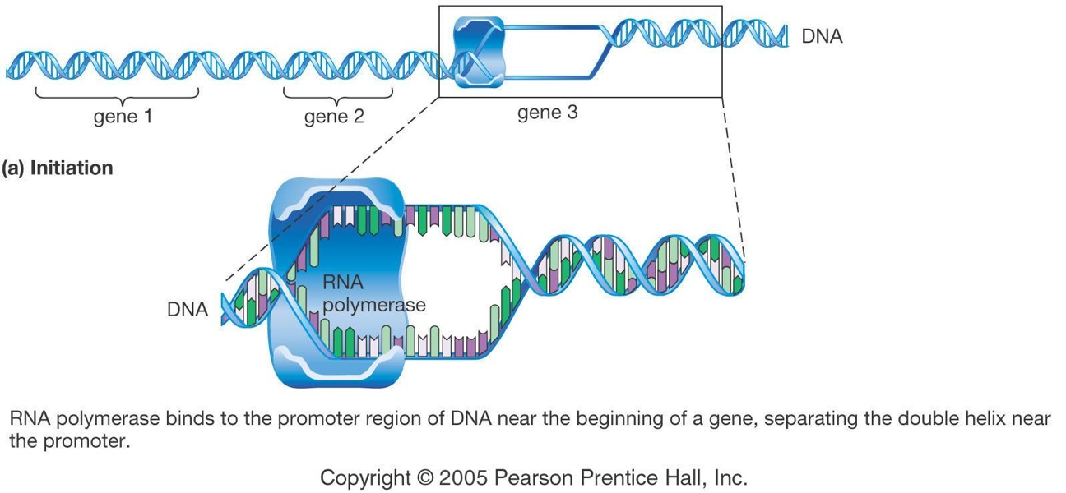
Transcription
RNA polymerase is the enzyme responsible for making mRNA copies of genes. DNA unzips at the site of the gene that is needed.

Slide 4
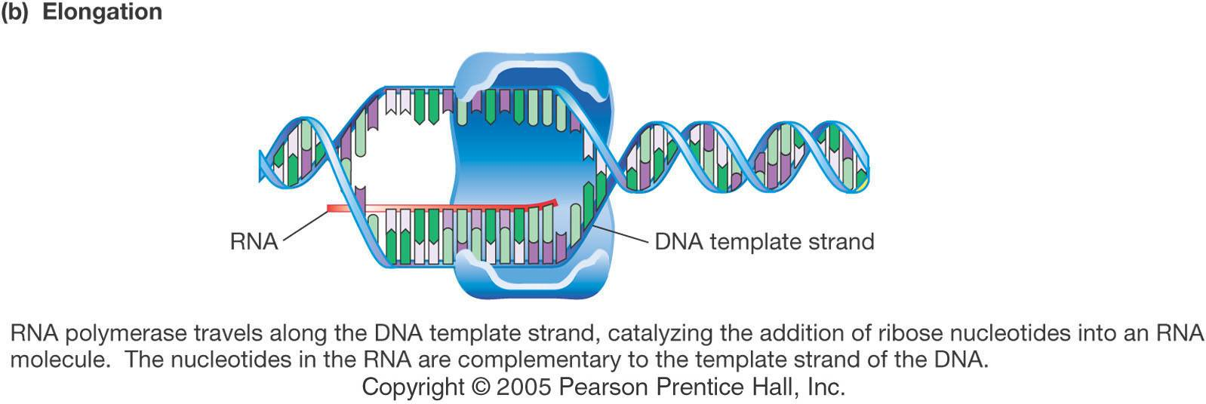
Transcription
RNA polymerase matches bases in the sense strand with RNA bases, building a strand of mRNA that carries the information encoded in the DNA.

Slide 5
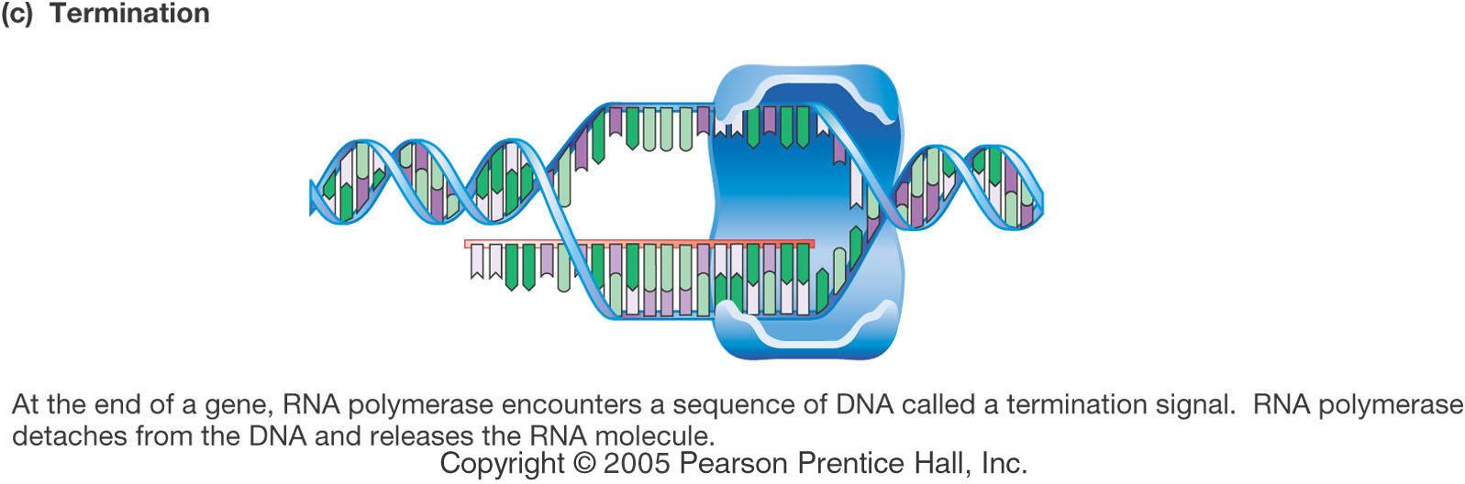
Transcription
Encoded in DNA is a signal telling RNA polymerase where to stop. Transcription ends at that point.

Slide 6
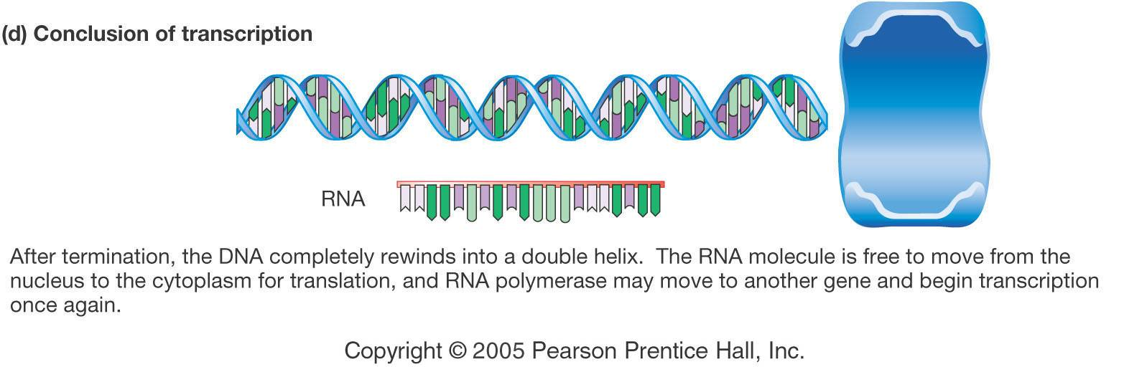
Transcription
The completed mRNA molecule then moves from the nucleus to the rough ER for translation.

Slide 7
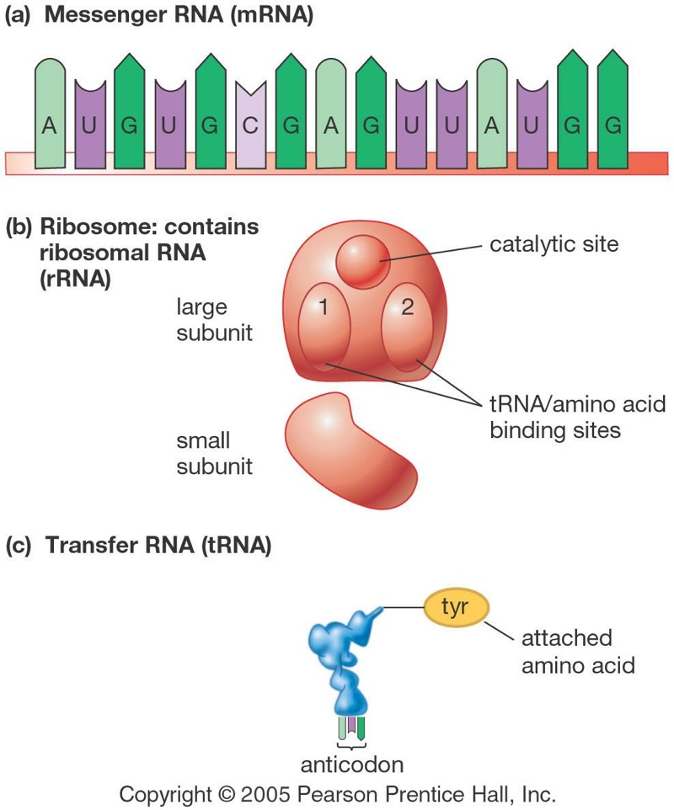
mRNA carries the information from a gene in DNA.
Ribosomes, made of rRNA, consist of subunits and carry out an enzyme-like role.
tRNA carries specific amino acids to the ribosome.

Slide 8
Regulation of Transcription
https://youtu.be/uths1TU1N_c
https://www.biointeractive.org/classroom-resources/regulation-eukaryotic-dna-transcription

Slide 9
Translation

Slide 10
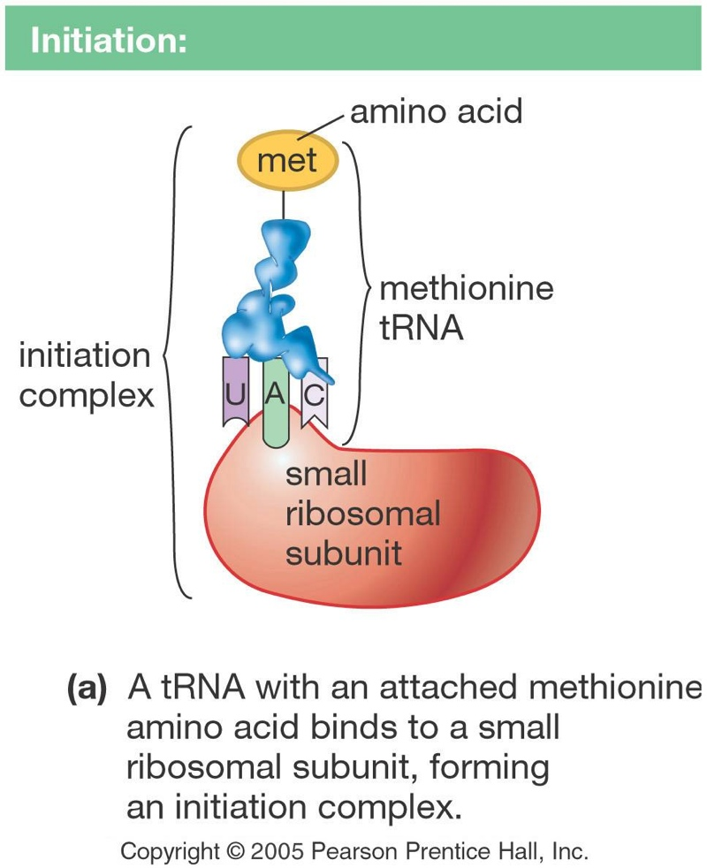
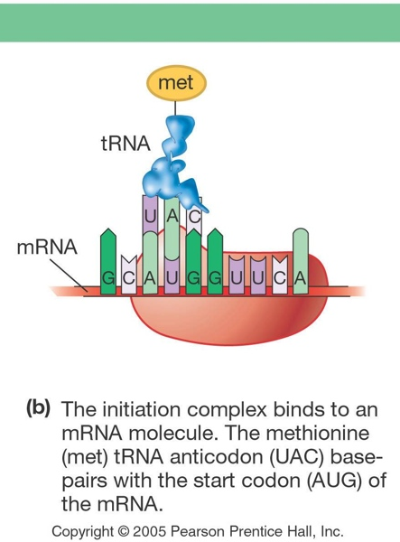
Translation

Slide 11
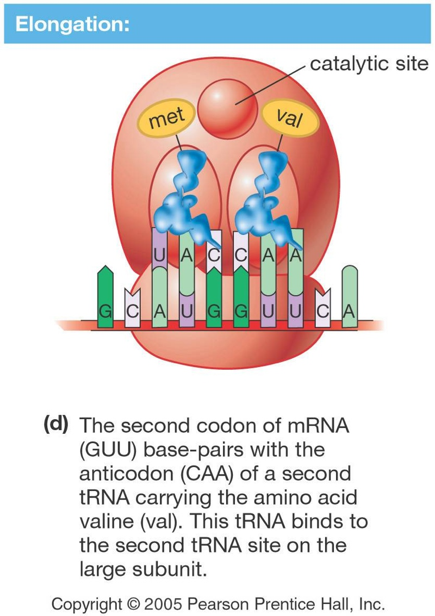
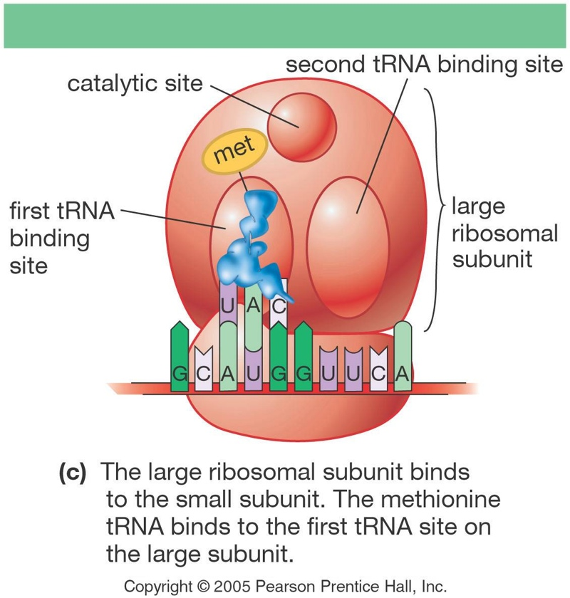
Translation

Slide 12
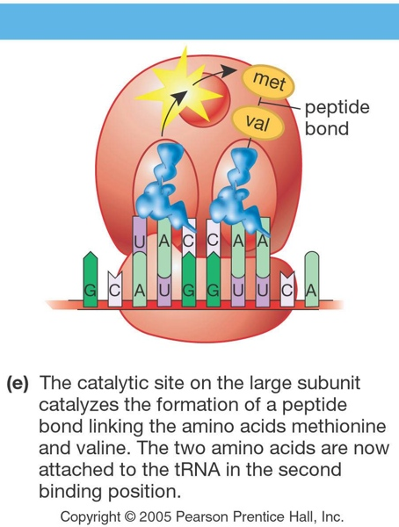
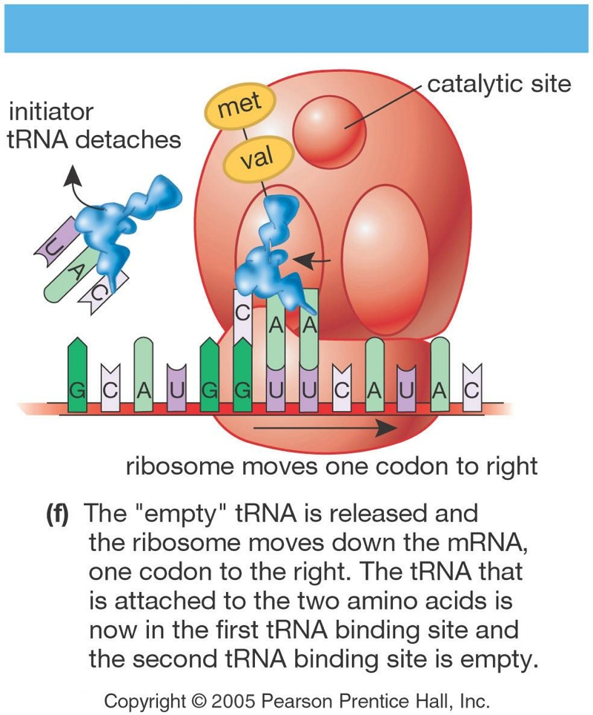
Translation

Slide 13
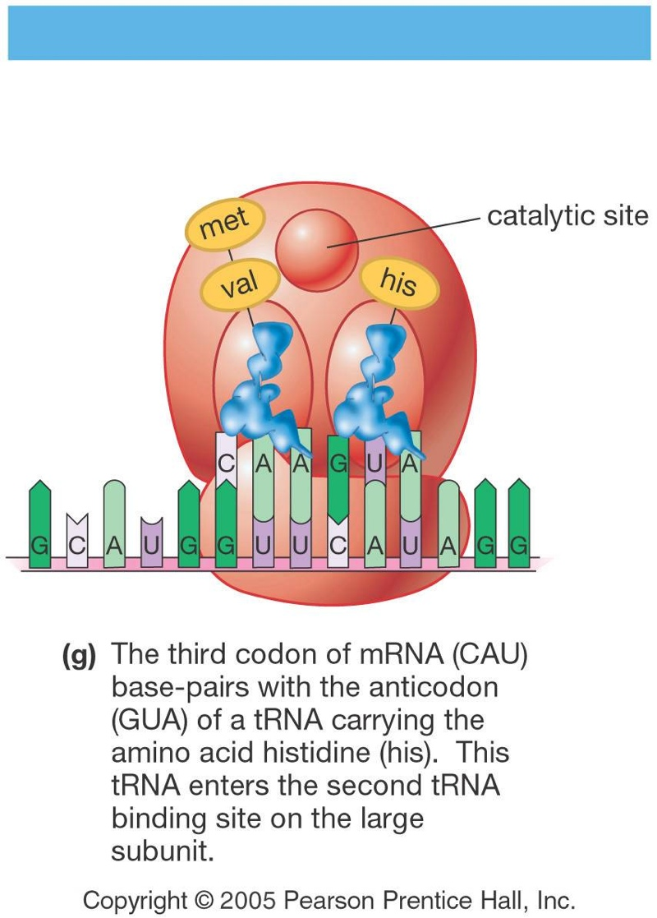
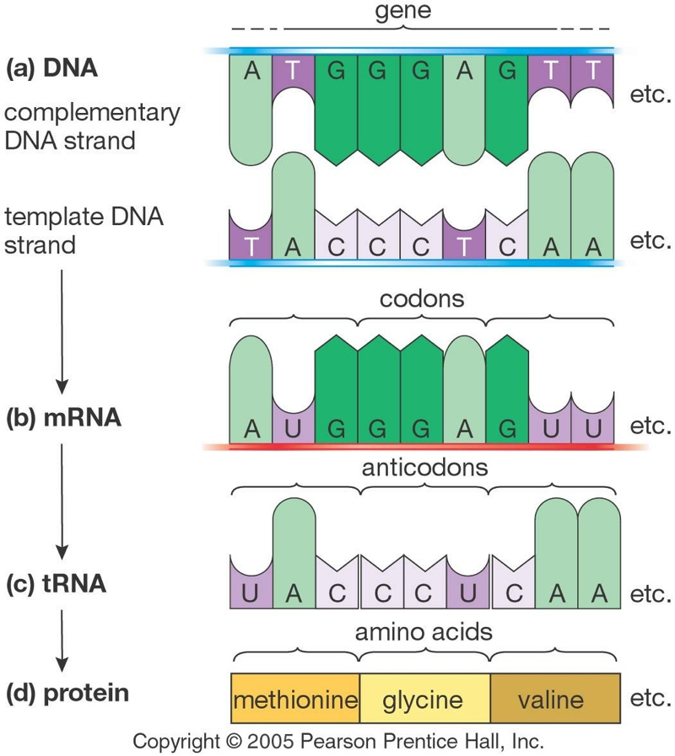
Translation
Summary

Slide 14
https://www.biointeractive.org/classroom-resources/translation-basic-detail

Slide 15
https://youtu.be/Pv4Ca-f4W9Q?t=23

Slide 16
Thank you

