Slide 1
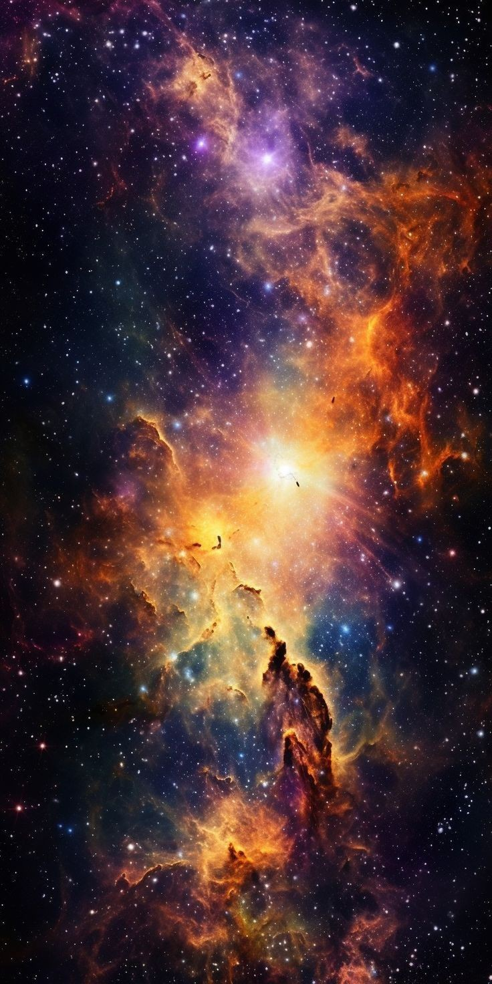
STELLAR ATLAS

Slide 2

About the website
Stellar atlas in a dedicated Platform for Exoplanet enthusiasts,students and researchers.The website is designed to offer interactive tools and a rich database of exoplanetery information , making complex astronomical data accessiable.
stelleratlas.com
fostering curiosity and understanding of worlds beyond our solar system.

Slide 3

What are exoplanets ?
Exoplanets are planets that orbit stars outside of our solar system.“
StellarAtlas provides articles and resources that explain why exoplanet research is one of the most exciting fields in astronomy today.
StellarAtlas uses visual aids, such as diagrams, artist renderings, and 3D models of exoplanets, to help users visualize these distant worlds.
Reference well-known exoplanets, such as Kepler-186f or Proxima b, as case studies for explaining what exoplanets are and how they are categorized.
StellarAtlas features profiles on specific exoplanets, complete with their properties (e.g., size, distance from Earth, atmosphere) to give users a better understanding.

Slide 4
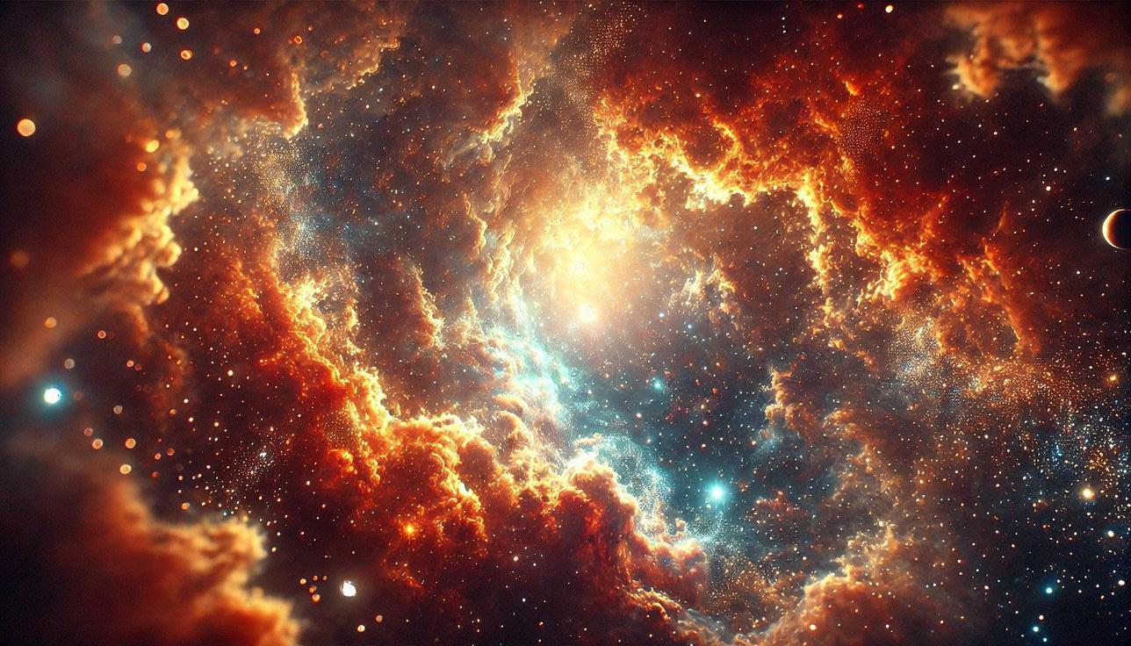
Example you could find about exoplanets
GJ 504b : Pink Jupiter
GJ 504b the planet is made of pink gas. It’s similar to Jupiter, a giant gas planet in our own solar system. But GJ 504b is four times more massive
Location:
GJ 504b is located in the constellation Virgo, 57 light-years from Earth. Mass:
GJ 504b is about four times more massive than Jupiter. Orbit:
GJ 504b orbits the G0-type star GJ 504 at a distance of nearly nine times the distance Jupiter orbits the sun. Its orbital period is 259.9 years.
J1407b : Super Saturn
The planet J1407b is the biggest ringed planet ever found, with a ring system that’s 200 times larger than Saturn
Location 433.8 light years from Earth in the constellation Centaurus Mass 20 times more massive than Saturn Ring system 180 million kilometers wide, with over 30 rings, each tens of millions of kilometers in diameter

Slide 5

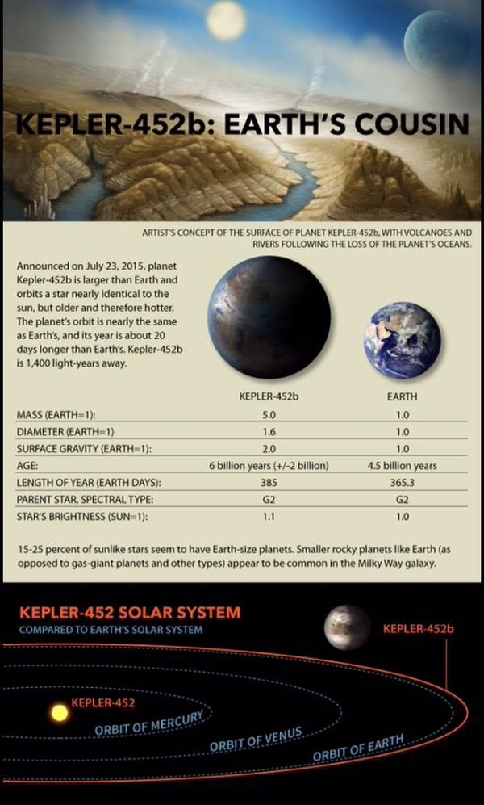
_{Mysterious planet:} _{kepler-452 b}
KEPLER-452 B
Location:
Kepler-452b is located in the constellation Cygnus, about 1,400 light-years from Earth.
Size Kepler-452b is about 1.5 times the size of Earth and has a mass at least five times greater.
Orbit Kepler-452b orbits its star every 385 days, which is similar to Earth’s orbital period of 365.25 days

Slide 6

Types of Exoplanets
StellarAtlas features in-depth profiles on different types of exoplanets, such as Gas Giants, Super-Earths, and Ice Giants.
This website showcase how users can browse through detailed descriptions and images of these planets, alongside comparison charts.
The website categorizes exoplanets based on their size, composition, and distance from their host star, making it easier for users to understand the diversity of these distant worlds.
StellarAtlas features in-depth profiles on different types of exoplanets, such as Gas Giants, Super-Earths, and Ice Giants.
This website showcase how users can browse through detailed descriptions and images of these planets, alongside comparison charts.
The website categorizes exoplanets based on their size, composition, and distance from their host star, making it easier for users to understand the diversity of these distant worlds.

Slide 7

Habitable Zones and the Search for Life
This slide will explain how StellarAtlas guides users through the concept of the “habitable zone”-the region around a star where liquid water could exist.
Highlight how the website showcases exoplanets like Proxima-b, and others that could potentially support life.
The website features an interactive tool where users can visualize the position of exoplanets within habitable zones of their respective stars.

Slide 8

Conclusion
Conclusion
Recap: Highlight how Stellar Atlas offers interactive tools, educational resources, and up-to-date information on exoplanets, making the vast field of astronomy accessible to everyone.
Importance: Emphasize that Stellar Atlas connects users to the latest in exoplanet research, allowing them to explore distant worlds and stay informed on new discoveries.
Future Growth: Mention how the website will continue to expand with upcoming research and technological advancements, like the James Webb Space Telescope
Call to Action: Encourage the audience to visit StellarAtlas and start exploring the universe of exoplanets themselves.

Slide 9


