Slide 1
SEMEVAL-2026 TASK 6 · CLARITY
Knowledge over Structure
ONE DEV ITEM
A controlled study of response clarity classification in political interviews
Sub-question
Would you campaign against Senator Joe Lieberman on Iraq?
Answer
“I’m going to stay out of Connecticut.”
Mid-evaluation progress: from a DeBERTa baseline to a LoRA-tuned 8B classifier
Subtask 2 (9 evasion types)
Dodging, Dodging, Implicit
Team Nier_ANLP
Vidvathama R (2024122002)
Siddarth Gottumukkula (2023102040)
Sanjana Reddy Vonteri (2026901007)
Shashikanta Sahoo (2026900007)
Subtask 1 (3 clarity levels)
Ambivalent
International Institute of Information Technology, Hyderabad · October 2026
Notes:
Title. The task: given an interview question and the politician's answer, classify how the answer responds. The example on the right (dev item 17, three annotators) returns later as our annotated failure case. Source: Report/Report.pdf, title page and Figure 4.

Slide 2
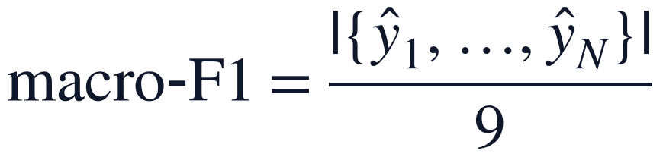
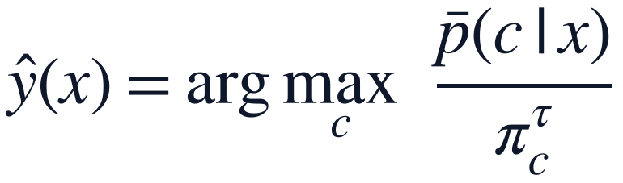
Label how an answer responds to one sub-question
PROBLEM FORMULATION
Input: sub-question q (15 tokens), full question Q (62), answer a (266).
Subtask 2 predicts one of 9 evasion types; Subtask 1 follows through g.
69% of train rows share an answer; 71.7% of those differ in label.
Dev: 308 items, 3 annotators, only 125 unanimous. Test labels never released.
Input and label maps
$$x=\left(q,Q,a\right), f:𝒳→𝒴_{9}, g:𝒴_{9}→𝒴_{3}$$
Multi-reference macro-F1, when every prediction is in its item's reference set
$$macro-F1=\frac{\left|\left\{{\hat{y}}_{1}, …, {\hat{y}}_{N}\right\}\right|}{9}$$
Decision rule used by every system (τ fitted by nested CV)
$$\hat{y}\left(x\right)=\underset{c}{arg max}{\frac{\overline{p}\left(c | x\right)}{π_{c}^{τ}}}$$
Clarification (4 dev reference sets) therefore weighs as much as Explicit (115): the score rewards landing in-set and naming every class.
Notes:
Each item is a triple: the sub-question q, the journalist's full turn Q, and the full answer a. Subtask 2 asks for one of nine evasion types; Subtask 1's three clarity levels follow through the fixed taxonomy g. The metric is multi-reference macro-F1: a prediction is a true positive if any annotator gave that label; a miss charges a false negative to every label in the reference set. If every prediction is acceptable, the score equals the number of distinct classes predicted over nine, so naming every class matters. Sources: Report §2, Table 1; docs/01_scorer_geometry.md.

Slide 3
Encoders plateau; the winners call an LLM per item
BASELINES AND STATE OF THE ART
Fine-tuned encoders plateau near 0.50 test S2, whatever their size or ensembling.
Winners run multi-call LLM pipelines: 1.94 calls, ~7,300 input tokens per item.
Published systems change several components at once; gains cannot be attributed.
Our question: what limits a single-pass classifier on this task?
System (dev set) | Type | S2 | S1
Always “Explicit” | floor | 0.060 | 0.136
Uniform random | floor | 0.129 | 0.299
TF-IDF + logistic regression | classical | 0.257 | 0.445
ChulaNLP, DeBERTa-large fine-tune | encoder | 0.46 | 0.65
TeleAI, Qwen2.5-7B fine-tune | single-pass LLM | 0.495 | –
ChulaNLP, DeBERTa top-5 + Kimi-K2 | hybrid | 0.52 | –
TeleAI, 3-stage DeepSeek-V3 (1st) | multi-call LLM | 0.617 | 0.812
Human annotator vs. other two | ceiling | 0.684 | –
Floors: docs/raw/mideval/trivial_baselines.csv. Published rows are dev scores from each team's paper, under their own protocols.
Notes:
Fine-tuned encoders level off near 0.50 test S2 in the organisers' overview, however large or ensembled. The top systems are multi-call LLM pipelines: TeleAI makes 1.94 calls per item with about 7,300 input tokens. Published systems change many components at once, so their gains cannot be attributed. Our question is narrower: what limits a single-pass classifier? Floors: docs/raw/mideval/trivial_baselines.csv. Published rows: each team's paper, dev set, own protocol.

Slide 4
One classifier, one swappable backbone, one fitted scalar
PROPOSED ARCHITECTURE
Four candidate limits: label noise, decision rule, knowledge, or label meaning.
One flat 9-way head; Subtask 1 derived through the fixed taxonomy g.
System = 10-seed probability mean + one-parameter logit adjustment.
Swappable backbone tests knowledge with everything else held fixed.
Input x = (q, Q, a)
sub-question + full question + answer, ≤ 1,024 tokens
backbone (one of)
DeBERTa-v3-large
full fine-tune, [CLS] pooling
Qwen3-8B-Base + LoRA
r = 16, last-token pooling
Linear head: 9 logits, softmax per seed
Mean of the 10 seeds' probabilities
Logit adjustment: argmax of p / prior^τ (τ by nested CV)
Subtask 2
evasion type (9)
g
Subtask 1
clarity level (3)
Redrawn from Report Figure 1. Accent boxes: the one component that differs between the two tracks.
Notes:
Four explanations predict different things: label noise, the decision rule, missing knowledge, or label meaning that cannot be learnt from 3,448 examples. The system is built so each can be tested by one change. A flat 9-way head; Subtask 1 is read off through g. A system averages ten seeds and applies logit adjustment, the only parameter fitted on dev. The backbone box is the one component the E13 experiment swaps. Source: Report §1 and Figure 1.

Slide 5
Every claim rests on ten paired seeds and a fixed bar
EVALUATION PROTOCOL
Epoch chosen on a fixed 345-row train slice; dev never selects anything.
Only dev-fitted parameter is τ, chosen by 5-fold nested cross-validation.
Seeds 0–9 paired across configurations: same head initialisation and data order.
Hypotheses and predicted outcomes logged before every run.
Register hypothesis and predicted outcome
Change one component against a named control
Screen on 3 paired seeds
below
Log as negative,
with its mechanism
gain ≥ +0.015, 2 of 3 seeds up
The bar is fixed before each run.
Extend to 10 paired seeds
System: 10-seed ensemble + logit adjustment
Report paired Δ, t, seeds up,
bootstrap 95% CI, 2-annotator rescoring
Notes:
The epoch is chosen on a fixed 10% slice of train (345 rows); dev never selects anything. The only parameter fitted on dev is tau, by 5-fold nested cross-validation, so reported scores are held out. Seeds 0-9 fix head initialisation and data order, so they are paired across configurations. Each variant is screened on three seeds against a bar fixed in advance (+0.015 with 2 of 3 seeds up). Source: Report §2, docs/02_experiment_log.md.

Slide 6
A sound baseline took a library fix and three attempts
ITERATION 1 · STEPS 0–2, E0
DeBERTa-v3-large: sub-question + answer, 512 tokens, 8 epochs, plain cross-entropy.
Library loaded fp16 weights; attention overflowed, loss stuck at 1.887.
Fixed by an explicit fp32 load: baseline S2 0.337 ± 0.044, 5 seeds.
A 5-epoch rerun scored 0.223: schedule truncation, not a bad idea.
# code/models/encoder.py:176
# transformers 5.x loads DeBERTa-v3 in its stored fp16;
# the model then predicts "Explicit" for every item.
self.enc = AutoModel.from_pretrained(
name, dtype=torch.float32)
Seed | 0 | 1 | 2 | 3 | 4
Dev S2 | 0.389 | 0.339 | 0.279 | 0.311 | 0.368
Dev S1 | 0.642 | 0.580 | 0.532 | 0.596 | 0.579
Mean S2 0.337 ± 0.044 · S1 0.586 ± 0.039
E0c, docs/raw/E0_analysis.txt. A seed spread of 0.28–0.39 forces paired multi-seed comparisons from here on.
Notes:
The first runs did not learn: transformers 5.x loads DeBERTa-v3 in its stored fp16 weights, attention overflowed and the loss sat at 1.887 while the model predicted Explicit for everything. Loading in fp32 fixed it. A 5-epoch rerun scored 0.223 because the cosine schedule spans the run: a budget problem, not a bad idea, a pattern that recurs. The 8-epoch baseline is 0.337 +/- 0.044 on five seeds. Sources: docs/02_experiment_log.md Steps 1-2 and E0; docs/raw/E0_analysis.txt.

Slide 7
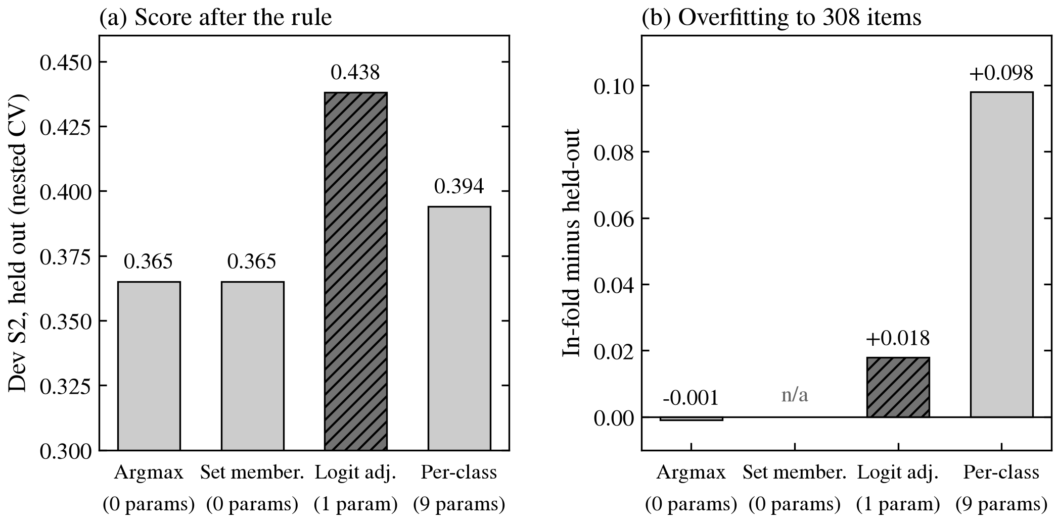
The ranking is better than the decision
ITERATION 2 · E2–E4
5-seed ensemble lifts S2 from 0.337 to 0.365.
Acceptable label in the top 3 for 90% of items (oracle 0.745).
One-scalar logit adjustment: 0.438 held out, overfit gap only 0.018.
Nine per-class weights overfit 308 items: gap +0.098.
E4 on the E0 5-seed ensemble; every score held out by nested CV. Hatched: the rule kept for every later system.
Notes:
Averaging the five baseline seeds lifts S2 from 0.337 to 0.365. An acceptable label is in the top three for 90% of items, an oracle of 0.745, so the decision is the weak point. One-scalar logit adjustment reaches 0.438 held out and barely overfits (in-fold minus held-out 0.018). Nine per-class weights, the metric-optimal rule in theory, overfit 308 items by 0.098. Logit adjustment joins every later system. Source: docs/02_experiment_log.md E2-E4.

Slide 8
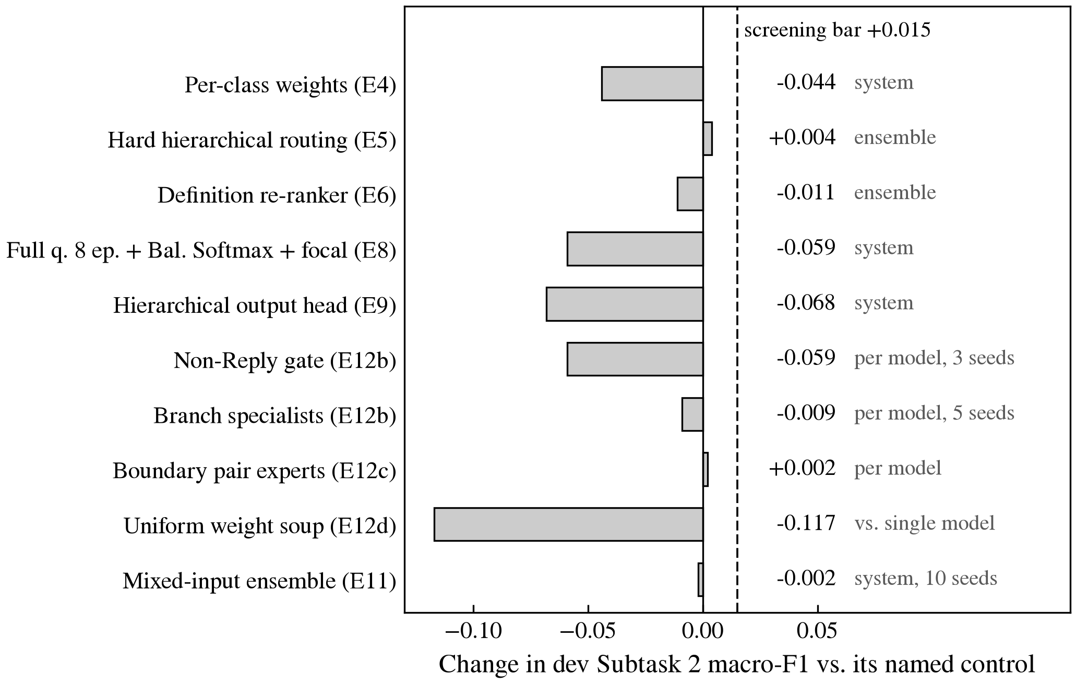
Structure, rebalanced losses and soups do not help
ITERATION 3 · E5–E12
Three hierarchies (routing, factorised head, gate + specialists): none beats flat softmax.
Definition re-ranker 0.354 vs. 0.365: same 3,448 examples, no new knowledge.
Weight soups fail: seeds differ in head initialisation and data order.
Balanced Softmax + focal over-corrects: Explicit F1 falls 0.679 to 0.319.
Each variant against its own named control (docs/02_experiment_log.md); the comparison level is printed beside each bar.
Notes:
Ten variants, each against its own named control; none clears the +0.015 screening bar. Three hierarchies fail because a flat softmax already scores all nine labels jointly. The definition re-ranker learns from the same 3,448 examples, so it has no knowledge the first model lacks. Weight soups fail because seeds differ in head initialisation and data order. Balanced Softmax with focal loss over-corrects (Explicit F1 0.679 to 0.319); note E8 also changed the input. Source: docs/02_experiment_log.md E4-E12, Report §4.

Slide 9
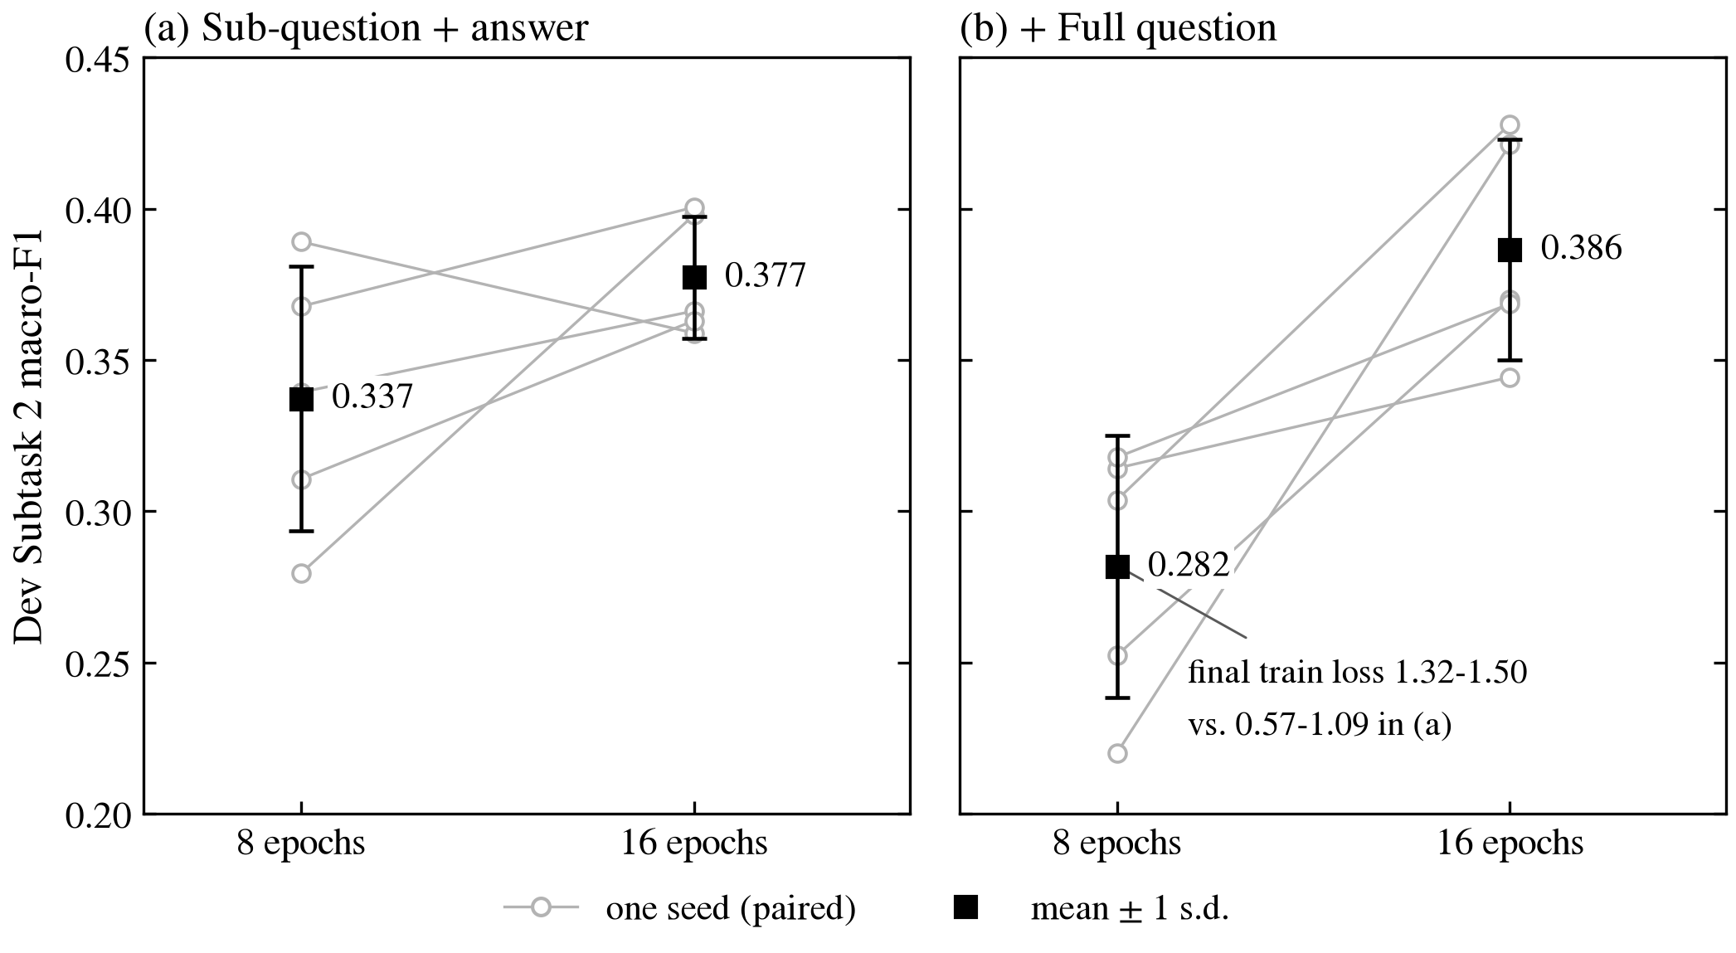
A negative result that was really undertraining
ITERATION 4 · E7–E10
E7: a comparable published DeBERTa (0.46) sees the full journalist question.
E8b: full question at 8 epochs scored below baseline (0.282 vs. 0.337).
Diagnosis: train loss 1.32–1.50, low confidence (top-p 0.445 vs. 0.594).
E10: 16 epochs reverse it; full question gives the best single model.
Single-model dev S2, seeds 0–4, paired: E0 → E10 control (a), E8b → E10 (b).
Notes:
E7: ChulaNLP's comparable DeBERTa (0.46) sees the full journalist question, which ours did not. Adding it at 8 epochs (E8b) scored below the baseline, 0.282 against 0.337. The run reports showed why: final train loss 1.32-1.50 against 0.57-1.09, and low confidence (mean top probability 0.445 vs 0.594). At 16 epochs (E10) the same input gives the best single model. E8's first diagnosis, the loss, was revised after this one-change control. Source: docs/02_experiment_log.md E7-E10; per-seed scores from runs/*/seed*/metrics.json.

Slide 10
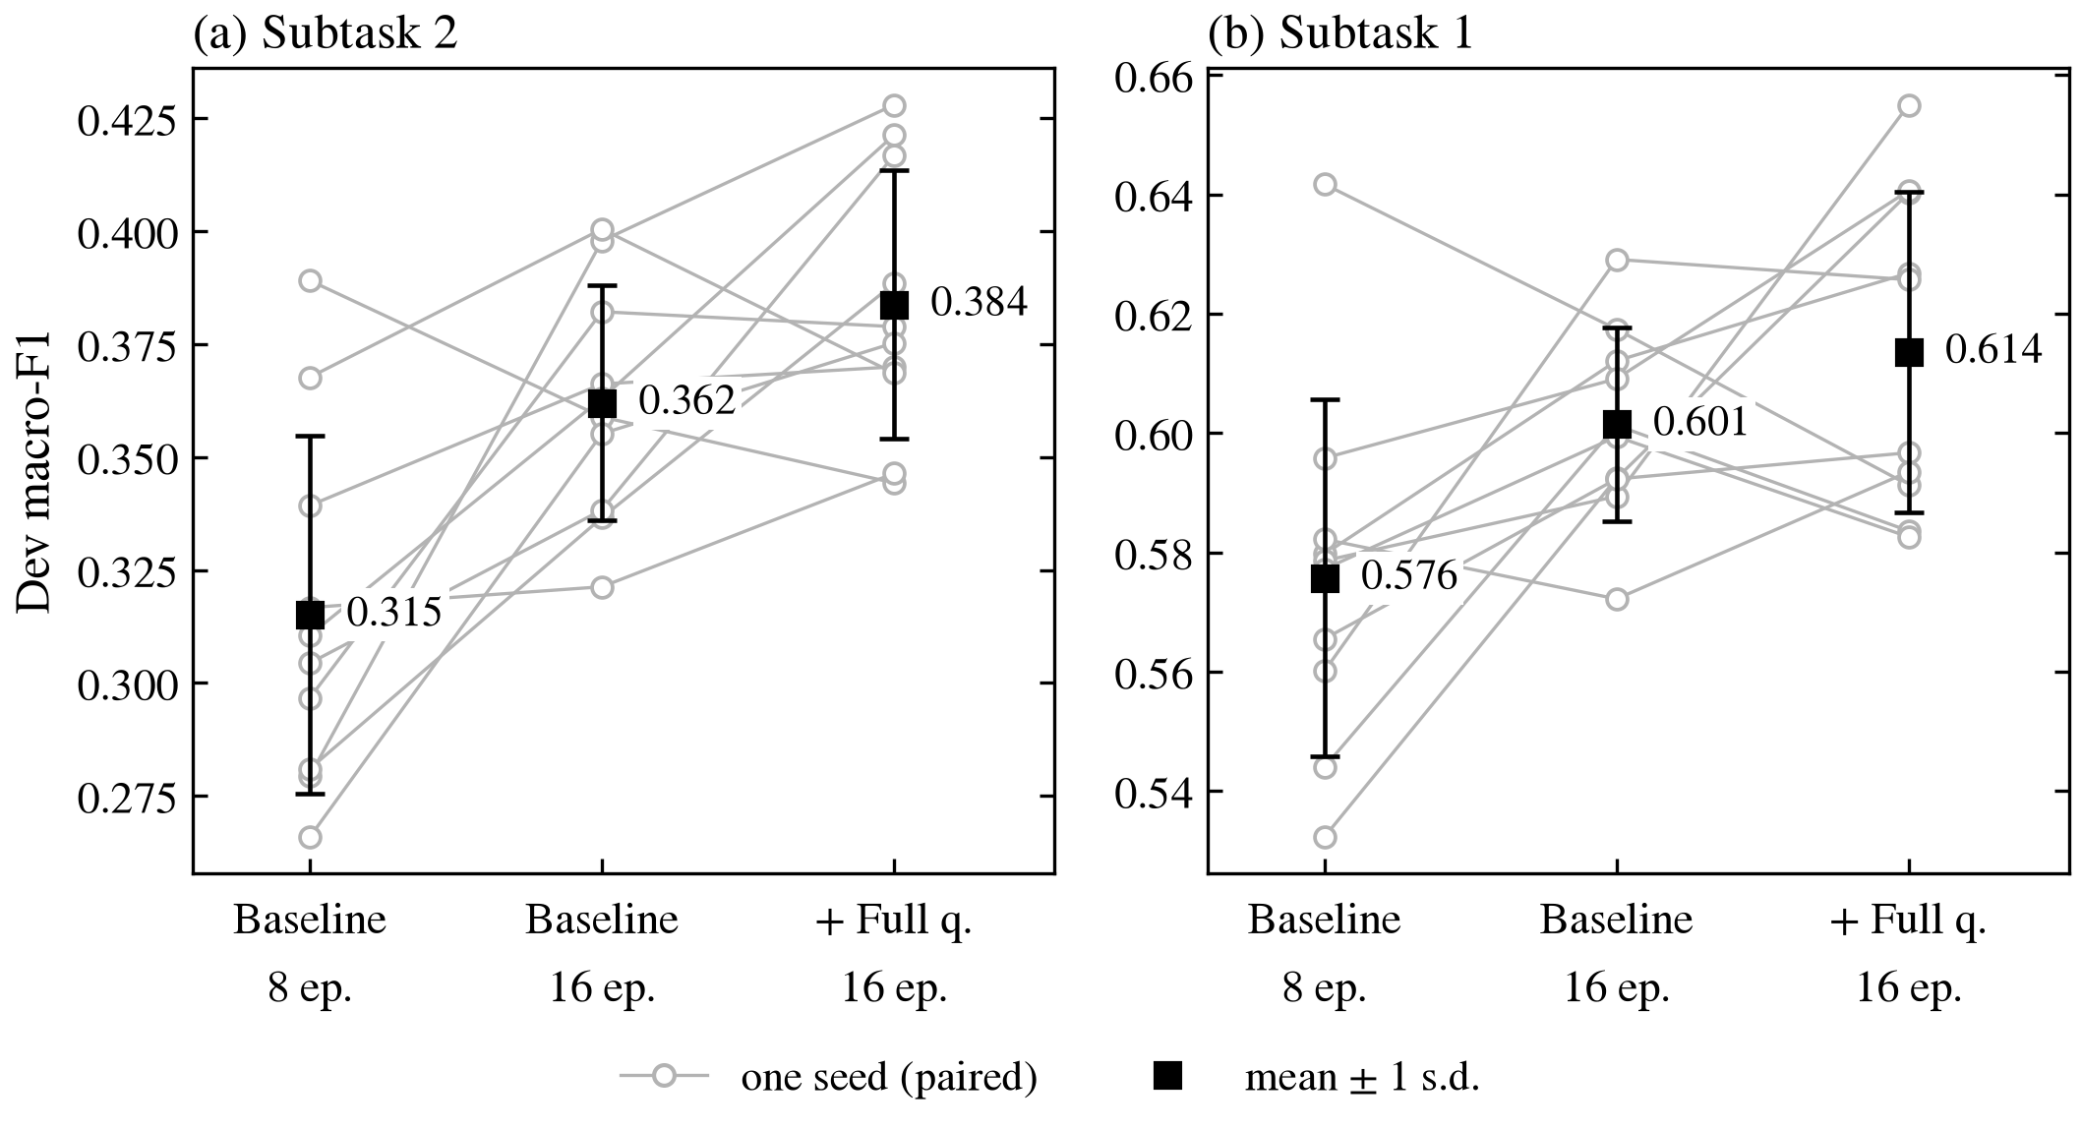
Per-model gains replicate; five-seed systems do not
ITERATION 5 · E10–E11
E11 reruns all three configurations on seeds 5–9: ten paired seeds.
Per model: S2 0.315 → 0.384, S1 0.576 → 0.614, 9 of 10 seeds up.
Five-seed systems swing 0.08; E10's 0.478 fell to 0.434 on new seeds.
Final DeBERTa system, by pre-registered rule: 0.405 S2, 0.648 S1.
Report Figure 2. Open circles: one seed, paired across configurations; squares: mean ± 1 s.d. over 10 seeds.
Notes:
E11 reruns all three configurations on seeds 5-9, giving ten paired seeds. Per model the two changes add +0.069 S2 and +0.038 S1, each on 9 of 10 seeds. Systems are another matter: the baseline system scored 0.438 on seeds 0-4 and 0.356 on seeds 5-9, and E10's 0.478 fell to 0.434. So all system claims use ten seeds. The final DeBERTa system, chosen by a rule fixed in advance, is full question + 16 epochs: 0.405 S2, 0.648 S1. Source: docs/raw/E11_replication.txt; Report Table 2, Figure 2.

Slide 11
Swapping only the backbone tests the knowledge hypothesis
ITERATION 6 · E13
Remaining hypothesis: the 0.4B encoder lacks knowledge, not rule or labels.
Swap DeBERTa for Qwen3-8B-Base with LoRA r = 16 on all linear layers.
Same rows, input, slice, loss and selection; a padding self-check guards the head.
Screen +0.081 (3/3), then ten seeds: S2 +0.092, S1 +0.095, 10/10.
Registered before the run, checked after
Prediction | Observed | Verdict
Passes the 3-seed screen | +0.081, 3 of 3 seeds | held
Single-model S2 in 0.43–0.50 | 0.476 ± 0.043 | held
S1 gain of +0.02 to +0.05 | +0.095 | exceeded
Gain on the commitment boundary | largest on Non-Reply types | wrong
Larger gain on agreed items | +0.076 agreed, +0.105 split | wrong
Predictions: docs/02_experiment_log.md §E13. Outcomes: docs/raw/E13_final_analysis.txt (in-set rate by annotator agreement).
Notes:
With the decision layer saturated and the error analysis pointing at the model, two explanations remain: knowledge or label meaning. A larger pretrained classifier tests knowledge with nothing else changed: same 3,103 rows, input, 345-row slice, loss and selection rule. LoRA r=16, alpha 32, on all attention and MLP projections; a new 9-way head on the last token; a padding self-check aborts any run whose head reads a pad token. Predictions were registered before the run. Sources: docs/02_experiment_log.md §E13, docs/raw/E13_final_analysis.txt, code/models/llm_classifier.py:124.

Slide 12
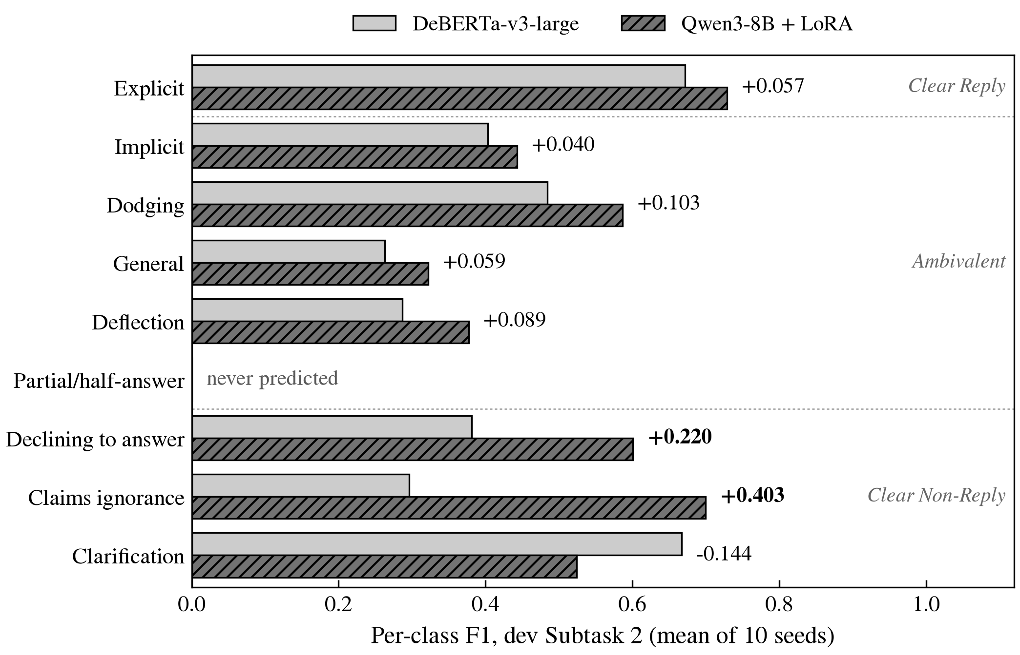
The 8B gain is broad, not on the expected boundary
ITERATION 7 · E13
Per-class F1 rises in 7 of 9 classes.
Largest gains on Non-Reply types: Claims ignorance +0.403, Declining +0.220.
Commitment classes move least: Implicit +0.040, Explicit +0.057.
In-set gain similar on agreed (+0.076) and split items (+0.105).
Report Table 4: single models averaged over the same 10 seeds; dashed lines separate the clarity levels.
Notes:
Per-class F1 rises in 7 of 9 classes. The largest gains are on the Non-Reply types, Claims ignorance +0.403 and Declining +0.220, which depend on recognising what kind of statement an answer is. The commitment classes we expected to gain most moved least. Clarification falls, but it has only 4 dev reference sets, and neither model ever predicts Partial/half-answer. Source: Report Table 4; docs/raw/E13_final_analysis.txt section D.

Slide 13
Longer training adopted; all-of-train unresolved
ITERATION 8 · E13B, E13C
12 epochs: slice F1 +0.084 on all three seeds; adopted by registered rule.
Selected epochs 8–11; train loss near 0.02 with no slice decline.
All of train: +0.017 per model (6/10); system interval spans zero.
Mixing Qwen and DeBERTa probabilities adds nothing (0.543 vs. 0.549).
Follow-up (one change) | Variant | Qwen, 3 ep. | Δ | Seeds up
12 epochs, single, S2 ‡ | 0.543 ± 0.015 | 0.462 ± 0.080 | +0.082 | †
All of train, single, S2 | 0.492 ± 0.045 | 0.476 ± 0.043 | +0.017 | 6/10
All of train, system, S2 | 0.575 | 0.543 | +0.028 | –
All-of-train system difference: 95% CI [−0.026, +0.092].
As with the encoder, its 3-seed screen (+0.039) overstated the gain.
Report Table 3 (bottom). ‡ seeds 0–2. † reported only: the 12-epoch choice was made on the train slice, not on dev.
Notes:
In the 3-epoch runs the last epoch was always selected, which under a cosine schedule proves little. With 12 epochs (seeds 0-2) the slice selected epochs 8-11 and slice F1 rose +0.084 on all three, so the registered rule adopted 12 epochs; dev S2 0.543 is reported, not used. Training on all 3,448 rows gave +0.017 per model on 6 of 10 seeds; its system interval spans zero and S1 fell 0.746 to 0.711. Mixing Qwen and DeBERTa probabilities adds nothing. Source: Report Table 3; docs/raw/E13_final_analysis.txt.

Slide 14
The backbone swap outweighs the whole encoder track
BENCHMARK RESULTS
Backbone swap alone exceeds the encoder track's gain (+0.092 vs. +0.069).
System S2 +0.136, 95% CI [+0.054, +0.224].
Holds on 2-annotator reference sets: 0.524 vs. 0.382.
Logit adjustment adds +0.062 per Qwen model, +0.005 for DeBERTa.
System (dev) | S2 | S1
DeBERTa baseline, single model | 0.315 ± 0.040 | 0.576 ± 0.030
DeBERTa, full question + 16 ep., single | 0.384 ± 0.030 | 0.614 ± 0.027
DeBERTa, 10-seed system | 0.405 | 0.648
Qwen3-8B + LoRA, single model | 0.476 ± 0.043 | 0.709 ± 0.031
Qwen3-8B + LoRA, 10-seed system | 0.543 | 0.746
TeleAI, 1st place (multi-call) | 0.617 | 0.812
Human annotator vs. other two | 0.684 | –
Single model: mean ± s.d. over 10 seeds. System: 10-seed ensemble + logit adjustment, first nested-CV split.
Notes:
Per model, Qwen adds +0.092 S2, more than the entire encoder track gained (+0.069 from 0.315 to 0.384). The 10-seed system gain is +0.136 with a bootstrap 95% CI of [+0.054, +0.224], and it holds on the three two-annotator reference sets that mimic the test regime (0.524 vs 0.382). Logit adjustment matters more for Qwen, whose raw predictions lean to frequent classes (General predicted for 24 items but in 113 reference sets). System numbers here use the first nested-CV split. Sources: Report Table 3; docs/raw/E13_final_analysis.txt; README §6.

Slide 15
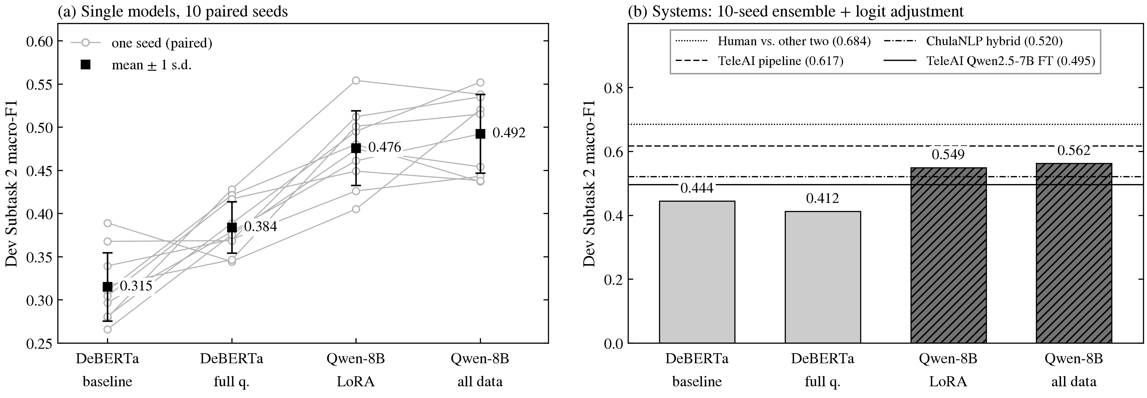
Between published single-pass and multi-call systems
BENCHMARK RESULTS
Report Figure 3. (b) bars: mean over 10 nested-CV splits; horizontal lines: published dev results.
Above TeleAI's fine-tuned 7B (0.495) and ChulaNLP's hybrid (0.52); 0.074 below the 1.94-call winner, with zero LLM calls.
Notes:
Panel (a): every Qwen seed beats its paired DeBERTa seed. Panel (b): the systems against published dev results. Bars here are the mean over 10 nested-CV splits (0.412 and 0.549), slightly different from the first-split numbers in the table. The Qwen system sits above TeleAI's fine-tuned Qwen2.5-7B and ChulaNLP's hybrid, and 0.074 below TeleAI's winning pipeline, while making no LLM calls. Those systems follow other protocols. Source: Report Figure 3.

Slide 16
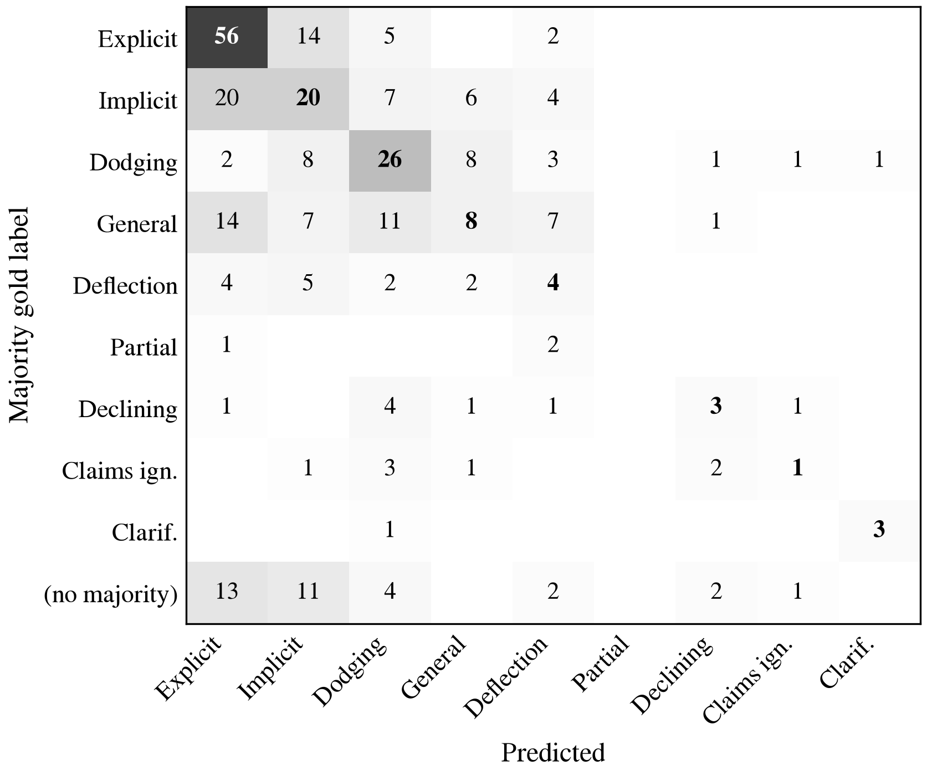
The model fails, not the labels
FAILURE ANALYSIS
137 of 308 predictions miss the reference set; 53 on unanimous items.
Annotator vs. other two: 0.684; ensemble: 0.380.
Top error pairs: Implicit→Explicit 25, General→Implicit 20, General→Explicit 20.
Length hurts: the 20 inputs still truncated land in-set 20% vs. 58%.
Final DeBERTa 10-seed ensemble, argmax, rows = majority gold. Bold: correct.
Notes:
Of the final DeBERTa ensemble's 308 predictions, 137 miss the reference set, and 53 of those are on items all three annotators agreed on. Scored like the test set, each annotator against the other two reaches 0.643-0.766 (mean 0.684), the ensemble 0.380. The biggest error pairs concern how committed an answer is. Long inputs hurt: the 20 inputs still cut at 1,024 tokens land in-set 20% of the time. The matrix uses majority gold; the error-pair counts use reference sets. Source: Report §6; docs/raw/mideval/mideval_analysis.txt, confusion_final.csv.

Slide 17
One answer that needs world knowledge
FAILURE EXAMPLE AND LIMITATIONS
Dev-only evaluation: 308 items, so system differences carry wide intervals.
Labels moderately reliable: Fleiss κ 0.48 on nine types; human ceiling 0.684.
12-epoch schedule screened on three seeds only: adopted, not established.
Partial/half-answer never predicted; 8B pretraining may include these transcripts.
Dev item 17
Sub-question | Would you campaign against Senator Joe Lieberman on Iraq?
Answer | “I’m going to stay out of Connecticut.”
Annotators | Dodging, Dodging, Implicit (S1: Ambivalent)
 | DeBERTa system | Qwen system
Mean p, top 3 | General .373, Implicit .282, Deflection .205 | Dodging .327, Implicit .189, Declining .170
Ensemble argmax | General (miss) | Dodging (in-set)
After logit adj. | General (miss) | Declining (miss)
Subtask 1 | Ambivalent (correct) | Clear Non-Reply (miss)
Report Figure 4. The prior correction (0.205 vs. 0.042) moves Qwen's correct top-1 to a rarer class.
Notes:
Dev item 17 was fixed in advance as the error to discuss. Reading 'I'm going to stay out of Connecticut' as a near-answer needs to know Lieberman is Connecticut's senator; this is our reading, not a measurement. Qwen ranks the acceptable Dodging first, but logit adjustment divides by the train prior (0.205 for Dodging, 0.042 for Declining) and moves the decision to the rarer class. Limitations: dev-only evaluation, moderate label agreement (Fleiss kappa 0.48 on nine types), a 12-epoch schedule screened on 3 seeds, possible pretraining exposure to the public transcripts, and Partial/half-answer never predicted. Source: Report Figure 4 and Limitations.

Slide 18
What the mid-evaluation establishes
SUMMARY AND CONTRIBUTIONS
Encoder limits isolated: only longer training and the full question helped.
Seven documented negatives (hierarchies, losses, re-ranker, soups), each with a mechanism.
Knowledge hypothesis supported: the 8B backbone wins on all ten paired seeds.
Our registered “where” prediction was falsified: the gain is broad.
DeBERTa-v3-large, 10-seed system
Qwen3-8B + LoRA, 10-seed system
0.405
0.543
dev S2 · S1 0.648
dev S2 · S1 0.746
System gain, Subtask 2
Acceptable label in Qwen top 3
+0.136
93.1%
95% CI [+0.054, +0.224]
top 5: 99.1%
Notes:
Four contributions. First, a controlled DeBERTa system whose two real improvements, longer training and the full question, are separated from seven documented failures. Second, evidence that the remaining gap is the model, not label noise or the decision rule. Third, a one-change test of the knowledge explanation: the 8B backbone improves both subtasks on all ten paired seeds. Fourth, an analysis showing our own registered prediction about where the gain falls was wrong. Source: Report §1, §7.

Slide 19
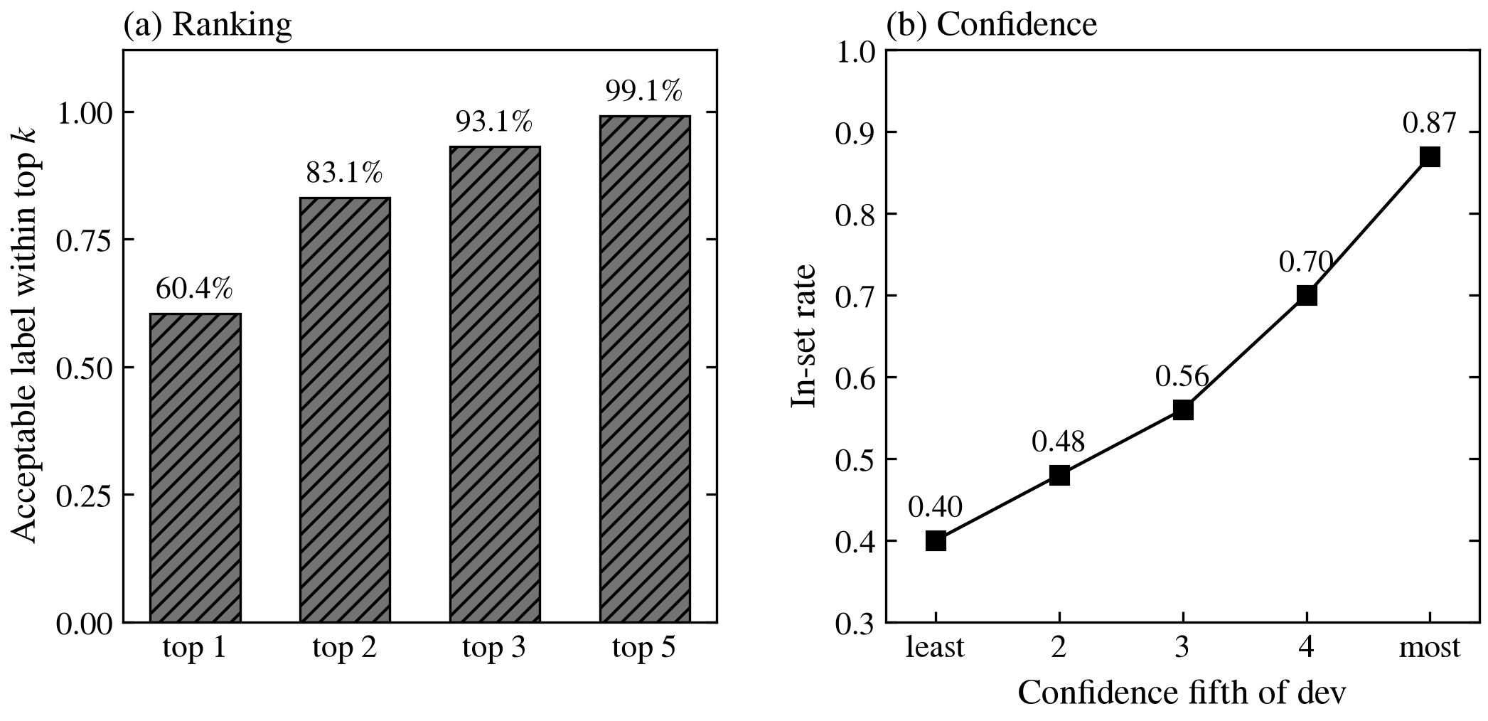
Qwen ranks well and knows when it is unsure
FROM RESULTS TO PLAN
Acceptable label in Qwen's top 3 for 93.1% of items; top 5, 99.1%.
In-set rate rises from 0.40 to 0.87, least to most confident fifth.
Most errors are choices among a few highly ranked candidates.
So an LLM is needed only on uncertain items, not on all.
Qwen3-8B + LoRA, seeds 0–2, dev (docs/raw/E13_Q8_topk_confidence.txt). Exploratory; dev chose nothing.
Notes:
For Qwen (seeds 0-2) an acceptable label is first for 60.4% of items, in the top three for 93.1% and the top five for 99.1%. The in-set rate climbs from 0.40 in the least confident fifth of dev to 0.87 in the most confident. So most remaining errors are a choice among a few candidates the model already ranks highly, and confidence tells us which items those are. That is the case for a cascade that spends LLM calls only on uncertain items. Source: docs/raw/E13_Q8_topk_confidence.txt.

Slide 20
A confidence-routed cascade by October 31
ROADMAP
Oct 5–11, M1: 12-epoch Qwen on ten seeds; calibrated candidate set C(x).
Oct 12–18, M3: local LLM scores only C(x), with definitions and boundary examples.
Oct 19–25, M2: uncertainty router; sweep deferral δ for accuracy vs. calls.
Oct 26–31, M4: distil into M1, 4-bit inference; freeze and final scores.
Input (q, Q, a)
M4 Distillation
M3's train decisions
as soft targets;
4-bit inference
M1 Candidate generator
Qwen3-8B + LoRA, K seeds,
logit adj. → C(x), u(x)
soft targets (train)
M3 LLM adjudicator
scores only C(x):
definitions, boundary
examples
M2 Router
defer the δ most uncertain
δ
keep, 1 − δ
Subtask 2 → Subtask 1
Target: at least 0.60 dev S2 with at most 0.3 LLM calls per item.
Redrawn from Report Figure 5. Dashed: planned, none run yet. LLM calls per item = δ.
Notes:
Four modules, each added as one change under the same protocol. M1: the 12-epoch Qwen classifier on ten seeds returns a calibrated candidate set C(x) holding the gold label for 95% of held-out items, plus an uncertainty score u(x). M3: a local open-weight LLM scores only the labels in C(x), with definitions, a confusion guide and boundary examples. M2: route the fraction delta with the highest u(x) to M3; sweep delta for an accuracy-versus-calls curve. M4: distil M3 back into M1 and run 4-bit. Target: at least 0.60 dev S2 with at most 0.3 LLM calls per item, a sixth of the winner's. Source: Report §7, Figure 5, Table 5.

