Slide 1


Bank Customer Churn Prediction
Savitribai Phule Pune University
K. K. Wagh Institute of Engineering Education and Research, Nashik
Department of Computer Engineering
Presentation on Data Analytics (DA)
Mini Project
PID: 26
Guided By: Prof. N.G. Sharma
Group members:
DIVISION | ROLL NO. | NAME OF THE STUDENT
BE-B | 29 | Ashutosh Srivastava
BE-B | 30 | Vaibhav Bhavsar
BE-B | 31 | Vaibhav Chalse
BE-B | 32 | Vinay Deokar

Slide 2
PROBLEM STATEMENT
A Bank wants to take care of customer retention for its product: savings accounts. The bank wants us to identify customers likely to churn balances below the minimum balance. We have the customer’s information such as age, gender, demographics along with their transactions with the bank.

Slide 3
OBJECTIVES
Analyzing the dataset by using data preprocessing techniques and libraries
Impute the missing values in some variables using data pre-processing techniques
Scaling the numerical features using data pre-processing techniques
Analyzing the dataset by plotting various graphs and visual representations
Applying Machine Learning algorithms on the processed dataset to predict the propensity to churn for each customer

Slide 4
OUTCOMES
A Machine Learning Model to predict propensity to churn for each customer is developed
Implemented 2 ML algorithms for better efficiency score
Random Forest model is giving the best result for each fold after cross validation

Slide 5
DATASET
There are multiple variables in the dataset which can be cleanly divided into 3 categories:
Demographic information about customers
Customer Bank Relationship
Transactional Information

Slide 6
TOOLS & LIBRARIES USED
TOOLS | LIBRARIES
Anaconda Navigator | Numpy
Jupyter Notebook | Pandas
Language: Python 3.8 | Matplotlib
 | Seaborn
 | Scikit Learn

Slide 7
ALGORITHMS USED
Logistic Regression
With baseline features
With all features
Random Forest Classifier

Slide 8
DEMO

Slide 9
EVALUATION MATRICS COMPARISON
ALGORITHM | AUC ROC SCORE | RECALL SCORE | PRECISION SCORE
Logistic Regression (Baseline features) | 0.7624 | 0.1122 | 0.5813
Logistic Regression (All features) | 0.7588 | 0.1730 | 0.5987
Random Forest | 0.8240 | 0.3498 | 0.7390
Random Forest model is giving the best result for each fold

Slide 10

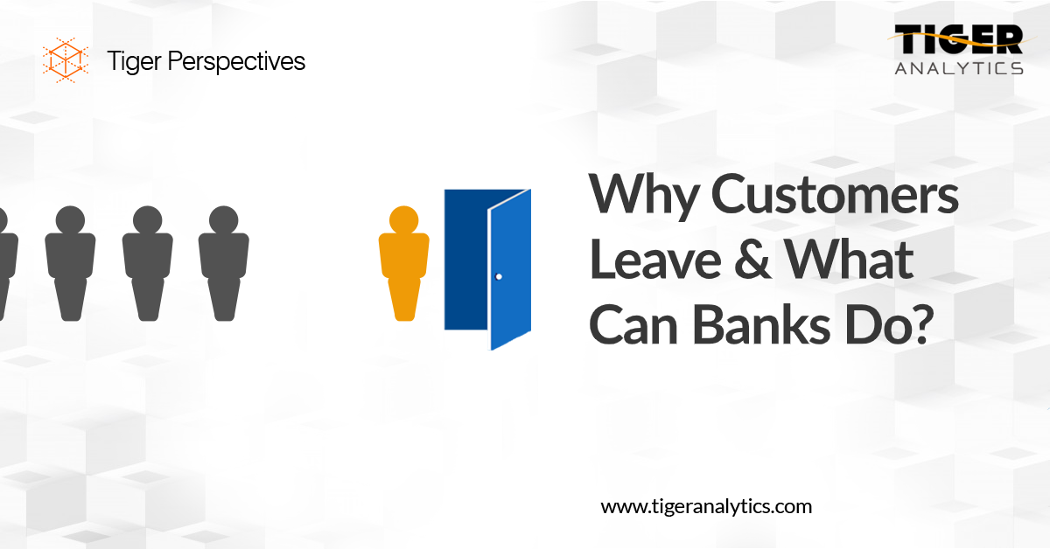
APPLICATIONS
Financial Institutions: Banks/NBFC, Lending Companies can predict propensity to churn for each customer and take necessary actions to attract the customers
Similar models can also be developed to predict probability to churn for each customers in different domains

Slide 11
CONCLUSION
A Machine Learning Model to predict propensity to churn for each customer is developed
Missing value imputation, numerical value transformation are performed on dataset
Logistic Regression and Random Forest algorithm is used while building model
Random Forest model is giving the best result for each fold after cross validation

Slide 12
THANK YOU!

