Slide 1
Chronic Kidney Disease Predicter Using Machine Learning Techniques
Mentor :
Mr. Anil Vats
KSHITIZ SHARMA(41513302715)
SHUBHAM SHARMA (36013302715)
SHIVAM WADHWA (41013302715)
(GROUP NO. – 7)

Slide 2
INTRODUCTION
Chronic kidney disease is a worldwide public health problem with an increasing incidence, prevalence, and high cost.
If the doctors have a good tool that can identify patients who are likely to have kidney disease in advance, they can take required steps to treat the patients in time.

Slide 3
OBJECTIVE
The objective is to develop a simple yet powerful tool, Chronic Kidney Disease Predicter, which predicts whether a Person have CKD or not (through Data Set of 400 people) and provide a prediction which can be confirmed by performing a KFT, Medical test.
With the help of Machine Learning and use of Random Forest and SVM Algorithms we can be able to Predict whether a Patient have C.K.D. or not.

Slide 4
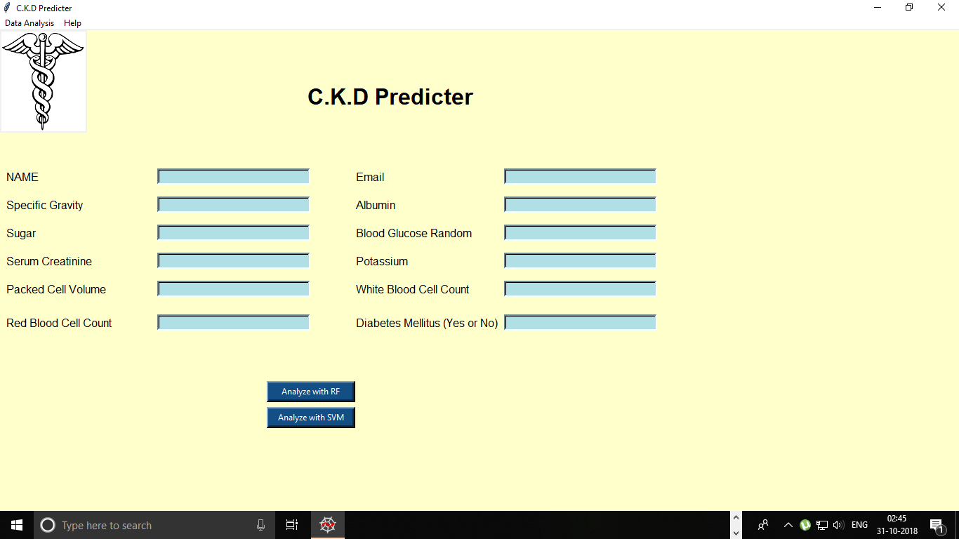
C.K.D Predicter

Slide 5
Backend (Project.py)
Literature Survey
Data collection
Data cleaning and Transformation
Important Feature Selection
Accuracy of The Algorithms

Slide 6
Literature Survey and Data Collection
Literature survey to understand the previous work done in the field of machine learning and data prediction.
Data collection from sources, public data providers, etc. Scraping the best possible data and parsing of data to the Appropriate level.
A. Charleonnan, T. Fufaung [3] worked on Analytics Using Machine Learning Techniques which is the research paper we cited upon.

Slide 7
PRE-PROCESSING
We’ve completed the pre-processing of dataset in this span of time.
The preprocessing of dataset is done using the python modules namely NumPy, seaborn, matplotlib, Ski-kit(sklearn) and Pandas.
The Attributes of this dataset are of two types of namely - numeric and categorical attributes. The entire dataset can be divided into 11 numeric attributes and 14 categorical attributes.

Slide 8
These are all the attributes(as shown above) which are present in the dataset. Their full forms are listed below :
Age
Blood Pressure
Specific Gravity
Albumin
Sugar
Red Blood Cells
Pus Cell
Pus Cell clumps
Bacteria
Blood Glucose Random
Blood Urea
Serum Creatinine
Sodium
Potassium
Haemoglobin
Packed Cell Volume
White Blood Cell Count
Red Blood Cell Count
Hypertension
Diabetes Mellitus
Coronary Artery Disease
Appetite
Pedal Edema
Anemia
Class

Slide 9
DATA CLEANING AND TRANSFORMATION
We reworked over the data cleaning that we did because the data was being lost in our last attempt of cleaning.
We came through 3 attributes or features that were being stored as object(string) type even when their data was of floating type. So, we converted them prior to the cleaning this time.
Removing null values from the dataset with a different approach.
The process of converting data from one format or structure into another format or structure is Data Transformation
In case of categorical features, they are simply converted(one hot encoded) into numeric ones
Also, the target attribute is converted into numeric type.

Slide 10
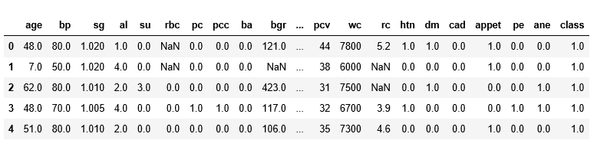
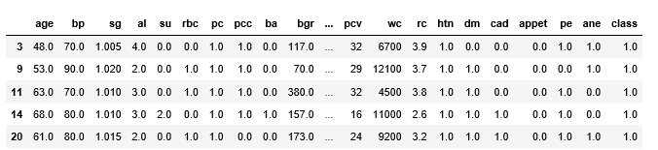
UNCLEANED DATA FRAME
CLEANED DATA FRAME

Slide 11
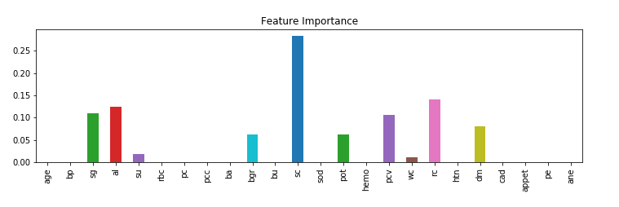
Feature Selection
Using GridSearchCV under ski-kit module, we had the best possible features for the classifier and then, we plotted them as shown using matplotlib module :

Slide 12
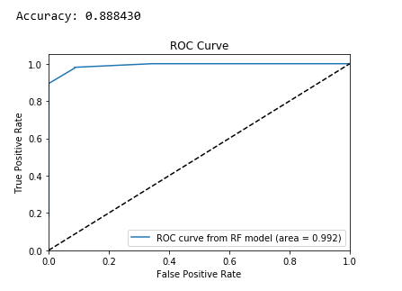
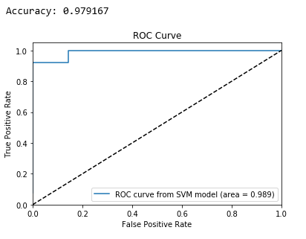
ACCURACY OF ALGORITHMS USED

Slide 13
Frontend
User Friendly Experience
Easy Result Extraction
Alerting the Patient

Slide 14
USER FRIENDLY
The UI is extremely user friendly and simple.
It contains Entry Boxes to entry the Input and once all the inputs are entered the Result can be extracted on a click.

Slide 15
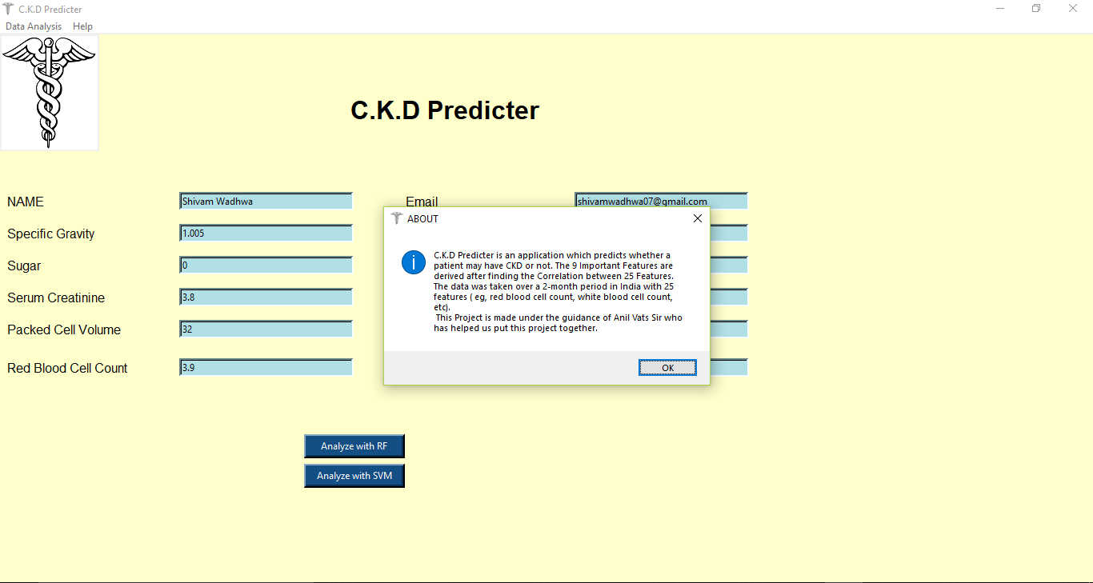

Slide 16
EASY RESULT EXTRACTION AND ALERT SYSTEM
The is extracted on click of a button.
It’s got two level check system by applying two algorithms instead of just one
The result can instantly be shared with the Patient Immediately via EMAIL using the SMTP

Slide 17
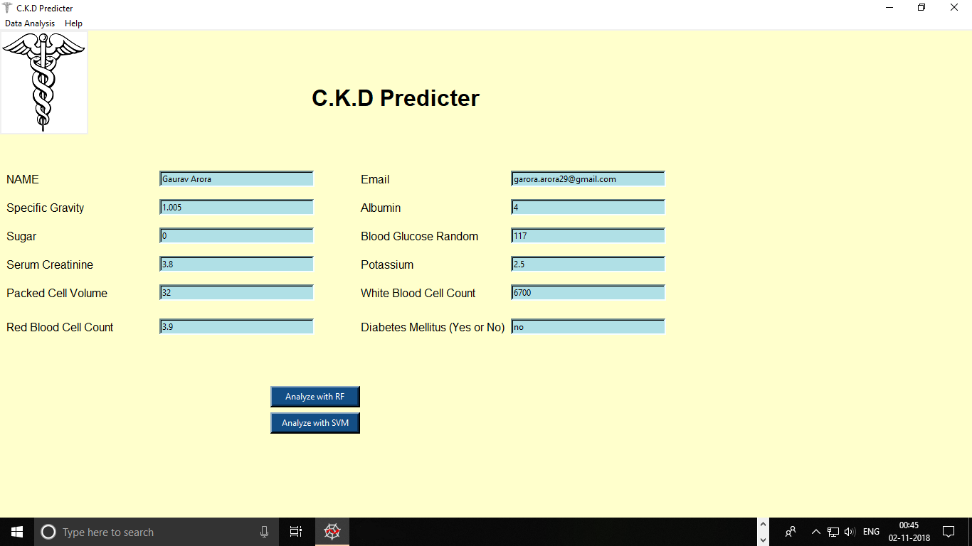

Slide 18
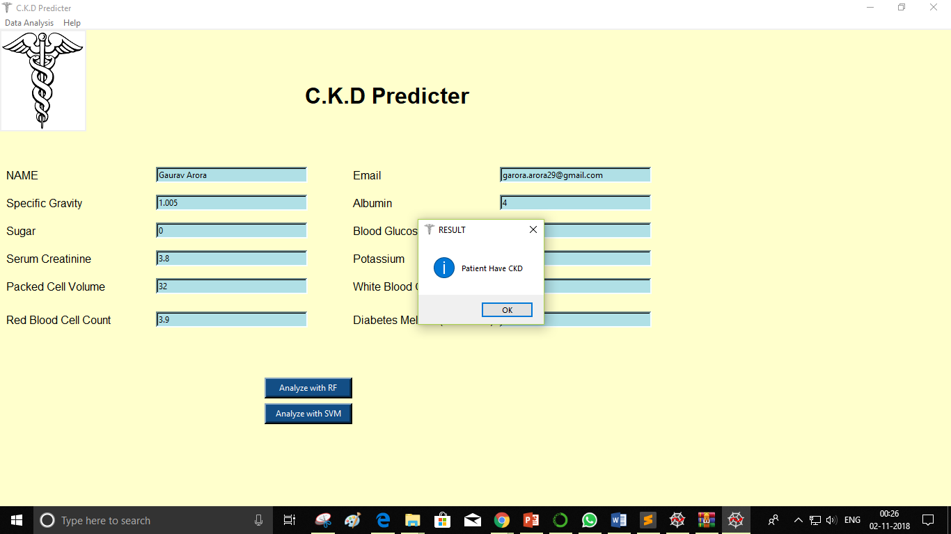

Slide 19
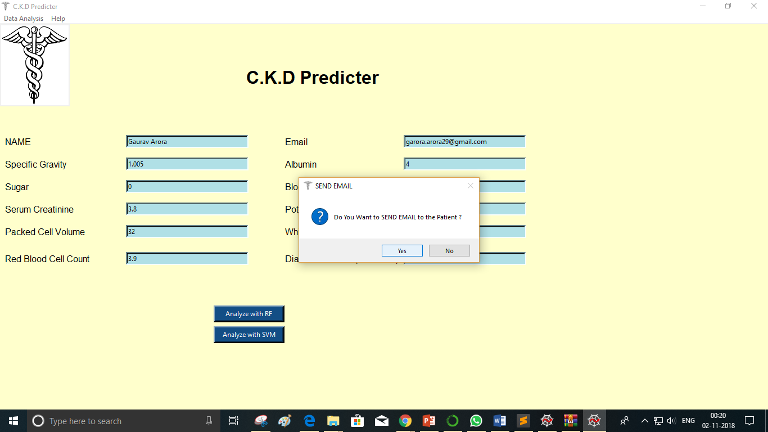

Slide 20
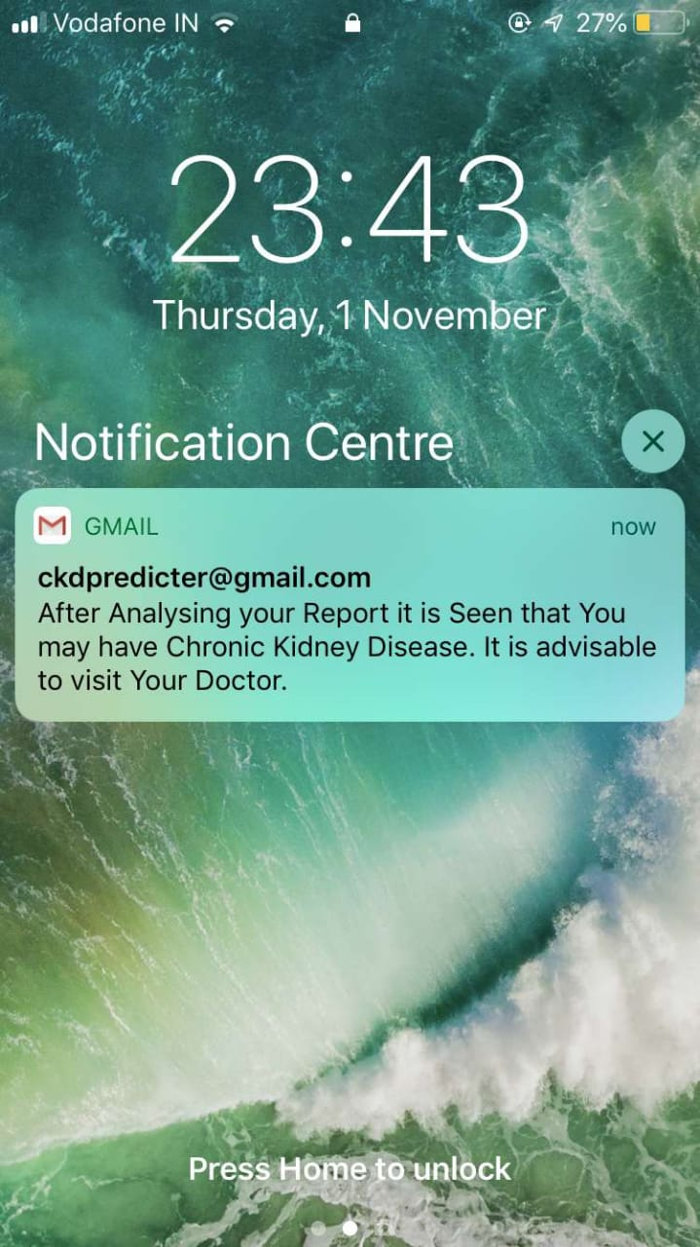
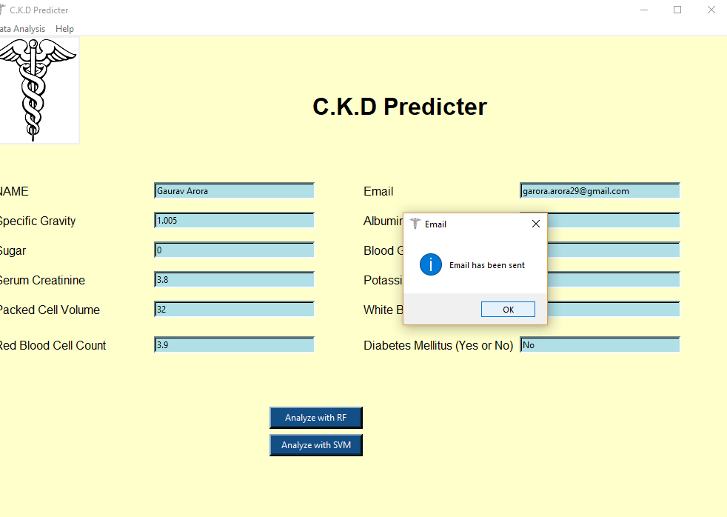

Slide 21
PHYSICAL IMPLEMENTAION
This tool can be used by Doctors if they find any abnormalities in a Patient’s Report.
If the tools says the Patient got C.K.D. then doctors can confirm it by performing a KFT, Medical test.

Slide 22
REFERENCES
[1] A. Charleonnan, T. Fufaung, Tippawan Niyomwong, W. Chokchueypattanakit, Sathit Suwannawach, Nitat Ninchawee, "Predictive Analytics for Chronic Kidney Disease Using Machine Learning Techniques", Proc. Management and Innovation Technology International Conference (MITiCON-2016), Oct. 2016.
[2] https://quantdare.com/data-cleansing-and-transformation/
[3] https://archive.ics.uci.edu/ml/datasets/chronic_kidney_disease
[4] https://www.nation.co.ke/news/WHO-CONCERNED-ABOUT-CANCER-DEATHS/1056-3802196-il66ag/index.html

