Slide 1
HW1
助教： 黃郁洺 M11015203@mail.ntust.edu.tw 湯冠維 M11015045@mail.ntust.edu.tw 郭勁宏 M11015068@mail.ntust.edu.tw

Slide 2
作業規定
分數：每題 4%，共 8%
OJ 網址: https://nlp.csie.ntust.edu.tw:2021/contest/3/problems
OJ 截止日期：2022/10/12 11:19 (截止前無限制上傳次數)
請將上傳到OJ的程式碼壓縮成 zip 檔，並命名為「學號_姓名.zip」 (例如：b1234567890_王小明.zip)上傳至 Moodle，遲交 0 分。
程式語言開放使用 C (gcc 9.4)、C++ (g++ 9.4)、python (3.8)，除了標準輸入輸出 (例如：stdio.h)和字串 (例如：string.h)相關的 library，請勿使用其他 library，請自行實作基礎資料結構。
請勿抄襲他人程式碼

Slide 3
HW1-1 Shortest path of Cave

Slide 4

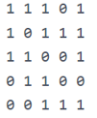






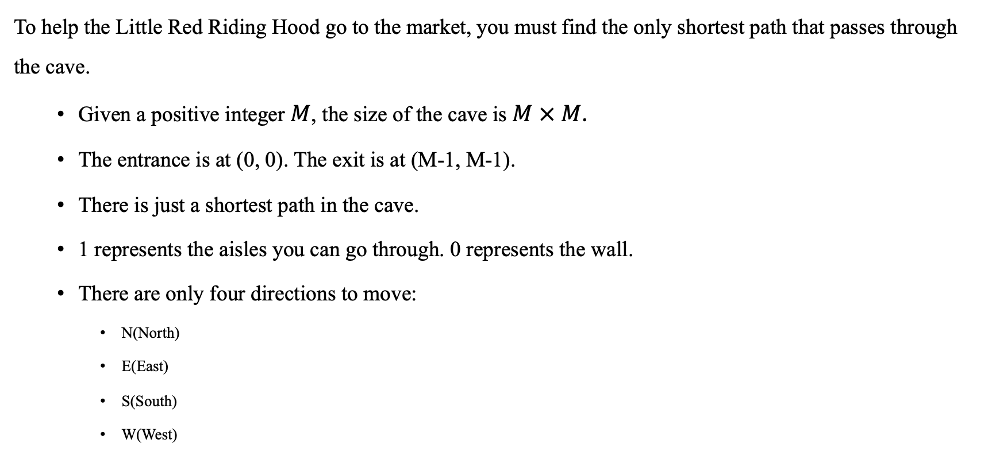



Description
To help the Little Red Riding Hood go to the market, you must find the only shortest path that passes through the cave.
Given a positive integer $M$, the size of the cave is $M × M$.
The entrance is at (0, 0). The exit is at (M-1, M-1).
There is just a shortest path in the cave.
1 represents the aisles you can go through. 0 represents the wall.
There are only four directions to move:
N(North)
E(East)
S(South)
W(West)
$$N$$
$$(0, 0)$$
$$W$$
$$E$$
$$S$$
$(M−1, M−1)$

Slide 5
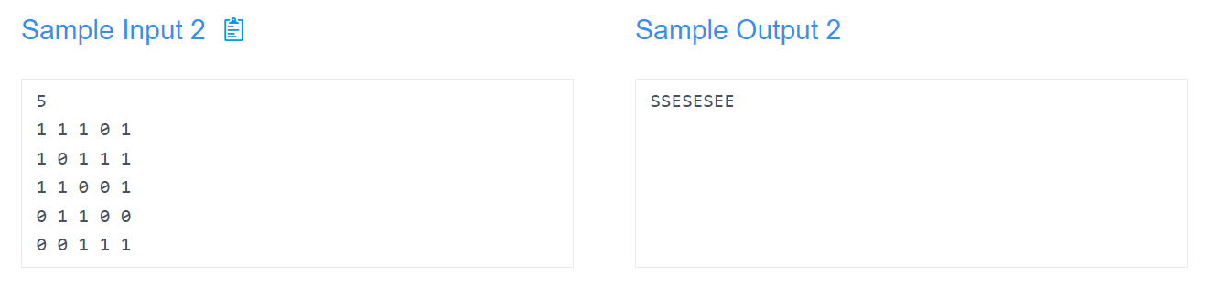
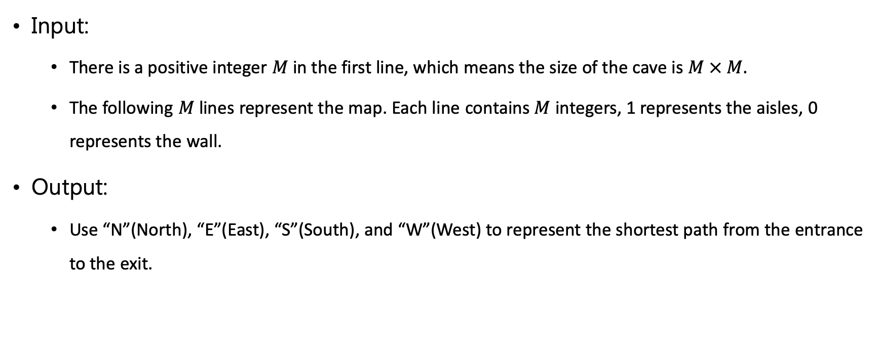
Input/output
Input:
There is a positive integer $M$ in the first line, which means the size of the cave is $M × M.$
The following $M$ lines represent the map. Each line contains $M$ integers, 1 represents the aisles, 0 represents the wall.
Output:
Use “N”(North), “E”(East), “S”(South), and “W”(West) to represent the shortest path from the entrance to the exit.

Slide 6
HW1-2 Queuing system

Slide 7
Description
Ming is an IT of a bank, one day, his boss told him to build a system for the service desks to deal with a queuing problem, the following are the system needs:
The number of desks is limited, if the customer is the first person at the desk, then we can start serving immediately, otherwise, the customer should wait in line.
Every customer will choose the desk with the least number of people. If the number of people at every desk is equal, then join the desk with the smallest ID.
Desk ID starts from 0. (0, 1, 2, ....)
The system needs to record the “name”, “business completion time” and ”desk ID for handling” of each customer.

Slide 8
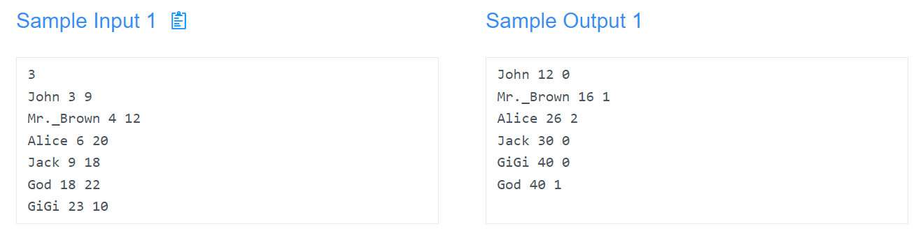
Input/output
Input:
The first line is the number of desks, up to 10 desks.
The followings are the customer’s information in sequence according to their arrival time, including the “name”, “arrival time”, and “time required to handle the business”.
Output:
Please output the customer's "name", "business completion time", and "desk ID handle for him", and sort by "business completion time".
If there are two people who finish at the same time, then sort by their desk's ID (increasing).

Slide 9
Current time: 0
Counter 0
Counter 1
Counter 2
Input:
Name | Reach time | duration
John | 3 | 9
Mr.Brown | 4 | 12
Alice | 6 | 20
Jack | 9 | 18
God | 18 | 22
GiGi | 23 | 10

Slide 10
Current time: 3
Counter 0
Counter 1
Counter 2
Name | duration
John | 9
Input:
Name | Reach time | duration
Mr.Brown | 4 | 12
Alice | 6 | 20
Jack | 9 | 18
God | 18 | 22
GiGi | 23 | 10

Slide 11
Current time: 4
Counter 0
Counter 1
Counter 2
Name | duration
John | 8
Name | duration
Mr.Brown | 12
Input:
Name | Reach time | duration
Alice | 6 | 20
Jack | 9 | 18
God | 18 | 22
GiGi | 23 | 10

Slide 12
Current time: 6
Counter 0
Counter 1
Counter 2
Name | duration
John | 6
Name | duration
Mr.Brown | 10
Name | duration
Alice | 20
Input:
Name | Reach time | duration
Jack | 9 | 18
God | 18 | 22
GiGi | 23 | 10

Slide 13
Current time: 9
Counter 0
Counter 1
Counter 2
Name | duration
John | 3
Jack | 18
Name | duration
Mr.Brown | 7
Name | duration
Alice | 17
Input:
Name | Reach time | duration
God | 18 | 22
GiGi | 23 | 10

Slide 14
Current time: 12
Counter 0
Counter 1
Counter 2
Name | duration
John | 0
Jack | 18
Name | duration
Mr.Brown | 4
Name | duration
Alice | 14
Input:
Finish:
Name | Reach time | duration
God | 18 | 22
GiGi | 23 | 10
Name | Leave time | Counter id
John | 12 | 0

Slide 15
Current time: 16
Counter 0
Counter 1
Counter 2
Name | duration
Jack | 14
Name | duration
Mr.Brown | 0
Name | duration
Alice | 10
Input:
Finish:
Name | Reach time | duration
God | 18 | 22
GiGi | 23 | 10
Name | Leave time | Counter id
John | 12 | 0
Mr.Brown | 16 | 1

Slide 16
Current time: 18
Counter 0
Counter 1
Counter 2
Name | duration
Jack | 12
Name | duration
God | 22
Name | duration
Alice | 8
Input:
Finish:
Name | Reach time | duration
GiGi | 23 | 10
Name | Leave time | Counter id
John | 12 | 0
Mr.Brown | 16 | 1

Slide 17
Current time: 23
Counter 0
Counter 1
Counter 2
Name | duration
Jack | 7
GiGi | 10
Name | duration
God | 17
Name | duration
Alice | 3
Finish:
Name | Leave time | Counter id
John | 12 | 0
Mr.Brown | 16 | 1

Slide 18
Current time: 26
Counter 0
Counter 1
Counter 2
Name | duration
Jack | 4
GiGi | 10
Name | duration
God | 14
Name | duration
Alice | 0
Finish:
Name | Leave time | Counter id
John | 12 | 0
Mr.Brown | 16 | 1
Alice | 26 | 2

Slide 19
Current time: 30
Counter 0
Counter 1
Counter 2
Name | duration
Jack | 0
GiGi | 10
Name | duration
God | 10
Name | duration
Finish:
Name | Leave time | Counter id
John | 12 | 0
Mr.Brown | 16 | 1
Alice | 26 | 2
Jack | 30 | 0

Slide 20
Current time: 40
Counter 0
Counter 1
Counter 2
Name | duration
GiGi | 0
Name | duration
God | 0
Name | duration
Finish:
Name | Leave time | Counter id
John | 12 | 0
Mr.Brown | 16 | 1
Alice | 26 | 2
Jack | 30 | 0
GiGi | 40 | 0
God | 40 | 1

