Slide 1
DS HW3
助教： 黃郁洺 M11015203@mail.ntust.edu.tw 湯冠維 M11015045@mail.ntust.edu.tw 郭勁宏 M11015068@mail.ntust.edu.tw

Slide 2
Dodge ball competition

Slide 3
Description
Dodge ball competition in Ming's class, the teacher decided to use red-black tree for splitting whole players in class into two groups according to everyone's ID number.
Red nodes will fall into group 1, and black nodes will be group 2.
The teacher now need to choose the outfield and jump ball player for each team:
First, players in each team sorted by "Level-order".
First node in level-order sequence will be the "jump ball player".
Last 3 nodes in level-order sequence will be the "outfield player".
** The jump ball player should not be one of the outfield players.
** If any team has fewer than three outfield players, or no jump ball player, the game will not start.
** If the game cannot be established, then output "No game“.

Slide 4
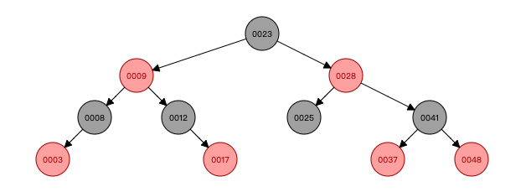
Example
Input: 23 25 8 9 12 3 17 28 41 48 37
Output:
Red team: 3,9,17,28,37,48 (in ascending order)
outfield: 17,37,48 (in ascending order)
jump ball: 9
Black team: 8,12,23,25,41 (in ascending order)
outfield: 12,25,41 (in ascending order)
jump ball: 23
Level-order:
Red: 9 28 3 17 37 48
Black: 23 8 12 25 41

Slide 5
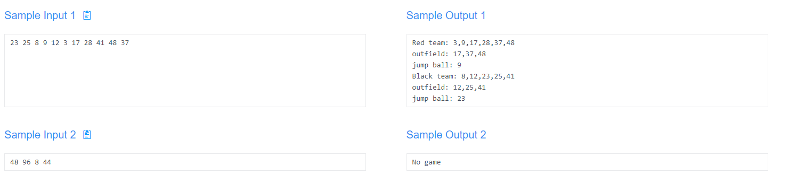

Slide 6
5 is the best number

Slide 7
Description
Please sort the sequence by bubble, insertion, and selection algorithm, and output the sorted sequence and the process according to the requests.
Requests
Bubble sort: The two numbers of the fifth swap and the sequence after swapping.
-> Bubble: a1, a2; 1 2 3 4 a1 a2 9 10 … (a1, a2 follows the ascending order)
Insertion sort: The sequence result after the fifth insertion.
-> Insertion: 1 2 3 4 a1 a2 9 10 …
Selection sort: The smallest number selected for the fifth step and the sequence after swapping.
-> Selection: a1; 1 2 3 4 a1 9 10 …
** If there are two numbers with same value, selects leftmost number first.
Sorted sequence: The result of sorting the entire sequence.
-> 1 2 3 4 5 6 7 8 9 10 …

Slide 8
Bubble sort:
Input: 21 24 28 15 20 19 30 41 20 28 13 12 33 25 7
Output: 28, 41; 21 24 15 20 19 28 30 20 28 41 13 12 33 25 7
21 24 28 15 20 19 30 41 20 28 13 12 33 25 7 <- initial
21 24 28 15 20 19 30 41 20 28 13 12 33 25 7 <- first swap: 28, 15
21 24 15 28 20 19 30 41 20 28 13 12 33 25 7 <- after swapping
21 24 15 28 20 19 30 41 20 28 13 12 33 25 7 <- second swap: 28, 20
21 24 15 20 28 19 30 41 20 28 13 12 33 25 7 <- after swapping
21 24 15 20 28 19 30 41 20 28 13 12 33 25 7 <- third swap: 28, 19
21 24 15 20 19 28 30 41 20 28 13 12 33 25 7 <- after swapping
21 24 15 20 19 28 30 41 20 28 13 12 33 25 7 <- fourth swap: 41, 20
21 24 15 20 19 28 30 20 41 28 13 12 33 25 7 <- fourth swap: 41, 20
21 24 15 20 19 28 30 20 41 28 13 12 33 25 7 <- fifth swap: 41, 28
21 24 15 20 19 28 30 20 28 41 13 12 33 25 7 <- after swapping

Slide 9
Insertion sort:
Input: 21 24 28 15 20 19 30 41 20 28 13 12 33 25 7
Output: 15 20 21 24 28 19 30 41 20 28 13 12 33 25 7
21 24 28 15 20 19 30 41 20 28 13 12 33 25 7 <- initial
21 24 28 15 20 19 30 41 20 28 13 12 33 25 7 <- first insertion
21 24 15 28 20 19 30 41 20 28 13 12 33 25 7 <- second insertion
15 21 24 28 20 19 30 41 20 28 13 12 33 25 7 <- third insertion
15 21 24 28 20 19 30 41 20 28 13 12 33 25 7 <- fourth insertion
15 20 21 24 28 19 30 41 20 28 13 12 33 25 7 <- fifth insertion
: sorted sequence

Slide 10
Selection sort:
Input: 21 24 28 15 20 19 30 41 20 28 13 12 33 25 7
Output: 19; 7 12 13 15 19 20 30 41 20 28 28 24 33 25 21
21 24 28 15 20 19 30 41 20 28 13 12 33 25 7 <- initial
21 24 28 15 20 19 30 41 20 28 13 12 33 25 7 <- first selection: 7
7 21 24 15 28 20 19 30 41 20 28 13 12 33 25 <- after swapping
7 21 24 15 28 20 19 30 41 20 28 13 12 33 25 <- second selection: 12
7 12 21 24 15 20 28 19 30 41 20 28 13 33 25 <- after swapping
7 12 21 24 15 20 28 19 30 41 20 28 13 33 25 <- third selection: 13
7 12 13 21 24 15 20 28 19 30 41 20 28 33 25 <- after swapping
7 12 13 21 24 15 20 28 19 30 41 20 28 33 25 <- fourth selection: 15
7 12 13 15 21 24 20 28 19 30 41 20 28 33 25 <- after swapping
7 12 13 15 21 24 20 28 19 30 41 20 28 33 25 <- fifth insertion: 19
7 12 13 15 19 20 30 41 20 28 28 24 33 25 21 <- after swapping
: sorted sequence
: Minimum number

Slide 11
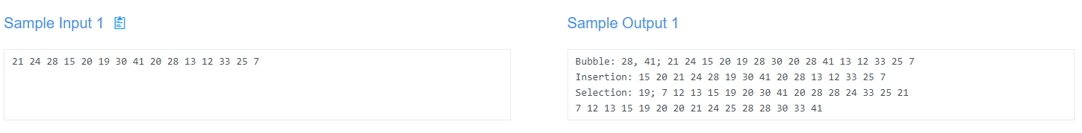

Slide 12
Rules
OJ Link: https://nlp.csie.ntust.edu.tw:2021/contest/7
OJ 截止日期： 2022/12/07 11:19 (截止前無限制上傳次數)
程式語言：C (gcc 9.4)、C++ (g++ 9.4)、python(3.8)
請注意 OJ 的 compiler version，以及 python 版本，否則能會產生 compile error, runtime error 等問題。
請勿使用與 sorting 或 tree 相關的 library (vector 可以使用)，請自行實作基礎資料結構。
請勿抄襲他人程式碼

