Slide 1
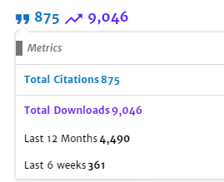

Neural Collaborative Filtering
He Xiangnan¹, Liao Lizi¹, Zhang Hanwang¹, Nie Liqiang²,
Hu Xia³, Tat-Seng Chua¹
April 05, 2017 @ WWW 2017
1 National University of Singapore
2 Shandong University, China
3 Texas A&M University
Notes:
发表：17年四月，world wide web会议，深度学习的网络结构，训练方法，GPU硬件的不断进步，促使其不断征服其他领域
何向南：中科大教授，92年，28岁

Slide 2
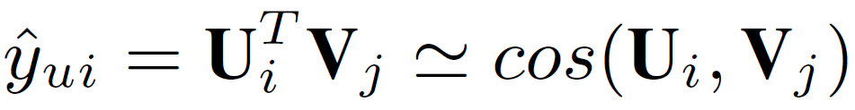
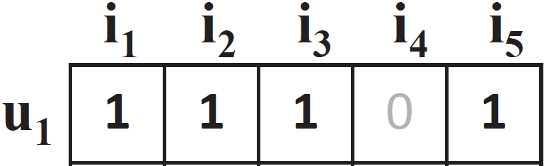


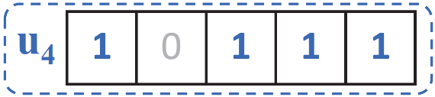

Limitation of Matrix Factorization
The simple choice of inner product function can limit the expressiveness of a MF model.
Example:
(E.g., assuming a unit length)
S₄₂ > S₄₃ (X)
u1
S₄₂ > S₄₃ (X)
sim(u2, u1) = 0.5
u2
sim(u3, u1) = 0.4
sim(u3, u2) = 0.66
u3
sim(u4, u1) = 0.6
sim(u4, u2) = 0.2
sim(u4, u3) = 0.4
Jaccard Similarity:
Notes:
因为评分矩阵等于将用户属性矩阵乘以电影属性矩阵的结果,所以我们可以使用矩阵分解反向工作以找到U和V的值
Jaccard系数作为实际的结果，先计算u1，2，3，而后添加u4，发现，4和2的距离一定比4和3的距离更近
矩阵分解的限制性：Jaccard系数作为实际的结果，先计算u1，2，3，而后添加u4，发现，4和2的距离一定比4和3的距离更近

Slide 3
Proposed Methods
Proposals:
A Neural Collaborative Filtering (NCF) framework that learns the interaction function with a deep neural network.
A NCF instance that generalizes the MF model (GMF).
A NCF instance that models nonlinearities with a multi-layer perceptron (MLP)
A NCF instance NeuMF that fuses GMF and MLP.
Notes:
ranking loss：度量学习，相对位置，the objective of Ranking Losses is to predict relative distances between inputs. This task if often called metric learning.
解决方式：使用大量的隐藏因子去学习交互函数。

Slide 4
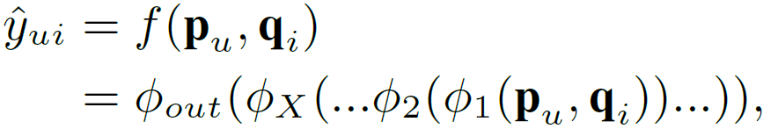
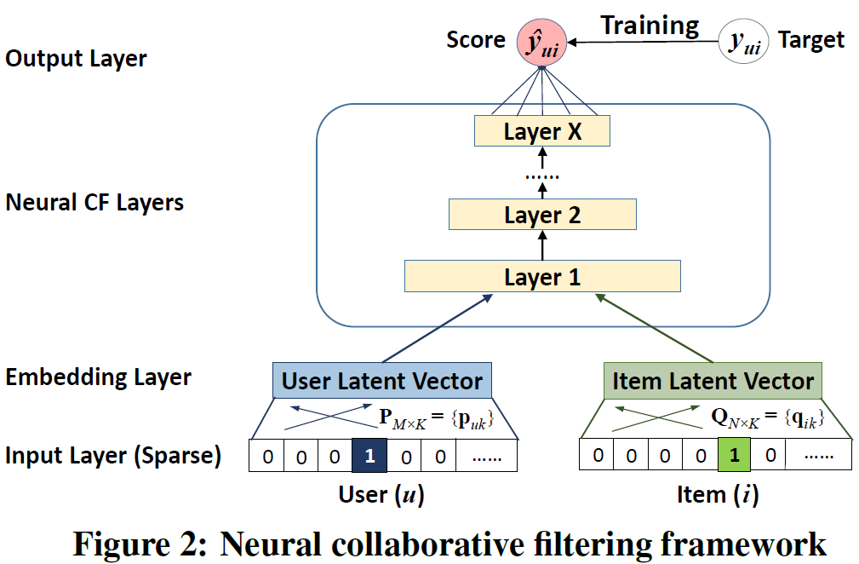
NCF Framework
Interaction function
NCF uses a multi-layer model to learn the user-item interaction function
Input: sparse feature vector for user u (v_{u}) and item i (v_{i})
Output: predicted score ŷ_{ui}
Note: Input feature vector can include any categorical variables other than user/item ID, such as attributes, contexts and content.
Notes:
神经协同过滤，通用框架，MLP

Slide 5
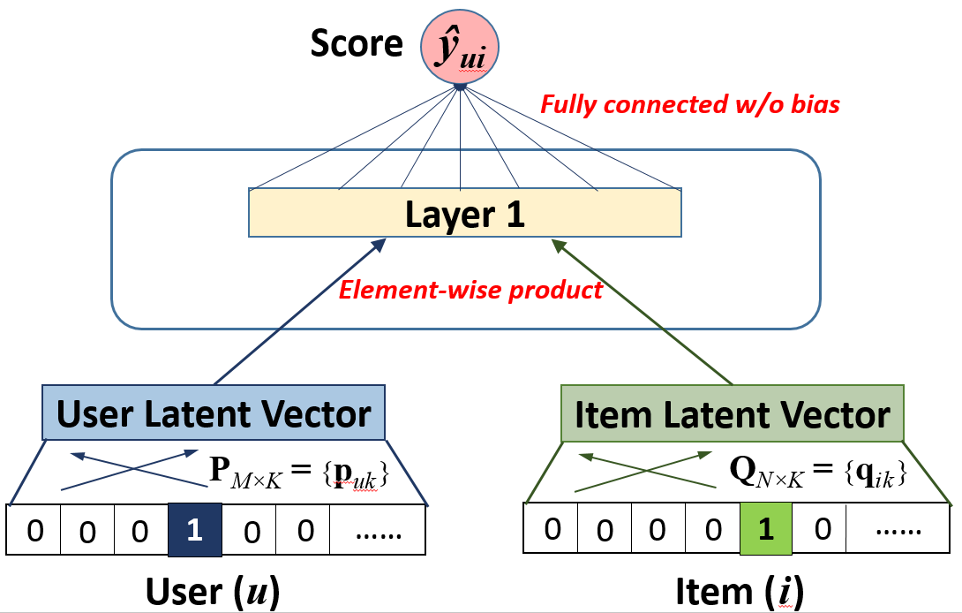
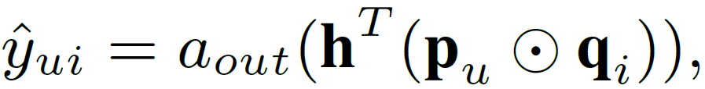
Generalized Matrix Factorization (GMF)
NCF can express and generalize MF:
Let we define Layer 1 as an element-wise product, and Output Layer as a fully connected layer without bias, we have:
If we use an identity function for a_{out} and enforce h to be a uniform vector of 1,
we can exactly recover the MF model.
Notes:
element-wise product:按元素积
将GMF作为一种特殊的NCF
如果a是恒等函数，h是1的均匀向量

Slide 6
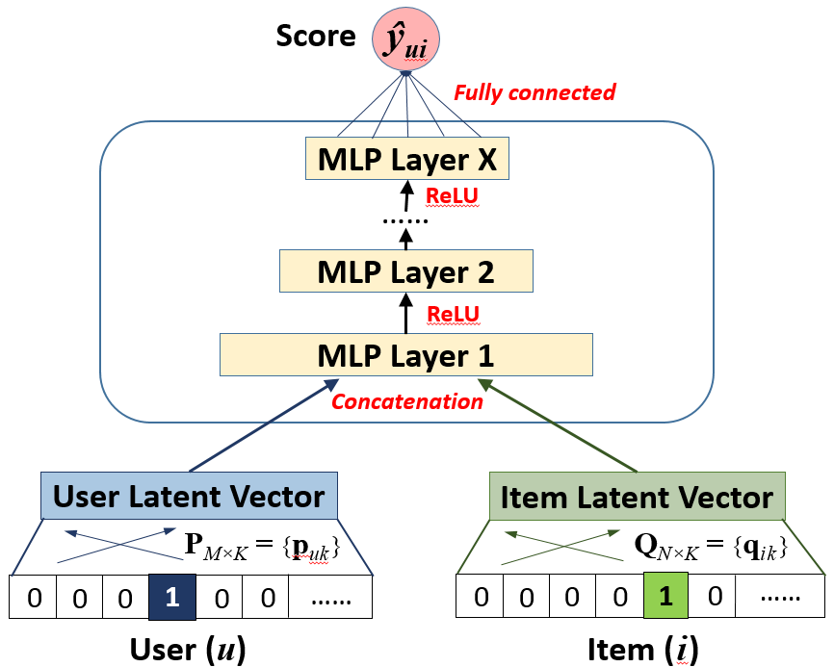
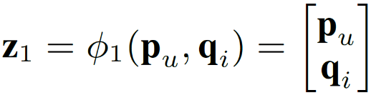
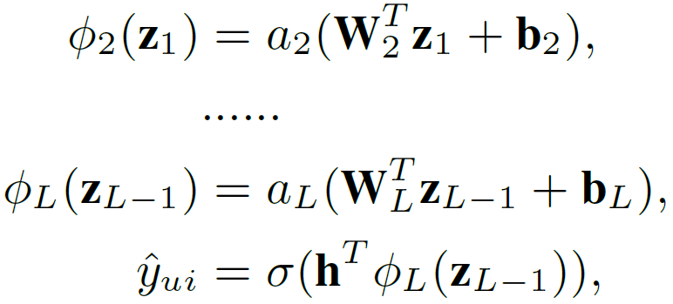
Multi-Layer Perceptron (MLP)
NCF can endow more nonlinearities to learn the interaction function:
Activation function: ReLU > tanh > sigmoid
Layer 1:
Remaining Layers:
Notes:
经验：tower structure，halving the layer size for each successive higher layer

Slide 7
MF vs. MLP
MF uses an inner product as the interaction function:
Latent factors are independent with each other;
It empirically has good generalization ability for CF modelling
MLP uses nonlinear functions to learn the interaction function:
Latent factors are not independent with each other;
The interaction function is learnt from data, which conceptually has a better representation ability.
However, its generalization ability is unknown as it is seldom explored in recommender literature/challenge.
Can we fuse two models to get
a more powerful model?
Notes:
generalization ability：泛化的比较好
representation ability：拟合的比较好

Slide 8
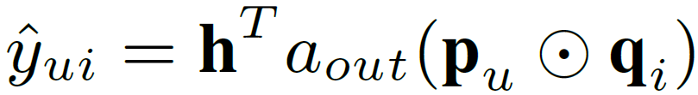
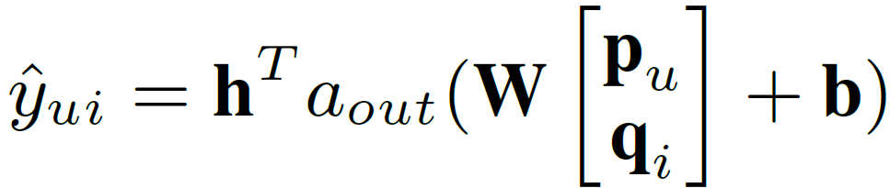
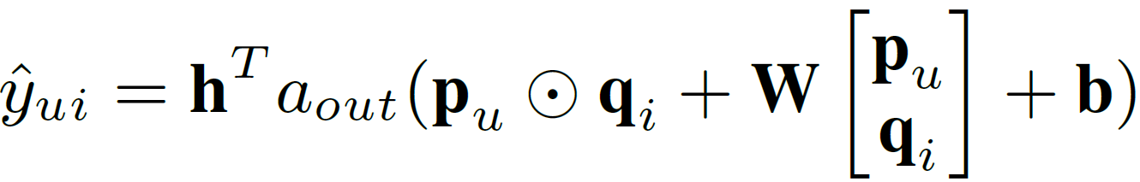
An Intuitive Solution – Neural Tensor Network
MF model:
MLP model (1 linear layer):
The Neural Tensor Network* naturally assumes MF and MLP share the same embeddings, and combines their latent space by an addition:
However, NTN does not significantly improve over MF:
A possible reason is due to the limitation of the shared embeddings.
* Socher Richard, et al. NIPS 2013 "Reasoning with neural tensor networks for knowledge base completion"
Notes:
注意，这里是加号

Slide 9
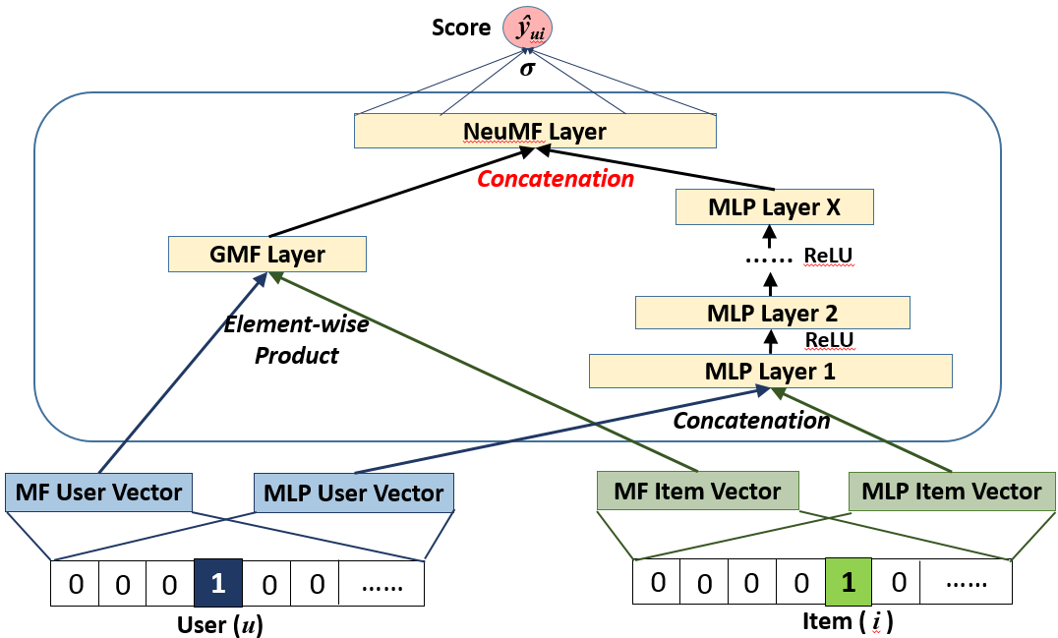
Fusion of GMF and MLP
We propose a new Neural Matrix Factorization (NeuMF) model, which fuses GMF and MLP by allowing them learn different sets of embeddings:
Notes:
神经矩阵分解，使用连结操作

Slide 10
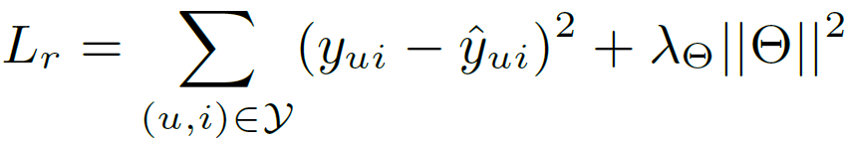
Learning NCF Models
For explicit feedback (e.g., ratings 1-5):
Regression loss:
For implicit feedback (e.g., watches, 0/1):
Classification loss:
Optimization is done by SGD (adaptive learning rate variants: Adagrad, Adam, RMSprop…)
Notes:
显示评分：回归损失，预测一个值，**平方损失**
隐式交互：分类损失，预测离散结果，logistic
优化方法：随机梯度下降法

Slide 11
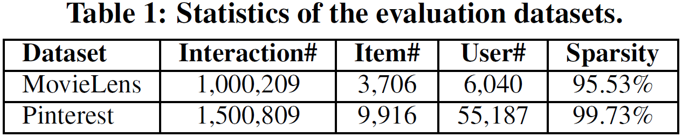
Experimental Setup
Two public datasets from MovieLens and Pinterest:
Transform MovieLens ratings to 0/1 implicit case
Evaluation protocols:
Leave-one-out: holdout the latest rating of each user as the test
Top-K evaluation
The ranked list are evaluated by Hit Ratio and NDCG (@10).
Notes:
实验环境设置：
数据集，留一法，top-k排序，
HR@10：分母是所有的测试集合，分子式每个用户top-K推荐列表中属于测试集合的个数的总和
NDCG@10：最终所产生的增益（归一化折损累计增益）

Slide 12
Baselines
ItemPop.
Items are ranked by their popularity.
ItemKNN [Sarwar et al, WWW’01]
The standard item-based CF method.
BPR [Rendle et al, UAI’09]
Bayesian Personalized Ranking optimizes MF model with a pairwise ranking loss, which is tailored for implicit feedback and item recommendation.
eALS [He et al, SIGIR’16]
The state-of-the-art CF method for implicit data. It optimizes MF model with a varying-weighted regression loss.
Notes:
BPR:基于矩阵分解的一种排序算法，针对每一个用户自己的商品喜好分贝做排序优化。在实际产品中，BPR之类的推荐排序在海量数据中选择极少量数据做推荐的时候有优势。淘宝京东有在用。部分填充，速度十分快。
eALS:最新的关于隐式数据的协同过滤算法，用一步到位的计算公式全部填充缺失值。

Slide 13
Example for HR@10
Hit Ratio@10:三个用户在测试集中商品个数分别是10，12，8，模型得到的top-10推荐列表中，分别有6个，5个，4个正确，那么此时
HR的值是 (6+5+4)/(10+12+8) = 0.5。
HR = 命中的个数/所有的个数
Notes:
Rel表示关联性，就是跟所想要的结果的关联度，0表示没有关联，越高说明关联性越高
i是位置，关联性乘以位置，就是第i个结果所产生的效益
IDCG是理想化的最大效益。

Slide 14


Example for NDCG@10
Normalized Discounted Cummulative Gain(NDCG)@10:
i | reli | log₂(i+1) | rel_{i} /log₂(i+1)
1 | 3 | 1 | 3
2 | 3 | 1.58 | 1.89
3 | 3 | 2 | 1.5
4 | 2 | 2.32 | 0.86
5 | 2 | 2.58 | 0.77
6 | 1 | 2.8 | 0.35
i | reli | log₂(i+1) | rel_{i} /log₂(i+1)
1 | 3 | 1 | 3
2 | 2 | 1.58 | 1.26
3 | 3 | 2 | 1.5
4 | 0 | 2.32 | 0
5 | 1 | 2.58 | 0.38
6 | 2 | 2.8 | 0.71
IDCG = 3+1.89+1.5+0.86+0.77+0.35 = 8.37
NDCG@6 = 6.86/8.37 = 81.96%
Notes:
Rel表示关联性，就是跟所想要的结果的关联度，0表示没有关联，越高说明关联性越高
i是位置，关联性乘以位置，就是第i个结果所产生的效益
IDCG是理想化的最大效益。

Slide 15
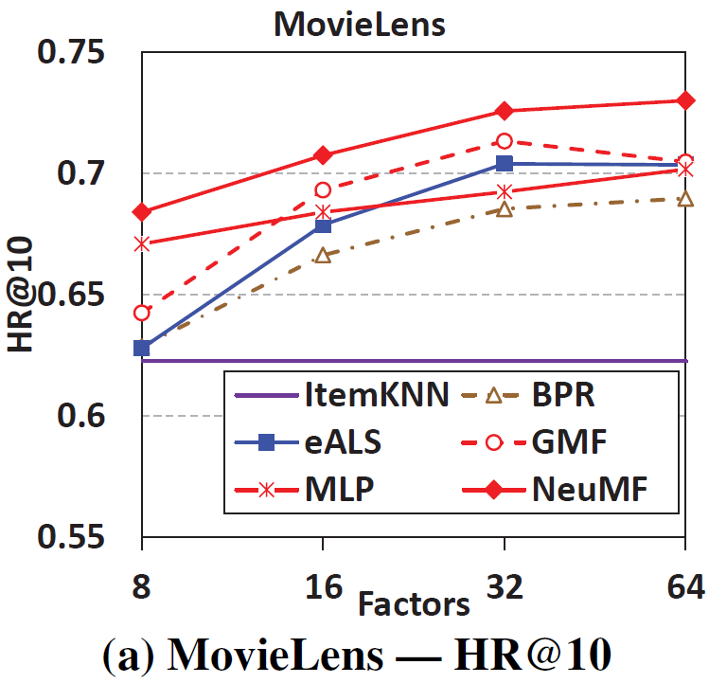
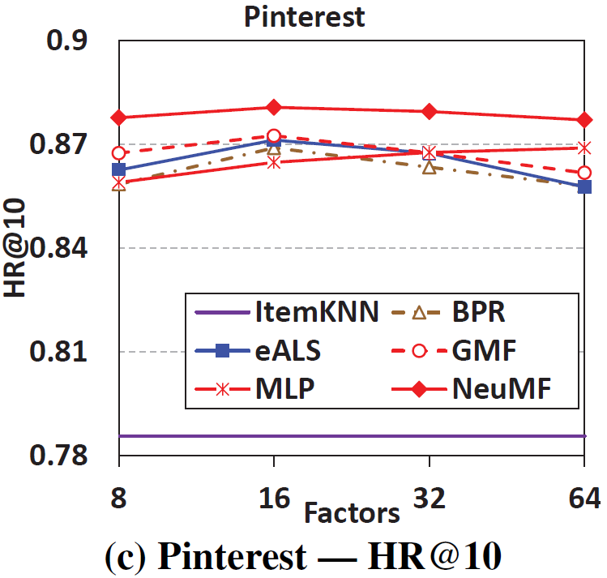
Performance vs. Embedding Size
1. NeuMF outperforms eALS and BPR with about 5% relative improvement.
2. Of the three NCF methods: NeuMF > GMF > MLP (lower training loss but higher test loss)
3. Three MF methods with different objective functions:
GMF (log loss) >= eALS (weighted regression loss) > BPR (pairwise ranking loss)
Notes:
Three-layer MLP and NeuMF.

Slide 16
Conclusion
理论成果：
Devised a general framework NCF;
Presented three instantiations GMF, MLP and NeuMF.
实验成果：
Deeper models are helpful.
Combining deep models with MF in the latent space leads to better results.
Notes:
Since most existing recommenders use shallow models, we believe this work opens up a new avenue of research possibilities for recommendation based on deep learning.

Slide 17
Recently
(2017.04) XiangNan Zhou--Neural Collaborative Filtering
Codes: https://github.com/hexiangnan/neural_collaborative_filtering
(2020.02) XiangNan Zhou--LightGCN: Simplifying and Powering Graph Convolution Network for Recommendation
周向南最新成果，认为效果最好，正在和快手合作落地
Codes: https://github.com/kuandeng/LightGCN
(2020.05)Steffen Rendle--Neural Collaborative Filtering vs. Matrix Factorization Revisited
Google工程师: NCF is cherry-picked
Codes: https://github.com/google-research/google-research/tree/master/dot_vs_learned_similarity
Notes:
Since most existing recommenders use shallow models, we believe this work opens up a new avenue of research possibilities for recommendation based on deep learning.

Slide 18
Neural Collaborative Filtering vs. Matrix Factorization Revisited
MF vs MLP : more model parameters, more expensive
MF vs NeuMF : 将NeuMF视为MLP+MF，而不是[MLP,MF]，存在问题
GMF （数学证明）
Not improve the model expressivity;
Numerical instability;
Not properly regularized;
工业界的大规模应用需求，用向量内积要优于用神经网络。
当数据量非常大，不得不用small embedding size时，神经网络优于内积。
Notes:
GMF: weights w can simply be absorbed into the embeddings matrices P and Q
NCF优化的是log loss，MF优化的是eALS和BPR loss
Rendle是自己手算微分进行梯度下降实现的MF
总之，应用场景（数据集）不同，采用的方法应该不同，灵活使用推荐算法或模型

