Slide 1

8085
MICROPROCESSOR
Presented by:
Bishwa Karn

Slide 2
CONTENTS
What is Microprocessor
Intel 8085 Microprocessor
The Block Diagram of 8085 Microprocessor
Functional units of 8085 Microprocessor

Slide 3
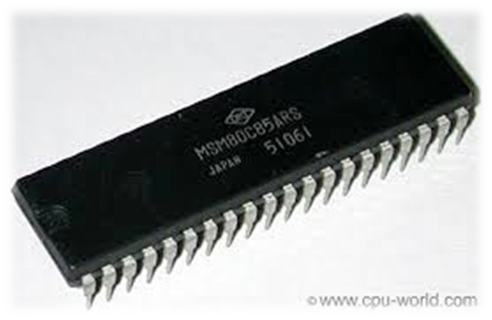
WHAT IS MICROPROCESSOR?
A microprocessor is a computer processor which incorporates the functions of a computer's central processing unit (CPU) on a single integrated circuit (IC), or at most a few integrated circuits.

Slide 4
8085 MICROPROCESSOR
The Intel 8085 ("eighty-eighty five") is an 8-bit microprocessor produced by Intel and introduced in 1976.
It is a software-binary compatible with the more- famous Intel 8080 with only two minor instructions added to support its added interrupt and serial input/output features.

Slide 5
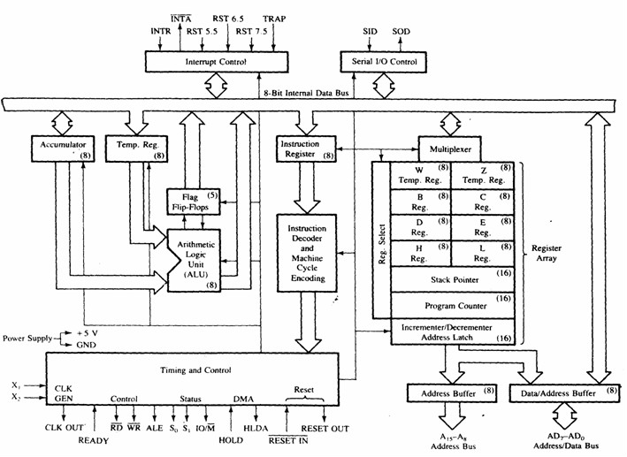
BLOCK DIAGRAM OF 8085

Slide 6
REGISTER SECTION
Temporary Register
General purpose register
Special purpose register

Slide 7
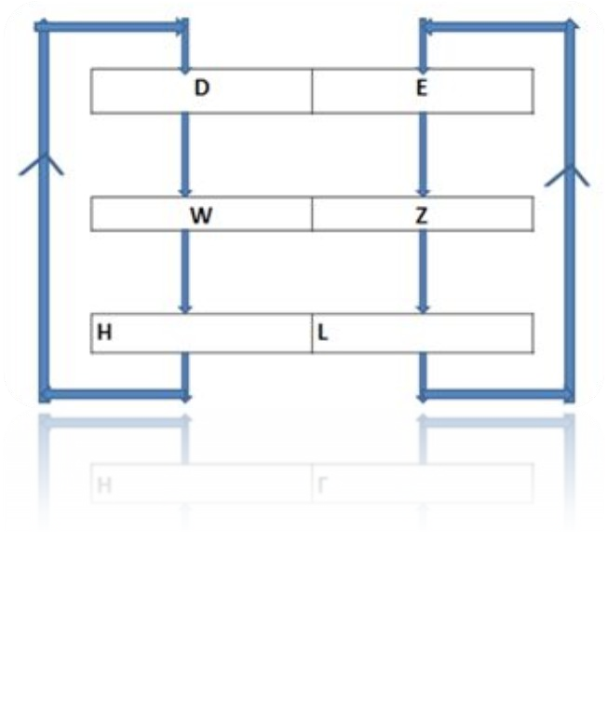
TEMPORARY REGISTER
In 8085 microprocessor, there are three temporary 8 bit register. One is used during calculation to keep data temporarily and then move it to destination ,the other two ‘W’ and ‘Z’ temporary register are used to hold data/address temporarily during execution of some instruction.

Slide 8
GENERAL PURPOSE REGISTER
B-C, D-E, H-L are the general purpose register.
This register can also be used to work in pairs to hold 16-bit data.
The H-L pairs works as a memory pointer.
A memory pointer holds the address of a particular memory location.

Slide 9
SPECIAL PURPOSE REGISTER
Accumulator
Instruction Register and Decoder
Program Counter
Stack Pointer
Flag Register

Slide 10
1. ACCUMULATOR
It is an 8 bit Register use to perform Arithmetic Logical Input and output Operation.
It is connected to the Internal Bus and ALU.

Slide 11
INSTRUCTION REGISTER & DECODER
In computing, an Instruction Register (IR) is the part of a CPU’s control unit that holds the instruction currently being executed or decoded.
There is an Instruction Decoder which decodes the information’s present in the instruction register for further processing.

Slide 12
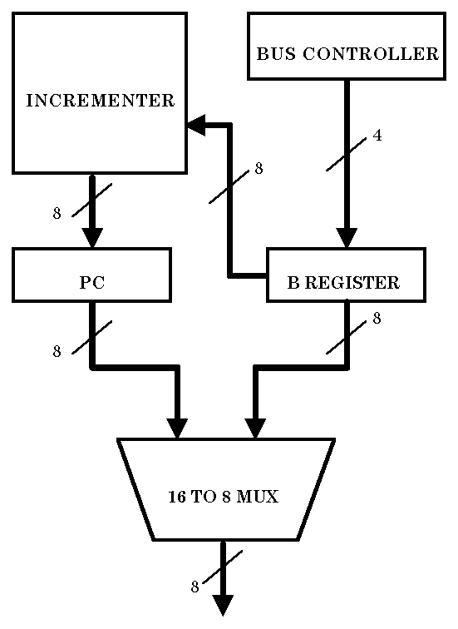
3. PROGRAM COUNTER
A Program counter is a register in a computer processor that contains the address (location) of the instruction being executed at the current time.

Slide 13
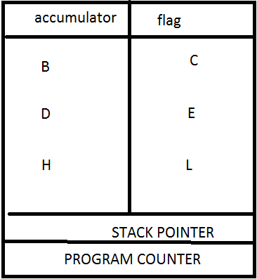
4. STACK POINTER
A Stack pointer is a small register that stores the address of the last program request in a stack.
A stack is a specialized buffer which stores data from the top down.

Slide 14
5. FLAG REGISTER
Sign Flag (S): Sign flag occupies the 7th bit of the flag register which is also known as the Most Significant Bit ( MSB ).
Zero Flag (Z): Zero flag occupies the 6th bit of the flag register. It is set(1) when the operation performed in the ALU (Arithmetic and Logic unit) results in 0 and is reset(0) when the result is not zero.
Auxiliary Carry Flag (AC): If an operation performed in ALU generates the carry from D7 to next stage then CY flag is set, else its reset.

Slide 15
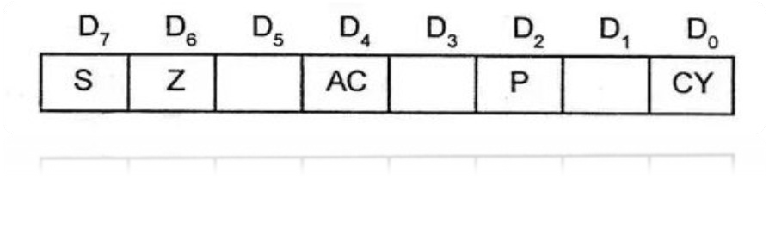
Parity Flag (P): If the result contains Even number of 1’s then parity exists and flag bit is set.
Carry Flag (CY): If the arithmetic operation finally results in a carry, carry flag is set(1). Else, it is reset(0).

Slide 16
ALU
The Arithmetic Logic Unit performs the actual numerical and logic operation such as AND, OR, NOT etc.
It is not accessible by user.
The world length of ALU depends upon of an internal data bus.
It is 8 bit. It is always controlled by timing and control circuits
It provides status or result of flag register.

Slide 17
ARITHMETIC & LOGICAL SECTION
Instruction Decoder and Machine cycle encoder
Address Buffer & Data Buffer
Increment/Decrement Address latch
Interrupt control
Serial I/O CONTROL Group
Timing and Control

Slide 18
1. INSTRUCTION DECODER & MACHINE CYCLE ENCODER
▪ The Instruction Decoder of a processor is a combinatorial circuit sometimes in the form of a read-only memory, sometimes in the form of an ordinary combinatorial circuit.
▪ A Machine Cycle, also called a processor cycle or a instruction cycle, is the basic operation performed by a Central Processing Unit (CPU).

Slide 19
2. ADDRESS BUFFER & DATA BUFFER
Address Buffer Data Buffer
It is a group of lines (wires) used to refer a physical location in memory.
It is unidirectional.
8085 has 16-bit address bus.
It also called memory bus.
Used to carry the data.
It is bidirectional.
the width of the data bus is determined by the size of the individual memory blocks (in 8085, it is 8-bit).

Slide 20
3. INCREMENT/DECREMENT ADDRESS LATCH
This 16-bit register is used to increment or decrement the contents of program counter or stack pointer as a part of execution of instructions related to them.

Slide 21
4. INTERRUPT CONTROL
The processor fetches, decodes and executes instructions in a sequence. Sometimes it is necessary to have processor the automatically execute one of a collection of special routines whenever special condition exists within a program or the microcomputer system.

Slide 22
There are 6 pins available in 8085 for interrupt:
TRAP
RST 7.5
RST6.5
RST5.5
INTR
INTA

Slide 23
5. SERIAL I/O CONTROL GROUP
The data transferred on to data bus is parallel data, but under some conditions it is advantages to use serial data transfer at that time this control group is brought into application.
The input and output of serial data can be carried out using 2 instructions in 8085:
SID : Serial Input Data
SOD : Serial Output Data

Slide 24
TIMING & CONTROL
It provides timing and control signal to the microprocessor to the perform operation.
❑ Control Signals :
READY
RD’
WR’
AM’
❑ DMA (Direct Memory Address) :
HOLD
HLDA
❑ Status Signals :
❑ Reset Signals:
S₀
S₁
IO/M’
RESET IN
RESET OUT

Slide 25
WHAT IS BUS?
It is a set of pins, wires or signals having common function as bus.
➢ Address Bus :
A15-A8, it carries the most significant 8-bits of memory/IO address.
➢ Data Bus :
AD7-AD0, it carries the least significant 8-bit address and data bus.

Slide 26
CONCLUSION
The 8085 processor was used in a few early personal computers, produced from 1977 to early-to-mid1980’s. Now-a-days, in many engineering schools the 8085 processor is used in introductory microprocessor courses. However with time, better quality microprocessors have been developed with greater bit processing Capability (32 and 64 bit) along with huge no of other modifications.

