Slide 1
Precision Targeting: Unveiling Customer Niches for Strategic Growth

Slide 2

Executive summary
Precision targeting is a strategic marketing approach that involves identifying and reaching specific customer segments with a high degree of accuracy and relevance. This process goes beyond broad and generic marketing efforts, aiming to unveil distinct customer niches within a market.
By utilizing data-driven insights and segmentation strategies, businesses can tailor their marketing efforts to address the unique needs, preferences, and behaviors of these targeted customer groups. The ultimate goal is to maximize the effectiveness of marketing initiatives, drive customer engagement, and achieve strategic growth objectives.

Slide 3
Table of contents
01
02
03
04
Business Challenge
Use Cases
Proposed Solution
Applications

Slide 4
01
Business Challenge

Slide 5
1. Data Quality and Integration
Ensuring the quality, accuracy, and completeness of the data used for precision targeting is crucial. Inaccurate or incomplete data can lead to flawed customer profiles, resulting in ineffective targeting.
2. Privacy Concerns and Compliance
Balancing the need for personalized targeting with customer privacy concerns and
compliance with data protection regulations is a delicate task. Mishandling of customer data can lead to trust erosion and legal consequences.

Slide 6
The potential for biases in algorithms can result in unfair targeting or unintended consequences, leading to suboptimal outcomes and potential reputational damage.
3. Algorithm Bias
4. Segmentation Accuracy
Ensuring that customer segmentation accurately reflects real-world behaviors and preferences is essential for effective targeting. Inaccurate segmentation may lead to misdirected marketing
efforts.
Maintaining a consistent and cohesive customer experience across various marketing channels is challenging due to the diversity of platforms and communication methods.
5. Cross-Channel Consistency:

Slide 7
02
Use Case

Slide 8
1.E-commerce: Personalized Product Recommendations:
Challenge: Enhance customer experience and boost sales through personalized product recommendations.
Data Collection: Analyze customer browsing and purchase history.
Customer Segmentation: Identify segments based on product categories, purchase frequency, and preferences.
Tailored Marketing: Precision targeting with personalized recommendations through email, website banners, and social media ads.
Outcome: Increased customer engagement, higher conversion rates, and improved satisfaction, leading to strategic sales growth.
2. Retail: Location-Based Offers
Challenge: Boost foot traffic and sales in specific store locations.
Data Collection: Analyze customer data, including location, purchase history, and preferences.
Customer Segmentation: Segment based on proximity to store locations and shopping behaviors.
Tailored Marketing: Launch location-specific promotions and offers through mobile apps or targeted advertisements.
Outcome: Increased store visits, higher in-store sales, and strategic revenue growth in targeted locations.

Slide 9
3. Telecommunications: Targeted Service Plans
Challenge: Reduce customer churn and increase loyalty with personalized service plans.
Data Collection: Analyze usage patterns, preferences, and historical interactions.
Customer Segmentation: Segment based on data usage, calling patterns, and preferred services.
Tailored Marketing: Introduce personalized service plans based on individual communication needs.
Outcome: Reduced churn, increased loyalty, and strategic growth in subscription renewals.
4. Healthcare: Precision Health Campaigns
Challenge: Improve patient engagement and preventive care.
Data Collection: Utilize electronic health records and patient history data.
Customer Segmentation: Identify segments based on health conditions, risk factors, and interactions.
Tailored Marketing: Precision targeting for health awareness campaigns, check-up reminders, and personalized health tips.
Outcome: Improved patient engagement, enhanced preventive care, and strategic growth in overall health outcomes.

Slide 10
5. Automotive: Targeted Vehicle Promotions
Challenge: Boost sales for specific vehicle models.
Data Collection: Analyze preferences, past purchases, and demographic data.
Customer Segmentation: Segment based on vehicle preferences, features, and lifestyle.
Tailored Marketing: Launch targeted campaigns emphasizing features aligned with customer preferences.
Outcome: Increased sales for targeted models and strategic growth in market share.
6. Financial Services: Personalized Financial Advice
Challenge: Increase customer satisfaction and loyalty through personalized financial advice.
Data Collection: Analyze financial transactions, investment history, and life events.
Customer Segmentation: Segment based on financial goals, risk tolerance, and investment preferences.
Tailored Marketing: Provide personalized financial advice through targeted communication channels.
Outcome: Improved satisfaction, increased loyalty, and strategic growth in managed assets.

Slide 11
03
Proposed Solution

Slide 12
1.Dataset
(a) Demographic Information:
Age, gender, income, marital status, and other demographic details help in understanding the basic characteristics of customers.
(b) Geographic Information:
Location data, such as city, state, and country, can be useful for regional segmentation and targeting.
(c) Behavioral Data:
Purchase history, browsing behavior, transaction frequency, and interactions with marketing campaigns provide insights into customer behavior.
(d) Customer Preferences:
Preferences for certain products, brands, or categories help tailor marketing strategies and product recommendations.
(e) Customer Loyalty:
Information about loyalty program participation, repeat purchases, and customer tenure provides insights into customer loyalty.
(f) Customer Interactions:
Data on interactions with customer service, feedback, and reviews can help understand customer satisfaction and sentiment.

Slide 13
(g) RFM Metrics (Recency, Frequency, Monetary):
Calculating recency (time since last purchase), frequency (number of purchases), and monetary value (total spending) helps identify high-value customers.
(h) Customer Engagement Metrics:
Metrics like click-through rates, open rates, and engagement with marketing materials provide insights into customer engagement.
(i) Social Media Activity:
Data on social media interactions and mentions can be valuable for businesses with a strong online presence.
(j) Churn or Retention Information:
Identifying customers who have churned or remained loyal is critical for segmentation and targeted retention strategies.
(k) Website Interaction Data:
For online businesses, data on website navigation, time spent on pages, and specific actions taken on the site can be valuable.

Slide 14
2. Machine Learning Algorithm Used
i. K-Means Clustering:
Description: K-Means is a popular unsupervised machine learning algorithm used for clustering. It partitions the dataset into 'k' clusters based on similarity, with each cluster represented by its centroid.
Application: Fintech companies can use K-Means to group customers with similar transaction patterns, spending behaviors, or financial goals. For instance, it could be used to identify clusters of customers with high transaction frequency and similar spending habits.
ii. DBSCAN (Density-Based Spatial Clustering of Applications with Noise):
Description: DBSCAN is a density-based clustering algorithm that groups together data points that are close to each other and have a sufficient number of neighbors, while marking isolated points as outliers.
Application: Fintech companies may use DBSCAN to identify densely populated regions of customers with similar financial behaviors. It is particularly effective in identifying outliers, which can be useful in detecting anomalies or potential fraud.

Slide 15
3.Association Rule Mining:
Description: Association rule mining identifies relationships between variables in a dataset, revealing patterns such as "if A then B." It is commonly used in market basket analysis but can also be applied to financial transactions.
Application: Fintech companies can apply association rule mining to understand associations between different financial products or services, helping in targeted cross-selling efforts.

Slide 16
04
Our Project

Slide 17
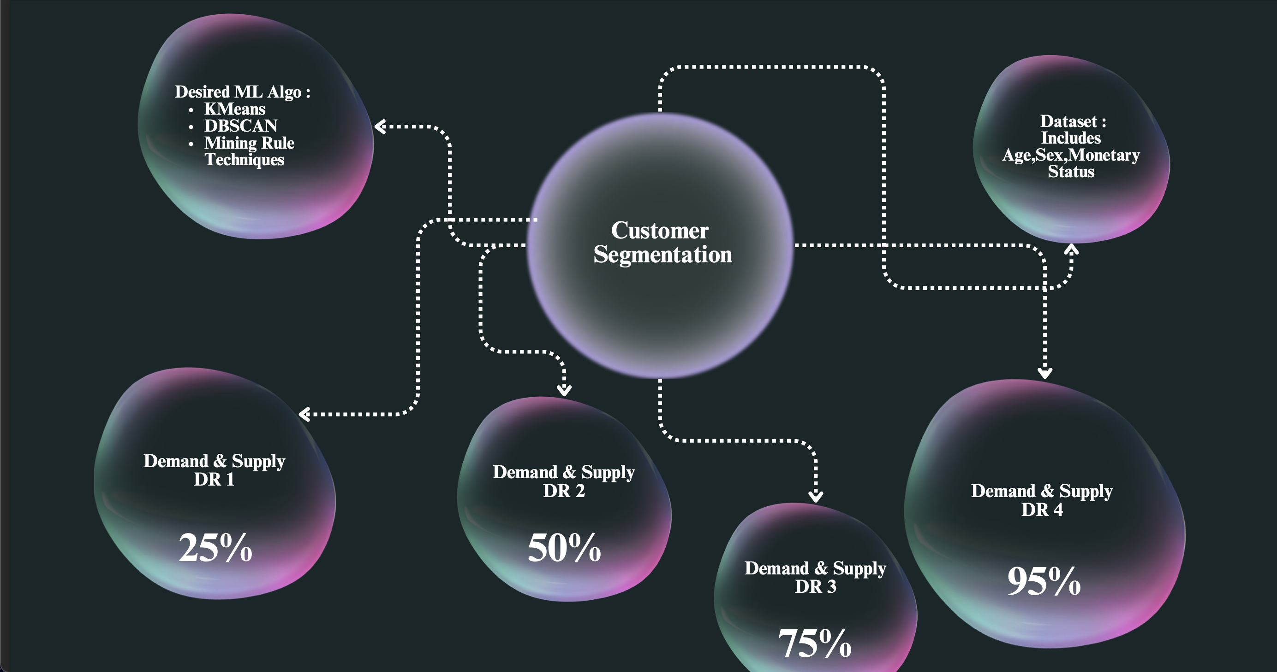

Slide 18
Our project focuses on customer segmentation as a strategic tool for driving market growth, particularly in the fashion industry. By dividing customers into distinct niches based on demand and supply, we aim to:
Identify key customer segments: We've defined four segments (DR1, DR2, DR3,DR4) representing different demand-supply ratios (25%, 50%, 75%, 95% of the population consuming a given product).
Understand preferences within segments: We recognize that within each segment, further sub-divisions can exist based on specific preferences. For example, within the 15-25 age group, some might favor "cocky or drip" designs for daily wear.
Solution: Fashion Recommendation System:
To address these needs, we've developed a "fashion recommendation system" that serves as our core offering. This system operates across three key facets:
Age-Group Targeting: It tailors recommendations to different age groups,recognizing their distinct fashion styles (e.g., 10-12 vs. 15-25 vs. 50-60).
Segment-Level Customization: Within each age group, it can delve deeper to identify preference niches (e.g., "cocky or drip" within 15-25).
Data-Driven Insights: It leverages consumer data to dynamically determine optimal pricing and timing strategies for maximizing sales and profitability.

Slide 19
Impact and Benefits:
This project holds significant potential for organizations seeking to achieve:
Targeted Marketing: More effective and efficient marketing efforts by focusing on distinct customer segments with tailored messaging and offerings.
Increased Sales: Reaching the right customers with the right products at the right time, leading to higher conversion rates and sales volume.
Enhanced Profitability: Optimized pricing strategies based on data-driven insights, maximizing profit margins while remaining competitive.
Improved Customer Satisfaction: Catering to specific preferences within segments, fostering customer loyalty and positive brand experiences.

Slide 20
Thank You

