Slide 1
Yoyo Card’s 12-month journey
Treasury and Trade Solutions
February 7, 2024
Notes:
1

Slide 2
Yoyo Card – Corporate Transaction Insights
The following insights were derived from 5,000 corporate transactions made over the last year:
Clientele – Majority of the client are mid to large corporate clients with a smaller section of Them contributing heavily.
Transactions – About 75% transaction are domestic with 25% overseas transaction. The overseas transaction fee drives more revenue than domestic ones.
Region – Domestic transaction Contribute more in transaction revenue and more transaction counts, overseas transaction total fees is higher than domestic
Payment Mode – 51% payments were made in Cash, followed by 33% made via online mode and 16% in bank transfer.
Suggestions
Tiered pricing can be introduced to increase overseas transactions.
Virtual cards can be introduced flto drive more online transactions.
Bundled FX and card solutions can be introduced to increase transaction count and hence drive more revenue in overseas transactions

Slide 3
Yoyo Card – Spending Insights

Slide 4
Yoyo Card – Charge Insights
From the graph above, we could gather:
Annual Charge – $1200 which is in the middle of the charges by competitors.
Transaction Value Charge (%) – 0.5% of the transaction value in domestic transaction and 5% of transaction value in overseas transaction. Both domestic and overseas transaction charges can be increased along with a minimum cash withdrawal fee

Slide 5
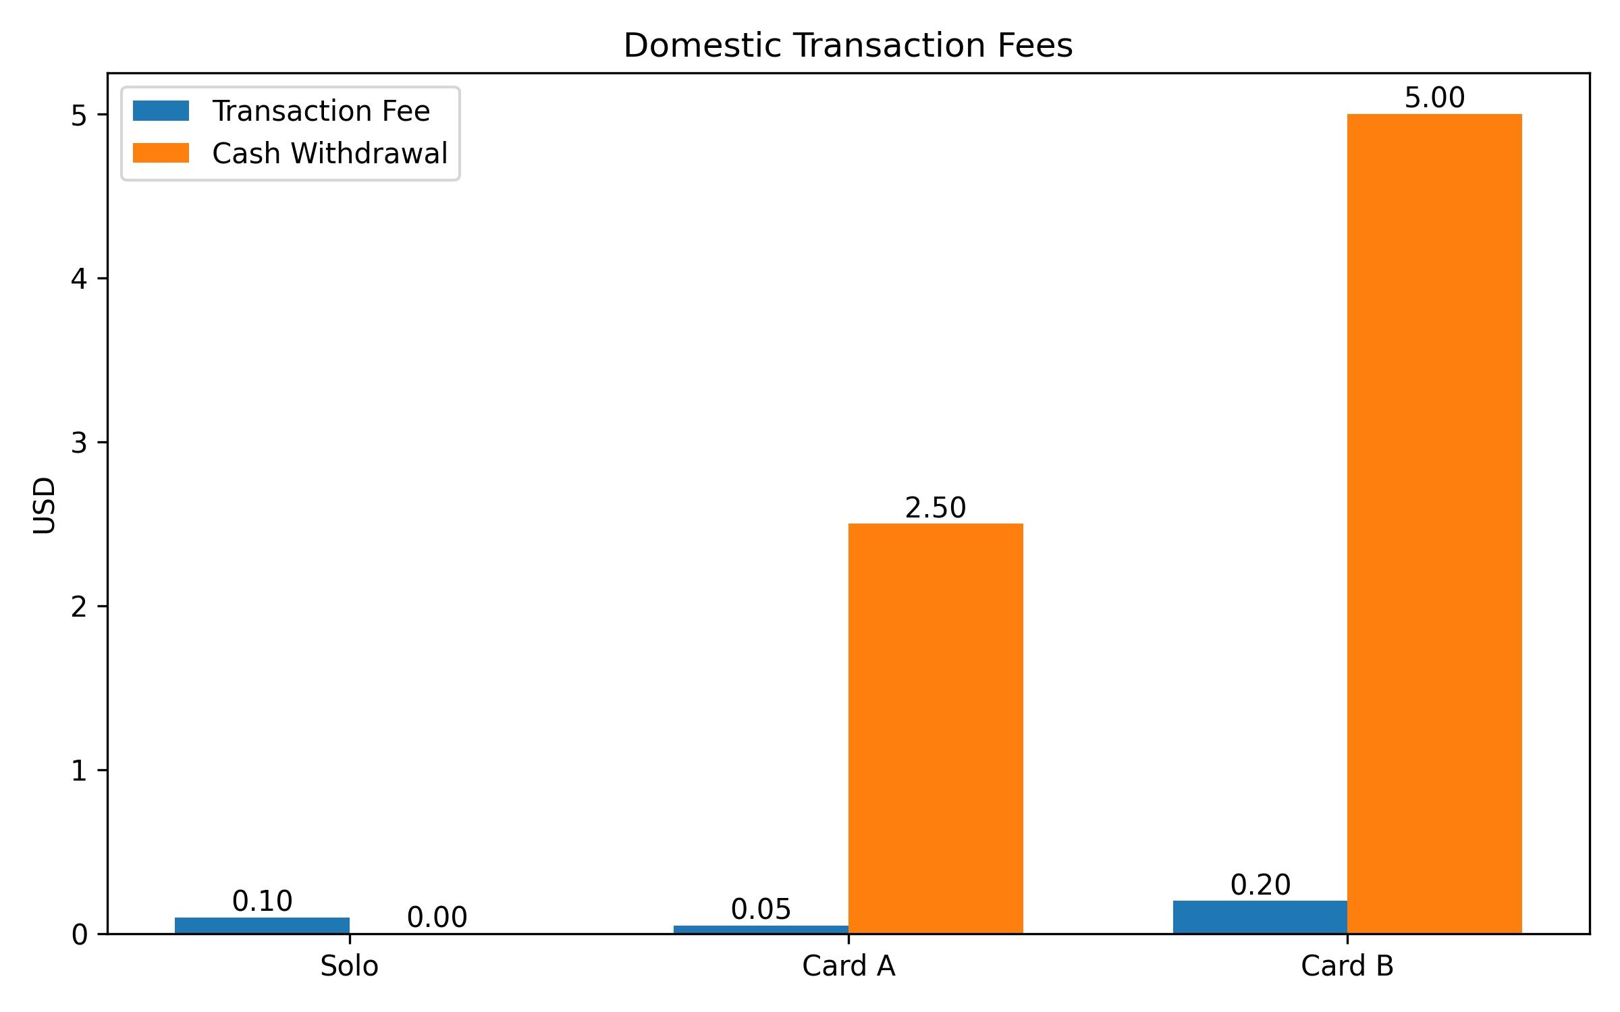
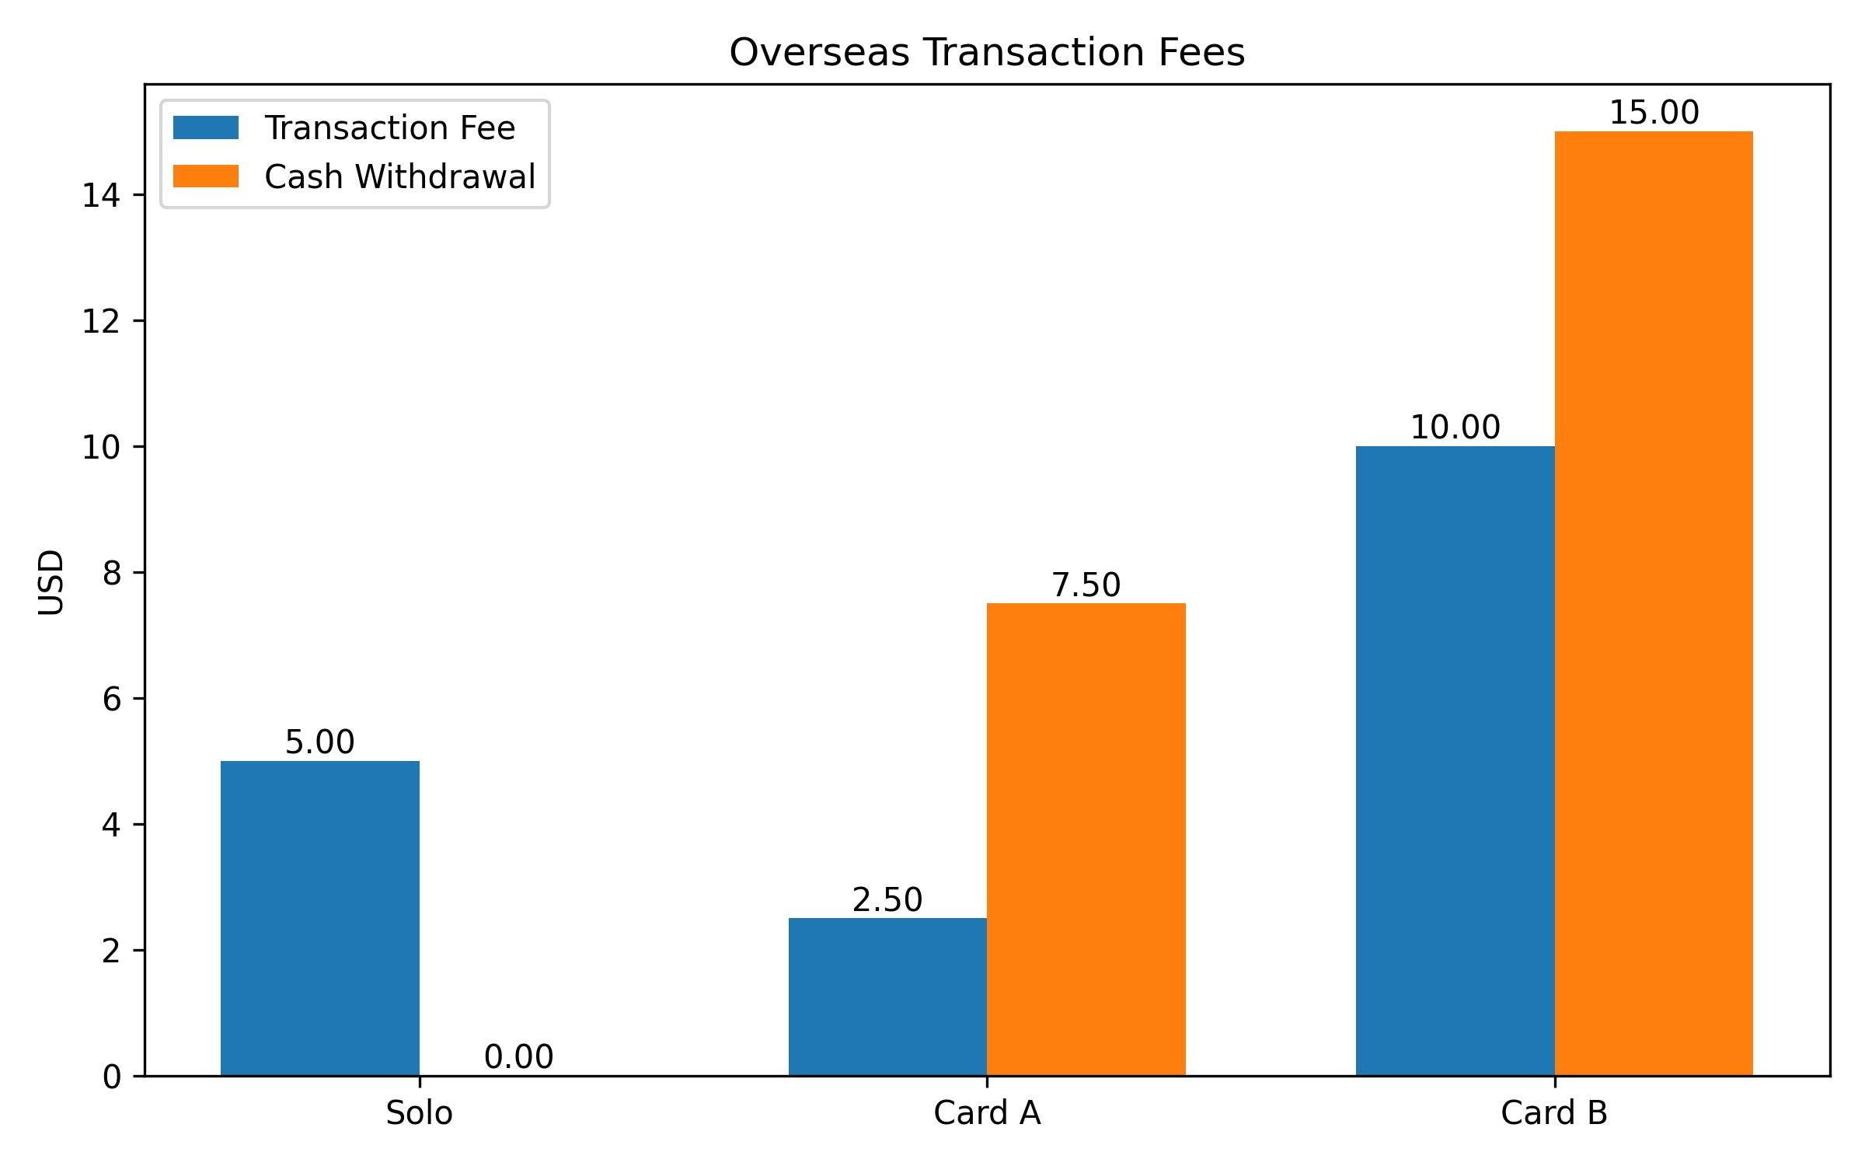
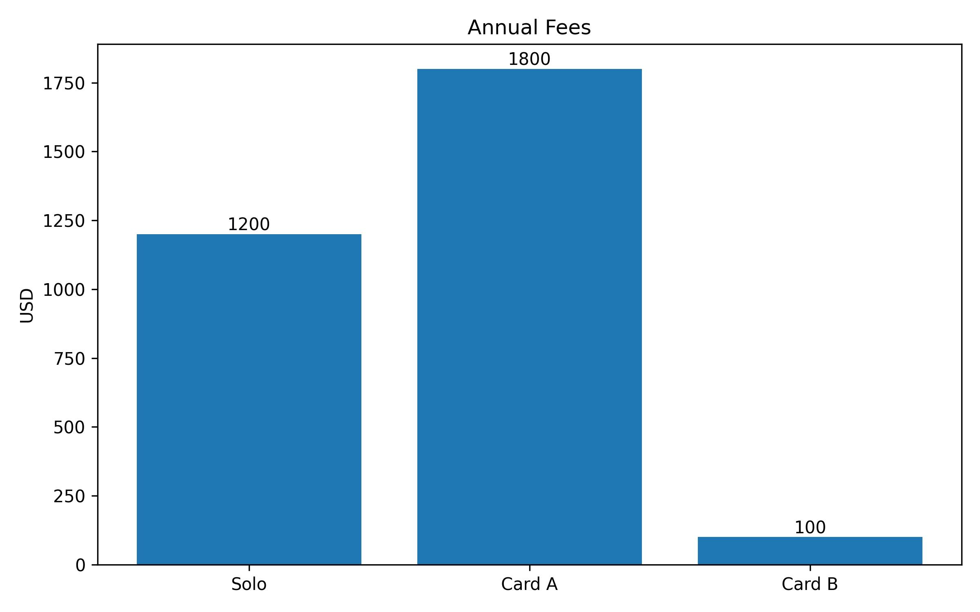
Yoyo Card – Charge Insights (cont.)
From the graph above, we could gather:
Fixed fee per transaction – Fixes fee per transaction is good in market.
Cash withdrawal fees – cash withdrawal fees needs to be added to increase revenue.

