Slide 1
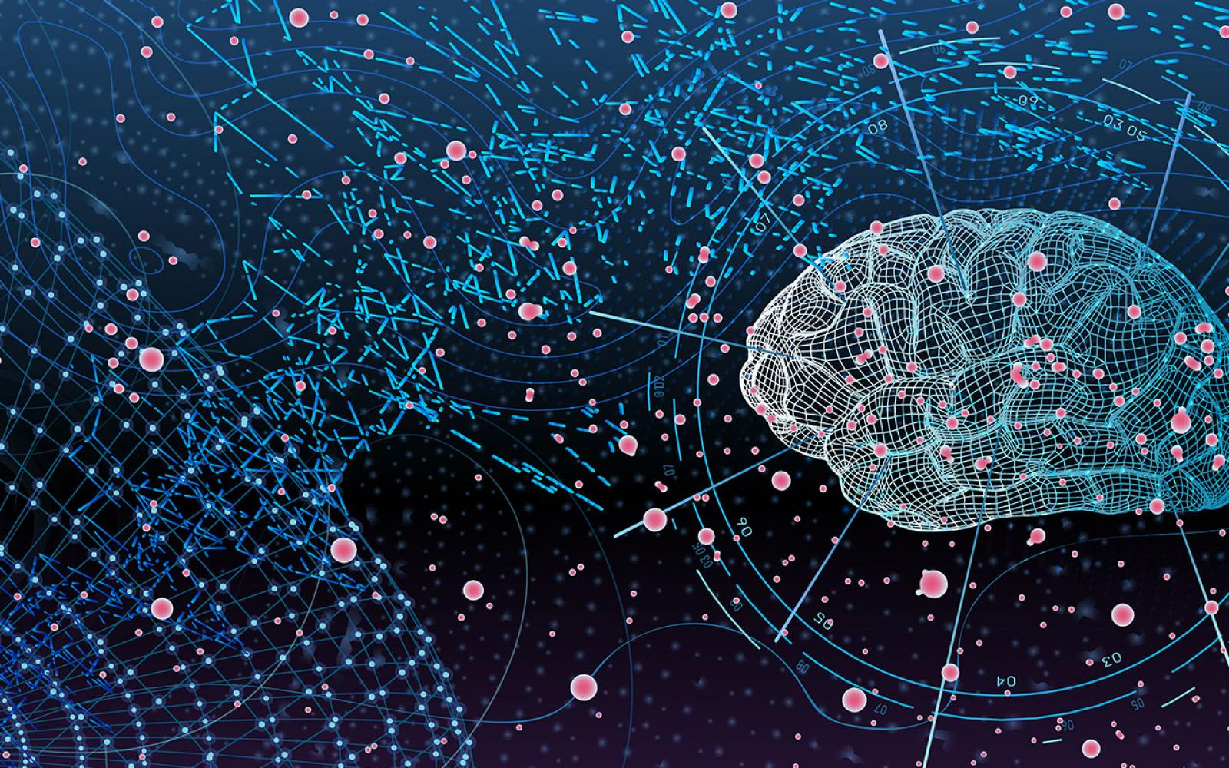
U-Net: Convolutional Networks for biomedical image segmentaion
Pattern Recognition Lab
Author:Olaf Ronneberger,Philipp Fischer and Tomas Brox

Slide 2
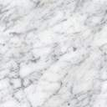
Presented By Group 7
Pattern Recognition Lab
Mazharul Islam Leon 011 153 031
Md Ifraham Iqbal 011 161 282
Sadaf Meem 011 153 048
Sharmin Sultana 011 153 002
Morshed Ahmed 011 162 036
Sanjana Rahman 011 161 065

Slide 3
Outline
Pattern Recognition Lab
Introduction To Neural Network
Architecture & U-Net
Image Segmentation
Conclusion
Summaries of official Papers
3

Slide 4
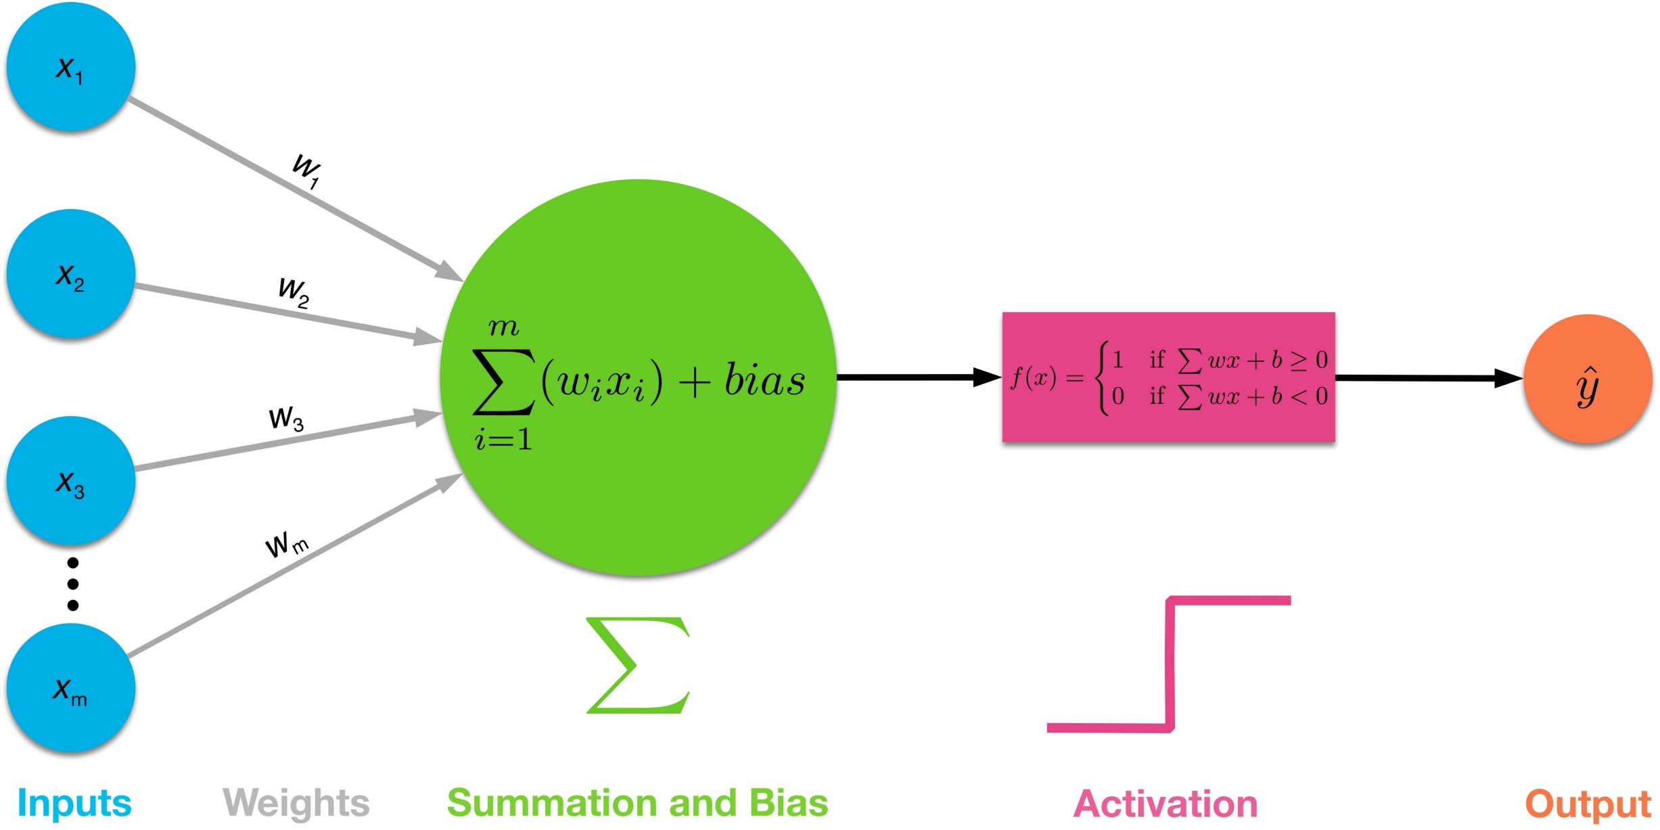
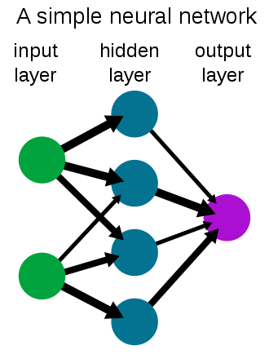
Inro to NN
Pattern Recognition Lab
Input Data
Weight & Bias
Activation Function
4

Slide 5
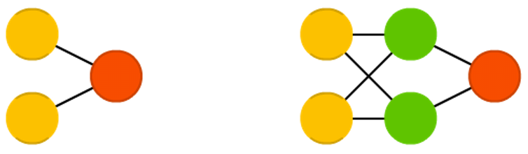
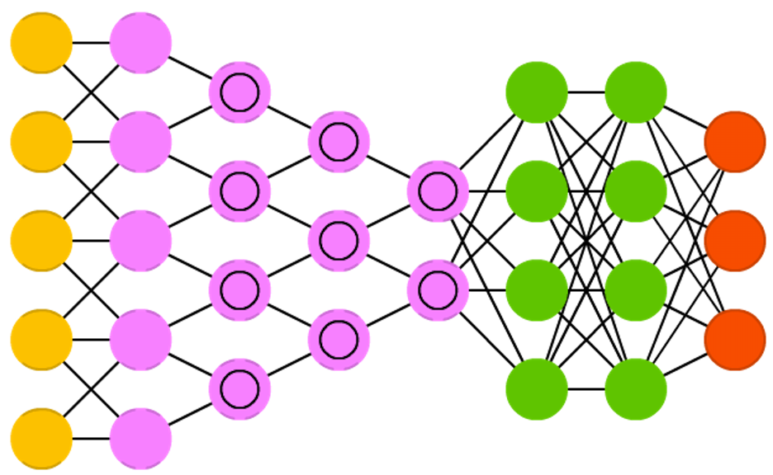
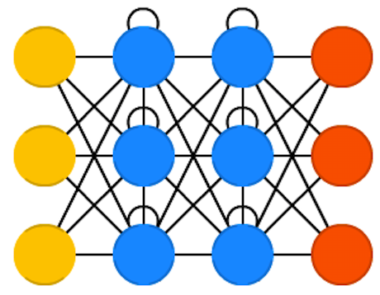
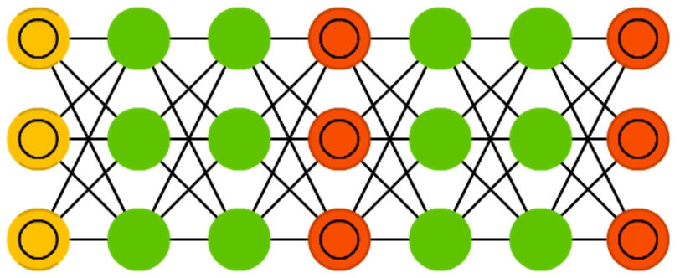
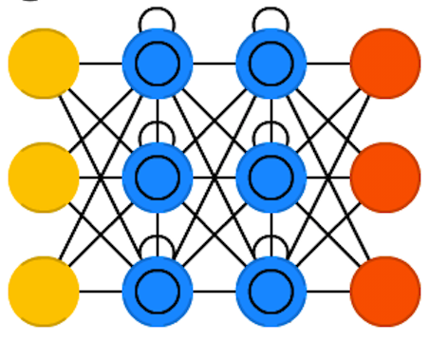
Architecture & U-Net
Pattern Recognition Lab
Single – Perceptron's & Multi Layer Perceptron's
AlexNet
Convolutional Neural Network (CNN)
VGG-16, VGG-19
GAN
Recurrent Neural Network (RNN)
LSTM
And .. Many more architecture available
Why need different type of architecture ?
Peceptrons
CNN
RNN
LSTM
GAN
5

Slide 6
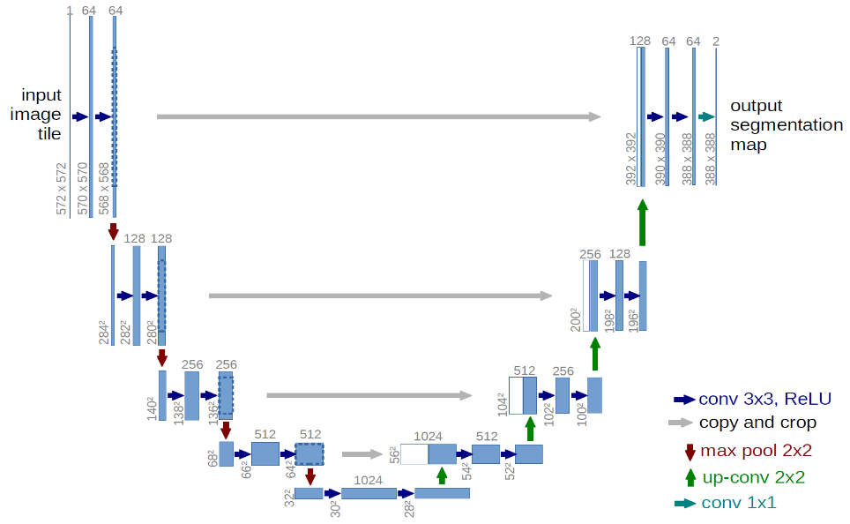
Architecture & U-Net
Pattern Recognition Lab
U Shape Architecture
Conv Layer
Contraction
Encoding
Expansion
Decoder
6

Slide 7
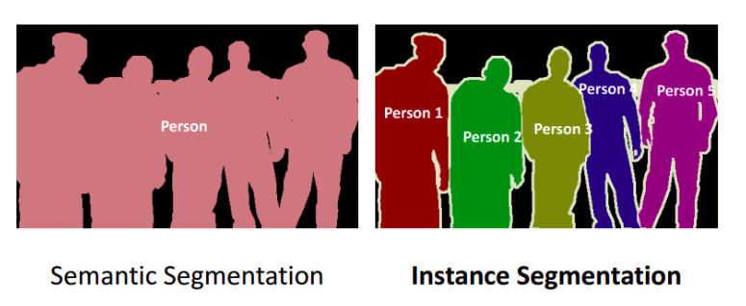
Image Segmentation
Pattern Recognition Lab
Instance Segmentation- Objection detection
Semantic Segmentation- Biomedical, cell/neuclous tracking, tumor detection etc.
U-Net Architecture use semantic segmentaion
7

Slide 8
Summaries
Pattern Recognition Lab
8

Slide 9
Conclusion
Pattern Recognition Lab
9

Slide 10
THANK YOU
Pattern Recognition Lab
“To deal with a 14-dimensional space, visualize a 3-D space and say ‘Fourteen’ to yourself very loudly. Everyone does it”
Geoffrey Hinton

