Slide 1
Nepali Audio Signal Synthesizer
Prepared By:
Milan Maharjan (072bex426)
Ravikiran Aryal (072bex434)
Tejasvi Raj Pant (072bex447)
Tribikram Panthi (072bex448)
Submitted To:
Department of Electronics and Computer Engineering

Slide 2
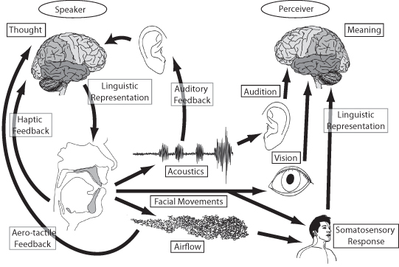
Audio Signal has always been a part of interest.

Slide 3
What is our project?
It is a concatenative model based Nepali text to speech system.
Text
Input
Conversion Model
Audio Output

Slide 4
How it is all done?
Text
Input
Preprocess the text
Divide the text into phonetic code
Apply
Filter
Concatenate
them
Load waveform for each phoneme
Play
the audio

Slide 5
We started with Data collection.

Slide 6
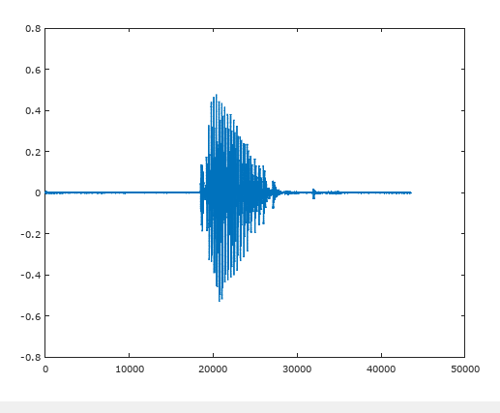
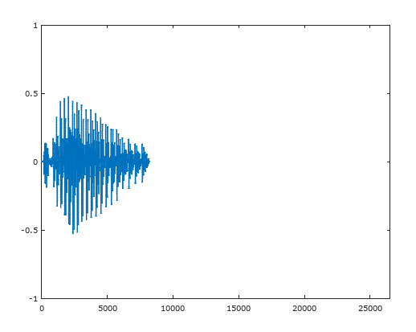
Data Collection
At Raw state
After Preprocessing

Slide 7
Behind the scene, what happens is:
पुल्चोक $ *
पुल्चोक
पुल्चोक = पु + ल् + चो +क

Slide 8
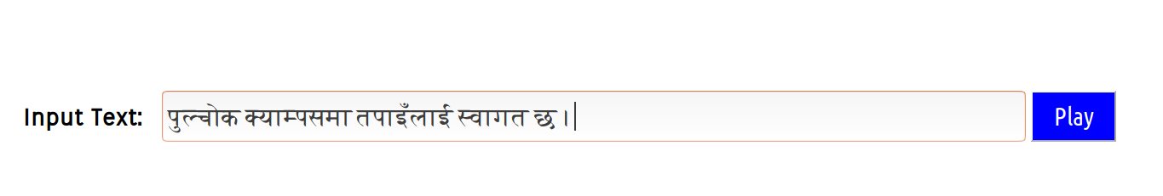
User interface

Slide 9
SWOT ANALYSIS
S
-Can handle many unexpected situation
W
-Non-humanly sound
O
Possibility of further enhancement
T
- Outdated Model

Slide 10
Applications
It can be used as assistance technology for verbally impaired
and illiterate people.
It can be used for giving humanoid ability to robots.
It can be used for making voice bots which can serve people in many field like hospitals, government offices etc.
It may change the way we produce audiobooks, radio programs and many more.

Slide 11
Thank you

