Slide 1


Expense Tracker Web Project
This project involves creating a dynamic web application using PHP to help users track their expenses. It will empower users to effectively manage their finances by providing a comprehensive platform for recording, managing, and analyzing spending habits.
by ALGORITHM AVENGERS

Slide 2

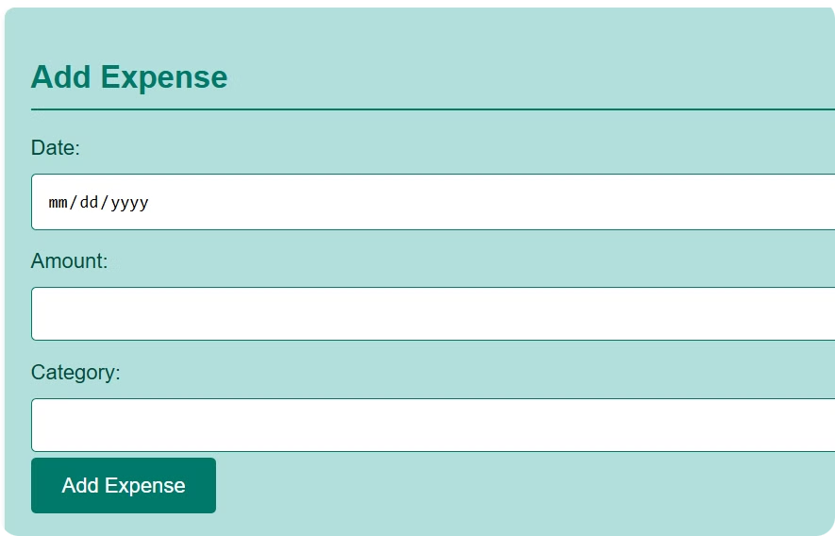
Add Expense Functionality
1
User Input
2
Data Validation
This feature will allow users to enter details about their expenses, such as date, category, amount, and description.
The application should validate user inputs to ensure accuracy and prevent errors.
3
Database Storage
4
Confirmation Message
The entered expense data will be securely stored in a database for easy access and retrieval.
After successful data submission, users will receive a confirmation message, ensuring that the expense has been added correctly.

Slide 3
Update Expense Functionality
User Interface
Data Retrieval
Data Validation
Users should have a user-friendly interface for updating expense entries, allowing them to modify any previously entered data.
The application should efficiently retrieve the existing expense record for editing, ensuring that the correct entry is being updated.
Input validation is crucial for updates as well, ensuring data integrity and preventing errors.

Slide 4





Delete Expense Functionality
Confirmation Prompt
The application should display a confirmation prompt before deleting an expense to prevent accidental deletion.
Database Removal
Upon confirmation, the selected expense record will be removed from the database.
Update Display
The user interface should be updated, reflecting the deletion and removing the deleted expense from the list.

Slide 5
Total Expenditure Calculation
1
Data Aggregation
The application will aggregate all expense entries to calculate the total expenditure for a specified period.
2
Filtering Options
Users should have options to filter expenses by date range, category, or other criteria for detailed analysis.
3
Display Results
The calculated total expenditure will be displayed in a clear and user-friendly format, enabling users to quickly understand their overall spending.

Slide 6

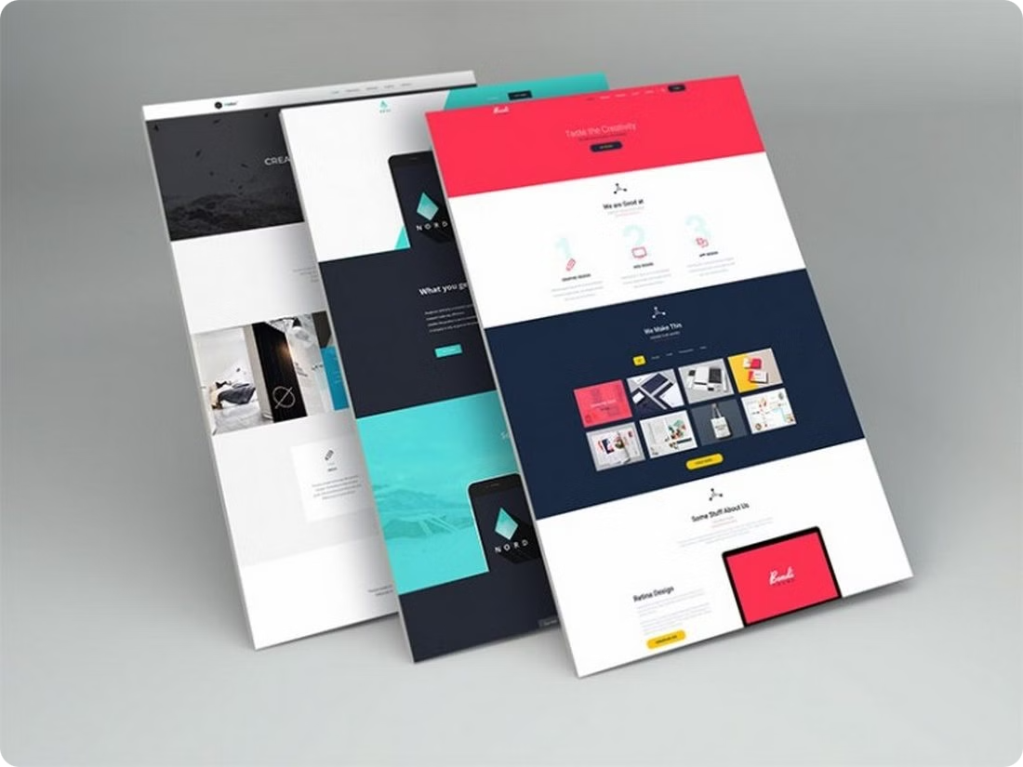
User Interface Design
Intuitive Navigation
Clear Visual Hierarchy
The UI should provide a simple and intuitive navigation structure, enabling users to easily access different functionalities of the application.
The design should effectively prioritize information, ensuring that important elements are prominently displayed.
Responsive Design
User Feedback
The application should be accessible and functional across various devices, including desktops, laptops, tablets, and smartphones.
Gather feedback from users to identify areas for improvement and ensure a user-centric design.

Slide 7
Database Integration
Database Management System
MySQL
Table Structure
Design tables to store expense details efficiently, considering columns like date, category, amount, description, and user ID.
Data Relationships
Establish appropriate relationships between tables to ensure data integrity and consistency, like a user table linking to the expense table.
Security Measures
Implement measures like data encryption and secure user authentication to safeguard sensitive financial data.

Slide 8




Conclusion and Future Enhancements
Reporting Features
Budgeting Integration
The application could be enhanced with advanced reporting features to generate insightful charts and graphs summarizing expenditure trends.
Integrating budgeting functionalities would allow users to set financial goals and track progress towards them.
Cloud Synchronization
Automated Notifications
Enabling cloud synchronization would allow users to access their expense data from multiple devices, ensuring data accessibility.
The application could send automated notifications to users about upcoming bill payments or spending thresholds.

