Slide 1




Group18
Design and build 2025
BEIJING UNIVERSITY OF POSTS AND TELECOMMUNICATIONS
2025/10/20

Slide 2

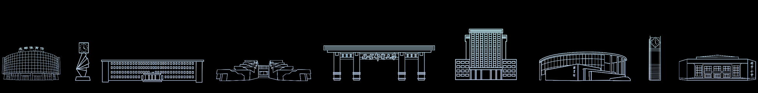
Team members
Jialing Ma: Frontier Point Filtering, Map Denoising, Host System Architecture Design and coding
01
06
Qiran Sun: System Architecture
07
Shangyang Li: Motor Drive
02
Zhenzhan Zhao: Visualization
08
Ran Sun: Bluetooth Data Transmission
03
Tianxiao Ma: A* Algorithm
09
Chuqi Liu: Radar Data Processing
04
Zhichun Tang: Decoding Pose
10
Kaixi Xu: MPU Attitude Sensing
05
Zhengxiao Zha: SLAM Algorithm
11
Jiaqi Yin: System Integration

Slide 3

PART
01
Software Code

Slide 4




Software part
Project objectives
and overall planning
The core objective of this project is to build a fully autonomous intelligent navigation system.
This system serves as the "brain" of the car, enabling it to independently complete intelligent exploration, path planning and other tasks in a completely unknown maze environment, relying solely on the real-time map constructed by SLAM. Finally, within the shortest time, it can find and plan a path to the maze exit and successfully drive out of the maze.

Slide 5
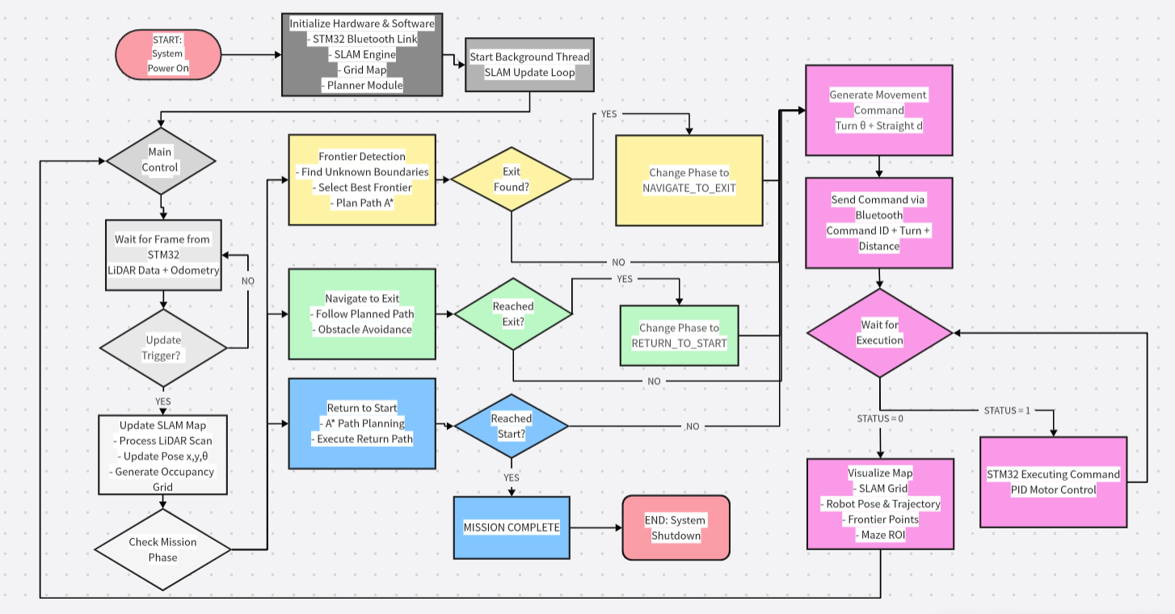
host system architecture design

Slide 6





Software part
01
02
03
State Machine
Decision & Planning
Safety & Execution
We have defined clear task stages, including EXPLORE, GO_TO_EXIT, RETURN_HOME, etc.
This is the "chief commander" of the system, ensuring that the car performs the correct macro tasks at the right time.
MapRectifier: Identify the effective boundaries of the maze to prevent wasting time outside of it.
Obstacle Inflation: Inflate all obstacles to ensure that all planned paths maintain a safe distance from the walls.
waypoint_to_turn_and_go: Finally, the system decomposes the complex A* path into specific action instructions and hands them over to the underlying hardware for execution.
OptimizedFrontierExplorer : Selects the best frontier point using a funnel-based algorithm considering connectivity and goal direction.
GlobalPathPlanner: Uses the A* algorithm to compute the shortest pixel-level route to the target.

Slide 7
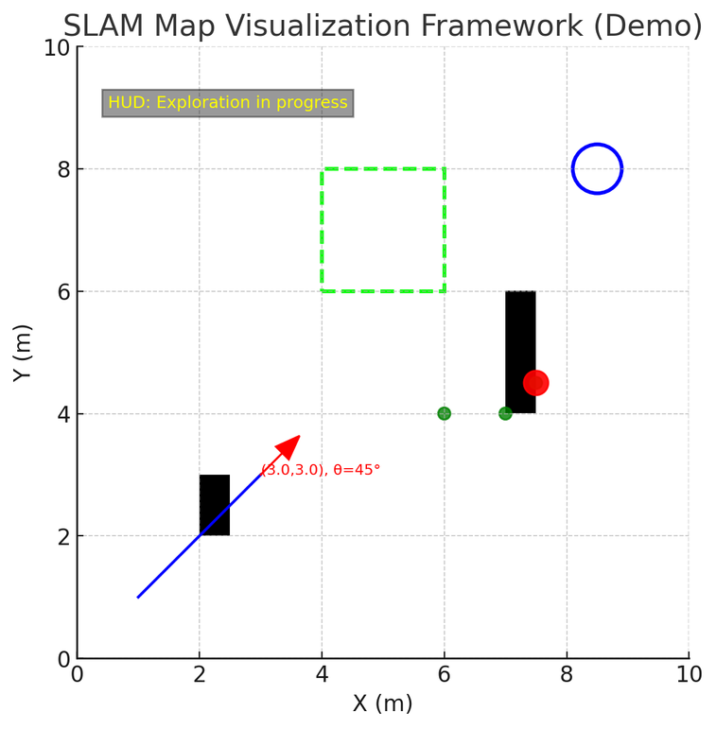





Visualization
Core Objectives
Display SLAM occupancy grid map dynamically
Track robot pose and trajectory in real time
Overlay additional markers (frontier points, exit points, ROI)
Provide intuitive visualization tools for debugging and experiments
01
SLAM Map Visualization Framework
System Structure
Map Display: Occupancy grid shown as grayscale image (imshow)
Robot Rendering: Red arrow indicating position and orientation
Trajectory Tracking: Blue polyline recording historical path
HUD Text: Extra debugging information (yellow text with black background)
ROI Rectangle: Green dashed box highlighting region of interest
02

Slide 8
Visualization
01
02
03
04
Robot & Trajectory
Frontier & Exit Points
ROI Region
Dynamic Refresh
Frontier Points → Exploration boundaries (green/blue small circles) (_draw_frontier_points_extra())
Best Frontier → Highlighted red circle (_draw_frontier_points_extra())
Exit Pose → Blue hollow circle (_draw_exit_pose())
Green Dashed Box → Marks region of interest (display() with mpatches.Rectangle)
Real-time Update → plt.pause(0.01)
Artist Reuse → Prevents ghosting, improves performance
Red Arrow → Current robot pose and heading (_draw_car())
Text Label → Real-time state (x, y, θ) (_draw_car())
Blue Line → Historical trajectory (_update_traj())

Slide 9


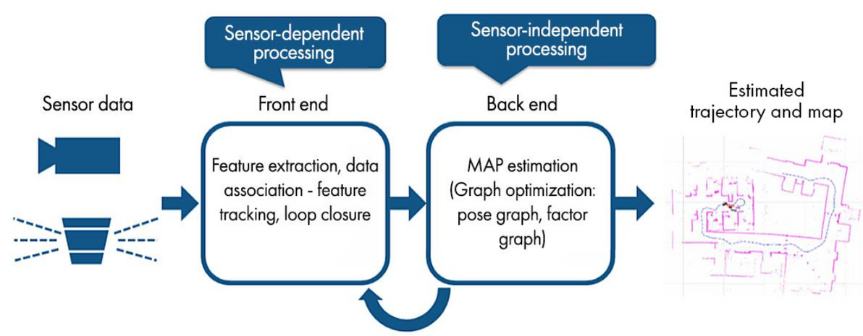
SLAM Algorithm
We employ the SLAM (Simultaneous Localization and Mapping) method to enable robots to simultaneously localize themselves and construct maps in unknown environments. With each movement, the robot must not only utilize the existing map to estimate its new position but also update and expand the map based on new sensor observations.
Core Idea
We use the SLAM (Simultaneous Localization and Mapping) algorithm to help robots simultaneously locate themselves and build a map in unknown environments.
"Simultaneous" means localization and mapping depend on each other and happen in real time — one cannot work without the other.
As the robot moves, it must both estimate its new position using the existing map and update the map with new sensor data.
Output and Example
Core Principles and Workflow

Slide 10
MAP update
Since the system uses BreezySLAM for real-time localization and mapping, the raw occupancy grid produced in each frame often contains considerable noise and temporal instability
To achieve a clean, stable, and geometrically reliable map, a series of post-processing algorithms were designed for noise suppression, temporal fusion, and structure preservation.
Voting-Based Temporal Fusion
Implemented in _update_votes()
Each grid cell keeps two counters:
obstacle_votes[y][x] and free_votes[y][x].
Every new SLAM frame updates these votes:
Obstacle pixel → add one obstacle vote.
Free pixel → add one free vote.
Unknown → ignored.
Locked cells are excluded from updates.
Locking Mechanism for Stable Cells
Implemented in _update_locked_map()
A cell becomes locked (permanently classified) when votes exceed certain thresholds
Final Map Generation
Implemented in _generate_final_map()
Merges locked information with the latest SLAM output:
Locked cells → from locked_map
Unlocked cells → from recent slam_map
Produces a clean, fused occupancy grid ready for navigation and exploration.

Slide 11
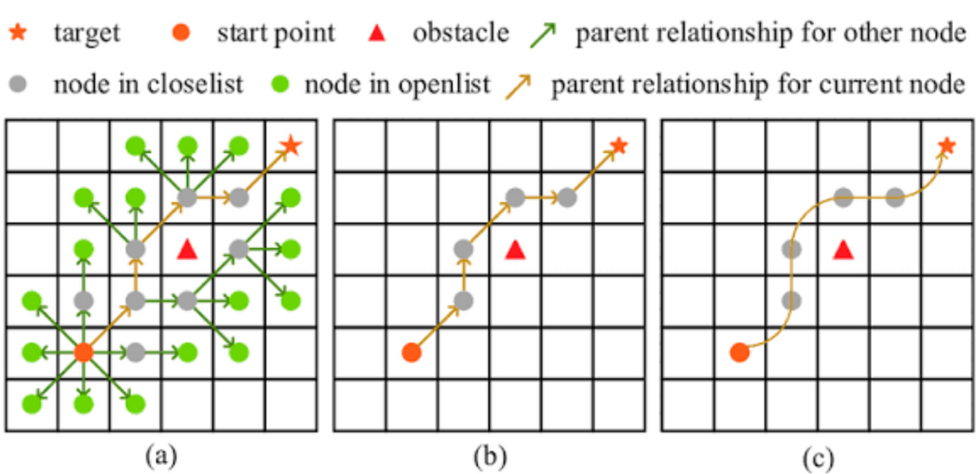
We use the A* algorithm (A-Star) to plan the optimal path from the starting point to the target point.
The so-called "optimal" refers to the shortest distance that a path travels under the premise of feasibility.
A* Algorithm
core
Each time you expand a grid, you should not only look at "how far you have gone", but also consider "how far you are from the goal".
It finds the current point with the greatest hope of approaching the finish line by integrating two parts of information.
idea
f(n)=g(n)+h(n)
g(n) : The actual cost of walking from the starting point to the current node.
h(n) : The estimated cost from the current node to the target.
f(n) : Total cost = Actual + Predicted. The system prioritizes expanding the node with the smallest f.
core cost
function

Slide 12
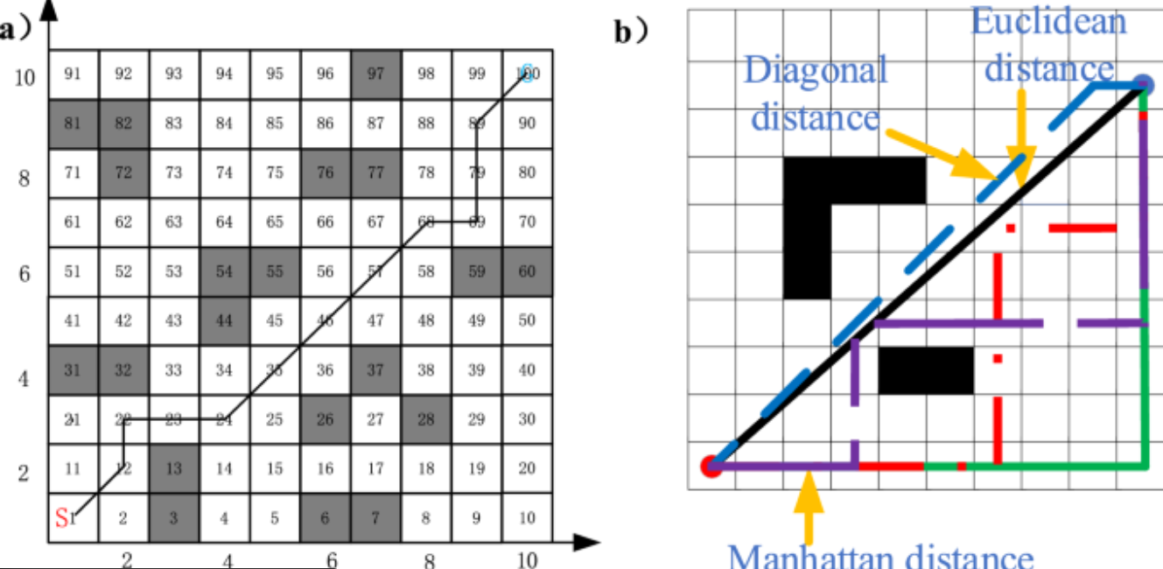
A* Algorithm
Path
The path output by the A* algorithm is a "zigzag line" composed of pixel grid points. For example, the output path of A* is:
(1,1) → (2,1) → (3,1) → (3,2) → (3,3)
But if we don't simplify it, the robot will treat each of these five grids as an independent action to execute
Simplification

Slide 13

Optimized Frontier Explorer
by introducing multi-layer filtering and prioritization to select the most informative and reachable frontier points efficiently.
01
02
03
04
filter by distance
spatial sampling
filter by connectivity simple
filter by goal proximity
Check whether at least 70% of the area around the goal is free of obstacles, ensuring a safe landing zone.
Reduce the number of frontier candidates in dense areas.
Guide exploration toward the global goal once it becomes partially reachable.
Ensure the candidate frontiers are reachable from the robot’s current position.
Perform a BFS (Breadth-First Search) over “robust free space,” i.e., regions surrounded by a sufficient amount of free cells (≥70%).

Slide 14
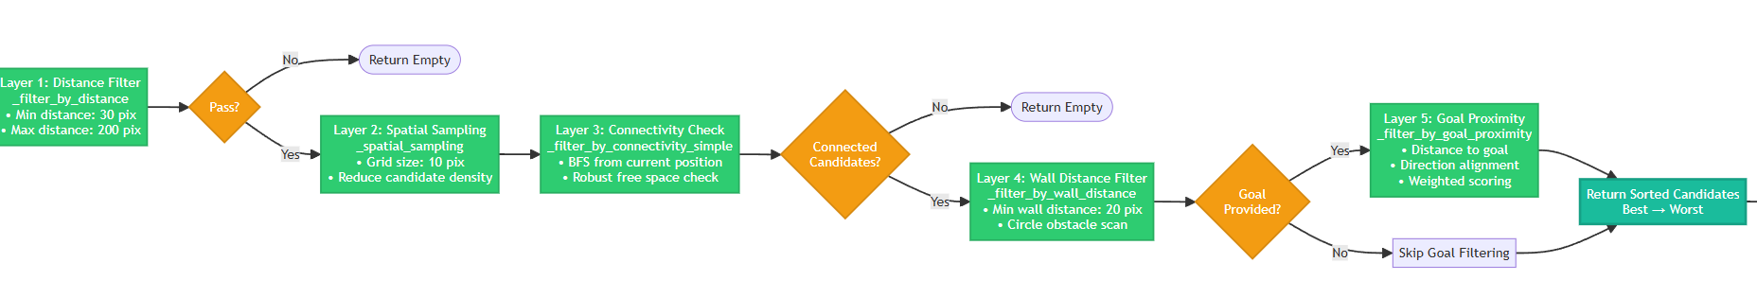
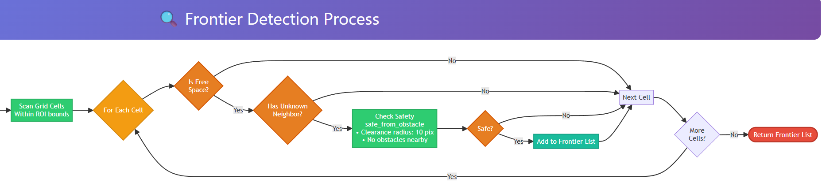
Optimized Frontier Explorer
by introducing multi-layer filtering and prioritization to select the most informative and reachable frontier points efficiently.

Slide 15
This module is responsible for collecting real-time environmental and vehicle state data through various onboard sensors. It processes raw data to filter noise and extract key features, ensuring reliable input for subsequent decision-making and control modules.
Vehicle Pose Decoding
Bluetooth Protocol (BTLink class)
Lidar Data Processing (build_scan360 function)
Generate SLAM Inputs (to_slam_inputs function)
Defines bidirectional communication frames between PC and vehicle, ensuring reliable command and telemetry exchange.
send_cmd(cmd_id, turn_rad, distance_m): Sends movement commands to the vehicle.
get_latest_frame(): Retrieves the latest telemetry data frame from the vehicle.
Input: Raw LidarPoint list with quality, angle_q6, distance_q2.
Process: Decodes, aggregates by angle, interpolates gaps, reorders to CCW.
Output: A 360-element list of ranges in mm.
Input: prev_state, UpFrame, WheelGeom.
Process: Calls build_scan360 and ticks_to_motion.
Output: (scan360_mm, (dxy_mm, dtheta_deg, dt_s), curr_state).
Pose Decoding (ticks_to_motion function)
Execute SLAM Update
If all data is valid, pass the outputs to BreezySLAM.update();
otherwise, await the next frame.
Input: Previous and current encoder ticks (encoder_l, encoder_r, time_us).
Process: Uses WheelGeom params to compute (dxy_mm, dtheta_deg, dt_s).
Output: Velocities for SLAM.

Slide 16
PART
02
Hardware Introduction

Slide 17
Define the high-level system architecture, including hardware and software components.
Specify the interaction between sensors (2D LiDAR, odometry), processing units (e.g., Raspberry Pi, Arduino), and actuators (motors).
Design the communication protocols between components.
System Architecture Design
Sensor Integration and SLAM Implementation
Navigation and Path Planning
Simulation Environment and Real-World Deployment
Sensor Integration
Path Planning
Simulation Environment
Integrate the 2D LiDAR sensor to capture environmental data (angle and distance measurements).
Integrate global path planning using the A* algorithm.
Implement local obstacle avoidance using the Dynamic Window Approach (DWA).
Ensure seamless switching between global and local planning for efficient and safe navigation.
Set up a simulation environment to test navigation and mapping algorithms.
Simulate LiDAR and odometry data to validate the SLAM and navigation stack before real-world deployment.
Implement odometry data processing (x, y, θ) for localization.
Ensure synchronization between LiDAR and odometry data for accurate SLAM.
Bluetooth Communication
Real-World Deployment and Testing
Establish Bluetooth communication (e.g., using Arduino Blue or similar) for sending control commands to the robot.
Enable manual control and high-level command execution (e.g., start, stop, return to start).
Deploy the integrated system on the physical robot.
Test the robot in both structured (9-cell, 16-cell) and random mazes.
Optimize performance for speed, accuracy, and reliability.
SLAM Implementation
Develop or integrate a SLAM (Simultaneous Localization and Mapping) algorithm to construct a map of the maze in real-time.

Slide 18
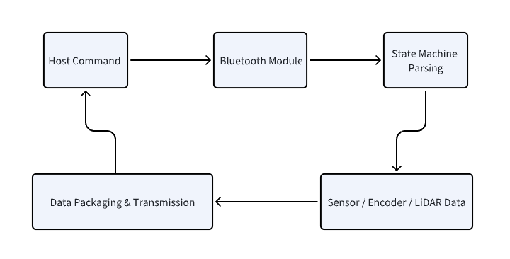
This module is responsible for the bidirectional communication link between the vehicle and the host computer. It handles command reception and status feedback, providing the fundamental communication capability for remote control and data synchronization.
Bluetooth Communication Protocol
& Data Transmission
Downlink Protocol
Uplink Data Transmission
Communication Workflow
Frame Format:
Frame Format
In this system, the Bluetooth module serves as the communication bridge between the host computer and the on-board control core.
The host sends command frames to control vehicle actions, while the lower computer parses and executes them.
Meanwhile, it packages real-time attitude, encoder readings, and LiDAR data and transmits them back to the host,
forming a closed-loop data exchange and feedback mechanism.
0xAA 0x55 | LenL LenH | Payload | CrcL CrcH
0x55 0xAA | Payload | Crc
State Machine Parsing:
Payload Includes
The Bluetooth_Uart_Receive_Handler runs under HAL UART interrupt and transitions through the states above.
Once complete, data is stored in Bluetooth_Receive_buff and the flag Complete_Bluetooth_Receive_Frame is set.
Timestamp
Command ID
Vehicle Status
Encoders of Left & Right Motors
Current Yaw Angle
RPLIDAR_Send_Data
Command Format:
cmd_id(2B) | turn_rad(4B) | straight_m(4B)
Data Preparation
The decoded result is passed to Car_FSM_Cmd_Set() for execution.
New commands are accepted only when the car is in the STOP state.
Before each transmission, data from car state, IMU, motor encoders, and LiDAR are synchronized.
car_state
mpu6500_data
l_motor/r_motor
last_rplidar_data。
Buffer & CRC Check:
The receive buffer is dynamically allocated and reset. CRC verification is currently a placeholder (if(1)), ready for future implementation.
The transmitting side uses DMA (HAL_UART_Transmit_DMA()) for segmented transmission. Once completed, HAL_UART_TxCpltCallback() sets bluetooth_send_enable to continue sending.

Slide 19
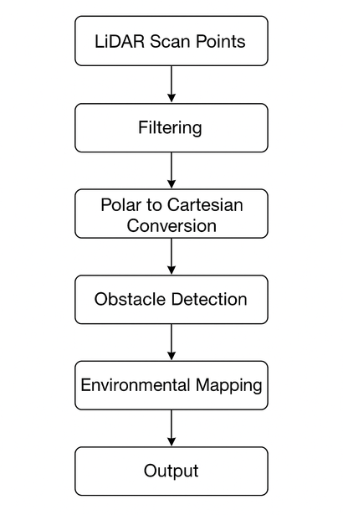
The system mainly obtains environmental point cloud data through RPLIDAR, and then completes perception tasks through the following process: LiDAR raw data acquisition, polar coordinate to Cartesian coordinate conversion, noise filtering and effective distance screening, obstacle detection, environmental modeling, and output control signals
Lidar Data Processing and Environmental Perception
LiDAR Data Acquisition
Noise Filtering and Validation
Environmental Perception and Control
Serial Data Reception
Range threshold
The processed LiDAR data are used for:
Obstacle avoidance – detecting obstacles in front or near the vehicle.
Path planning – marking non-traversable areas.
Visualization – transmitting scan results via Bluetooth for real-time display.
The LiDAR continuously streams scan frames via UART.
Each frame includes angle, distance, and signal strength values.
Signal quality filtering
Smoothing filter to remove sharp jumps between consecutive points.
Frame Parsing
[Header][Angle_L][Angle_H][Distance_L][Distance_H][Quality]
Obstacle Detection and Environmental Modeling
Environmental Perception and Control
Polar to Cartesian Conversion
Before sending, LiDAR data are synchronized with other sensors such as IMU and wheel encoders.The system combines and packages various sensor data in the bluetooth_send_data() .This fusion enables more accurate pose estimation and map alignment.
LiDAR provides polar coordinates (r, θ). The code converts them to Cartesian (x, y):
x = distance * cos(angle * PI / 180);
y = distance * sin(angle * PI / 180);

Slide 20
Motor drive
& PID control
The motor module adopts a dual-wheel differential drive design. It controls the left and right wheels independently through two separate motors to achieve actions such as moving forward, backward, and turning. The motor speed is controlled by PWM, the position information is provided by the encoder, and the PID controller is used to achieve precise speed and position control.
Multi-level PID control
The multi-level PID adopts an engineering design of "external slow, internal fast, decoupling and hierarchical, limiting and preventing saturation, normalization and anti-jitter", achieving closed-loop control of the differential chassis with stable straight-line operation, smooth steering, and rapid response.
Cascade control: Position loop (outer loop) → Speed loop (inner loop) → PWM output. The angle loop is responsible for heading control, and the speed difference ensures linearity and synchronization of the two wheels.
Each loop has clear responsibilities, clear sequence, and parameters are layered, reducing coupling and mutual interference.
Position loop (outer loop)
Speed loop (inner loop)
PWM output
Position error
Speed error
Target speed
Motor output
Two-wheel differential drive
Real-time feedback
The differential drive chassis generates angular velocity through the difference in linear speeds of the left and right wheels, enabling straight driving, turning, and spinning on the spot.
Kinematic relationship: v = (vL + vR) / 2, ω = (vR - vL) / L. In terms of control, the target speeds vL and vR for the left and right wheels are given, and then the closed loop is converted to PWM.
Each wheel uses two PWM channels. The mutually exclusive output determines the direction, and the duty cycle determines the force.
Using a 1ms timer interrupt, the encoder and timestamp are uniformly sampled. The main loop calculates the speed based on the increment and microsecond timing, ensuring the real-time, consistency and anti-jitter capabilities of the feedback.

Slide 21
IMU Attitude Estimation & Orientation Computation
Calculating the real-time attitude of the vehicle using the MPU6500 inertial measurement unit.
By fusing accelerometer and gyroscope data, it provides accurate roll, pitch, and yaw estimation for SLAM localization, ensuring smooth motion control and improved mapping precision.
Sensor Overview
Algorithm Options:
Complementary Filter: Lightweight software implementation, ideal for real-time embedded systems.
DMP (Digital Motion Processor): Hardware-accelerated fusion inside MPU6500, offloading STM32 CPU load.
Device Specification:
MPU6500 Six-Axis IMU (3-Axis Accelerometer + 3-Axis Gyroscope)
Communication Interface:
I²C bus connected to STM32 microcontroller
Function Description:
The IMU continuously measures the car’s linear acceleration and angular velocity.
Raw sensor data are acquired by the STM32 at a fixed sampling rate and passed to the filtering module for further processing.
This data provides a reference for estimating the vehicle’s spatial orientation, compensating for wheel-encoder drift, and stabilizing SLAM localization.
System Integration & Code Implementation
Acquisition and Filtering:
The STM32 reads raw data via I²C and applies noise suppression through low-pass and complementary filtering.Accelerometer readings correct long-term drift, while gyroscope integration provides high-frequency motion response.
Attitude Computation:
The fusion algorithm combines both sources to output Euler angles (Roll, Pitch, Yaw) or quaternion representation.
This ensures high-stability orientation even during vibration or fast rotation.
Result: Real-time orientation with low latency (<10 ms), reducing pose drift and improving mapping consistency.
Data Processing & Fusion Algorithm
Acquisition and Filtering:
The STM32 reads raw data via I²C and applies noise suppression through low-pass and complementary filtering.
Accelerometer readings correct long-term drift, while gyroscope integration provides high-frequency motion response.
Attitude Computation:
The fusion algorithm combines both sources to output Euler angles (Roll, Pitch, Yaw) or quaternion representation.

Slide 22

Low-level hardware driver development (including core peripherals, sensors, communication interfaces, etc.), hardware abstraction layer (HAL) design, and system-level initialization and module integration ensure that hardware resources are correctly called and modules work together to provide a stable hardware interface for upper-level applications.
Low-level hardware driver and system integration
Low-level hardware driver development
It supports interrupt reception (to avoid blocking) and polling transmission (simple scenarios), and realizes continuous data transmission and reception through buffer management to adapt to different communication needs.
System integration and initialization
GPIO Driver
System initialization process
Function: Initialize hardware resources (clock, peripherals, interrupts) in order of dependency and establish the system operating environment.
Function:
Implement the initialization of general input and output pins ,level reading and writing, interrupt configuration, etc.
Sensor driver
taking I2C interface sensor as an example)
Hardware resource management
Function: Solve problems such as GPIO multiplexing and interrupt priority conflicts to ensure the coordinated operation of multiple peripherals.
GPIO is configured by directly manipulating registers, balancing efficiency and flexibility; a standardized interface is encapsulated, so the upper layer does not need to pay attention to the details of the hardware registers.
Function: Communicate with sensors via the I2C bus to read data (such as temperature, humidity, acceleration, etc.).
Strictly follow the sensor timing requirements, encapsulate the initialization and data reading interface, and the upper layer can directly call it to obtain sensor data without having to pay attention to the I2C underlying communication details.
Hardware layer
UART communication driver
Function:
Implement serial port initialization , send and receive data in interrupt/polling mode, and support upper-layer data communication.
Low-level drivers
System Integration

Slide 23
Group18
THANK YOU VERY MUCH FOR WATCHING
2025/10/20

