Slide 1


Employee Attrition Prediction
- using Data Mining
Robin Roy

Slide 2


BUISNESS PROBLEM FORMATION
Objective 1: Problem Statement
Objective 2: Stakeholders
Objective 3: Feasibility
Objective 4: Constraints
Objective 5 : Benefits

Slide 3
Problem Statement: Employee Attrition
Gradual reduction in the number of employees in the business organization
Revenue loss
Time and effort for training new employees

Slide 4


STAKE HOLDERS:
Employees
HR department
Production cycle
BENEFITS:
Helps to retain the current trained and experienced key employees.
Minimizes revenue loss to the company
Improves productivity
It helps to reduce the tasks of HR department
FEASIBILITY:
Voluntary attrition Data

Slide 5
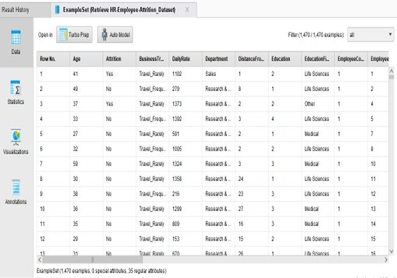
Open dataset source:
https://www.kaggle.com/pavansubhasht/ibm-hr-analytics-attrition-dataset
Data Provider: IBM
The data file contains 1470 rows/records and
35 columns/attributes.
Better accuracy and low classification error gives the best model.

Slide 6

DATA EXPLORATION
Objective 1: Acquire Data
Objective 2: Explore data visually
Objective 3: Harmonize, Rescale and Clean Data

Slide 7
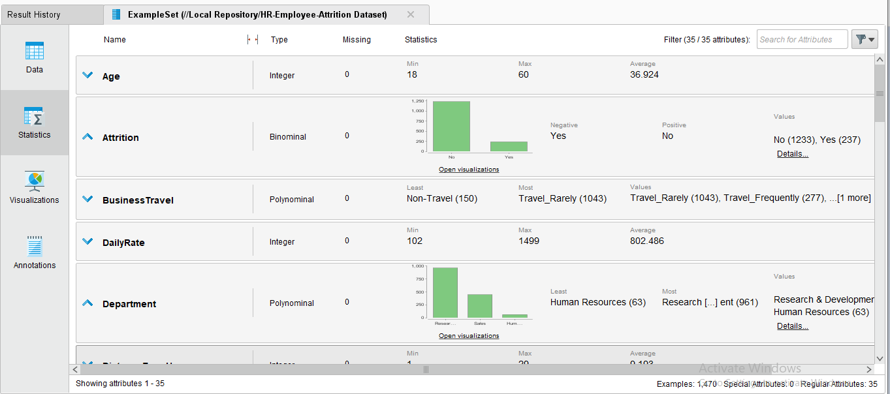
Data Exploration
Target variable is converted into binomial form.
Input variables are in integer and polynomial type.
Remove null values and duplicates
No missing values exist in this dataset
Remove the unnecessary attributes

Slide 8
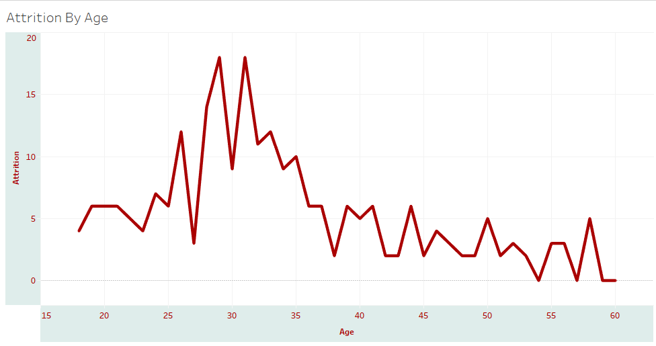
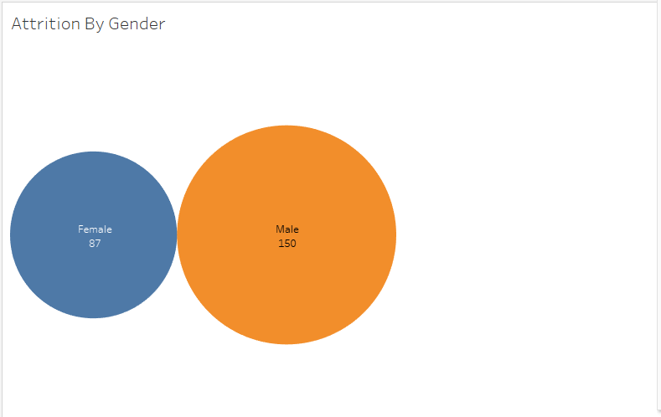
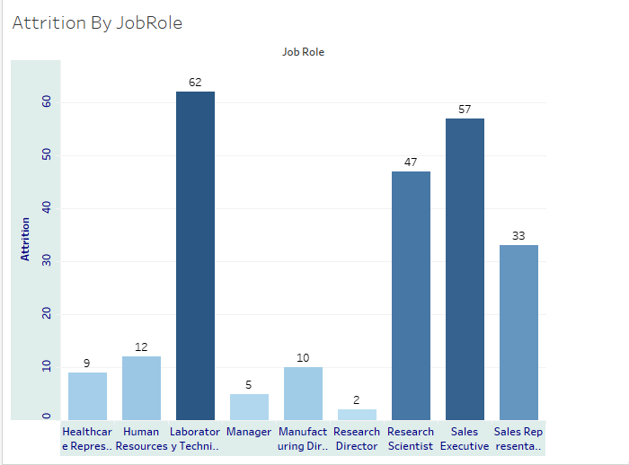
Data Visualization

Slide 9
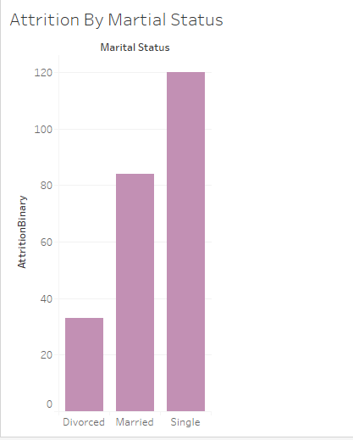
Data Visualization

Slide 10
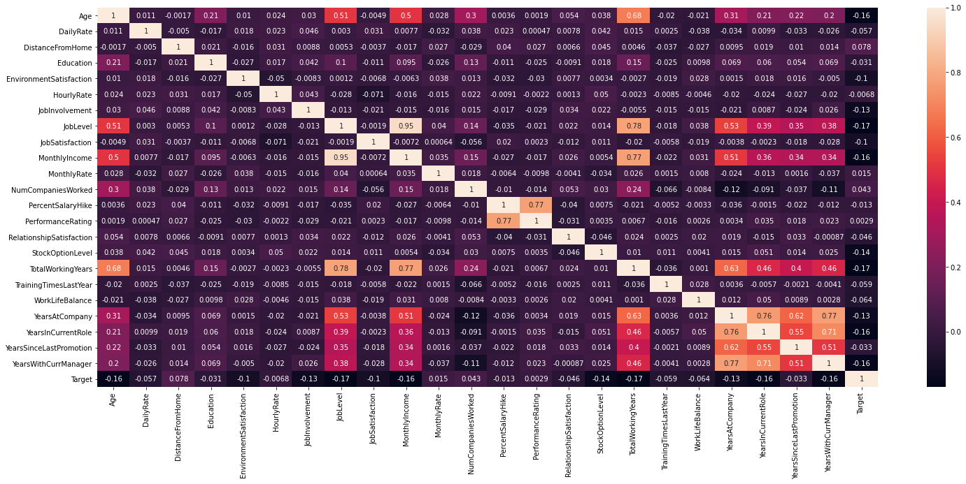
CORRELATION MATRIX
Monthly income is highly correlates to job level.
Year at current role is highly correlated to years at the company
Monthly income and job level are correlated to the total working years.

Slide 11
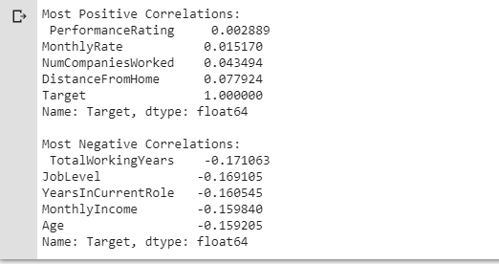
CORRELATION MATRIX
The strongest positive correlations with the target features are: Performance Rating, Monthly Rate, Num Companies Worked, Distance From Home
The strongest negative correlations with the target features are: Total Working Years, Job Level, Years In Current Role, and Monthly Income

Slide 12
METHODOLOGY
Objective 1: Problem Solving Approach
Objective 2: Software tools
Objective 3: Test Approaches
Objective 4 : Select Approaches

Slide 13
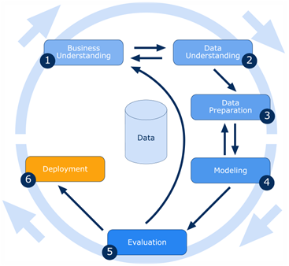
CRISP-DM
Cross Industry Standard Process for Data Mining- CRISP DM
Business Understanding
Select Business objectives and goals
Data Understanding
Collect the Initial Data
Identify the data quality
Discover insights
Data Preparation
Removing null values and duplicates
Replacing missing values
Scaling numerical values
Modelling
Select the modelling technique
Build and Asses the model
Evaluation
Valuate prediction and accuracy results
& Deployment

Slide 14
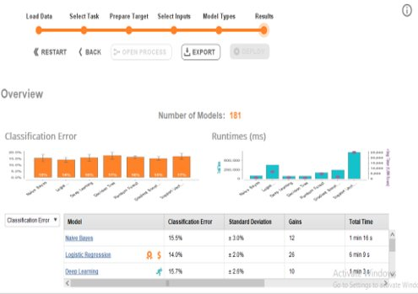
Approaches
Logistic regression
Deep Learning
Decision Tree
Naïve Bayes
Random Forest
Gradient Boosted Tree
SVM
Tools Used:
Rapid Miner
Tableau, Python : For visualization

Slide 15

MODEL BUILDING
Objectives1: Identify Model structure
Objectives2: Run and Evaluate the model
Objectives3: Calibrate models and Data

Slide 16
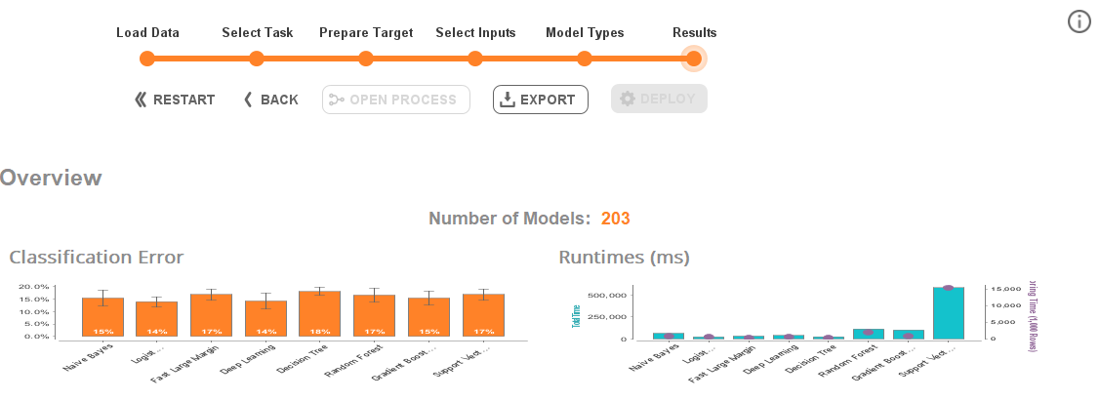
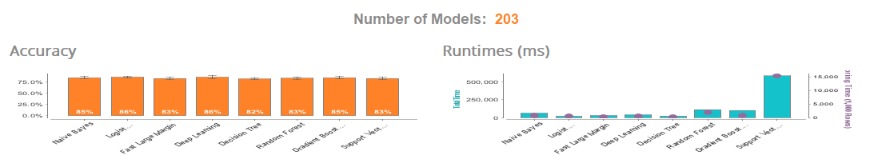
Best fit algorithms
Logistic regression
Gradient Boosted Tree
Decision Tree
Deep Learning
Set role : Attrition attribute is set to label
One-Hot Encoding : Encode categorical variables into numerical values.
SMOT Up Sampling : Dataset is imbalanced with most observations describing Currently Active Employees.

Slide 17
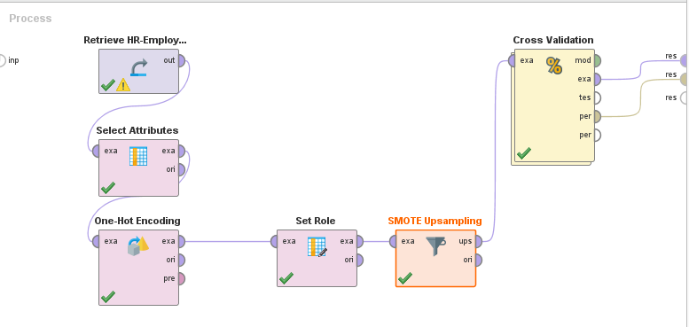
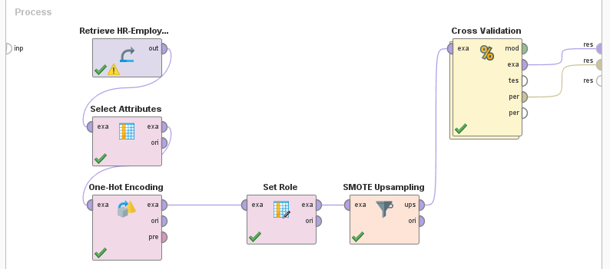
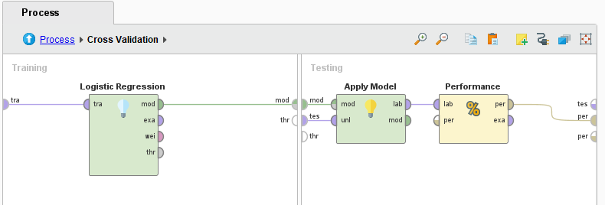
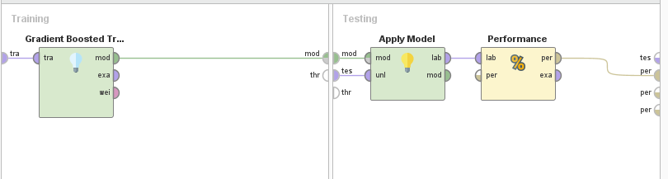
Logistic Regression
Gradient Boosted Tree

Slide 18
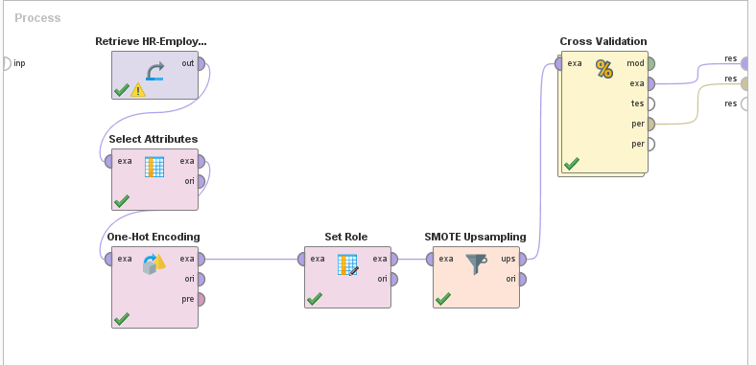
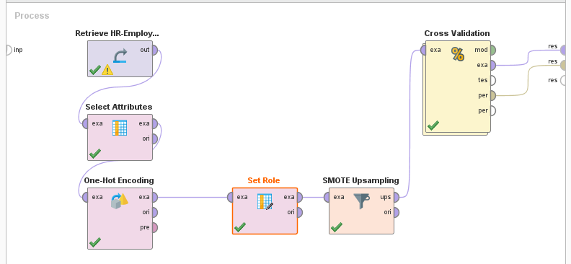
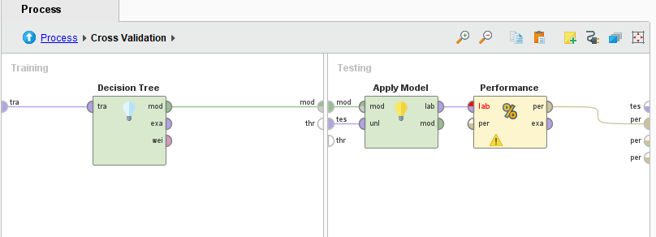
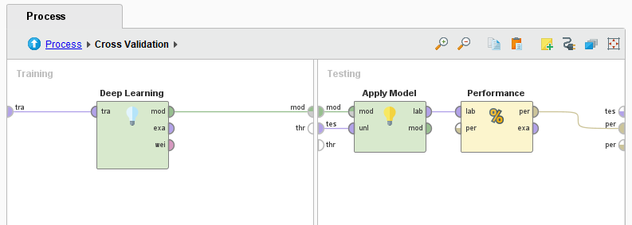
Decision Tree
Deep Learning

Slide 19
Models | Accuracy (%) | Precision (%) | Recall (%) | AUC (%) | Sensitivity (%) | Specificity (%)
Deep Learning | 84.75 +/- 1.68 | 85.68 +/- 2.68 | 83.61 +/- 3.94 | 0.968 +/- 0.014 | 83.61 +/- 3.94 | 85.88 +/- 3.26
Gradient Boosted Tree | 84.18 +/- 2.13 | 83.47 +/- 2.84 | 85.40 +/- 2.82 | 0.940 +/- 0.021 | 85.40 +/- 2.82 | 82.96 +/- 3.65
Decision Tree | 82.16 +/- 2.02 | 82.63 +/- 1.31 | 81.43 +/- 4.05 | 0.850 +/- 0.021 | 81.43 +/- 4.05 | 82.89 +/- 1.50
Logistic Regression | 79.12 +/- 2.51 | 79.96 +/- 3.13 | 77.86 +/- 3.89 | 0.867 +/- 0.023 | 77.86 +/- 3.89 | 80.37 +/- 3.82

Slide 20
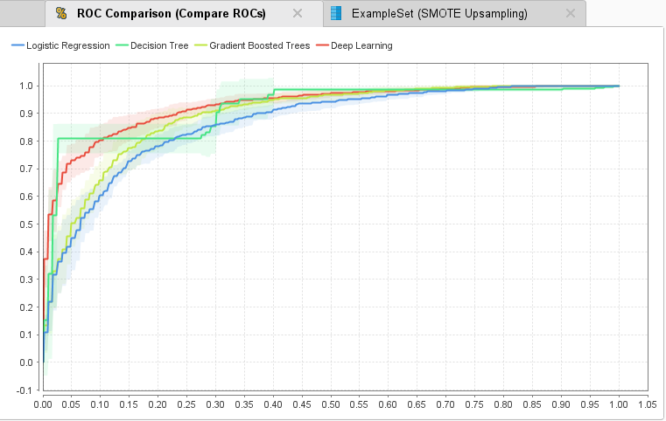
ROC Curve

Slide 21

Conclusion & Future work
Deep learning gives better performance and gain than the other models.
Adding new features by combining different features eg: Monthly income + age
Deployed model in the local repository and got 16.12 % error rate
Advanced machine learning techniques can be constructed to provide better prediction performances
Thank you!!
Robin Roy

