Slide 1








KEPLER – ROMINFO
software solutions & services
Northwind Phones eShop
ROMÂNIA
B^{dul} Dimitrie Pompei, nr 3
020335 Bucureşti - Sector 2
Tel.: + 40 21 233 10 80
Fax: + 40 21 233 19 11
pguta@kepler-rominfo.com
FRANCE
204, rue de la Vallée
78410 Bouafle
Tél.: + 33 (0)1 30 90 11 74
Fax: + 33 (0)1 30 90 11 96
jcsilvestre@kepler-rominfo.com
www.kepler-rominfo.com

Slide 2
Main Features of Northwind Phones eShop
Northwind Phones eShop – E-Commerce features
It is an E-Commerce site, which sells smartphones.
Any user has his own shop cart where he can add products intended for purchase.
Administrators can access the Dashboard. He can add/edit/delete almost anything in the database.
Reports can be exported to PDF, XML, WORD, EXCEL…
Responsive Front-End web interface(small ,medium and large devices)

Slide 3
Detailed technical informations
Northwind Phones eShop – Microsoft Web Stack Architecture
ASP.NET MVC 5.2.2 - C# 5.0 with .NET framework 4.5.2 ;
Entity Framework 6.0
ASP.NET Identity Authentication
SQL Server 2016 & Reporting Services
The Apache Log4Net logger
Bootstrap 3.0, HTML 5 & CSS3, AJAX, JavaScript and JQuery
DataTable, JavaScript library: Raphael, Morris
Chrome, Internet Explorer 11.0, Edge
GitHub

Slide 4
Client technologies
Northwind Phones eShop – Microsoft Web Stack Architecture
Bootstrap 3.0
HTML 5 & CSS3
AJAX, JavaScript and Jquery
DataTable, JavaScript library: Raphael, Morris
Chrome, Internet Explorer 11.0, Edge

Slide 5
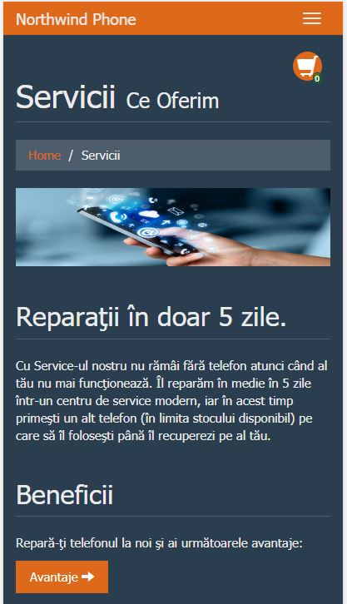
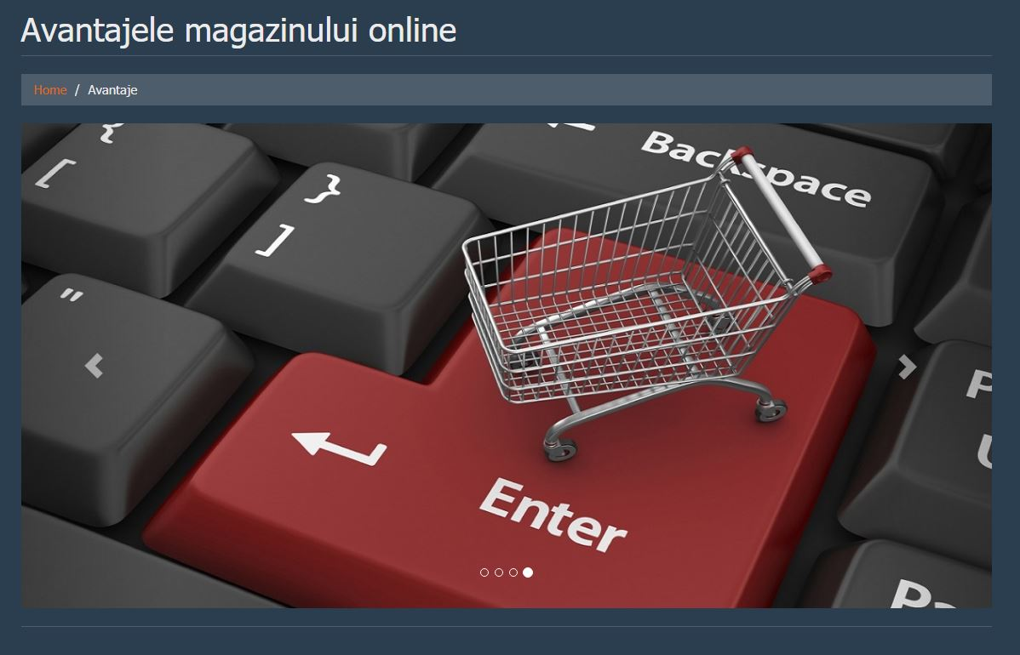
Bootstrap
Bootstrap is an open-source front-end web framework for designing websites, web applications and for developing responsive, mobile-first web sites. It contains HTML and CSS, based design templates for typography, forms, buttons, navigation and other interface components, as well as optional JavaScript extensions .

Slide 6
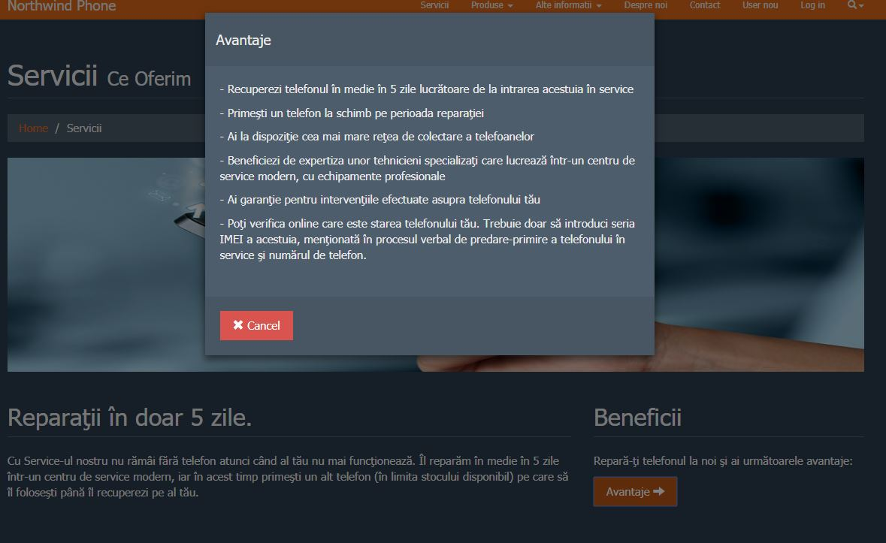
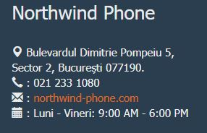
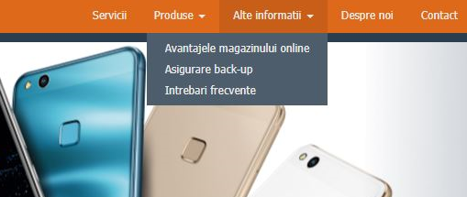
Bootstrap

Slide 7
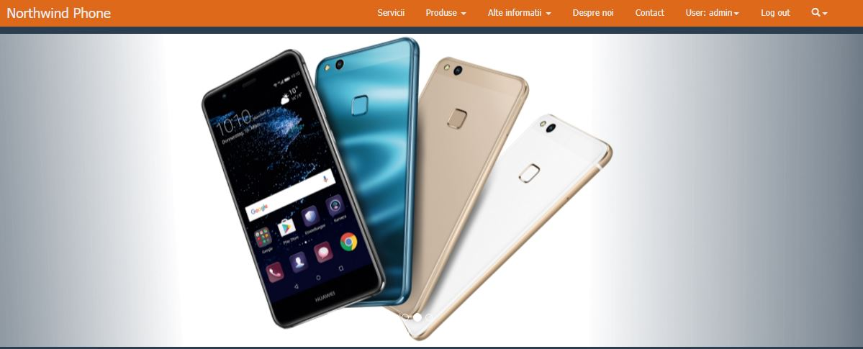
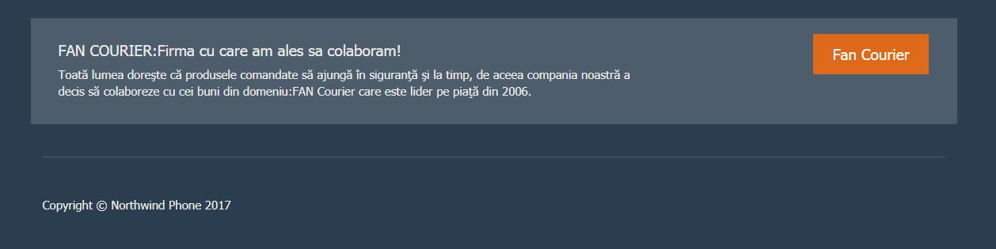
HTML5
HTML – Hyper Text Markup Language
-the fifth and current major version of the HTML standard

Slide 8
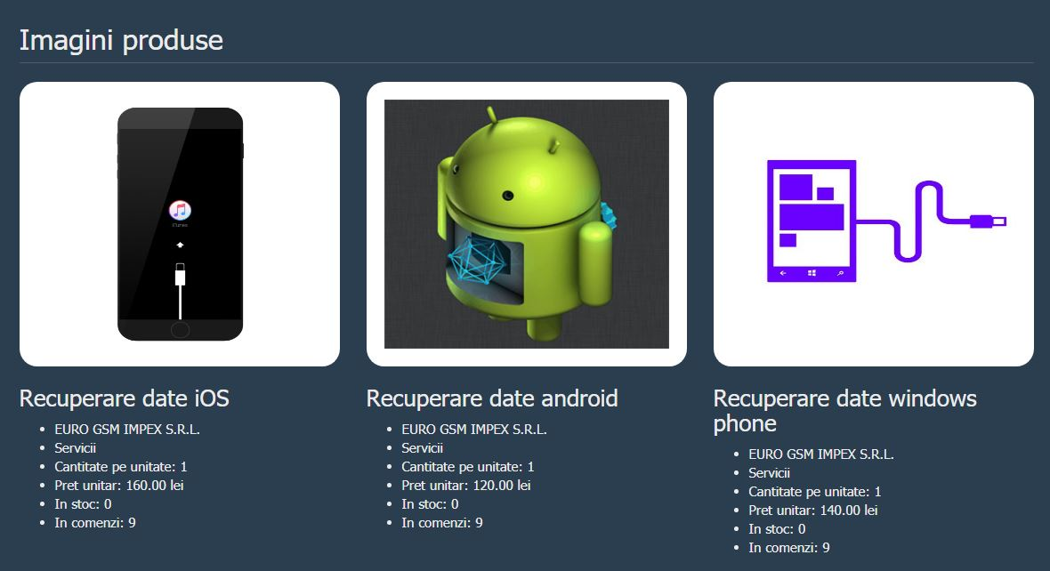

CSS3
CSS – Cascading Style Sheets
-is a simple mechanism for adding style to Web documents.

Slide 9
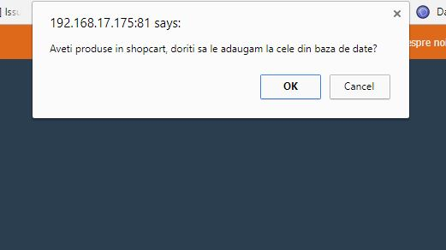
JavaScript, JQuery and AJAX
JavaScript is used to program the behavior of web pages.
JQuery is a cross-platform JavaScript library designed to simplify the client-side scripting of HTML.
JQuery's syntax is designed to make it easier to navigate a document, select DOM elements, create animations, handle events, and develop Ajax applications.
AJAX – Asynchronous JavaScript And XML
Update a web page without reloading the page
Request data from a server - after the page has loaded
Receive data from a server - after the page has loaded
Send data to a server - in the background

Slide 10
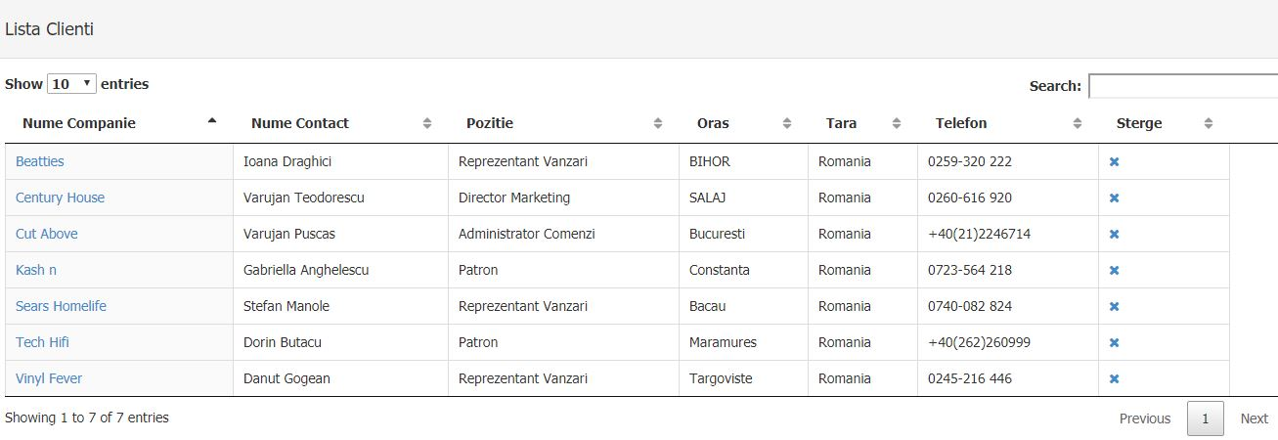
DataTable

Slide 11
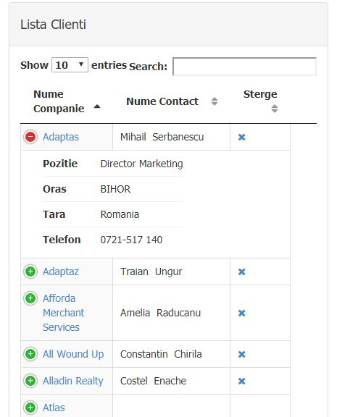
DataTable
DataTables is a plug-in for the jQuery Javascript library. It is a highly flexible tool, based upon the foundations of progressive enhancement, and will add advanced interaction controls to any HTML table.
Pagination, instant search and multi-column ordering
Supports almost any datasource: DOM, JavaScript, Ajax and server-side processing.
Easily theme-able: DataTables, jQuery UI, Bootstap, Foundation.
Link:
https://datatables.net/

Slide 12
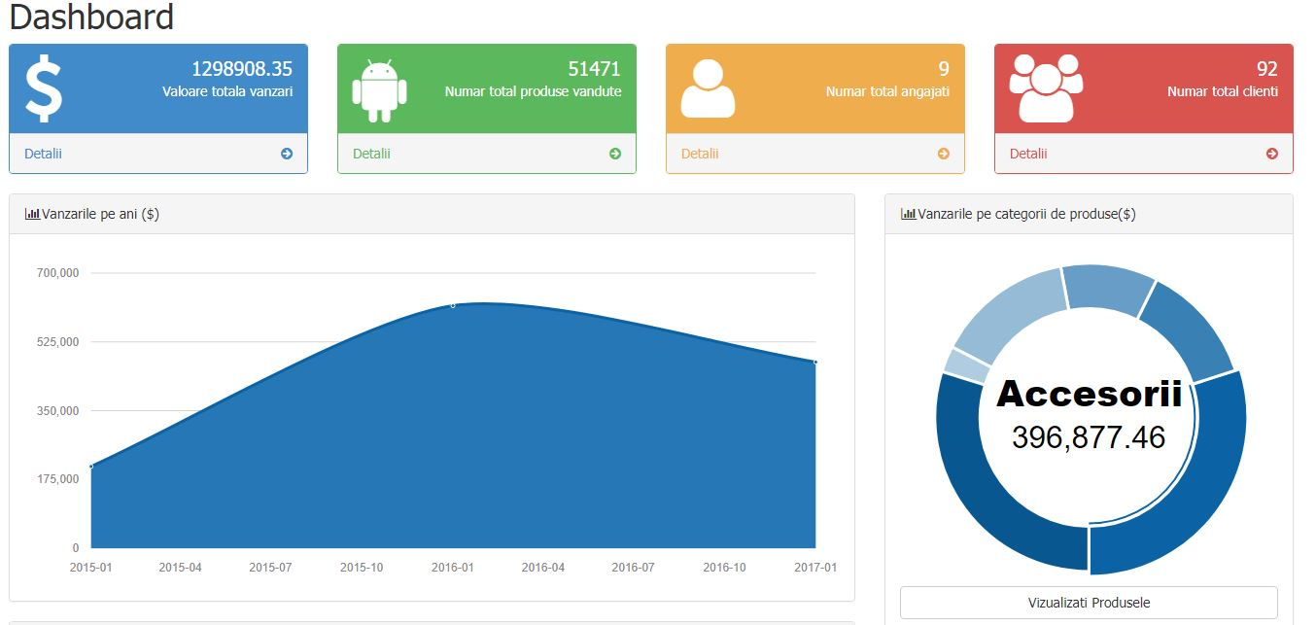
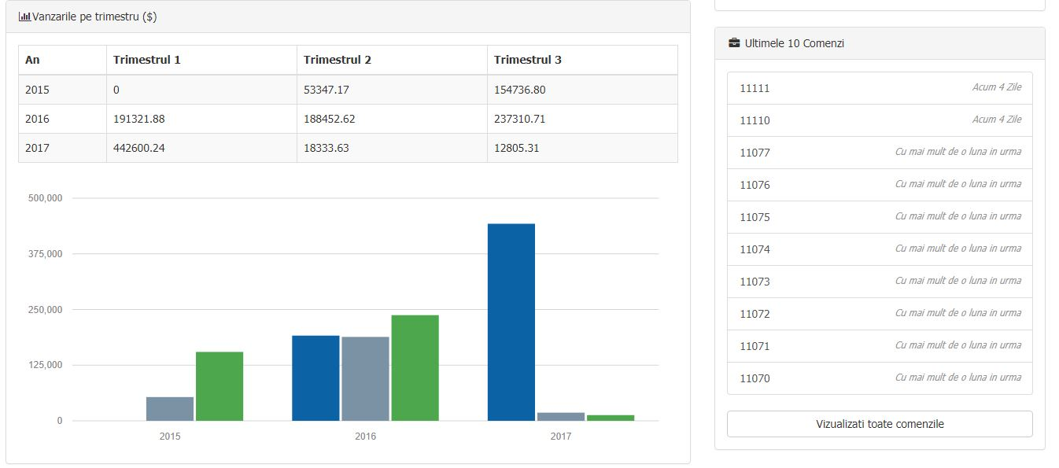
Morris & Raphael
Raphael is a small JavaScript library that should simplify the work with vector graphics on the web. Is used to create specific chart or image crop and rotate widget.
Morris is a very simple API for drawing line, bar, area and donuts charts.
Link:
https://startbootstrap.com/
https://morrisjs.github.io/morris.js/

Slide 13
Server technologies
Northwind Phones eShop – Microsoft Web Stack Architecture
ASP.NET MVC 5.2.2 - C# 5.0 with .NET framework 4.5.2 ;
Entity Framework 6.0, Razor 3.2 & LINQ
ASP.NET Identity Authentication
SQL Server 2016 & Reporting Services
The Apache Log4Net logger
PagedList package 1.17.0
Newtonsoft.JSON 10.0.3
Unit Testing

Slide 14
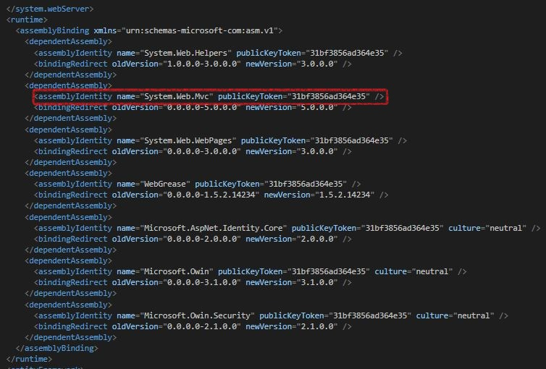
ASP.NET MVC 5.2.2 - C# 5.0 with .NET framework 4.5.2
The ASP.NET MVC is a web application framework developed by Microsoft, which implements the model-view-controller (MVC) pattern.
It is open-source software, apart from the ASP.NET Web Forms component which is proprietary.
C# is a general object-oriented programming (OOP) language for networking and Web development.
C# is specified as a common language infrastructure (CLI) language.

Slide 15
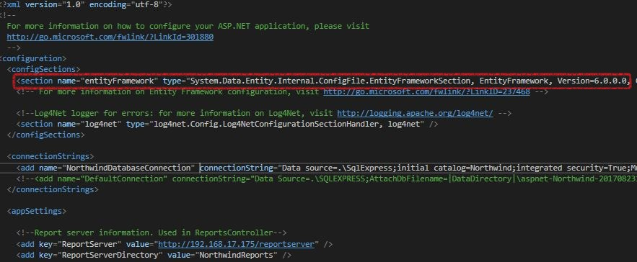
Entity Framework , Razor & LINQ
Entity Framework (EF) is an open source object-relational mapping (ORM) framework for ADO.NET. It was a part of .NET Framework, but since Entity framework version 6 it is separated from .NET framework.
Razor is a markup syntax that lets you embed server-based code (Visual Basic and C#) into web pages. Razor is based on ASP.NET, and designed for creating web applications. It has the power of traditional ASP.NET markup, but it is easier to use, and easier to learn.
Language Integrated Query (LINQ) is a Microsoft.NET Framework component that adds native data querying capabilities to .NET languages, although ports exist for PHP, JavaScript, TypeScript and ActionScript.

Slide 16
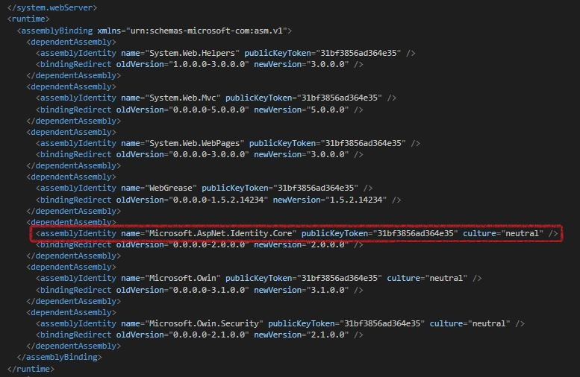
ASP.NET Identity Authentication
ASP.NET Identity is a membership system which allows you to add login functionality to your application.
Users can create an account and login with a user name and password or they can use an external login provider such as Facebook, Google, Microsoft Account, Twitter or others.
There are five roles, they offer different degrees of access for two categories of Customers and Employees
Anyone logged in or out has access to the presentation interface
Customers:
Guest: They have the lowest degree of access, they only have access to change the password
Customers: When a user places his first order, he becomes Customers and can see their orders
Employees:
Employee: They have access to the list of orders they handle
Managers: They have access to the list of all orders
Admins: They have access to the dashboard where they can manage the database and see company statistics

Slide 17
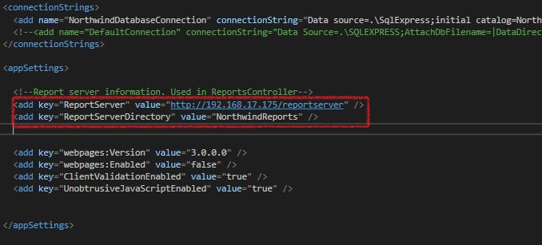
SQL Server 2016 & Reporting Services
SQL Server is a relational database management system developed by Microsoft.
As a database server, it is a software product with the primary function of storing and retrieving data as requested by other software applications, which may run either on the same computer or on another computer across a network (including the Internet).
SQL Server Reporting Services is a solution that customers deploy on their own premises for creating, publishing, and managing reports, then delivering them to the right users in different ways, whether that’s viewing them in web browser, on their mobile device, or as an email in their in-box.

Slide 18
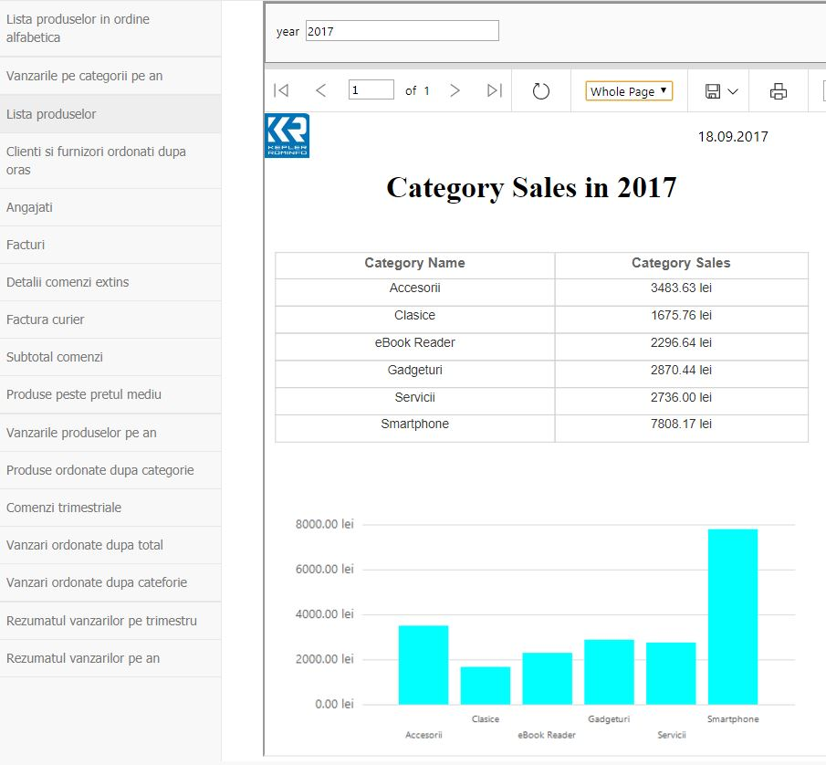
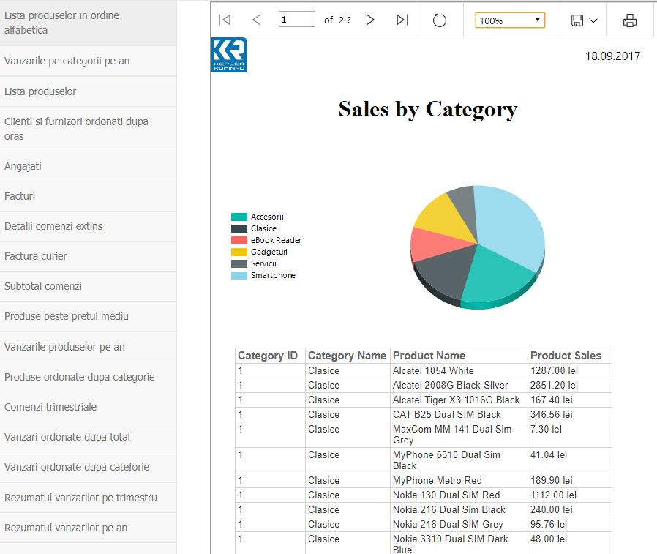
SQL Server 2016 & Reporting Services

Slide 19
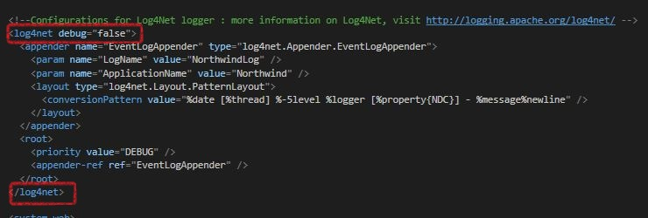
Log4Net
Log4net is a tool to help the programmer output log statements to a variety of output targets.
In case of problems with an application, it is helpful to enable logging so that the problem can be located. With log4net it is possible to enable logging at runtime without modifying the application binary. The log4net package is designed so that log statements can remain in shipped code without incurring a high performance cost. It follows that the speed of logging (or rather not logging) is crucial. One of the distinctive features of log4net is the notion of hierarchical loggers.

Slide 20
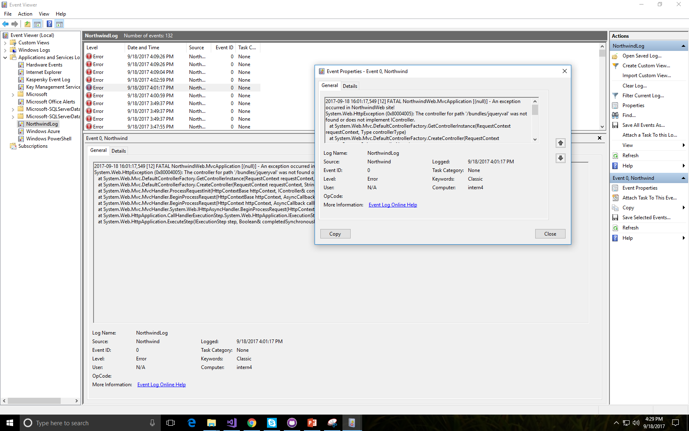
Log4Net

Slide 21
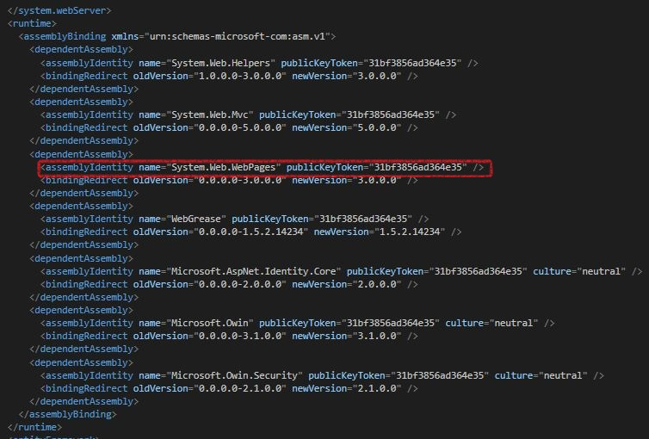
PagedList package
PagedList is a package used for writing paging code.
It allows you to take any IEnumerable(T) and, by specifying the page size and desired page index, it can select only a subset of that list. PagedList also provides properties that are useful when building UI paging controls.

Slide 22
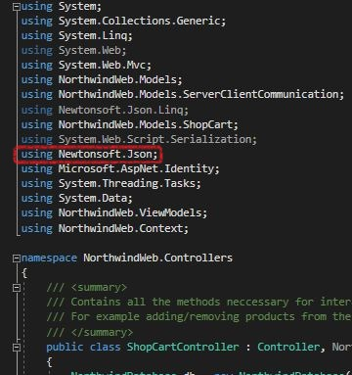
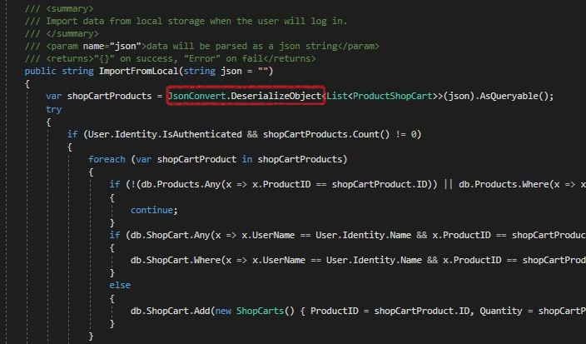
Newtonsoft.JSON
This package is used to convert a JSON object into a C# class.

Slide 23
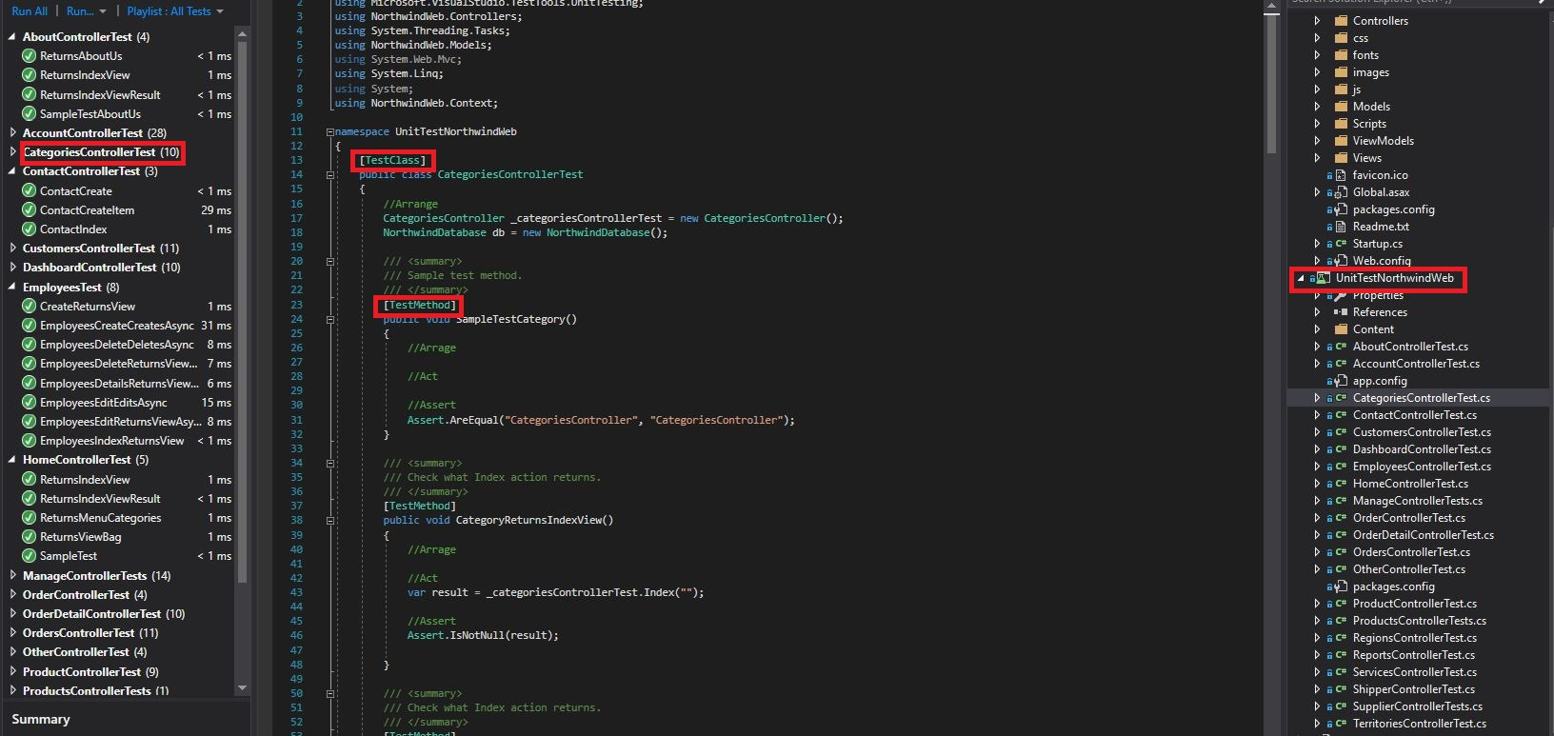
Unit Testing
In computer programming, unit testing is a software testing method by which individual units of source code, sets of one or more computer program modules together with associated control data, usage procedures, and operating procedures, are tested to determine whether they are fit for use.

Slide 24
Effort Estimation
Northwind Phones eShop – Project Management Phases
Phase | Tool
Training
Analysis
Design
Coding and Unit Testing
Testing and Continuous Integration
Delivery

