Slide 1
FarmStat
Weekly mandi price forecasts and a sell-or-hold call for onion, tomato and potato farmers across 24 Indian states
Machine learning course project | github.com/Iamshi-vissa/FarmStat
Notes:
FarmStat forecasts mandi prices 1, 2 and 4 weeks ahead and turns them into a plain call. This talk covers the data, the model, how it was validated, and the app.

Slide 2
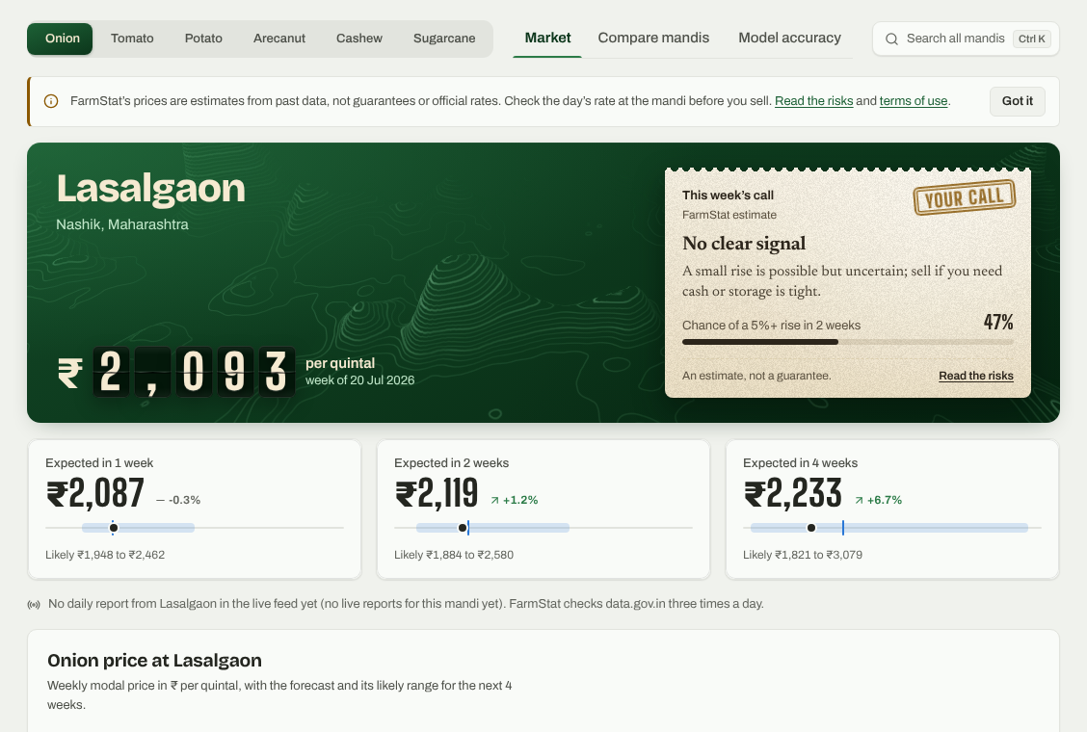
Every farmer faces one decision: sell today or hold
Prices swing within weeks, and the only guide is today's rate board
~980
mandis with weekly prices, in 24 states
3
questions FarmStat answers: where is the price going, how sure, and what to do
Notes:
Onion can double or halve in a season; tomato spoils in days. The app adds a forecast with a range, the chance of a real rise, and a call on a paper slip.

Slide 3
23 years of Agmarknet prices, plus a live daily feed
622,763 weekly rows from 1,414 series, Jan 2003 to Jul 2026, real reports only
Source | What it gives | Coverage
Agmarknet weekly panel | Modal price and arrivals per mandi | Onion, tomato, potato, 2003 to 2026
Agmarknet monthly | State average prices | Cashew, 5 states, 2019 to 2026
Government (CCEA) | Fair and Remunerative Price | Sugarcane, yearly
data.gov.in daily feeds | Min, max, modal price per day | All six crops, live since Nov 2026
Cleaning: typing errors removed (a price ten times its neighbours that snaps back), real spikes kept, mandi names standardised so a live "Lasalgaon APMC" joins 20 years of Lasalgaon history.

Slide 4
One model learns from all 1,414 series at once
Quantile gradient boosting gives the forecast and its range; guards keep weak signals cautious
38 features
Quantile models
Rise classifier
Guards
The call
Price returns, distance from averages, volatility, arrivals, national and state moves, season
10th, 50th and 90th percentile of the log return, for 1, 2 and 4 weeks ahead
Chance of a 5%+ rise within 2 weeks
Median shrunk 0.8 toward no change; 4-week warm-up after a reporting gap
Sell now, hold, or no clear signal, with the likely range
Tuned: learning rate 0.03, 15 leaves per tree, at least 1,000 rows per leaf. Arecanut, cashew and sugarcane get no forecast model where none beat "no change".

Slide 5
Tested as it would be used: retrained every January
Walk-forward test: each year is forecast by models that only saw outcomes known before it began
Train on 2003 up to
2022
calibrate ranges
2023
test 2023
2024
test 2024
2025
test 2025
2026
test 2026
Grey: training data. Blue: forecast weeks never seen in training. Benchmark: "no change" (next price = today's). 168,637 mandi-weeks tested at 2 weeks ahead.

Slide 6
Beats "no change" at every horizon, by 8% at 2 weeks
Average error in rupees per quintal on 2023 to 2026, onion, tomato and potato, every mandi
8.0%
less error than "no change", 2 weeks ahead
67%
direction right when the price moved more than 2%
0.73
ROC-AUC of the rise warning (0.5 = guessing)

Slide 7
The gain is real at 1 and 2 weeks, weaker at 4
Diebold-Mariano test (Newey-West variance) and a 95% block bootstrap over weeks
Ahead | Less error | 95% interval | DM p-value
1 week | 7.7% | 4.8% to 10.4% | < 0.001
2 weeks | 8.0% | 3.6% to 12.2% | 0.006
4 weeks | 6.5% | 1.0% to 12.0% | 0.137
The bootstrap intervals stay above zero at every horizon, but the stricter Diebold-Mariano test only confirms 1 and 2 weeks. The gain also varies by year: 2025, when hundreds of new mandis joined, was barely above zero.

Slide 8
Calibrated ranges now hold the price 80% of the time
Left: share of weeks the real price fell inside the 10th to 90th percentile range. Right: does a 40% warning mean 40%?

Slide 9
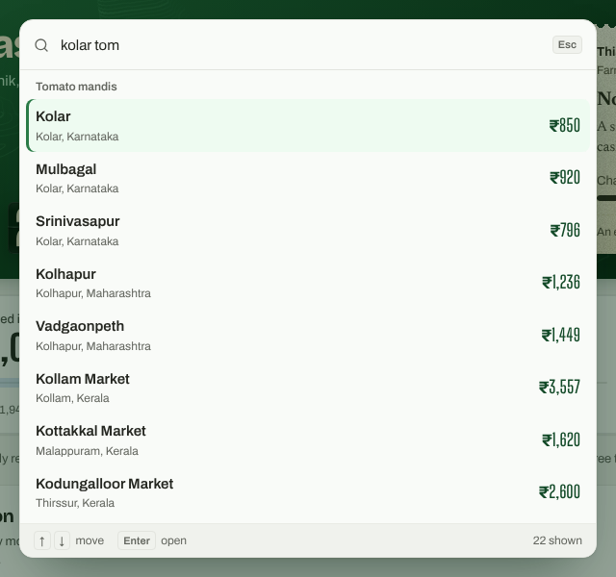
An app that looks like the mandi it serves
1
Rate board
Split-flap price on a forest-green board, the way mandis post rates
2
The parchi
Sell or hold printed on a textured paper slip with a stamp
3
Charts with context
Forecast band, plus the usual range for the same weeks of 5 past years
4
Search anywhere
Ctrl/⌘ K finds any of 1,388 series by mandi, district, state or crop
React 19, Vite, Recharts; FastAPI back end; one Vercel deployment

Slide 10
Live today, honest about its limits
Live pipeline
Limits
Next
data.gov.in daily prices, 3 pulls a day
Stored in Supabase Postgres (read-only public)
Forecasts rebuilt every evening
Weekly champion / challenger retrain
New mandis: onion does not beat "no change"
Policy shocks are not in past prices
Ranges assume shocks no bigger than 2024–26
Only half of live mandi names match
Refresh range calibration monthly
Personal API key for fast back-fills
Reviewed list of mandi name matches
Weather and policy events as features
Estimates from past prices, not guarantees. Check the day's rate at the mandi before you sell.

