Slide 1
Face Recognition system
Submitted by:
Ishwar Gautam (11834)
Biplove Jaisi (11825)
Kolaj Joshi (11842)
Diwas Neupane (11829)

Slide 2
Contents:
Introduction
Objectives, scopes and limitations
Requirement analysis and feasibility analysis
Design of face recognition system
GUI (Graphical user interface)
Implementation and testing
Maintenance
Conclusion

Slide 3
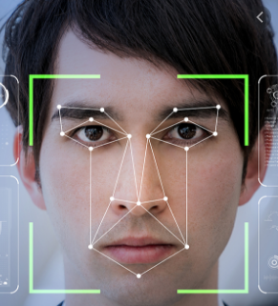

Introduction:
Face Recognition system comes under object recognition.
Image processing and Machine learning plays an important role.

Slide 4
Objectives:
To recognize face of multiple authorized users.
To be able to listen the name of authorized user in mp3 format.

Slide 5
Scopes:
The face recognition system may be required by all property owners for their security.
The property owners don’t want unauthorized person to enter in their property.
So, he/she definitely wants to have this system in their hand.

Slide 6
Limitations:
Face recognition system doesn’t work well under poor lighting, sunglasses, long hair, low resolution images or another object partially covering the subject’s face.
This system can’t tell the difference between identical twins.

Slide 7
Requirement analysis:
Functional Requirements
Non-functional Requirements
Technical Requirements:
a. Hardware requirements
b. Software requirements

Slide 8
Feasibility study:
Technical Feasibility
Economic Feasibility
Operational Feasibility

Slide 9
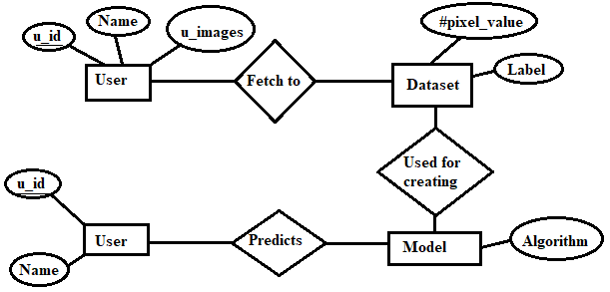
Design of face recognition system:
Input part
Face detection part
Face recognition part
Output part

Slide 10
GUI (Graphical user interface)
Python offers several methods for developing GUI.
Out of which, we use Tkinter in this project.
To create a tkinter app:
Importing the module – tkinter
Create the main window (container)
Add any number of widgets to the main window
Apply the event Trigger on the widgets.

Slide 11
Implementation:
The implementation phase started when the majority of the code for the program is written.
We used Jupyter notebook as an integrated development environment to write code.

Slide 12
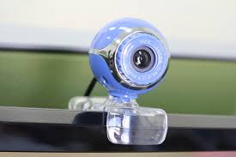

Tools used:
Camera integrated system
Jupyter notebook

Slide 13



Libraries used:
OpenCV
TensorFlow
TfLearn

Slide 14
Testing:
Unit testing
Integration testing
System testing

Slide 15
Maintenance:
This face recognition system can be preserved for future use.
The dataset can be updated in time to maintain the accuracy.

Slide 16
Conclusion:
The main steps of this project are concluded below:
Step 1: To generate the dataset of authorized users
Step 2: Use that dataset to train the model
Step 3: Calculate the accuracy
Step 4: Use that trained model to predict new images
Step 5: Representing the project into GUI and also can be able to listen the name of authorized users in mp3 format

Slide 17
References:
https://www.geeksforgeeks.org/python-gui-tkinter/
https://www.geeksforgeeks.org/convert-text-speech-python/

Slide 18
Thank You !

