Slide 1
Sales Data Analysis and Reporting for a Retail Chain
Data Analytics Project
Project Lead: Sushmitha Gowda S
Technologies: SQL, Python (Pandas, Matplotlib, Seaborn), Excel

Slide 2

Project Overview
This comprehensive analysis examines retail transaction data to uncover sales trends, identify patterns, and generate actionable insights. By integrating multiple data sources and applying rigorous analytical methods, we've created a foundation for data-driven decision-making across inventory management and marketing strategy.
Data Integration
Merged transaction details with customer response data
Comprehensive Cleaning
Removed duplicates, nulls, and standardized date formats
Advanced Analysis
Generated reports and visualizations for actionable insights

Slide 3
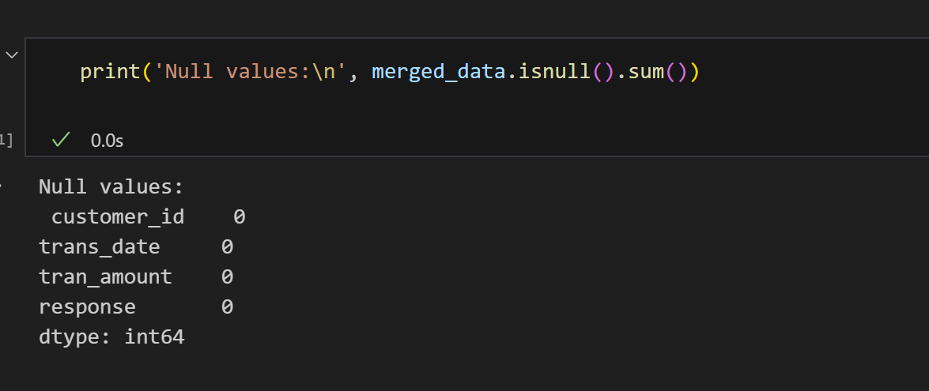
Data Cleaning & Preparation
The foundation of reliable analysis is rigorous data preparation. Our cleaning process transformed raw transaction data into a unified, validated dataset ready for analysis.
Cleaning Operations
Eliminated duplicate transaction records
Removed rows with missing critical values
Standardized date formats (trans_date)
Extracted temporal features (Month, Year)
Merged datasets via customer_id
Validated data integrity post-merge

Slide 4
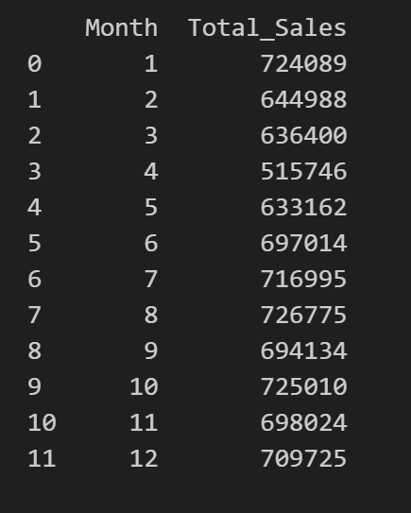
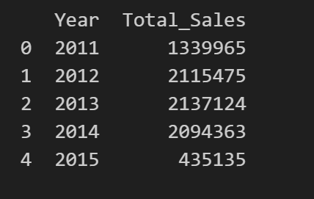
Tabular Reports & Analysis
Sales by Month
Monthly revenue aggregation revealing seasonal patterns
Summary tables provide the quantitative foundation for understanding sales performance. We created structured reports organized by temporal dimensions and product categories, all consolidated in a unified Excel dashboard.
Sales by Year
Year-over-year comparison tracking long-term growth

Slide 5
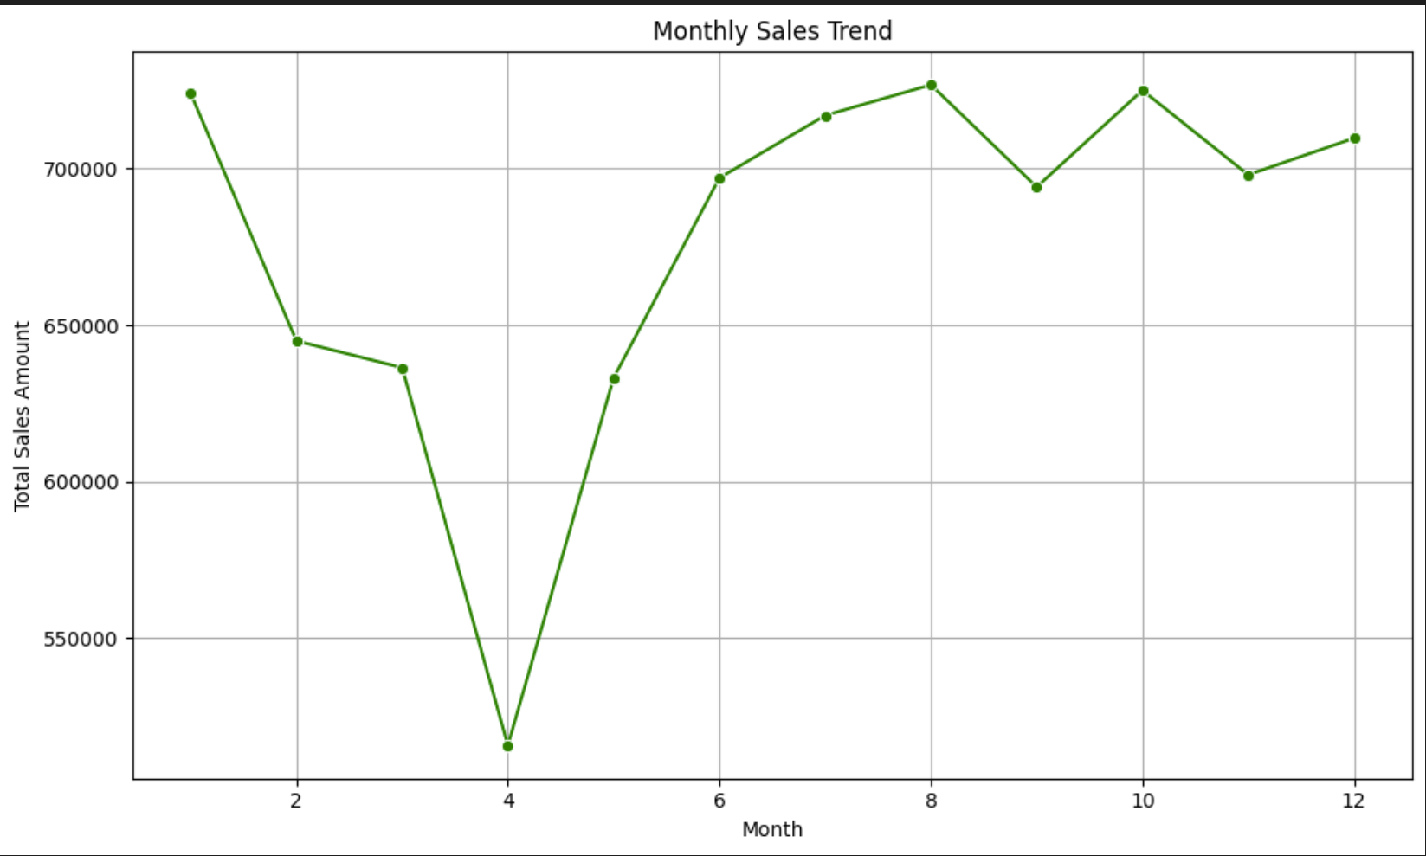
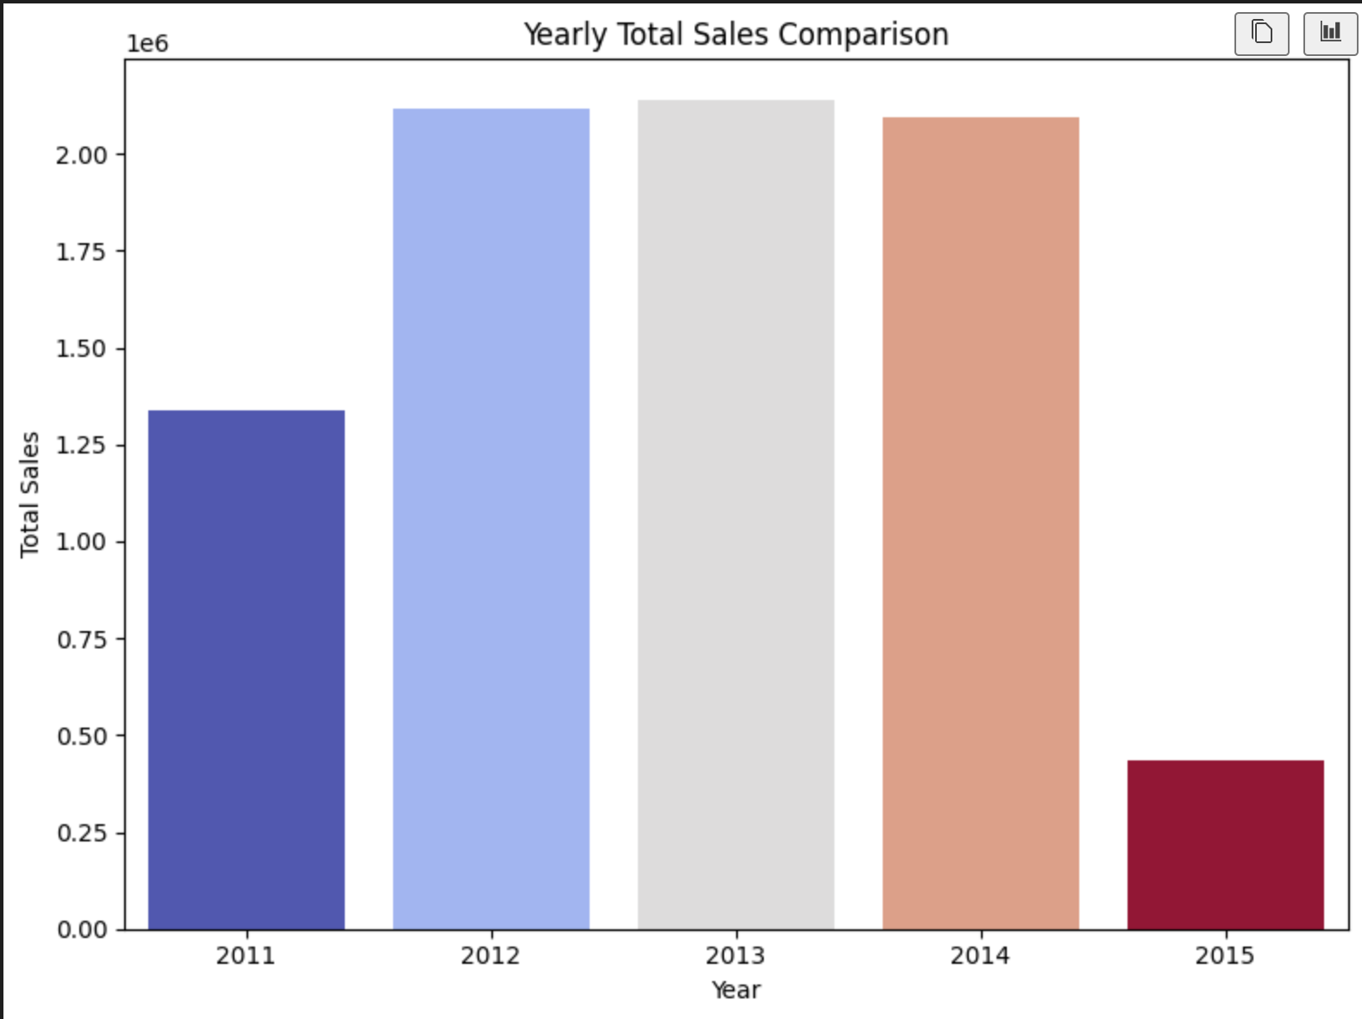
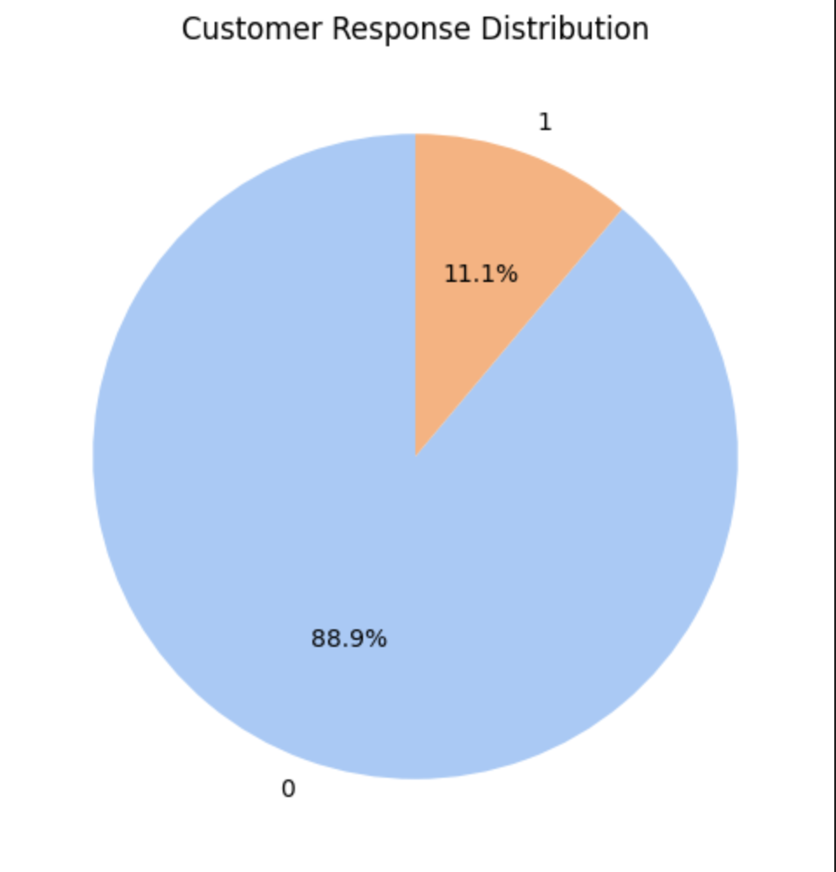
Visual Analytics & Insights
Data visualization transforms raw numbers into compelling narratives. Our charts reveal critical patterns that guide strategic decision-making across the retail organization.
Monthly Distribution
Yearly Trends
Response Distribution
Identifies seasonal peaks and revenue fluctuations throughout the year
Demonstrates year-over-year growth patterns and trajectory
Shows customer engagement levels and satisfaction metrics

Slide 6
Project Conclusion
01. End-to-End Implementation
Successfully executed complete analytical pipeline from raw data to actionable insights
02. Technology Integration
Leveraged SQL, Python, and Excel to create a robust, reproducible analysis framework
Thank You 🙏

