Slide 1
VTM/VVC – Efficiency Optimization Study
~300 logs • RA (coarse 16 frames) • 2025-09-26

Slide 2
Protocol & Dataset
Mode: Random Access (encoder_randomaccess_vtm.cfg)
BD-Rate QPs: 27, 32, 37 (coarse); 5 sequences (Class B/C/D), 16 frames/sequence
Anchors: Baseline_Ref (reference) and Baseline_Min (minimal)
Metric: BD-Rate on PSNR-Y (lower is better for absolute RD; negative BD-Rate is better)

Slide 3
Parsing & BD-Rate Method
VTM 23.11 logs: prefer Layer summary (Total Frames | Bitrate | Y-PSNR ...)
Fallbacks: average PSNR-Y from POC lines; if bitrate missing, compute from POC bits × fps/1000
BD-Rate: cubic fit in log-rate domain (JVET practice); integration over PSNR-Y overlap
Normalize effect to 'benefit when ON': perf_ablate → +BD, perf_add → −BD

Slide 4
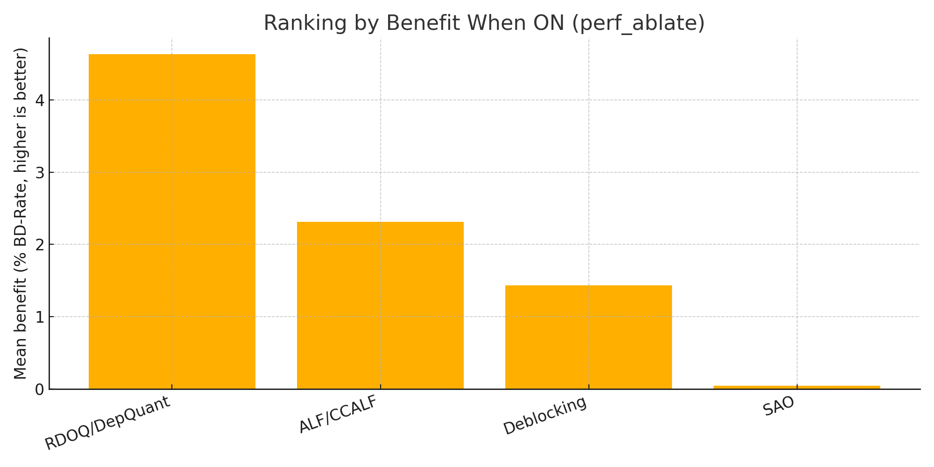
Ranking by Benefit (perf_ablate)

Slide 5
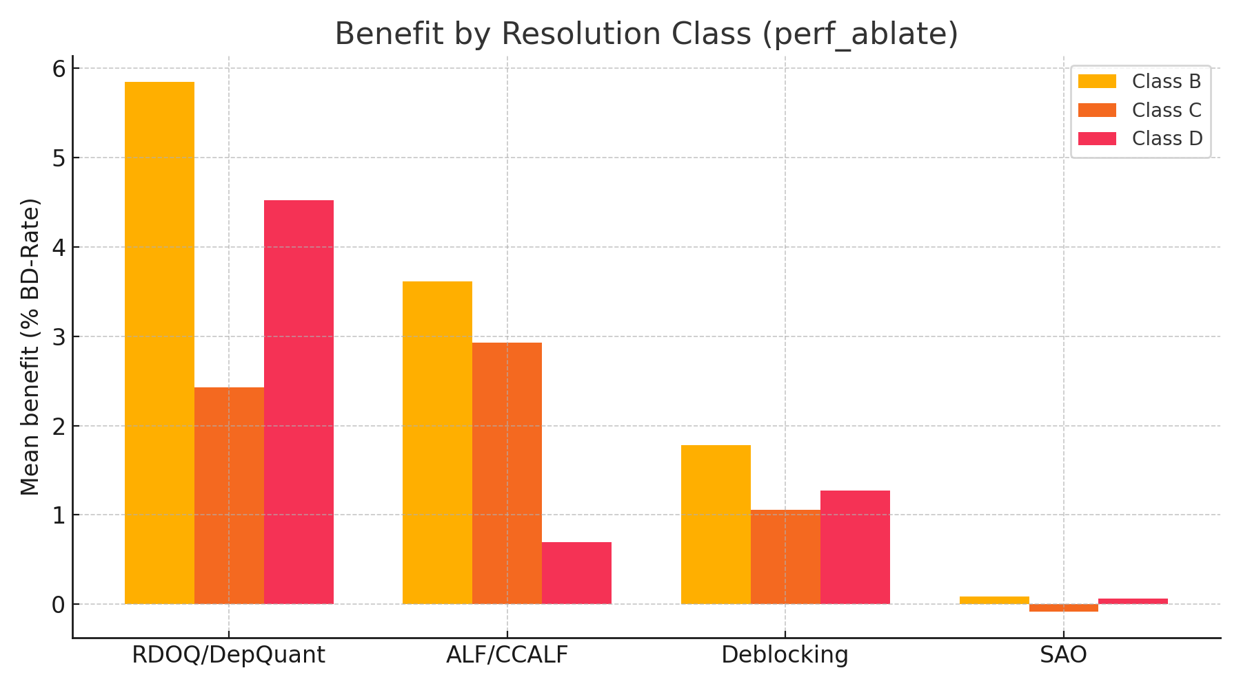
Benefit by Resolution Class (perf_ablate)

Slide 6
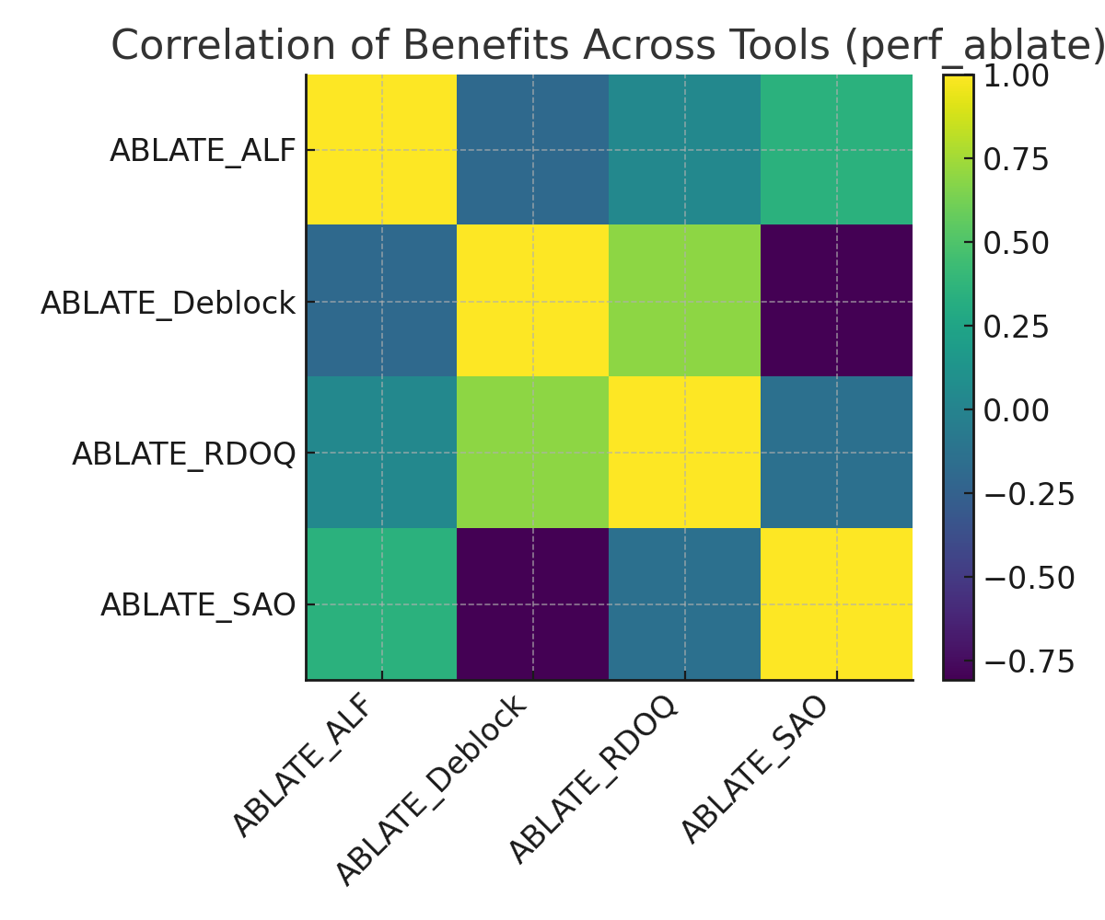
Correlation of Benefits Across Tools (perf_ablate)

Slide 7
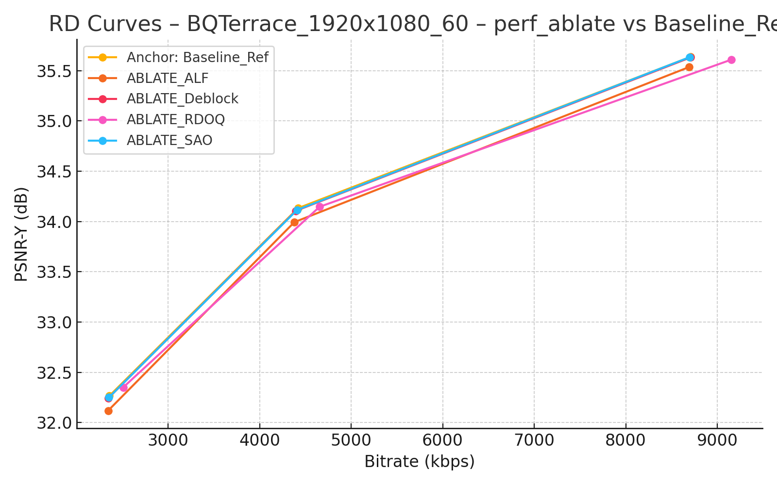
RD Curves – BQTerrace_1920x1080_60 – perf_ablate vs Baseline_Ref

Slide 8
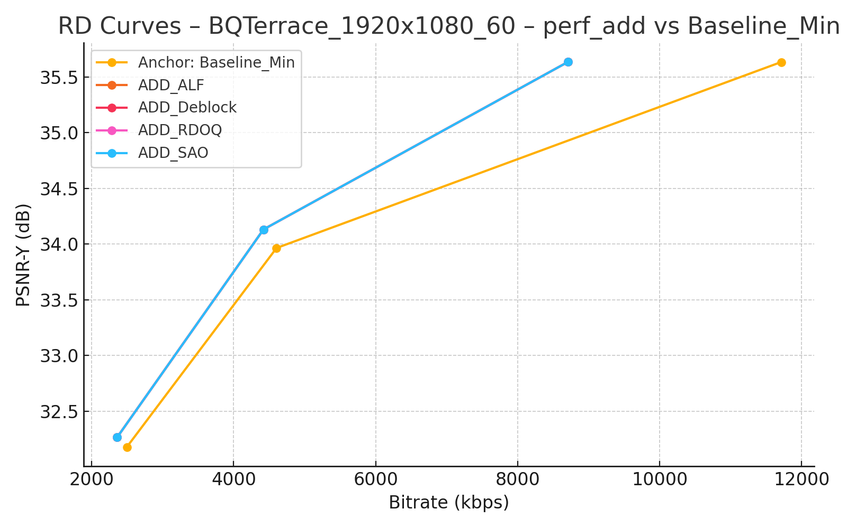
RD Curves – BQTerrace_1920x1080_60 – perf_add vs Baseline_Min

Slide 9
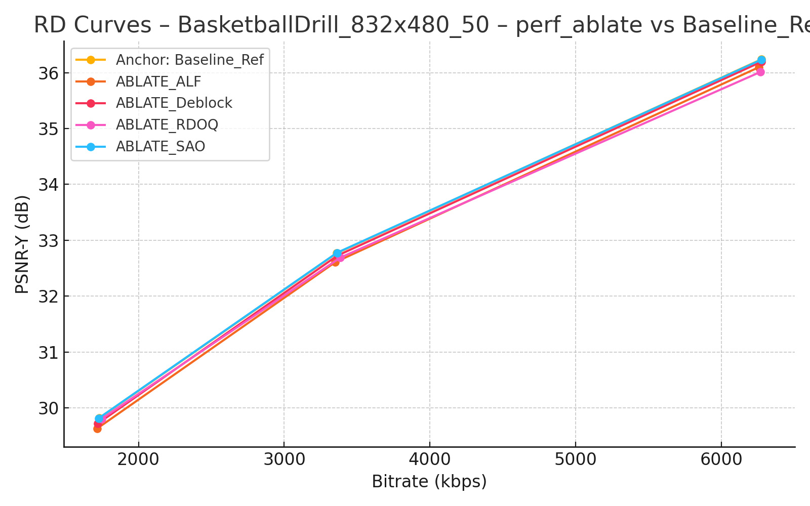
RD Curves – BasketballDrill_832x480_50 – perf_ablate vs Baseline_Ref

Slide 10
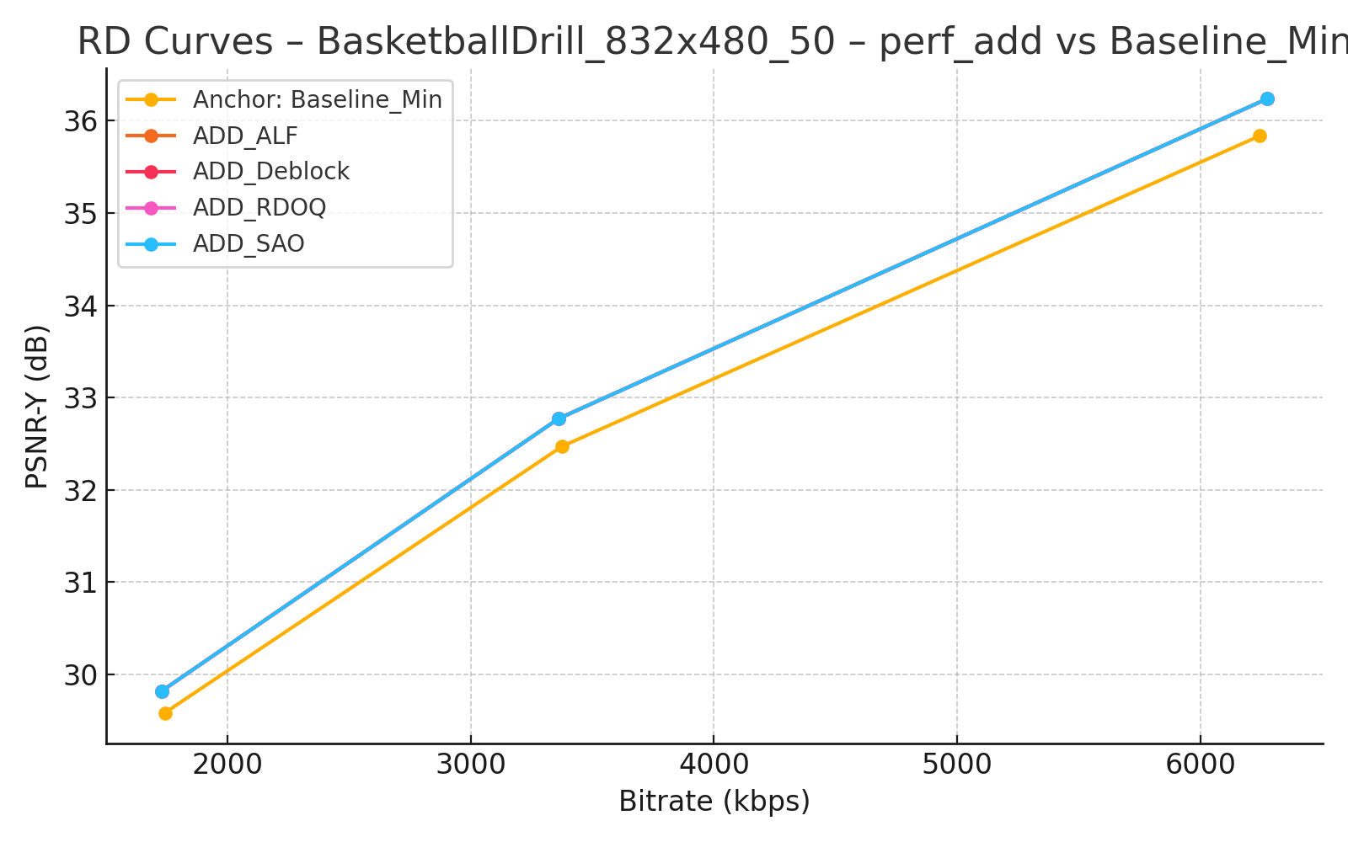
RD Curves – BasketballDrill_832x480_50 – perf_add vs Baseline_Min

Slide 11
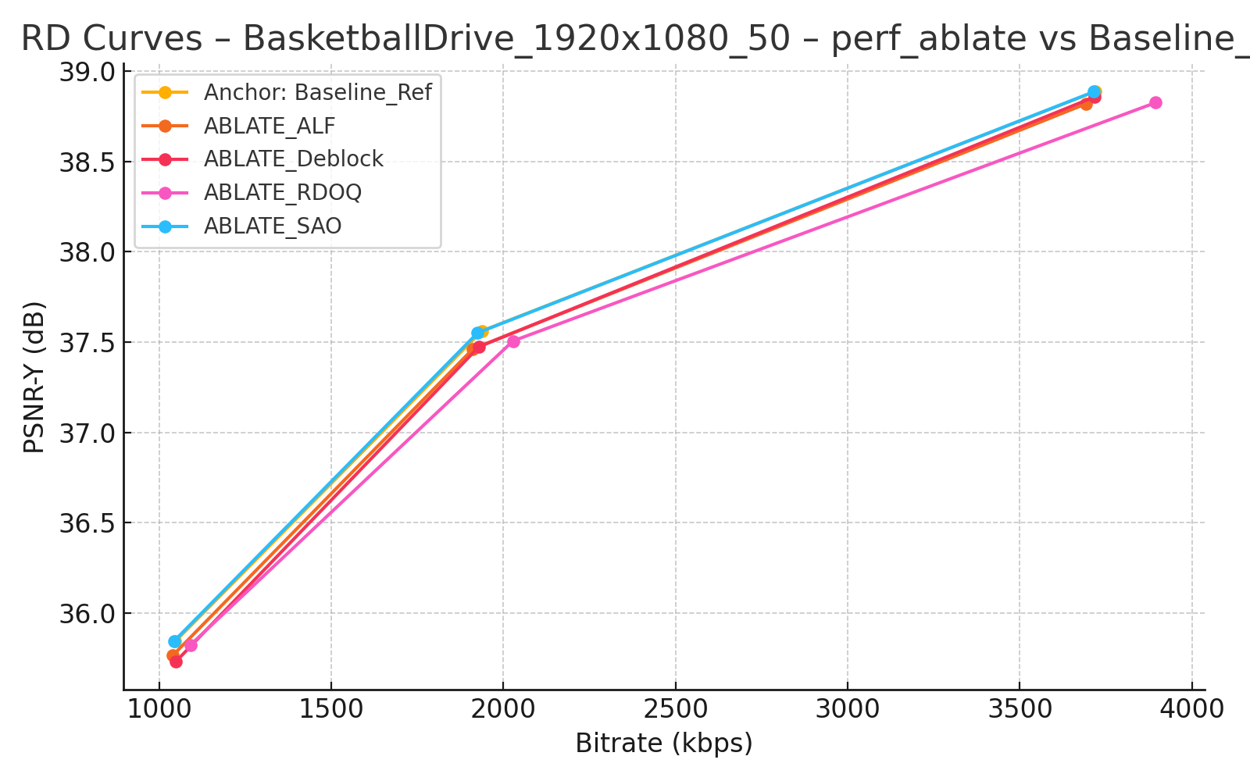
RD Curves – BasketballDrive_1920x1080_50 – perf_ablate vs Baseline_Ref

Slide 12
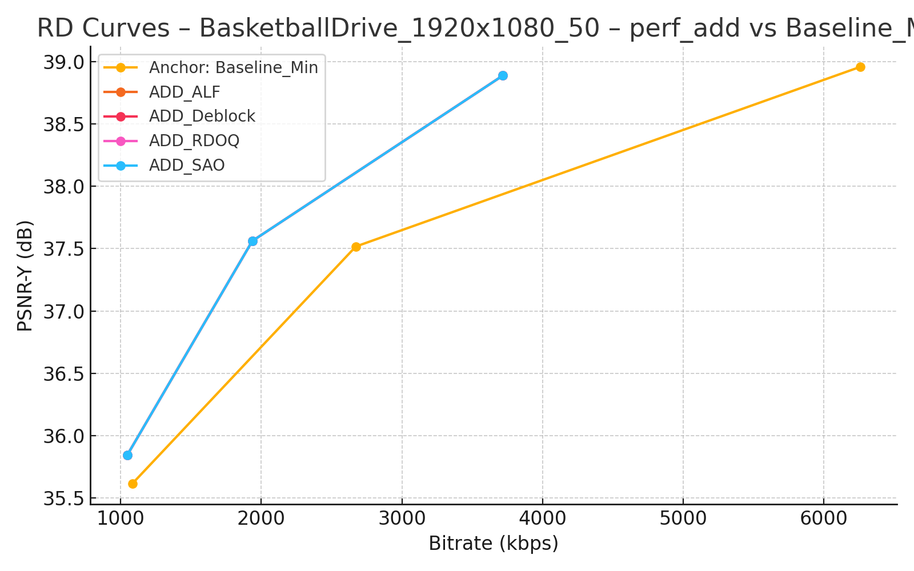
RD Curves – BasketballDrive_1920x1080_50 – perf_add vs Baseline_Min

Slide 13
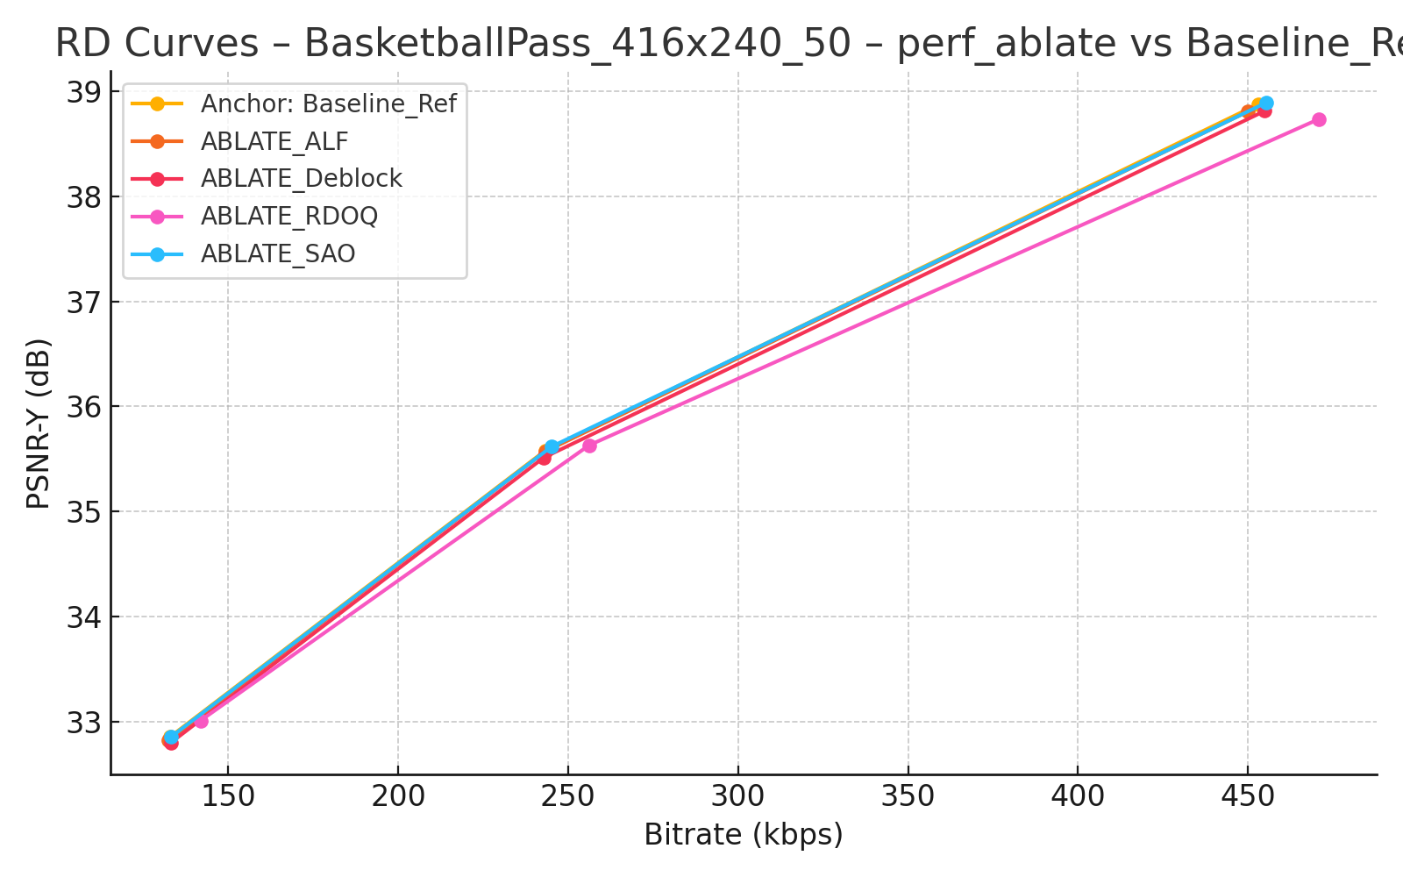
RD Curves – BasketballPass_416x240_50 – perf_ablate vs Baseline_Ref

Slide 14
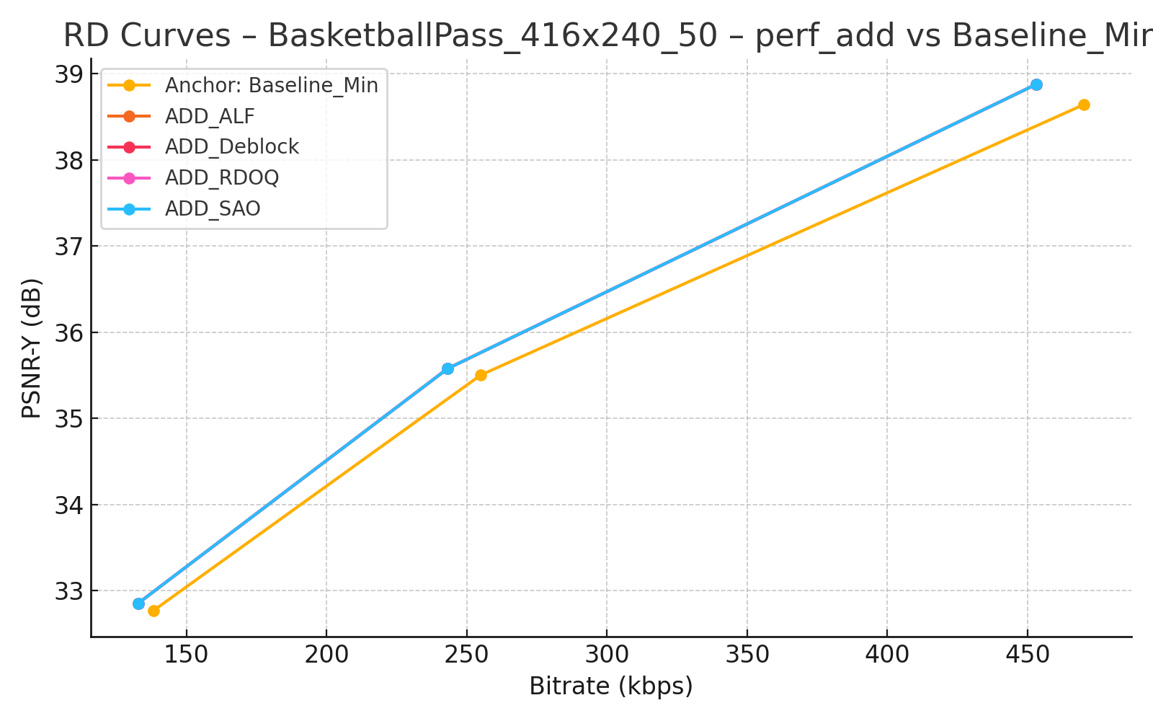
RD Curves – BasketballPass_416x240_50 – perf_add vs Baseline_Min

Slide 15
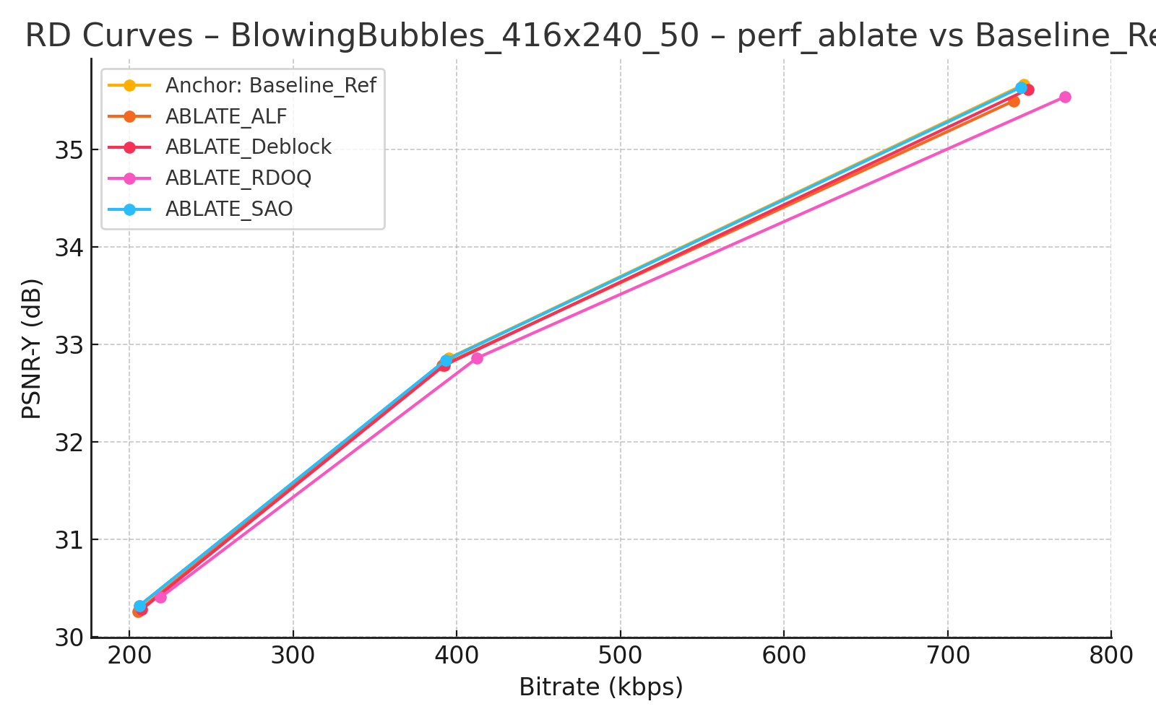
RD Curves – BlowingBubbles_416x240_50 – perf_ablate vs Baseline_Ref

Slide 16
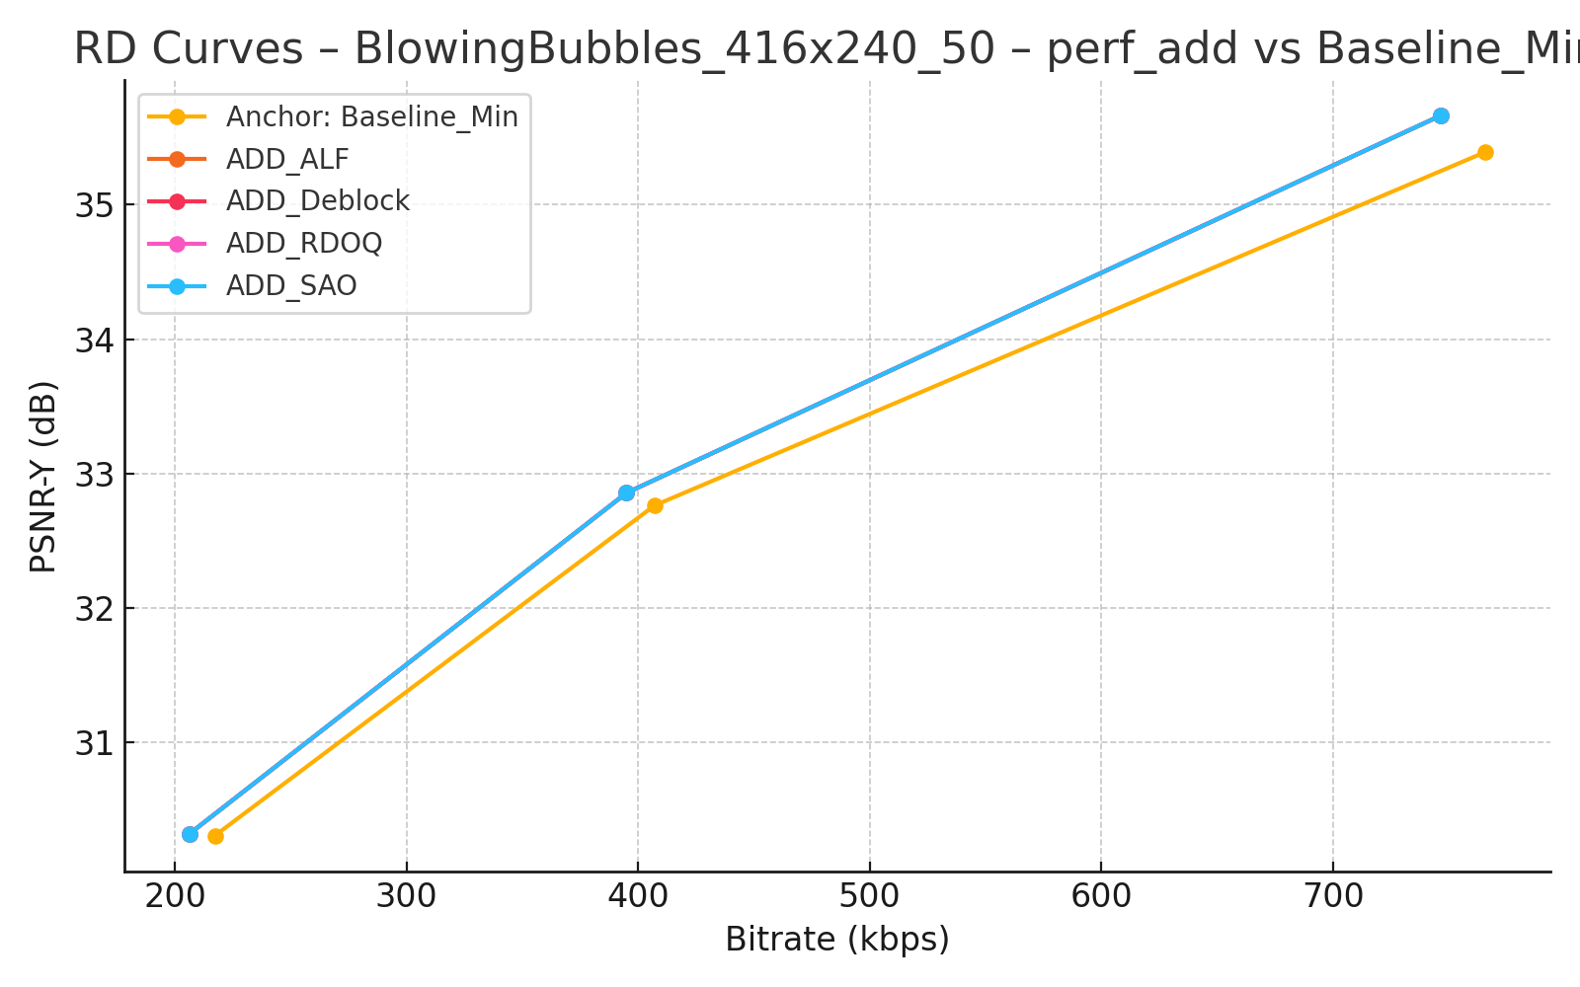
RD Curves – BlowingBubbles_416x240_50 – perf_add vs Baseline_Min

Slide 17
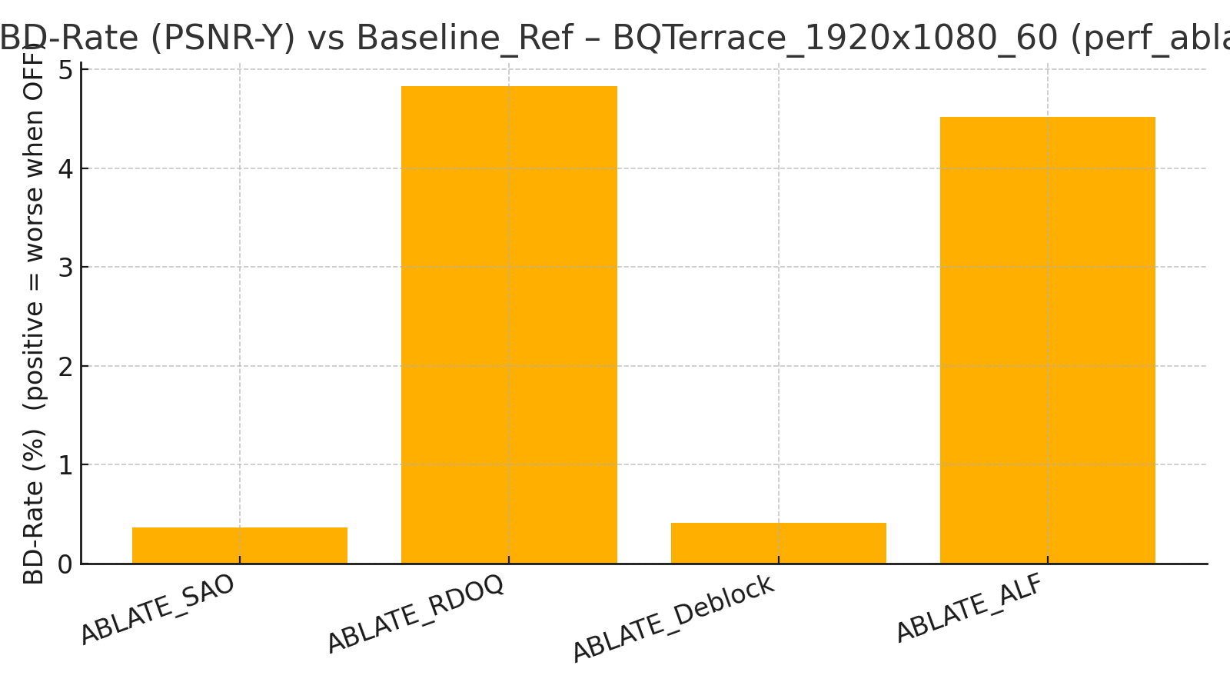
BD-Rate per Sequence – perf_ablate

Slide 18
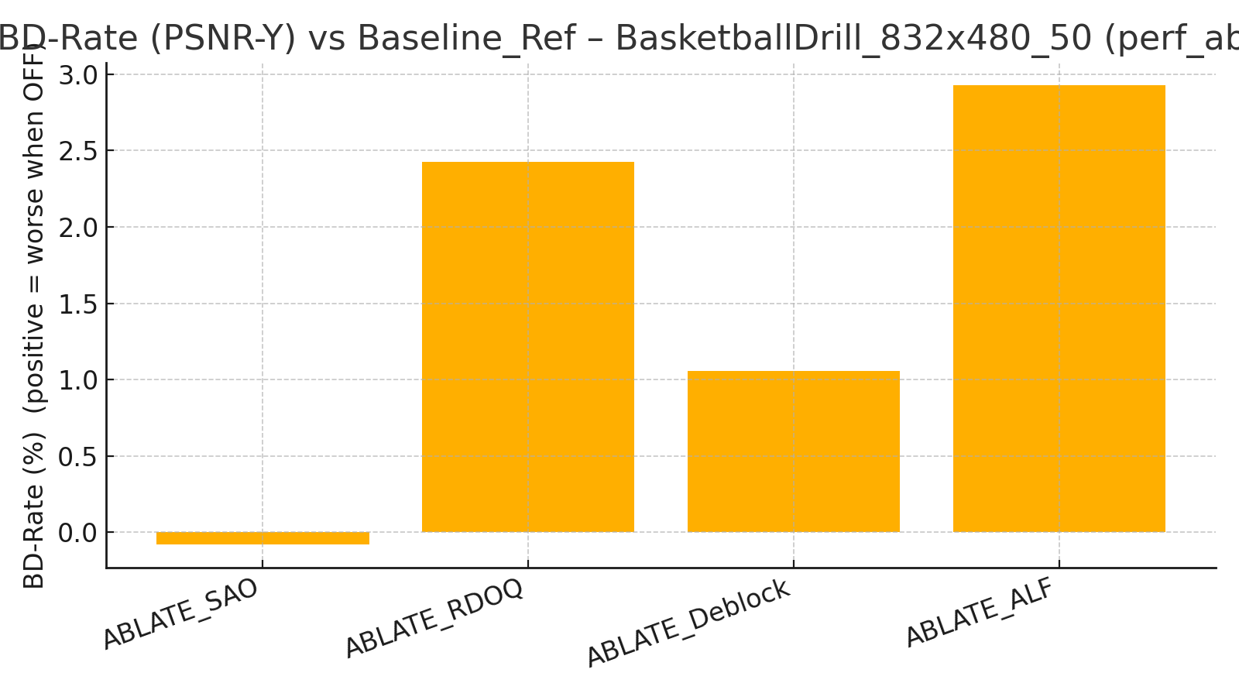
BD-Rate per Sequence – perf_ablate

Slide 19
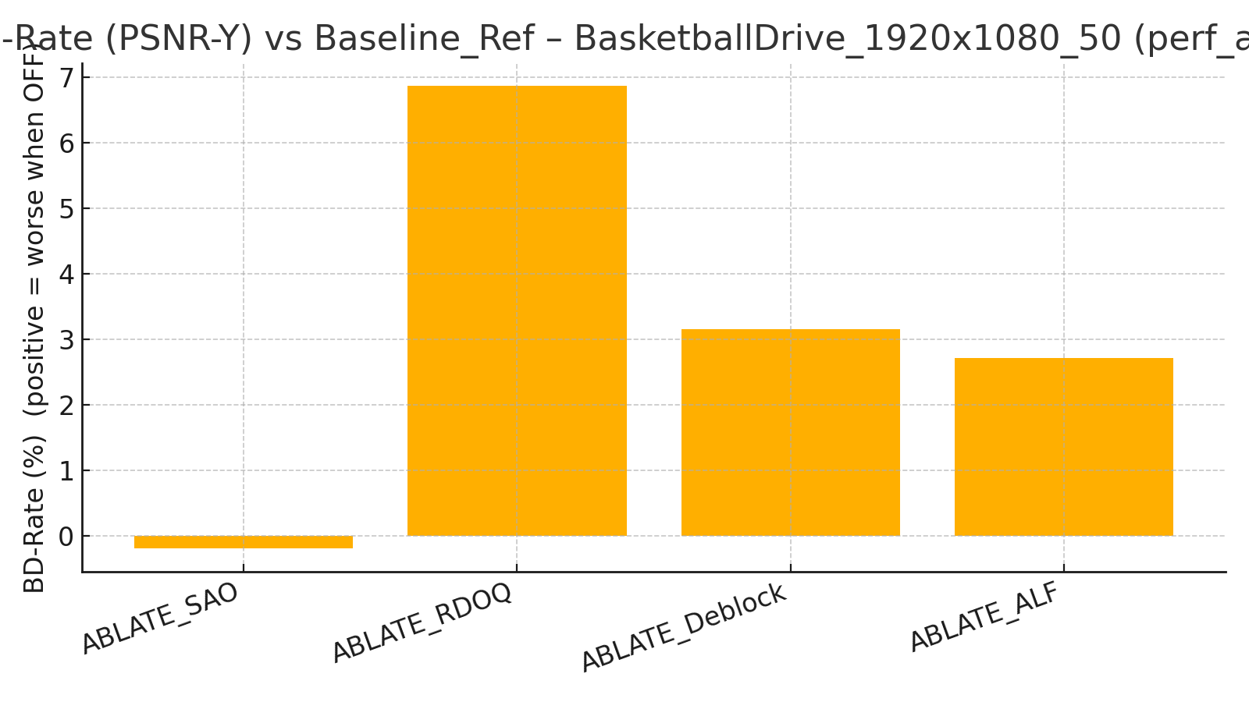
BD-Rate per Sequence – perf_ablate

Slide 20
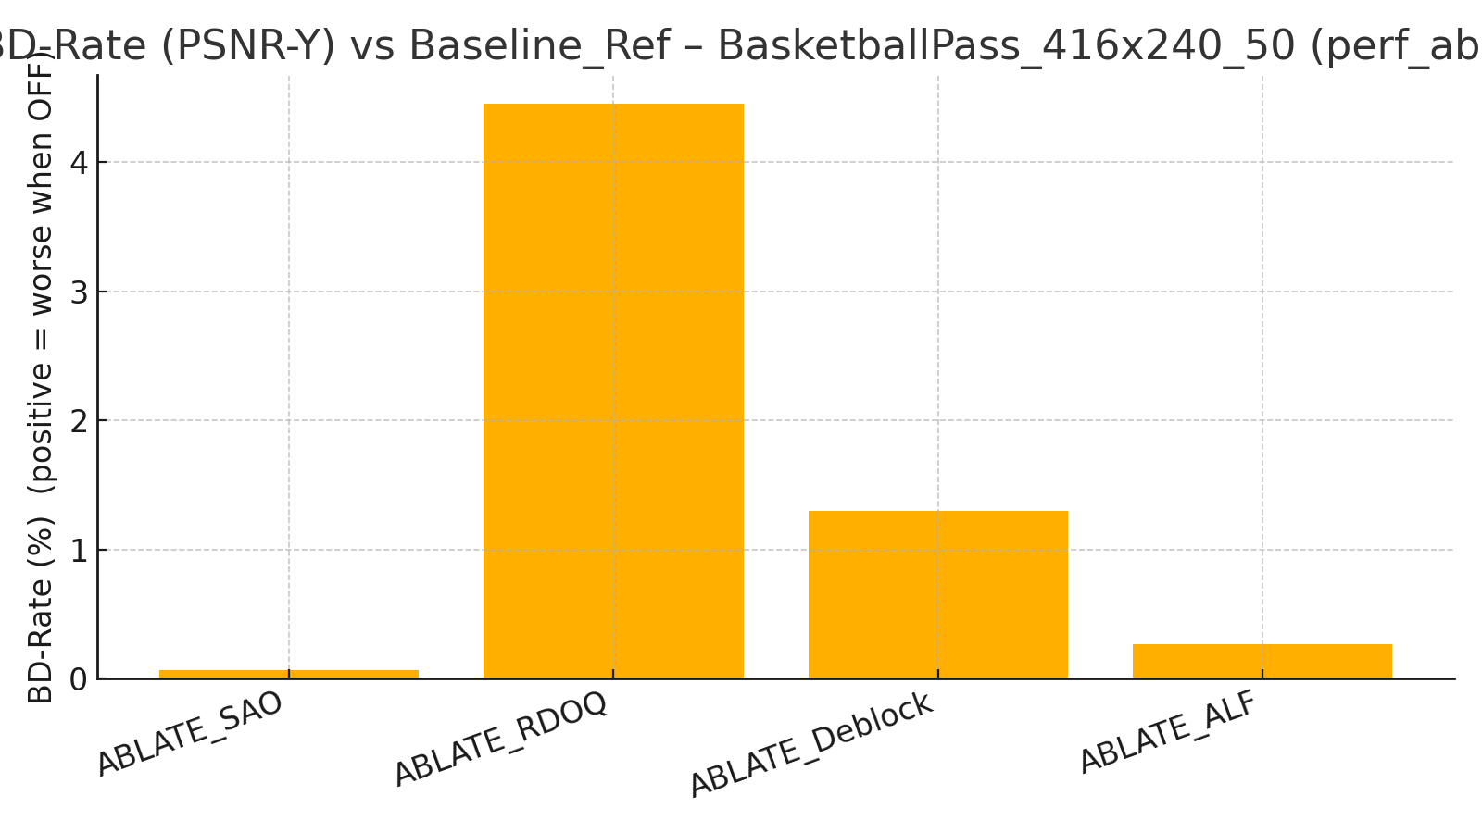
BD-Rate per Sequence – perf_ablate

Slide 21
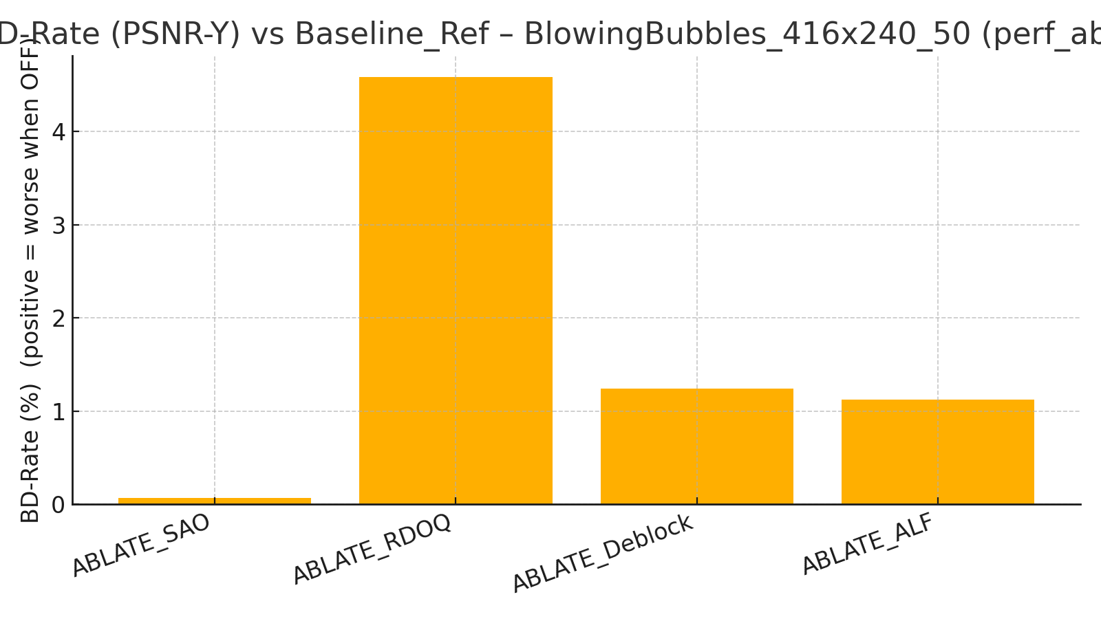
BD-Rate per Sequence – perf_ablate

Slide 22
Recommended Efficiency Preset (Eff_Best)
RDOQ/DepQuant – must keep; strongest and most stable gains
ALF/CCALF – strong gains; synergizes with deblocking/SAO
Deblocking – consistent PSNR-Y improvements; prepares signal for ALF
SAO – small in 16-frame coarse, but typically synergistic over longer runs
Flags (CLI): --DepQuant=1 --RDOQ=1 --RDOQTS=1 --ALF=1 --CCALF=1 --SAO=1 --DeblockingFilterDisable=0

Slide 23
Next Steps & Validation
Confirm run: RA, 33 frames (or full clips), QP 22/27/32/37, Baseline_Ref vs Eff_Best
Re-run perf_add ensuring CLI flags are applied (sanity: TOOL CFG in log shows toggles)
Optional: greedy forward selection on additional tools (LMCS/LFNST/MTS/ISP/MIP/CIIP/GEO/Affine/AMVR/BDOF/DMVR/BCW)

