Slide 1

Understanding Customer Churn: A Data-Driven Approach
Presented By
Sademoni Vamshi
Power BI Intern
vamshis218@gmail.com
9000468453
Welcome to our deep dive into customer churn analysis. In today's competitive landscape, understanding why customers leave is paramount to sustainable growth. This presentation will leverage comprehensive data to identify key demographics and behaviors associated with churn, providing actionable insights for our business stakeholders and product managers. Our current churn rate stands at 0.27, highlighting an urgent need for strategic interventions. By dissecting customer distribution across various segments and analyzing engagement patterns, we aim to uncover the root causes of attrition and formulate effective retention strategies.
Notes:
1

Slide 2
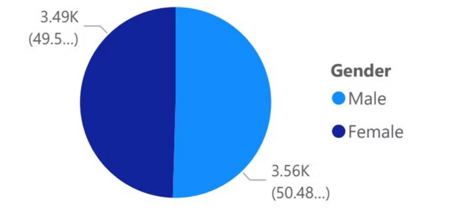
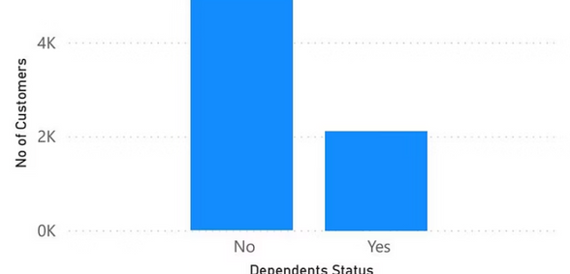
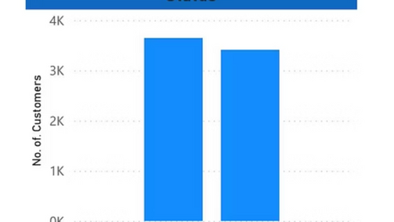
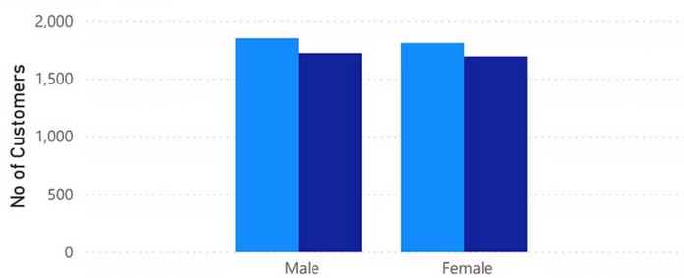
Customer Demographics: A Deep Dive
Understanding the demographic makeup of our customer base is the first step in identifying patterns related to churn. This section breaks down our customer distribution by key attributes such as gender, partner status, and dependent status. Analyzing these foundational elements allows us to build a comprehensive profile of who our customers are and how these characteristics might influence their propensity to churn. While individual attributes may seem minor, their collective impact often reveals significant trends that can inform targeted retention efforts.
Customer Distribution by Gender
Gender distribution within our customer base shows a relatively balanced split, indicating that churn is not disproportionately affecting one gender over the other. This balance suggests that the drivers of churn may be more universally experienced across both male and female customer segments, rather than being specific to gender-based preferences or challenges. Therefore, retention strategies should aim for broad applicability, addressing factors that resonate with all customer groups.
Notes:
2

Slide 3
Customer Breakdown by Gender and Partner Status
Delving deeper into demographics, we analyze the combined impact of gender and partner status on our customer base. This combined view can reveal nuanced segments that might experience different service needs or challenges, potentially contributing to varied churn rates. For instance, single individuals may have different service usage patterns compared to those with partners, which could influence their long-term engagement.
Married Customers
Single Customers
Gender Parity
Customers who are married or in a partnership tend to exhibit higher stability in their subscription patterns. This could be attributed to shared financial responsibilities or a greater need for household-wide services. Understanding their specific needs, such as multi-user accounts or family-oriented features, can enhance retention.
Single customers, while a significant segment, might show slightly different engagement behaviors. Their purchasing decisions may be more individualistic and less influenced by household needs. Tailoring communications and offers that resonate with individual preferences could be key for this segment.
Across both partnered and single categories, the gender distribution remains largely consistent, reinforcing the idea that gender alone isn't a primary churn driver. The interaction between gender and partner status provides a more insightful lens, pointing towards lifestyle factors rather than inherent gender differences.
Notes:
3

Slide 4
Customer Distribution by Dependent Status
The presence of dependents (children, elderly parents, etc.) often significantly impacts household needs and financial priorities, which in turn can influence subscription decisions. This analysis examines how the distribution of customers with and without dependents varies and its potential correlation with churn rates. Households with dependents may seek different value propositions, such as affordability, ease of use for multiple users, or content suitable for various age groups.
Households with Dependents
Customers Without Dependents
Strategic Implications
The distribution by dependent status suggests that a one-size-fits-all retention strategy may not be effective. Instead, segmentation based on family structure can lead to more personalized marketing campaigns, product enhancements, and customer support, ultimately reducing churn by addressing specific segment needs.
A substantial portion of our customer base consists of households with dependents. These customers often prioritize value for money, family-friendly features, and reliability. Understanding the specific demands of these households is critical for designing services that cater to their complex needs and enhance loyalty.
Conversely, customers without dependents may seek more individualized benefits, flexibility, and premium features. Their churn drivers might relate more to personal utility and cost-benefit analysis. Tailoring offerings to this segment requires focusing on convenience and specific niche features.
Notes:
4

Slide 5
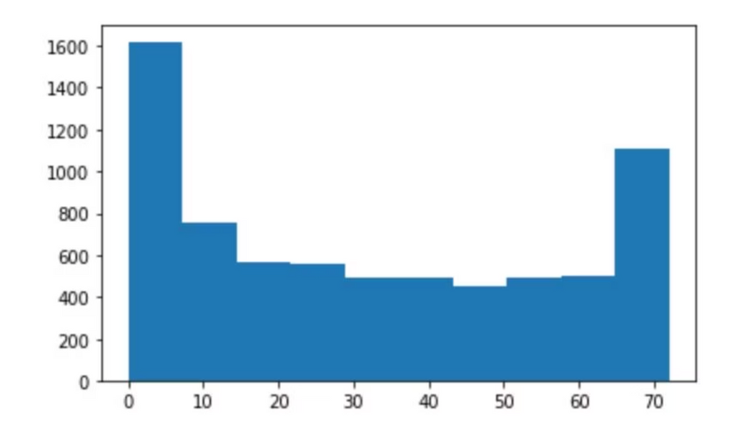
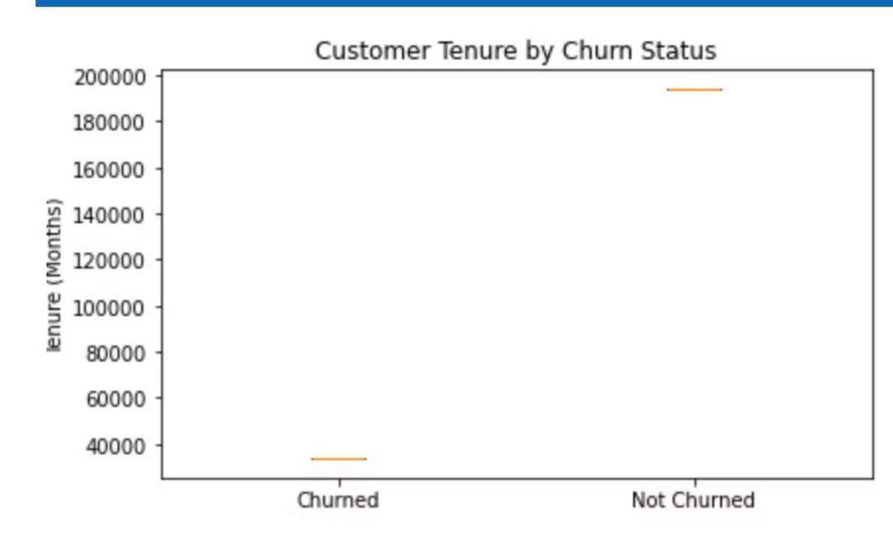
Tenure Analysis: Understanding Customer Lifecycles
Customer tenure is a crucial metric that provides insights into loyalty and satisfaction over time. This section examines the distribution of customer tenure and compares it against churn status, offering a clearer picture of when customers are most likely to leave and why. Identifying critical churn points in the customer lifecycle allows us to proactively intervene and improve retention.
The histogram illustrates the distribution of customer tenure, revealing typical engagement durations. A high frequency of churn in the early months suggests issues with onboarding or initial value proposition. Conversely, churn spikes at later stages might indicate evolving customer needs or competitive pressures. Understanding this distribution helps pinpoint crucial intervention windows.
Histogram for Tenure of Customers Distribution
Comparison of Customer Tenure by Churn Status
This comparison is vital for identifying at what stage in their lifecycle customers are most vulnerable to churn. For example, if a significant portion of churned customers have very short tenures, it points to challenges in the initial customer experience. If long-tenured customers are churning, it suggests issues with ongoing value or customer loyalty programs. These insights will directly inform our strategy for different stages of the customer journey.
Notes:
5

Slide 6
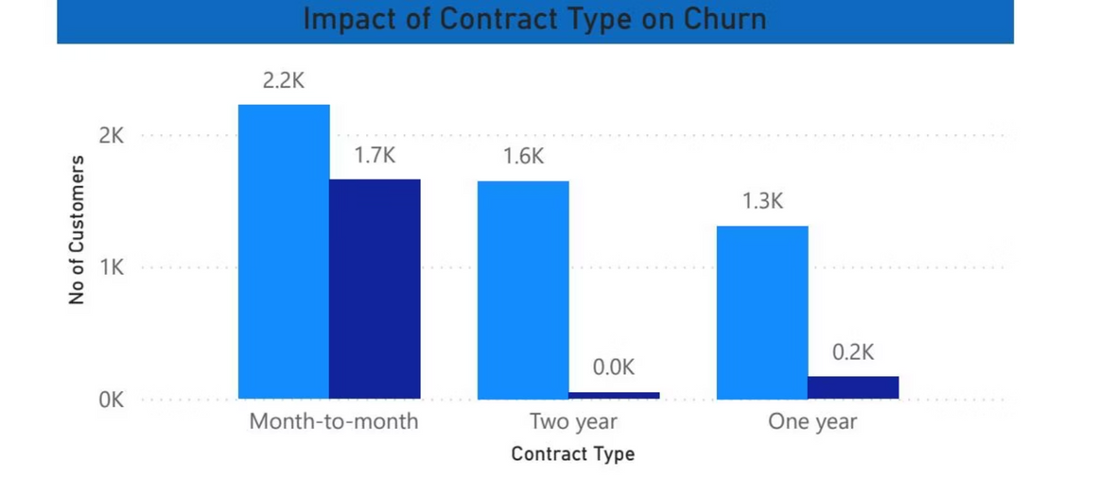
Median & Average of Tenure
Median of tenure: 29 months
The median tenure of 29 months indicates that half of our customers remain with us for less than 29 months, and half remain longer. This figure provides a robust measure, less susceptible to outliers than the average, and highlights a significant opportunity to extend customer relationships beyond this point.
Average of tenure: 32.37 months
The average tenure, at 32.37 months, is slightly higher than the median, suggesting a small number of very long-term customers are pulling the average up. This disparity underscores the importance of nurturing our most loyal customers while also focusing on strategies to extend the lifespan of those who churn earlier.
These figures collectively paint a picture of our customer retention health. While nearly three years of average tenure is respectable, there is clear room for improvement. Initiatives focusing on the 24-36 month mark could significantly impact overall customer lifetime value. For instance, targeted engagement campaigns, personalized offers, or proactive support could turn customers nearing the median tenure into long-term advocates.
Notes:
6

Slide 7
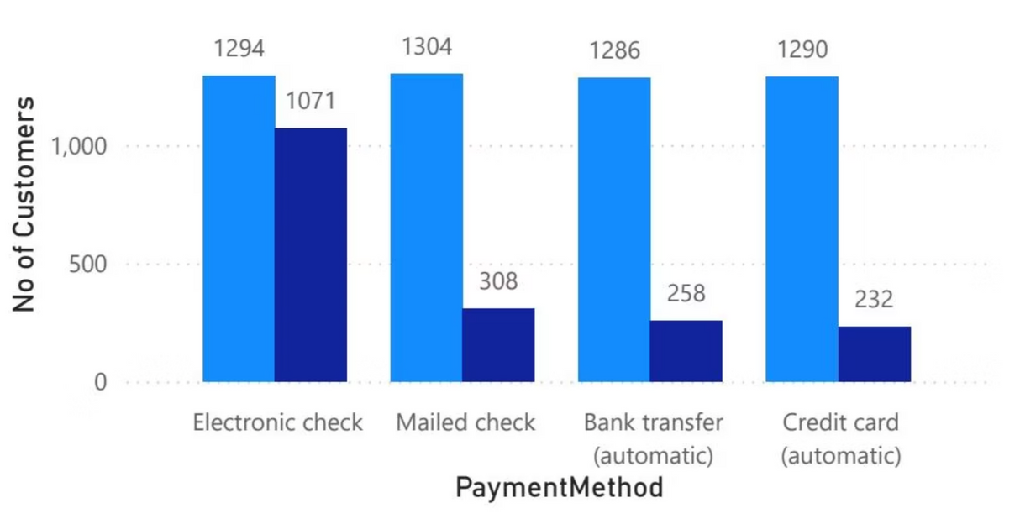
Payment Types and Churn Patterns
Payment Types By Customers
The method of payment a customer chooses can often be indicative of their long-term commitment and satisfaction. This section analyzes the distribution of customer payment types and investigates any correlations with churn rates. Different payment behaviors (e.g., electronic checks vs. credit cards) may reflect varying levels of trust, convenience, or perceived security, all of which can influence a customer's decision to stay or leave.
The chart illustrates the breakdown of customer payment methods. Understanding this distribution is crucial because it can highlight common pain points or preferences. For example, a high churn rate among customers using a less convenient payment method might suggest friction in the billing process, which could be an easily rectifiable issue to improve retention.
Notes:
7

Slide 8
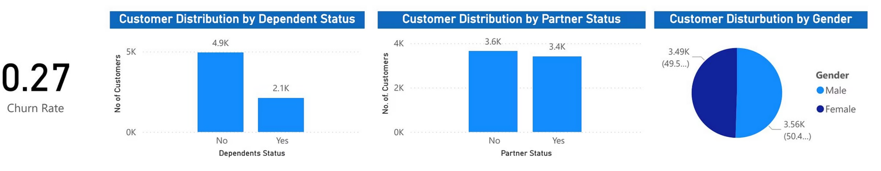
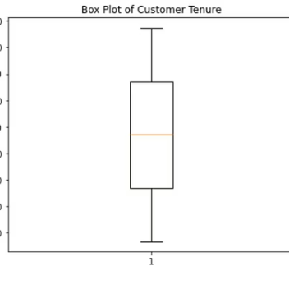
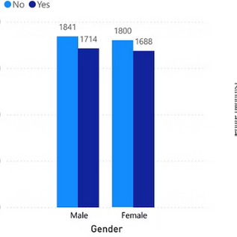
Power BI Integration: Unifying Our Insights
Power BI Desktop Customer Retention Insights
Our journey to conquer customer churn is significantly enhanced by leveraging advanced analytics tools. Power BI Desktop provides a robust platform for consolidating disparate data sources, visualizing complex relationships, and drilling down into granular insights. This integration empowers our business stakeholders and product managers with interactive dashboards, enabling them to explore churn drivers dynamically and make data-driven decisions with greater agility.
Customer Breakdown by Gender and Partner Status
Within Power BI, we can dynamically filter and view the customer breakdown by gender and partner status. This interactive capability allows for real-time segmentation and analysis, offering a deeper understanding of how these demographic factors intersect with churn. For instance, we can quickly identify if single males or partnered females exhibit particularly high churn rates, enabling targeted interventions.
Notes:
8

Slide 9
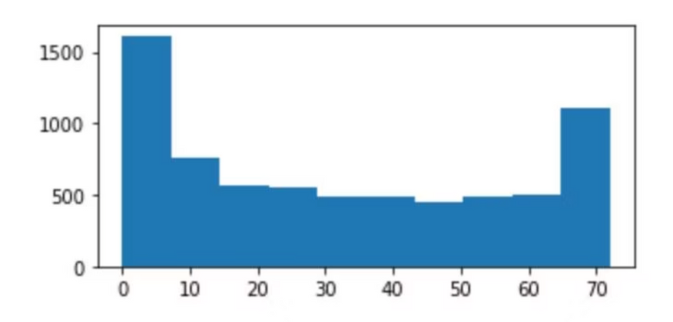
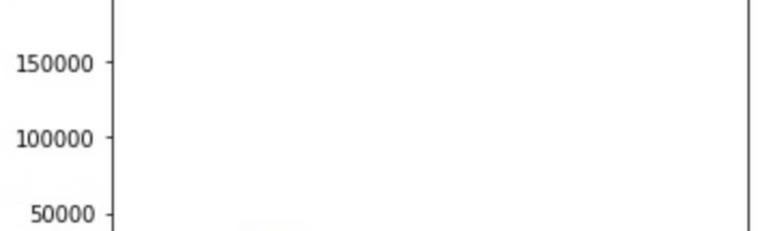
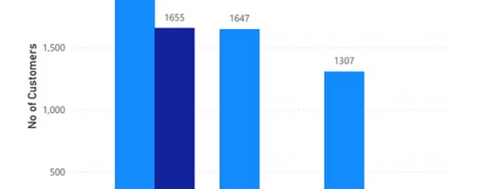
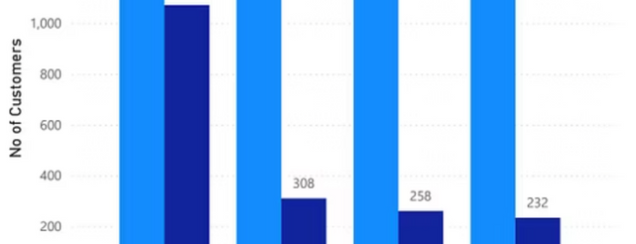
Distribution of Customer Tenure Histogram for Tenure of Customers
The Power BI visualization of the customer tenure histogram offers an interactive way to explore the lifespan of our customer relationships. Users can adjust parameters to focus on specific tenure ranges, allowing for a more granular analysis of churn at different stages of the customer journey. This helps in understanding critical retention points and designing interventions like early-stage onboarding improvements or loyalty programs for long-term customers.
Comparison of Customer Tenure by Churn Status
This Power BI dashboard provides a compelling visual comparison of customer tenure against their churn status. It clearly highlights how churn rates vary across different tenure brackets. Business stakeholders can quickly identify if new customers are churning too soon or if long-term customers are gradually disengaging. This immediate insight enables swift action to address the root causes of churn at specific lifecycle stages, from improving initial onboarding experiences to revitalizing value propositions for veteran users.
The interactive nature of Power BI empowers teams to conduct self-service analysis, reducing reliance on data analysts for every query. This democratizes data access and fosters a more data-driven culture within the organization.
Notes:
9

Slide 10
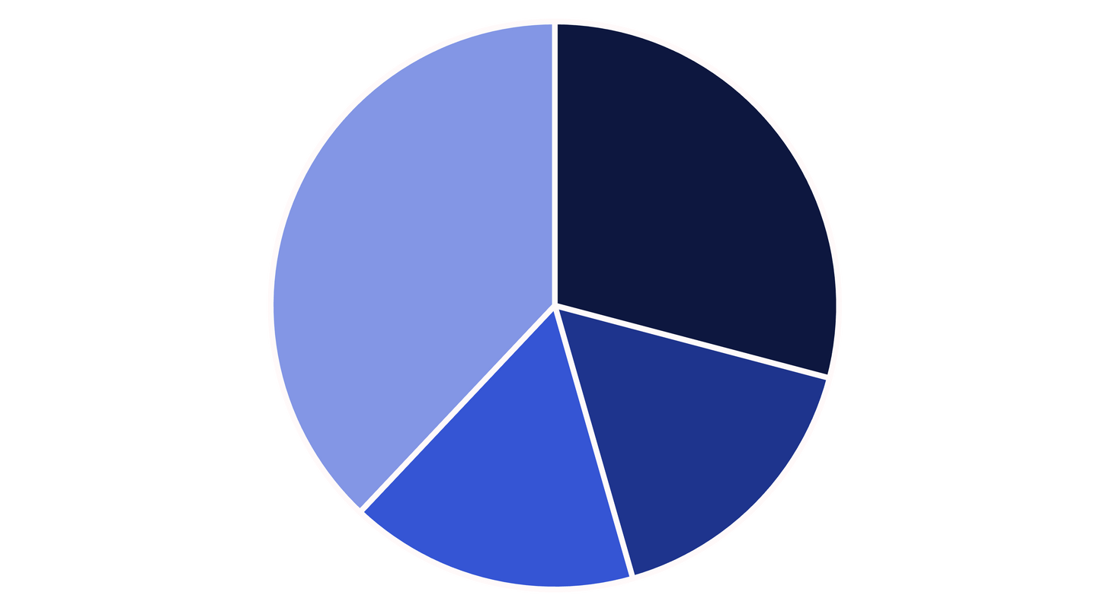
Key Takeaways & Next Steps
Payment Types By Customers: A Critical Factor in Churn
Our analysis of payment types has revealed significant insights into customer behavior and churn patterns. Understanding which payment methods are preferred, and more importantly, which are associated with higher churn, is crucial for optimizing our billing processes and improving customer retention.
Electronic Check
Mailed Check
Bank Transfer
Credit Card (Auto)
As observed in the chart, Credit Card (Auto) is the most popular payment method, suggesting a preference for convenience and automation. Conversely, Electronic Check and Mailed Check, while still used, represent payment types that might involve more friction or less commitment. High churn rates associated with these less automated methods could indicate issues with payment reminders, processing errors, or a general lack of engagement. Optimizing the user experience for these payment types, or incentivizing a shift to more stable methods, could be a valuable retention strategy.
Targeted Interventions
Product Enhancements
Develop specific retention campaigns for customer segments identified as high-risk (e.g., short-tenure, non-auto-pay).
Prioritize features that enhance value for long-term customers and address pain points for early churners.
Continuous Monitoring
Customer Feedback Loop
Utilize Power BI dashboards to continuously track churn metrics and the effectiveness of retention strategies.
Implement robust mechanisms for collecting and acting on customer feedback, especially from those considering churn.
Notes:
10

Slide 11
THANK YOU

