Slide 1
Robust Test Turbine

Slide 2
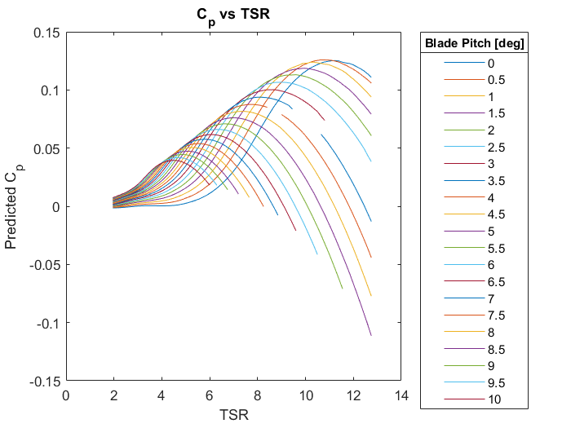
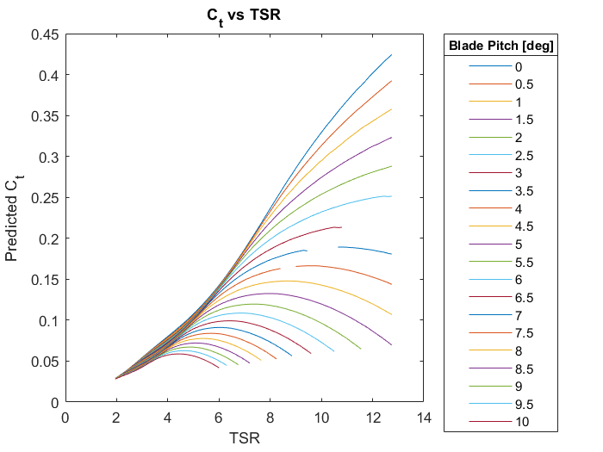
BEM Results: Turbine Cp & Ct

Slide 3
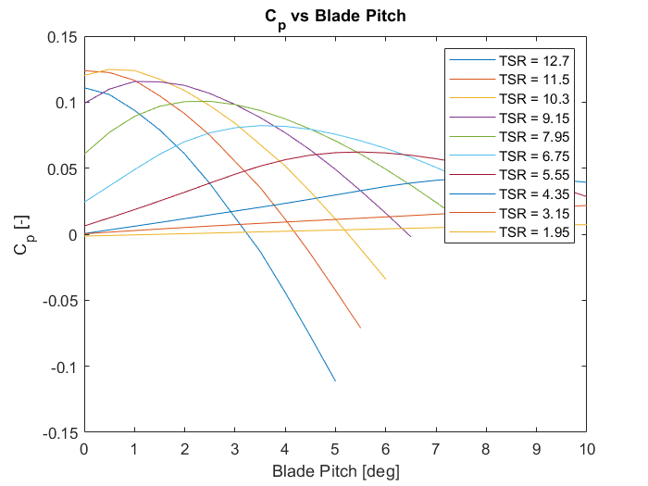
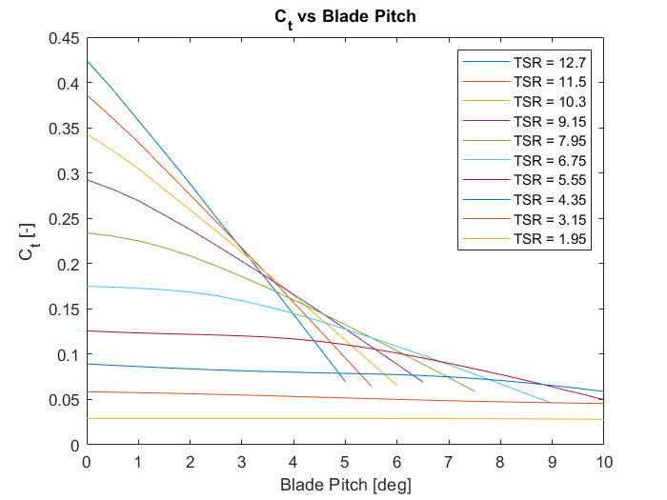
Blade Pitch Sensitivities

Slide 4
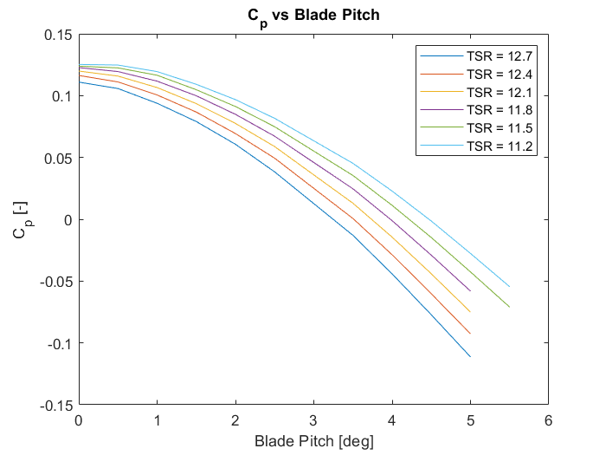
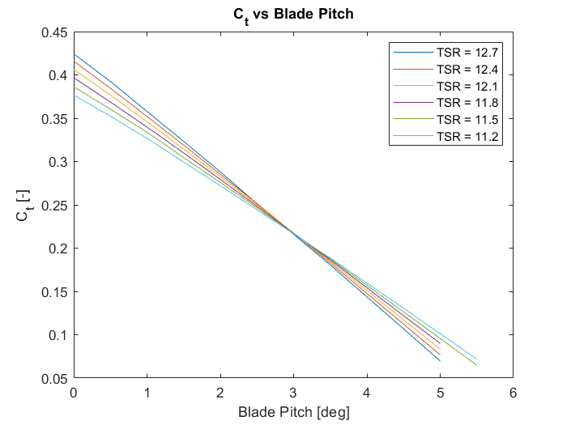
Blade Pitch Sensitivities (cont…)

Slide 5

Computing Scale Operating Parameters
Scale Thrust Target:
$$\frac{Full−Scale Thrust}{{lambda}^{0.5}}$$
Scale Wind Speed:
$$\sqrt{\frac{2∗F_{thrust}}{ρAC_{t}}}$$
Scale Operating RPM:
$$\frac{TSR∗scale_wind_target}{R_{rotor}}∗\frac{60}{2π}$$
Ct computed as function of TSR
Evaluated for TSRs from 6 - 12

Slide 6
