Slide 1
Robust Test Turbine

Slide 2
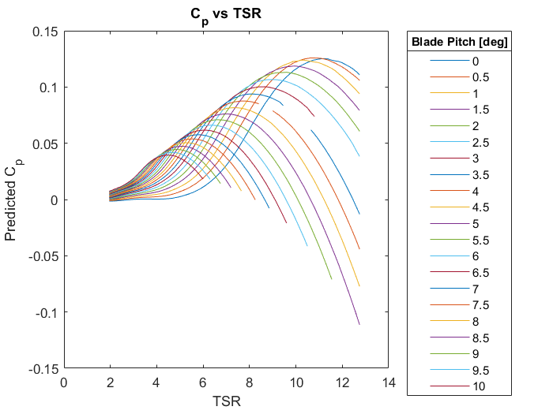
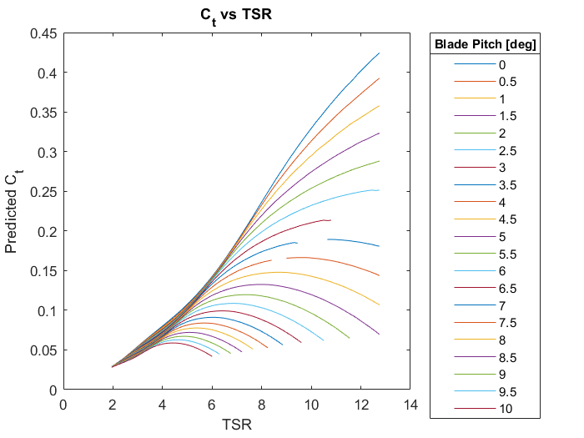
BEM Results: Turbine Cp & Ct

Slide 3
Operating Point Determination
OP Requirements:
Sufficient pitch sensitivity
Reasonable operating RPM
Centered on viable pitch range
Use above-rated RPM estimates to determine model rated speed
Design operating point

Slide 4
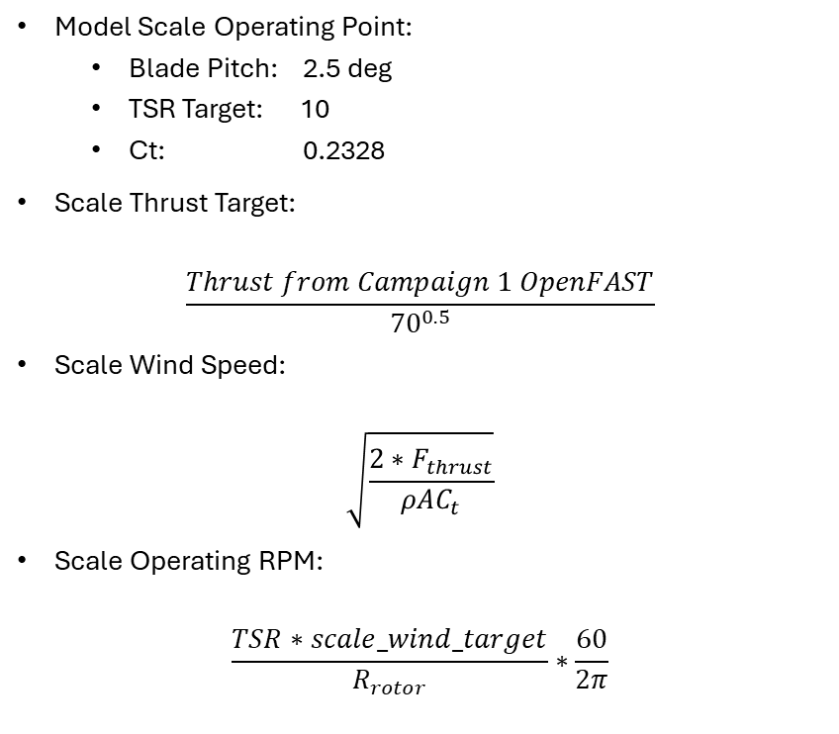
Necessary Model Scale Operating Parameters
Model Scale Operating Point:
Blade Pitch: 2.5 deg
TSR Target: 10
Ct: 0.2328
Scale Thrust Target:
$$\frac{Thrust from Campaign 1 OpenFAST}{{70}^{0.5}}$$
Scale Wind Speed:
$$\sqrt{\frac{2∗F_{thrust}}{ρAC_{t}}}$$
Scale Operating RPM:
$$\frac{TSR∗scale_wind_target}{R_{rotor}}∗\frac{60}{2π}$$

