Slide 1
Capsule Companion The Holographic Health Coach and Medication Monitor!
Psychedelic Psychologists

Slide 2
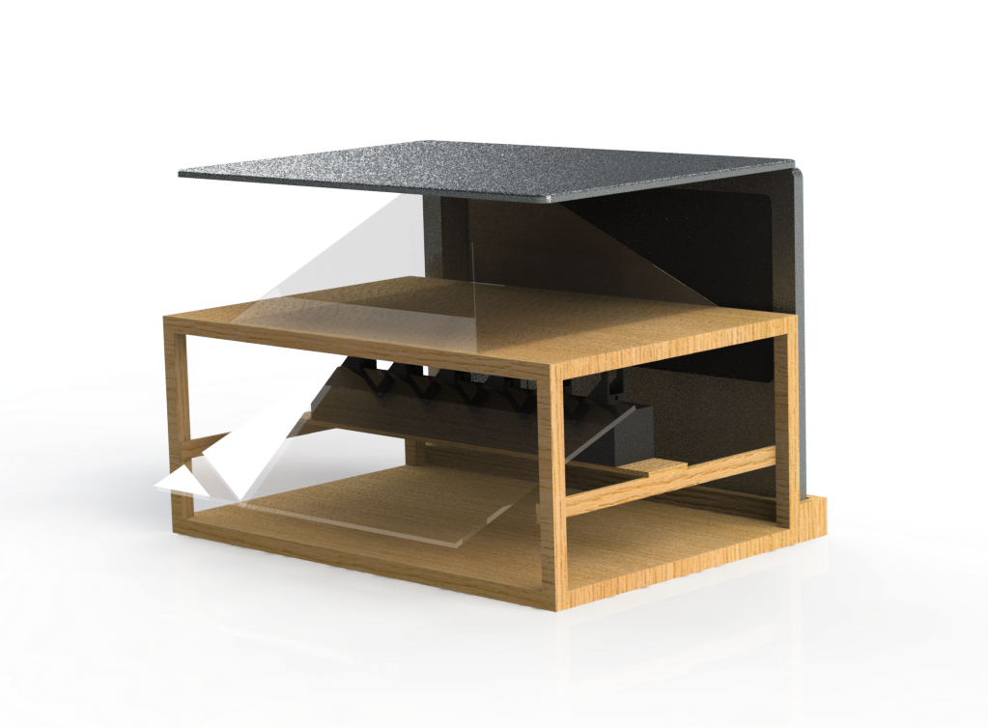
Main Body

Slide 3

Prompt Engineering

Slide 4

Pill Dispensing

Slide 5

Not a Smart Home Assistant

Slide 6

Hologram

