Slide 1
Liquidity vs Solvency
I
THE LANGUAGE of BUSINESS
26. 11. 2022
Pei-Hsun Chen, Ian Du, Lida Khachatryan, Jessica Olivares
Notes:
Complete title

Slide 2

CONTENTS
Introduction
Relevant Ratio
01
02
Case Study
Key Takeaways
03
04
I

Slide 3
01
Introduction
I

Slide 4


Liquidity
I & J
Definition
Solvency
Ability of the firm to pay off current liability with current assets
To know of how fast the current assets can be converted to cash
The ability of the firm to run the operation for a long term
To know if the firm can perpetuate year after year

Slide 5
Liquidity
I & J
Definition
Solvency
Short term (within 1 year) concept of having enough cash and cash equivalents to pay off the current debts
Low risk
Long term (over 1 year) concept about of how well the operations of the firm would be run
High risk
Notes:
Low risk: easier to fix, not impact the business
High risk: more structure change to fix the issue

Slide 6
Impact on each other
I & J
If solvency is high, liquidity can be achieved in a short period of time
If liquidity is high, solvency may not be achieved quickly

Slide 7
Liquidity
I & J
What to Look in the Balance Sheet?
Solvency
Current assets
Current liabilities
Detailed account of
every item beneath it
Shareholders’ equity
Debt
Long term assets, etc.
Notes:
Solvency: balance sheet/ ratios from income statement

Slide 8
02
Relevant Ratios
J

Slide 9
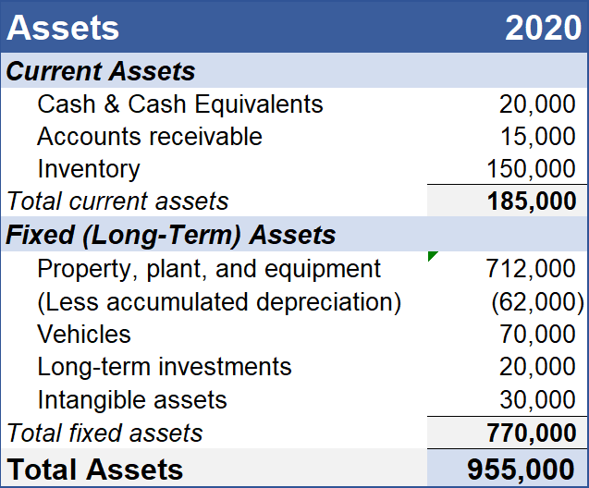
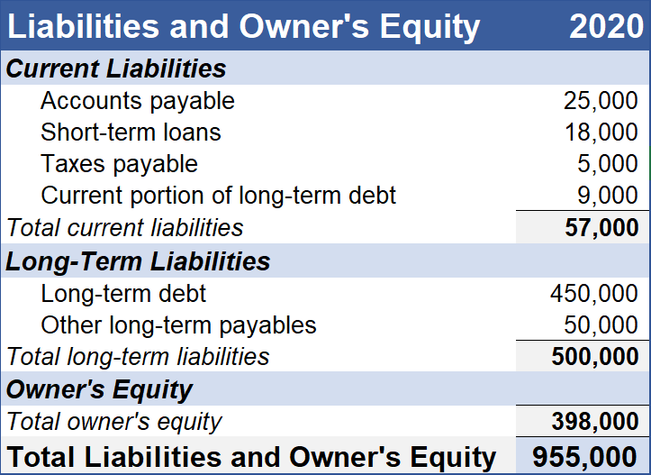
Balance Sheet
J
TBA – Simplified Balance sheet

Slide 10




Liquidity
Current Ratio
I
$$\frac{\text{Current} Assets}{Current Liabilities}$$
Quick Ratio (Acid-test Ratio) $$\frac{\text{Cash}, Cash Equivalents and Accounts Receivable}{Current Liabilities}$$
Cash Ratio $$\frac{\text{Cash} \text{and} \text{Cash} \text{Equivalents}}{Current Liabilities}$$
Notes:
Most common indicator, these are the one we choose
Only show asset side, if you need liability can go ba
Current ratio
How well a company is able to pay current liabilities
An attractive current ratio shows that a company‘s balance sheet is healthy and has solvency.
Quick ratio
A solvency metric to determine a firm's ability to pay down current liabilities with its cash, short term equivalents, and accounts receivables

Slide 11

Liquidity
Current Ratio
I
$$\frac{\text{Current} Assets}{Current Liabilities}$$
Quick Ratio (Acid-test Ratio) $$\frac{\text{Cash}, Cash Equivalents and Accounts Receivable}{Current Liabilities}$$
Cash Ratio $$\frac{\text{Cash} \text{and} \text{Cash} Equivalents}{Current Liabilities}$$
Notes:
Current ratio
How well a company is able to pay current liabilities
An attractive current ratio shows that a company‘s balance sheet is healthy and has solvency.
Quick ratio
A solvency metric to determine a firm's ability to pay down current liabilities with its cash, short term equivalents, and accounts receivables

Slide 12

Liquidity
Current Ratio
I
$$\frac{\text{Current} Assets}{Current Liabilities}$$
Quick Ratio (Acid-test Ratio) $$\frac{\text{Cash}, Cash Equivalents and Accounts Receivable}{Current Liabilities}$$
Cash Ratio $$\frac{\text{Cash} \text{and} \text{Cash} Equivalents}{Current Liabilities}$$
Notes:
Current ratio
How well a company is able to pay current liabilities
An attractive current ratio shows that a company‘s balance sheet is healthy and has solvency.
Quick ratio
A solvency metric to determine a firm's ability to pay down current liabilities with its cash, short term equivalents, and accounts receivables

Slide 13

Liquidity
Current Ratio
I
$$\frac{\text{Current} Assets}{Current Liabilities}$$
Quick Ratio (Acid-test Ratio) $$\frac{\text{Cash}, Cash Equivalents and Accounts Receivable}{Current Liabilities}$$
Cash Ratio $$\frac{\text{Cash} \text{and} \text{Cash} \text{Equivalents}}{Current Liabilities}$$
Notes:
Current ratio
How well a company is able to pay current liabilities
An attractive current ratio shows that a company‘s balance sheet is healthy and has solvency.
Quick ratio
A solvency metric to determine a firm's ability to pay down current liabilities with its cash, short term equivalents, and accounts receivables

Slide 14


Solvency
J
Debt to Assets $$\frac{Total Debt}{Total Assets}$$
Debt to Equity $$\frac{Total Debt}{Total Shareholders′ Equity}$$
Notes:
Current ratio
How well a company is able to pay current liabilities
An attractive current ratio shows that a company‘s balance sheet is healthy and has solvency.
Quick ratio
A solvency metric to determine a firm's ability to pay down current liabilities with its cash, short term equivalents, and accounts receivables

Slide 15
Solvency
J
Debt to Assets $$\frac{Total Debt}{Total Assets}$$
Debt to Equity $$\frac{Total Debt}{Total Shareholders′ Equity}$$
Notes:
Current ratio
How well a company is able to pay current liabilities
An attractive current ratio shows that a company‘s balance sheet is healthy and has solvency.
Quick ratio
A solvency metric to determine a firm's ability to pay down current liabilities with its cash, short term equivalents, and accounts receivables

Slide 16
Solvency
J
Debt to Assets $$\frac{Total Debt}{Total Assets}$$
Debt to Equity $$\frac{Total Debt}{Total Shareholders′ Equity}$$
Notes:
Current ratio
How well a company is able to pay current liabilities
An attractive current ratio shows that a company‘s balance sheet is healthy and has solvency.
Quick ratio
A solvency metric to determine a firm's ability to pay down current liabilities with its cash, short term equivalents, and accounts receivables

Slide 17
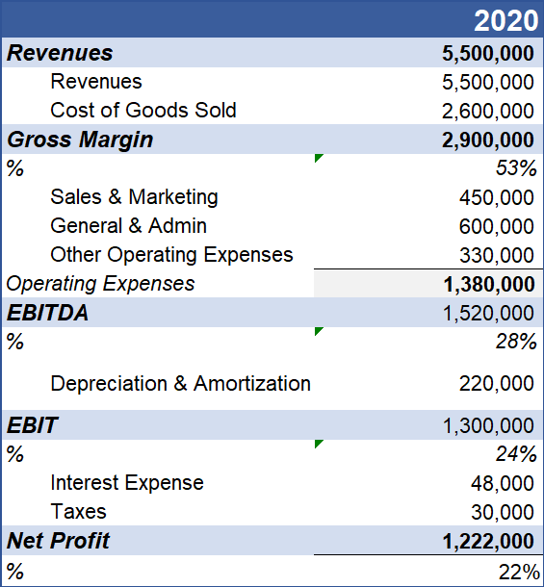


Other Perspectives
I & J
P
Interest Coverage Ratio $$\frac{EBIT}{Interest Expense}$$
Solvency Ratio $$\frac{Net Profit After Tax+Depreciation}{Total Liabilities}$$
Notes:
Interest coverage ratio: income statement

Slide 18
Other Perspectives
I & J
P
Interest Coverage Ratio $$\frac{EBIT}{Interest Expense}$$
Solvency Ratio $$\frac{Net Profit After Tax+Depreciation}{Total Liabilities}$$
Notes:
Interest coverage ratio: income statement

Slide 19
Other Perspectives
I & J
L
Interest Coverage Ratio $$\frac{EBIT}{Interest Expense}$$
Solvency Ratio $$\frac{Net Profit After Tax+Depreciation}{Total Liabilities}$$
Notes:
Interest coverage ratio: income statement

Slide 20
03
Case Study
P
Blockbuster

Slide 21
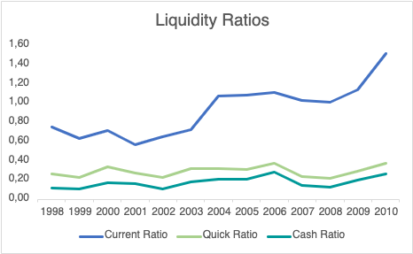

Liquidity
P
Current Ratio
$$\frac{\text{Current} Assets}{Current Liabilities}$$
Quick Ratio
$$\frac{\text{Cash}, Cash Equivalents and Accounts Receivable}{Current Liabilities}$$
Cash Ratio
$$\frac{\text{Cash} and Cash Equivalents}{Current Liabilities}$$
Notes:
Add formula/ go out of range, above one, does not indicate good finance health
Big difference: *inventory

Slide 22
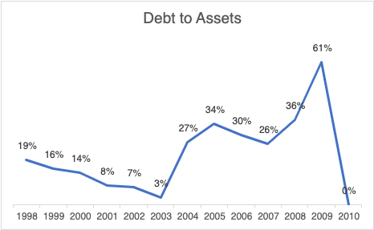
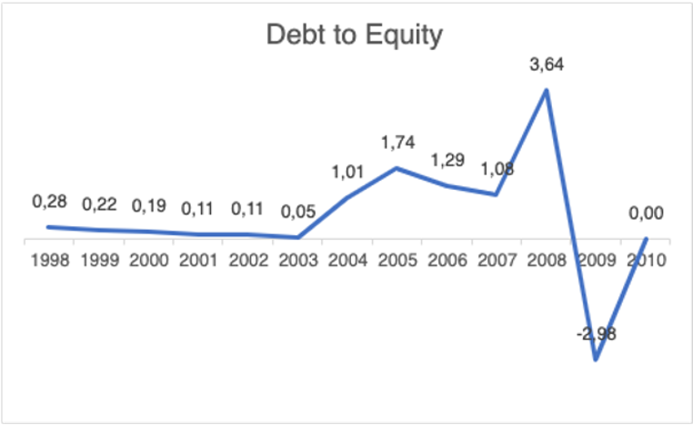


Solvency
P
Debt to Assets $$\frac{Total Debt}{Total Assets}$$
Debt to Equity $$\frac{Total Debt}{Total Shareholders′ Equity}$$
Notes:
Debt to equity:

Slide 23
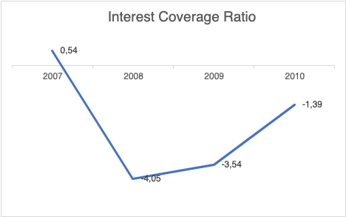
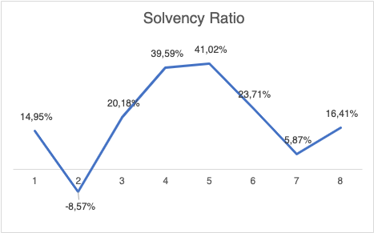


Solvency
L
Interest Coverage Ratio
$$\frac{EBIT}{Interest Expense}$$
Solvency Ratio $$\frac{Net Profit After Tax+Depreciation}{Total Liabilities}$$

Slide 24
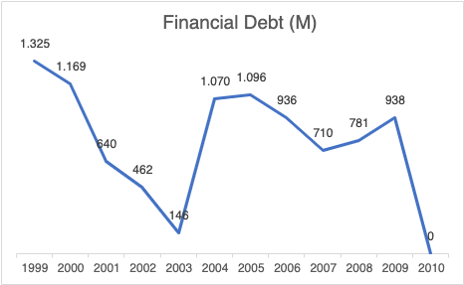
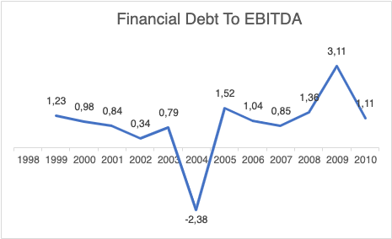

Overview
L
Financial Debt
Long Term Debt + Current Portion Debt + Dividends Payable + Notes Payable
Financial Debt to EBITDA $$\frac{Financial Debt}{EBITDA}$$
Notes:
Together
Financial debt: Amount of non-operational debt that a company has. This can be thought of as debt that is non-critical for a company's operations.
Financial Debt to EBITDA: is a representation of financial debt size compared to earnings before interest, taxes, depreciation, and amortization (EBITDA). Financial debt represents the amount of obligations the firm owes that are non-operational in nature. A ratio of one indicates the financial debt is the same size as EBITDA.

Slide 25
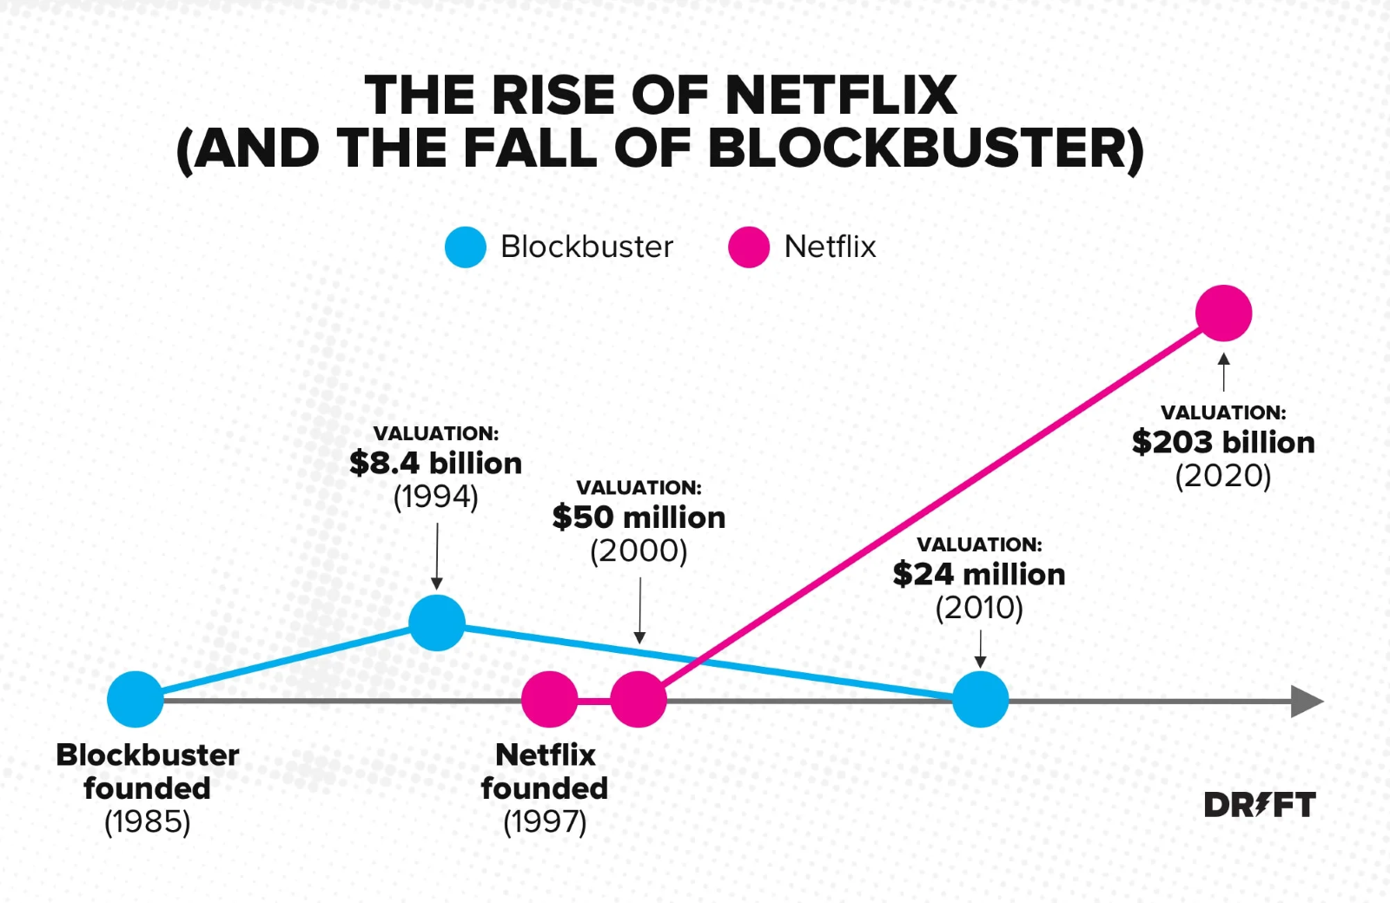
Background
P & I

Slide 26
04
Key Takeaways
P

Slide 27
Key Takeaways
PJLI
Liquidity
Ensure whether a firm can pay off its immediate debt. Focus more on a company's short-term debt obligations and current assets
Solvency
Handle long-term debt and a firm’s ability to perpetuate. Includes financial obligations in both the long and short term
Interaction
Liquidity and the solvency can’t be used interchangeably.
Tools to examine a company’s financial health (investor vs creditor's view)
Development over time should be examined. The key is adequacy in both
We shouldn’t look at single ratios in isolation. They must take into consideration multiple ratios to get a better picture of the company’s financial health. A comparison between peers within the sectors.
Ratios

Slide 28

In Code
J

Slide 29
THANKS

