Slide 1

Solar Thermal fuel predictions in deepchem
Kowalczyk Research Group
Ian McCleary

Slide 2
Goals
Dataset Creation
Run Deepchem Algorithms on the CSE cluster.
Understand various machine learning models in Deepchem.
Optimize and analyze results for any given model/parameters.
Predict isomerization energies, reverse isomerization energies, and vertical excitation energies

Slide 3
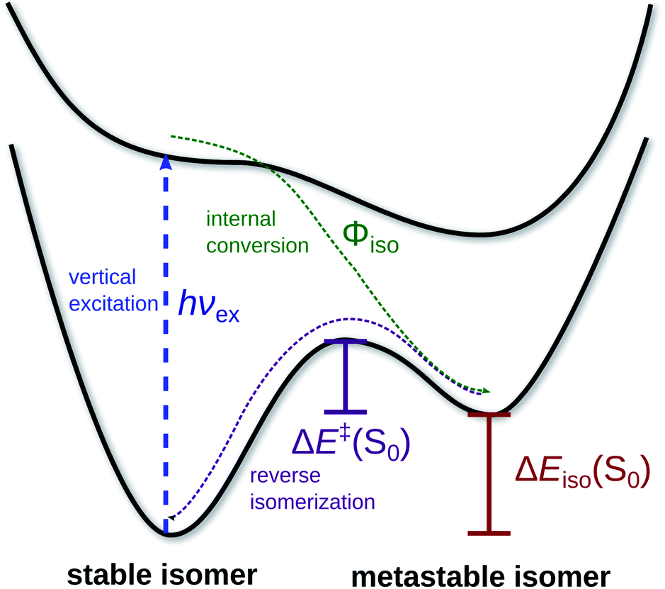
Molecular Properties
Azobenzene
Ground vs Excited state
potential energies
DFTB+

Slide 4
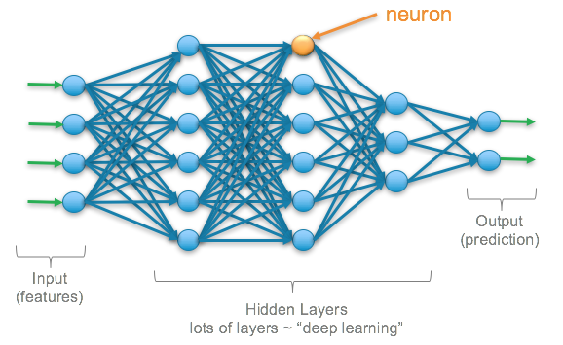
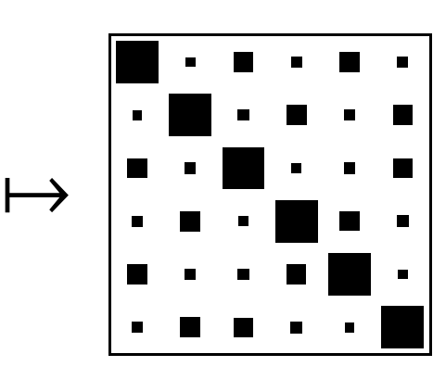
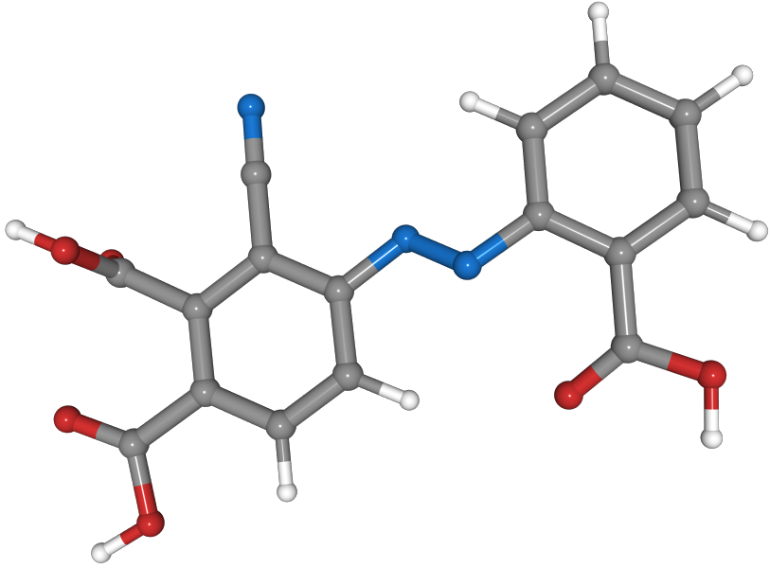



Machine Learning in Chemistry
Supervised Learning
Tasks
$$ΔE_{iso}$$
$$ΔE^{‡}$$
W⁽⁴⁾
$$hv_{ex}$$
W⁽¹⁾
W⁽²⁾
W⁽³⁾
Meta Stable
Smiles String
Featurizers
(Coulomb Matrix)
N#Cc1c(/N=N/c2ccccc2C(=O)O)ccc(C(=O)O)c1C(=O)O

Slide 5




Frameworks

Slide 6
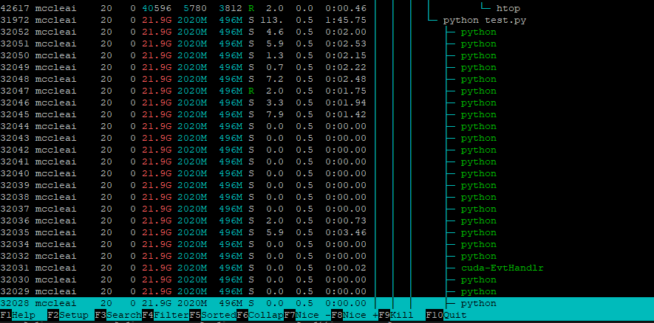
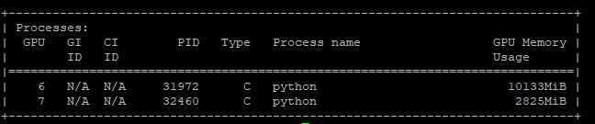
Checking Resources
htop
nvidia-smi

Slide 7
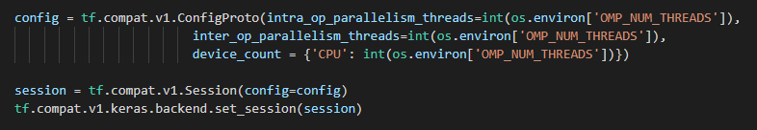
Thread Limiting
Tensorflow specific

Slide 8
Deepchem
Pros
Easy to implement
Quick results
Chemistry oriented
RDKit integration
Open source
Cons
Limited model customization
Limited model documentation
Possibly unexplainable results

Slide 9
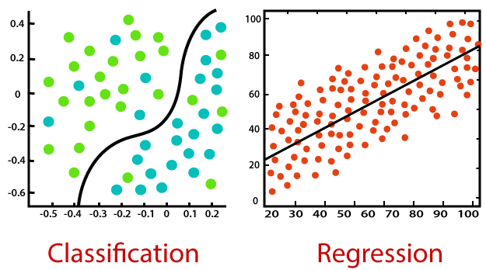
Regression vs Classification... vs both

Slide 10
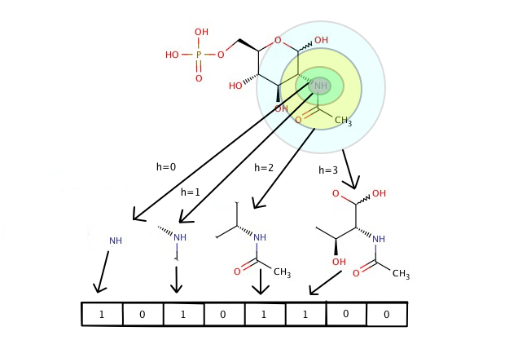
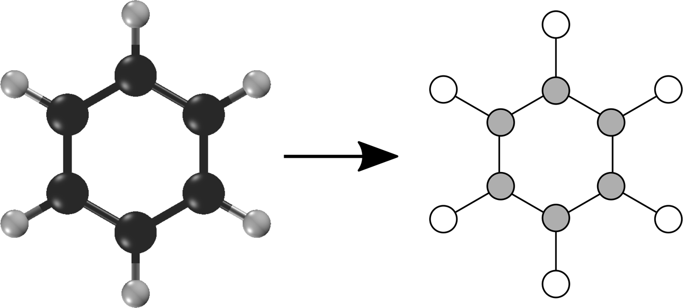
Featurizers
Coulomb Matrix & CM Eigenvalue
Circular Fingerprint
Graph Convolution

Slide 11
Regression Models (Keras)
Deep Tensor Neural Network(DTNN)
Coulomb Matrix
Multitask Regressor
Circular Fingerprint
Coulomb Eigen
RDKit Descriptors
RDKit Grid Featurizer
Graph Convolution Model
Convolutional Molecular Featurizer

Slide 12
Model Parameters
Model specific
Featurizer
Data splitting
Dropouts
Layer size
Depth of layers
Training iterations (epochs)
Number of tasks
Weight initialization
Weight decay penalty
Learning rate
Batch size
Metrics & loss functions
Transformers
Activation functions
W⁽⁴⁾
W⁽¹⁾
W⁽²⁾
W⁽³⁾

Slide 13
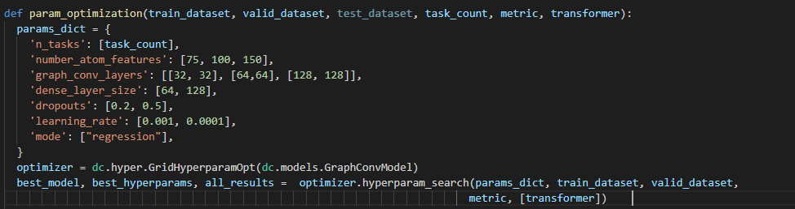
Hyperparameter Optimization
Grid Optimizer

Slide 14
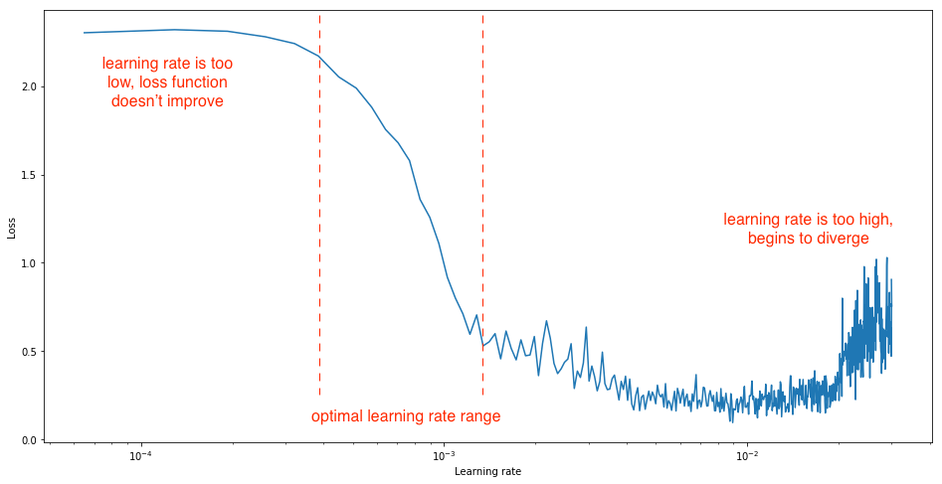
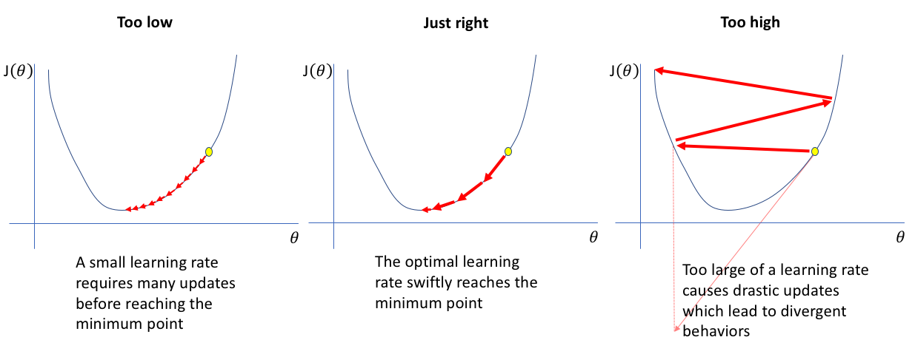
Finding Learning Rate
Learning rate scheduler
Learning rate curve

Slide 15
ML Models are Stochastic
Randomness in:
Data collection
Dataset splitting
Training order
Weight initialization

Slide 16
What Qualifies a Model as “Good”?
Evaluation metrics
Learning curve analysis
Weight vector analysis
Reproducible results
K-fold validation

Slide 17
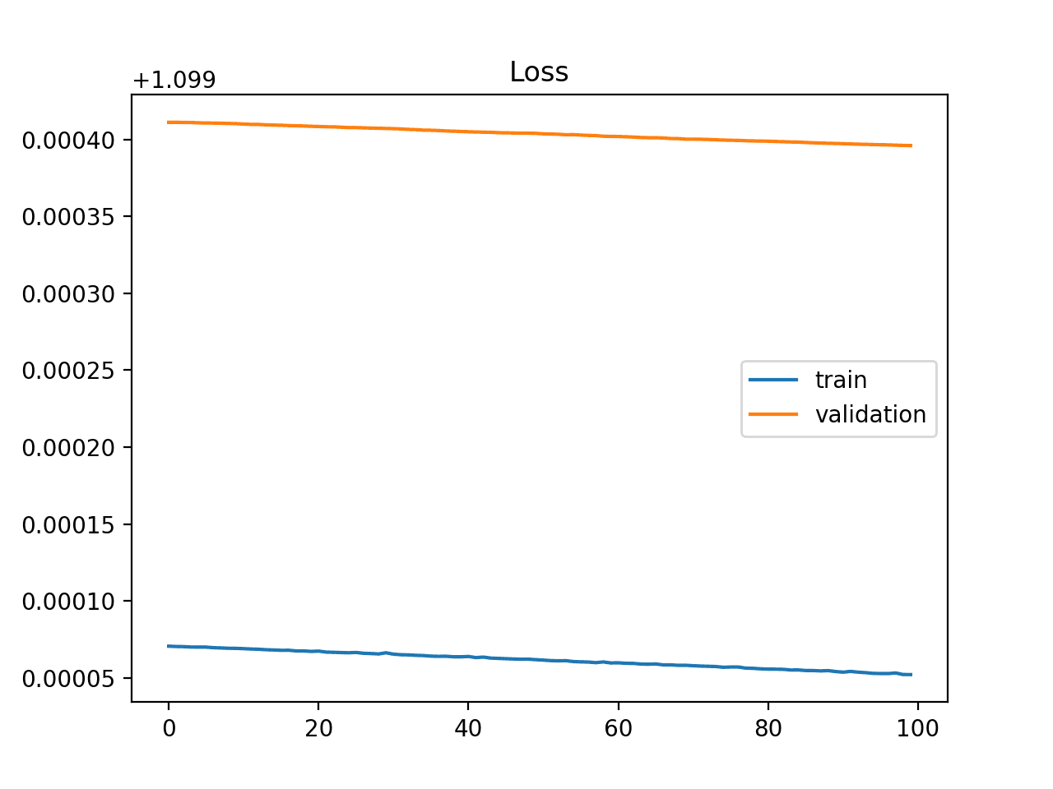
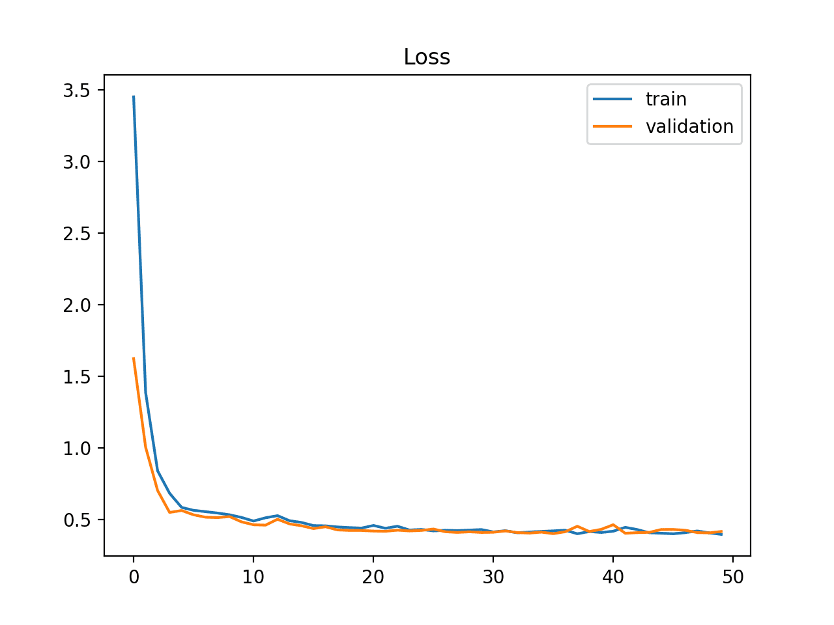
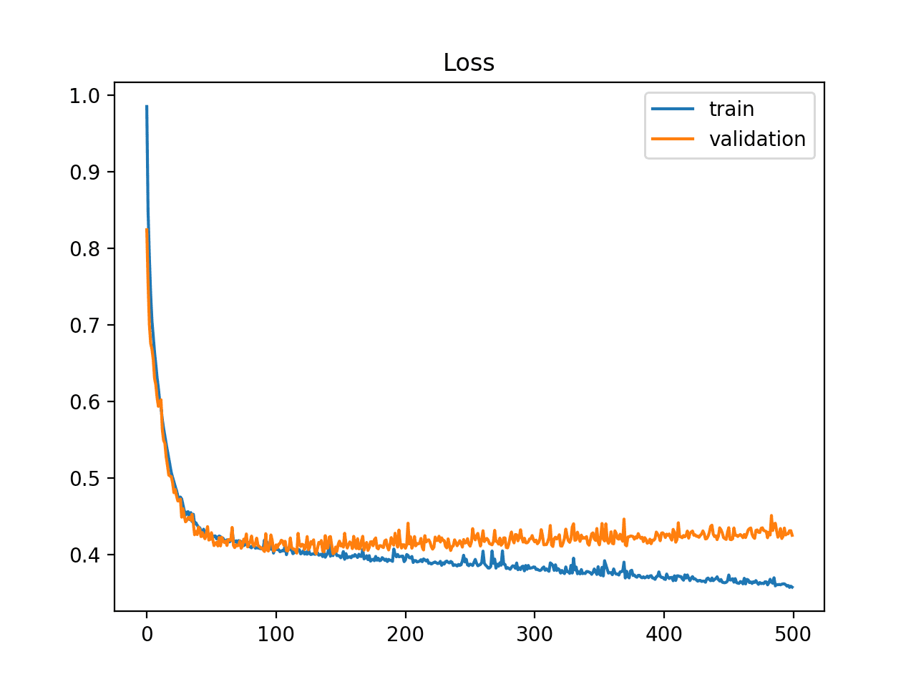
Learning Curves
Optimization Learning Curves
Performance Learning Curves
Underfit
Good Fit
Overfit

Slide 18
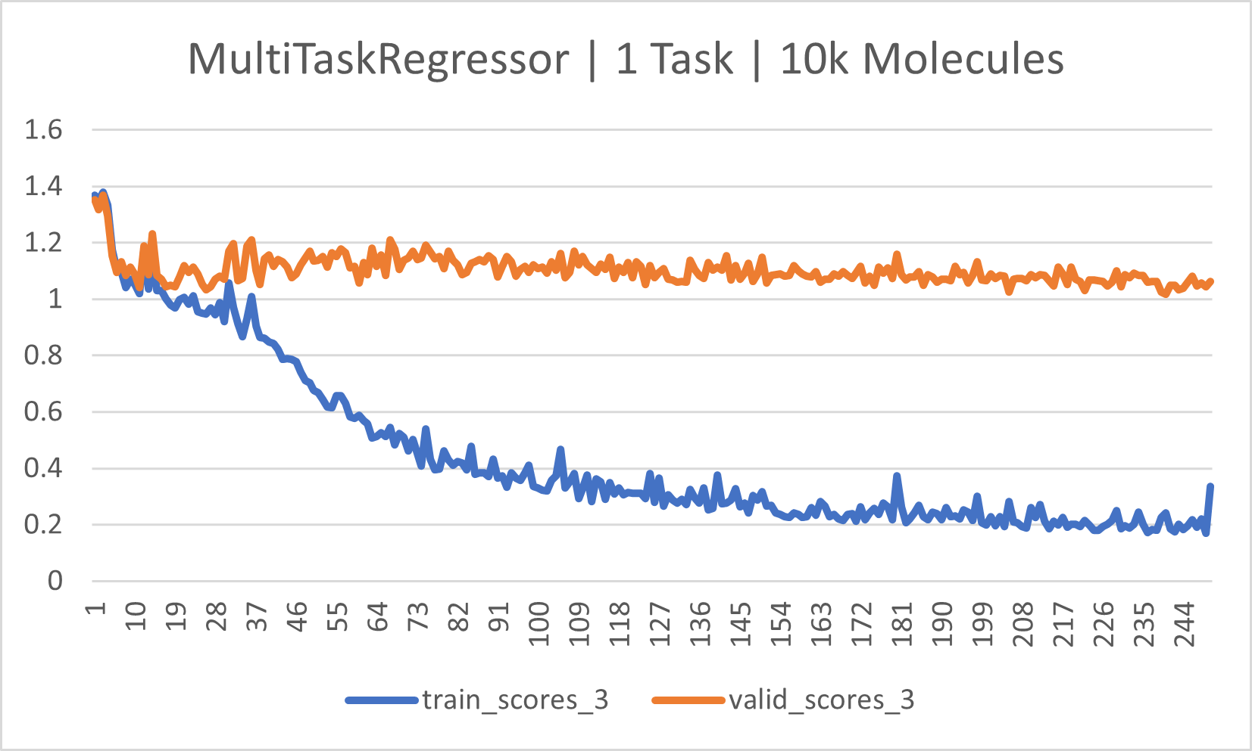
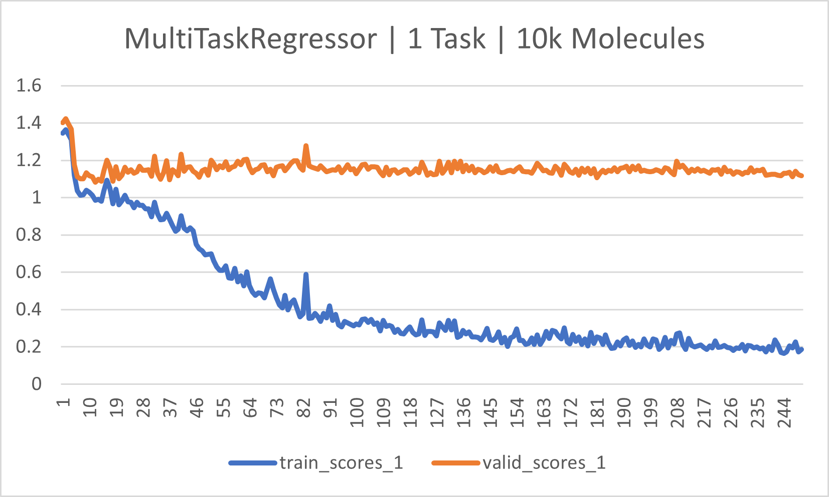
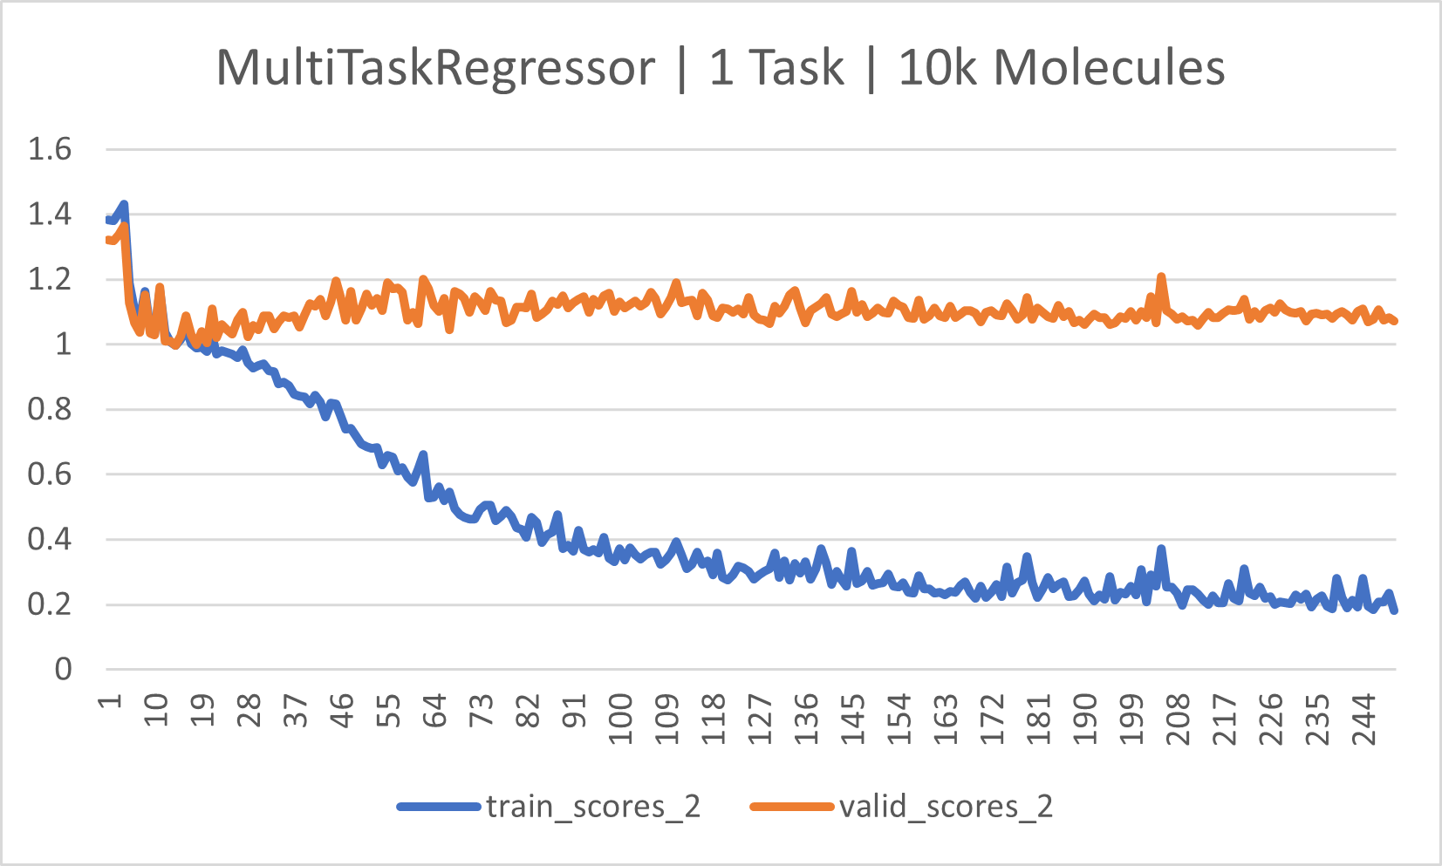
K-fold cross validation
Build K models
High, Low, Average
layer_sizes=[256, 512, 1024], dropouts=0.1,
weight_decay_penalty_type ="l2",
learning_rate=0.0001

Slide 19
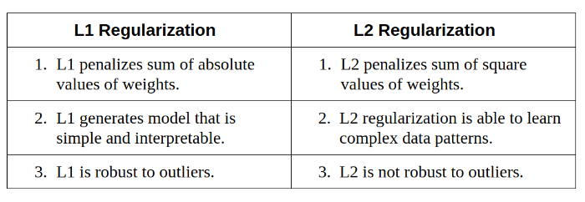
Weight Analysis
Weight penalty functions
Manual analysis

Slide 20

Seeding
Reduce randomness
Replicate results

Slide 21
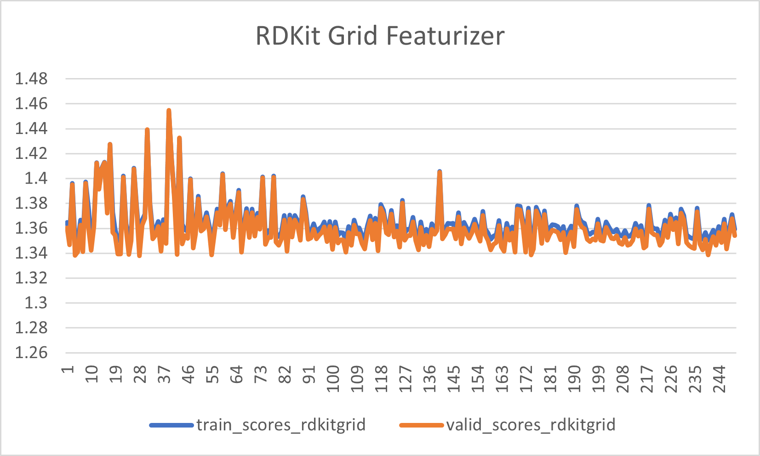
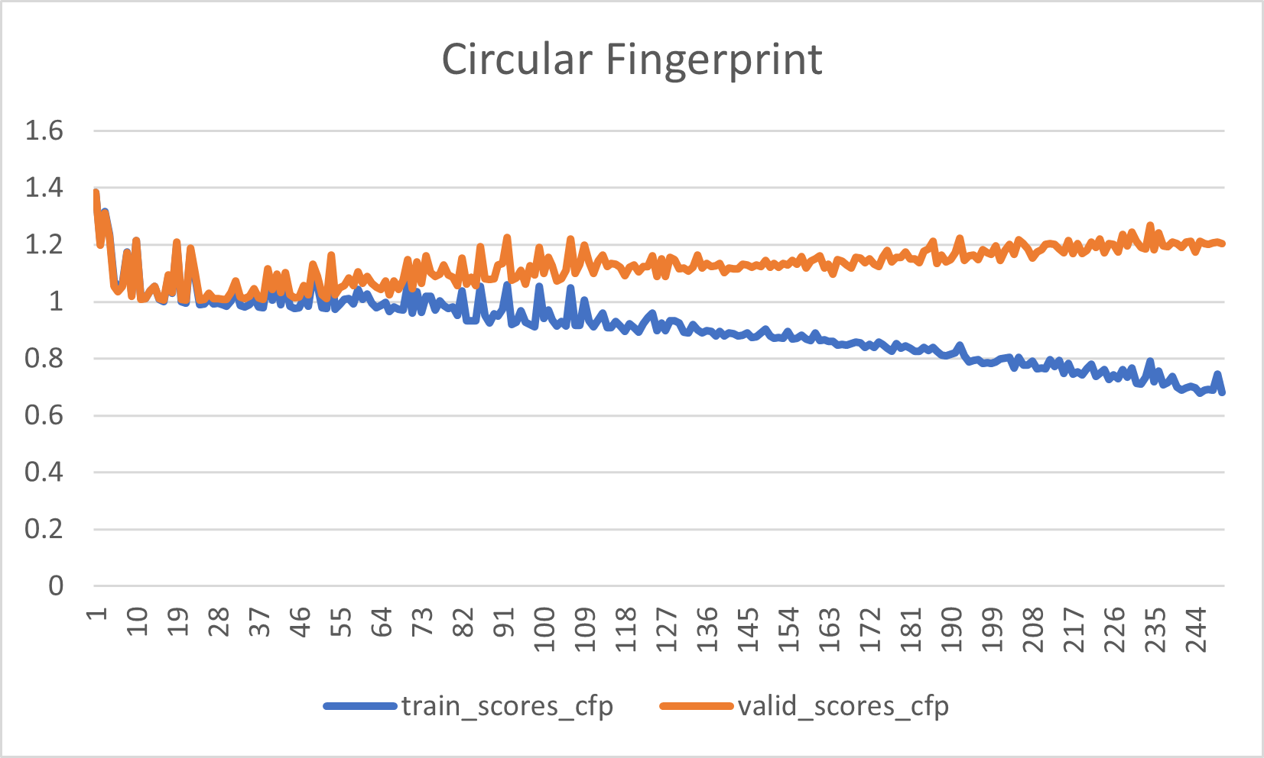
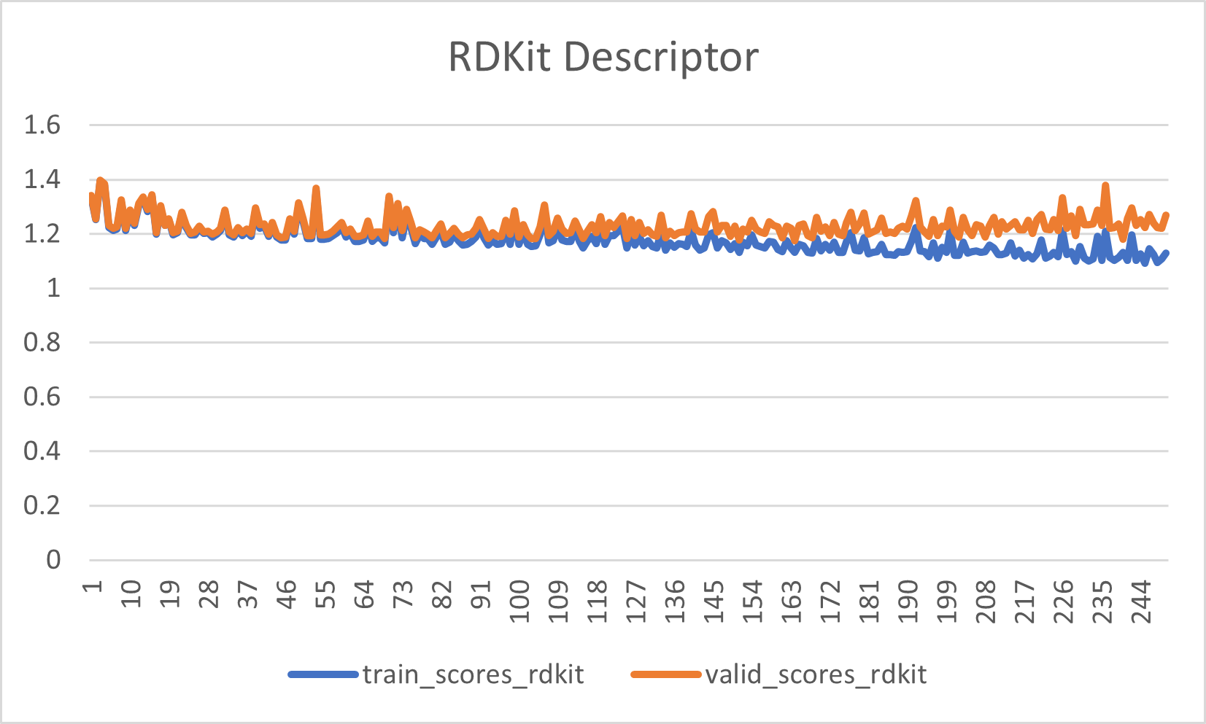
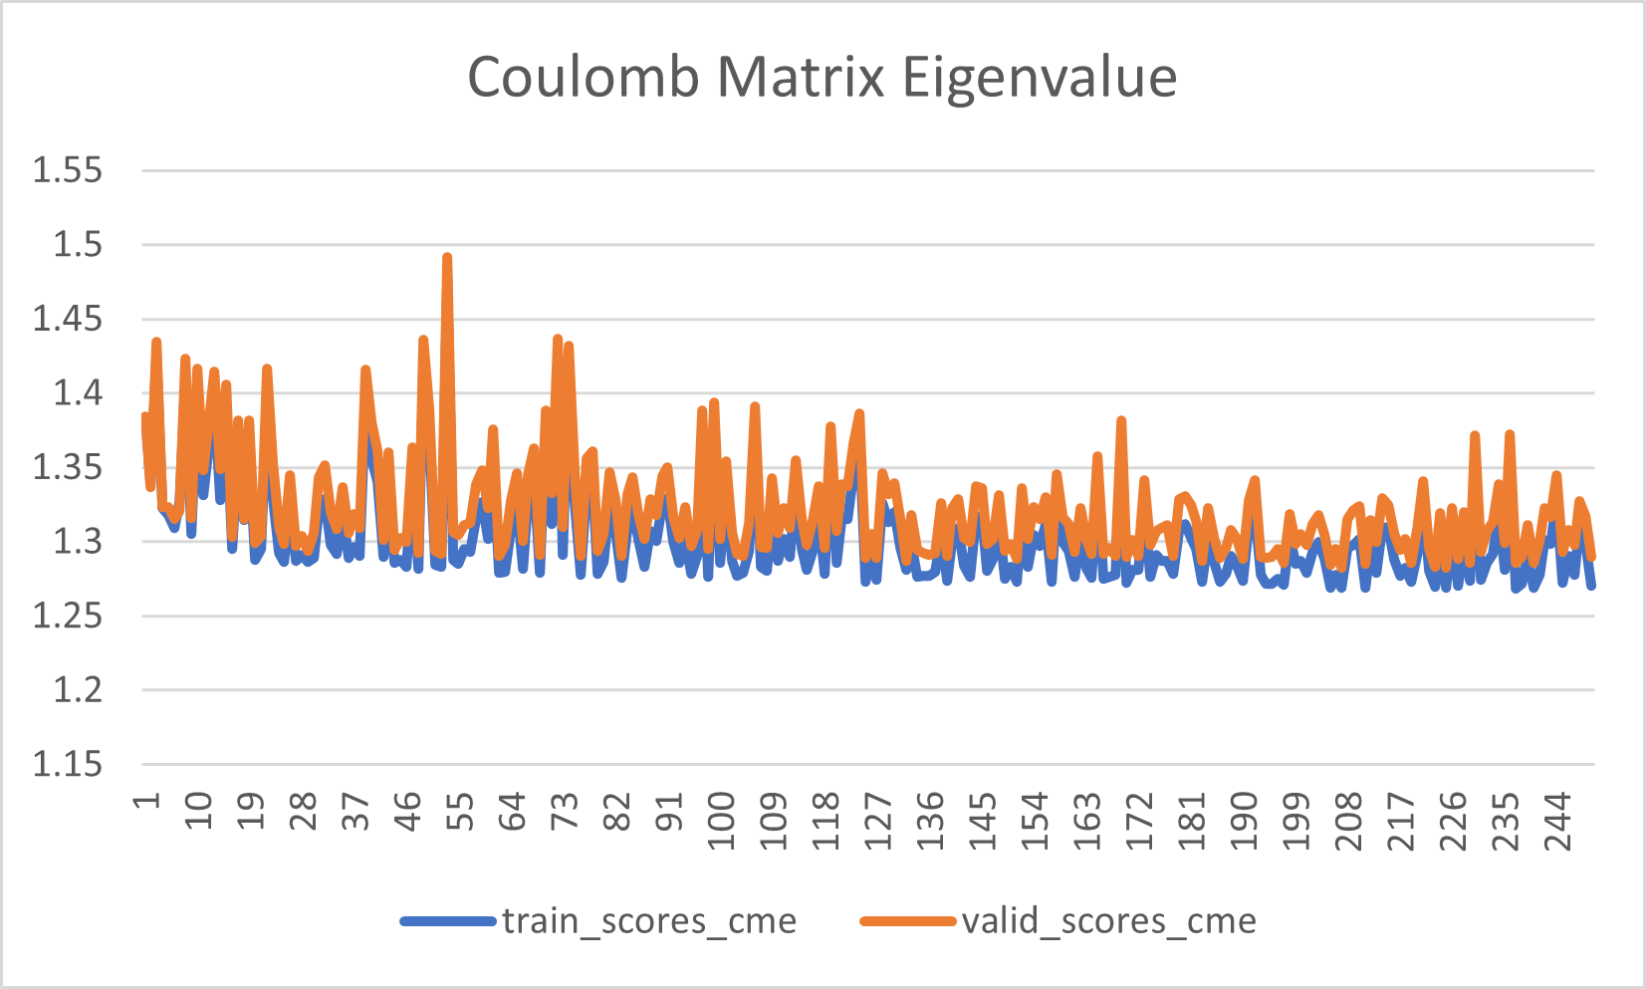
Featurizers Matter
10k molecules
Fixed parameter
Mean absolute error

Slide 22
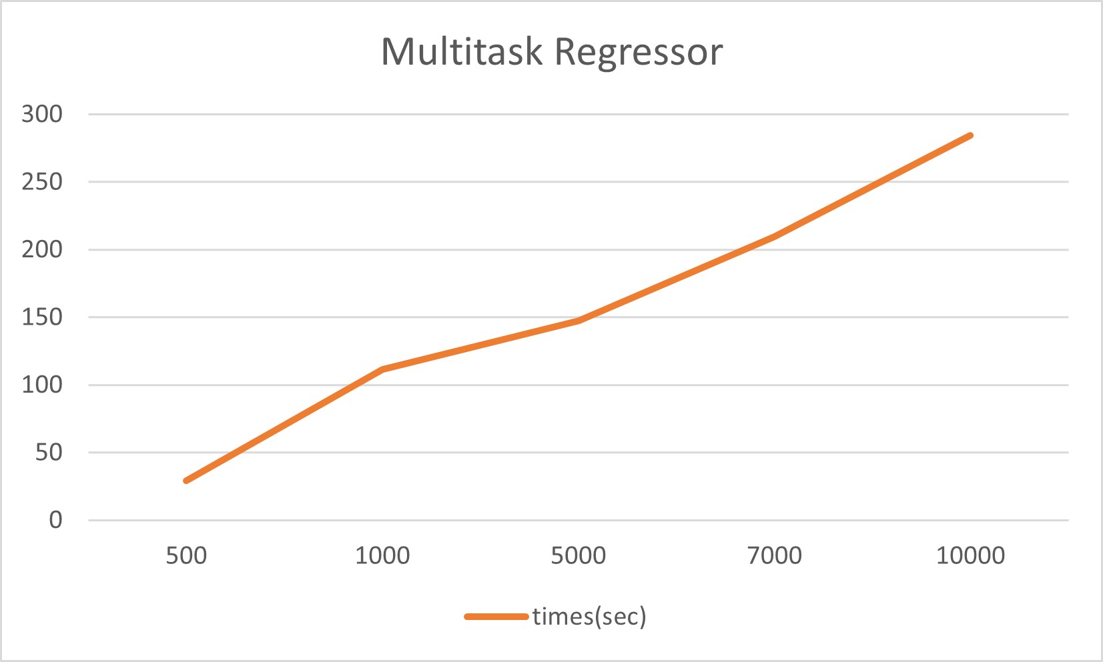
Time Analysis
DTNN
Linear with training epochs
Linearly with number of atoms
Quadratically with dataset size
Multitask Regressor (fixed epoch)
Circular Fingerprint

Slide 23
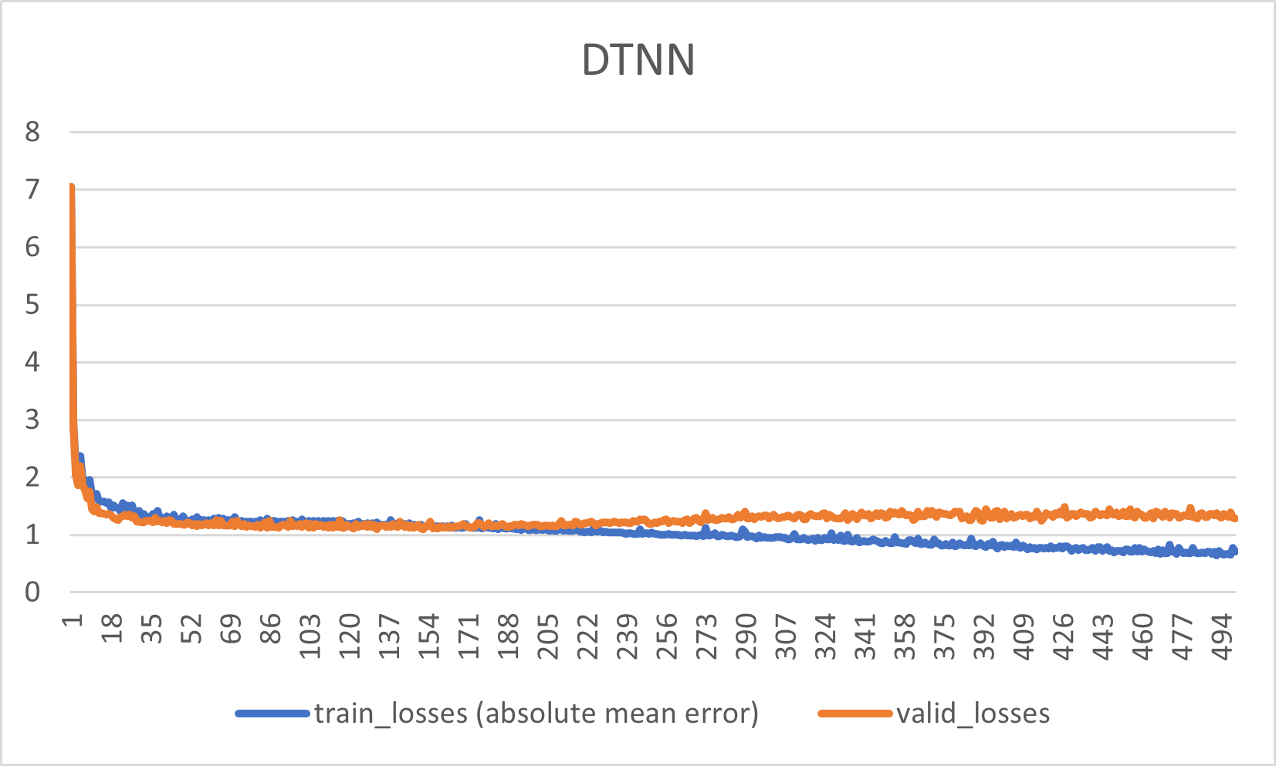
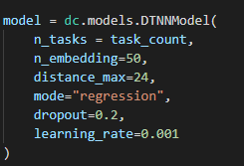
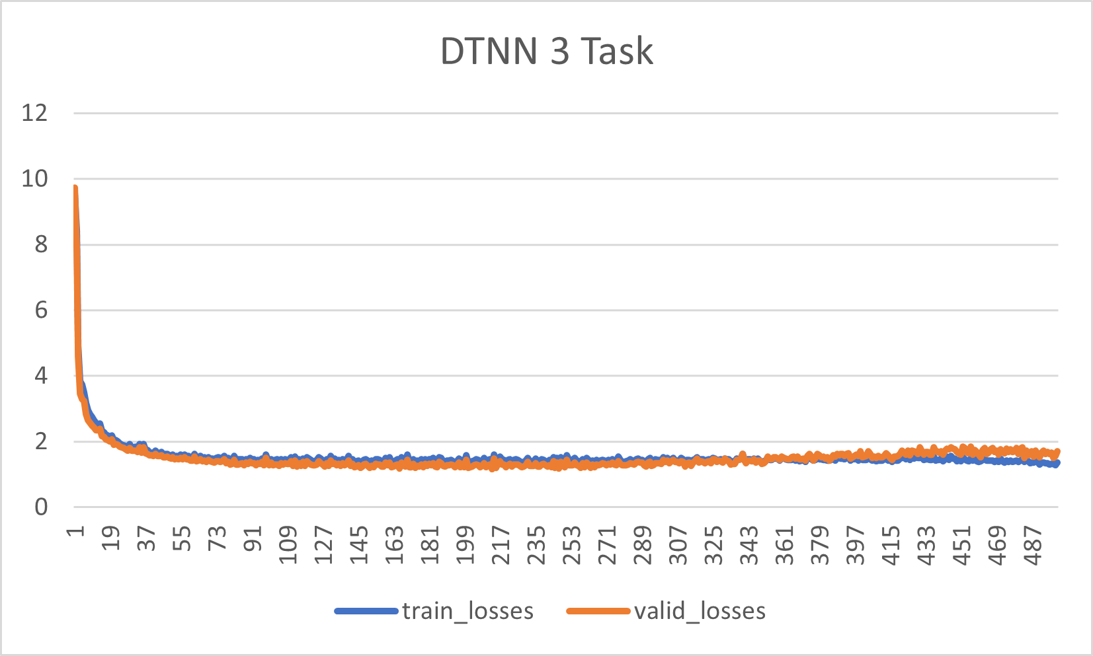
DTNN Learning Curve
Fixed learning rate recommended
1k Molecules

Slide 24
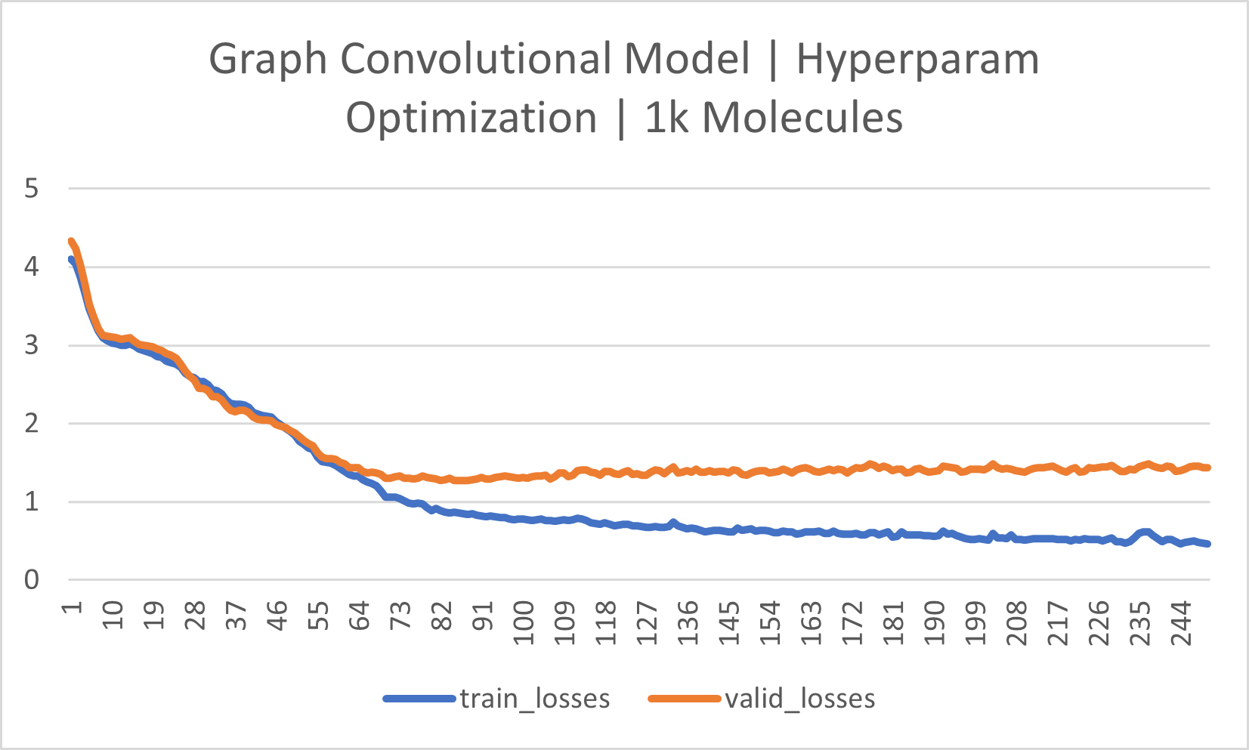
Graph Convolutional Model
Features per atom: 75
Dense layer size: 64
Convolutional Layer Config: [64, 64]
Dropout: 0.5
Learning Rate: 0.0001

Slide 25
Future Goals
Broader hyperparameter optimization
Direct comparison of different models
Expand dataset size to maximum number of molecules
Testing against “unseen” functional groups

Slide 26
Sources
Literature:
STF Manuscript: https://pubs.rsc.org/en/Content/ArticleLanding/2021/SE/D1SE00041A#!divAbstract
Randomness in ML: https://machinelearningmastery.com/randomness-in-machine-learning/
Dropouts: https://machinelearningmastery.com/dropout-for-regularizing-deep-neural-networks/
DTNN Model: https://www.nature.com/articles/ncomms13890#Sec8
Deepchem documentation: https://deepchem.readthedocs.io/en/latest/api_reference/docking.html
Learning rate: https://machinelearningmastery.com/learning-rate-for-deep-learning-neural-networks/
Photos:
https://miro.medium.com/max/578/1*ToPT8jnb5mtnikmiB42hpQ.png
https://static.javatpoint.com/tutorial/machine-learning/images/regression-vs-classification-in-machine-learning.png
https://chembioinfo.files.wordpress.com/2011/10/signature2.jpg
https://chembioinfo.files.wordpress.com/2011/10/signature2.jpg

