Slide 1
Model Statistics Report
Ian McCleary

Slide 2
Format
Hyperparameter Optimization
1k dataset
Same seed
70% train, 15% valid, 15% test
Params
Performance Curves
Per task rms
Per task r2 score
(0-100% correlation)
K Fold Cross Validation
50 epochs
Random Seed
Evaluated on hold-off test set
Per Task:
Mean
High
Low

Slide 3
Multitask Regressor (Standard)
(3, 2048, [64, 128, 256], 0.2, 1e-05)
Hyperparameter Optimizaiton
mean rms:
1.4806055284536939
eiso rms:
2.6431644817176982
riso rms:
1.7044699441360347
vert rms:
0.09418215950734864
mean r2:
-0.040493220463627244
eiso r2:
-0.030621088686842768
riso r2:
-0.08848976929041474
vert r2:
-0.002368803413624221
K fold Cross Validation:
eiso:
6.650632307115754
9.72626246587556
3.358727947338401
riso:
1.81338374285504
2.2418630015170726
1.3956130476727715
vert:
0.09874268570965279
0.13905299086704684
0.06647398040542708

Slide 4
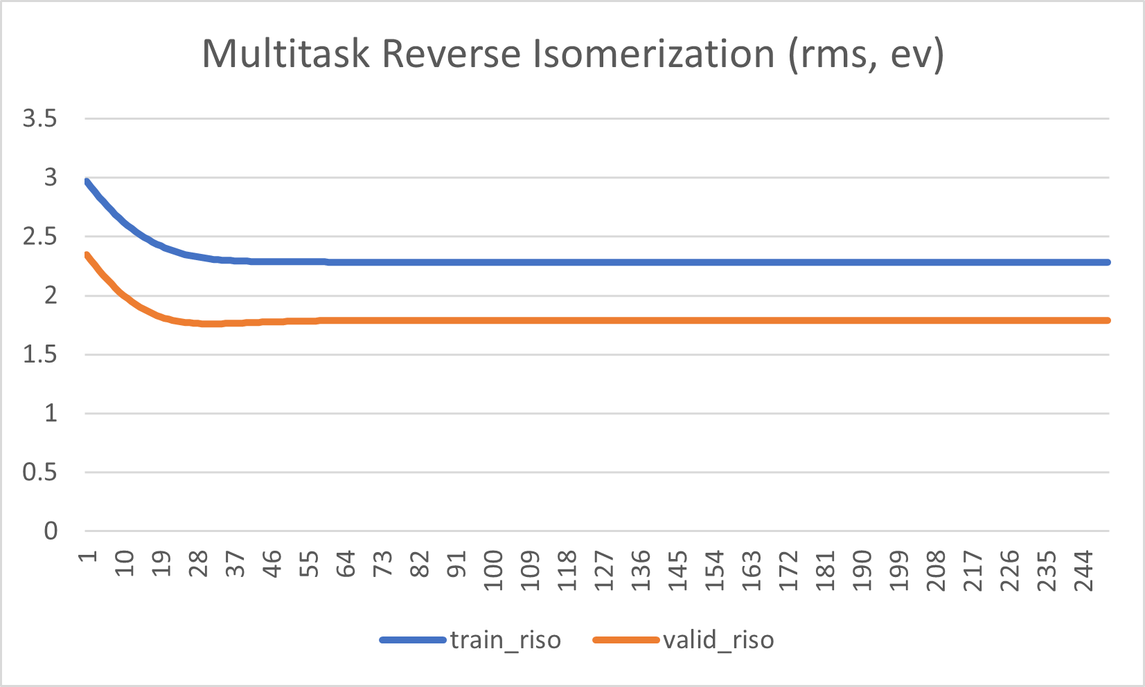
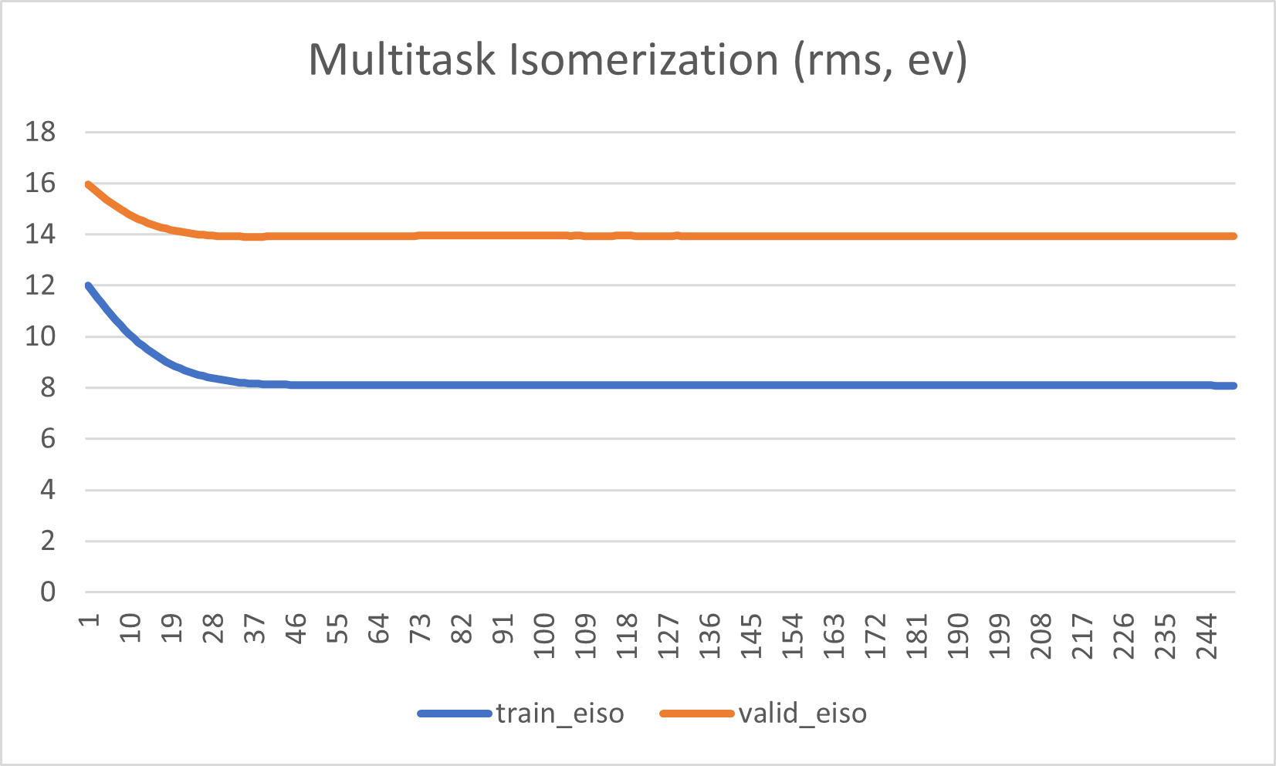
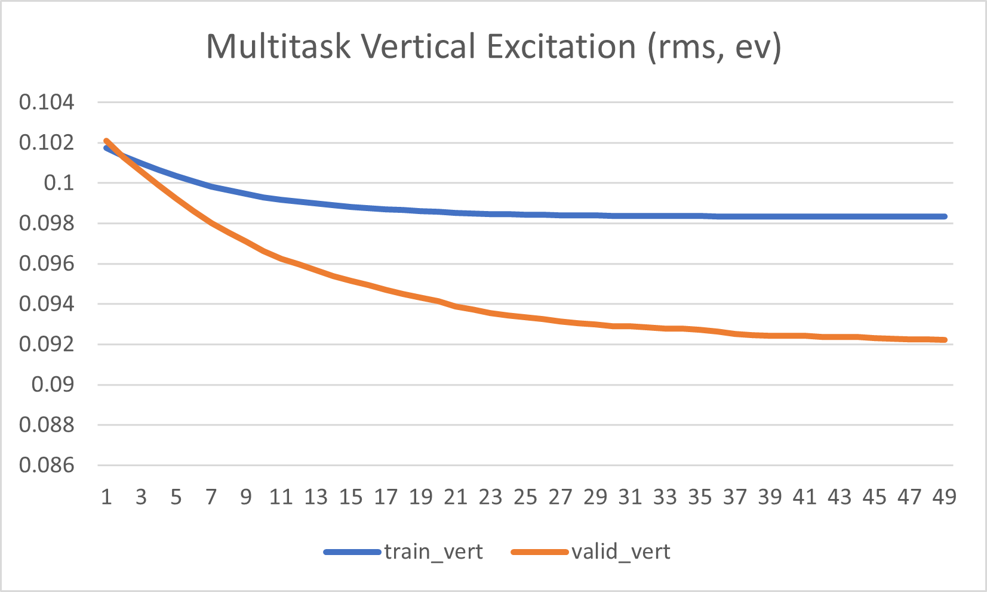
Multitask Regressor (Standard)

Slide 5
Robust Multitask
(3, 2048, [64, 128, 256], 0.02, 0.5, 'l2', 0.75, [20, 20, 20], 0.5, 0.75)
Hyperparameter Tuning
mean rms:
1.4083965241802279
eiso rms:
2.6236098191514987
riso rms:
1.5151559485783093
vert rms:
0.08642380481087583
K fold Cross Validation
Eiso rms:
5.474620748926964
15.179019188073633
2.0539618844661947
Riso rms:
1.029810723211074
1.5309629805582463
0.6856674015166054
Vert rms:
0.04298569844404496
0.059063508604507764
0.030884895127586645
eiso r2:
-0.015428013770883764
riso r2:
0.1398774635266382
vert r2:
0.15597168217249335

Slide 6
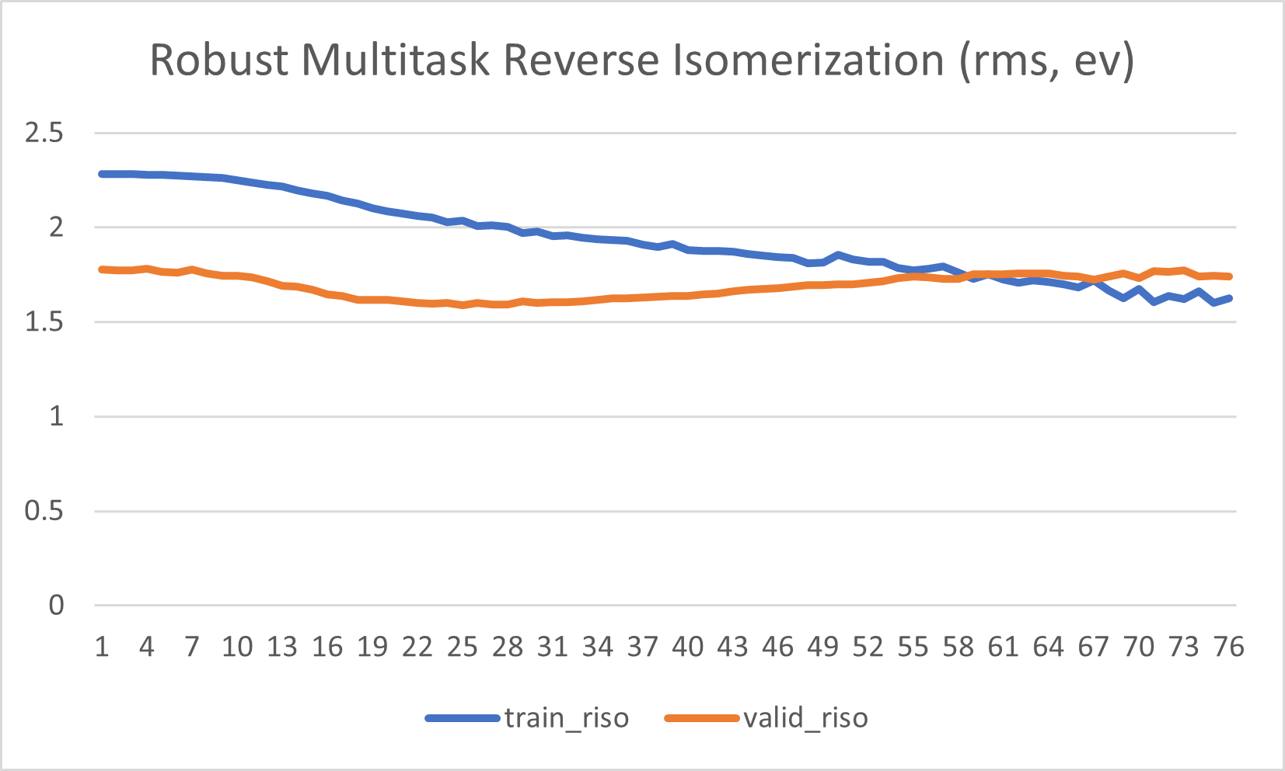
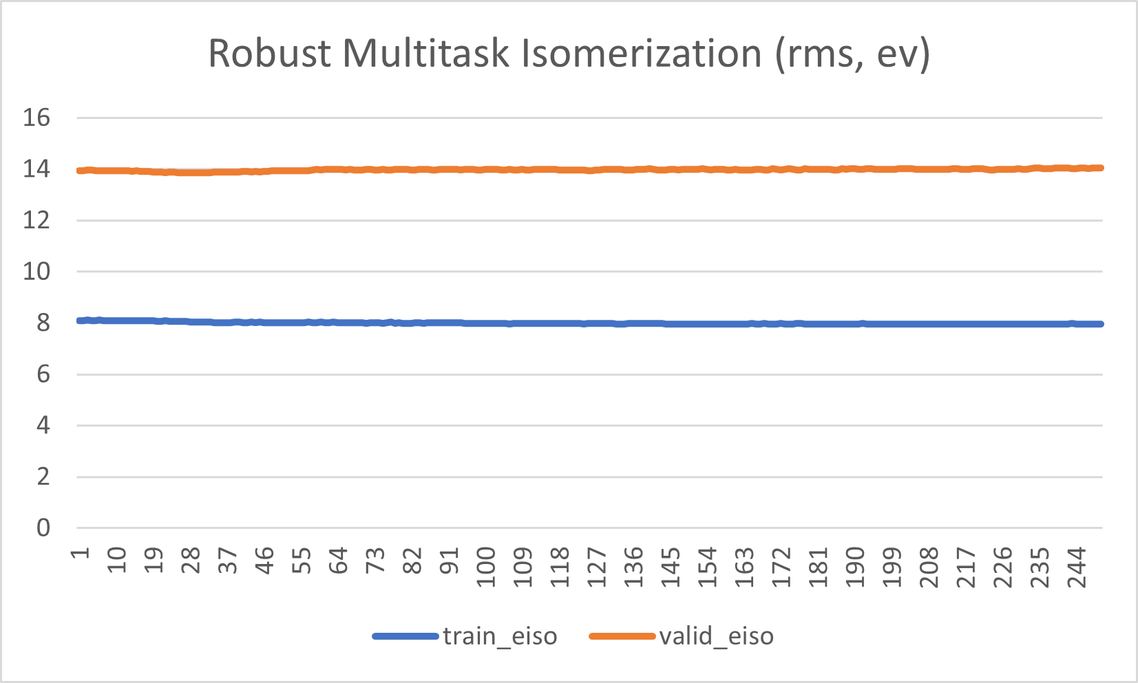
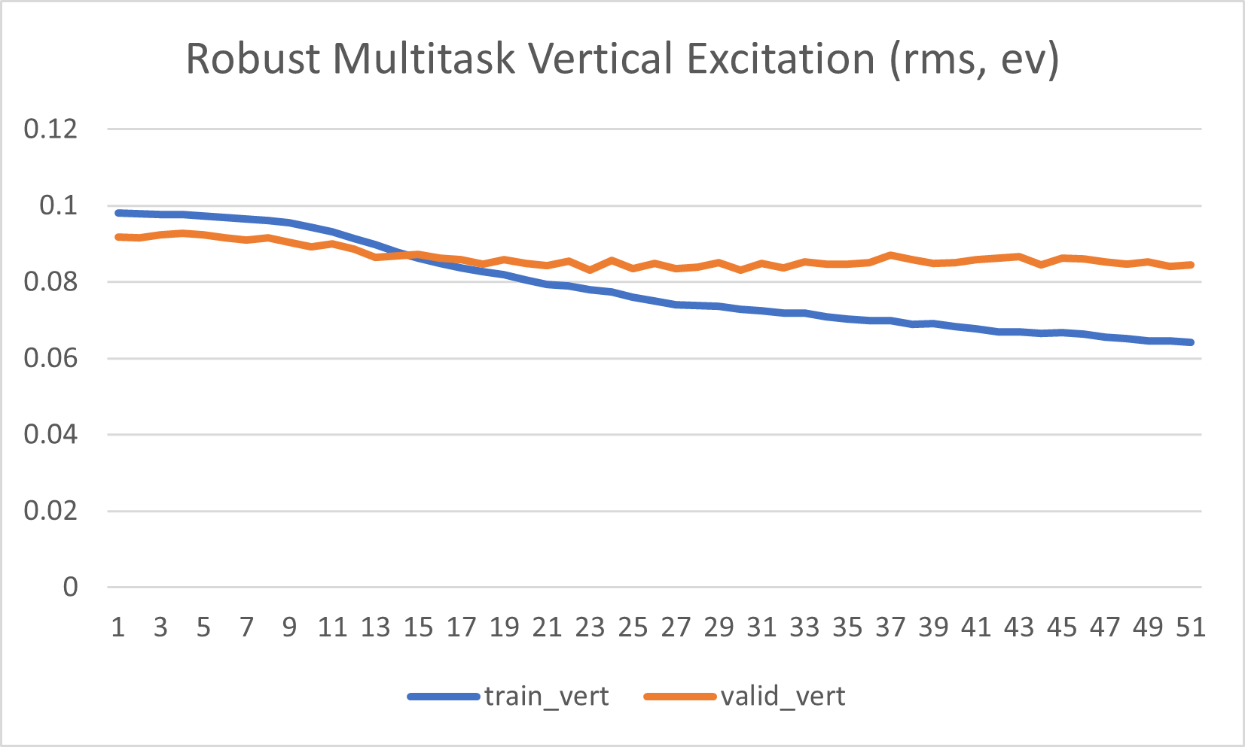
Robust Multitask

Slide 7
Graph Convolution
(3, 75, [64, 64], 128, 0.5, 1e-05, 'regression')
Hyperparameter Tuning
eiso rms:
4.909546980087412
riso rms:
1.7321460795641541
vert rms:
0.09720516309124799
K fold Validation
eiso:
6.177944716663087
12.562190255758589
2.7886980691678547
riso:
1.2411436208818043
2.2874527736031034
0.7759881685053086
vert:
0.057668341981982923
0.09638569020294567
0.038168409232674935
eiso r2:
-2.555768561335377
riso r2:
-0.12412520837124852
vert r2:
-0.06774837679102386

Slide 8
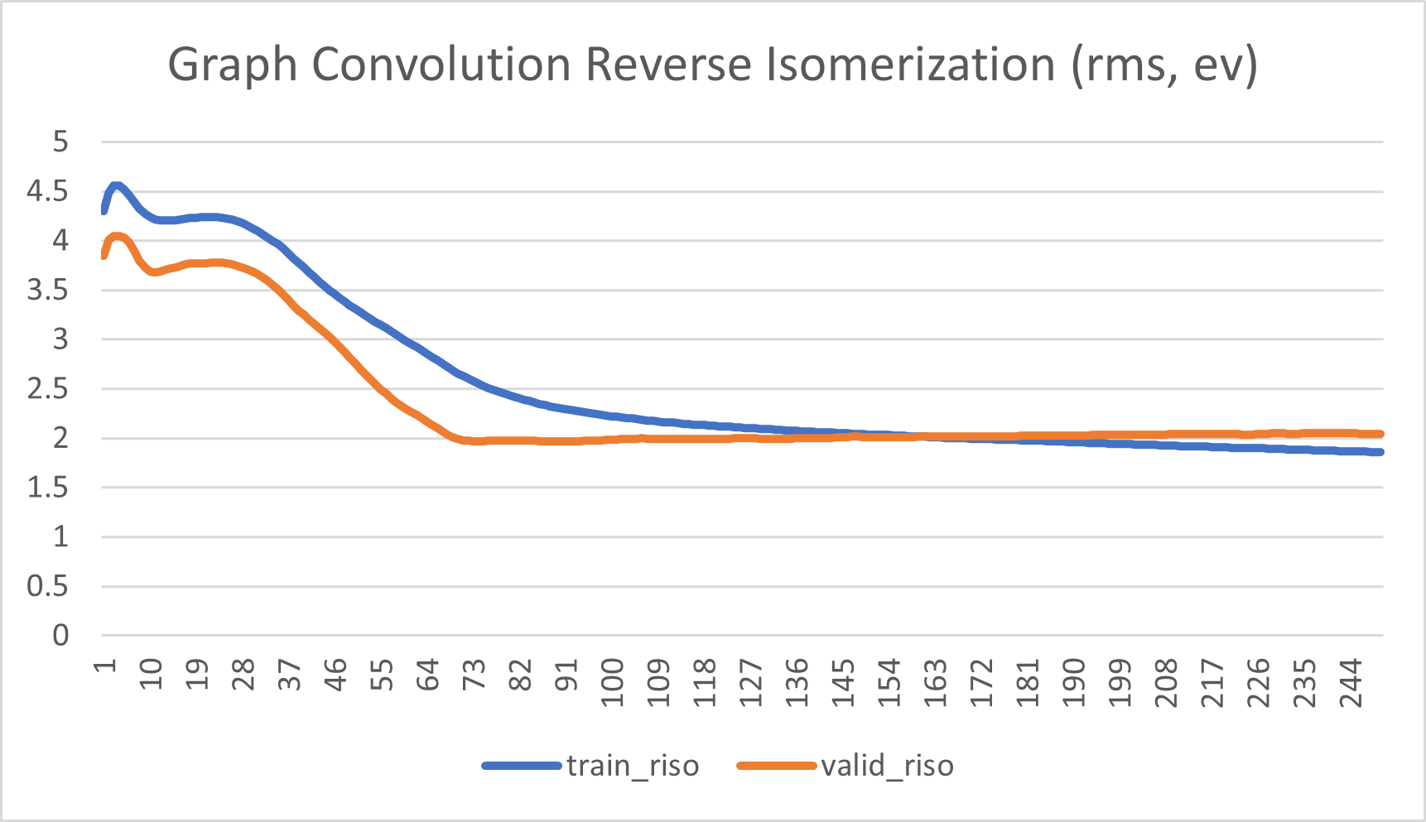
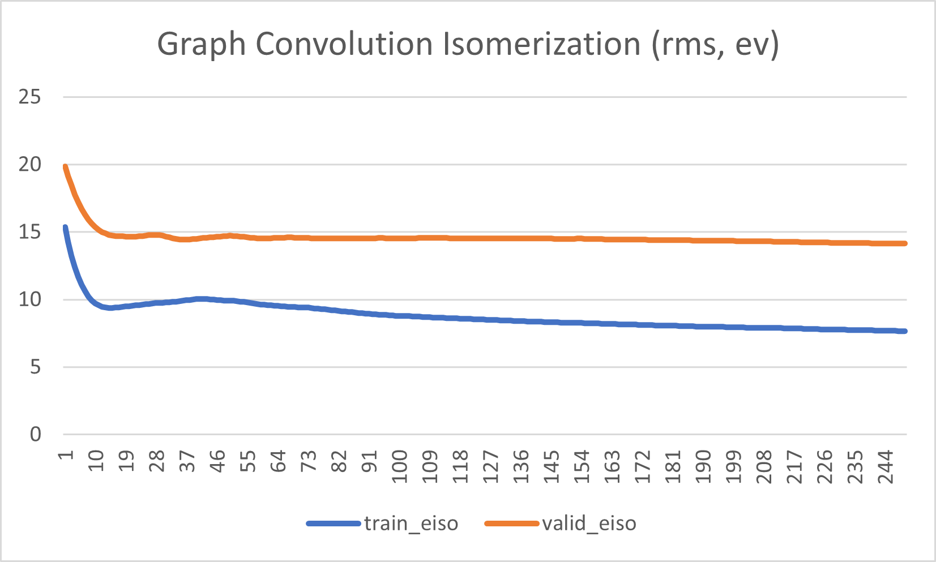
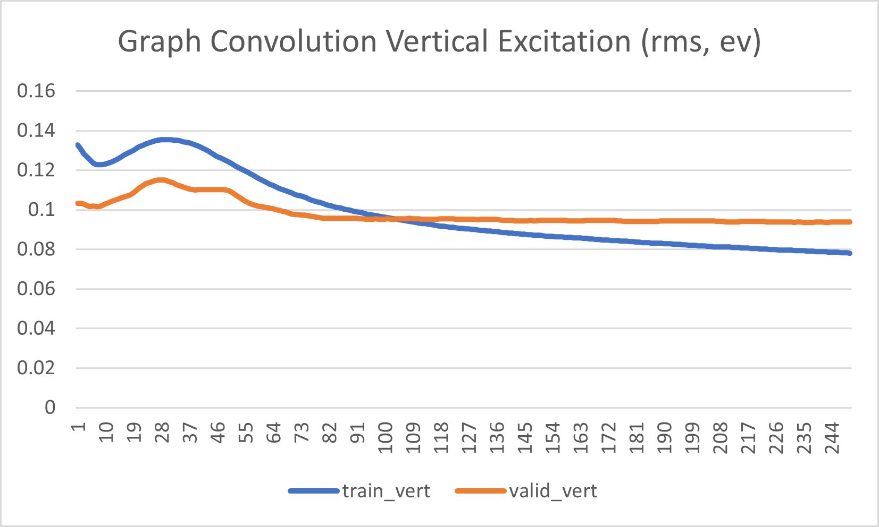
Graph Convolution

Slide 9
Deep Tensor Neural Network
(3, 50, 0.5, 1e-05)
Hyperparameter Optimization
mean rms:
6.152490962369434
eiso rms:
15.123132149372326
riso rms:
3.179177284616241
vert rms:
0.15516345311973226
eiso r2:
-32.73915019768623
riso r2:
-2.786824253229164
vert r2:
-1.7206277634171223
eiso:
8.502388271040594
15.916766283136463
4.140766340608504
riso:
2.112924811844965
3.734417824991303
1.4487933697915936
vert:
0.09457755321829611
0.14113022884079388
0.06577468262238037

Slide 10
Best Model
Robust Multitask Regressor
DTNN?

