Slide 1
Model Statistics Report
Ian McCleary, Summer 2021

Slide 2
Format
Hyperparameter Optimization
1k dataset
Same seed
70% train, 15% valid, 15% test
Params
Performance Curves
Per task rms
Per task r2 score
(0-100% correlation)
K Fold Cross Validation
50 epochs
Random Seed
Evaluated on hold-off test set
Per Task:
Mean
High
Low

Slide 3
Multitask Regressor (Standard)
(3, 2048, [64, 128, 256], 0.2, 1e-05)
Hyperparameter Optimizaiton
mean rms:
1.4806055284536939
eiso rms:
2.6431644817176982
riso rms:
1.7044699441360347
vert rms:
0.09418215950734864
mean r2:
-0.040493220463627244
eiso r2:
-0.030621088686842768
riso r2:
-0.08848976929041474
vert r2:
-0.002368803413624221
K fold Cross Validation:
eiso:
6.650632307115754
9.72626246587556
3.358727947338401
riso:
1.81338374285504
2.2418630015170726
1.3956130476727715
vert:
0.09874268570965279
0.13905299086704684
0.06647398040542708

Slide 4
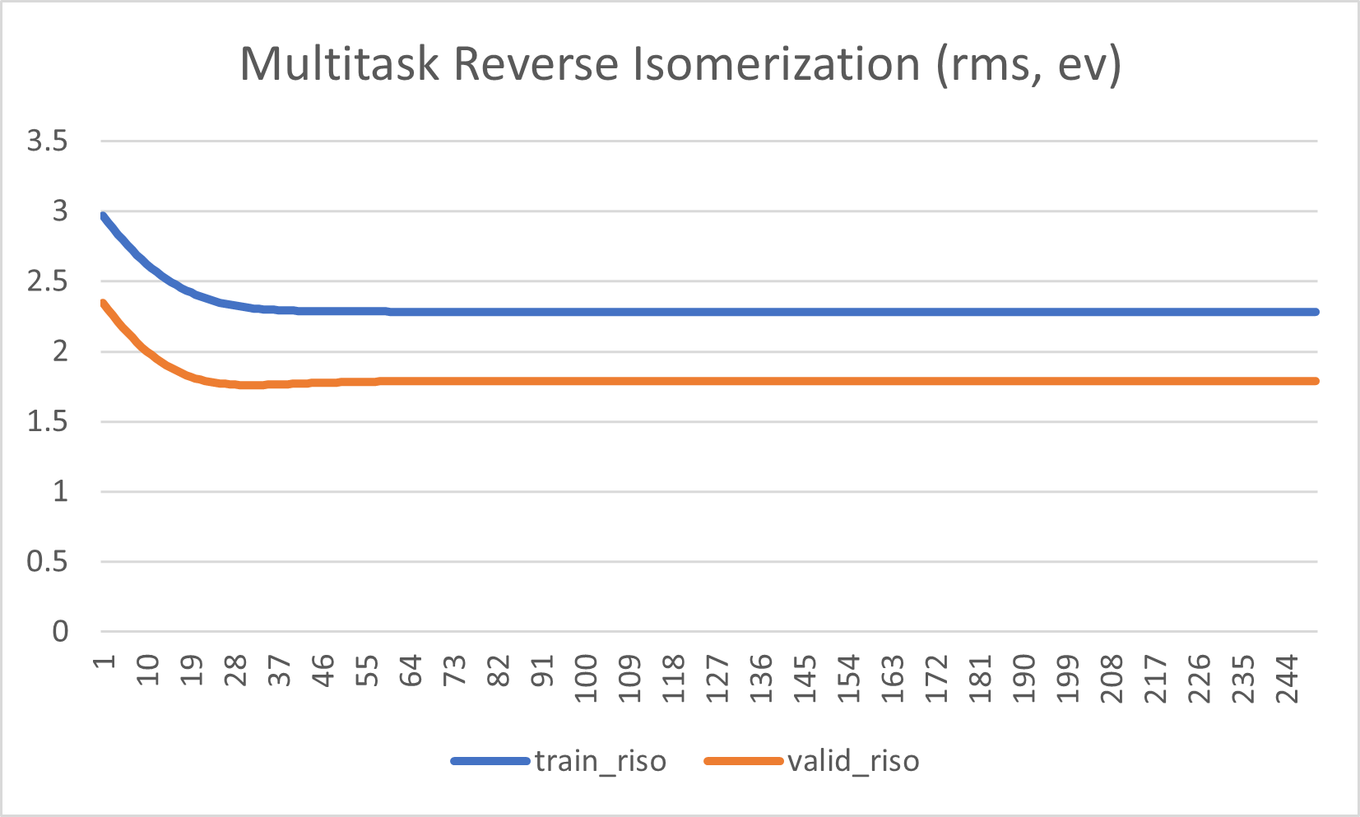
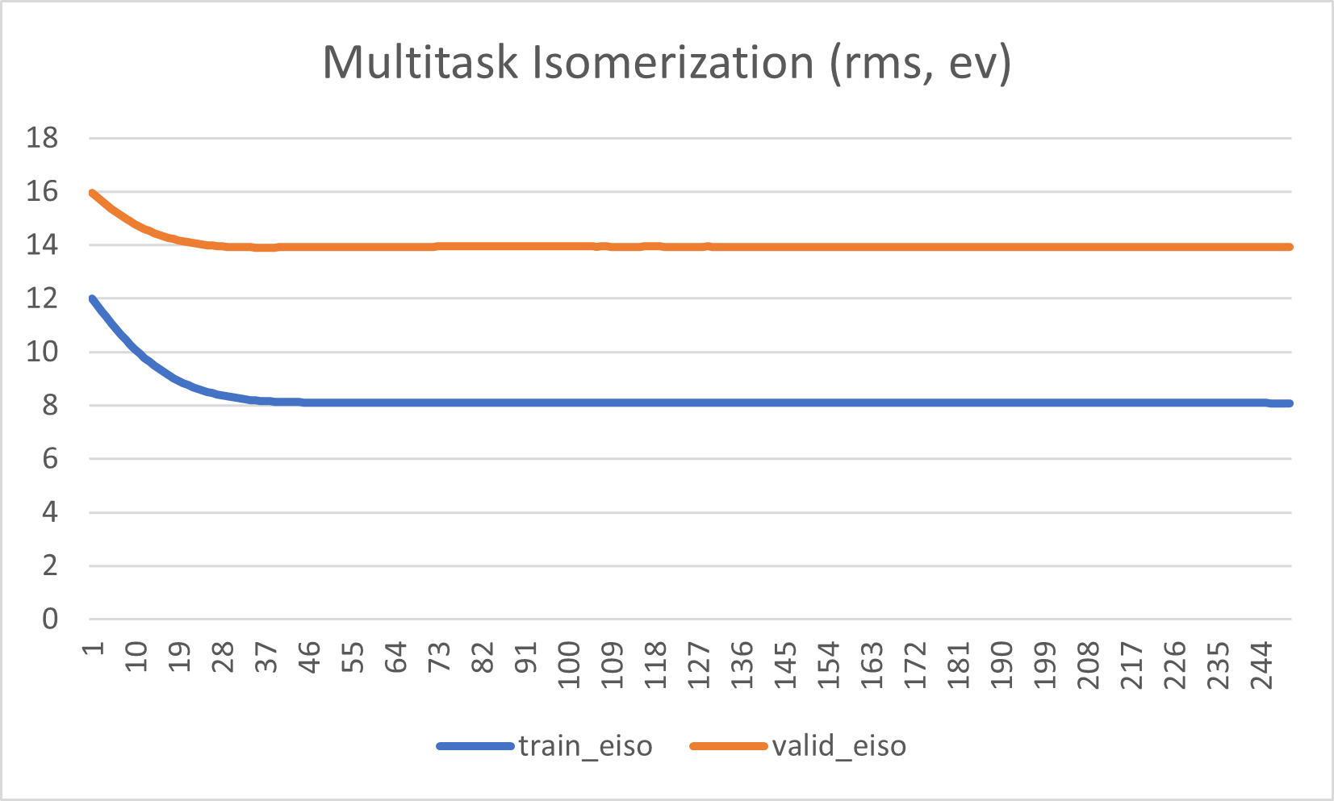
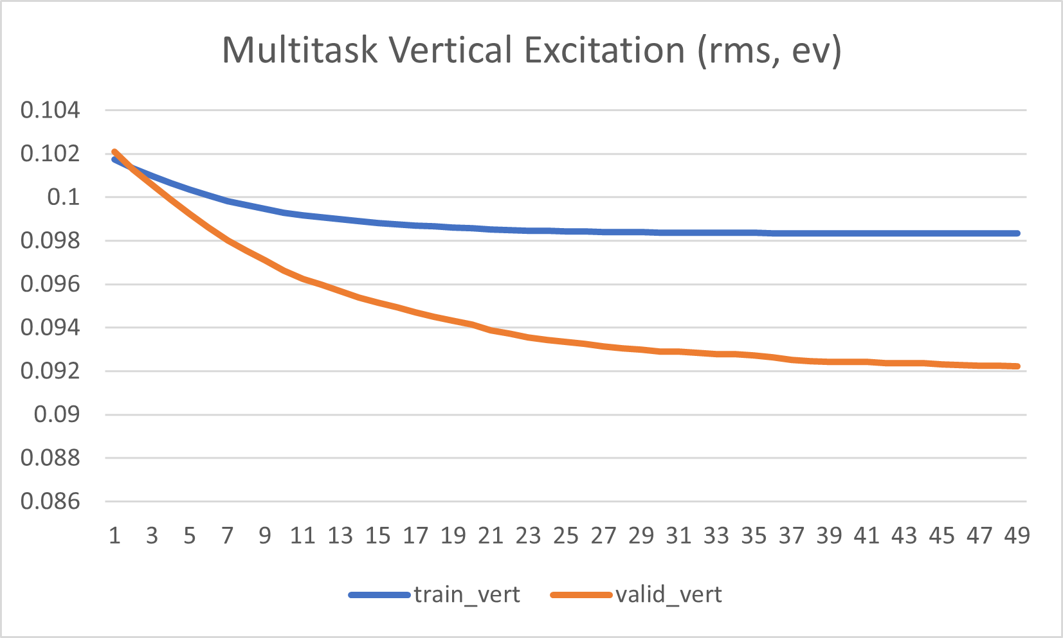
Multitask Regressor (Standard)

Slide 5
Robust Multitask
(3, 2048, [64, 128, 256], 0.02, 0.5, 'l2', 0.75, [20, 20, 20], 0.5, 0.75)
Hyperparameter Tuning
mean rms:
1.4083965241802279
eiso rms:
2.6236098191514987
riso rms:
1.5151559485783093
vert rms:
0.08642380481087583
K fold Cross Validation
Eiso rms:
5.474620748926964
15.179019188073633
2.0539618844661947
Riso rms:
1.029810723211074
1.5309629805582463
0.6856674015166054
Vert rms:
0.04298569844404496
0.059063508604507764
0.030884895127586645
eiso r2:
-0.015428013770883764
riso r2:
0.1398774635266382
vert r2:
0.15597168217249335

Slide 6
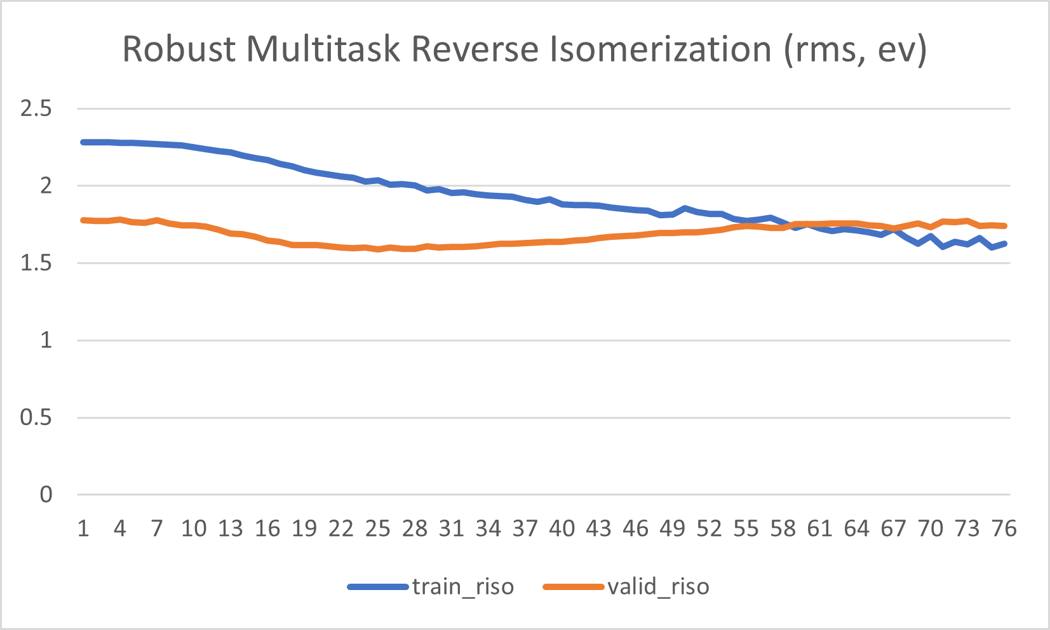
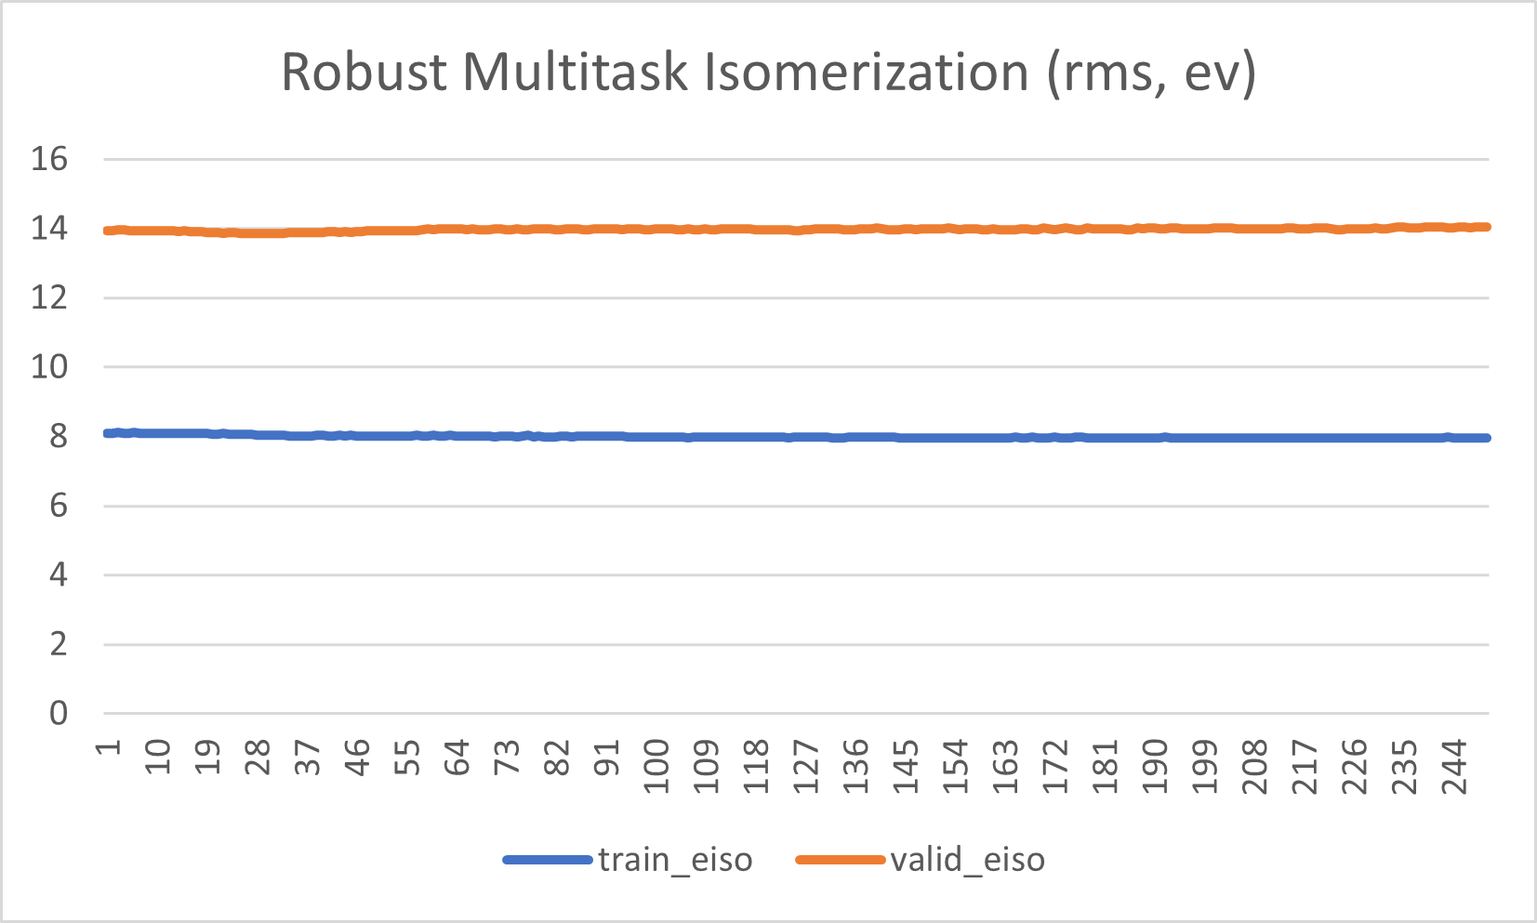
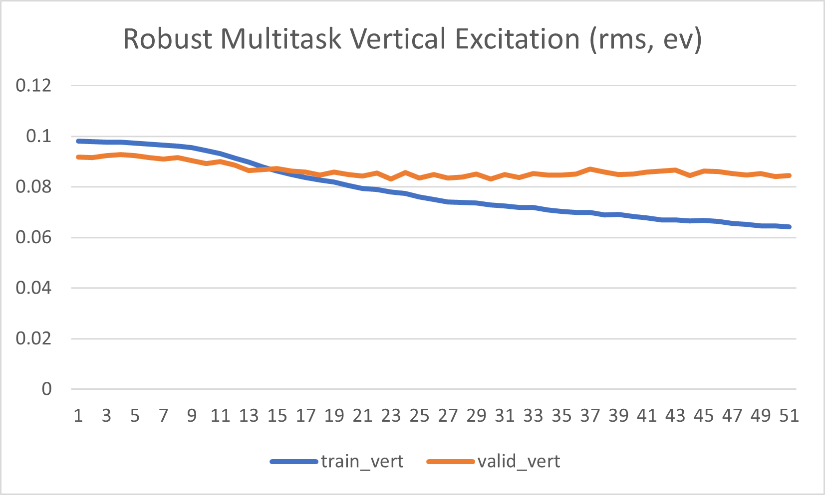
Robust Multitask

Slide 7
Graph Convolution
(3, 75, [64, 64], 128, 0.5, 1e-05, 'regression')
Hyperparameter Tuning
eiso rms:
4.909546980087412
riso rms:
1.7321460795641541
vert rms:
0.09720516309124799
K fold Validation
eiso:
6.177944716663087
12.562190255758589
2.7886980691678547
riso:
1.2411436208818043
2.2874527736031034
0.7759881685053086
vert:
0.057668341981982923
0.09638569020294567
0.038168409232674935
eiso r2:
-2.555768561335377
riso r2:
-0.12412520837124852
vert r2:
-0.06774837679102386

Slide 8
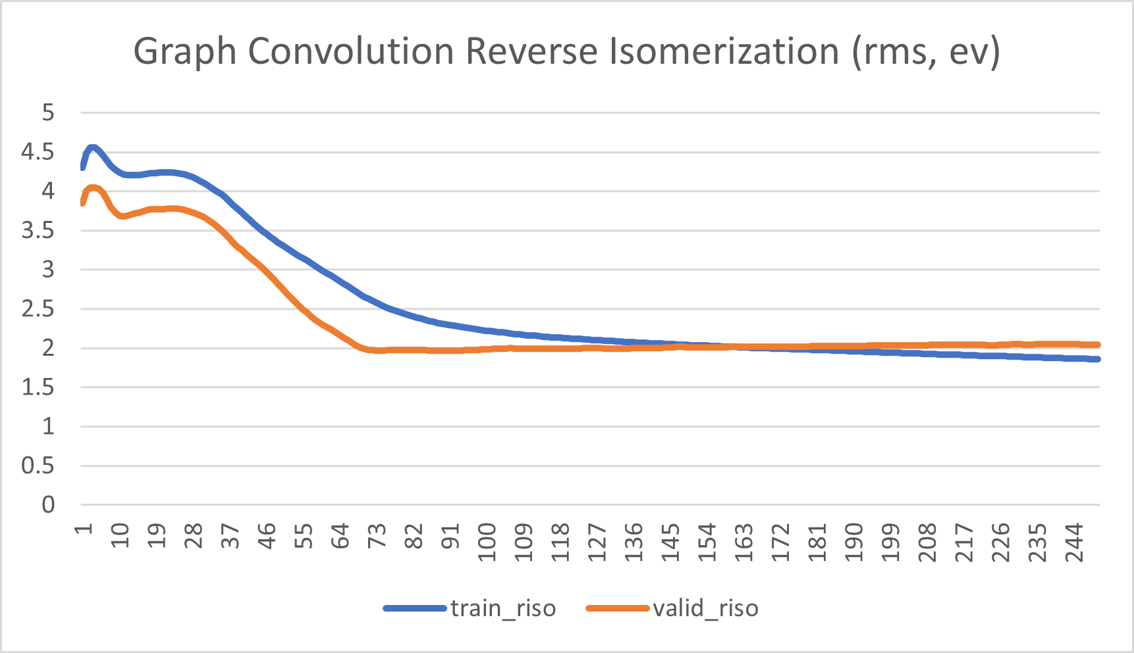
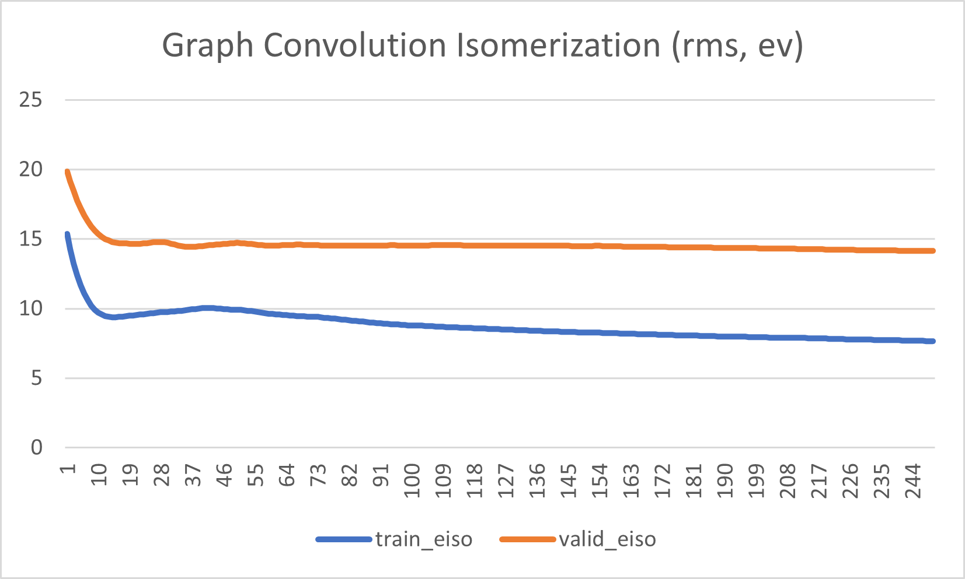
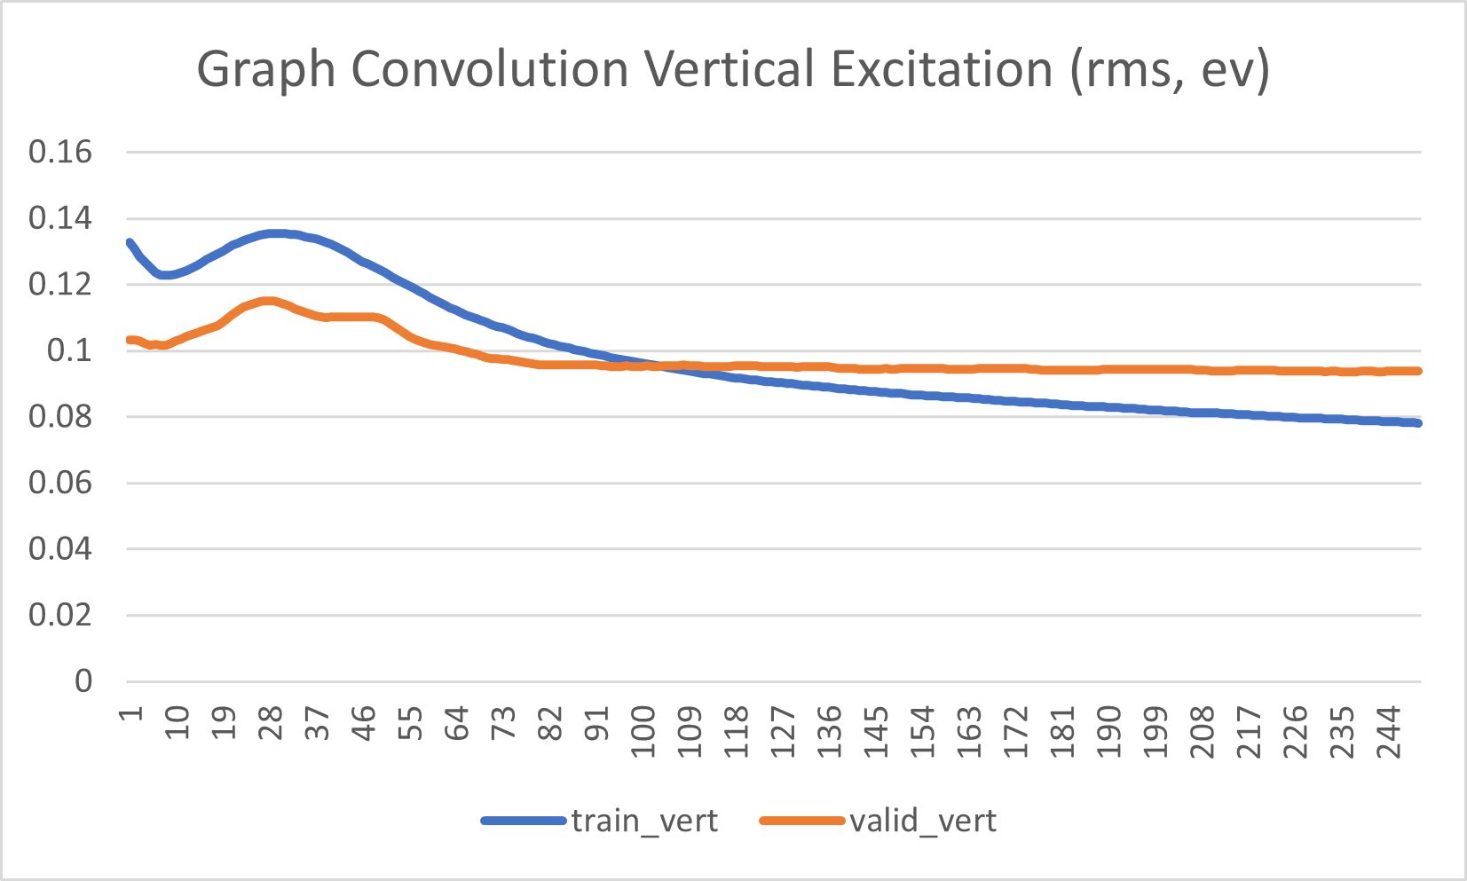
Graph Convolution

Slide 9
Deep Tensor Neural Network (DTNN)
(3, 50, 0.5, 1e-05)
Hyperparameter Optimization
mean rms:
6.152490962369434
eiso rms:
15.123132149372326
riso rms:
3.179177284616241
vert rms:
0.15516345311973226
eiso r2:
-32.73915019768623
riso r2:
-2.786824253229164
vert r2:
-1.7206277634171223
eiso:
8.502388271040594
15.916766283136463
4.140766340608504
riso:
2.112924811844965
3.734417824991303
1.4487933697915936
vert:
0.09457755321829611
0.14113022884079388
0.06577468262238037

Slide 10
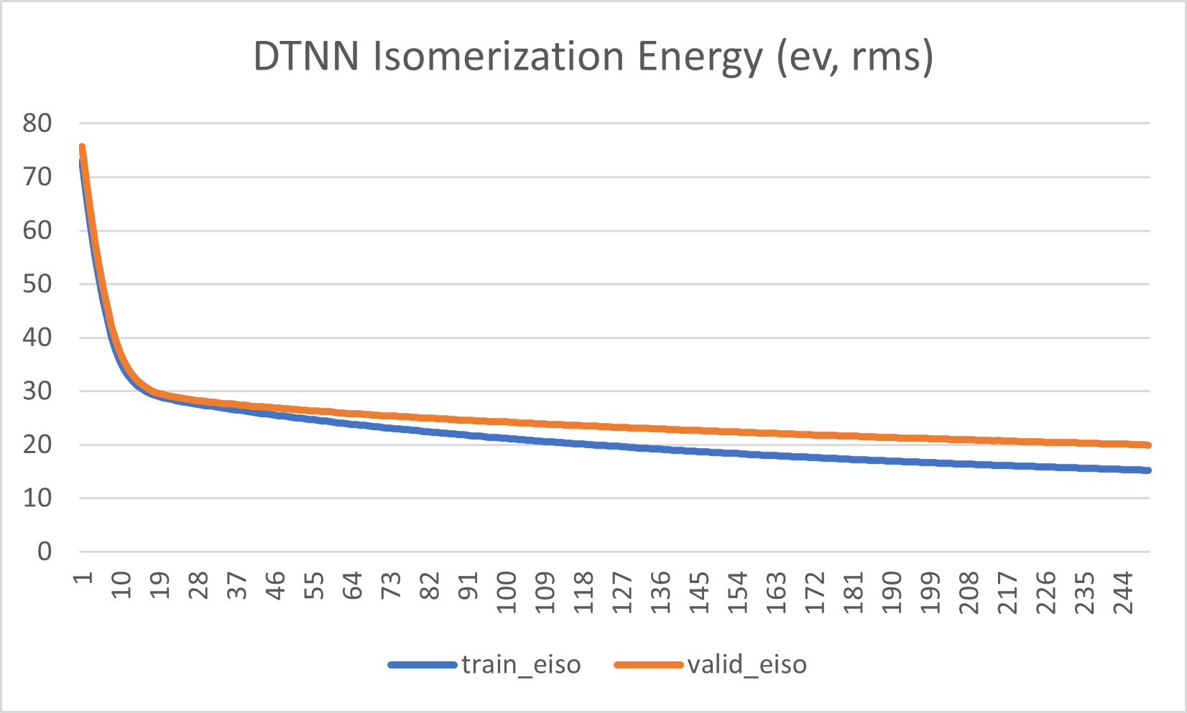
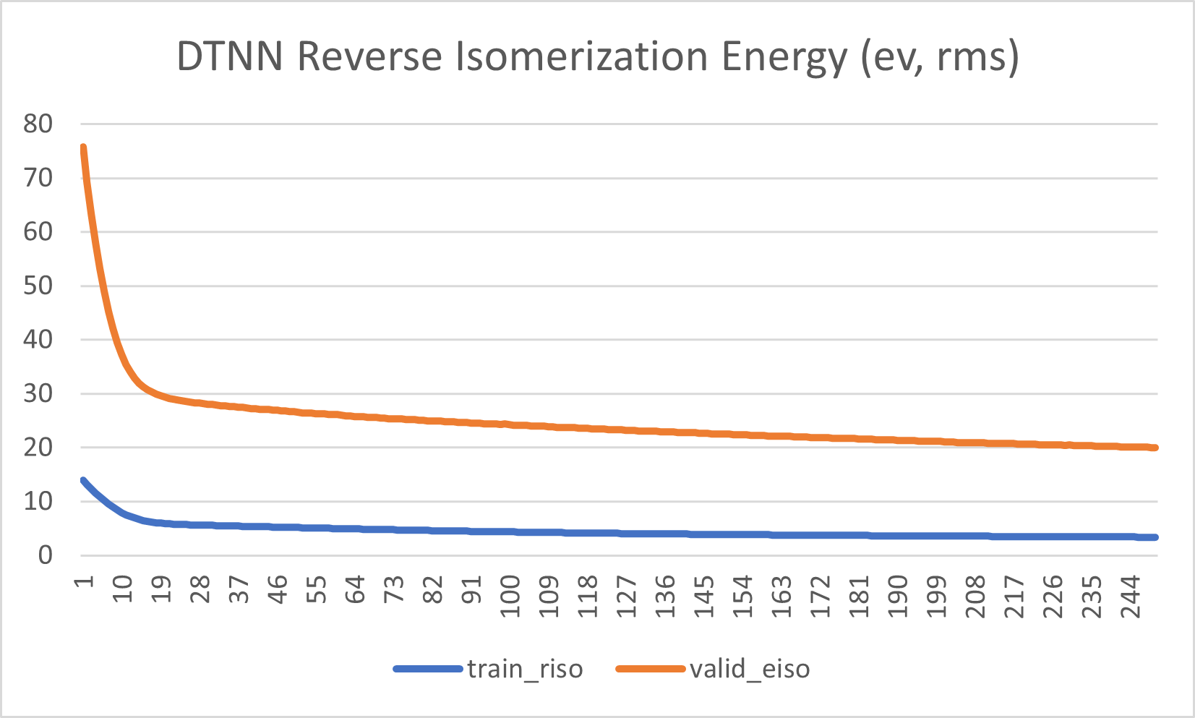
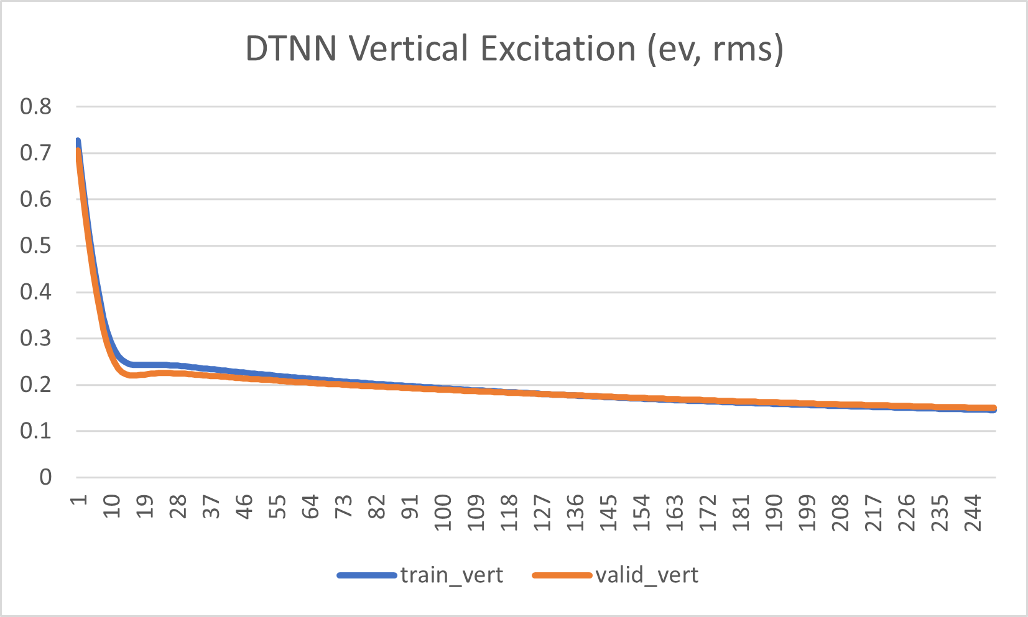
Deep Tensor Neural Network (DTNN)
Charts indicate that DTNN could benefit from more training epochs than other models.
50 epochs for K fold validation may not be enough training time.

Slide 11
Filtered Isomerization Energies
1k molecule dataset
Same tests, but filtered out negative isomerization energies
Hyperparameters may change during optimization

Slide 12
Multitask Regressor (Standard)
eiso r2:
0.0032425817974257587
riso r2:
-0.0017141308740074024
vert r2:
-0.006408986679876216
eiso:
7.358480187127993
14.183400760271924
2.27604825162993
riso:
1.1285673738589828
1.5450164582216586
0.910449279464517
vert:
0.07066552914981139
0.09955240848352048
0.05122999973198592
(3, 2048, [64, 128, 256], 0.2, 1e-05)
mean rms:
3.8019005692379366
eiso rms:
9.913886704058203
riso rms:
1.4154348448156524
vert rms:
0.07638015883995232

Slide 13
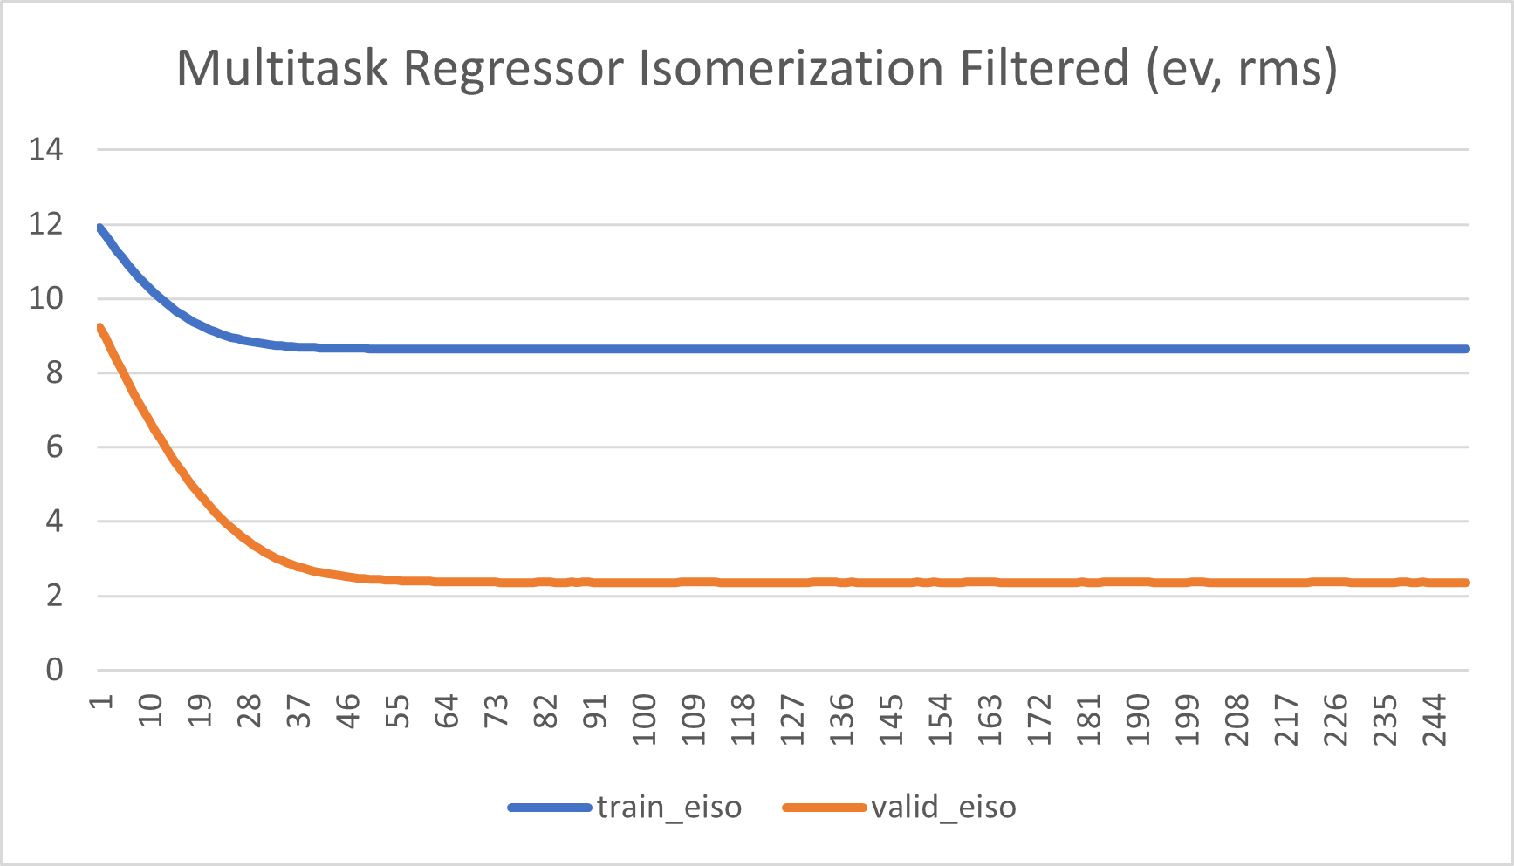
Multitask Regressor (Standard)

Slide 14
Robust Multitask Regressor
eiso r2:
0.09135338757346556
riso r2:
0.14285792446640855
vert r2:
0.1741533243779907
eiso:
0.9559072063382381
9.516167170108234
0.29702381138799
riso:
0.23565476825927129
0.7182611438628266
0.06979395011621882
vert:
0.00836522952677163
0.0396715622443771
0.0040378318814695835
(3, 2048, [500, 500, 500], 0.02, 0.5, 'l2', 0.25, [10, 10, 10], 0.5, 0.75)
mean rms:
3.614691516879612
eiso rms:
9.465568857692647
riso rms:
1.309315742974285
vert rms:
0.06918994997190568

Slide 15
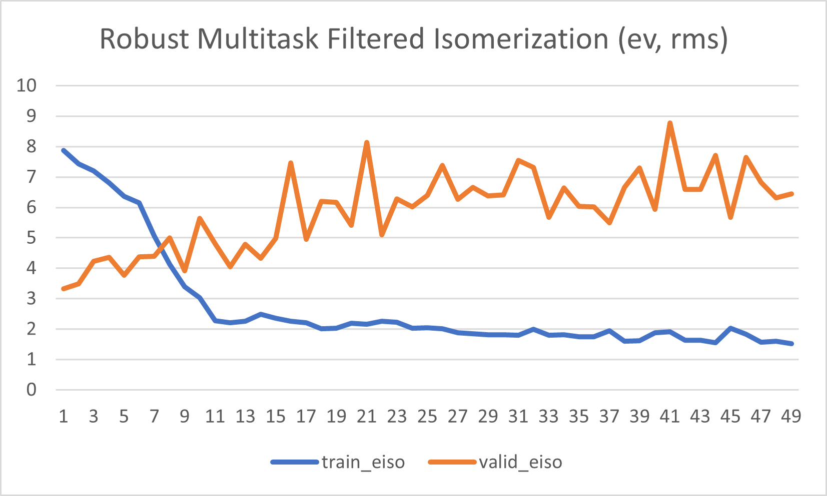
Robust Multitask Regressor

Slide 16
Graph Convolutional
eiso r2:
-0.12957346499642464
riso r2:
0.04502204063657389
vert r2:
-0.2172023128839271
eiso:
5.4803654558311425
13.469492486522725
2.7347964322768052
riso:
0.8165985783861613
1.1902025688505764
0.576203171052614
vert:
0.04953433143073547
0.07991326764795853
0.028881601457155587
(3, 75, [64, 64], 128, 0.5, 1e-05, 'regression')
eiso rms:
10.55374153871836
riso rms:
1.3820210461750784
vert rms:
0.08399911077473775

Slide 17
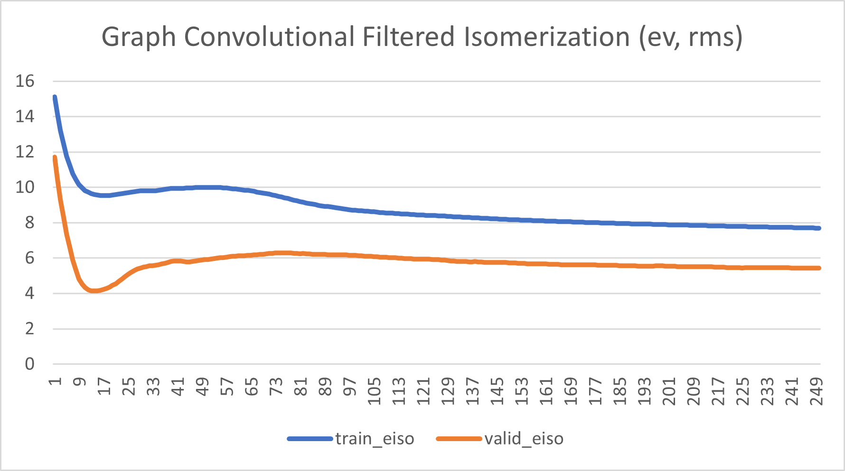
Graph Convolutional

Slide 18
DTNN
eiso r2:
-0.48667160058574277
riso r2:
-0.5778226573071736
vert r2:
-0.7426406507393715
eiso:
7.577075547060909
18.438200446523528
3.517238812677171
riso:
1.2627377625649203
1.7505591051625193
0.9955473099301386
vert:
0.08027429395037862
0.11257608763956967
0.055240139717823794
(3, 50, 0.5, 1e-05)
mean rms:
4.661498661711395
eiso rms:
12.107562954465415
riso rms:
1.7764258190566935
vert rms:
0.10050721161207572

Slide 19
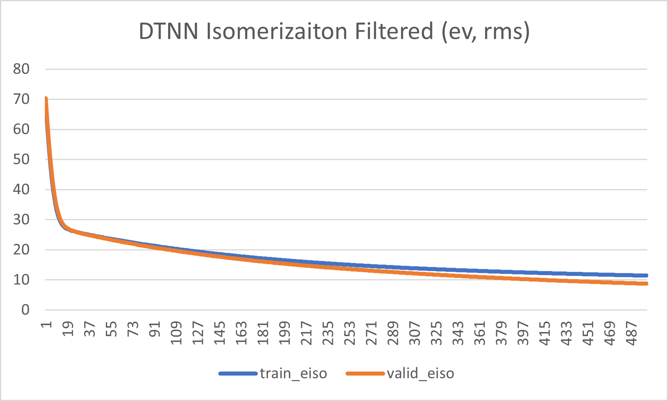
DTNN
Note twice as many training epochs

