Slide 1
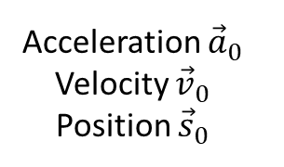

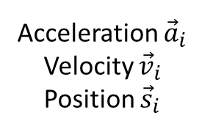

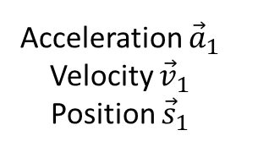



Acceleration ${\vec{a}}_{1}$
Velocity ${\vec{v}}_{1}$
Position ${\vec{s}}_{1}$
Acceleration ${\vec{a}}_{i}$
Velocity ${\vec{v}}_{i}$
Position ${\vec{s}}_{i}$
Frame:
0
1
2
$$⋯$$
$$i−1$$
$$i$$
$$i+1$$
$$Δt$$
Acceleration ${\vec{a}}_{0}$
Velocity ${\vec{v}}_{0}$
Position ${\vec{s}}_{0}$
Now
Notes:
Time is discrete. We only know where things are at discrete time slices. Riff on Heisenberg here if you wish. Yes, we can know both position and velocity.

Slide 2



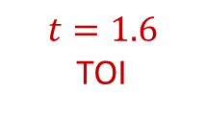


Position at TOI
POI
$$t=0$$
$$t=1$$
$$t=1.6$$
TOI
$$t=2$$

Slide 3



$$t=0$$
$$t=1$$
$$t=2$$

