Slide 1
$$60°$$
$$60°$$
1
2
6
3
5
4
$$60°$$

Slide 2
4
9
3
12
5
8
1
2
10
11
6
7

Slide 4


$$1$$
$$\vec{c}$$
$$h$$
$$h$$
$$\vec{p}$$
$$2$$

Slide 5
$$\vec{c}$$
$$\vec{c}$$
$$\vec{c}$$
$$\frac{π}{5}$$
$$r_{0}$$
$$\frac{2π}{5}$$
$$\vec{p}$$
$$\vec{p}$$
$$\vec{p}$$
$$1$$

Slide 6



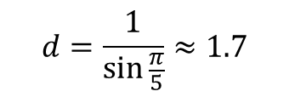




$$\frac{π}{5}$$
$$d$$
$$d$$
$$\frac{2π}{5}$$
$$2$$
$$1$$
$$\sin{\frac{π}{5}}=\frac{1}{d}$$
$$d=\frac{1}{\sin{\frac{π}{5}}}≈1.7$$

Slide 7
$$\vec{c}$$
$$\vec{c}$$
$$\sqrt{3}/2$$
$$r$$
$$\sqrt{3}/2$$
$$r_{0}$$
$$\vec{p}$$
$$\vec{p}$$
$$r_{0}$$

