Slide 1
CNearsort2
Use reachability heuristic to prune at third-last layer.
CNearsort
Use reachability heuristic to prune at second-last layer.
CAutocomplete
Build last layer during sorting test.
C2NF
Second normal form. Second layer drawn from set of representatives.
CSearchable
Exhaustive search. Levels also stored as matchings.
C1NF
First normal form. First layer fixed. Sorting test uses ternary reflected Gray code.
CSortingNetwork
Sorting test based on the 0-1 principle using binary reflected Gray code.
CComparatorNetwork
Levels stored in arrays. Can be saved as a text file.

Slide 2
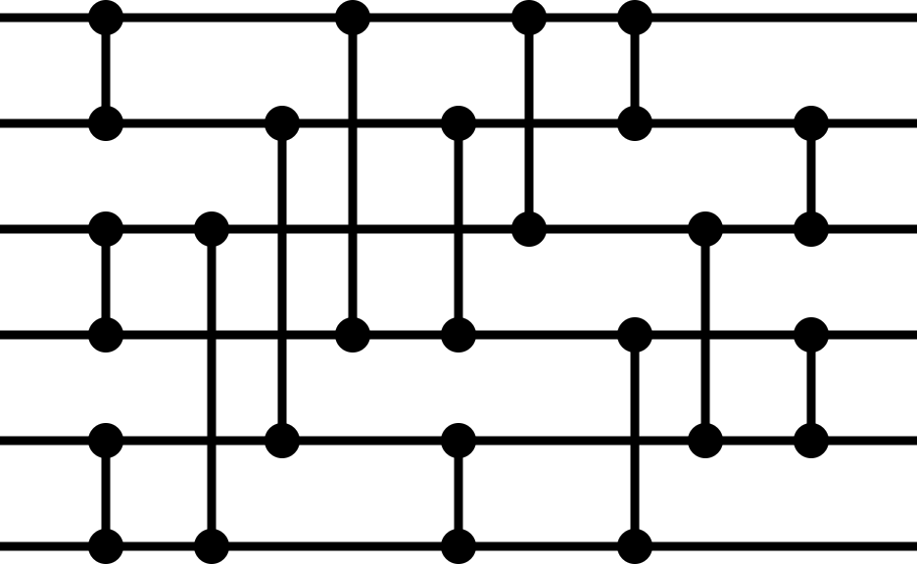


Channel
0
1
2
3
4
5
Level
0
0
1
2
3
4
5
1
2
3
4
5
1
0
3
1
4
2
5
Level $−1$
0
1
2
4
3
5
5
2
4
3
0
2
1
3
4
5
4
1
2
3
4
3
Channel
Channel
2
0
1
2
3
4
5
1
0
1
0
3
2
5
4
0
1
3
4
5
0
1
2
Level $−1$
1
0
4
5
2
3
2
3
2
3
0
1
5
4
4
0
2
1
4
3
6

