Slide 1
CComparatorNetwork
Levels stored in arrays. Can be saved as a text file.
CSortingNetwork
Sorting test based on the 0-1 principle using binary reflected Gray code.
C1NF
First normal form. First layer fixed. Sorting test uses ternary reflected Gray code.
CSearchable
Exhaustive search. Levels also stored as matchings.
C2NF
Second normal form. Second layer drawn from set of representatives.
CAutocomplete
Build last layer during sorting test.
CNearsort
Use reachability heuristic to prune at second-last layer.
CNearsort2
Use reachability heuristic to prune at third-last layer.

Slide 2
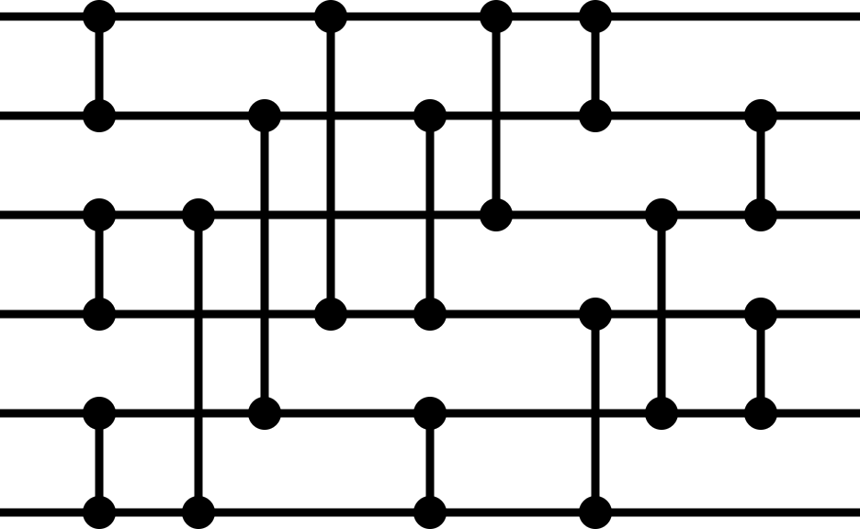

Level
1
2
3
4
5
5
Channel
0
1
2
3
4
5
4
0
1
0
3
2
5
4
3
1
3
4
5
0
1
2
Channel
Level $−1$
2
2
1
0
4
5
2
3
1
3
2
3
0
1
5
4
4
0
2
1
4
3
6
0
m_nComparator

Slide 3

Level
1
2
3
4
5
5
Channel
0
1
2
3
4
5
4
0
0
1
2
3
4
5
3
1
0
3
1
4
2
5
Channel
Level $−1$
2
2
0
1
2
4
3
5
1
3
0
2
1
3
4
5
4
1
2
3
4
0
m_nMatching

Slide 4
1
1
1
0
0
0
1
1
1
0
0
0
1
1
0
0
0
0
1
1
0
0
0
0
1
0
0
1
0
0
1
0
0
1
1
1
0
1
1
1
1
1
0
1
1
1
1
1
0
0
1
0
1
1
1
0
1
1
1
1
0
0
0
1
1
1
0
1
1
1
1
1

Slide 5
0
0
0
0
0
0
0
0
0
0
0
0
1
1
1
1
1
1
1
1
1
1
1
0
1
1
1
1
1
1
0
0
0
0
0
1
1
1
1
1
1
1
1
1
1
1
1
1
1
1
1
1
1
1
1
1
1
1
1
1
1
1
1
1
1
1
1
1
1
1
1
1

