Slide 1
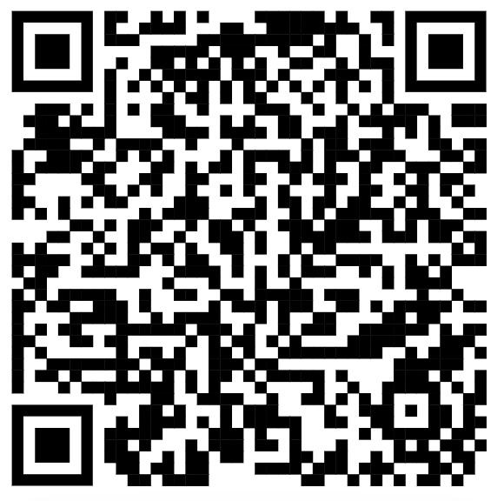

Session Resources
Attendance Form
github.com/ntu-dl-bootcamp/deep-learning-2026

Slide 2







Deep Learning Bootcamp 2025 - 26

Slide 3
Series Schedule
Event No. | Details
Event 1 24th Oct 2025 | Deep Learning Essentials Covers the basics of Python and necessary packages required for Deep Learning such as numpy, scipy, pandas etc.
Event 2 10th Nov 2025 | PyTorch for Deep Learning Covers the basics of PyTorch, as well as how to use PyTorch for performing classification and regression tasks.
Event 3 TBD, Sem 2 | Deep Learning for Images In this event, we will extend the classification using deep learning, specifically focusing on datasets involving images.
Event 4 TBD, Sem 2 | Deep Learning for Sequence Data (text and time series) In this event, we will focus on using Deep Learning models for datasets involving sequences or temporal relations. We plan to cover examples from both text and time-series datasets.
Event 5 TBD, Sem 2 | Reinforcement Learning The session will introduce Reinforcement Learning with some practical applications.

Slide 4
Session 2 – Getting Started with PyTorch For Regression and Classification

Slide 5
Agenda
Intro to Deep Learning and to PyTorch (30 mins)
Work Session 1 – Working with Tensors (30 mins)
Snacks break (20 mins)
PyTorch – Discussion (20 mins)
Work Session 2 – Solving a classification problem with PyTorch (1 hour)
Challenges – Create your own Neural Network for Regression (30 mins)

Slide 6
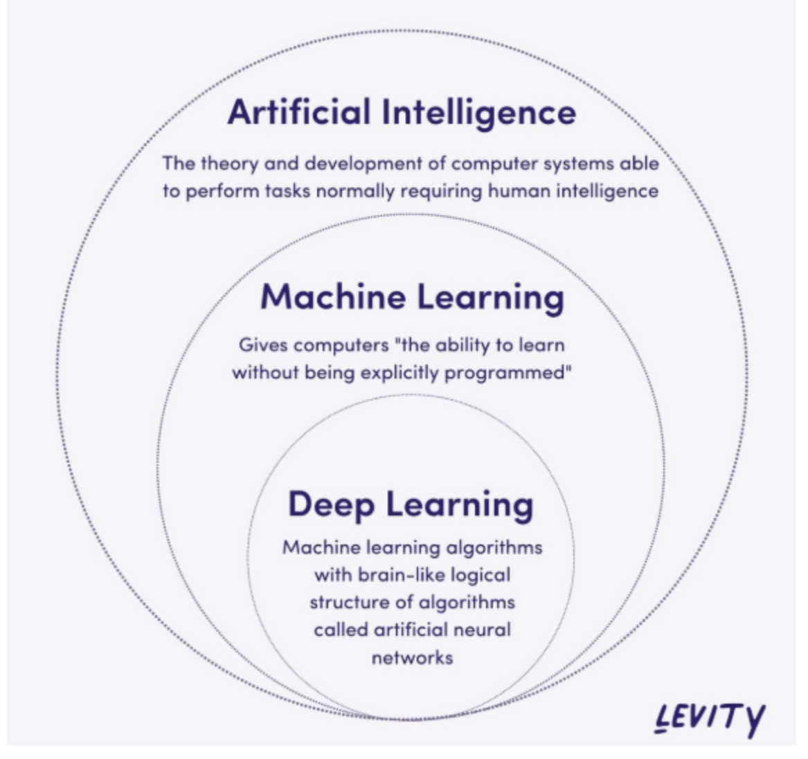
Revisiting Deep Learning
Machine Learning – learning from examples
Deep Learning – Machine Learning with a specific set of architectures – called deep neural networks
Neural Networks – a network of artificial neural networks modeled loosely based on biological neurons

Slide 7
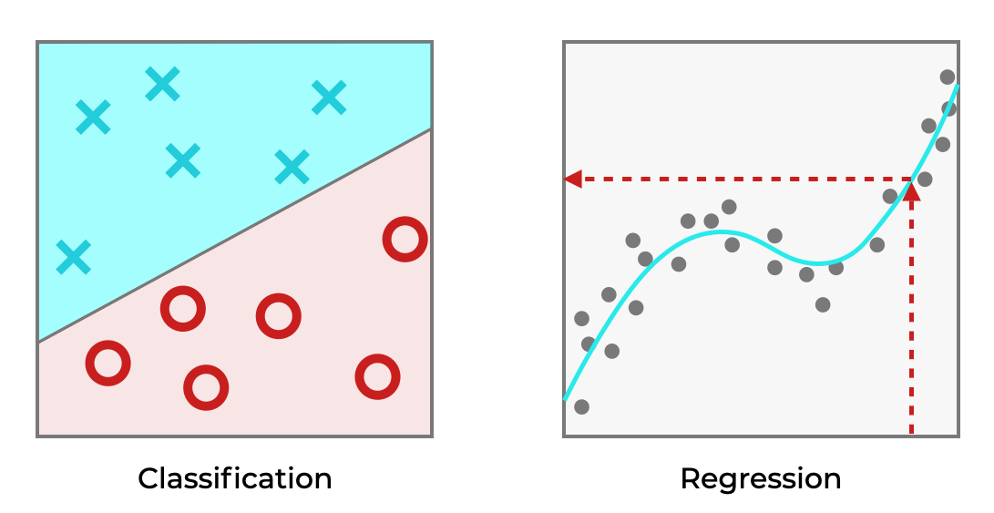
Machine Learning
Goal of machine learning – make accurate predictions about unseen data based on given data.
Classification – predicting which of the given categories does the given input belong to
Regression – predicting a numerical value for a certain input

Slide 8
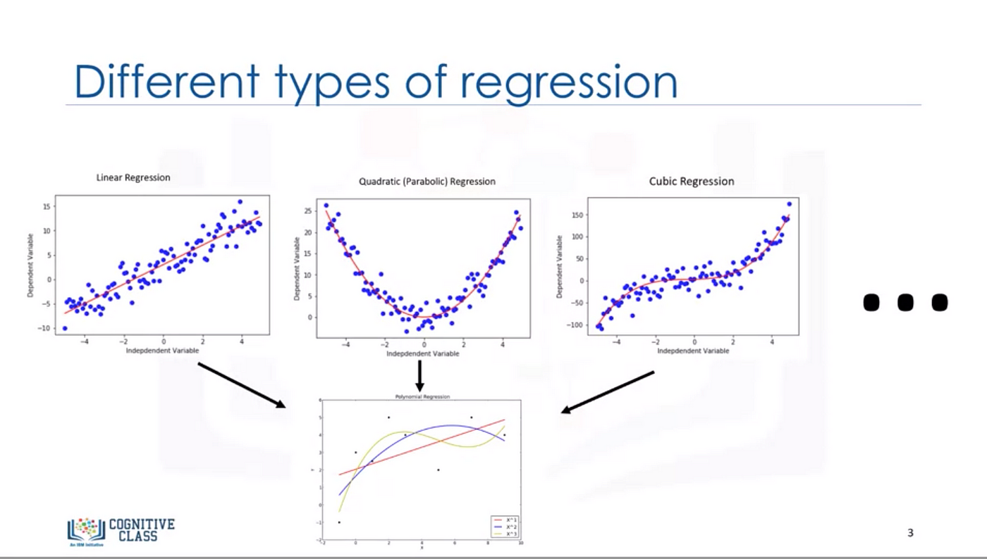
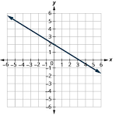
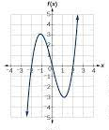
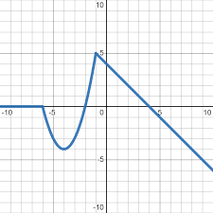
How do we make these predictions?
Inputs
Machine Learning Model
Using models!
We assume that the observed data comes from a target function. We want our model to take the form of this target function.
But the target function could be anything!
Predictions

Slide 9
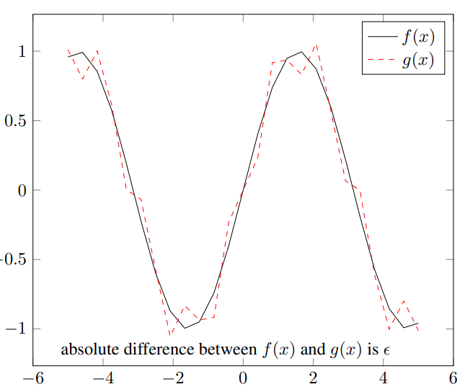
Neural Networks – Universal Function Approximators
Neural networks in their most basic form behave like continuous and piece wise linear (CPWL) functions.
They divide the input space into polygon like regions:
In each region, the function is linear
Between regions, the functions is continuous

Slide 10
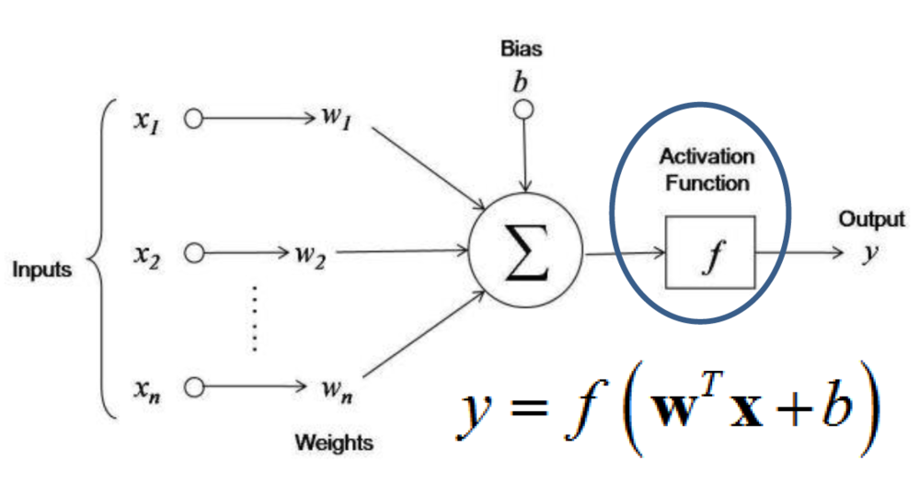
Components of a Neural Network
Artificial neuron – unit of the neural network
Weights for each input
Bias for the neuron
Activation function on the weighted average
Neurons are stacked together to form a layer
Layers are combined sequentially to form the network
Y = f(w₁x₁ + ... w_{n}x_{n} + b)

Slide 11
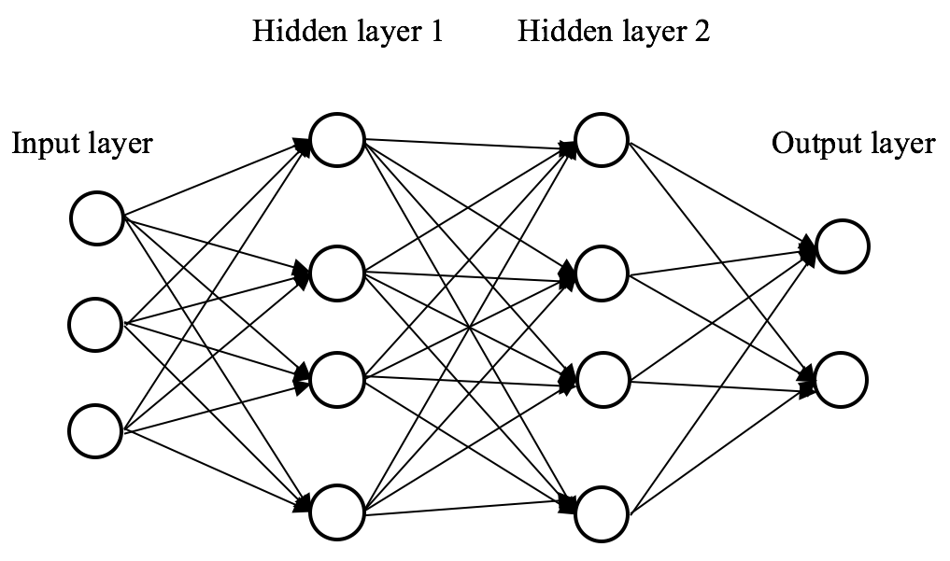
Components of a Neural Network
Neurons are stacked together to form a layer
x_{[i]} = f(W^{T}_{[i]}x_{[i-1]} + b_{[i]})
Layers are combined sequentially to form the network
Y = W^{T}_{[N]} f(… f(W^{T}_{[2]} f(W^{T}_{[1]}x + b_{[1]}) + b_{[2]}))+ b_{[N]})

Slide 12
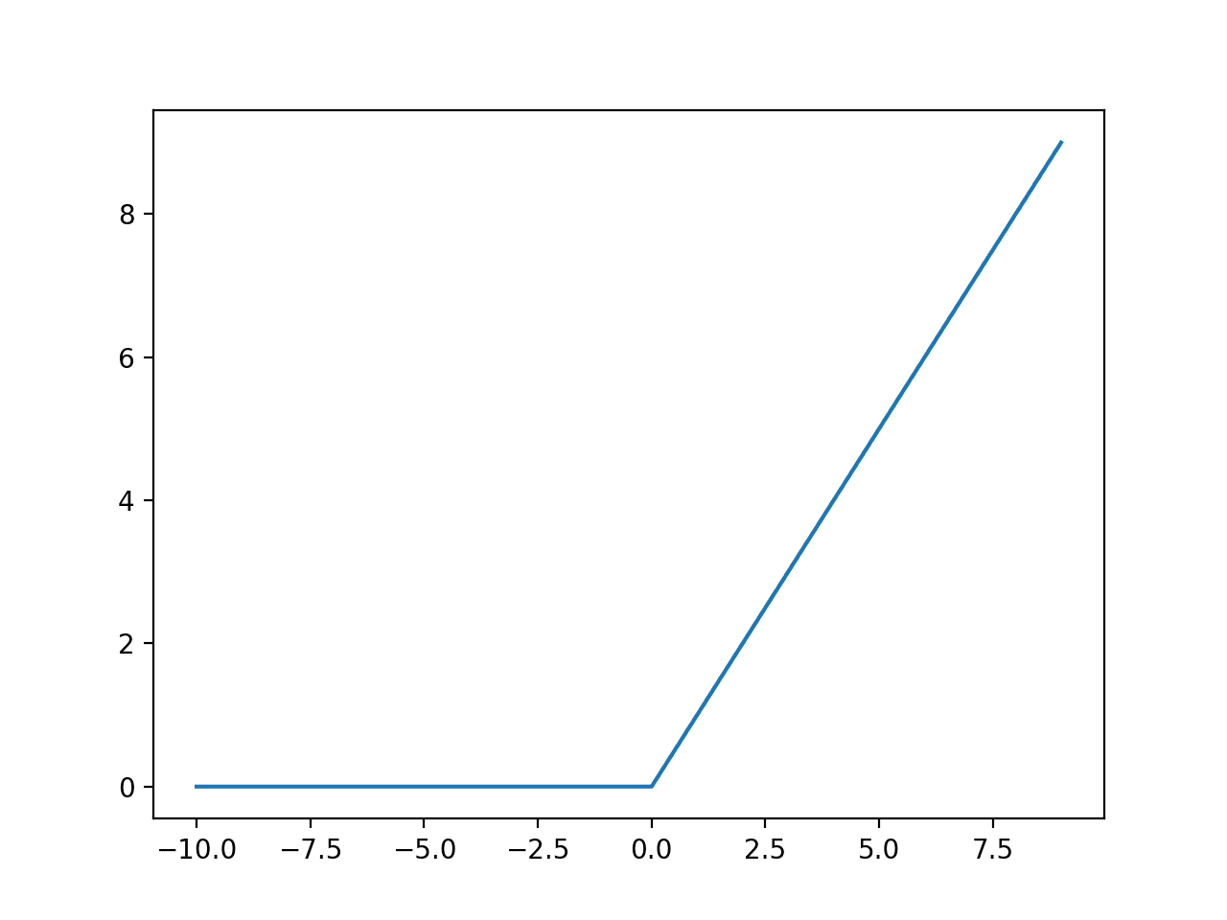
Components of a Neural Network
Activation function
A non-linear function that helps the network model different kinds of functions.
Most common example: ReLU – Rectified linear unit

Slide 13
How do we make the model learn?
Optimization! Find the right set of parameters that let our model perform well on our task of interest
Define a function that describes the loss we want to minimize and let the optimizer do its magic!

Slide 14
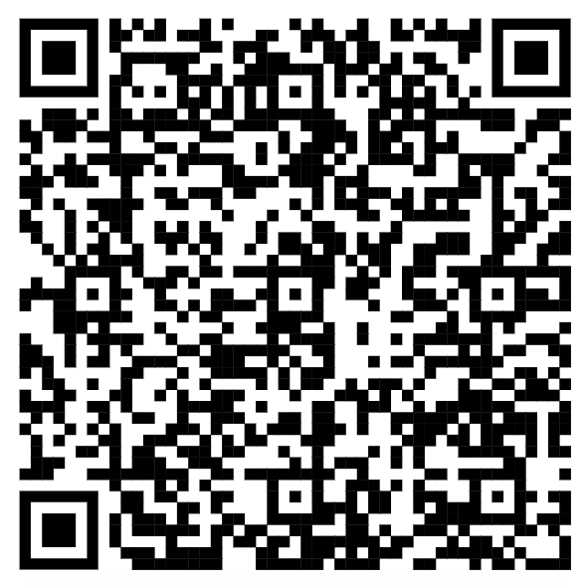
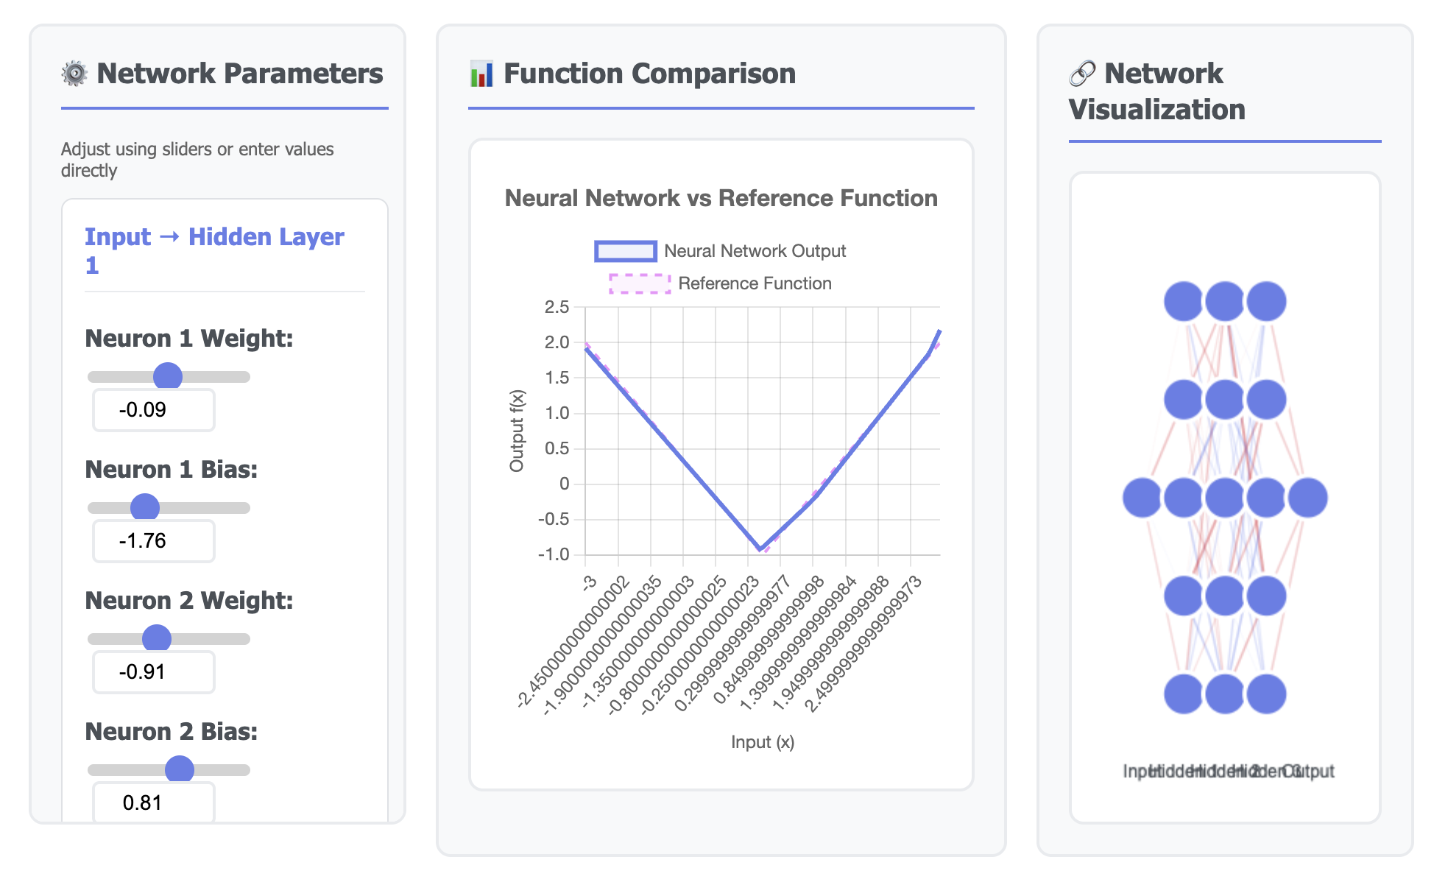
Let’s try it out!

Slide 15
Deep Learning Workflow
Training Data
NeuralNetwork
Optimization Algorithm
Loss Function
Trained Neural Network
Score
Test Data
Loss Function

Slide 16

Lets us build the network in a modular format – easy to create, easy to maintain
Provides support for GPU acceleration through the use of Tensors
Makes the task of optimization very easy by providing us with an automatic differentiation engine called Autograd

Slide 17
GPUs and Tensors
GPUs are specialized computers, which are composed of a large number of cores which can run things for us in parallel.
Tensors are objects provided by PyTorch that let us make use of this performance acceleration provided by GPUs

Slide 18
Open ntudlb-2026-session2-part-1.ipynb in Colab

Slide 19
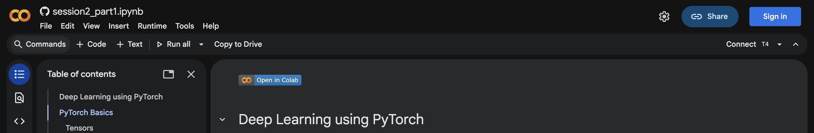
Google Colab Notebook
Let’s get started!

Slide 20
Build a neural network to classify hand-written images

Slide 21
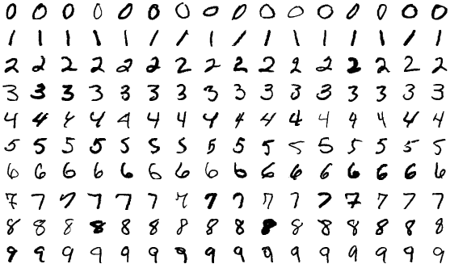
Hand-written images
https://en.wikipedia.org/wiki/MNIST_database
Notes:
An application of this would be reading zip codes from scanned images of postcards.

Slide 22
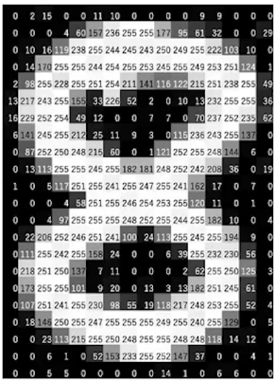
How computers “see” images
https://www.analyticsvidhya.com/blog/2021/03/grayscale-and-rgb-format-for-storing-images/
Notes:
An image is represented as a collection of scalars arranged in a regular grid with a height and and a width in pixels.
We might have a single scalar value per grid point (pixel) or multiple values.
The scalars representing individual pixels are often encoded using 8-bit integers.

Slide 23
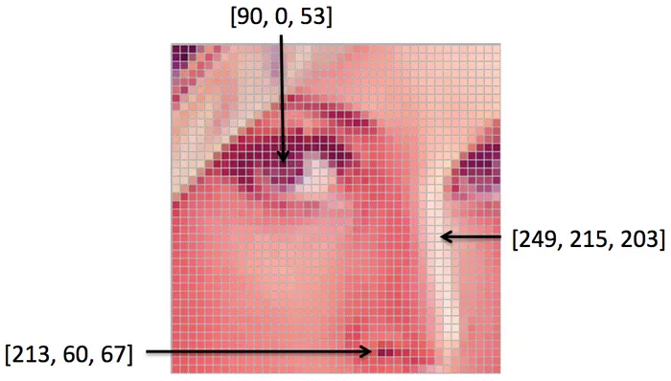
How computers “see” images
Notes:
For RGB images, the color is defined by 3 scalars, representing the intensity of red, green and blue.

Slide 24
The neural network
0
1
.
.
.
9
8

Slide 25
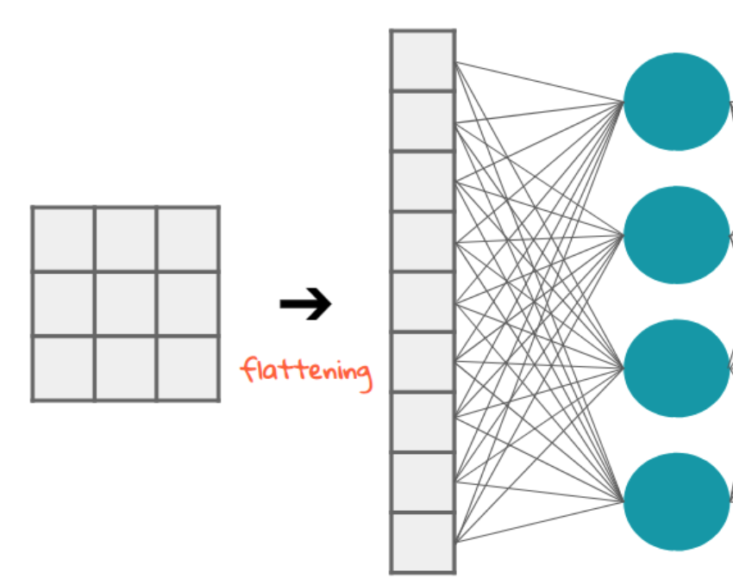
Flattening the input
https://stackoverflow.com/a/73661587/8519202

Slide 26
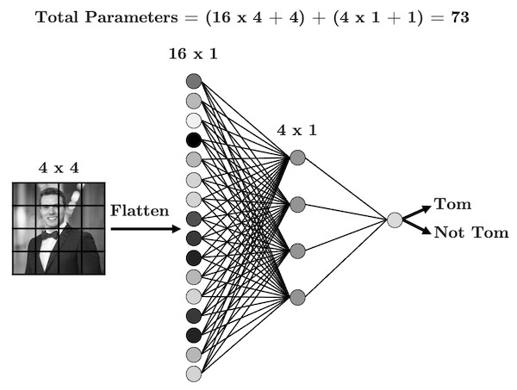
Linear Layer
https://www.tomasbeuzen.com/deep-learning-with-pytorch/_images/cnn-1.png

Slide 27
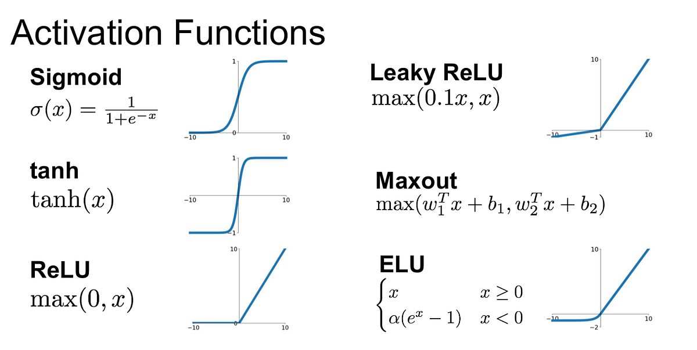
https://medium.com/@krishnakalyan3/introduction-to-exponential-linear-unit-d3e2904b366c

Slide 28
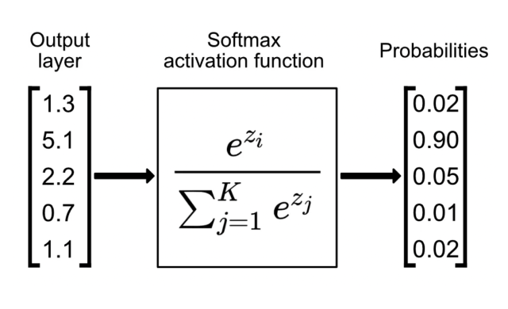
Softmax activation function
https://www.singlestore.com/blog/a-guide-to-softmax-activation-function/

Slide 29
The neural network
0
1
.
.
.
9
8

Slide 30
Open ntudlb-2026-session2-part-2.ipynb in Colab

Slide 31
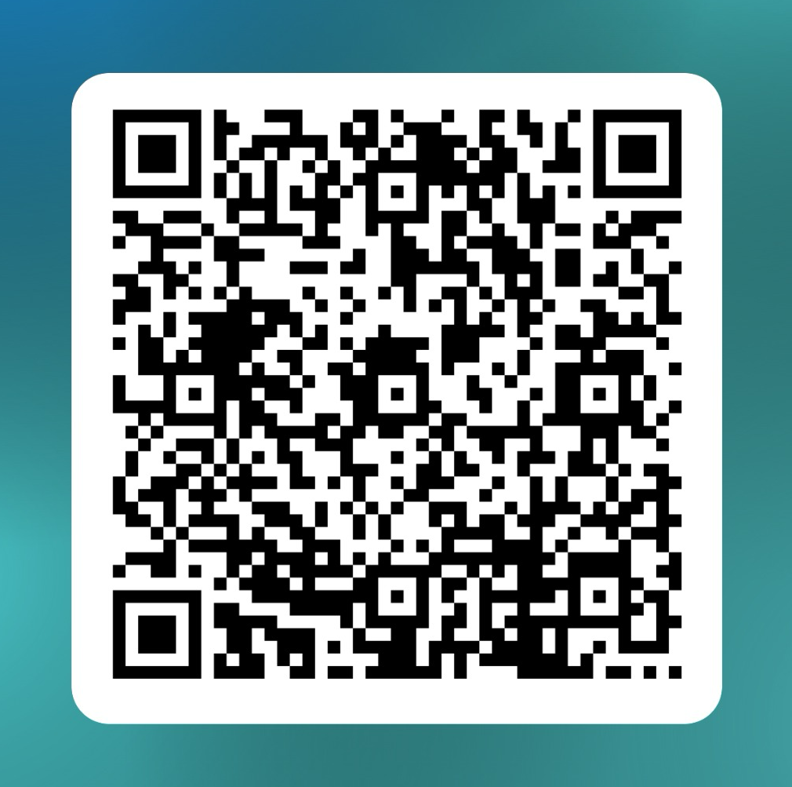
Feedback form for Session 2

Slide 32
For any questions, feel free to drop an e-mail to us! ☺ ntu-dl-bootcamp@e.ntu.edu.sg Bootcamp Website: ntu-dl-bootcamp.github.io//deep-learning-2026/
Thank You!

Slide 33
0
1
.
.
.
9
Sigmoid Non-linearity
Sigmoid Non-linearity
Sigmoid Non-linearity
8
786
256
128
10

